Slide 1
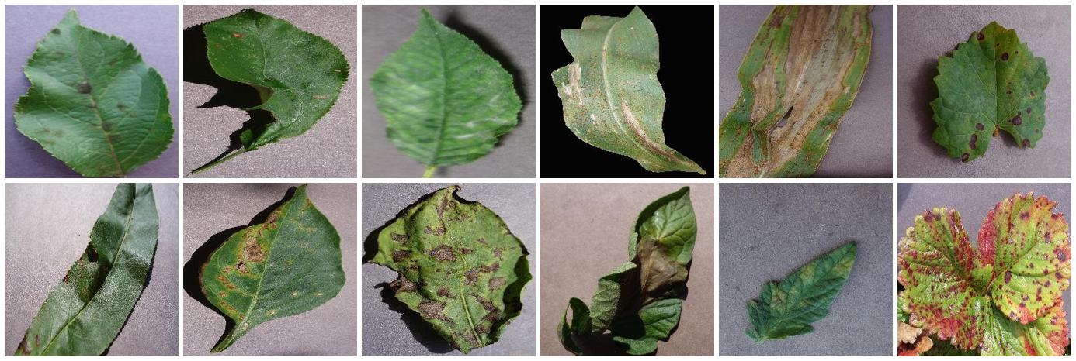
Automatic Plant Disease Detection Using Computer Vision
‹Austral›
‹Maoqin Liu (z5653393)›
‹Yuyi Zhu (z5629988)›
‹Ian Zhao (z5666368)›
‹Songning Liu (z5668661)›
COMP9444 25T1 · Project 090

Slide 2
Motivation: From Benchmark Accuracy to Field Reliability
Research motivation: a high laboratory score is only the start of the investigation — not evidence of deployment readiness.
1
2
3
4
5
Strong benchmark
Reality check
Explain the gap
Improve robustness
Adapt to the field
Train on PlantVillage. 38-way accuracy reaches 99.53%.
Zero-shot on PlantDoc field photos: 16.1% (236-image test split).
Find what the model is really using, with independent probes.
Retrain to remove the shortcut, and test whether it helps.
Give the model real field data and measure what returns.
Core question: What does the model learn, and what is needed for its performance to transfer beyond the laboratory?
Presenter: ‹Presenter A (zID)›
Notes:
开始用 PlantVillage 训练，发现 acc 过高（38 类 99.53%）。该数据集拍于实验室，于是用 PlantDoc 田间照片做零样本测试，只有 16.1%（236 张测试集；全部 2,525 张是 13.94%）。
反推原因：用 8 个背景边缘像素训练逻辑回归，38 类能到 33.7%（随机只有 2.6%）—— 背景本身就携带大量标签信息，模型学到的是拍摄背景这个捷径，不是病斑。
（注意：不是“灰度图”—— grayscale 是另一个独立实验，在它上训练得 97.76%。）
据此做叶片分组切分、背景随机化和更强增强，最后用田间数据微调，恢复到 55.9%。

Slide 3
Problem Statement: One Deployment Claim, Three Questions
Brief: classify a leaf as healthy or diseased, and estimate disease severity — plus the field test its stated aim implies.
Diagnostic capability
Field validity
Trustworthy severity
RQ1
RQ2
RQ3
Can a CNN identify the crop/condition from a leaf image?
Does laboratory accuracy transfer to real field photographs?
Can image features estimate disease severity reliably?
38 classes across 14 crops: 26 diseases plus healthy states. Evaluate both fine-grained diagnosis and healthy / diseased screening.
PlantVillage: detached leaves on uniform backgrounds. PlantDoc: whole plants, clutter, and variable scale and lighting.
PlantVillage has no severity labels: derive lesion-area targets, train a joint regression head, and validate against human judgements.
Evaluation safeguards
Leaf-grouped split
Shortcut audits
External validation
no duplicate leaf across train / test
background and image-variant controls
PlantDoc never seen in zero-shot training
Presenter: ‹Presenter A (zID)›

Slide 4
Literature Review: the Gap Is Known
Mohanty et al.
Ferentinos
Arsenovic et al.
Natarajan et al.
2016
2018
2019
2024
99.35% in lab poor field transfer
99.5% benchmark field drop remains
augmentation + GAN for robustness
deep model + XAI for interpretation
Our contribution: measure why benchmark accuracy fails — then test the remedy on real field data.
Presenter: ‹Presenter B (zID)›

Slide 5
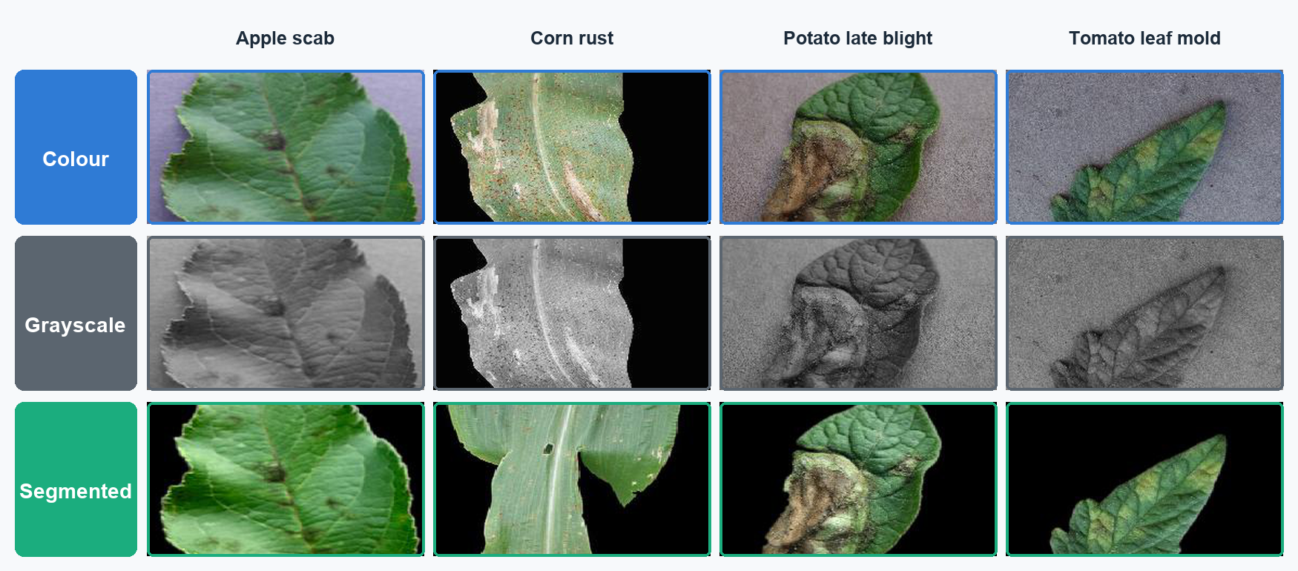
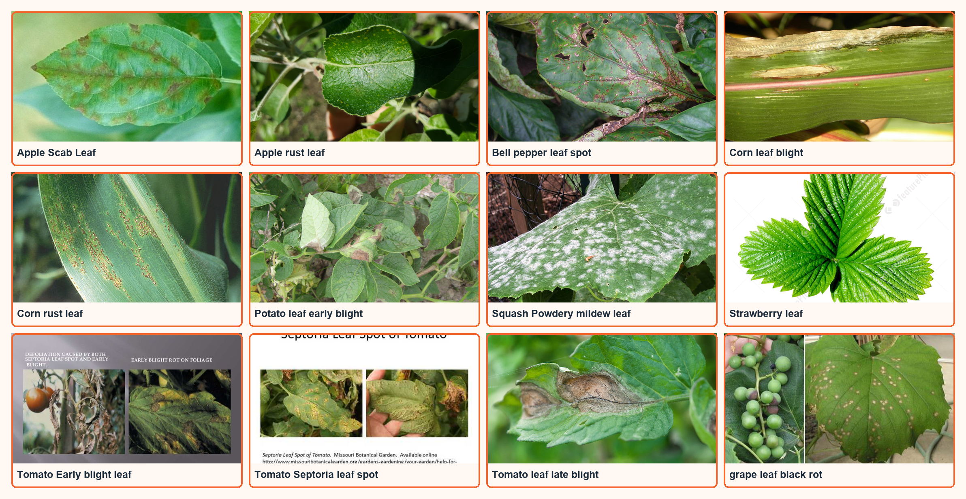
Datasets: Laboratory vs Field
PlantVillage
PlantDoc
54,305 detached-leaf images
2,525 real field photographs
14 crops · 38 crop/condition classes
27 mapped classes · selected examples
4 samples each: colour · grayscale · segmented
held out for external validation
Presenter: ‹Presenter C (zID)›

Slide 6
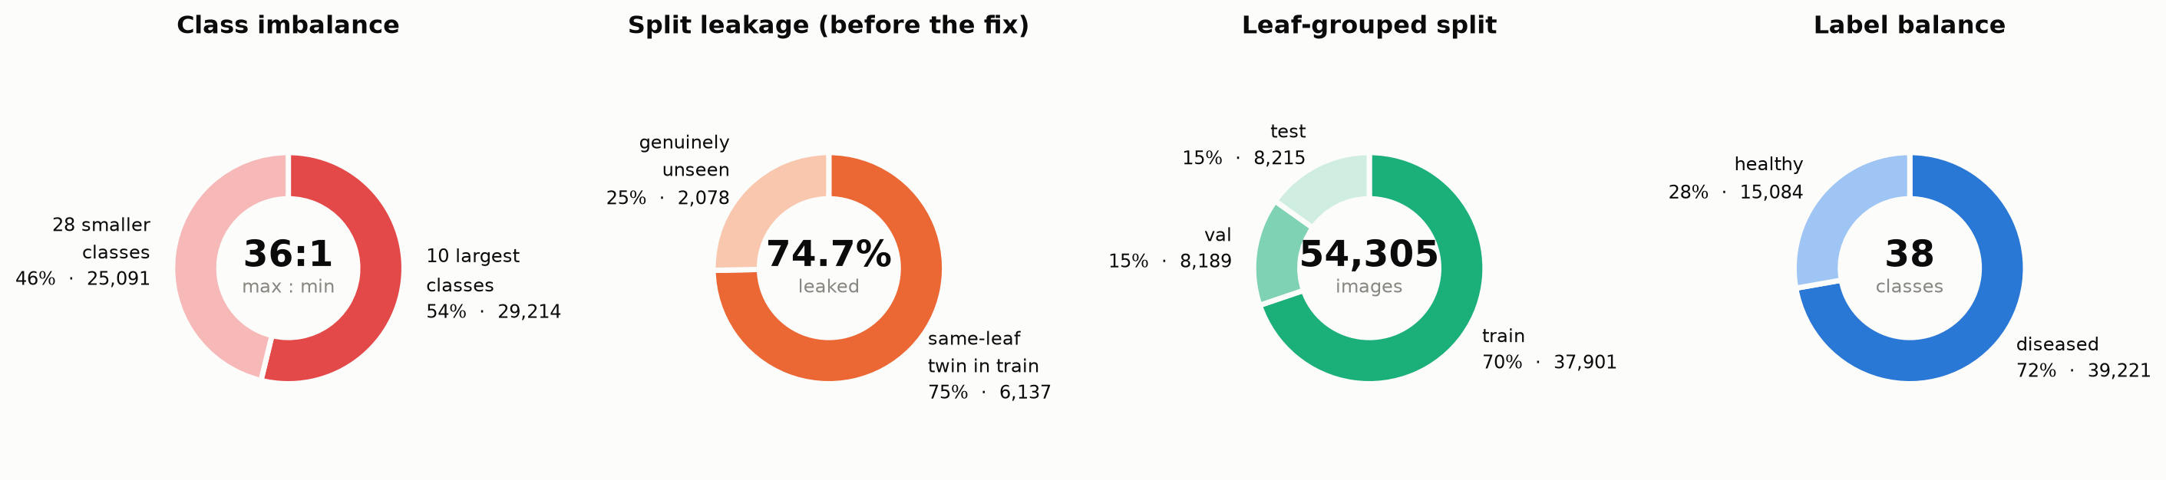
Data Analysis: Composition and Validity Risks
Processing
Resize
Normalise
Augment
De-shortcut
128² / 224²
ImageNet μ, σ
crop · flip · rotate
random backgrounds
Use macro metrics, leaf-grouped splits and external field validation to avoid misleading benchmark conclusions.
Presenter: ‹Presenter C (zID)›

Slide 7
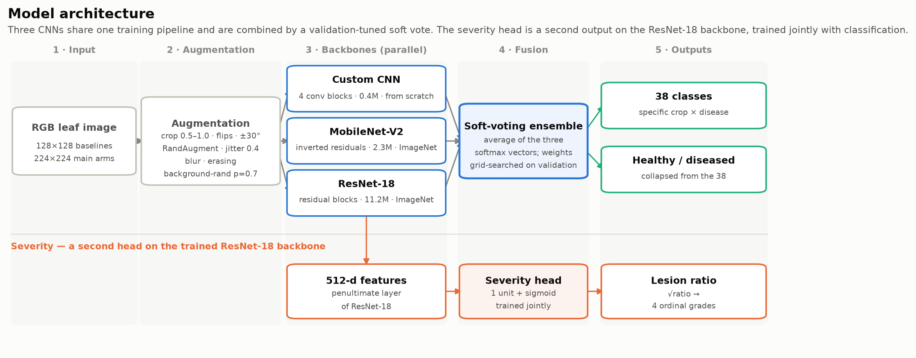
Methods: Architecture and Evaluation Design
Presenter: ‹Presenter D (zID)›

Slide 8
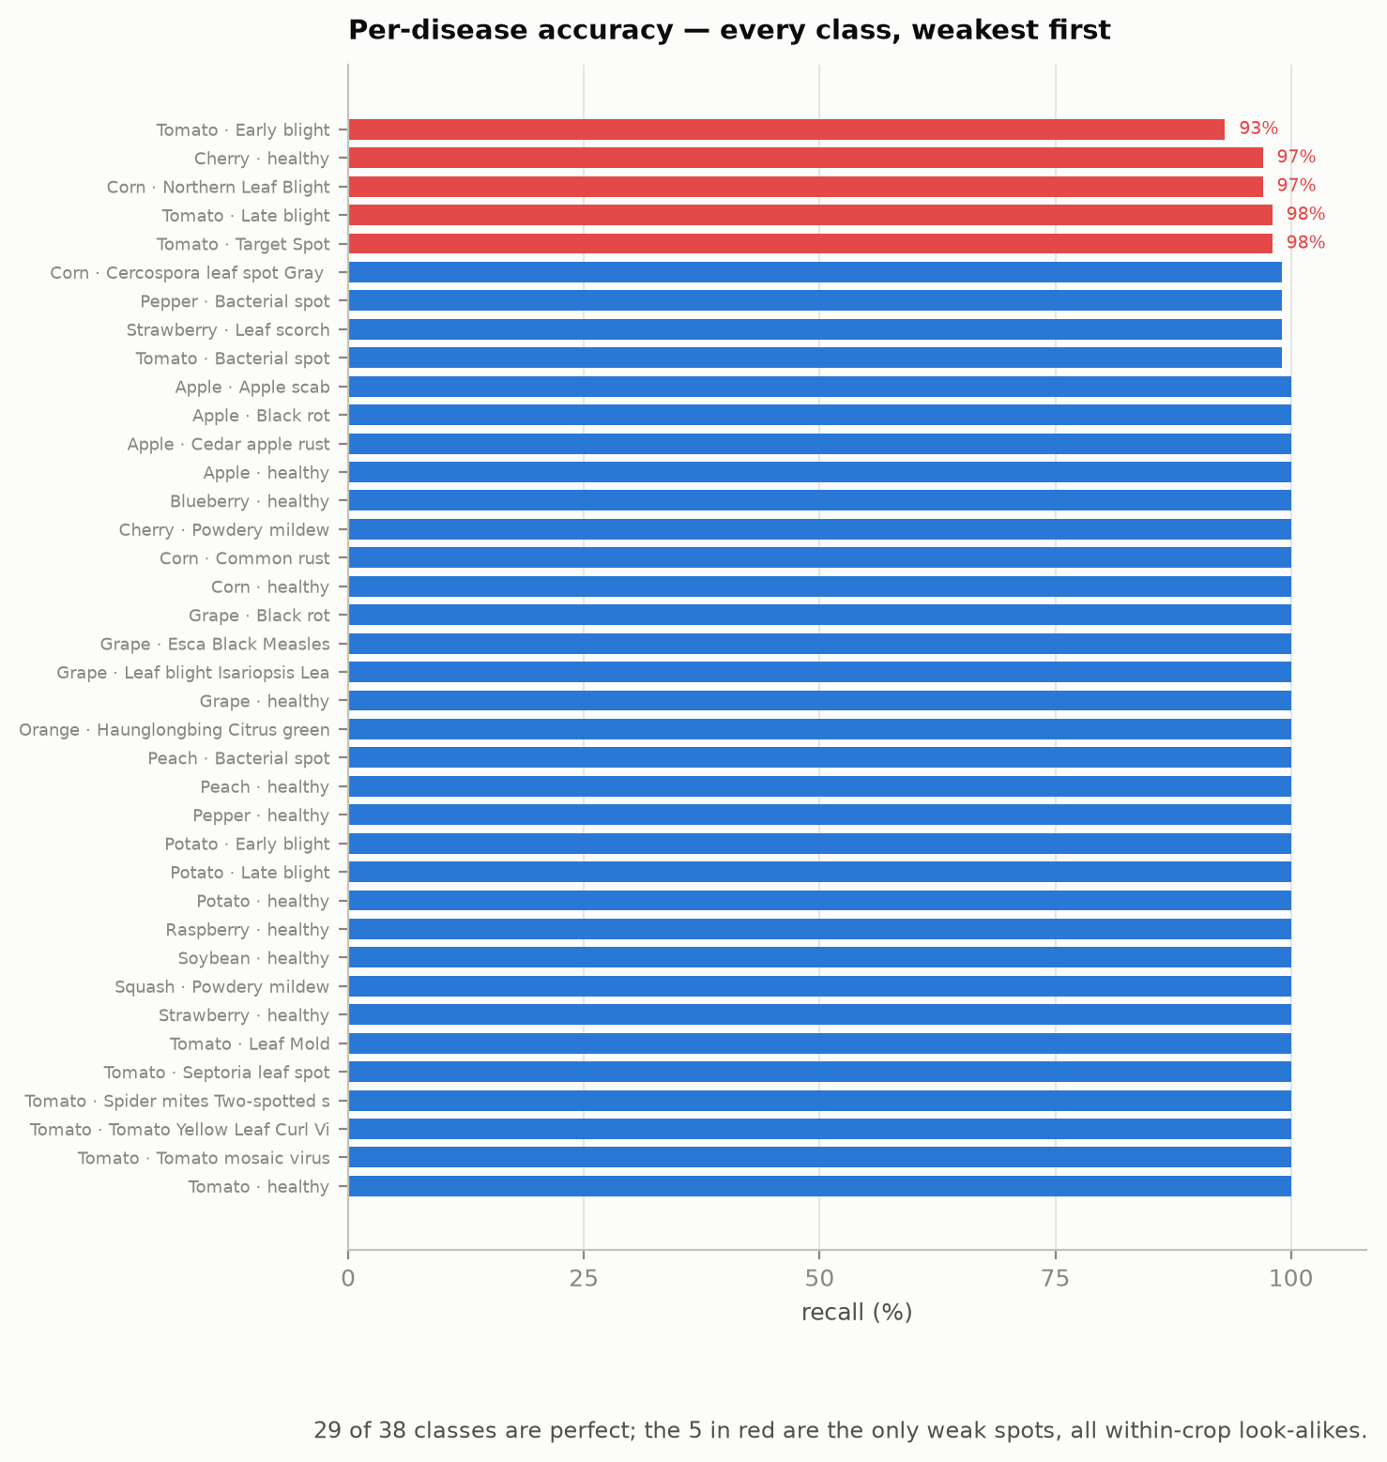
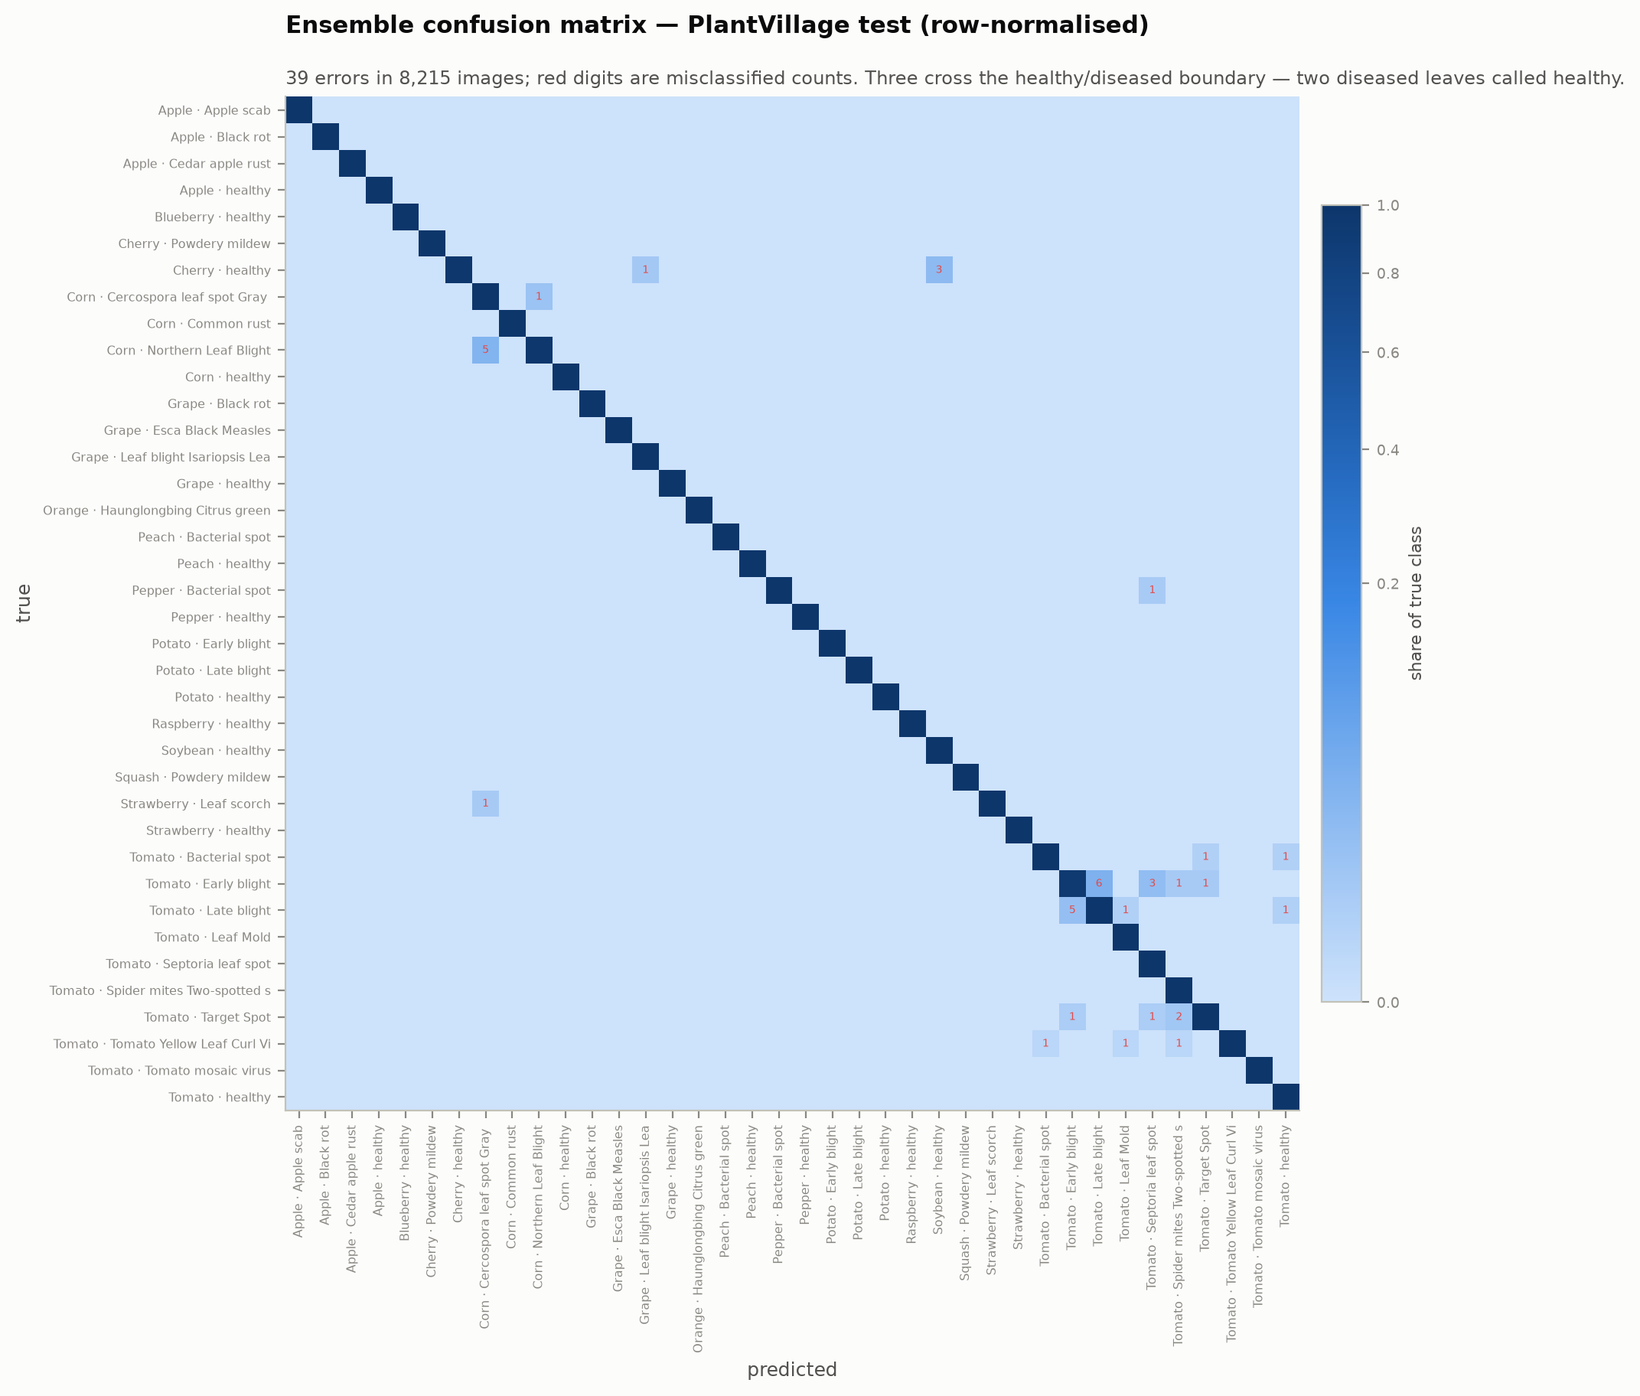
Results I: Near-Ceiling Laboratory Accuracy
Presenter: ‹Presenter E (zID)›

Slide 9
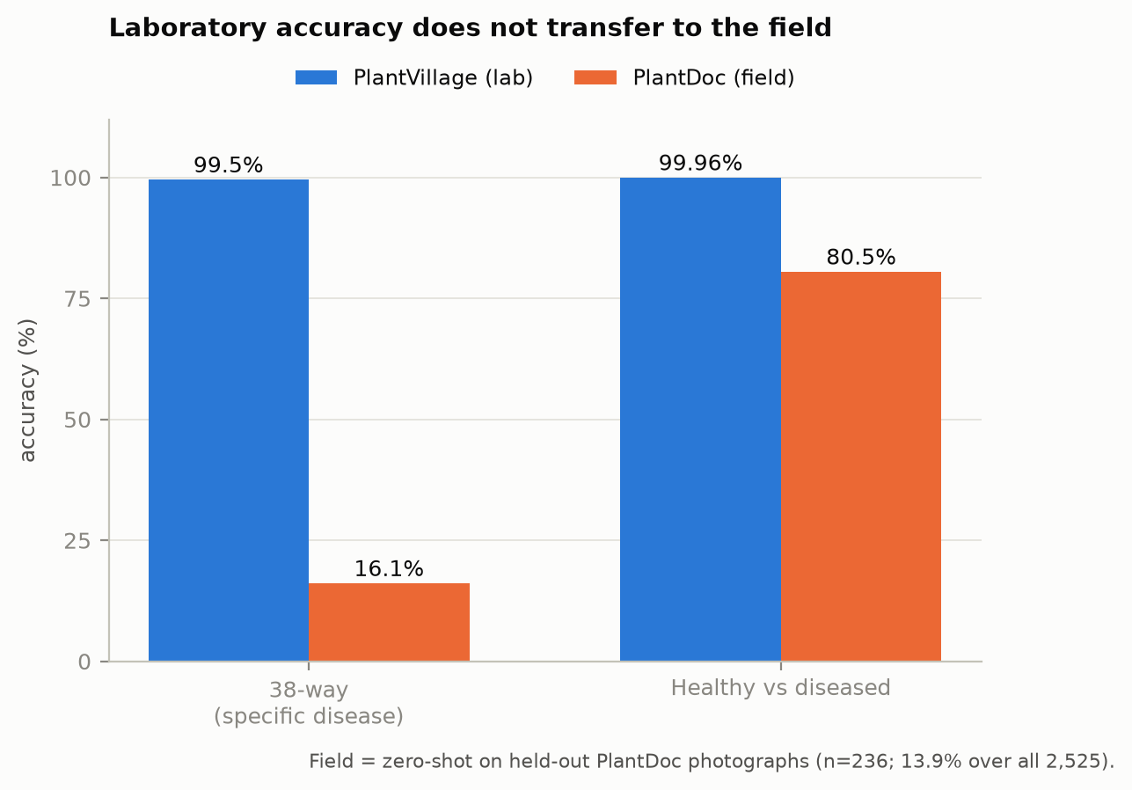
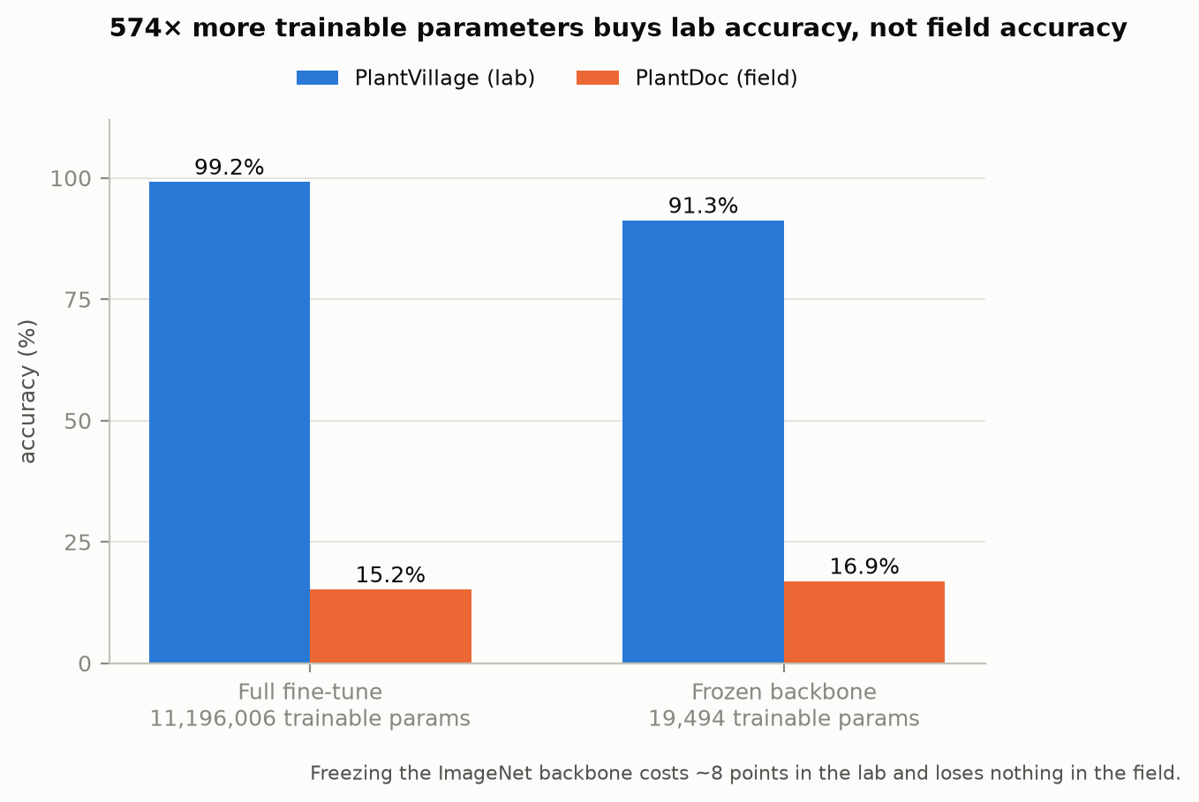
Results II: More Training Does Not Fix Domain Shift
Presenter: ‹Presenter E (zID)›

Slide 10
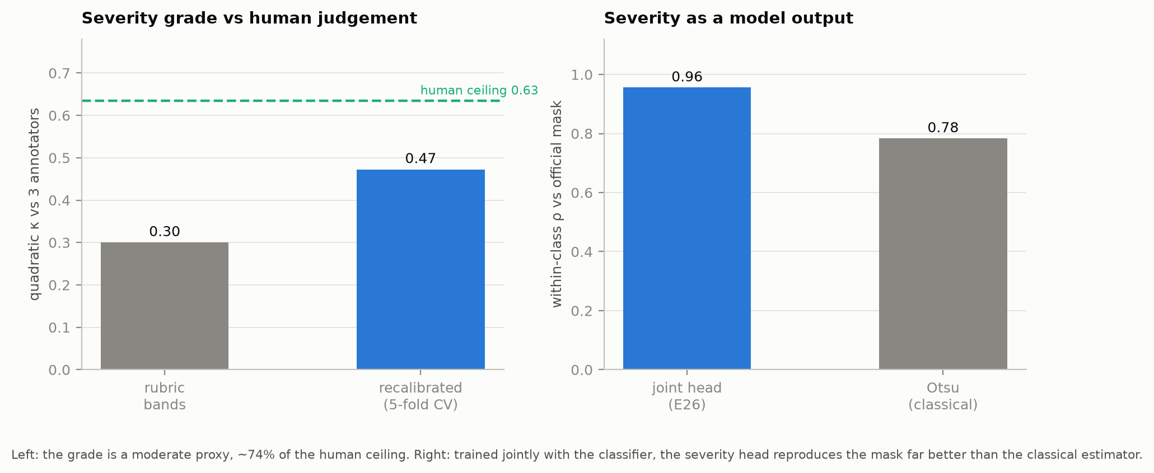
Results III: Severity Becomes a Model Output
ρ = 0.957
joint head vs official mask
κ = 0.47
recalibrated vs humans
Best estimator available, but still below human reliability.
Presenter: ‹Presenter E (zID)›

Slide 11
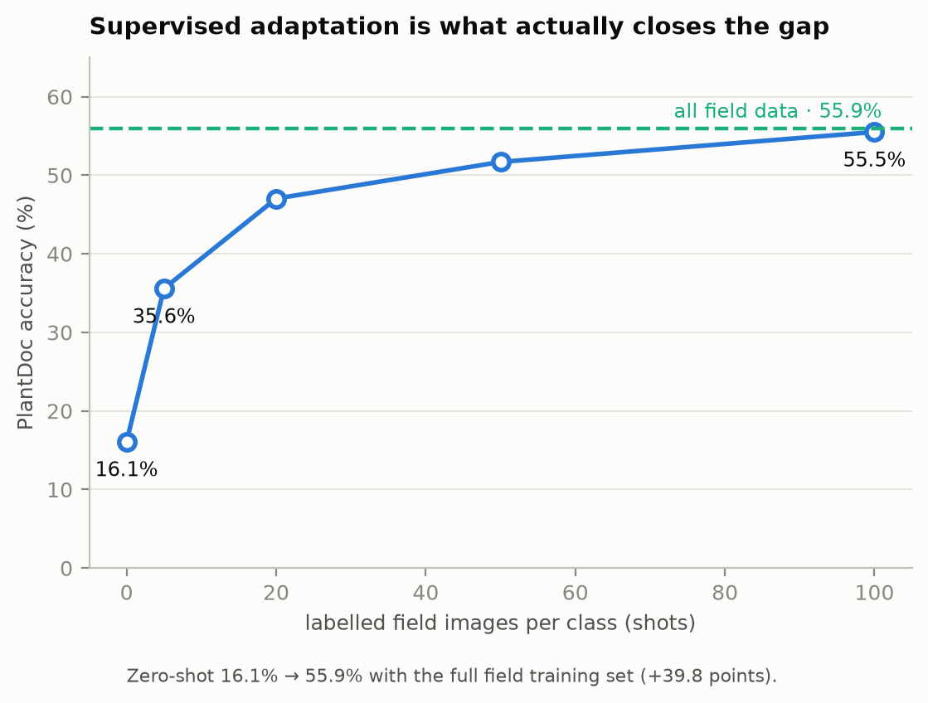
Conclusion: Adapt to the Field, Do Not Trust 99% Alone
1
Strong benchmark
99.53% laboratory accuracy
2
Weak deployment
16.1% zero-shot field accuracy
3
Honest remedy
field adaptation → 55.9%
Presenter: ‹Presenter E (zID)›

Slide 12

Thank you
Code & notebook: plant-disease-detection/ · COMP9444 25T1 Project 090

