Slide 1
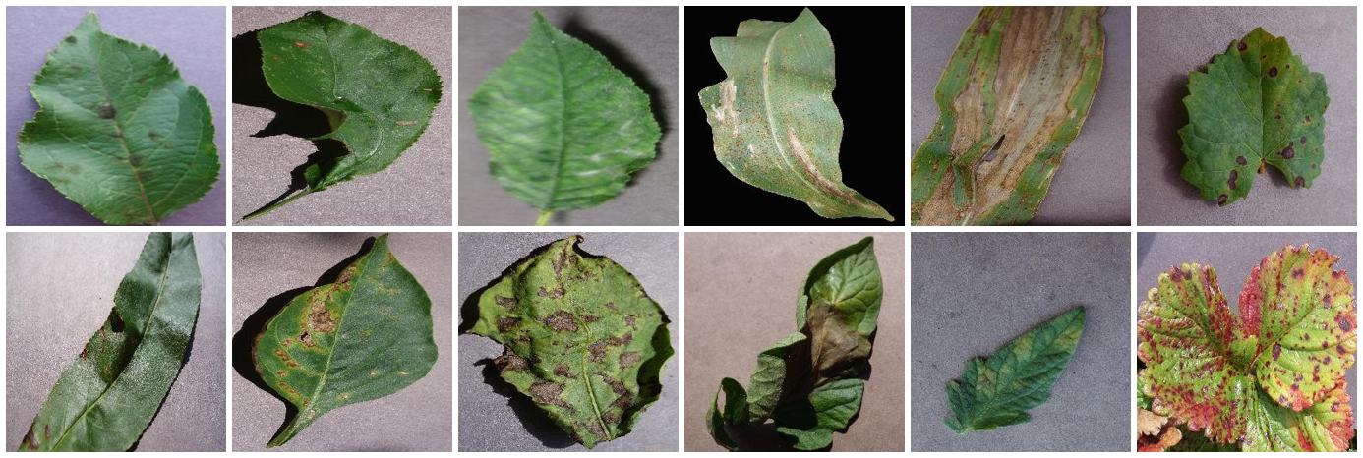
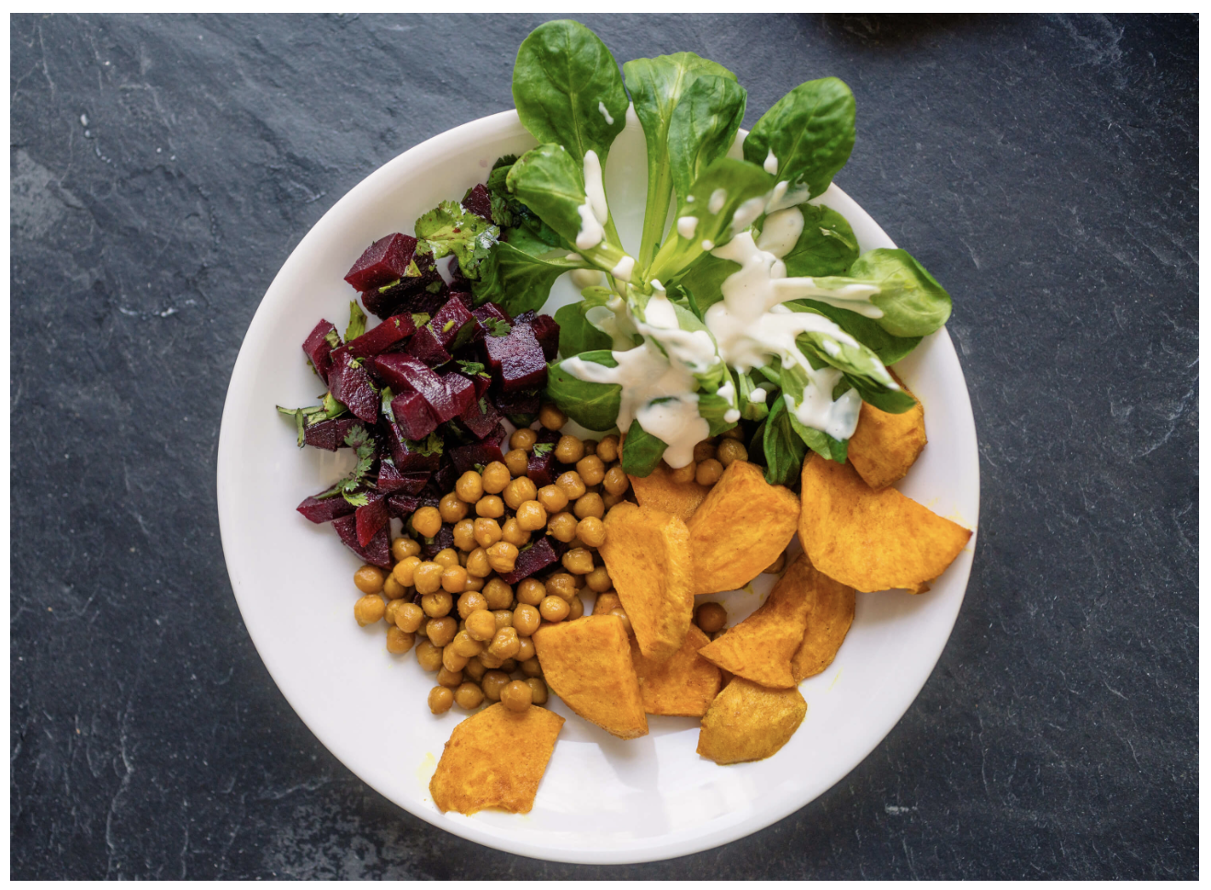
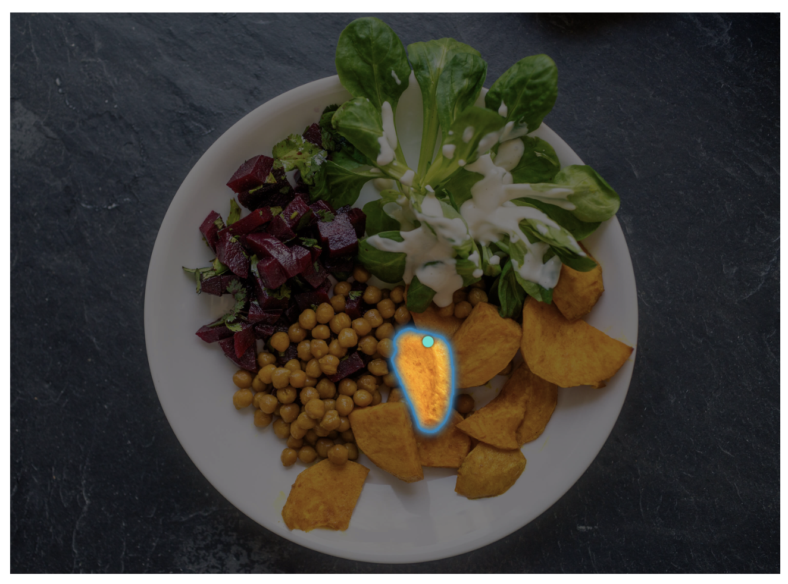
Automatic Plant Disease Detection Using Computer Vision
‹Team Name›
‹Member 1 (zID)›
‹Member 2 (zID)›
‹Member 3 (zID)›
‹Member 4 (zID)›
COMP9444 25T1 · Project 090

Slide 2
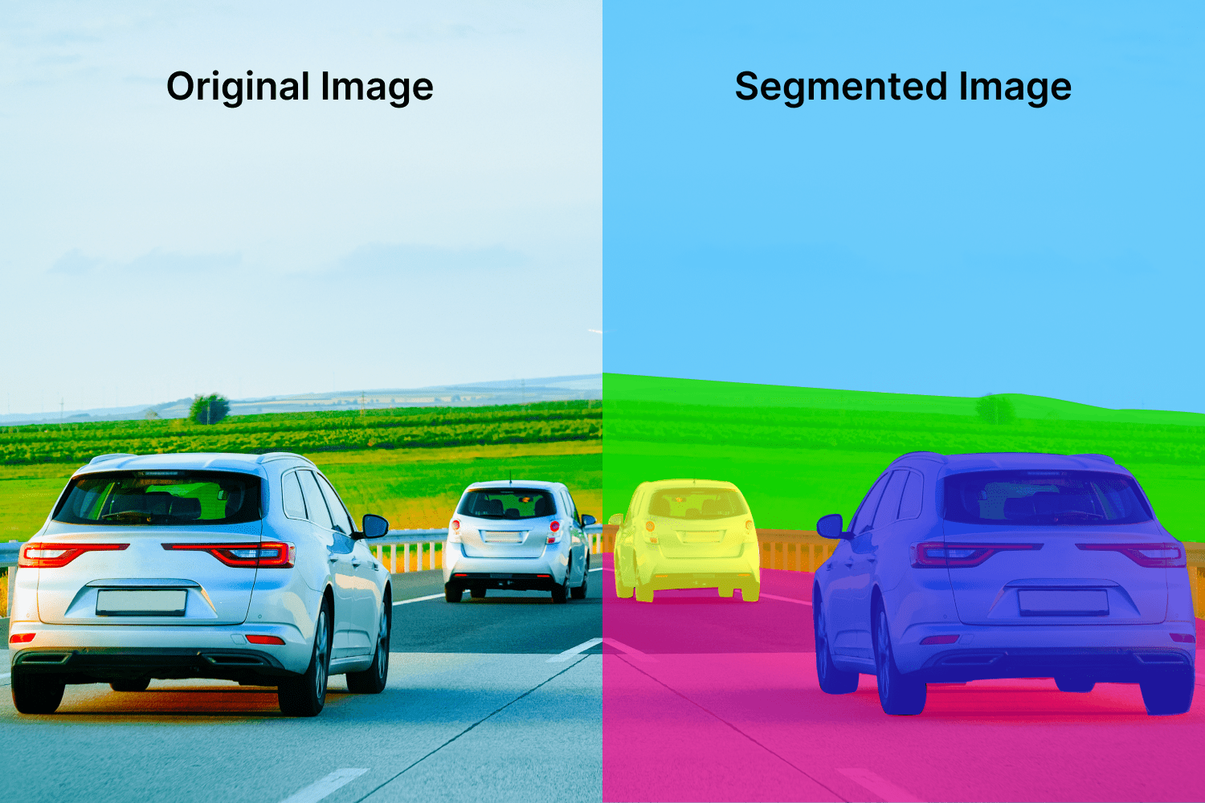
Motivation
Plant diseases cause major crop and yield losses, threatening food security.
Manual inspection by experts is slow, subjective, and hard to scale.
A CNN can label a leaf photo in milliseconds — enabling early, low-cost screening.
Goal: accurate disease classification plus an image-based severity estimate.
Presenter: ‹Presenter A (zID)›

Slide 3
Problem Statement
Classify a single leaf image into 1 of 38 crop/condition classes (14 crops).
Separate healthy vs. diseased, and name the specific disease (26 diseases + healthy).
Estimate disease severity from image features (PlantVillage has no severity labels).
Pipeline: leaf image → CNN → crop/condition + healthy/diseased → severity grade.
Presenter: ‹Presenter A (zID)›

Slide 4
Literature Review
Mohanty et al. (2016): AlexNet/GoogLeNet on PlantVillage, up to 99.35%; set the benchmark — but near-chance on independent field images.
Ferentinos (2018): 87,848 images, 58 classes; VGG 99.5% in the lab; accuracy drops in the field.
Arsenovic et al. (2019): heavy augmentation + GAN-synthesised data to close the lab-to-field gap.
Natarajan et al. (2024): deep architecture + explainable-AI visualisations for interpretability.
Presenter: ‹Presenter B (zID)›

Slide 5
Dataset(s)
PlantVillage colour subset: 54,305 leaf images.
14 crop species · 38 crop/condition classes (26 diseases + healthy).
Folders named Crop___Condition, loaded with torchvision ImageFolder.
Largest class 5,507 (Orange citrus greening); smallest 152 (Potato healthy).
Presenter: ‹Presenter C (zID)›

Slide 6
Data Analysis
Strong class imbalance (~36:1) → macro-averaged precision / recall / F1; 72% diseased, 28% healthy.
70/15/15 split by physical leaf (leaf-map.json), so no leaf is shared train ↔ test.
This matters: a naive random split leaks 74.7% of the test set as same-leaf duplicates.
Preprocess: resize + ImageNet normalisation; augment with crop, flip, ±20° rotation, colour jitter.
Presenter: ‹Presenter C (zID)›

Slide 7
Method(s)
Three CNN baselines — Custom CNN (from scratch), ResNet-18, MobileNet-V2 (ImageNet) — combined by a validation-tuned soft-voting ensemble.
Audits of what the model actually uses: background-only probe, Grad-CAM, background randomisation, and a frozen-backbone control.
External validation on held-out PlantDoc field photos, with supervised adaptation from 5 to all shots per class.
Severity: lesion-area ratio from HSV / official masks, plus a regression head trained jointly with the classifier.
Presenter: ‹Presenter D (zID)›

Slide 8
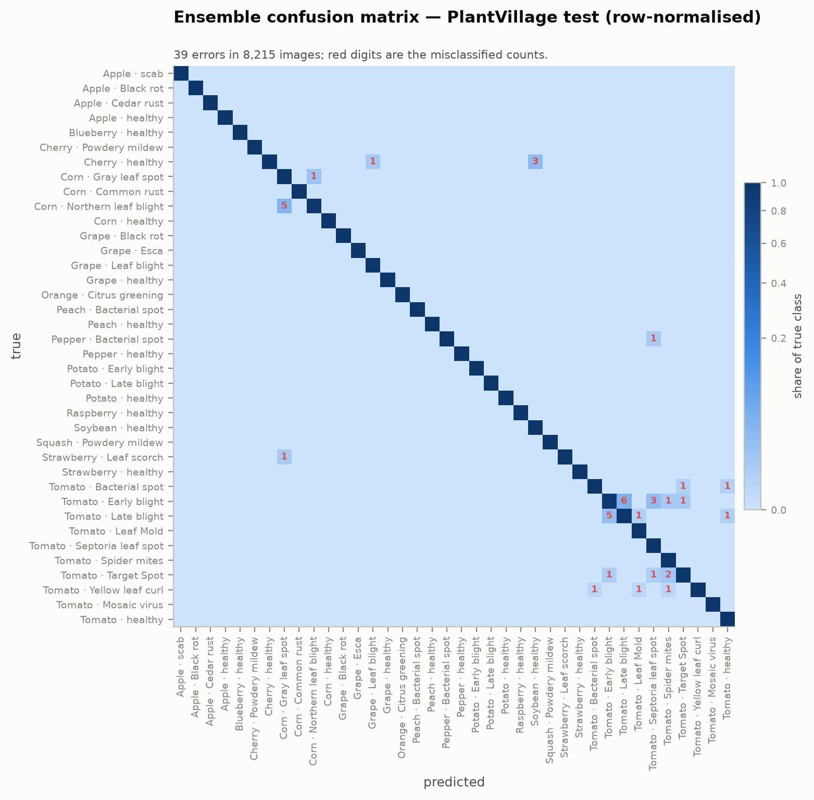
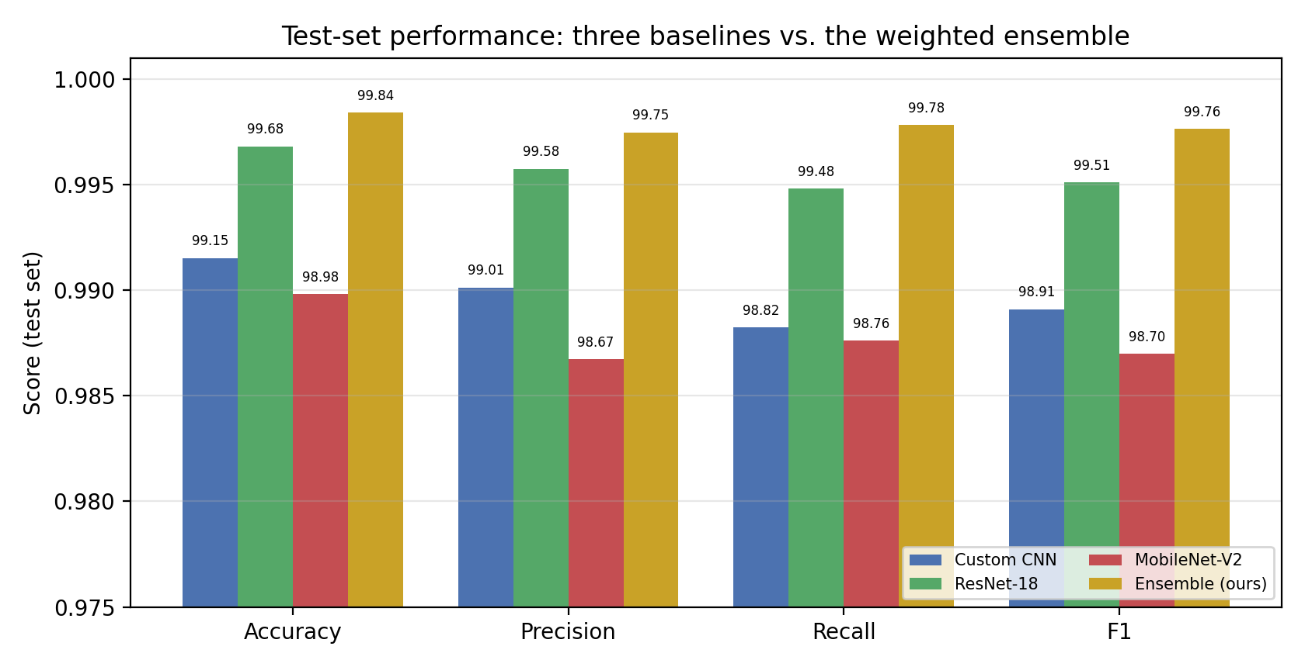
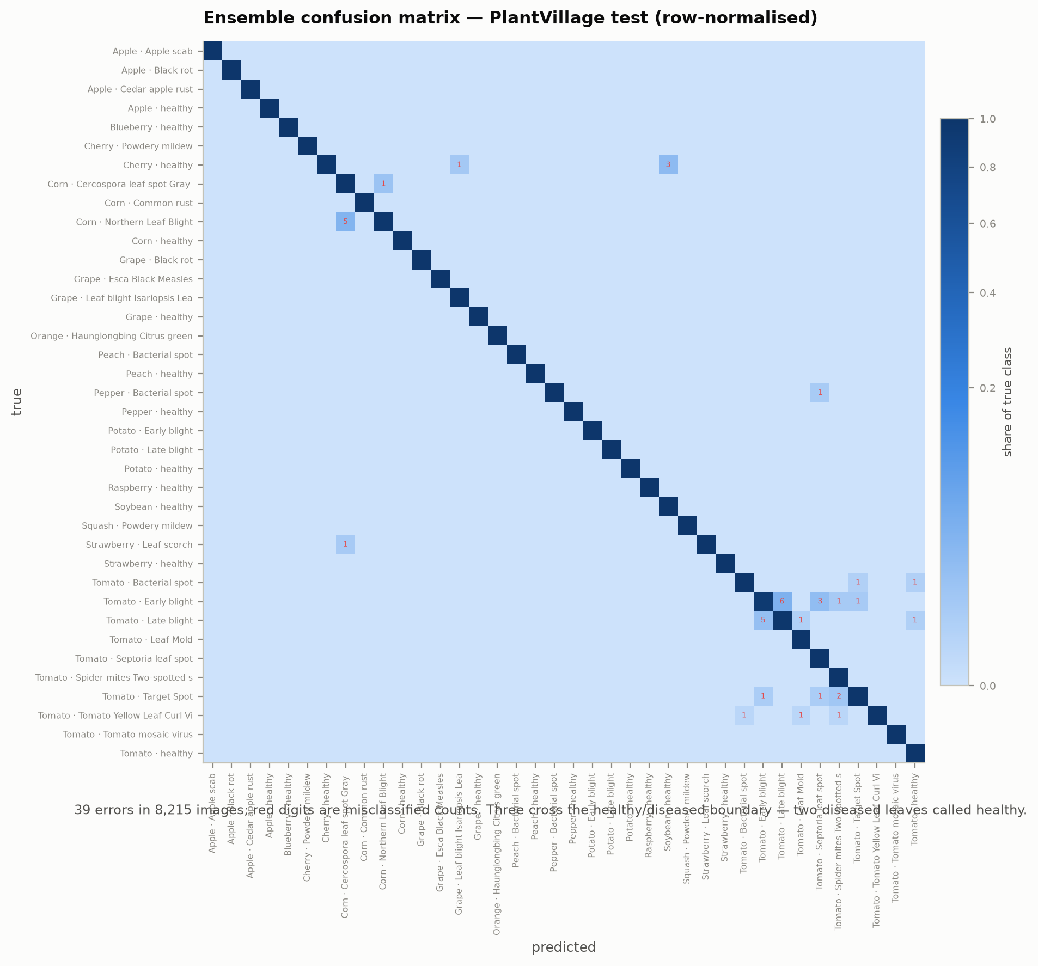
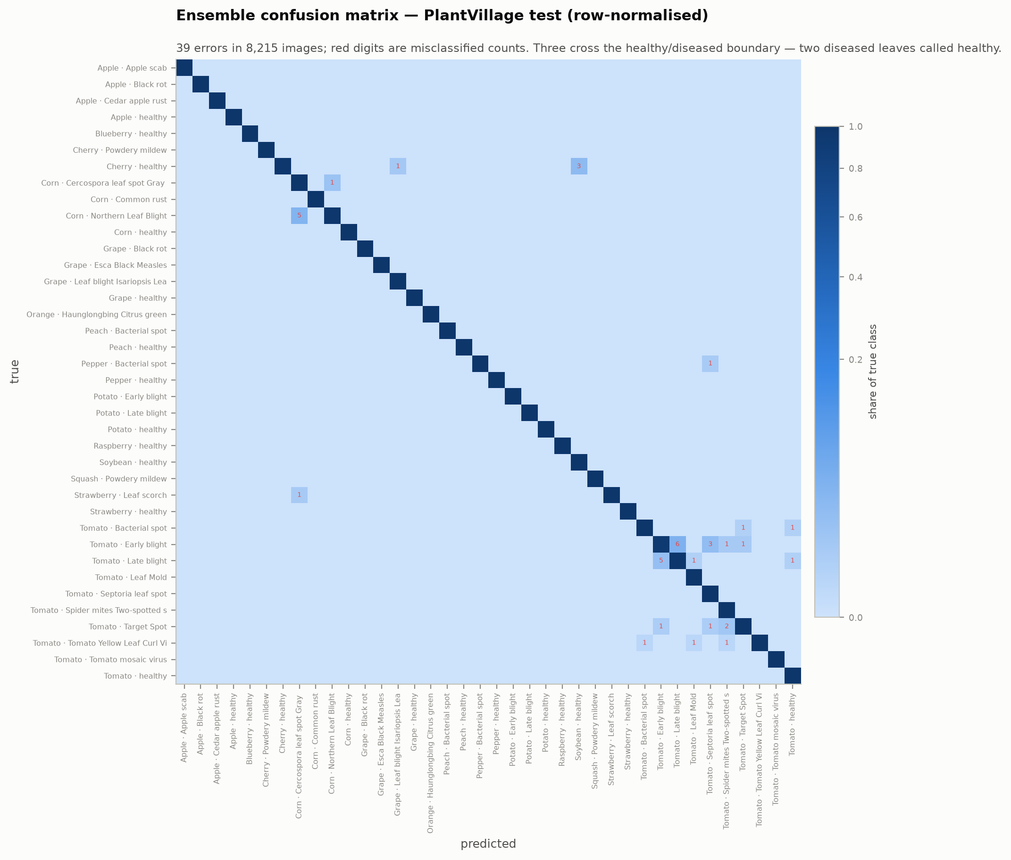
Results
Baselines exceed 98.6% on the 8,215-image leaf-grouped test split.
Ensemble (ours) is best: 99.53% over 38 diseases, 99.96% healthy-vs-diseased; 39 errors, only 3 crossing that boundary.
But zero-shot on real PlantDoc field photos collapses to 16.1% — the lab number does not transfer.
Bottleneck is crop identification (39.6%), not diagnosis; adaptation to field data recovers accuracy to 55.9%.
Presenter: ‹Presenter E (zID)›

Slide 9
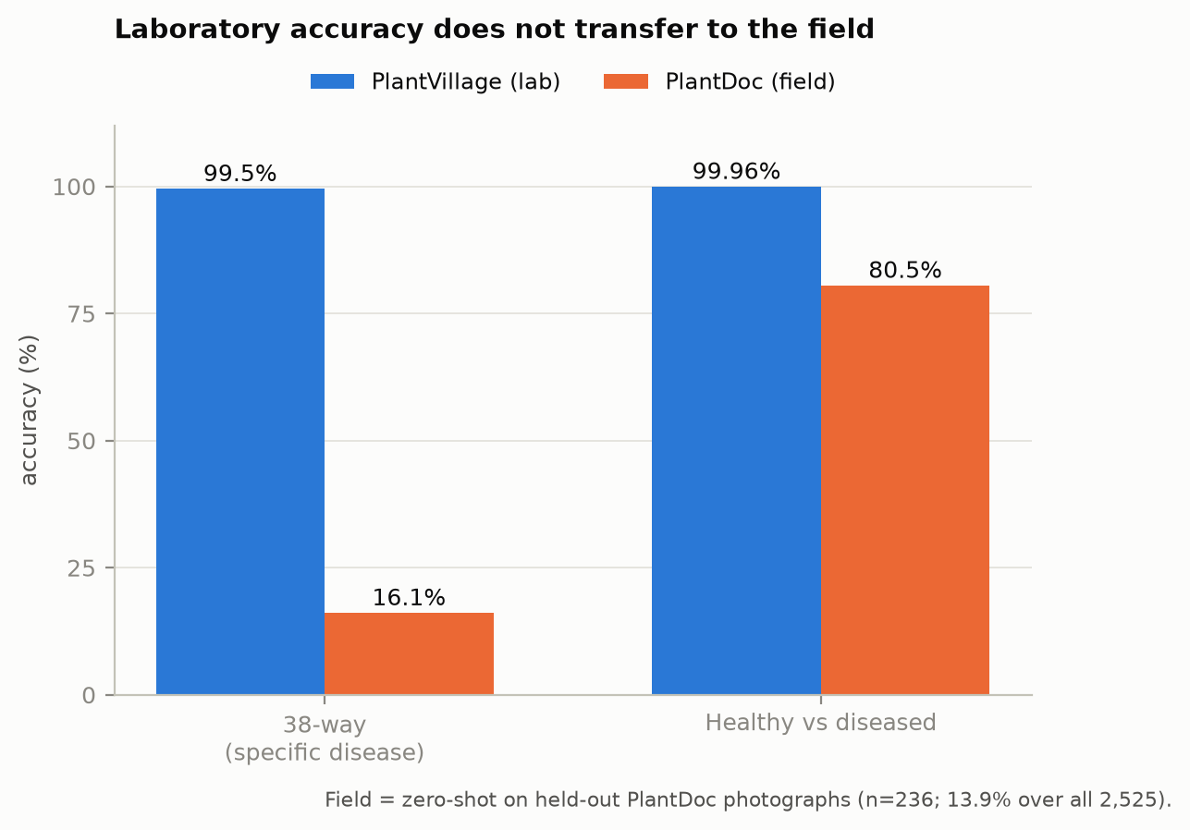
Discussion
The 99.5% is inflated: 8 background pixels alone classify at 33.7% (chance 2.6%), plus leaf-level train/test leakage.
574× the trainable parameters (full fine-tune vs a frozen 19k-param head) buys 8 lab points and zero field gain.
Severity validated by 3 annotators (κ 0.63 ceiling); trained jointly it is a model output (within-class ρ 0.957), best-in-class but capped near human reliability.
Remaining errors are benign within-crop look-alikes; only 3 of 39 cross the healthy/diseased line.
Presenter: ‹Presenter E (zID)›

Slide 10
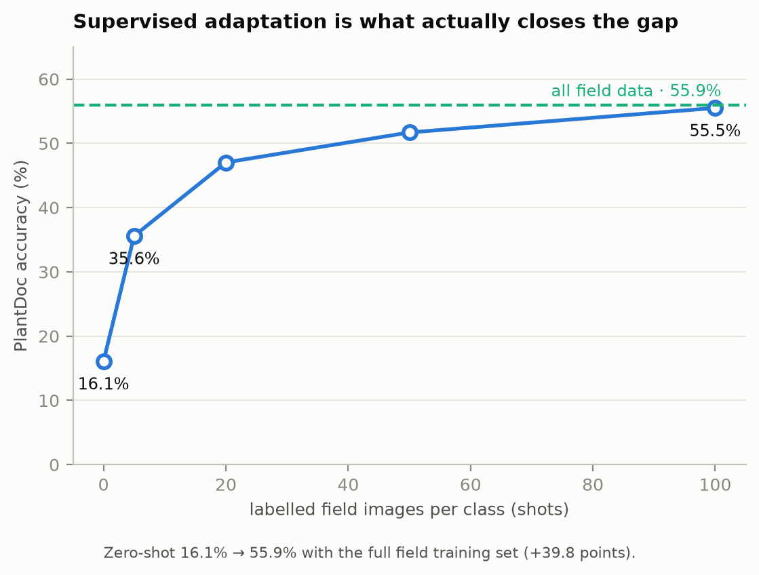
Conclusion
Ensemble classifies at 99.53% (38-way) and 99.96% (healthy vs diseased); severity is a jointly-trained model output.
But the lab accuracy is largely capture bias and leaf leakage — shown with controls, not asserted.
It collapses to 16% in the field; the honest deployment path is domain adaptation (→ 55.9%).
Reproducible, config-driven codebase; reporting the field number beside the lab one serves the farmer.
Presenter: ‹Presenter E (zID)›

Slide 11

Thank you
Code & notebook: plant-disease-detection/ · COMP9444 25T1 Project 090

