Slide 1

Big data
& Stocks
prediction

Slide 2
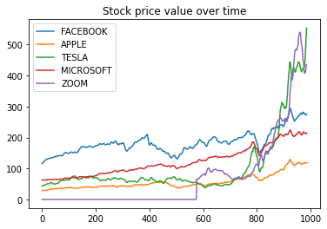
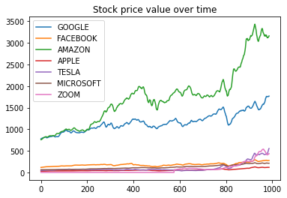
Previously on our stock analysis…

Slide 3
Added features
Close
Moving Average on 7 days
is_higher_than_rollavg
diffOpenClose
diffHighLow
786.14
786.90
794.02
806.15
806.65
804.78
807.90
798.93
Price > Moving Average
Open Price - Close Price
High Price - Low Price

Slide 4
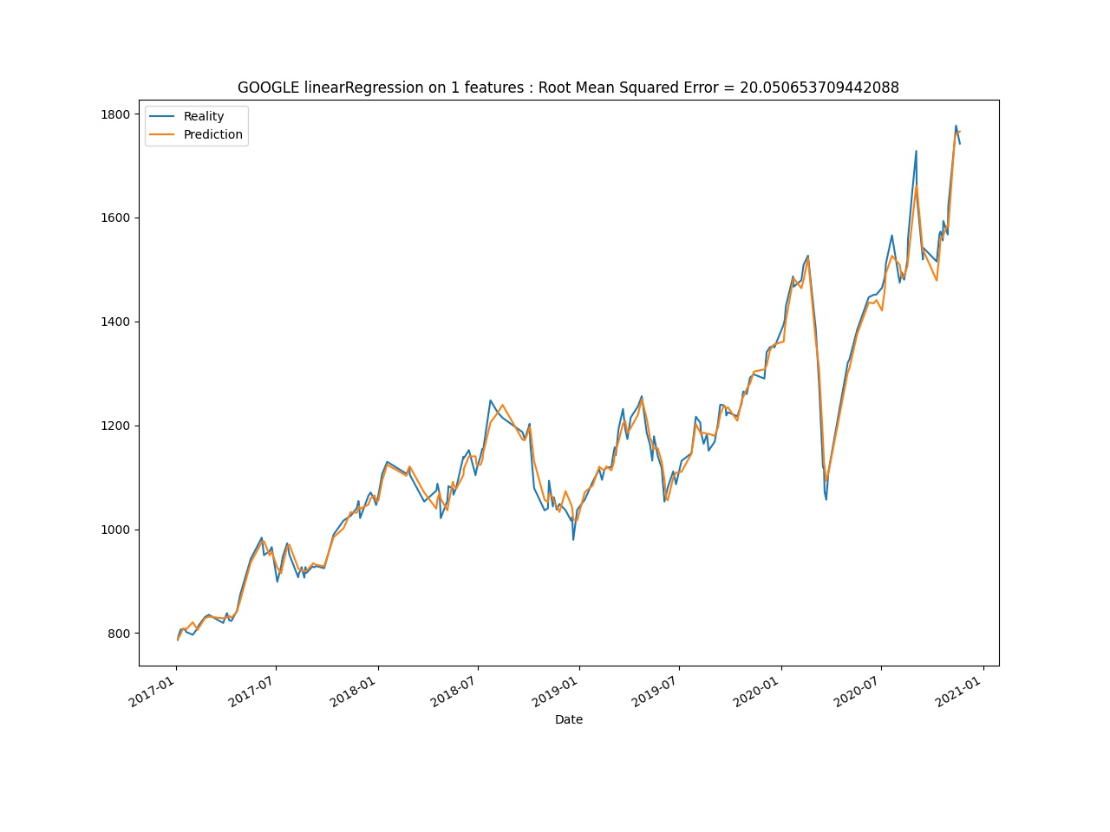
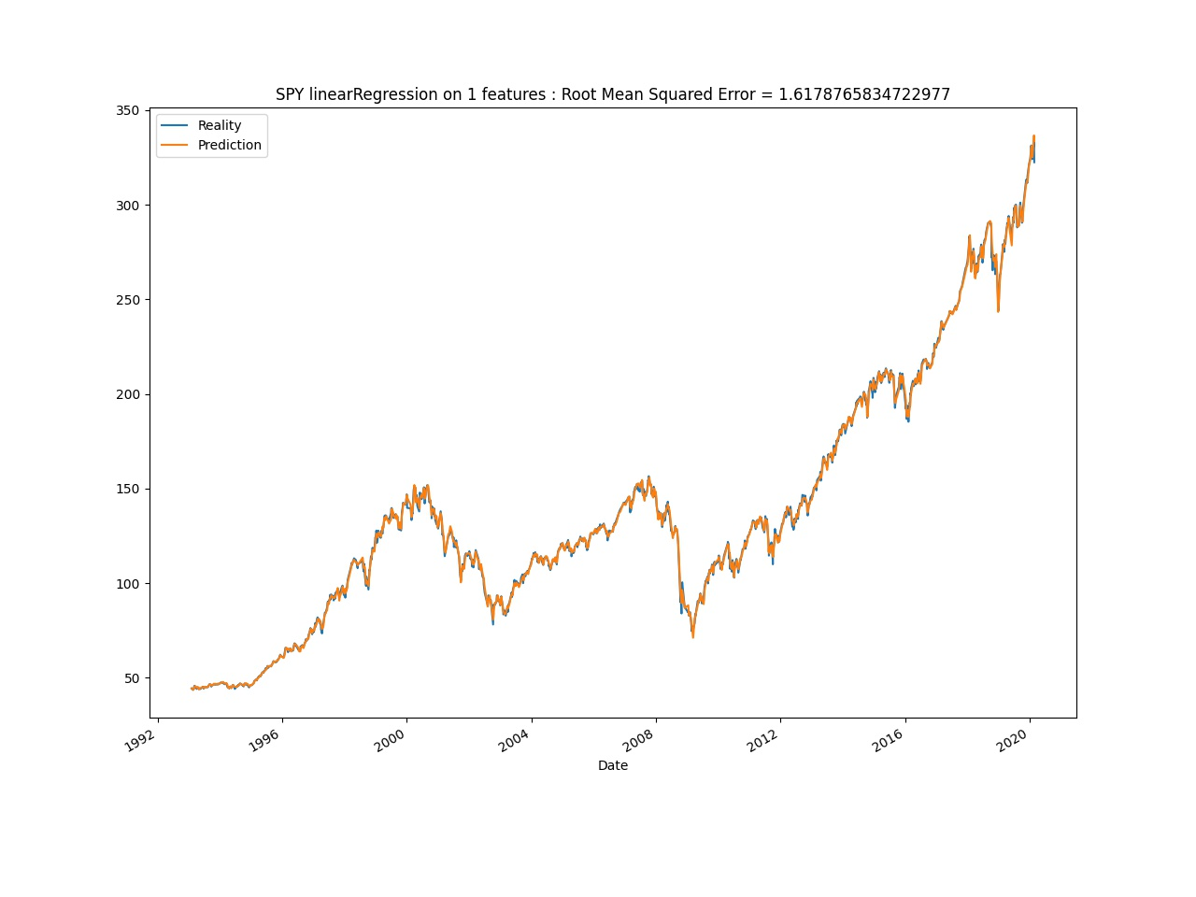
Linear regression with moving average only

Slide 5
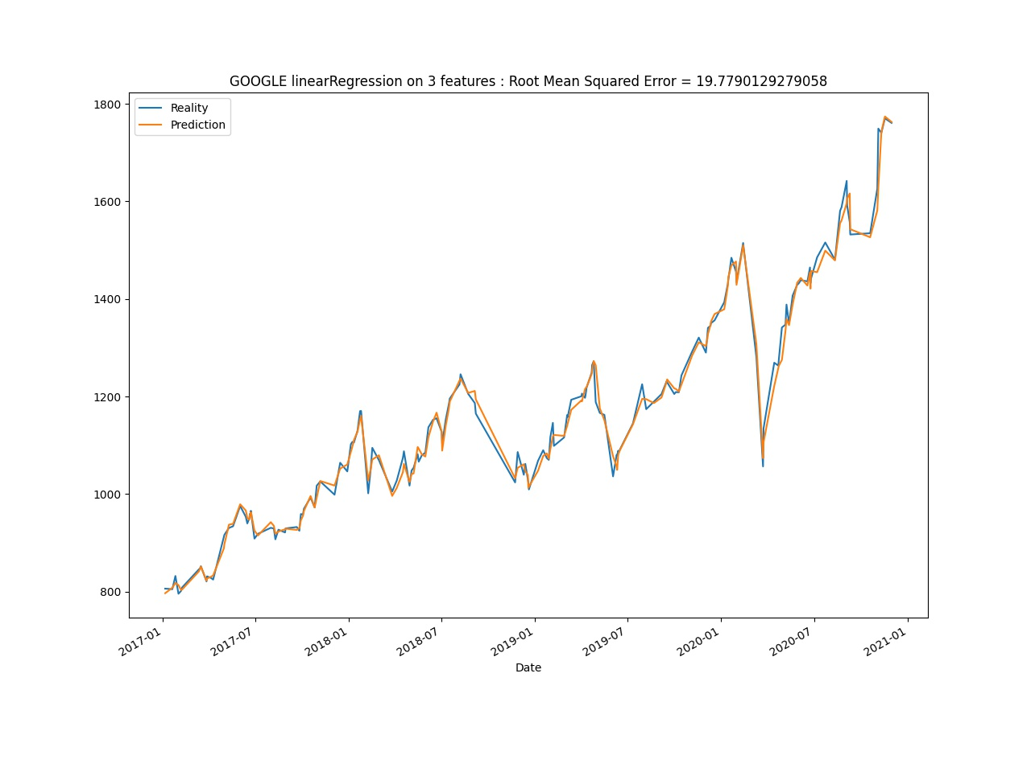
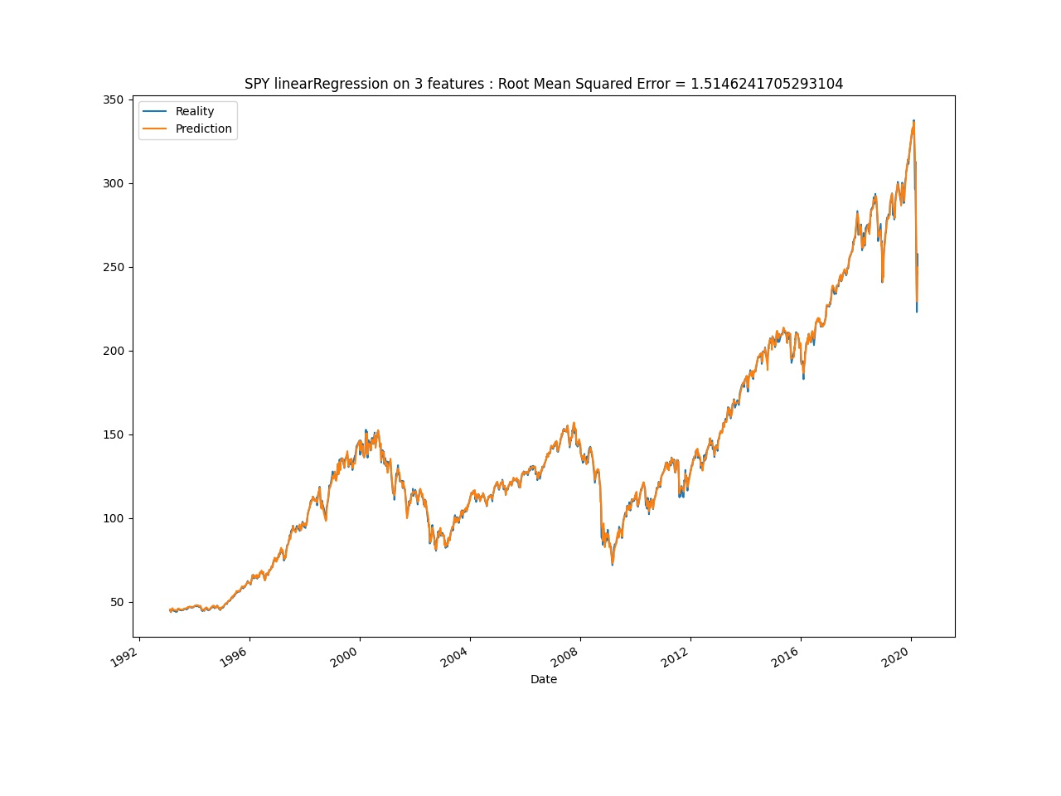
Linear regression with 3 features

Slide 6
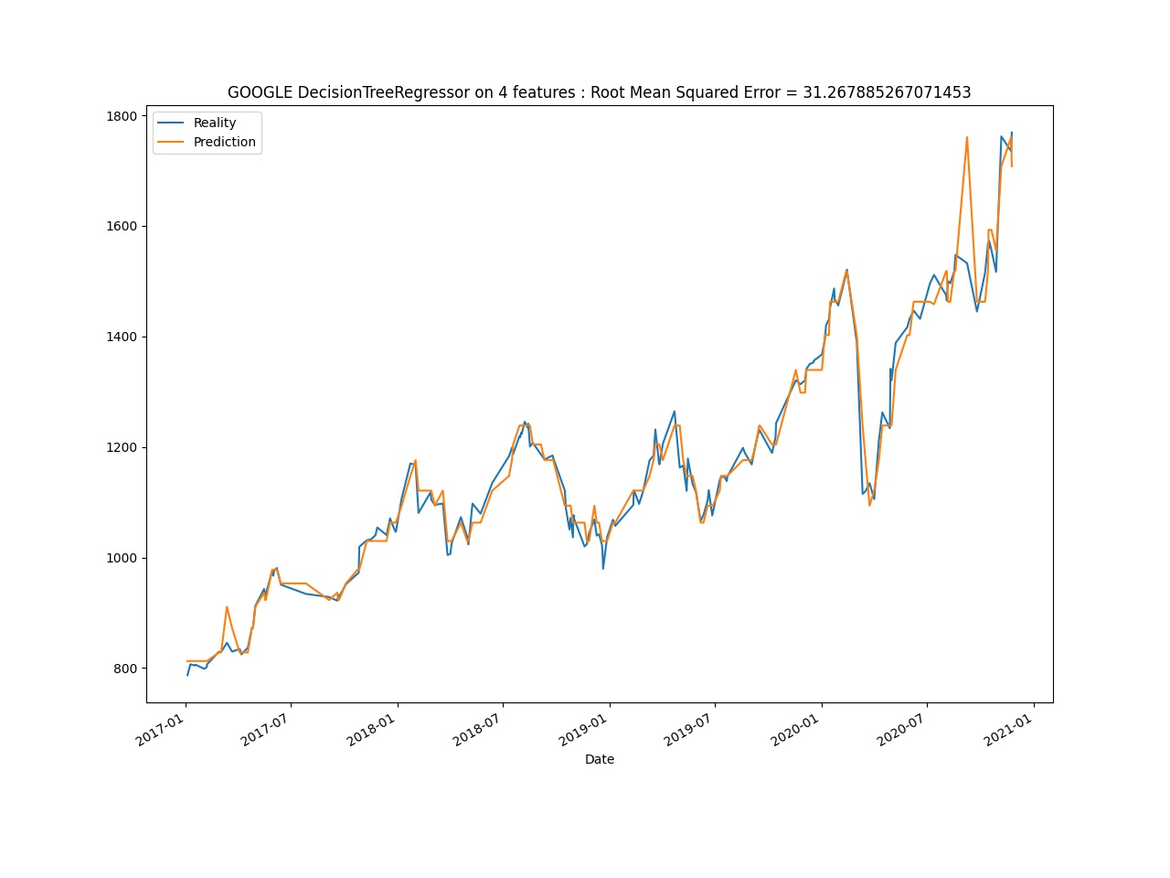
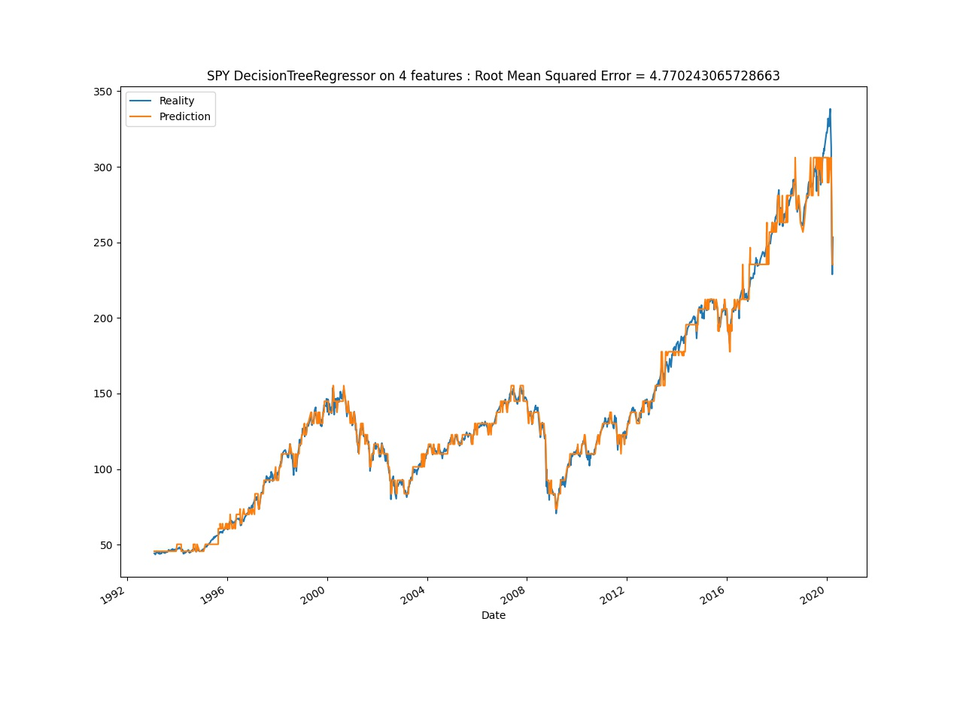
Tries on decision tree

Slide 7
Des questions ?

