Slide 1


An Introduction to Mixed-Integer Programming (MIP)

Slide 2

This is a MIP!
Algebraic representation
$\min{ −0.63x_{1} + 1.0x_{2}}$
$$s.t.−4.5x_{1} + 2.0x_{2} ≤ −0.25$$
$$0.2x_{1} + 0.67x_{2} ≤ 2.13$$
$$1.7x_{1} − 1.25x_{2} ≤ 2.85$$
$$− 2.32x_{1} − 5.0x_{2} ≤−5.91$$
$$x_{1}, x_{2}∈ℤ$$
Objective function
Linear constraints
Integrality constraint
MipMaster.org - 2020

Slide 3



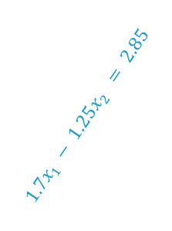

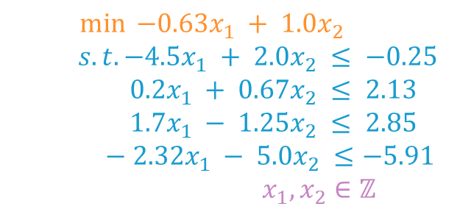
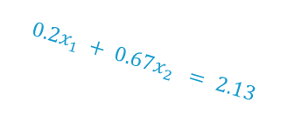

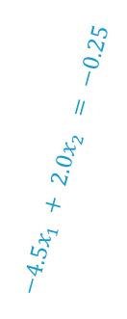


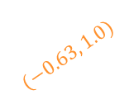
MIP depiction
Algebraic and graphical representations
$$x_{2}$$
$$0.2x_{1} + 0.67x_{2} = 2.13$$
$$+0.10$$
$\min{ −0.63x_{1} + 1.0x_{2}}$
$$s.t.−4.5x_{1} + 2.0x_{2} ≤ −0.25$$
$$0.2x_{1} + 0.67x_{2} ≤ 2.13$$
$$1.7x_{1} − 1.25x_{2} ≤ 2.85$$
$$− 2.32x_{1} − 5.0x_{2} ≤−5.91$$
$$x_{1}, x_{2}∈ℤ$$
$$−4.5x_{1} + 2.0x_{2} = −0.25$$
$$−0.26$$
$$−0.57$$
$$(−0.63, 1.0)$$
$$−0.89$$
$$1.7x_{1} − 1.25x_{2} = 2.85$$
$$2.32x_{1} + 5.0x_{2} = 5.91$$
$$x_{1}$$
Legend
LP relaxation
Objective function
Relaxation solution
Feasible solution
MipMaster.org - 2020

Slide 4


The goal is to close the MIP Gap
How do we solve a MIP?
$$x_{2}$$
$$x_{1}$$
Legend
LP relaxation
Objective function
Relaxation solution
Feasible solution
MipMaster.org - 2020

Slide 5


The goal is to close the MIP Gap
How do we solve a MIP?
$$x_{2}$$
Upper Bound (Primal bound)
MIP Gap
Lower Bound (Dual bound)
$$(x_{1}, x_{2})=(2.0, 1.0)$$
$$(x_{1}, x_{2})=(1.9, 0.3)$$
$$x_{1}$$
Legend
LP relaxation
Objective function
Relaxation solution
Feasible solution
Mip Master - 2020

Slide 6
Cutting planes
How do we solve a MIP?
$$x_{2}$$
Upper Bound (Primal bound)
MIP Gap
Lower Bound (Dual bound)
$$(x_{1}, x_{2})=(2.0, 1.0)$$
$$(x_{1}, x_{2})=(1.9, 0.3)$$
$$x_{1}$$
Legend
LP relaxation
Objective function
Relaxation solution
Feasible solution
Mip Master - 2020

Slide 7

Cutting planes
How do we solve a MIP?
$$x_{2}$$
Upper Bound
MIP Gap
Lower Bound
$$(x_{1}, x_{2})=(2.0, 1.0)$$
$$(x_{1}, x_{2})=(2.4, 1.0)$$
$$x_{1}$$
Legend
LP relaxation
Objective function
Relaxation solution
Feasible solution
Mip Master - 2020

Slide 8
Cutting planes
How do we solve a MIP?
$$x_{2}$$
Upper Bound
MIP Gap
Lower Bound
$$(x_{1}, x_{2})=(2.0, 1.0)$$
$$(x_{1}, x_{2})=(2.4, 1.0)$$
$$x_{1}$$
Legend
LP relaxation
Objective function
Relaxation solution
Feasible solution
MipMaster.org - 2020

Slide 9
Cutting planes
How do we solve a MIP?
$$x_{2}$$
Upper Bound = Lower Bound
$$(x_{1}, x_{2})=(2.0, 1.0)$$
$$x_{1}$$
Legend
LP relaxation
Objective function
Relaxation solution
Feasible solution
MipMaster.org - 2020

Slide 10
Perfect formulation
How do we solve a MIP?
$$x_{2}$$
Upper Bound = Lower Bound
$$(x_{1}, x_{2})=(2.0, 1.0)$$
$$x_{1}$$
Legend
LP relaxation
Objective function
Relaxation solution
Feasible solution
MipMaster.org - 2020

Slide 11




Branch & Bound
How do we close the MIP gap?
Node 0
$$z=−0.89$$
$$(x_{1}, x_{2})=(1.9, 0.3)$$
$$x_{2}$$
$$x_{1}≤1$$
$$x_{1}≥2$$
Node 1
Node 2
$$−0.89$$
$$(x_{1}, x_{2})=(1.9, 0.3)$$
$$x_{1}$$
Legend
LP relaxation
Objective function
Relaxation solution
Feasible solution
MipMaster.org - 2020

Slide 12






Branch & Bound
How do we close the MIP gap?
Node 0
$$z=−0.89$$
$$(x_{1}, x_{2})=(1.9, 0.3)$$
$$x_{2}$$
$$x_{1}≤1$$
$$x_{1}≥2$$
Node 1
Node 2
$$z=−0.81$$
$$(x_{1}, x_{2})=(2.0, 0.45)$$
$$x_{2}≤0$$
$$x_{2}≥1$$
Node 3
Node 4
$$Infeasible$$
$$−0.81$$
$$(x_{1}, x_{2})=(2.0, 0.45)$$
$$x_{1}$$
Legend
LP relaxation
Objective function
Relaxation solution
Feasible solution
MipMaster.org - 2020

Slide 13






Branch & Bound
How do we close the MIP gap?
Node 0
$$z=−0.89$$
$$(x_{1}, x_{2})=(1.9, 0.3)$$
$$x_{2}$$
$$x_{1}≤1$$
$$x_{1}≥2$$
Node 1
Node 2
$$z=−0.81$$
$$(x_{1}, x_{2})=(2.0, 0.45)$$
$$x_{2}≤0$$
$$x_{2}≥1$$
Node 3
Node 4
$$−0.51$$
$$Infeasible$$
$$z=−0.51$$
$$(x_{1}, x_{2})=(2.4, 1.0)$$
$$x_{1}≤2$$
$$x_{1}≥3$$
Node 5
Node 6
$$(x_{1}, x_{2})=(2.4, 1.0)$$
$$x_{1}$$
Legend
LP relaxation
Objective function
Relaxation solution
Feasible solution
MipMaster.org - 2020

Slide 14



Branch & Bound
How do we close the MIP gap?
Node 0
$$z=−0.89$$
$$(x_{1}, x_{2})=(1.9, 0.3)$$
$$x_{2}$$
$$x_{1}≤1$$
$$x_{1}≥2$$
Node 1
Node 2
$$z=−0.81$$
$$(x_{1}, x_{2})=(2.0, 0.45)$$
$$x_{2}≤0$$
$$x_{2}≥1$$
$$−0.26$$
Node 3
Node 4
$$Infeasible$$
$$z=−0.51$$
$$(x_{1}, x_{2})=(2.4, 1.0)$$
$$x_{1}≤2$$
$$x_{1}≥3$$
Node 5
Node 6
$$z=−0.26$$
$$(x_{1}, x_{2})=(2.0, 1.0)$$
$$(x_{1}, x_{2})=(2.0, 1.0)$$
$$x_{1}$$
Legend
LP relaxation
Objective function
Relaxation solution
Feasible solution
MipMaster.org - 2020

Slide 15

Next step: use cases
MipMaster.org - 2020

Slide 16
Designing a Logo

Slide 17
Designing a Logo

