Slide 1
SSD-Insider: Internal Defense of Solid-State Drive against Ransomware with Perfect Data Recovery
Trubachev Ilya 818, Nazarov Konstantin 818
Gazizov Yakov 818, Oparina Daria 815

Slide 2
Agenda
What is ransomware?
Project motivation
Examples of crypto ransomware
Effective detection
Implementation

Slide 3
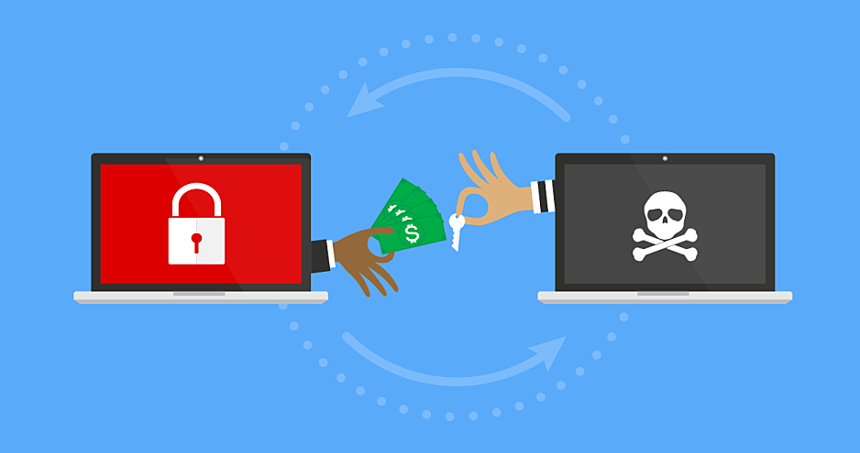
What is Ransomware?
malware that encrypts victim’s data, where the decryption key is released after a ransom is paid by the data owner to the attacker
ransomware encrypts data using strong encryption algorithms
ransomware tries to subvert standard malware defenses by using networks that utilize anonymous communication systems such as Tor
thieves collect ransom using cryptocurrency, such as Bitcoin, which is very difficult to track

Slide 4
Project motivation
Many ransomware attacks were reported recently.
Even after obtaining the secret key, there is no guarantee the data will be recovered completely.
Even IF THE RANSOM IS PAID there is no guarantee the secret key will be obtained

Slide 5
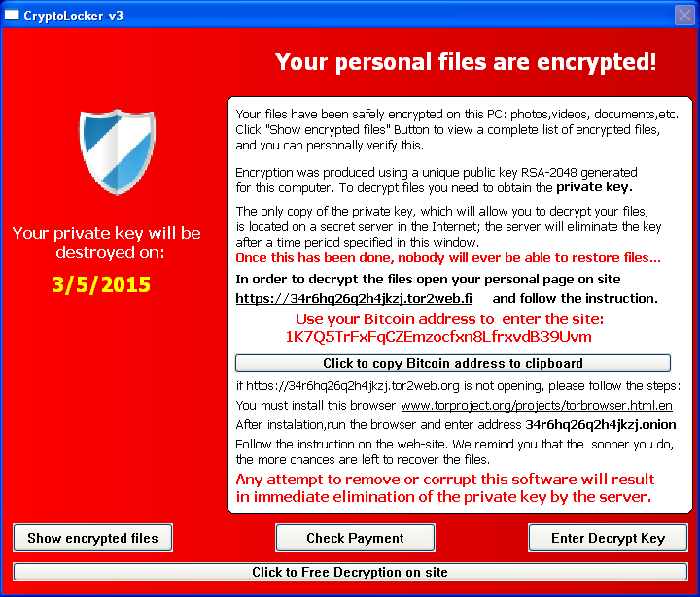
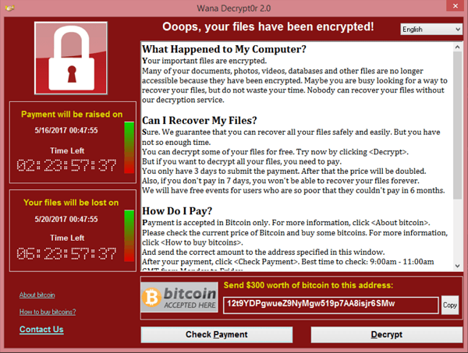
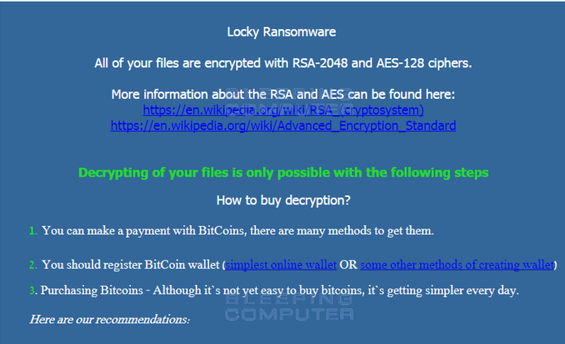
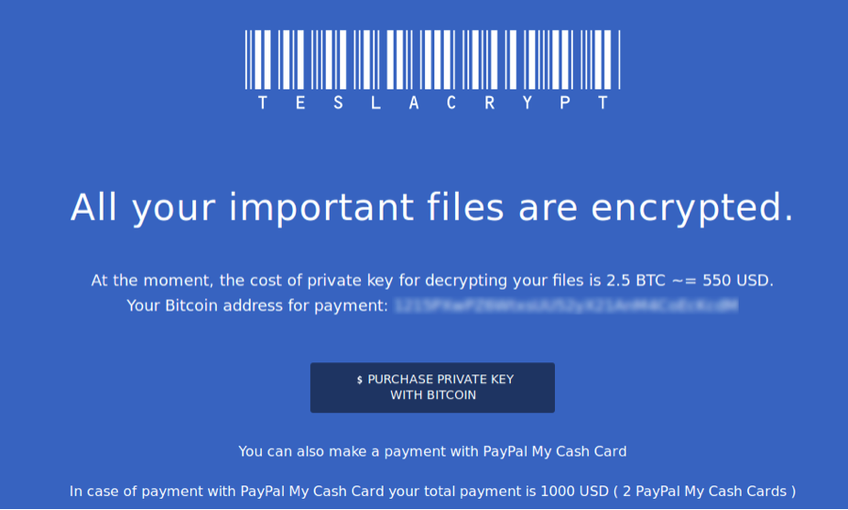

Slide 6
Examples of crypto ransomware
WannaCry
CryptoWall
TeslaCrypt (a.k.a. AlphaCrypt)
Locky

Slide 7
Effectively detect and perfectly recover data, even when:
a user does not run any ransomware monitoring application
the OS does not execute any ransomware monitoring task
it works for an unknown OS, an unknown file system and unknown applications
it confronts previously unknown ransomwares

Slide 8
Distinguishing ransomware from normal applications with similar overwriting behavior
OWIO denotes the number of overwritings for a time slice (e.g., 1 sec).
OWST is the fraction of overwritten blocks over the total number of write requests during a time window.
PWIO is the number of overwritings for a time window consisting of N time slices.
AVGWIO is the average length of continuously overwritten blocks in a current time window.
OWSLOPE is the fraction of the number of overwritings during a current time slice over the average number of overwritings over the previous time window.
IO is the fraction of the number of overwritings during a current time slice over the average number of writings over the previous time slice

Slide 9
the resource limitation and the tight time-bound characteristics of the SSD system
powerful machine learning algorithms, such as support vector machine or even deep learning
binary decision tree

Slide 10
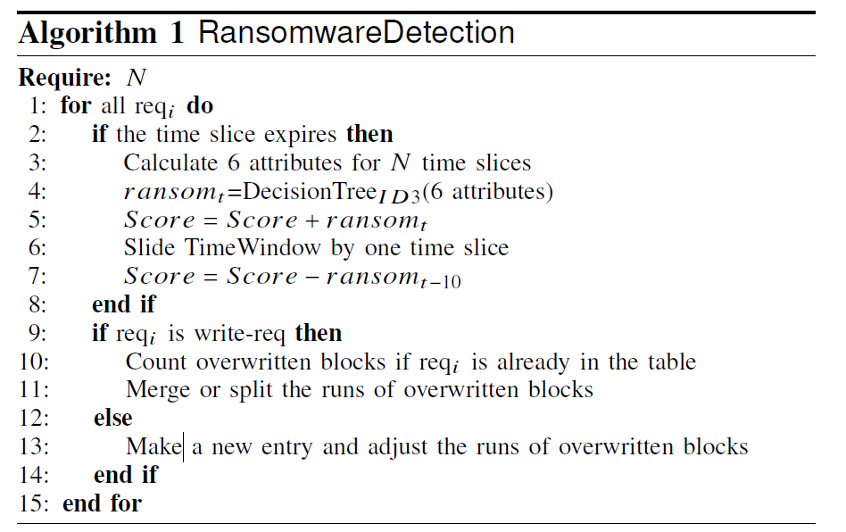

Slide 11
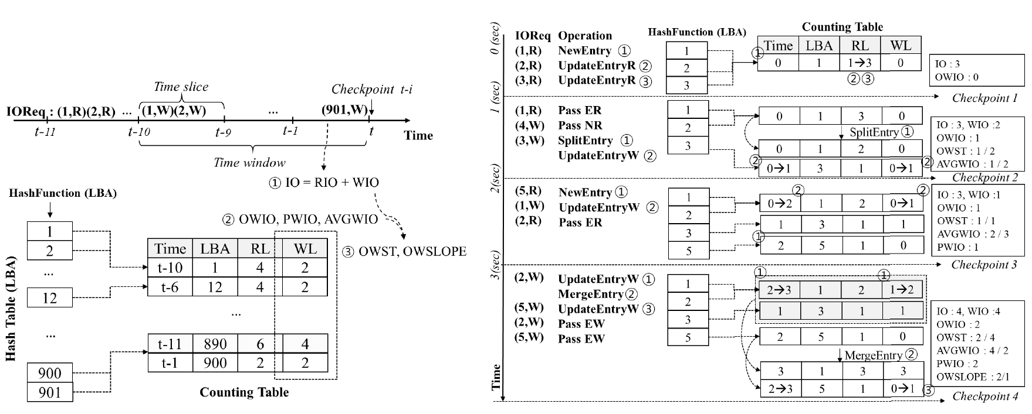

Slide 12
Data recovery process
SSD-Insider notifies users of which suspicious behaviors are detected
if a user responds that ransomware attack is suspected, SSD-Insider’s FTL first makes an SSD read-only
replace individual mapping entries with the corresponding backup entries
status of the mapping table is rolled back to the time just before 10 seconds
reboot the system and to get rid of ransomwares using anti-virus programs

Slide 13
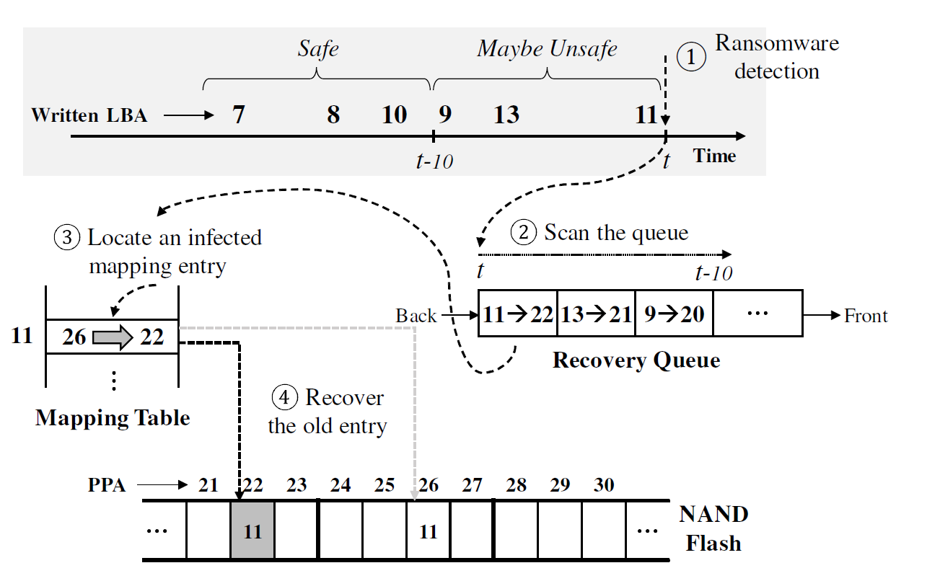

Slide 14
Reference
Based on the research supported by Global Research Lab. (GRL) Program of the National Research Foundation (NRF) funded by Ministry of Science, ICT (Information and Communication Technologies) and Future Planning(NRF-2016K1A1A2912757)

