Slide 1
NovaWallet Mobile
Send & Save
FirstBank Digital Factory · Frontend Engineer, Mobile (Flutter)
Ayorinde Michael Olamiposi
https://github.com/Miqhael857/NovaApp
Notes:
10 minutes. The one thing to remember: a queued transfer survives the app being killed and is never sent twice.

Slide 2
CONTEXT
Who this is built for
• Mass-market Nigerian users, largely on low-end Android
• Connectivity is patchy — offline is the normal case, not the error case
• NIBSS NIP settles instantly, so a send is final the moment it lands
• That combination is why idempotency matters more than polish here
“The app must degrade gracefully, not just look good on a fast Wi-Fi demo.” — the brief
Notes:
Set up why the offline path is the centre of the work rather than a nice-to-have.

Slide 3
PRIORITISATION
What I built, and what I chose not to
Built
Deliberately not
• Wallet home: ledger balance, lazy list, pull-to-refresh
• Send Money: recipient → amount → confirm
• Offline queue + sync, exactly-once
• Result screen: sent and queued
• NovaSave: create, contribute, progress
• Send validates against a constant, not the live balance
• TalkBack audit (Semantics are in, unaudited)
• Notifications, localisation, goldens, biometrics
The brief asked for judgment about priorities
rather than a rushed attempt at everything.
Notes:
Be straight about the gaps. Naming them is stronger than hoping they go unnoticed.

Slide 4
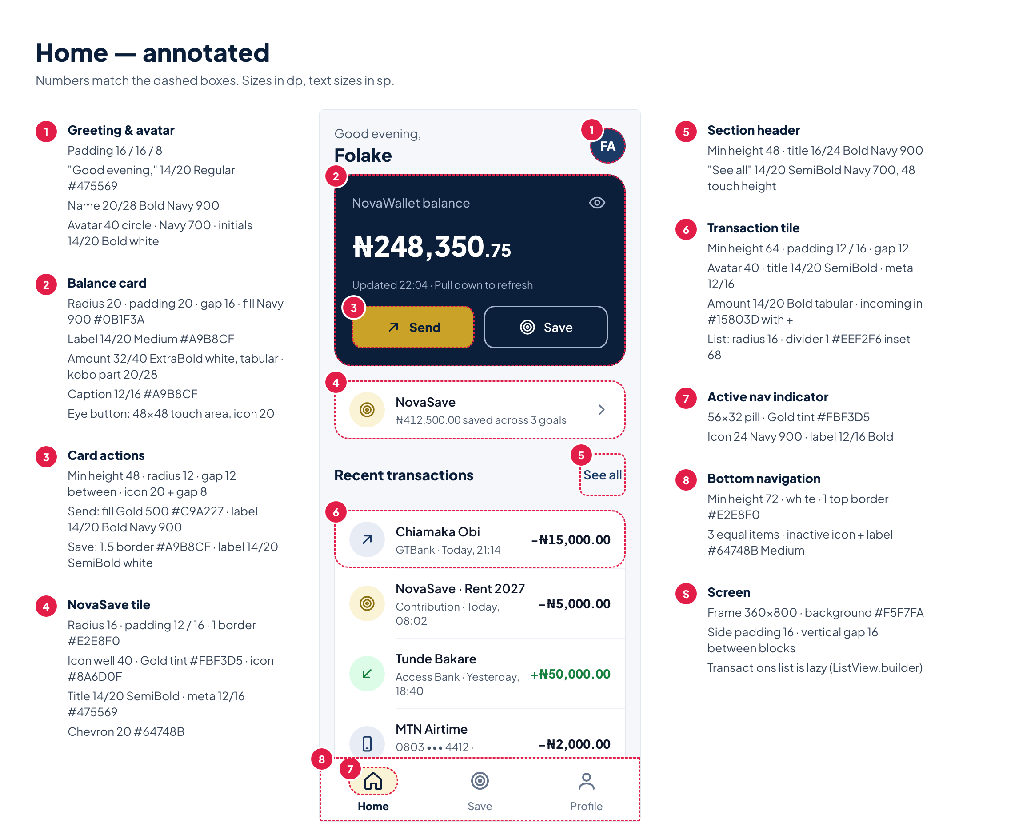
HOW IT IS PUT TOGETHER
Architecture
presentation/ screens + Riverpod notifiers
data/local/ outbox + client database
data/remote/ fake NovaPay API (idempotent receiver)
data/sync/ single-flight sync engine
core/money/ Kobo value type
Riverpod 3, no code generation.
Flow state lives in a notifier, never in the router's extra — extra is null after Android restarts a killed app.
Client and fake server are separate database files, so the client cannot repair the server's record of what it already processed.
Notes:
Two databases is the detail worth landing: it keeps the client/server boundary honest.

Slide 5
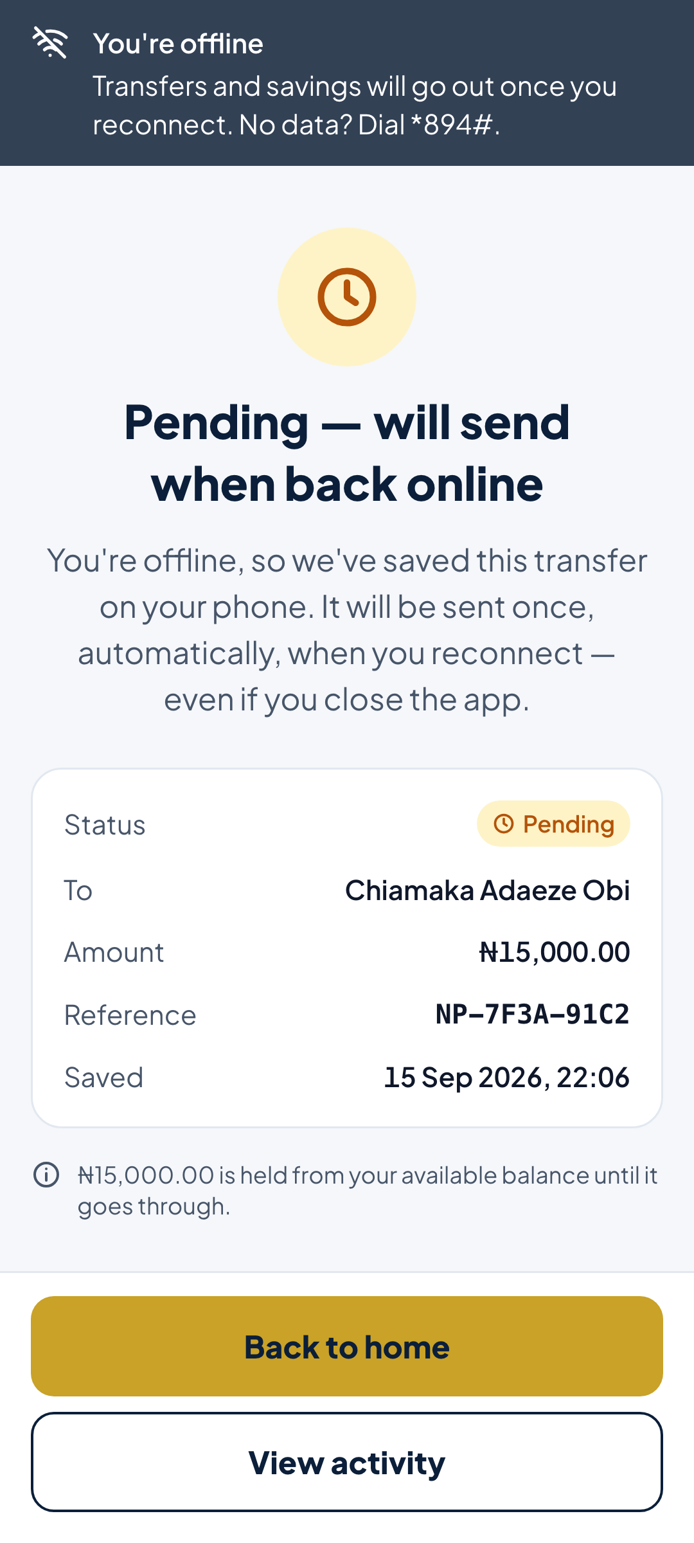
THE CORE
Exactly once — the honest version
A client cannot promise exactly-once on its own.
1. The client promises AT LEAST ONCE
The outbox row is written before any network call and cleared only
when the server answers. Die mid-send and the row is retried.
2. The server promises NO DUPLICATES
Same idempotency key every attempt; a key it has seen replays the
original outcome, re-checked inside the transaction.
Exactly-once is the effect of the two halves, not a property of either.
pending → in_flight → succeeded | failed
in_flight rows are re-sent: no answer means we do not know.
Notes:
This slide is the interview. Say the sentence: the client cannot guarantee exactly once alone.

Slide 6
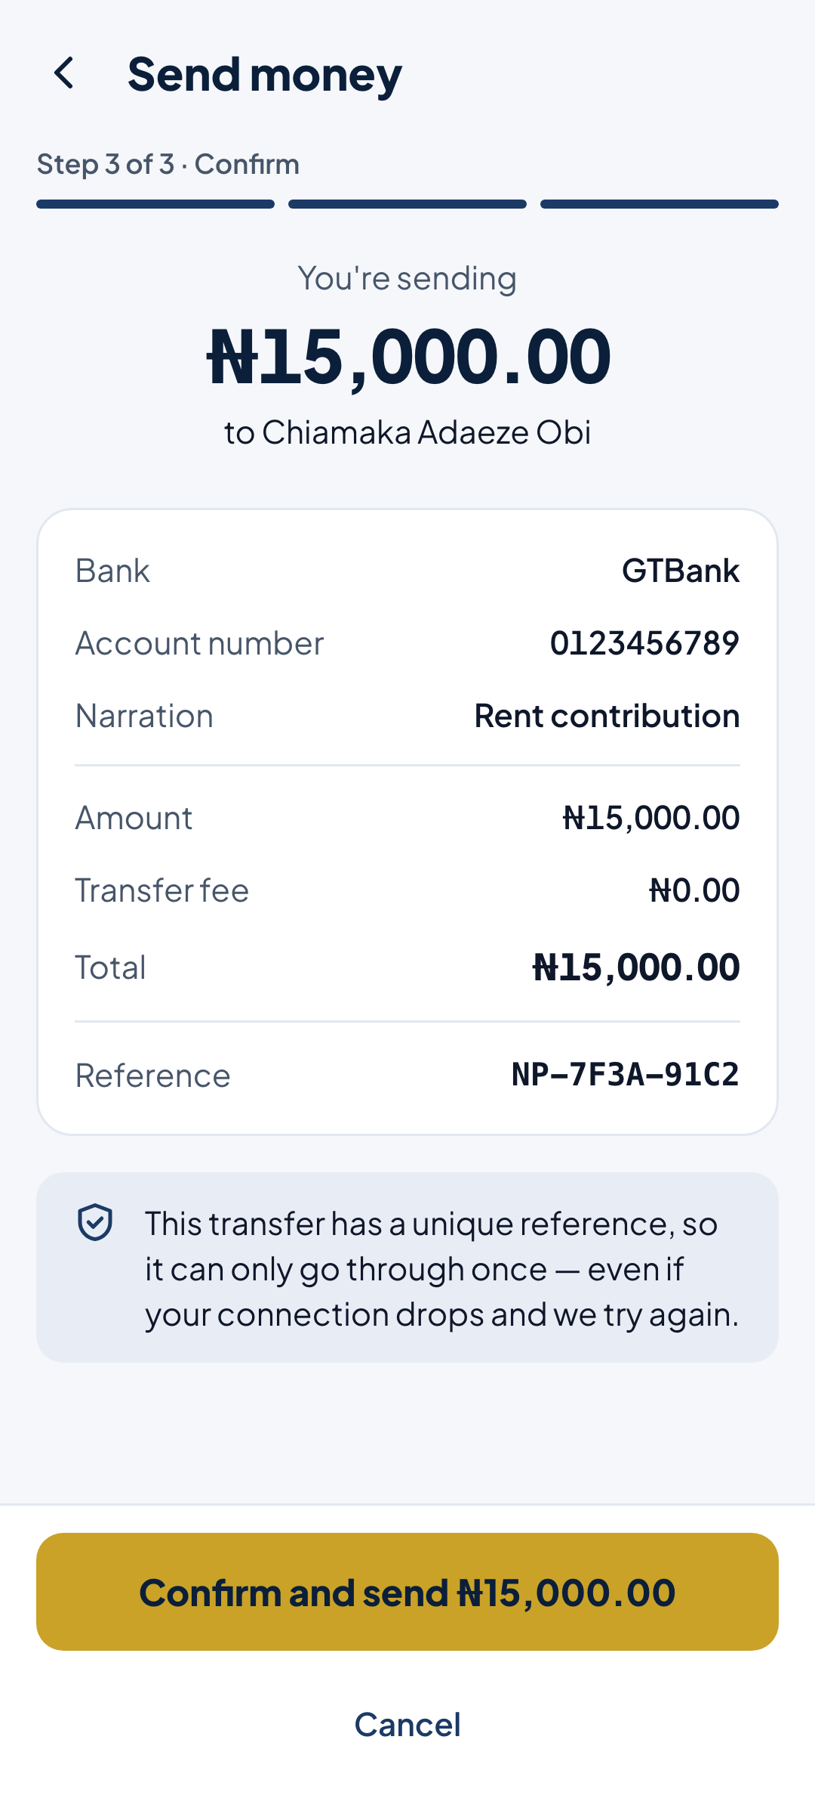
CORRECTNESS
Money is an integer, always
• Kobo wraps a whole int — no double touches an amount
• Formatting: integer division and manual thousands grouping
• Parsing: string → kobo, never double.parse
• Progress: value * 100 ~/ total, clamped 0–100
• 19 tests, including the classic 0.1 + 0.2 case
₦248,350.75 is Kobo(24835075)
Notes:
One kobo of drift in a balance is a support ticket. That is why it is a type, not a convention.

Slide 7
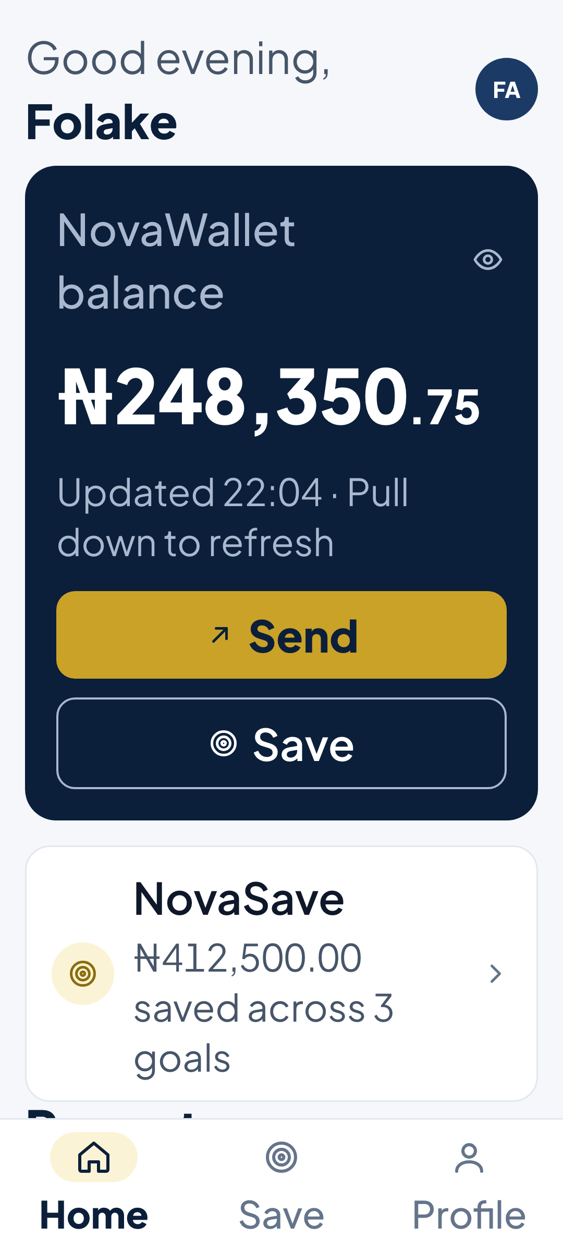
CONSTRAINTS
Accessibility and low-end devices
• Lists are lazy: SliverList.builder, not ListView.builder with shrinkWrap
(shrinkWrap still lays out every row — it only looks lazy)
• Line height is a ratio, so text grows with the system font setting
• Buttons use minHeight, never fixed heights
• Status carries an icon and a word — never colour alone
• MergeSemantics per row, so a screen reader reads one item
Notes:
The shrinkWrap point shows the constraint was understood, not just pattern-matched.

Slide 8
65 PASSING
Tests that fail if the guarantee breaks
• Two concurrent sync passes → one ledger entry
• Server already processed, then app restarts → no double debit
• Row left in_flight after a crash → retried with the same key
• Offline → stays queued, no retry loop
• Rejection is final, never retried
• Stepping back and forward keeps ONE idempotency key
The tests assert the property, not the implementation: they fail if the queue ever replays twice or loses an item. Plus an on-device integration test: offline → restart → reconnect → one ledger entry.
Notes:
Offer to run flutter test live — it takes four seconds.

Slide 9
JUDGMENT
Working with AI
Helped
Was wrong
• Outbox-first ordering
• The idempotent-receiver argument
• Single-flight sync
• Spotting three layout bugs from a screenshot
• Invented a “Share receipt” feature not in the brief
• Then “proved” it was absent by searching binary noise
• Reported a completed transfer as still pending
(joined a sync pass that predated the row)
The fabricated evidence is the one worth talking about: the answer was defensible, the reasoning behind it was worthless, and it looked settled.
Notes:
Do not oversell the tool. The catch matters more than the assist.

Slide 10
Next, with more time
• StatefulShellRoute so each tab keeps its own stack
• Transaction history read from the ledger, not seeded data
• SQLCipher for the client database (NDPA 2023: the queue holds account numbers)
• A real name-enquiry call instead of the faked directory
• Local notification when a queued transfer finally lands
https://github.com/Miqhael857/NovaApp
Notes:
Close on the demo: airplane mode, send, kill the app, reconnect, one debit.

