Slide 1

Web scraping to gain company insights
04/11/2024
Muhammad Daffa Miqoilla, Junior Data Scientist

Slide 2
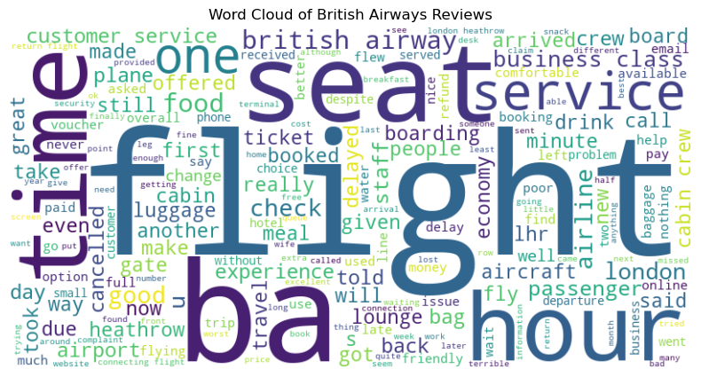
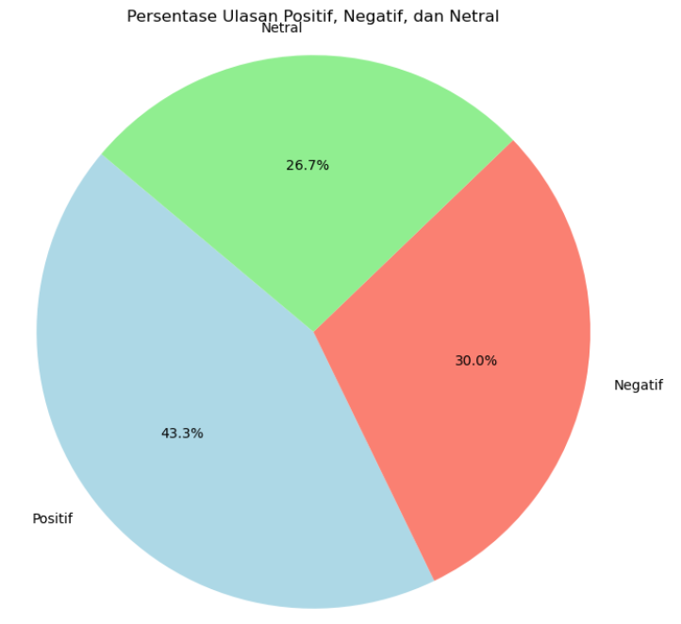
Insights FROM CUSTOMER REVIEWS
From cleaning 1000 reviews given by the customers, we obtained
Positive Reviews - 300
Negative Reviews - 2667
Neutral Reviews - 433

