Slide 1
British Airways
Predictive model
2024-11-05

Slide 2

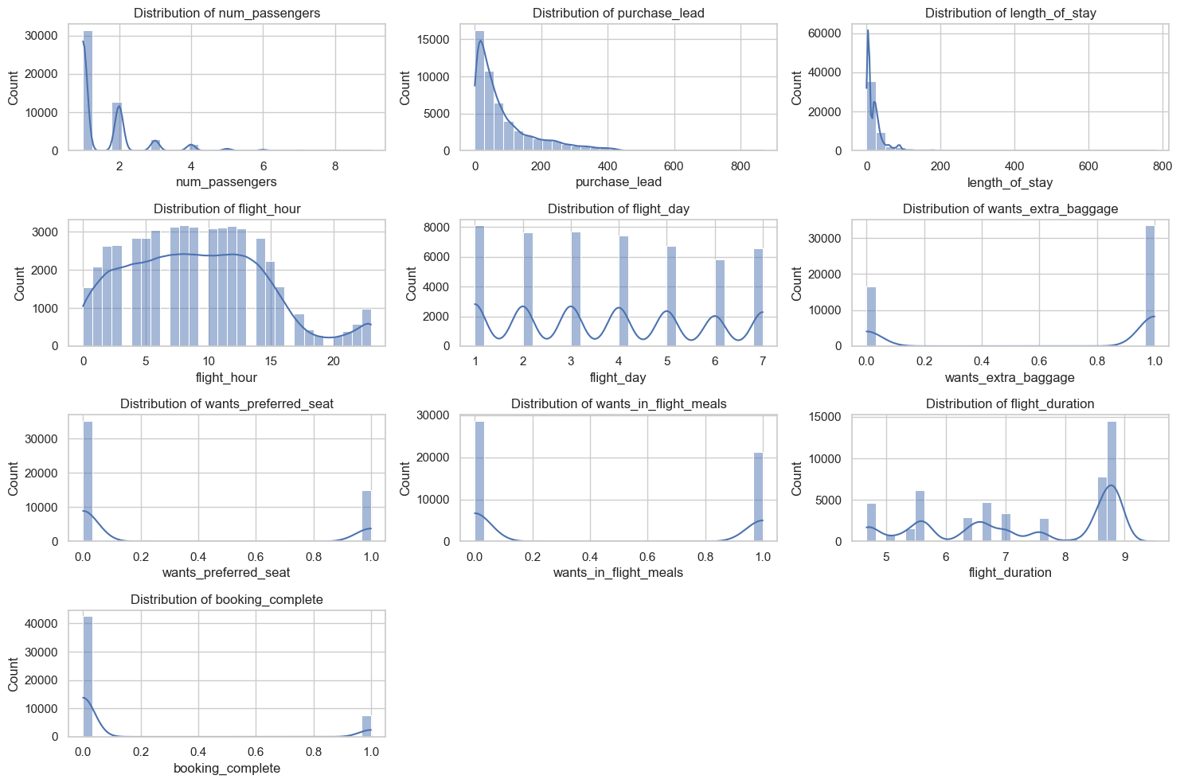
Results of Predictive Modeling Using Random Forest
Exploratory Data Analysis (EDA)
Metric | Class 0 | Class 1 | Marco Averager | Weighted Average
Precision | 0.86 | 0.52 | 0.69 | 0.81
Recall | 0.98 | 0.12 | 0.55 | 0.85
F1-Score | 0.92 | 0.19 | 0.56 | 0.81
Support | 8504 | 1496
Accuracy |  |  |  | 0.85

