Slide 1


Base Line Architectures for Channel Fusion

Slide 2
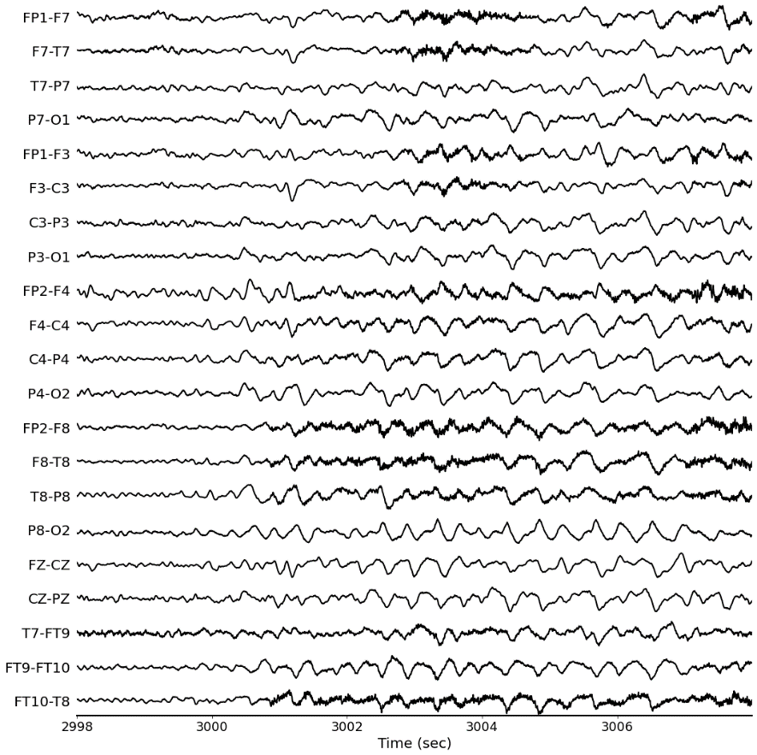
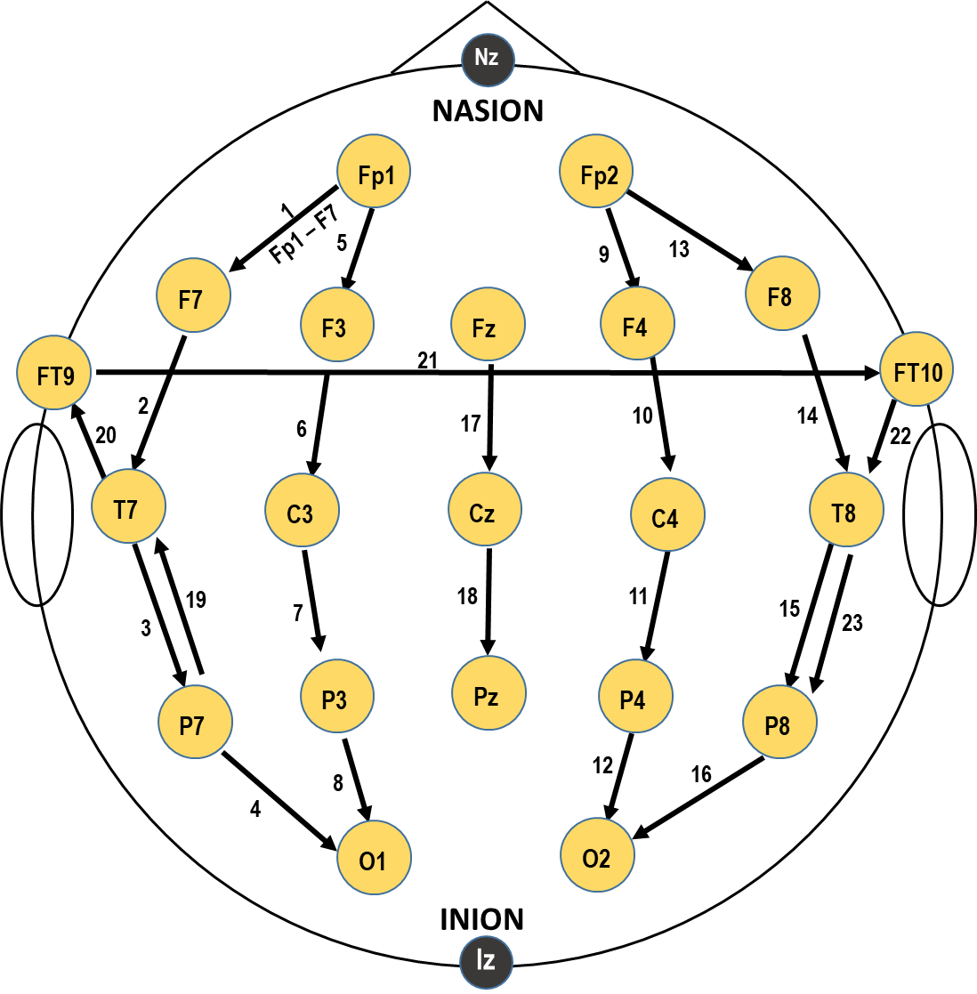
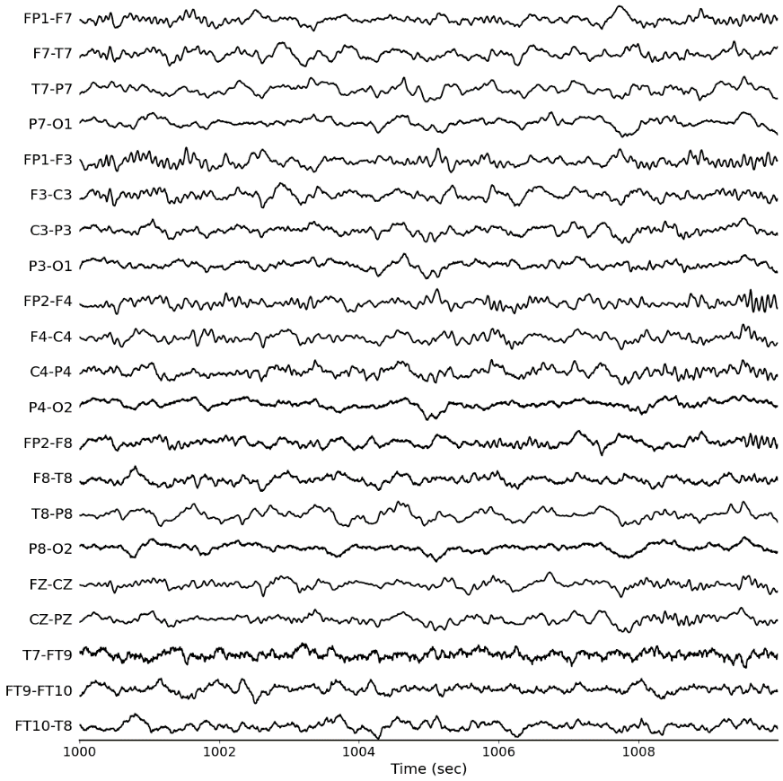
EEG Signals
normal
seizure
Nchannel EEG temporal signals recorded from same subject

Slide 3
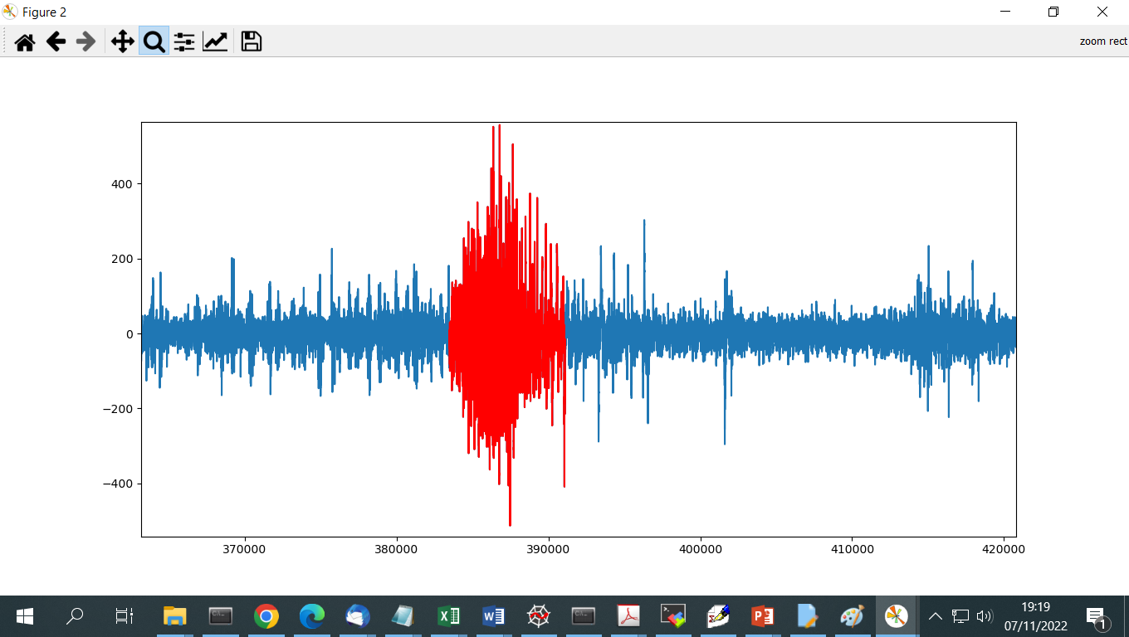
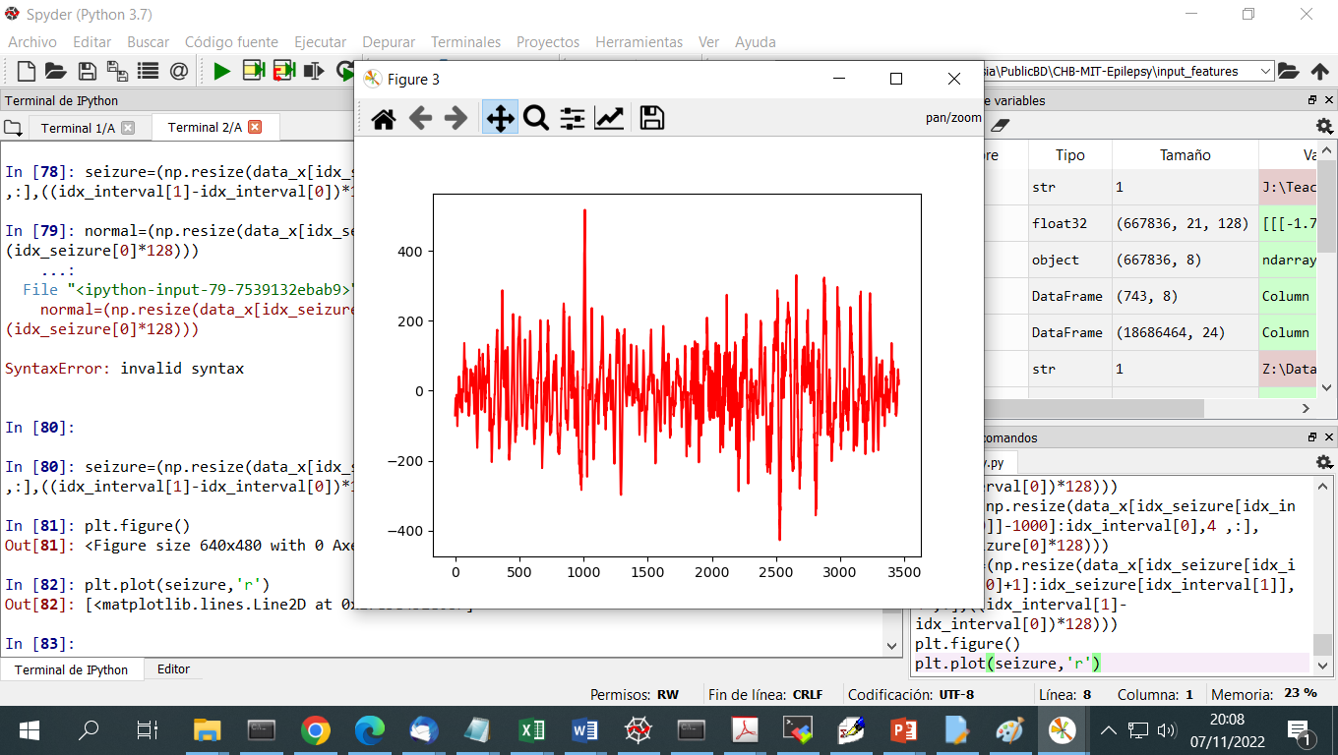
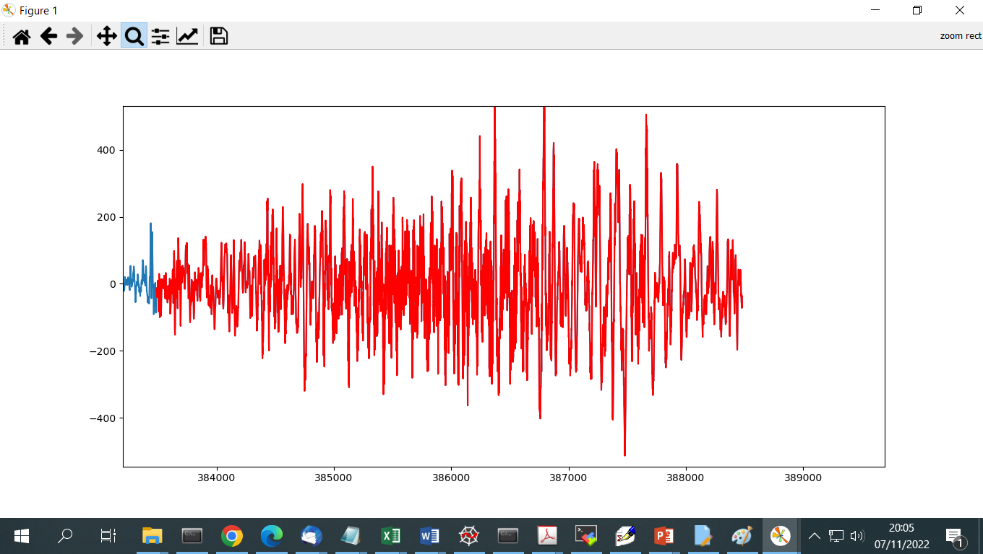
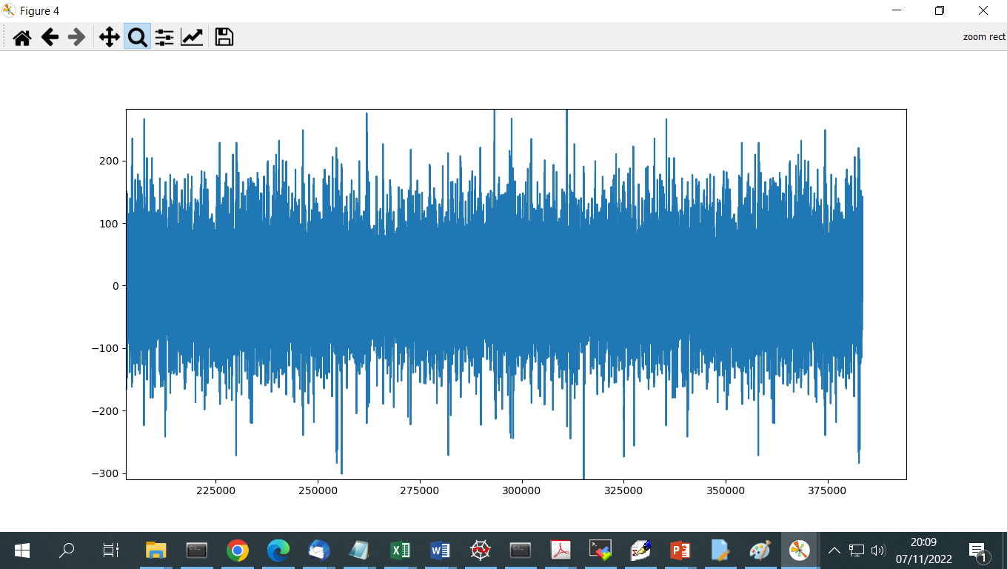
Input Data
Subject1
S1_seizure1
S1_normal1
S1_normal2
Signals are cut in temporal windows of 1 second
Each window is labelled as 0/1
SubjectN
SN_seizure1
SN_seizure2
SN_normal1
SN_normal2

Slide 4
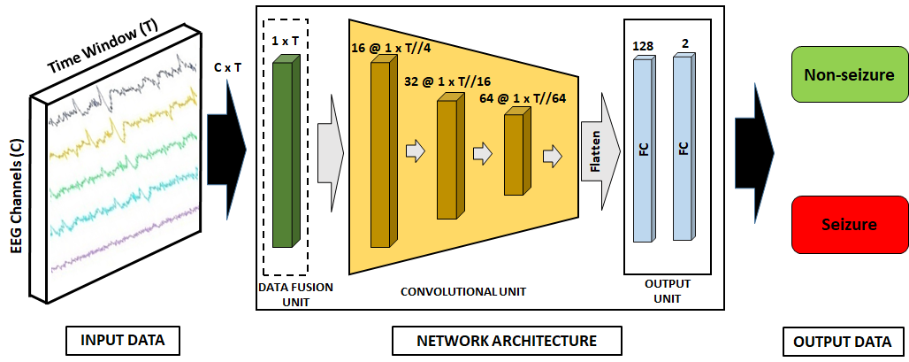
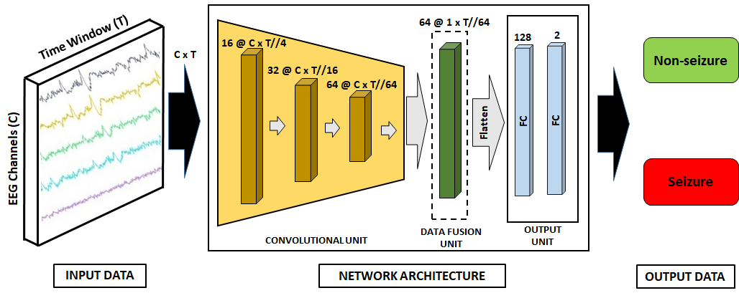
Base Line Static Approach
Architecture that classifies a window
Different approaches to combine EEG electrode signals (Channel Fusion)
Fusion of EEG channels at input level
Fusion of EEG channels at output level

Slide 5
Base Line Static Approach
Fusion Methods:
Concatenation (reshape)
Average (nn.AvgPool2d)
Weighted (trainable) average (nn.Conv1d)

Slide 6
Fusion at Input Level
Input data to Fusion Unit: [Nbatch, Nchannels (=21), L (=128)]
Fusion Unit:
Concatenation (reshape/flatten): [Nbatch, Nchannels*L (=21*128)]
Average (nn.AvgPool2d((Nchannels,1)): [Nbatch, 1, L ]
Weighted (trainable) average (nn.Conv1d(Nchannel,1, kernel=sze)): [Nbatch, 1, L ]

Slide 7
Fusion at Input Level
Input data to Convolutional Unit: [Nbatch, 1, L] or [Nbatch, 1, Nchannels*L ]
Convolutional Unit: NH sequential blocks [nn.Conv1d(NChin_i,NChout_i,kernel=sze_i), Relu, MaxPooling(kernel_size=sze_pool, stride=sze_pool)] with NChin_1=1
Output data: [Nbatch, NChout_NH, L’], where L’ = L/sze_pool**NH

Slide 8
Fusion at Input Level
Input data to Output Unit: [Nbatch, NChout_NH, L’]
Important: It has to be converted to [Nbatch,Nfeat]
Output Unit: Fully Connected layers [nn.Linear(NChin_i,NChout_i)], with NChin_1=Number of Features (Nfeat)
Output data: [Nbatch, Nclass]

Slide 9
Fusion at Feature Level
Input data to Convolutional Unit: [Nbatch, Nchannels (=21), L (=128)]
Convolutional Unit: NH sequential blocks [nn.Conv2d(NChin_i,NChout_i,kernel=(1,sze_i)), Relu, MaxPooling2d(kernel_size=(1,sze_pool), stride=(1,sze_pool))] with NChin_1=1
Output data: [Nbatch, NChout_NH, Nchannels(=21), L’], where L’ = L/sze_pool**NH

Slide 10
Fusion at Feature Level
Input data to Fusion Unit: [Nbatch, NChout_NH, Nchannels (=21), L’ ] for 1,2
[Nbatch, Nchannels (=21), NChout_NH, L’ ] for 3
Fusion Unit:
Concatenation (reshape/flatten): [Nbatch, NChout_NH ,Nchannels*L’ (=21*L’)]
Average (nn.AvgPool2d((Nchannels,1)): [Nbatch, NChout_NH, 1, L’ ]
Weighted (trainable) average (nn.Conv2d(Nchannels, 1, kernel=(1,1)): [Nbatch, 1, NChout_NH, L’ ]

Slide 11
Fusion at Feature Level
Input data to Output Unit: [Nbatch, NChout_NH, L’]
Important: It has to be converted to [Nbatch,Nfeat]
Output Unit: Fully Connected layers [nn.Linear(NChin_i,NChout_i)], with NChin_1=Number of Features (Nfeat)
Output data: [Nbatch, Nclass]

