Slide 1
Genetic Algorithm in Job Shop Scheduling
by Prakarn Unachak

Slide 2
Outline
Problem Definition
Previous Approaches
Genetic Algorithm
Reality-enhanced JSSP
Real World Problem
Ford’s Optimization Analysis Decision Support System

Slide 3
Job-Shop Scheduling
J × M JSSP: J jobs with M machines.
Each job has M operations, each operation requires a particular machine to run.
Precedence Constraint; each job has exact ordering of operations to follow.
Non-preemptible.

Slide 4
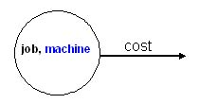
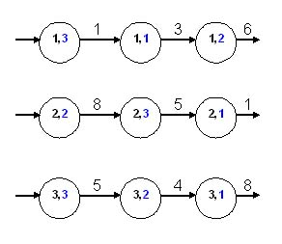
JSSP Instance
Job | Machine (Processing Time)
1 | 3(1) | 1(3) | 2(6)
2 | 2(8) | 3(5) | 1(4)
3 | 3(5) | 2(4) | 1(8)

Slide 5
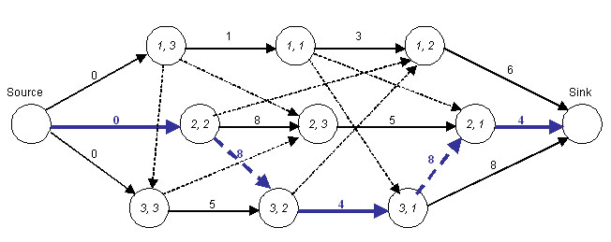
Disjunctive Graph:
Representing a Solution
Acyclic Graph.
The longest path from Source to Sink is called critical path.
Combined cost along the edges in the critical path is the makespan.

Slide 6
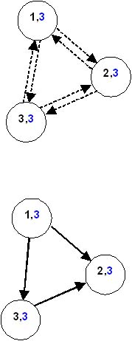
Disjunctive Graph:
Scheduling a graph
To schedule a graph is to solve all disjunctive arcs, no cycle allowed.
That is, to define priorities between operations running on the same machine.

Slide 7
Complejidad

Slide 8
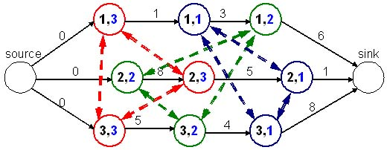
Disjunctive Graph
J × M + 2 nodes. One source, one sink and J × M operation nodes, one for each operation.
A directed edge = direct precedence relation.
Disjunctive arcs exists between operations that run on the same machine.
Cost of a directed edge = time require to run the operation of the node it starts from.

Slide 9
Objectives
Makespan
  Time from when first operation starts to last operation finishes.
Flow times
  Time when a job is ready to when the job finishes.
With deadlines
  Lateness
  Tardiness
  Unit penalty
If each job has varying importance, utilities can also be weighted.

Slide 10
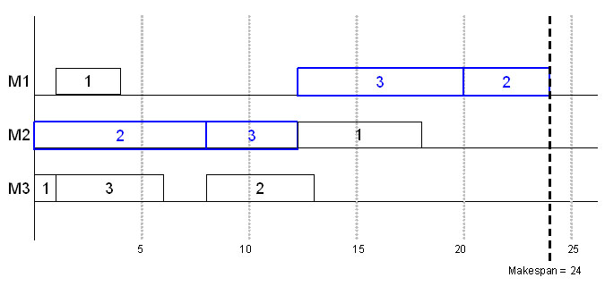
Gantt Chart
Represents a solution.
A block is an operation, length is the cost (time).
Can be either job Gantt Chart, or machine Gantt Chart.

Slide 11
Representations of JSSP
Direct
  Chromosome represents a schedule.
  e.g. list of starting times.
Indirect
  A chromosome represents a scheduling guideline.
  e.g. list of priority rules, job permutation with repetition.
  Risk of false competition.

Slide 12
Indirect Representations
Binary representation
  Each bit represent orientation of a disjunctive arc in the disjunctive graph.
Job permutation with repetition
  Indicate priority of a job to break conflict in GT.
3 3 2 2 1 2 3 1 1

Slide 13

Indirect Representations (cont.)
Job sequence matrix
  Similar to permutation, but separated to each machine.
Priority rules
  List of priority rules to break conflict in GT

Slide 14
Traducción a diagrama de Gantt

