Slide 1
LMiC e INTEGRACIONES juanfelixmateos@gmail.com
Diciembre 2018
Notes:
1

Slide 2

LMiC
LoraMAC-in-C → LoraWAN-in-C
Stack LoRaWAN para el entorno Arduino
Nos permite utilizar módulos basados en el SX1276 mediante SPI para conectar a TTN
Desarrollada por IBM
Adaptada al entorno Arduino por Matthijs Kooijman
https://github.com/matthijskooijman/arduino-lmic
Notes:
Range – up to 15km
Power consumption – Devices can last months / years on a single battery
Thousands of devices – Can be connected per gateway
Unlicensed spectrum – 868MHz (EU), 915 MHz (US), 433MHz (China) – free to use
Bandwidth – Very low, data rate is up to 50 kb/s
2

Slide 3
LMiC: Configuración pines
// Pin mapping para los nodos de TTN_Madrid
const lmic_pinmap lmic_pins = {
.nss = 10,
.rxtx = LMIC_UNUSED_PIN,
.rst = 9,
.dio = {2, 7, 8},
};
Notes:
Range – up to 15km
Power consumption – Devices can last months / years on a single battery
Thousands of devices – Can be connected per gateway
Unlicensed spectrum – 868MHz (EU), 915 MHz (US), 433MHz (China) – free to use
Bandwidth – Very low, data rate is up to 50 kb/s
3

Slide 4
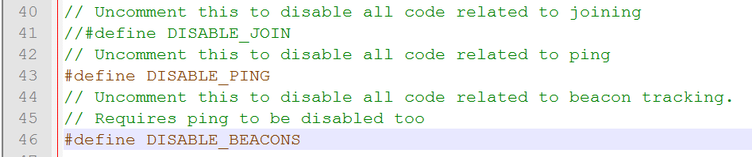
LMiC: Reducir el tamaño
Para reducir el tamaño podemos deshabilitar (descomentando) las opciones ping y beacon en el archivo config.h, que se utilizan en los dispositivos de clase B (Beacons)
También podemos usar un DEBUG_LEVEL 0 (ver diapositiva siguiente)
Notes:
Range – up to 15km
Power consumption – Devices can last months / years on a single battery
Thousands of devices – Can be connected per gateway
Unlicensed spectrum – 868MHz (EU), 915 MHz (US), 433MHz (China) – free to use
Bandwidth – Very low, data rate is up to 50 kb/s
4

Slide 5
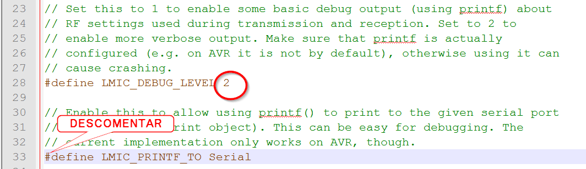
LMiC: Depuración
En el archivo config.h
Aumentar el DEBUG_LEVEL a 2
Descomentar el LMIC_PRINTF_TO
Notes:
Range – up to 15km
Power consumption – Devices can last months / years on a single battery
Thousands of devices – Can be connected per gateway
Unlicensed spectrum – 868MHz (EU), 915 MHz (US), 433MHz (China) – free to use
Bandwidth – Very low, data rate is up to 50 kb/s
5

Slide 6
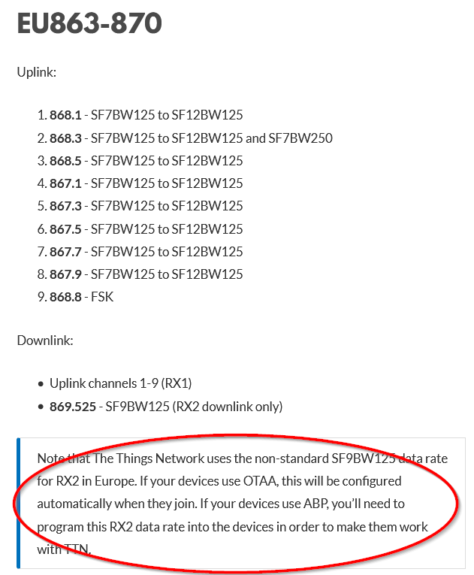
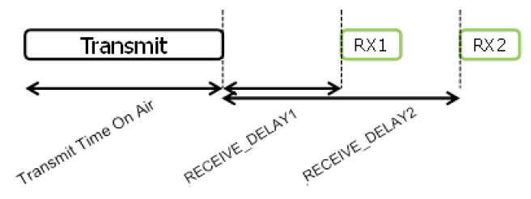
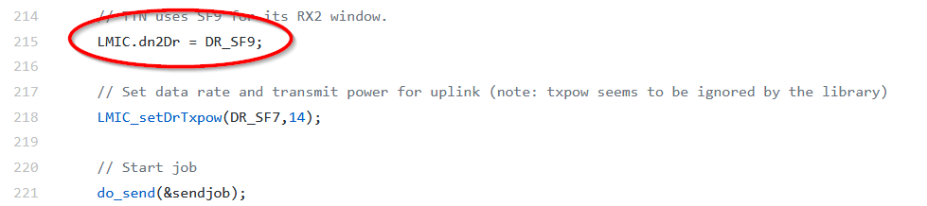
LMiC: Downlink RX2 en SF9
Los downlink RX2 de TTN usan un SF9 (en lugar del SF12 que establece el estándar)
Si usamos ABP, es nuestra responsabilidad establecer la configuración de los downlink en el RX2, que en el caso de TTN utilizan SF9 y 869.525Hz
En OTAA se configura automáticamente en la fase de JOIN
Notes:
Range – up to 15km
Power consumption – Devices can last months / years on a single battery
Thousands of devices – Can be connected per gateway
Unlicensed spectrum – 868MHz (EU), 915 MHz (US), 433MHz (China) – free to use
Bandwidth – Very low, data rate is up to 50 kb/s
6

Slide 7
LMiC: Downlink problema de precisión del oscilador
El oscilador de algunos Arduino no tiene suficiente precisión para gestionar los tiempos que requieren los downlink.
Tener en cuenta que para poder unirse por OTAA es necesario que funcionen los downlink
Puede corregirse introduciendo la siguiente línea en el setup
LMIC_setClockError(MAX_CLOCK_ERROR * 1 / 100);
O incluso:
LMIC_setClockError(MAX_CLOCK_ERROR * 10 / 100);
Notes:
Range – up to 15km
Power consumption – Devices can last months / years on a single battery
Thousands of devices – Can be connected per gateway
Unlicensed spectrum – 868MHz (EU), 915 MHz (US), 433MHz (China) – free to use
Bandwidth – Very low, data rate is up to 50 kb/s
7

Slide 8
LMiC: ¿Cómo funciona?
Modelo de programación basado en eventos
onEvent(ev_t ev)
Se prepara una tarea de envío que se ejecuta inmediatamente
LMIC_setTxData2(1, mydata, sizeof(mydata)-1, 0);
Cuando se complete la tarea anterior, se programa una nueva tarea para que se ejecute en un instante determinado
os_setTimedCallback(&sendjob, os_getTime()+sec2osticks(TX_INTERVAL), do_send);
No se respetará ese instante si no cumple el duty cycle de la banda ISM
Notes:
Range – up to 15km
Power consumption – Devices can last months / years on a single battery
Thousands of devices – Can be connected per gateway
Unlicensed spectrum – 868MHz (EU), 915 MHz (US), 433MHz (China) – free to use
Bandwidth – Very low, data rate is up to 50 kb/s
8

Slide 9
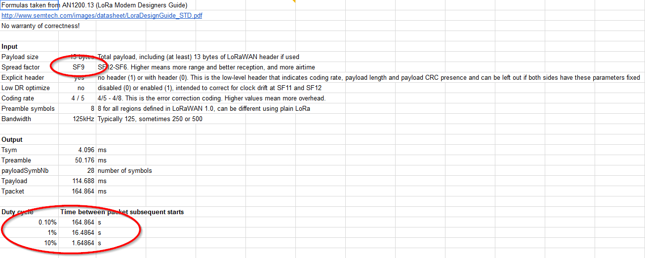
LMiC: Duty Cycle 1/2
https://docs.google.com/spreadsheets/d/1voGAtQAjC1qBmaVuP1ApNKs1ekgUjavHuVQIXyYSvNc/edit#gid=0
File>Make a copy
Notes:
Range – up to 15km
Power consumption – Devices can last months / years on a single battery
Thousands of devices – Can be connected per gateway
Unlicensed spectrum – 868MHz (EU), 915 MHz (US), 433MHz (China) – free to use
Bandwidth – Very low, data rate is up to 50 kb/s
9

Slide 10
LMiC: Duty Cycle 2/2
Los duty cycle están regulados por la sección 7.2.3 del estándar ETSI EN300.220:
g (863.0 – 868.0 MHz): 1%
g1 (868.0 – 868.6 MHz): 1%
g2 (868.7 – 869.2 MHz): 0.1%
g3 (869.4 – 869.65 MHz): 10% → Tiene sentido usarla para downlink (1 gateway para muchos nodos)
g4 (869.7 – 870.0 MHz): 1%
Existe una política de uso responsible en TTN que establece:
30 segundos de uplink por día y nodo
10 mensajes de downlink al día
Notes:
Range – up to 15km
Power consumption – Devices can last months / years on a single battery
Thousands of devices – Can be connected per gateway
Unlicensed spectrum – 868MHz (EU), 915 MHz (US), 433MHz (China) – free to use
Bandwidth – Very low, data rate is up to 50 kb/s
10

Slide 11
LMiC: Ejemplos de la biblioteca 1/4
En setup ()
do_send(&sendjob);
En do_send(osjob_t* j)
LMIC_setTxData2(1, mydata, sizeof(mydata)-1, 0);
Primer parámetro: puerto/port
Último parámetro: ¿confirmar upload?
En loop()
os_runloop_once();
Se encarga de llevar un control del tiempo (timer) y ejecutar las acciones que correspondan en cada instante.
Notes:
Range – up to 15km
Power consumption – Devices can last months / years on a single battery
Thousands of devices – Can be connected per gateway
Unlicensed spectrum – 868MHz (EU), 915 MHz (US), 433MHz (China) – free to use
Bandwidth – Very low, data rate is up to 50 kb/s
11

Slide 12
LMiC: Ejemplos de la biblioteca 2/4
En on_event(ev_t ev)
case EV_TXCOMPLETE:
Serial.println(F("EV_TXCOMPLETE (includes waiting for RX windows)"));
if (LMIC.txrxFlags & TXRX_ACK)
Serial.println(F("Received ack"));
if (LMIC.dataLen) {
Serial.println(F("Received "));
Serial.println(LMIC.dataLen);
Serial.println(F(" bytes of payload"));
}
// Schedule next transmission
os_setTimedCallback(&sendjob, os_getTime()+sec2osticks(TX_INTERVAL), do_send);
break;
Notes:
Range – up to 15km
Power consumption – Devices can last months / years on a single battery
Thousands of devices – Can be connected per gateway
Unlicensed spectrum – 868MHz (EU), 915 MHz (US), 433MHz (China) – free to use
Bandwidth – Very low, data rate is up to 50 kb/s
12

Slide 13
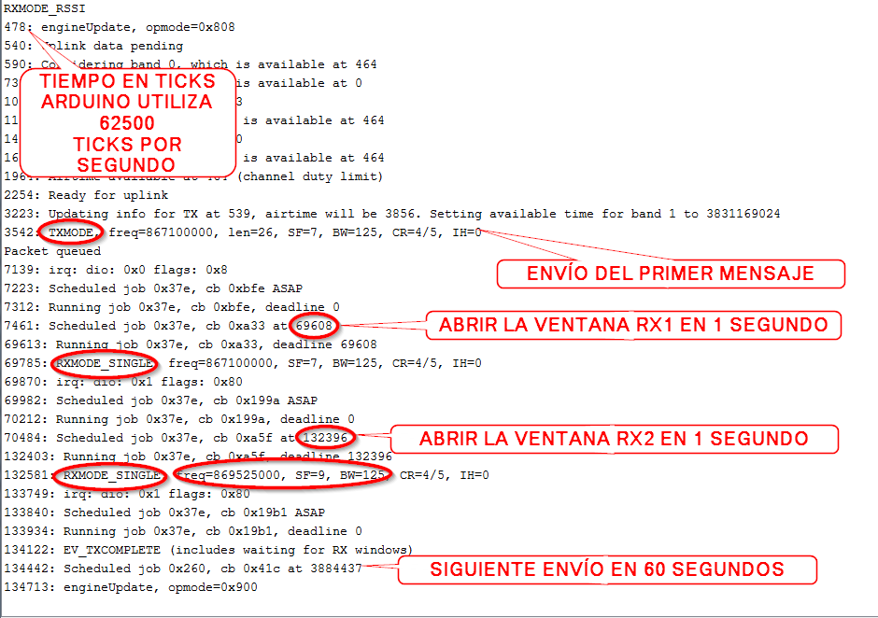
LMiC: Ejemplos de la biblioteca 3/4
ABP
Notes:
Range – up to 15km
Power consumption – Devices can last months / years on a single battery
Thousands of devices – Can be connected per gateway
Unlicensed spectrum – 868MHz (EU), 915 MHz (US), 433MHz (China) – free to use
Bandwidth – Very low, data rate is up to 50 kb/s
13

Slide 14
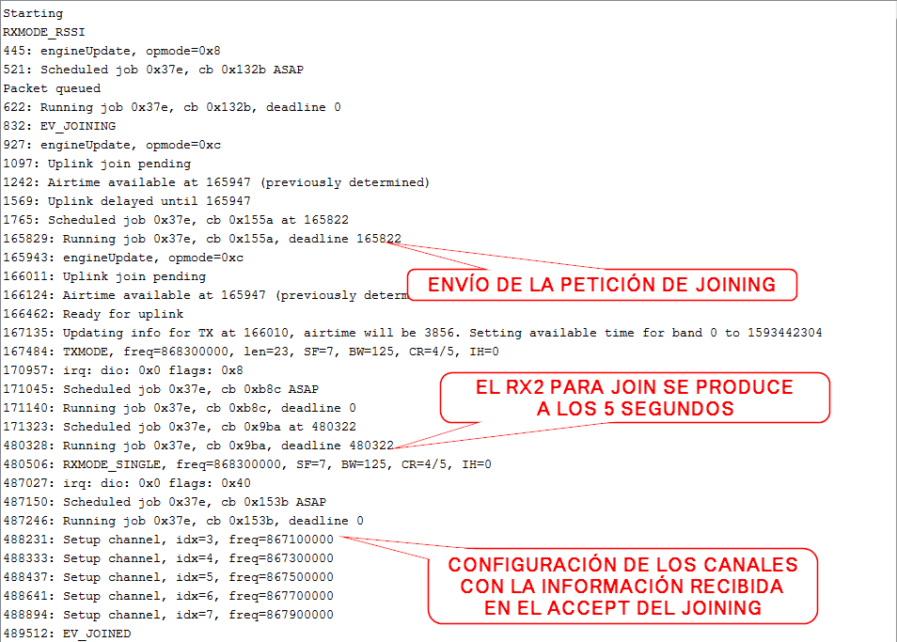
LMiC: Ejemplos de la biblioteca 4/4
OTAA
Notes:
Range – up to 15km
Power consumption – Devices can last months / years on a single battery
Thousands of devices – Can be connected per gateway
Unlicensed spectrum – 868MHz (EU), 915 MHz (US), 433MHz (China) – free to use
Bandwidth – Very low, data rate is up to 50 kb/s
14

Slide 15
LMiC: ¿Cómo hacer envíos inmediatos (no programados)?
Cambiamos…
os_setTimedCallback(&sendjob, os_getTime()+sec2osticks(TX_INTERVAL), do_send);
por…
os_setCallback (&sendjob, do_send);
ATENCIÓN: El duty cycle sigue aplicándose
Notes:
Range – up to 15km
Power consumption – Devices can last months / years on a single battery
Thousands of devices – Can be connected per gateway
Unlicensed spectrum – 868MHz (EU), 915 MHz (US), 433MHz (China) – free to use
Bandwidth – Very low, data rate is up to 50 kb/s
15

Slide 16


LMiC & Low-Power: Envíos periódicos 1/2
En lugar de programar un envío, hacemos envíos inmediatos y ponemos el uC a dormir tras completarse cada uno de ellos.
Notes:
Range – up to 15km
Power consumption – Devices can last months / years on a single battery
Thousands of devices – Can be connected per gateway
Unlicensed spectrum – 868MHz (EU), 915 MHz (US), 433MHz (China) – free to use
Bandwidth – Very low, data rate is up to 50 kb/s
16

Slide 17
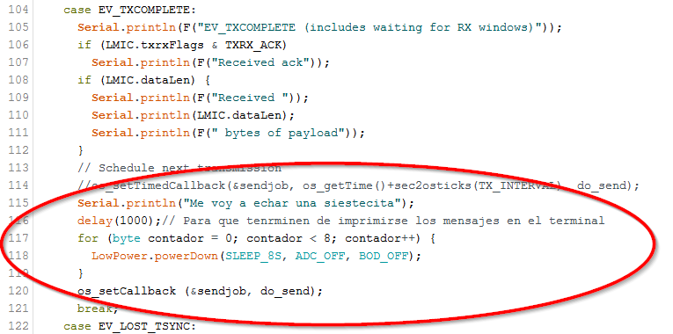
LMiC & Low-Power: Envíos periódicos 2/2
En el evento EV_TXCOMPLETE
Notes:
Range – up to 15km
Power consumption – Devices can last months / years on a single battery
Thousands of devices – Can be connected per gateway
Unlicensed spectrum – 868MHz (EU), 915 MHz (US), 433MHz (China) – free to use
Bandwidth – Very low, data rate is up to 50 kb/s
17

Slide 18
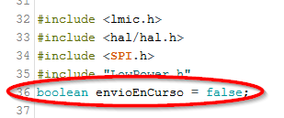
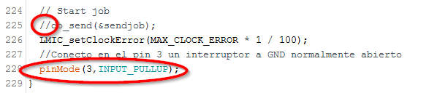
LMiC & Low-Power: Envíos por interrupción 1/3
Creamos una variable bandera para indicar si hay un envío en curso
En el setup() anulamos el envío inicial y ponemos el pin 3 en modo INPUT_PULLUP
Notes:
Range – up to 15km
Power consumption – Devices can last months / years on a single battery
Thousands of devices – Can be connected per gateway
Unlicensed spectrum – 868MHz (EU), 915 MHz (US), 433MHz (China) – free to use
Bandwidth – Very low, data rate is up to 50 kb/s
18

Slide 19
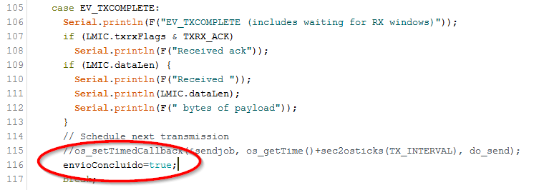
LMiC & Low-Power: Envíos por interrupción 2/3
En el evento EV_TXCOMPLETE, anulamos el envío periódico, e indicamos que el envío ha finalizado
Notes:
Range – up to 15km
Power consumption – Devices can last months / years on a single battery
Thousands of devices – Can be connected per gateway
Unlicensed spectrum – 868MHz (EU), 915 MHz (US), 433MHz (China) – free to use
Bandwidth – Very low, data rate is up to 50 kb/s
19

Slide 20
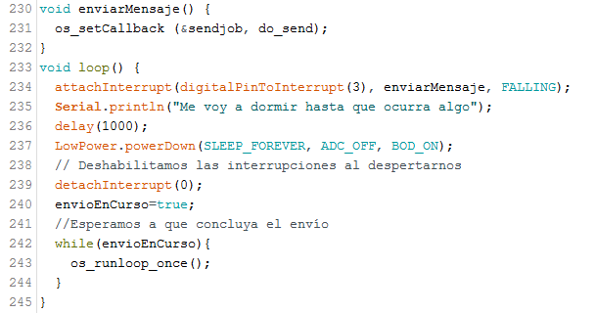
LMiC & Low-Power: Envíos por interrupción 3/3
En el loop() creamos la lógica de la interrupción
Notes:
Range – up to 15km
Power consumption – Devices can last months / years on a single battery
Thousands of devices – Can be connected per gateway
Unlicensed spectrum – 868MHz (EU), 915 MHz (US), 433MHz (China) – free to use
Bandwidth – Very low, data rate is up to 50 kb/s
20

Slide 21

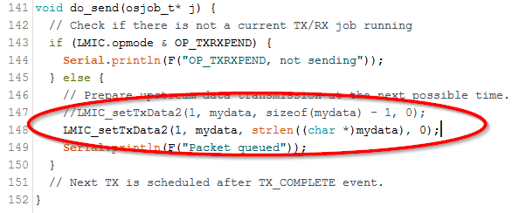
LMiC & Low-Power: Puerta abierta/cerrada 1/2
Cambiamos la variable my_data a un array de 51 elementos
En do_send() detectamos la longitud real del mensaje
Notes:
Range – up to 15km
Power consumption – Devices can last months / years on a single battery
Thousands of devices – Can be connected per gateway
Unlicensed spectrum – 868MHz (EU), 915 MHz (US), 433MHz (China) – free to use
Bandwidth – Very low, data rate is up to 50 kb/s
21

Slide 22
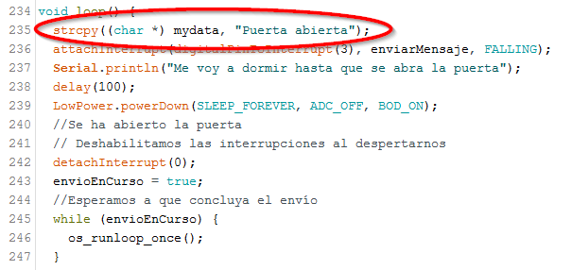
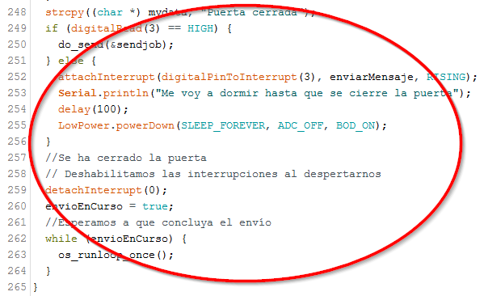
LMiC & Low-Power: Puerta abierta/cerrada 2/2
Cambios en loop()
Notes:
Range – up to 15km
Power consumption – Devices can last months / years on a single battery
Thousands of devices – Can be connected per gateway
Unlicensed spectrum – 868MHz (EU), 915 MHz (US), 433MHz (China) – free to use
Bandwidth – Very low, data rate is up to 50 kb/s
22

Slide 23
¿Qué son las integraciones?
Tus datos son tus datos: Si no te encargas de ellos se pierden
¿Cómo me encargo de ellos?
Con integraciones para:
Generar avisos
Almacenarlos
Modificar el estado de actuadores
Notes:
Range – up to 15km
Power consumption – Devices can last months / years on a single battery
Thousands of devices – Can be connected per gateway
Unlicensed spectrum – 868MHz (EU), 915 MHz (US), 433MHz (China) – free to use
Bandwidth – Very low, data rate is up to 50 kb/s
23

Slide 24
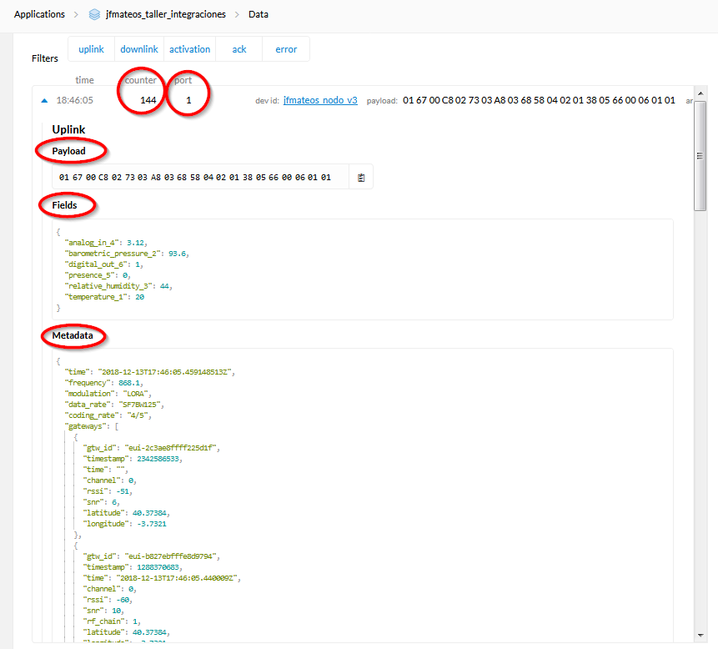
¿Qué aspecto tienen los datos?
Payload
RAW
Formateada
Metadata
Notes:
Range – up to 15km
Power consumption – Devices can last months / years on a single battery
Thousands of devices – Can be connected per gateway
Unlicensed spectrum – 868MHz (EU), 915 MHz (US), 433MHz (China) – free to use
Bandwidth – Very low, data rate is up to 50 kb/s
24

Slide 25
¿Cómo formateamos el Payload?
Podemos usar nuestro propio esquema…
…pero Cayenne lpp (low power payload) es muy popular y logra cierto nivel de estandarización basado en:
IPSO Alliance Smart Objects Guidelines
Notes:
Range – up to 15km
Power consumption – Devices can last months / years on a single battery
Thousands of devices – Can be connected per gateway
Unlicensed spectrum – 868MHz (EU), 915 MHz (US), 433MHz (China) – free to use
Bandwidth – Very low, data rate is up to 50 kb/s
25

Slide 26
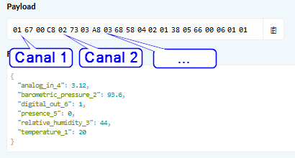
Cayenne LPP: Canal
Cada sensor/actuador está identificado por un número de canal del 0 al 64
Notes:
Range – up to 15km
Power consumption – Devices can last months / years on a single battery
Thousands of devices – Can be connected per gateway
Unlicensed spectrum – 868MHz (EU), 915 MHz (US), 433MHz (China) – free to use
Bandwidth – Very low, data rate is up to 50 kb/s
26

Slide 27
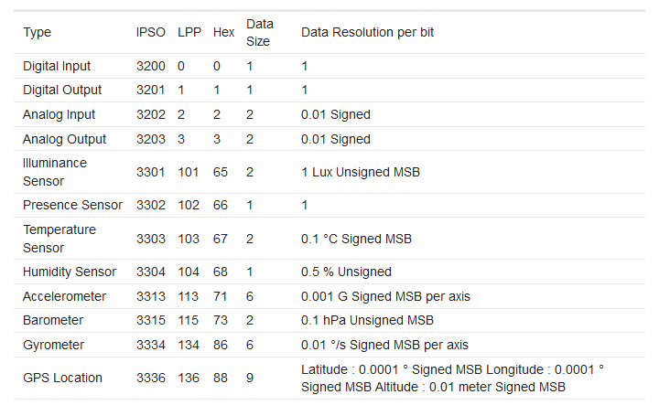
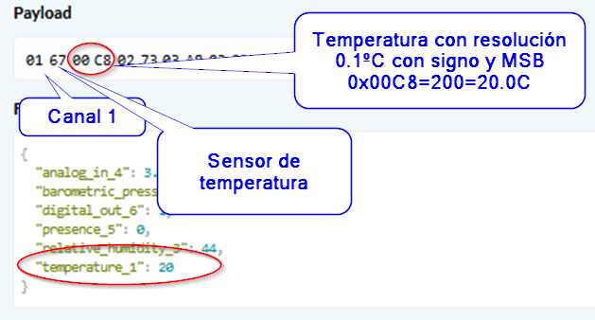
Cayenne LPP: Tipos de datos
Cada sensor/actuador tiene asociado un tipo de dato
Notes:
Range – up to 15km
Power consumption – Devices can last months / years on a single battery
Thousands of devices – Can be connected per gateway
Unlicensed spectrum – 868MHz (EU), 915 MHz (US), 433MHz (China) – free to use
Bandwidth – Very low, data rate is up to 50 kb/s
27

Slide 28

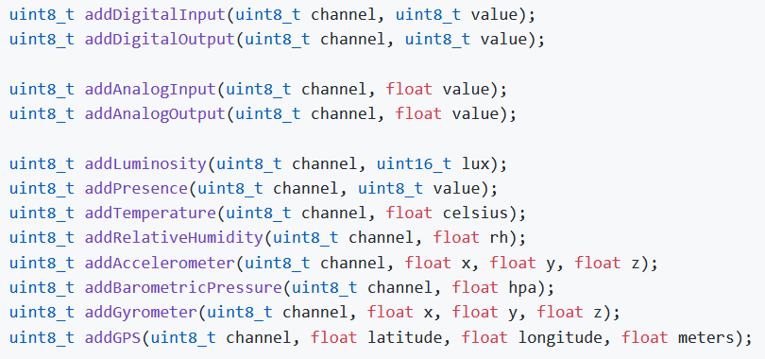
Cayenne LPP: Biblioteca para Arduino 1/2
#include <CayenneLPP.h>
CayenneLPP lpp(uint8_t size);
Reserva el buffer para el payload
El tamaño máximo varía en función de la frecuencia y el spread factor (un valor seguro es 51 bytes)
lpp.reset();
lpp.addTemperature(1, 22.5);
lpp.addBarometricPressure(2, 1073.21);
lpp.addGPS(3, 52.37365, 4.88650, 2);
LMIC_setTxData2(1, lpp.getBuffer(), lpp.getSize(), 0);
Notes:
Range – up to 15km
Power consumption – Devices can last months / years on a single battery
Thousands of devices – Can be connected per gateway
Unlicensed spectrum – 868MHz (EU), 915 MHz (US), 433MHz (China) – free to use
Bandwidth – Very low, data rate is up to 50 kb/s
28

Slide 29
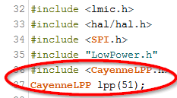
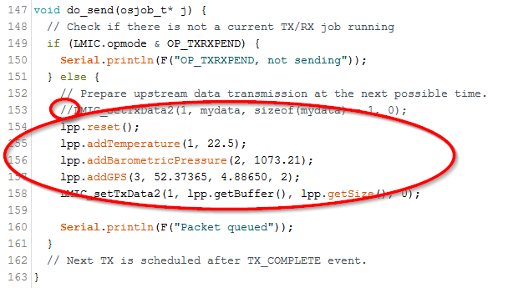
Cayenne LPP: Biblioteca para Arduino 2/2
Partiendo del ejemplo
_04_ttn-abp_madrid_envio_cada_60_segundos_lowpower
Incluir la biblioteca y crear el objeto lpp
Modificar do_send()
Notes:
Range – up to 15km
Power consumption – Devices can last months / years on a single battery
Thousands of devices – Can be connected per gateway
Unlicensed spectrum – 868MHz (EU), 915 MHz (US), 433MHz (China) – free to use
Bandwidth – Very low, data rate is up to 50 kb/s
29

Slide 30
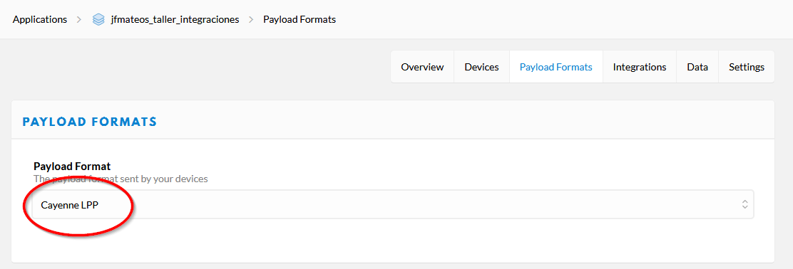
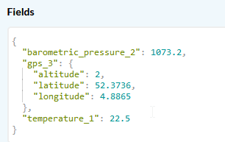
Cayenne LPP: Formato de payload
Activamos el formato de payload Cayenne lpp para extraer los campos de la carga de pago
De la carga de pago
016700E1027329EC038807FDD800BEE10000C8
Se extraen los campos
Notes:
Range – up to 15km
Power consumption – Devices can last months / years on a single battery
Thousands of devices – Can be connected per gateway
Unlicensed spectrum – 868MHz (EU), 915 MHz (US), 433MHz (China) – free to use
Bandwidth – Very low, data rate is up to 50 kb/s
30

Slide 31
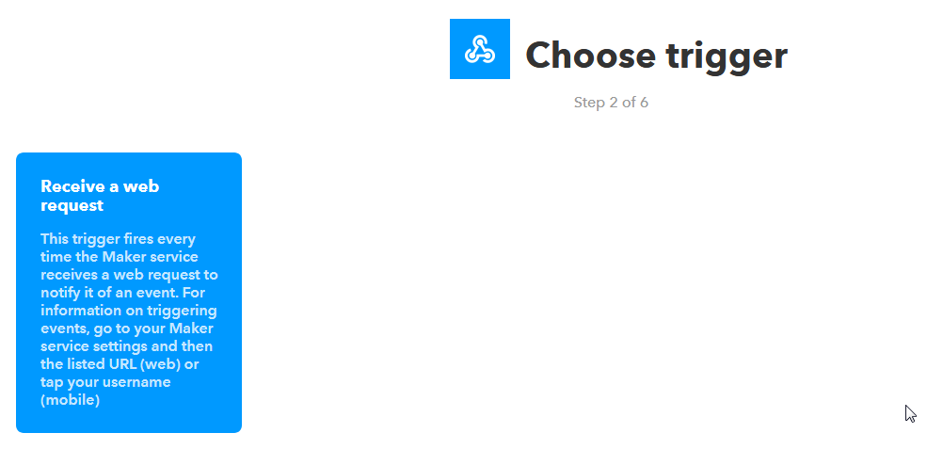
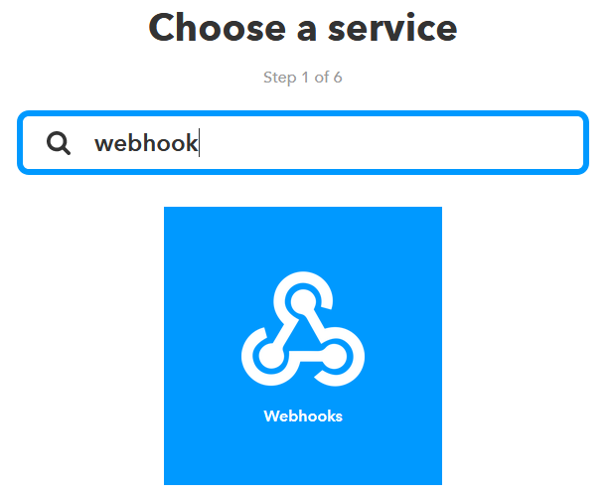

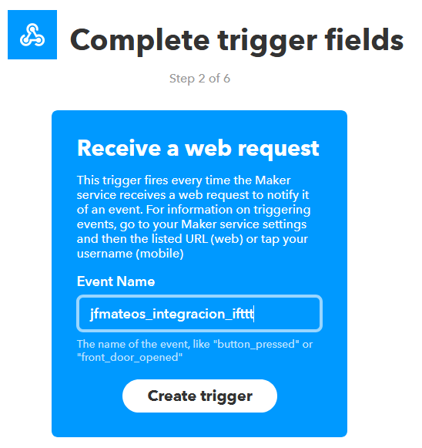
IFTTT: Crear un applet 1/3
Definimos la sección this como un webhook
Notes:
Range – up to 15km
Power consumption – Devices can last months / years on a single battery
Thousands of devices – Can be connected per gateway
Unlicensed spectrum – 868MHz (EU), 915 MHz (US), 433MHz (China) – free to use
Bandwidth – Very low, data rate is up to 50 kb/s
31

Slide 32
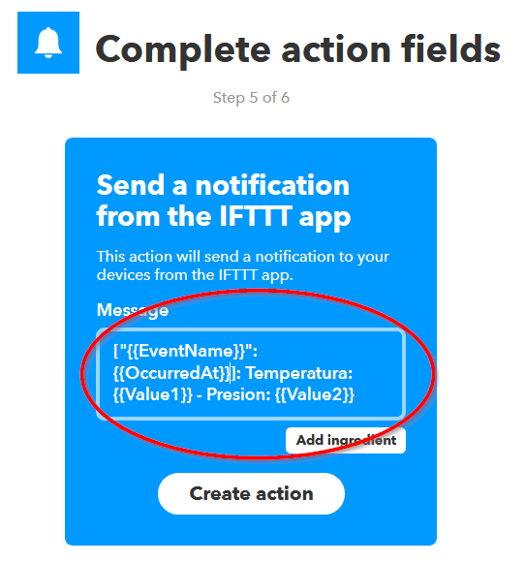
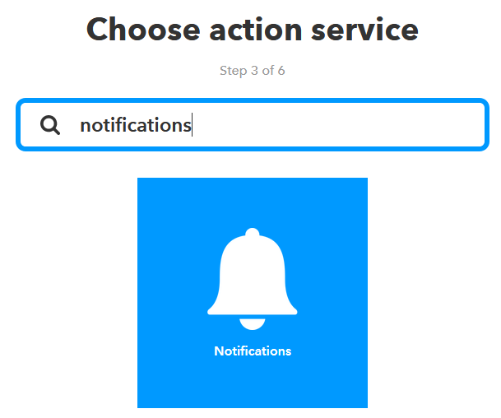
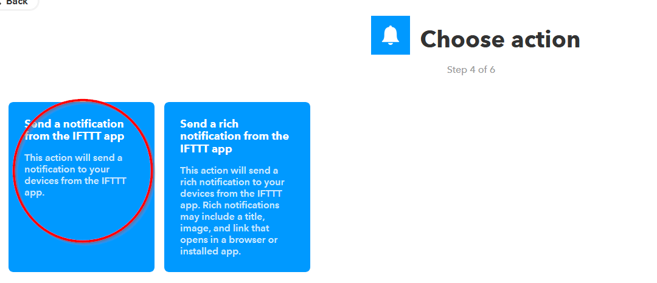
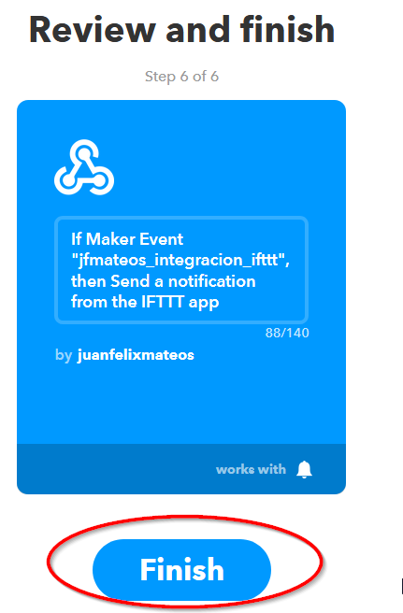
IFTTT: Crear un applet 2/3
Definimos la sección that para que nos envíe una notificación
Notes:
Range – up to 15km
Power consumption – Devices can last months / years on a single battery
Thousands of devices – Can be connected per gateway
Unlicensed spectrum – 868MHz (EU), 915 MHz (US), 433MHz (China) – free to use
Bandwidth – Very low, data rate is up to 50 kb/s
32

Slide 33
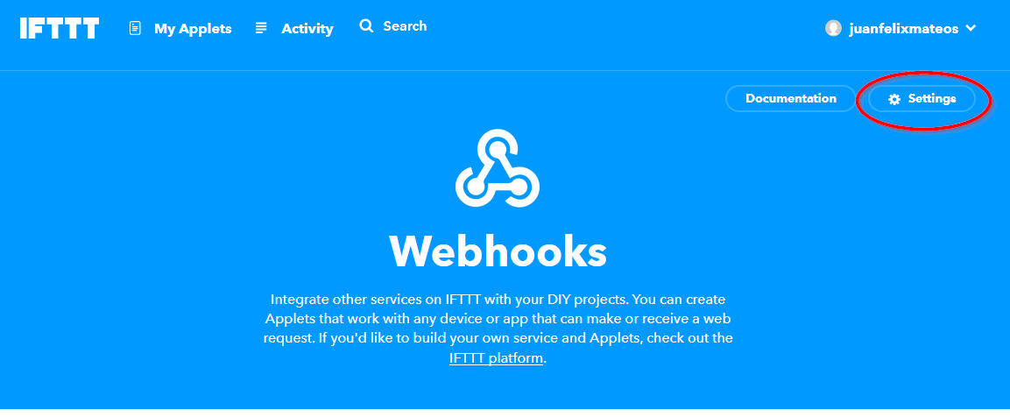
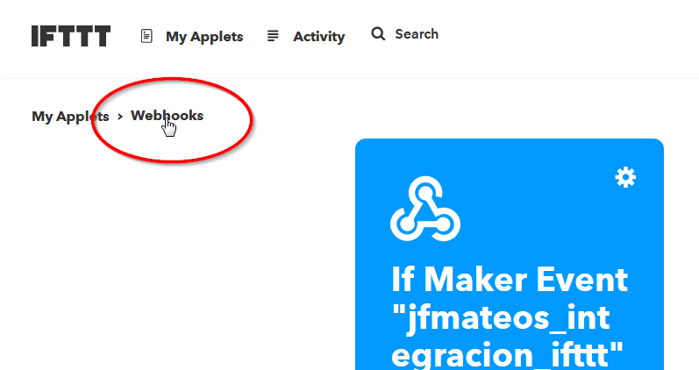
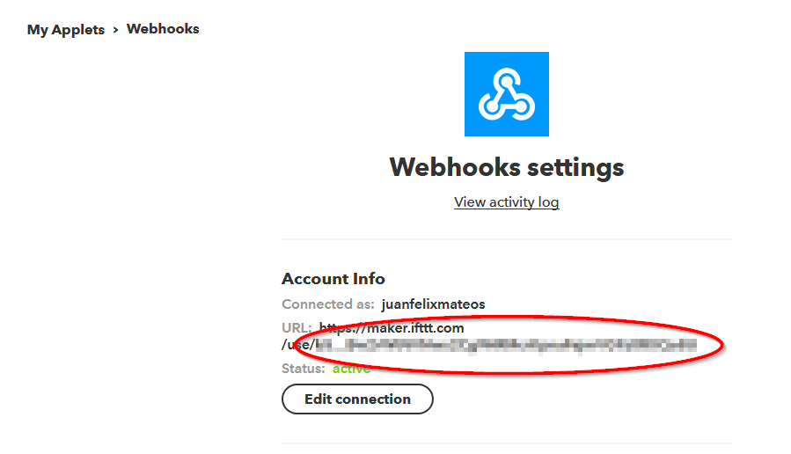
IFTTT: Crear un applet 3/3
Obtener la clave/llave del webhook
Notes:
Range – up to 15km
Power consumption – Devices can last months / years on a single battery
Thousands of devices – Can be connected per gateway
Unlicensed spectrum – 868MHz (EU), 915 MHz (US), 433MHz (China) – free to use
Bandwidth – Very low, data rate is up to 50 kb/s
33

Slide 34
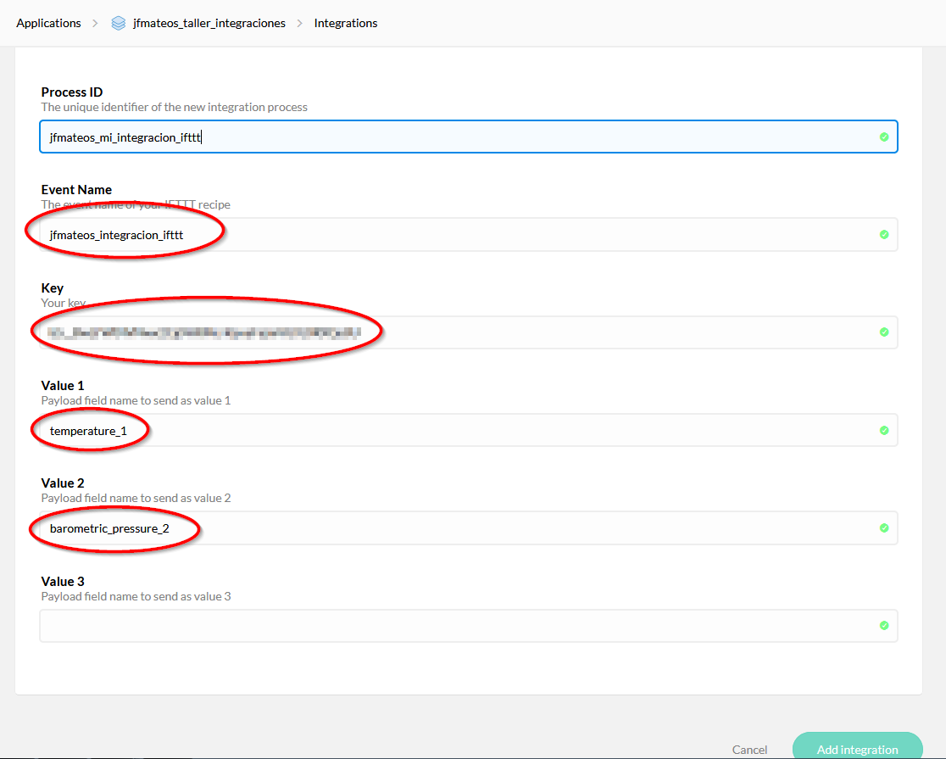
IFTTT: Activar la integración en TTN
Utilizar el nombre del evento y la clave de IFTTT
Notes:
Range – up to 15km
Power consumption – Devices can last months / years on a single battery
Thousands of devices – Can be connected per gateway
Unlicensed spectrum – 868MHz (EU), 915 MHz (US), 433MHz (China) – free to use
Bandwidth – Very low, data rate is up to 50 kb/s
34

Slide 35
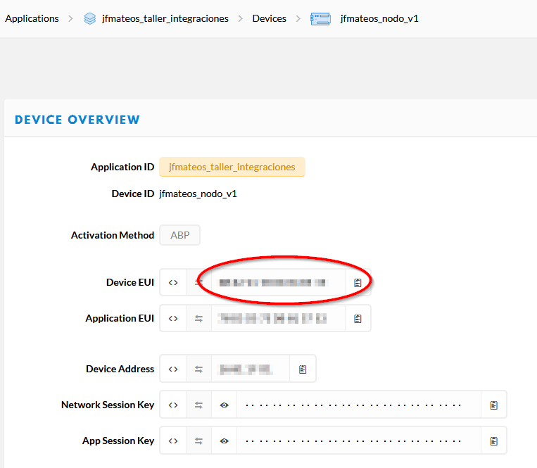
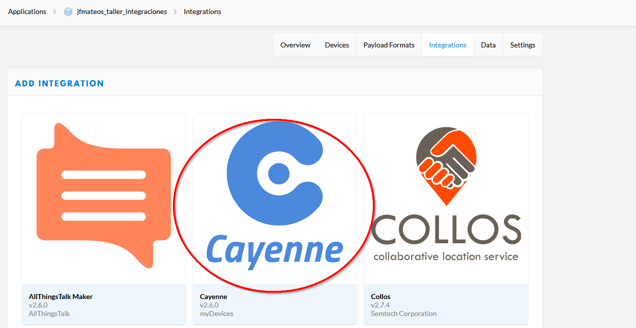
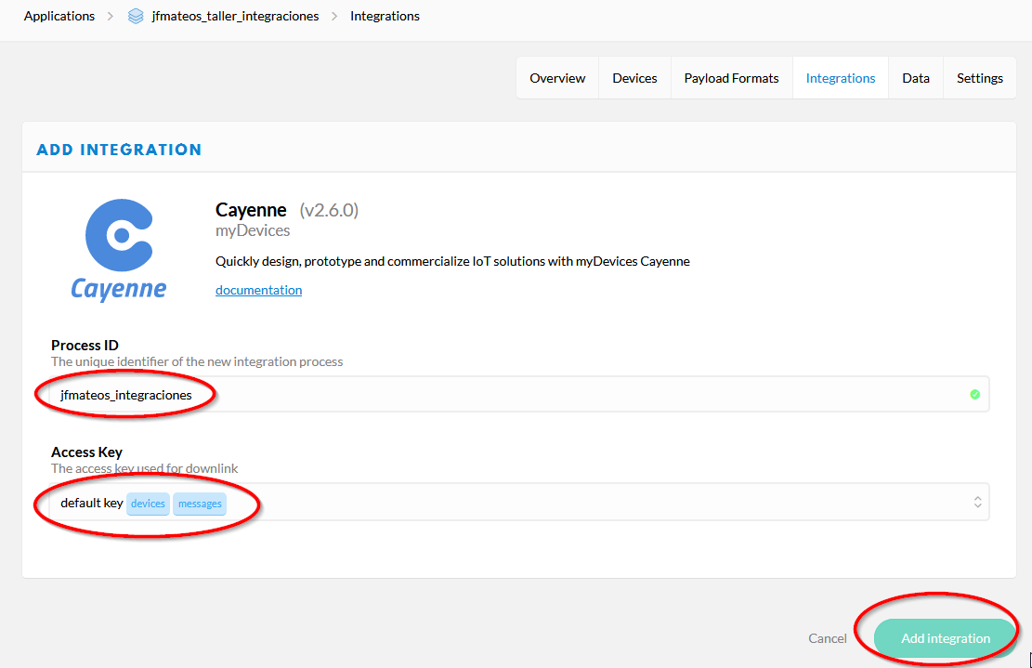
CAYENNE
Activamos la integración en TTN y tomamos el EUI del dispositivo
Notes:
Range – up to 15km
Power consumption – Devices can last months / years on a single battery
Thousands of devices – Can be connected per gateway
Unlicensed spectrum – 868MHz (EU), 915 MHz (US), 433MHz (China) – free to use
Bandwidth – Very low, data rate is up to 50 kb/s
35

Slide 36
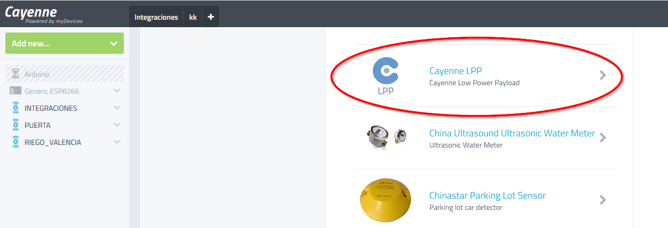
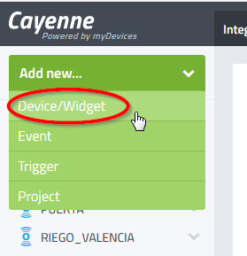
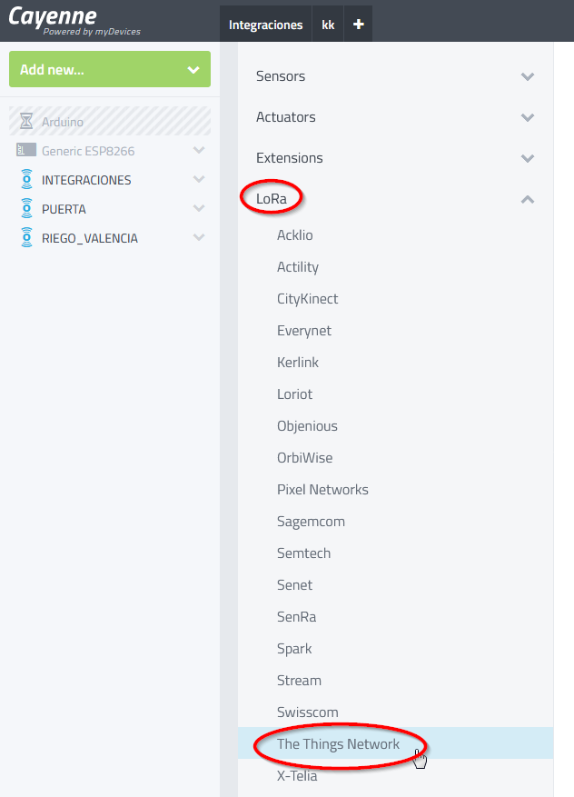
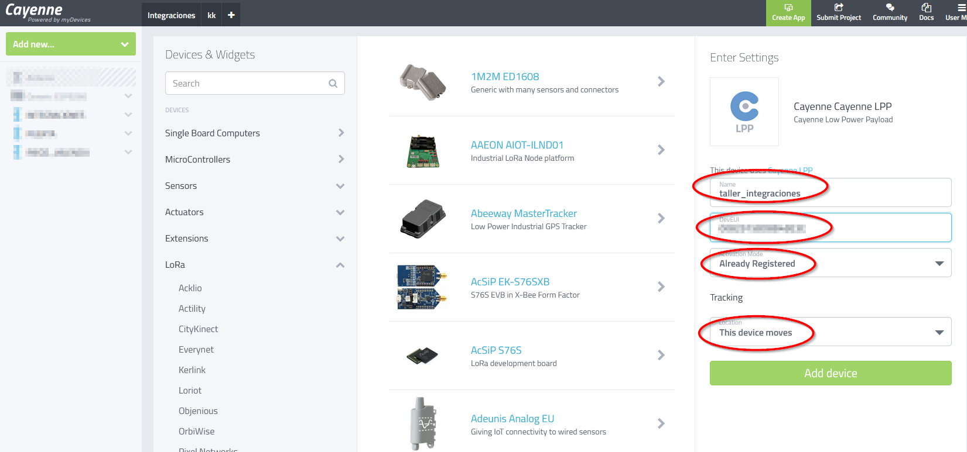
CAYENNE
Registramos el device en Cayenne
Notes:
Range – up to 15km
Power consumption – Devices can last months / years on a single battery
Thousands of devices – Can be connected per gateway
Unlicensed spectrum – 868MHz (EU), 915 MHz (US), 433MHz (China) – free to use
Bandwidth – Very low, data rate is up to 50 kb/s
36

Slide 37
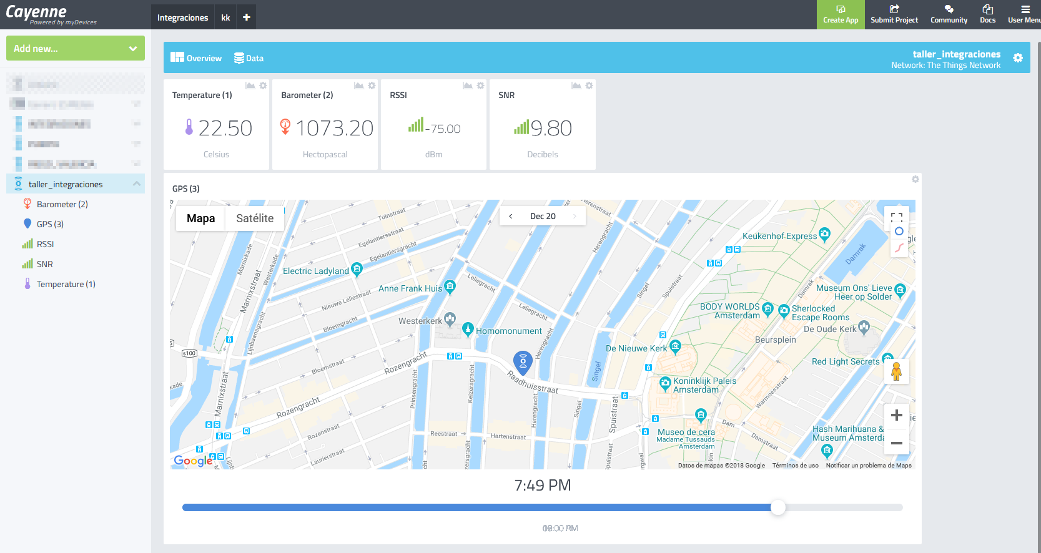
CAYENNE
Notes:
Range – up to 15km
Power consumption – Devices can last months / years on a single battery
Thousands of devices – Can be connected per gateway
Unlicensed spectrum – 868MHz (EU), 915 MHz (US), 433MHz (China) – free to use
Bandwidth – Very low, data rate is up to 50 kb/s
37

Slide 38
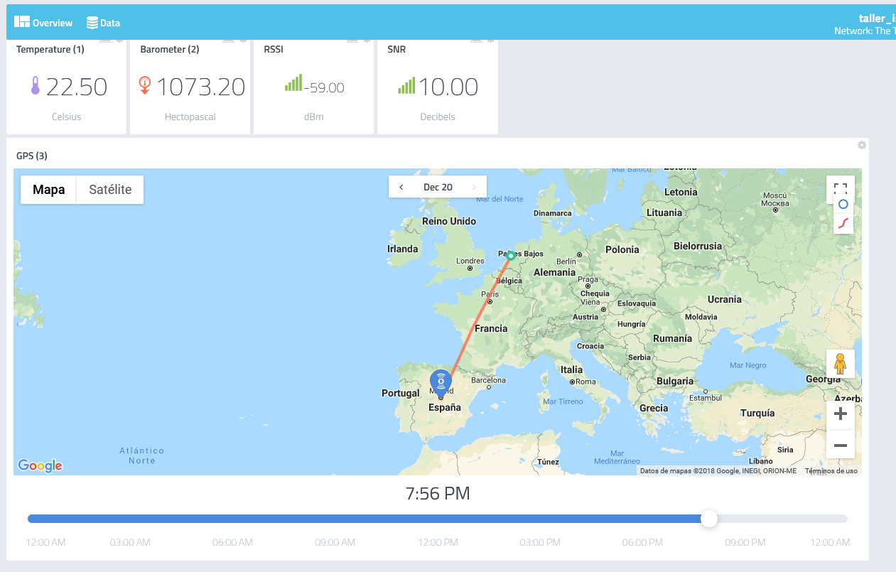
CAYENNE
Simular un uplink con esta carga de pago para cambiar de Amsterdam a Madrid
016700E1027329EC0388062A88FF6FB80000C8
Notes:
Range – up to 15km
Power consumption – Devices can last months / years on a single battery
Thousands of devices – Can be connected per gateway
Unlicensed spectrum – 868MHz (EU), 915 MHz (US), 433MHz (China) – free to use
Bandwidth – Very low, data rate is up to 50 kb/s
38

Slide 39
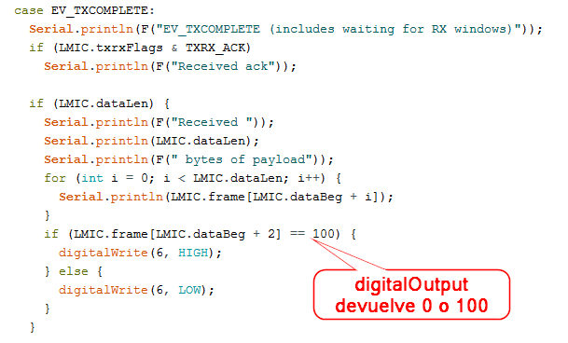
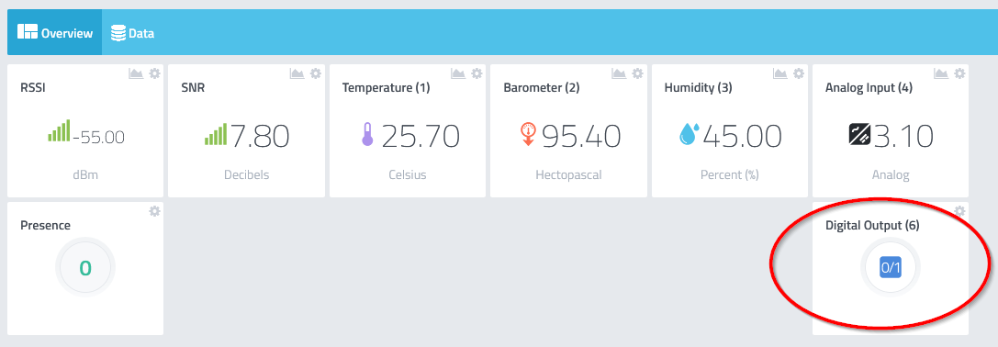
CAYENNE: Downlink
Con los método addDigitalOutput() y addAnalogOutput() podemos generar downlinks desde Cayenne
Los downlink de Cayenne se envían con solicitud de ACK
Notes:
Range – up to 15km
Power consumption – Devices can last months / years on a single battery
Thousands of devices – Can be connected per gateway
Unlicensed spectrum – 868MHz (EU), 915 MHz (US), 433MHz (China) – free to use
Bandwidth – Very low, data rate is up to 50 kb/s
39

Slide 40
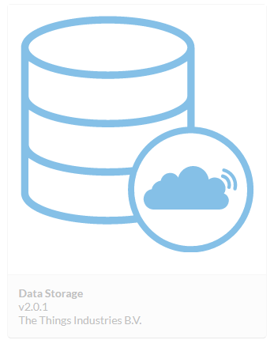
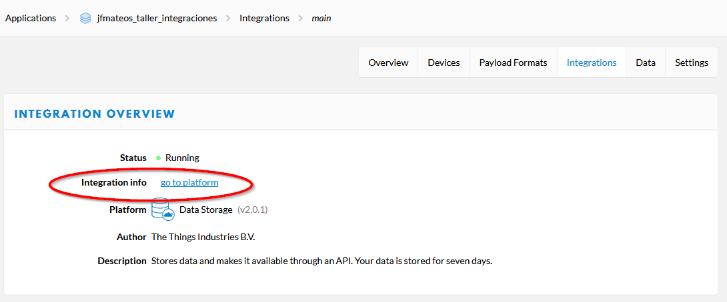
Data Storage
La integración Data Storage almacena nuestros datos de la última semana
Notes:
Range – up to 15km
Power consumption – Devices can last months / years on a single battery
Thousands of devices – Can be connected per gateway
Unlicensed spectrum – 868MHz (EU), 915 MHz (US), 433MHz (China) – free to use
Bandwidth – Very low, data rate is up to 50 kb/s
40

Slide 41
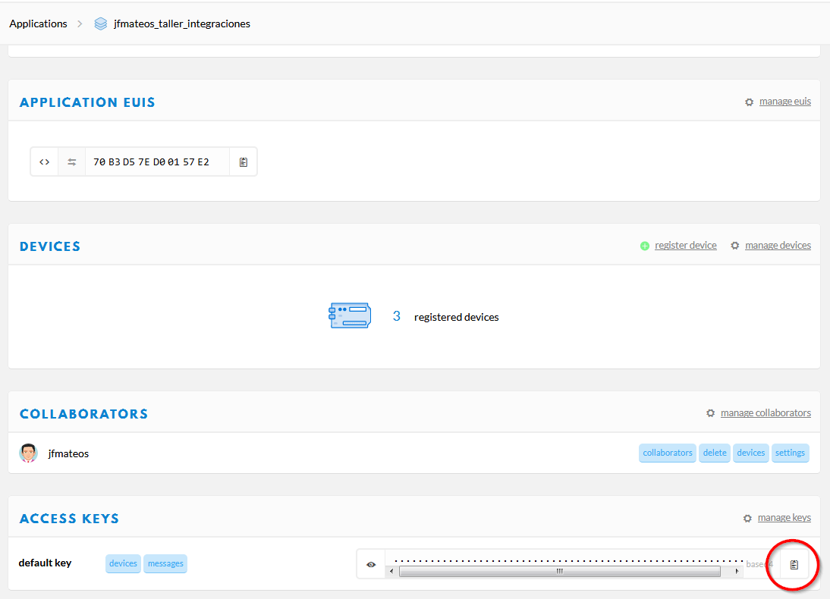

Data Storage
Usamos la Access Key para acreditarnos en la REST API de Swagger
Notes:
Range – up to 15km
Power consumption – Devices can last months / years on a single battery
Thousands of devices – Can be connected per gateway
Unlicensed spectrum – 868MHz (EU), 915 MHz (US), 433MHz (China) – free to use
Bandwidth – Very low, data rate is up to 50 kb/s
41

Slide 42


Data Storage
Probamos el query de todos los datos
Notes:
Range – up to 15km
Power consumption – Devices can last months / years on a single battery
Thousands of devices – Can be connected per gateway
Unlicensed spectrum – 868MHz (EU), 915 MHz (US), 433MHz (China) – free to use
Bandwidth – Very low, data rate is up to 50 kb/s
42

Slide 43

Node-RED
Desarrollado por IBM en 2013 → Open Source
Objetivo: Facilitar la construcción de sistemas IoT
Programación visual basada en nodos y flujos
Los nodos "consumen" y "produce" mensajes
Un mensaje es un objeto JavaScript, que contiene al menos la propiedad payload
msg={payload:"juanfe"};
Adicionalmente, por defecto, todos los mensajes poseen las propiedades topic y _msgid
Notes:
Range – up to 15km
Power consumption – Devices can last months / years on a single battery
Thousands of devices – Can be connected per gateway
Unlicensed spectrum – 868MHz (EU), 915 MHz (US), 433MHz (China) – free to use
Bandwidth – Very low, data rate is up to 50 kb/s
43

Slide 44





Node-RED: Tipos de nodos
Entrada
Salida
Función
Otros
Notes:
Range – up to 15km
Power consumption – Devices can last months / years on a single battery
Thousands of devices – Can be connected per gateway
Unlicensed spectrum – 868MHz (EU), 915 MHz (US), 433MHz (China) – free to use
Bandwidth – Very low, data rate is up to 50 kb/s
44

Slide 45


Node-RED: Nodos y deployment
Deployment/Despliegue = Poner en funcionamiento
Notes:
Range – up to 15km
Power consumption – Devices can last months / years on a single battery
Thousands of devices – Can be connected per gateway
Unlicensed spectrum – 868MHz (EU), 915 MHz (US), 433MHz (China) – free to use
Bandwidth – Very low, data rate is up to 50 kb/s
45

Slide 46


Node-RED: Ejemplo básico
En función del valor recibido, redirigimos la ejecución hacia un nodo u otro
Notes:
Range – up to 15km
Power consumption – Devices can last months / years on a single battery
Thousands of devices – Can be connected per gateway
Unlicensed spectrum – 868MHz (EU), 915 MHz (US), 433MHz (China) – free to use
Bandwidth – Very low, data rate is up to 50 kb/s
46

Slide 47

Node-RED & Data Storage
Vamos a comparar la temperatura actual con la de hace 24 horas
Notes:
Range – up to 15km
Power consumption – Devices can last months / years on a single battery
Thousands of devices – Can be connected per gateway
Unlicensed spectrum – 868MHz (EU), 915 MHz (US), 433MHz (China) – free to use
Bandwidth – Very low, data rate is up to 50 kb/s
47

Slide 48

Node-RED & Data Storage
Vamos a comparar la temperatura actual con la de hace 24 horas
Notes:
Range – up to 15km
Power consumption – Devices can last months / years on a single battery
Thousands of devices – Can be connected per gateway
Unlicensed spectrum – 868MHz (EU), 915 MHz (US), 433MHz (China) – free to use
Bandwidth – Very low, data rate is up to 50 kb/s
48

Slide 49


Node-RED & Data Storage
Solicitamos los registros de las últimas 24 horas
Notes:
Range – up to 15km
Power consumption – Devices can last months / years on a single battery
Thousands of devices – Can be connected per gateway
Unlicensed spectrum – 868MHz (EU), 915 MHz (US), 433MHz (China) – free to use
Bandwidth – Very low, data rate is up to 50 kb/s
49

Slide 50

Node-RED & Data Storage
var i,registros,hoy,respuesta;respuesta={};
respuesta.payload={};
hoy=Date.now();
registros=msg.payload.length;
for(i=0;i<registros;i++){
if(Date.parse(msg.payload[i].time) > (hoy - (24 * 60 * 60 * 1000))){ respuesta.payload.temperatura_ayer=msg.payload[i].temperature_1; respuesta.payload.timestamp_ayer=Date.parse(msg.payload[i].time); respuesta.payload.temperatura_hoy=msg.payload[registros-1].temperature_1; respuesta.payload.timestamp_hoy=Date.parse(msg.payload[registros-1].time); respuesta.payload.intervalo=Math.floor((respuesta.payload.timestamp_hoy- respuesta.payload.timestamp_ayer)/(1000*60)); respuesta.payload.deltaT=(respuesta.payload.temperatura_hoy - respuesta.payload.temperatura_ayer).toFixed(2);
return respuesta;
}
}
Notes:
Range – up to 15km
Power consumption – Devices can last months / years on a single battery
Thousands of devices – Can be connected per gateway
Unlicensed spectrum – 868MHz (EU), 915 MHz (US), 433MHz (China) – free to use
Bandwidth – Very low, data rate is up to 50 kb/s
50

Slide 51


Node-RED & Data Storage
Notes:
Range – up to 15km
Power consumption – Devices can last months / years on a single battery
Thousands of devices – Can be connected per gateway
Unlicensed spectrum – 868MHz (EU), 915 MHz (US), 433MHz (China) – free to use
Bandwidth – Very low, data rate is up to 50 kb/s
51

Slide 52

Node-RED & ThingSpeak
Creamos en ThinkSpeak un canal con 2 campos llamados Temperatura y Presión
Notes:
Range – up to 15km
Power consumption – Devices can last months / years on a single battery
Thousands of devices – Can be connected per gateway
Unlicensed spectrum – 868MHz (EU), 915 MHz (US), 433MHz (China) – free to use
Bandwidth – Very low, data rate is up to 50 kb/s
52

Slide 53



Node-RED & ThingSpeak
Creamos en Node-RED el siguiente flujo
Notes:
Range – up to 15km
Power consumption – Devices can last months / years on a single battery
Thousands of devices – Can be connected per gateway
Unlicensed spectrum – 868MHz (EU), 915 MHz (US), 433MHz (China) – free to use
Bandwidth – Very low, data rate is up to 50 kb/s
53

Slide 54


Node-RED & ThingSpeak
Usamos un nodo Template para crear el formato de carga de pago que requiere ThingSpeak
Notes:
Range – up to 15km
Power consumption – Devices can last months / years on a single battery
Thousands of devices – Can be connected per gateway
Unlicensed spectrum – 868MHz (EU), 915 MHz (US), 433MHz (China) – free to use
Bandwidth – Very low, data rate is up to 50 kb/s
54

Slide 55

Node-RED & ThingSpeak
Obtenemos nuestra key MQTT de ThingSpeak en Account > My Profile
Notes:
Range – up to 15km
Power consumption – Devices can last months / years on a single battery
Thousands of devices – Can be connected per gateway
Unlicensed spectrum – 868MHz (EU), 915 MHz (US), 433MHz (China) – free to use
Bandwidth – Very low, data rate is up to 50 kb/s
55

Slide 56



Node-RED & ThingSpeak
Configuramos el nodo MQTT output con los datos del bróker de ThingSpeak
Notes:
Range – up to 15km
Power consumption – Devices can last months / years on a single battery
Thousands of devices – Can be connected per gateway
Unlicensed spectrum – 868MHz (EU), 915 MHz (US), 433MHz (China) – free to use
Bandwidth – Very low, data rate is up to 50 kb/s
56

Slide 57


Node-RED & ThingSpeak
Configuramos el Topic con el número del canal y su key de escritura
Notes:
Range – up to 15km
Power consumption – Devices can last months / years on a single battery
Thousands of devices – Can be connected per gateway
Unlicensed spectrum – 868MHz (EU), 915 MHz (US), 433MHz (China) – free to use
Bandwidth – Very low, data rate is up to 50 kb/s
57

Slide 58

Node-RED & Adafruit.io con MQTT
Creamos un grupo Integraciones con un feed Temperatura en adafruit.io
Notes:
Range – up to 15km
Power consumption – Devices can last months / years on a single battery
Thousands of devices – Can be connected per gateway
Unlicensed spectrum – 868MHz (EU), 915 MHz (US), 433MHz (China) – free to use
Bandwidth – Very low, data rate is up to 50 kb/s
58

Slide 59




Node-RED & Adafruit.io con MQTT
Notes:
Range – up to 15km
Power consumption – Devices can last months / years on a single battery
Thousands of devices – Can be connected per gateway
Unlicensed spectrum – 868MHz (EU), 915 MHz (US), 433MHz (China) – free to use
Bandwidth – Very low, data rate is up to 50 kb/s
59

Slide 60


Node-RED & Adafruit.io con MQTT
Notes:
Range – up to 15km
Power consumption – Devices can last months / years on a single battery
Thousands of devices – Can be connected per gateway
Unlicensed spectrum – 868MHz (EU), 915 MHz (US), 433MHz (China) – free to use
Bandwidth – Very low, data rate is up to 50 kb/s
60

Slide 61





Node-RED & Adafruit.io con MQTT
Notes:
Range – up to 15km
Power consumption – Devices can last months / years on a single battery
Thousands of devices – Can be connected per gateway
Unlicensed spectrum – 868MHz (EU), 915 MHz (US), 433MHz (China) – free to use
Bandwidth – Very low, data rate is up to 50 kb/s
61

Slide 62


TTN →IFTTT →Adafruit.io (sin Node-RED)
Notes:
Range – up to 15km
Power consumption – Devices can last months / years on a single battery
Thousands of devices – Can be connected per gateway
Unlicensed spectrum – 868MHz (EU), 915 MHz (US), 433MHz (China) – free to use
Bandwidth – Very low, data rate is up to 50 kb/s
62

Slide 63

HTTP Integration
Podemos utilizar RequestBin para analizar el formato que utiliza TTN
Notes:
Range – up to 15km
Power consumption – Devices can last months / years on a single battery
Thousands of devices – Can be connected per gateway
Unlicensed spectrum – 868MHz (EU), 915 MHz (US), 433MHz (China) – free to use
Bandwidth – Very low, data rate is up to 50 kb/s
63

Slide 64




HTTP Integration
Por ejemplo, podemos crear un Trigger de tipo Reactive en Adafruit.io para enviar una petición a un webhook de IFTTT, en el que formatearemos los datos (la carga de pago debe ir en base64), y se los mandaremos a la dirección del downlink de TTN.
{ "dev_id": "jfmateos_nodo_v1", "port": 1, "confirmed": false, "payload_raw": "AQIDBA==" }
Notes:
Range – up to 15km
Power consumption – Devices can last months / years on a single battery
Thousands of devices – Can be connected per gateway
Unlicensed spectrum – 868MHz (EU), 915 MHz (US), 433MHz (China) – free to use
Bandwidth – Very low, data rate is up to 50 kb/s
64

