Slide 1

HEART RATE AND FUTSAL

Slide 2

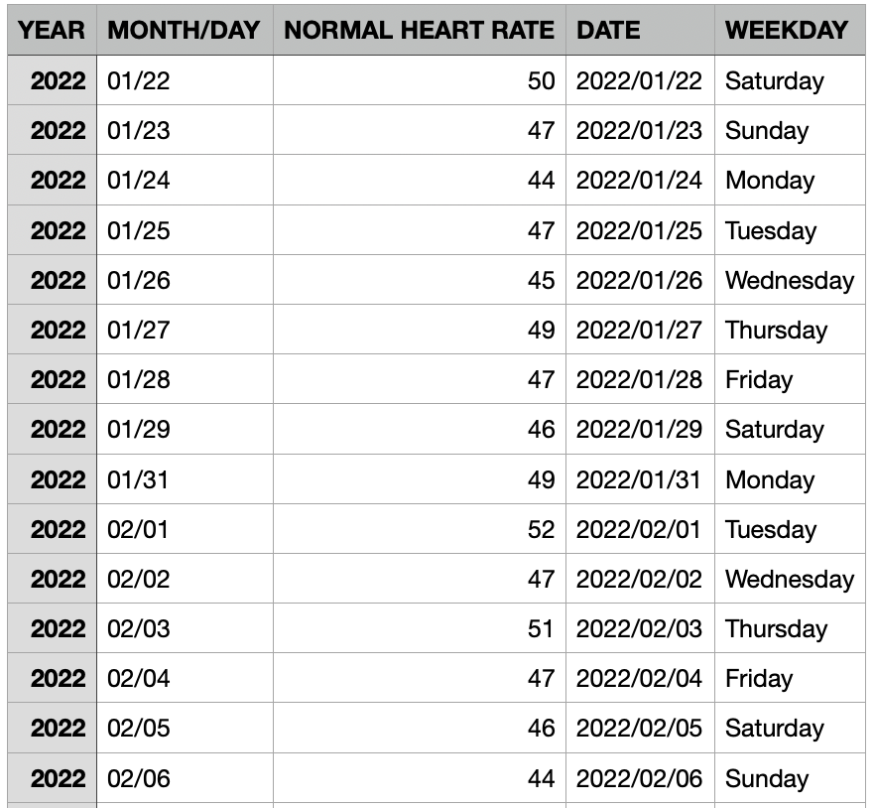
Garmin Database
- Data Extraction
- Data cleaning
- Organize the information in 4 columns:
- YEAR
- MONTH
- NORMAL HEART RATE
- DATE
- WEEKDAY
- Display the information so it can be related with the second DB

Slide 3

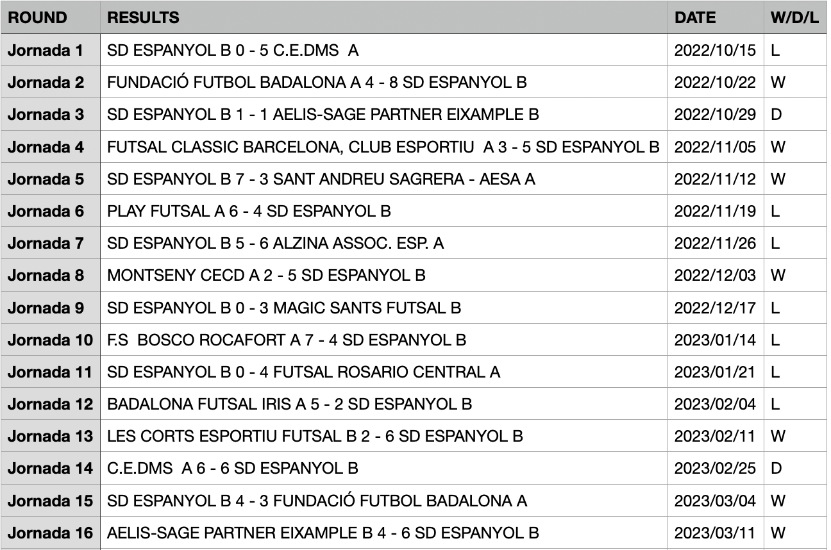
Futsal Database
- Web Scrapping from fcf.cat
- Get the desired information.
- Transform it into DF with 4 columns:
- ROUND
- RESULTS
- DATE
- W/D/L
- Merge it with Garmin DF

Slide 4
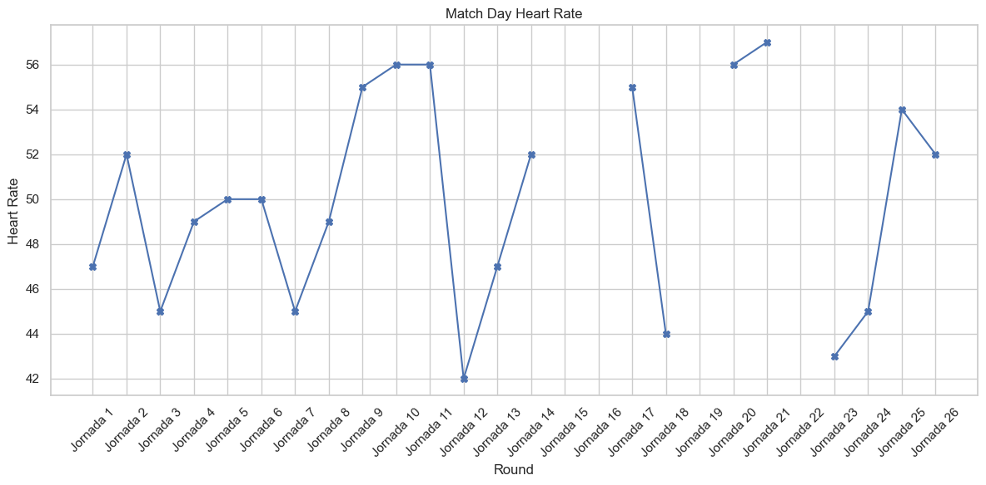
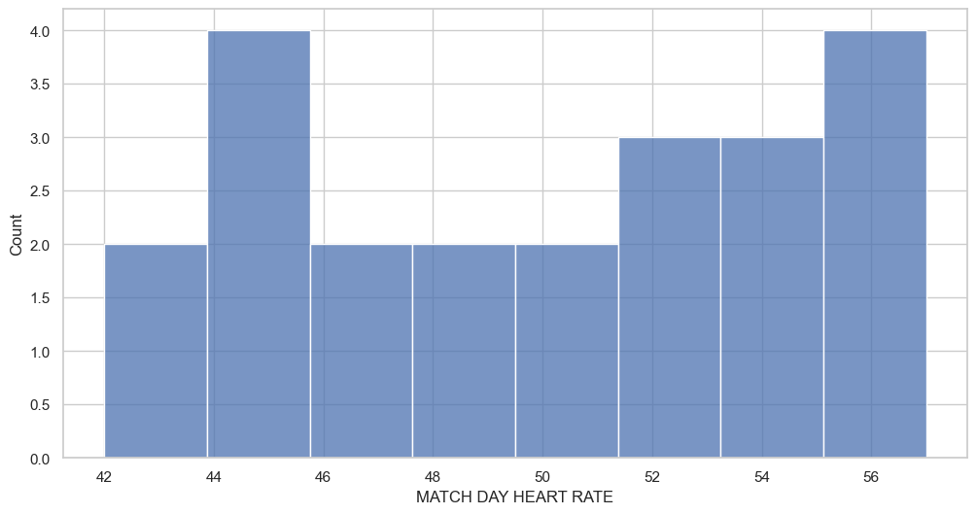
Match Day Heart Rate
Distribution of match day heart rate:
Min heart rate is 42
Max heart rate is 57
Match day heart rate per round
No pattern noticeable during match days

Slide 5
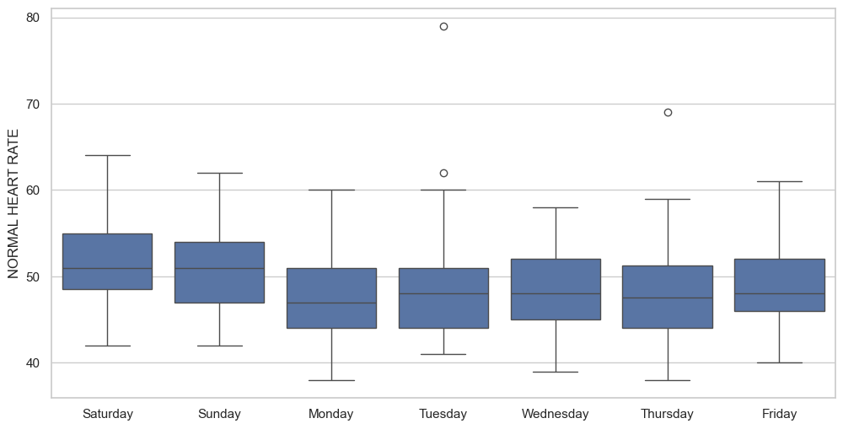
Average heart Rate per day
- Weekends higher heart rate
- Monday lowest HR → Due to the fatigue of the match

Slide 6
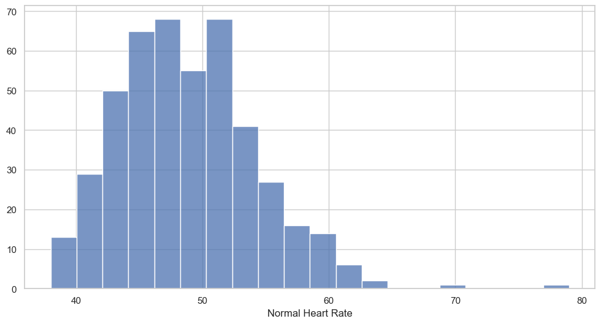
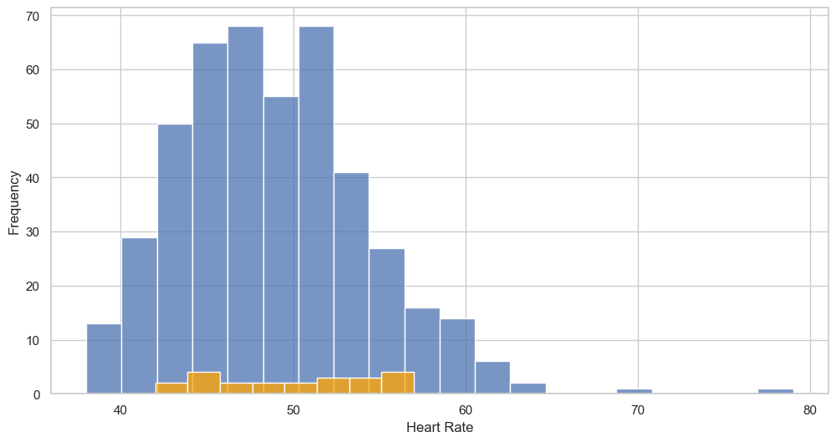
Average Heart Rate vs Match Day Heart Rate

Slide 7
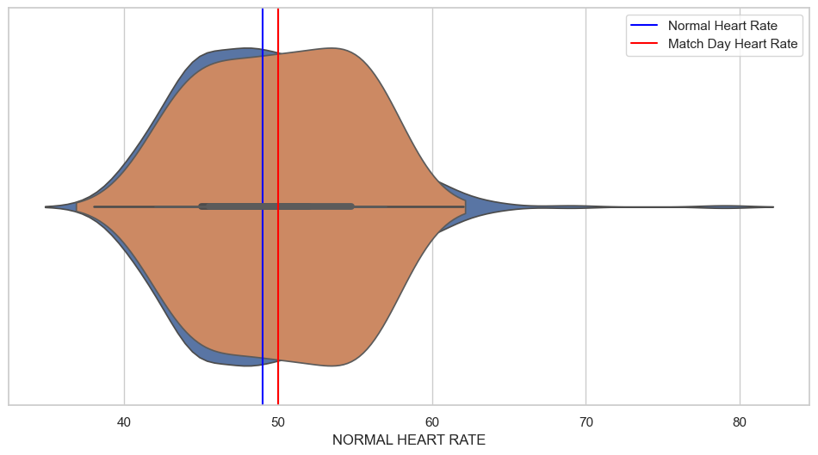
Average Heart Rate vs Match Day Heart Rate
- Average match day HR is 2 beats higher than normal day HR.

Slide 8
Conclusions
There is not a noticeable pattern in match day average heart rate:
Min 42 / Max 57
Mondays: Lowest average Heart Rate. Can be related with the match fatigue
Match days Heart rate has a higher concentration around the mean
Match Days:
On match days the average heart rate is 2 beats higher than the average heart rate for the normal days. Despite being days where I stay calm, I can be more nervous, thus increasing the average heart rate

