Slide 1
BLOCKCHAIN AND SECURITY ANALYSIS IN E-HEATHCARE
18BCI0103 ABHINAV YADAV
18BCI0108 AMRIT KANOI
18BCI0174 ARYAN CHANDRAKAR

Slide 2
MODULES IMPLEMENTED

Slide 3
WEB APPLICATION
This is a prototype for a website that can be used to connect doctors to patients throughout the world. The website has doctors and patients according to the patient the doctor can be assigned to him or her. Once the doctor is assigned they can be added to a private chat group where the patient can consult the doctor. Besides this there is a record of medicines used by the patient and their prize (score) which provided to blockchain supply chain.
In full working there will be analysis of patients’ time of wait and the severity of disease can be accessed by the score of medicines he/she has been using in the past. So there can be dynamic doctor and patient pairing to facilitate customers quickly who have more value in terms of medical score.

Slide 4


Slide 5
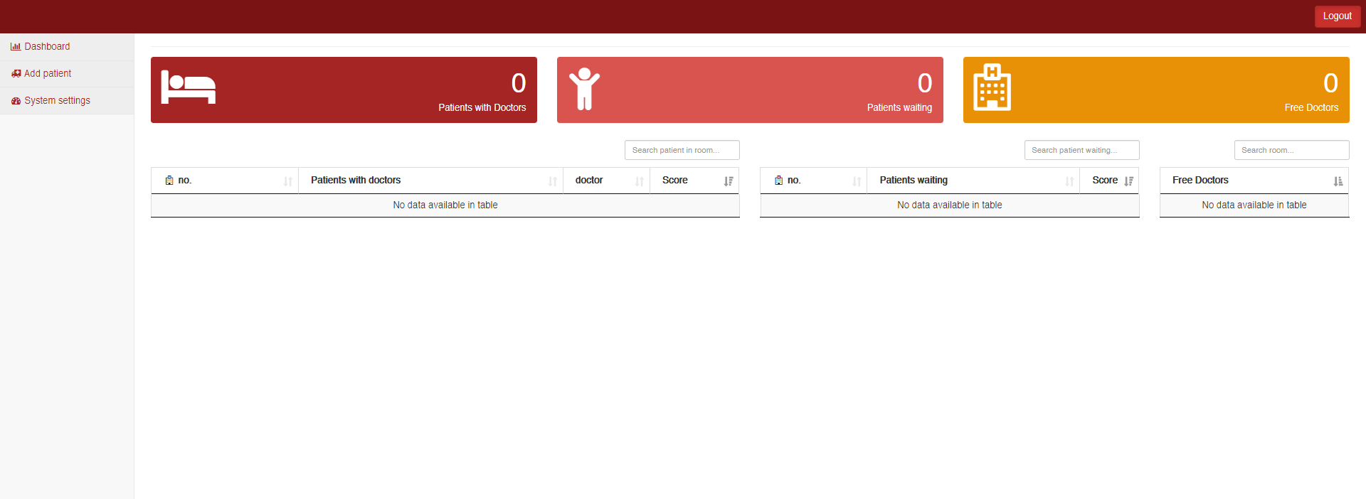

Slide 6
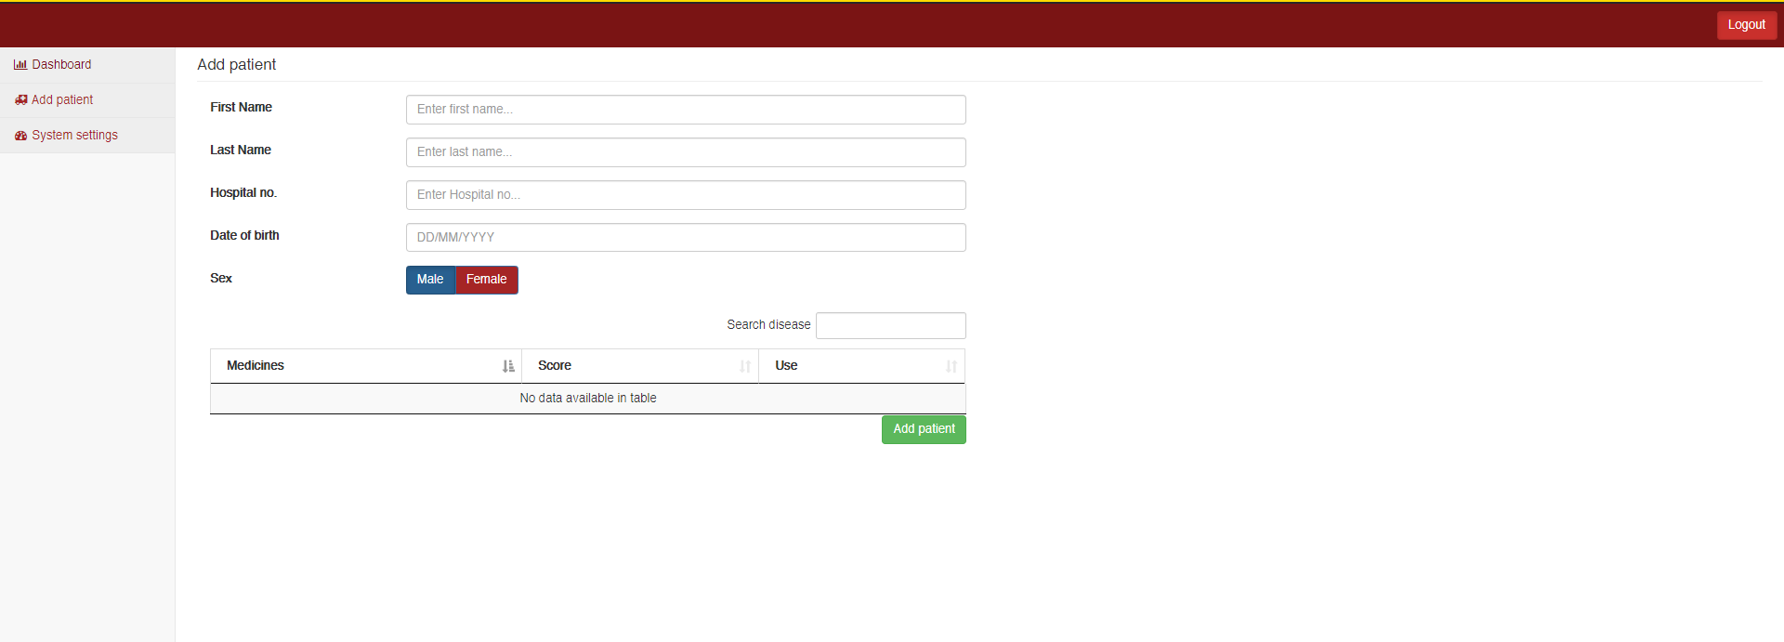

Slide 7
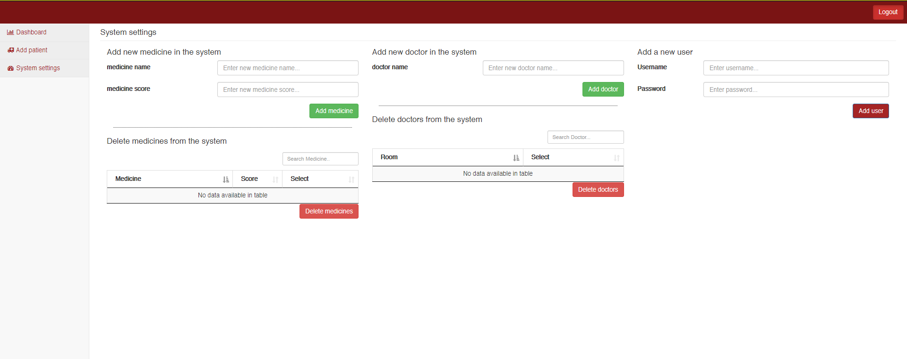

Slide 8
SUPPLY CHAIN
A supply chain blockchain could boost transparency, trust, and predictability by allowing users to track where a shipment is at any given time.
Since a blockchain is an immutable ledger, changes in possession and ownership of goods as they move from their producer to their point of retail could be entered into the ledger instantaneously and permanently.
Because a blockchain is decentralized, it has no single point of failure.
So, shipping, possession and ownership information could be better protected from tampering or hacks.
Supply chain professionals can use blockchain technology to gather and use tracking data in dynamic new ways.
Entries in a blockchain database could trigger other tasks such as the assignment of the next batch of goods arriving at a port to a certain dock or container area.
Applying blockchain technology to instant settlement of transactions could also reduce friction in commercial financing

Slide 9
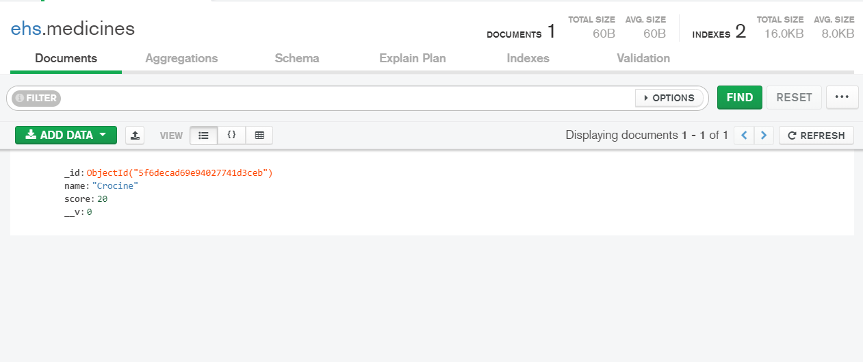

Slide 10
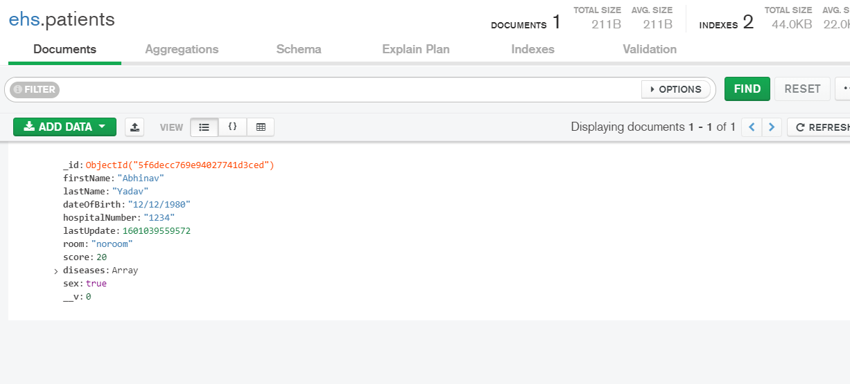

Slide 11
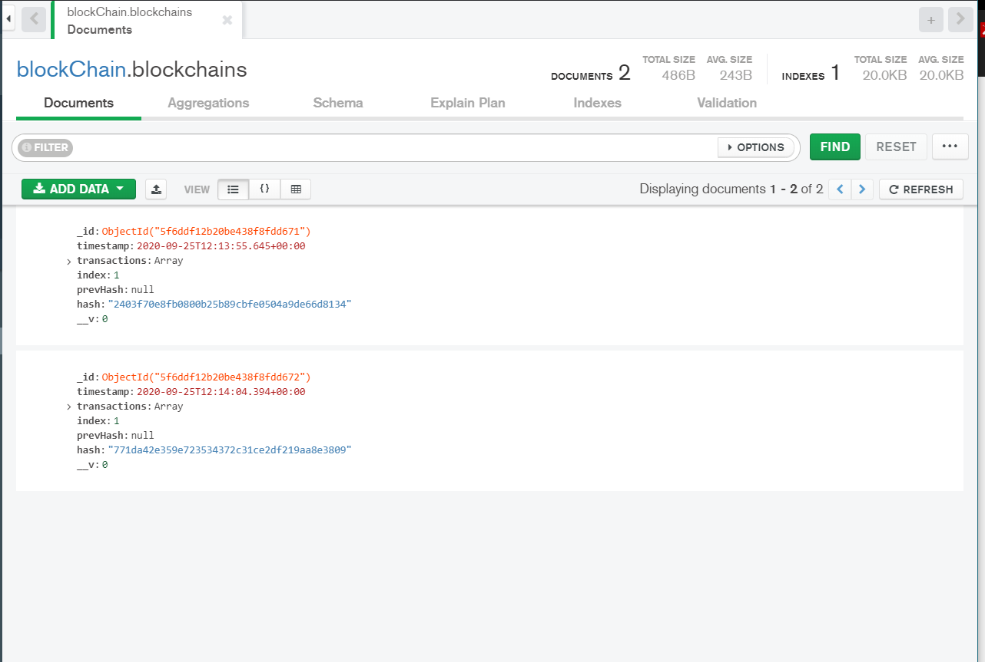

Slide 12
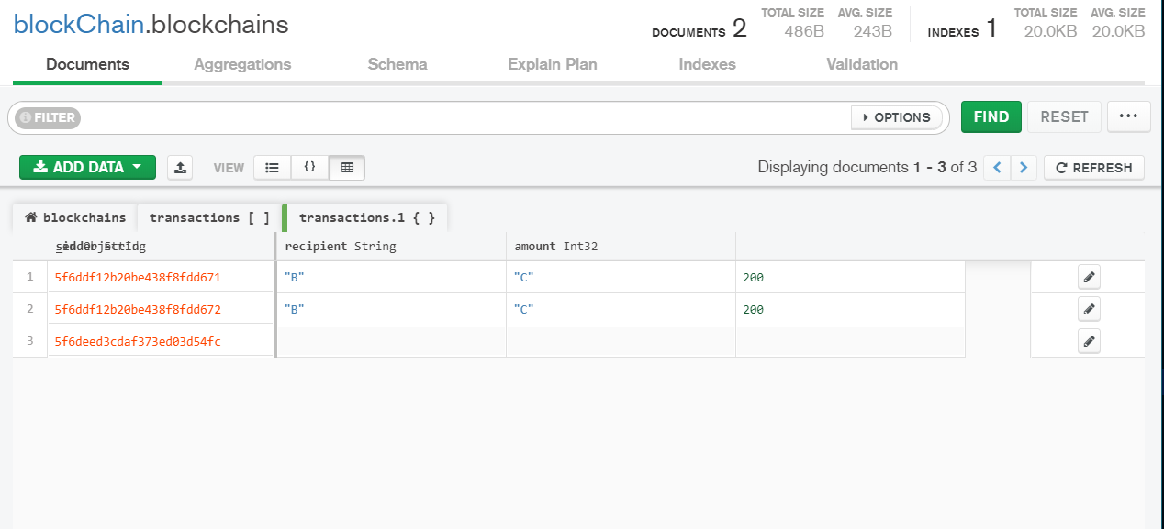

Slide 13
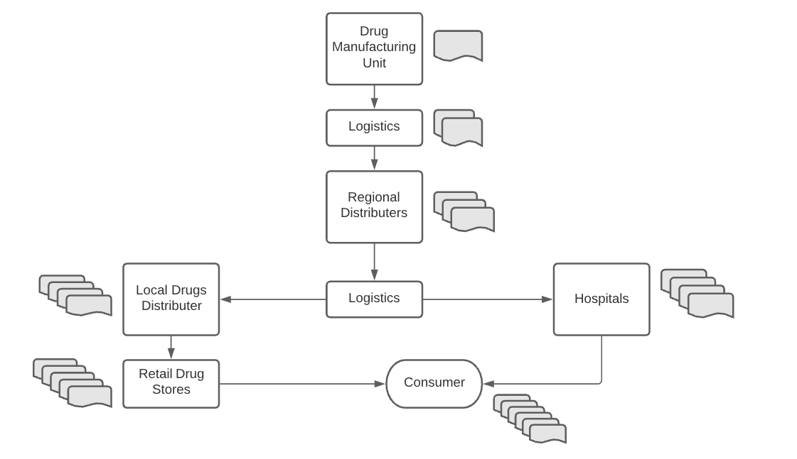
FLOWCHART

Slide 14
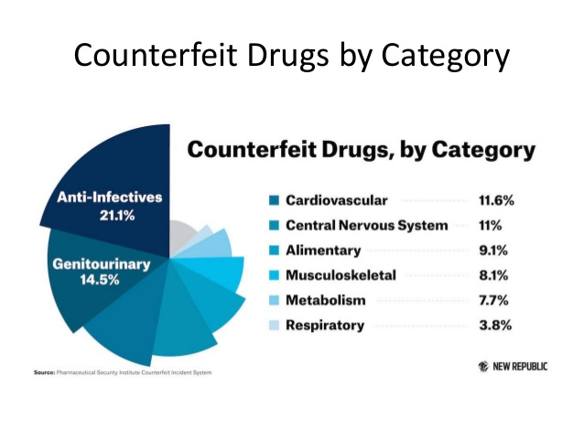

Slide 15
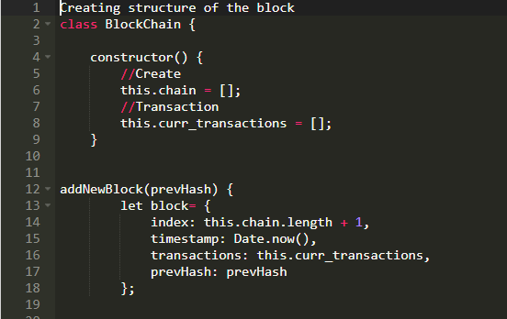
CODE

Slide 16
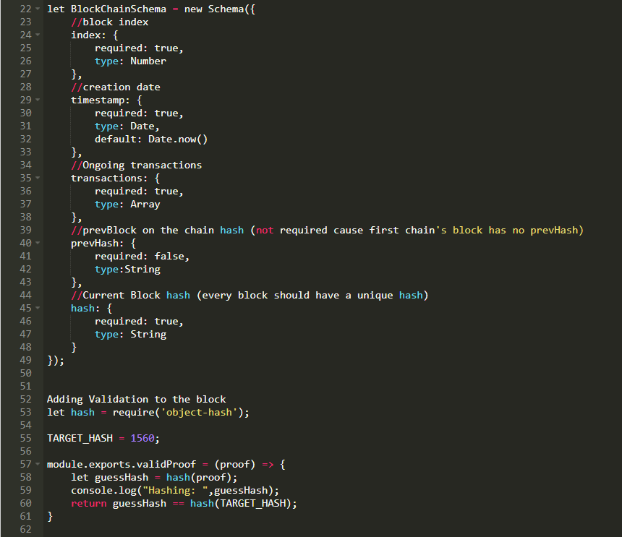

Slide 17
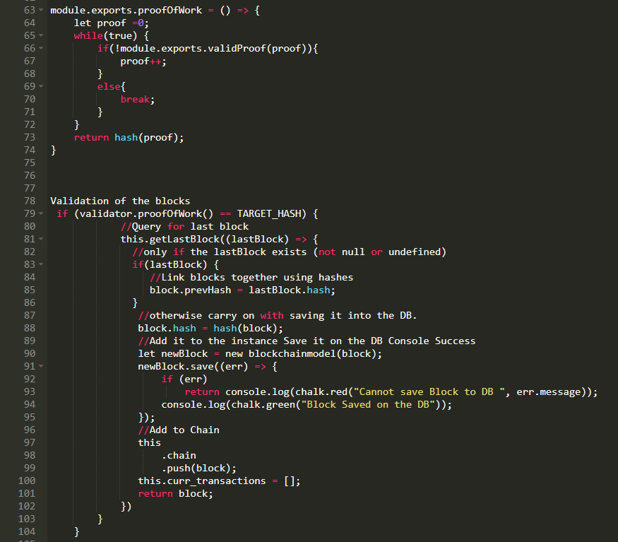

Slide 18
ANALYSIS
let hash = require('object-hash');
const TARGET_HASH = hash(1560);
The target hash is generated after mining loads of SHA256 hashed codes and that hash is associated to the block, the mining of these hashes makes the hash un-predictable so that no unauthorised user can guess it. These hashes are then send to the previous block associated in the chain. So this creates a chain of blocks connected by unknown hashes. When the block is mined in the server the miner who gets the block has to submit a proof of work if the hash in the proofofwork and block matches the block is added to the chain. This ensures no delicacy and additional security to the chain.

Slide 19
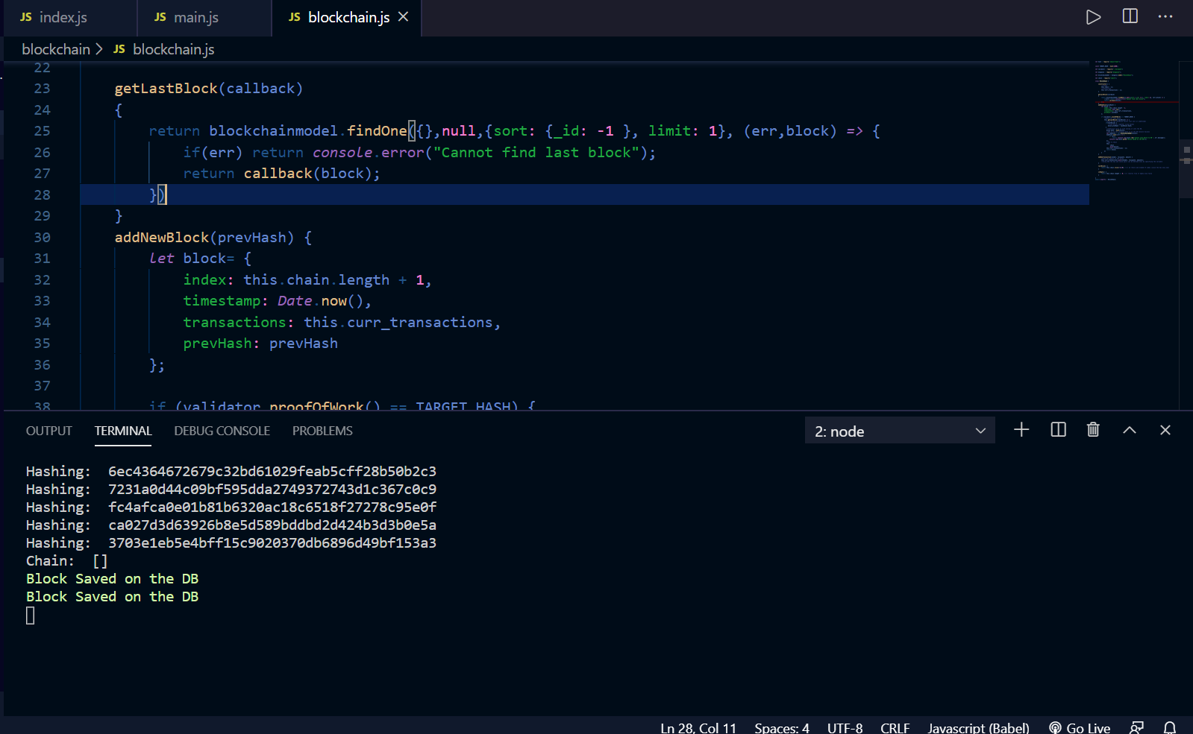
RESULT

Slide 20
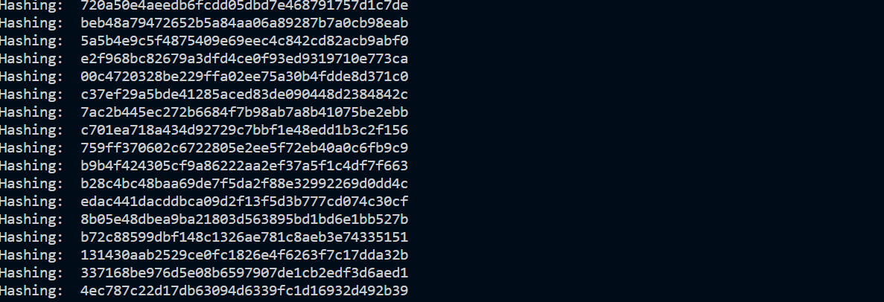

Slide 21
BIT COIN WALLET
A simple bitcoin wallet which has features like –
(i) Proof of Work – A new block can be created in an interval of desired time units .
(ii) Mining Reward – We provide user a mining reward for mining each block .
(iii) Difficulty – This defines the number of zeroes to be attached to our hash value generated by SHA – 256.
(iv) Key-generator – Each transaction has to signed and verified by user public key and private key . The user can only use coins of the wallet to which he the has the private key

Slide 22
METHODOLOGY
(1) Each block will have a constructor which will receive the properties of the block . Each block will have index , timestamp , data , previous hash . Timestamp tells us when this block was created . Data will contain details of transaction i.e. sender , receiver and amount transacted . Previous hash is a string which contains the hash of the block before this one . This ensures the integrity of our entire blockchain .
(2) Next , we have calculate hash method which will calculate the hash of each block created and help to identify it in the chain . We are using SHA 256 as our hash function . For this we need to install crypto.js module of JavaScript .
(3) The first block in our blockchain is genesis block which is added manually . Since , this is the first block , so previous hash wont exist . We will have get_latest_block() method , add_new_block() method , and also a method which validates whether our blockchain is valid or not at each step .

Slide 23
(4) Modern computers can create hundred of thousands of blocks per second and spam our blockchain . There’s also a security issue that contents of the block can be changed and re calculate the hash for each block and ends with a valid chain even though it is tampered with it . To solve this issue , blockchain have proof of work . This is also called mining . Therefor , bitcoins has a certain number of zeroes to start with in their hash i.e. difficulty .
(5) Increasing difficulty will take a lot longer in mining the blocks that could be a solution against the adversary . Our blocks now has hash value starting with 4 zeroes since difficulty by default is set to 4 . With this mechanism , we can control how fast new blocks can be added to our blockchain . This is essential for safety of the blockchain .
(6) Now , we are going add rewards for miners . When we start a cryptocurrency , we need to have virtual money or coins . Mining rewards steadily increases new coins into the system . We have created a new class transaction . A transaction always goes from someone , comes from someone and carries some coins .
(7) We only create blocks on a specific interval . In bitcoins case , proof of algorithm makes sure that we only create a new block every 10 minutes . All the transactions that are made in between the blocks , are temporarily stored in pending transaction array , so that they can be included in next block .
(8) Many people think that if you send some bitcoins around , they actually move away from our wallet balance to some balance . But in reality , we don’t really have a balance . The transaction is just stored on the blockchain and if want to check our balance , we have to go through all the transaction that involve our address and calculate it that way .

Slide 24
(9) After a block is mined , we create a new Transaction to give the user mining reward , but that is added to pending transaction array . So ,the mining reward will he sent , when the block is mined . But , after mining in the second block we again get a new reward , which is in the pending transaction array state and will be included in the next block that is mined .
(10) But currently anyone can make any transaction that he wants. So effectively a user can spend coins that aren’t his . So , for that we are making it mandatory for transaction to be signed with a private and public key . That way we can only spend coins in the wallet if we have a private key to it .
(11) Next , we import a new library ELLIPTIC . This library will allow us to generate a public and private key . It also has methods to sign something and verify a signature . We can use any elliptic curve which is used in bitcoin . We than generate a new key pair and convert them into hex strings. We don’t need this only to sign transaction but also to get the balance in our wallet .
(12) Our sign Transaction method will receive a signing key , which will be our private and public key pair . Signing key will be the object that we got from our elliptic library . Before we sign a transaction we check if our public key equals the from address . We can only spend the coins from the wallet for which we have the private key .

Slide 25
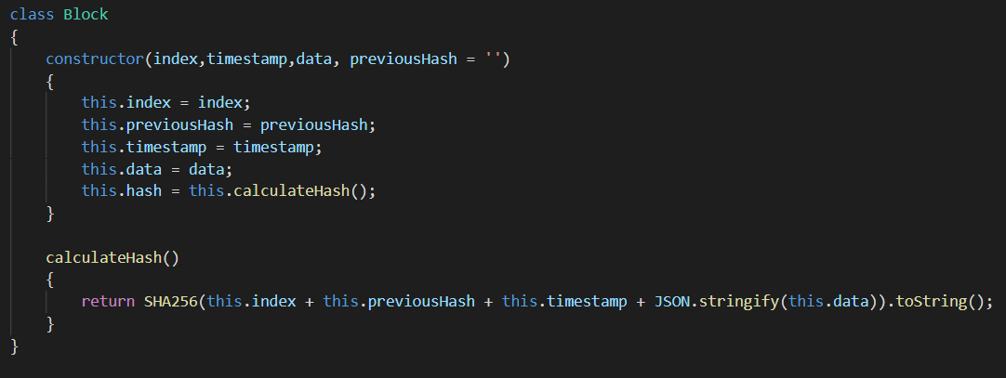
ALGORITHM

Slide 26
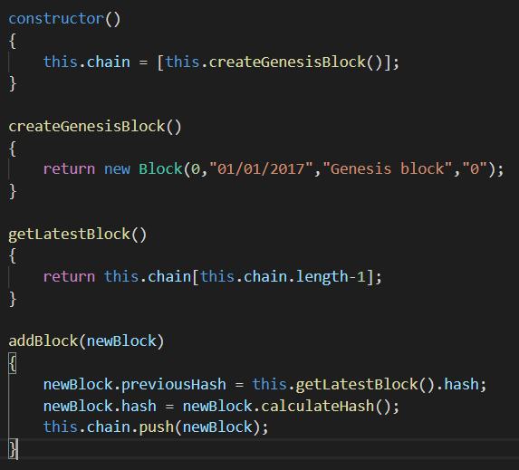
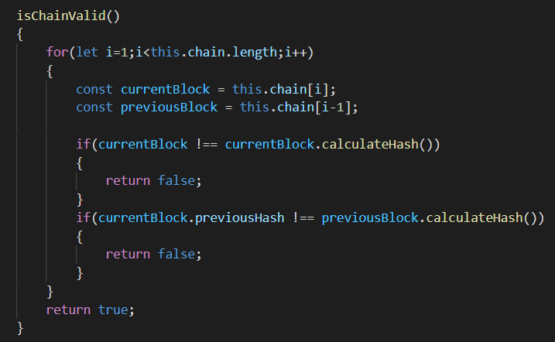

Slide 27
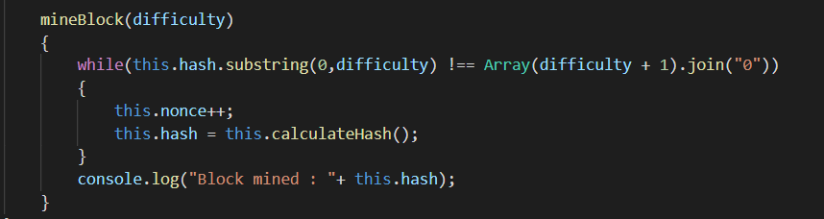
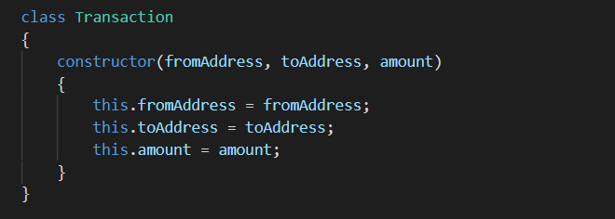

Slide 28
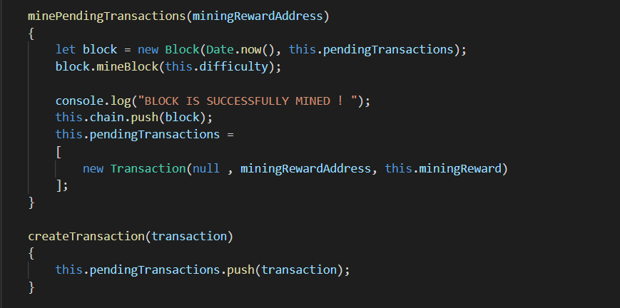
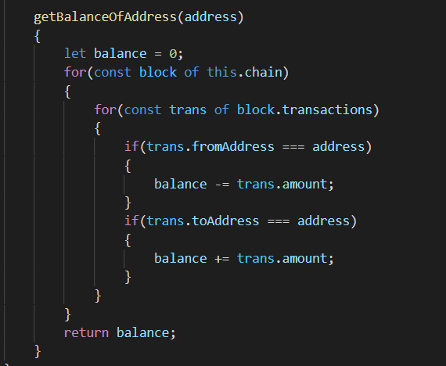

Slide 29
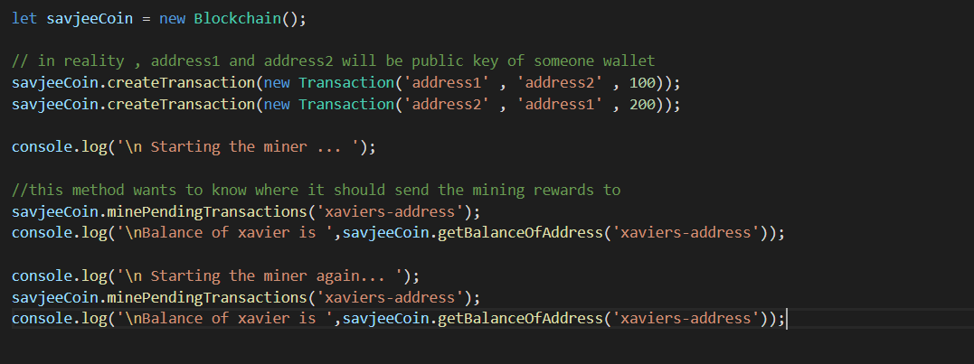

Slide 30
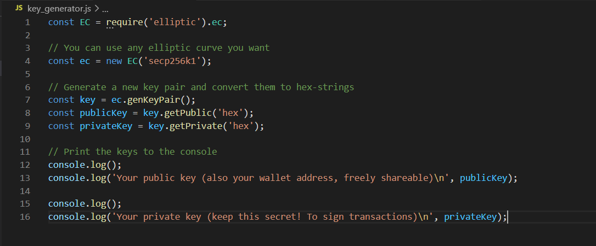

Slide 31
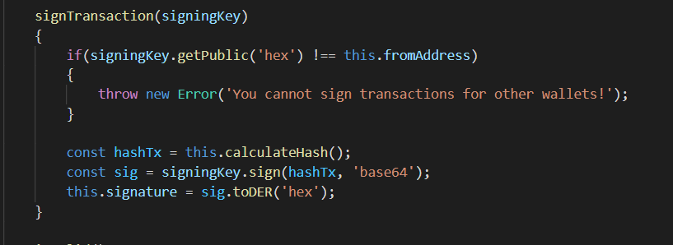
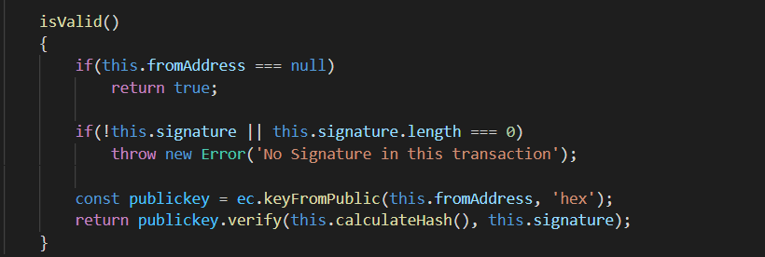

Slide 32
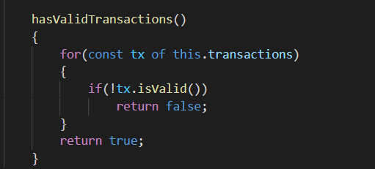
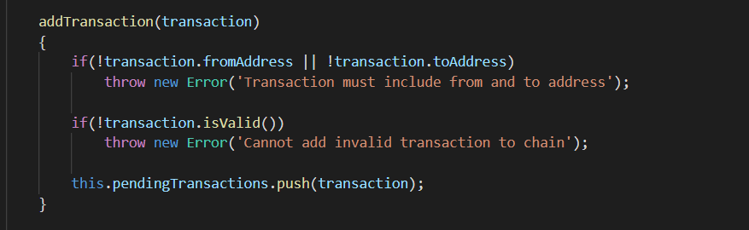

Slide 33
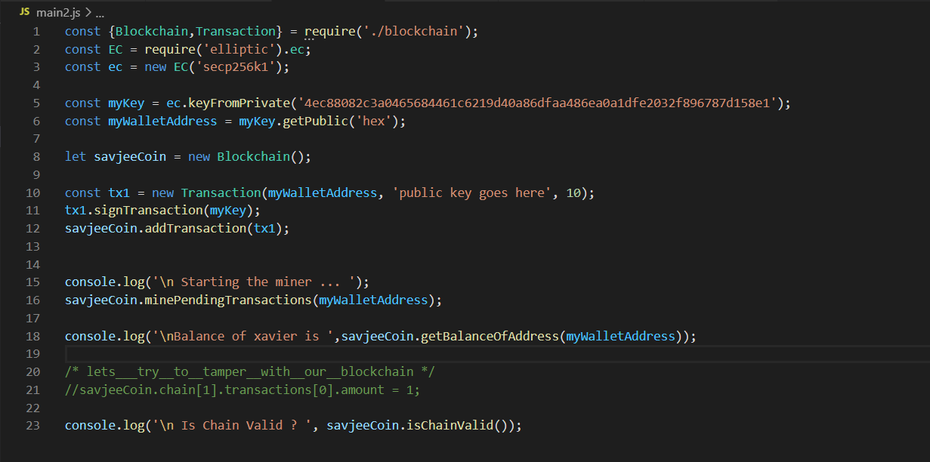

Slide 34
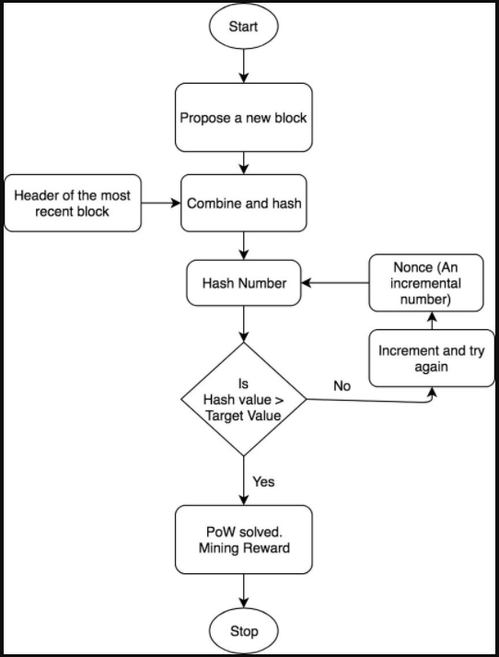
FLOWCHART

Slide 35
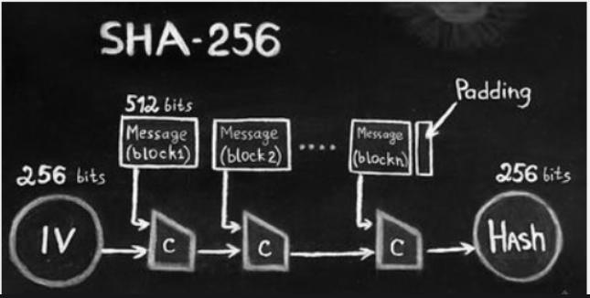
SHA 256 WORK FLOW

Slide 36
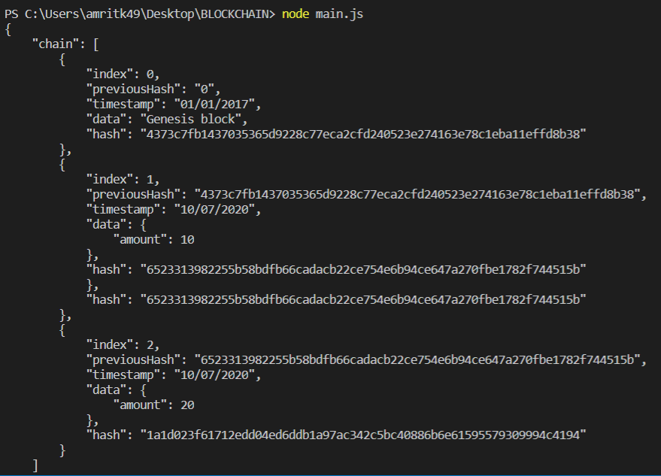
RESULTS

Slide 37
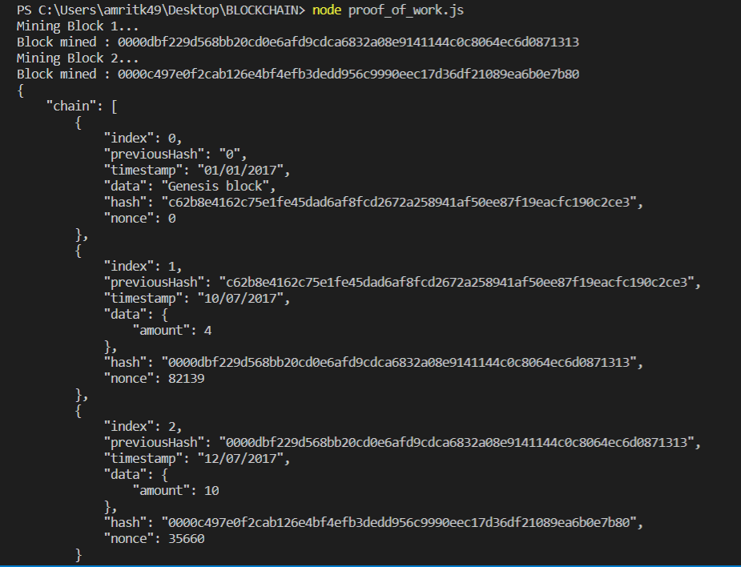

Slide 38
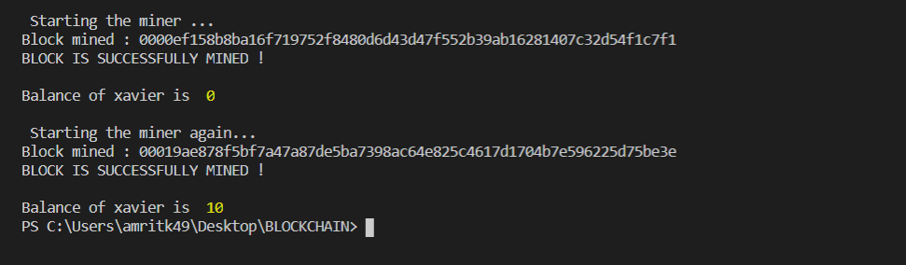
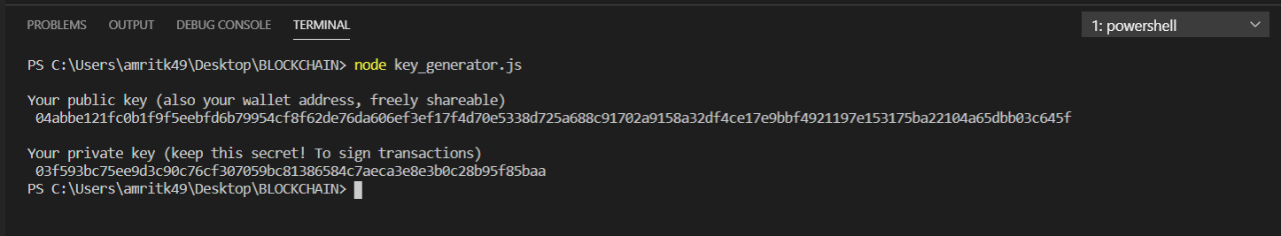

Slide 39
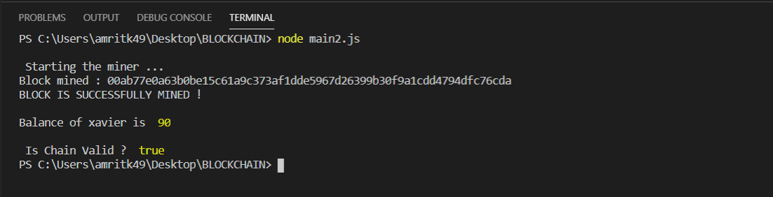
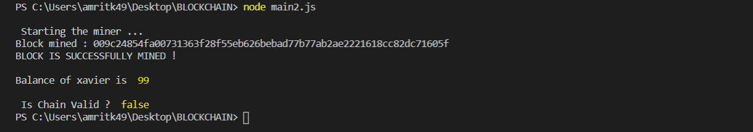

Slide 40
CRYPTO CURRENCY AND BLOCKCHAIN USAGE

