Slide 1


Graph Hawkes Neural Network for Forecasting on Temporal Knowledge Graphs
Amirhossein Abedi
Stochastic processes
Presentation
Winter 2023
Notes:
1

Slide 2
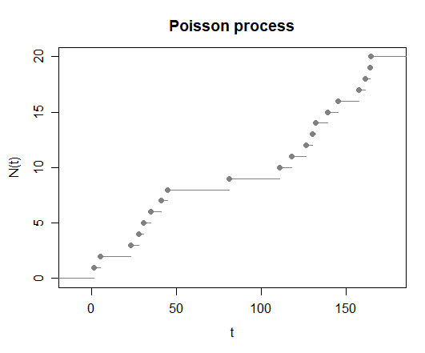


Background
Poisson Process
A Simple point process
Independent events
Can not model history
Notes:
2

Slide 3
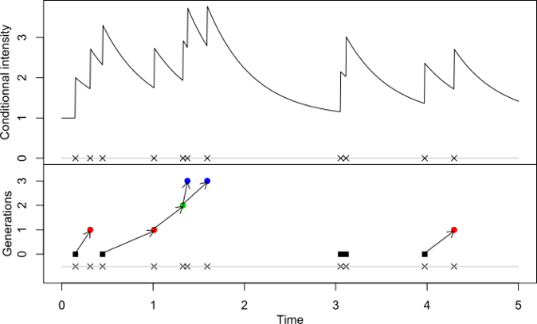
Background
Hawkes Process
Self-exciting point process
Good for modeling history
Fails to model different type of events
Notes:
3

Slide 4
Background
Hawkes Process fails under following conditions:
Effect of events not being additive
Effects being inhibitory
Notes:
4

Slide 5
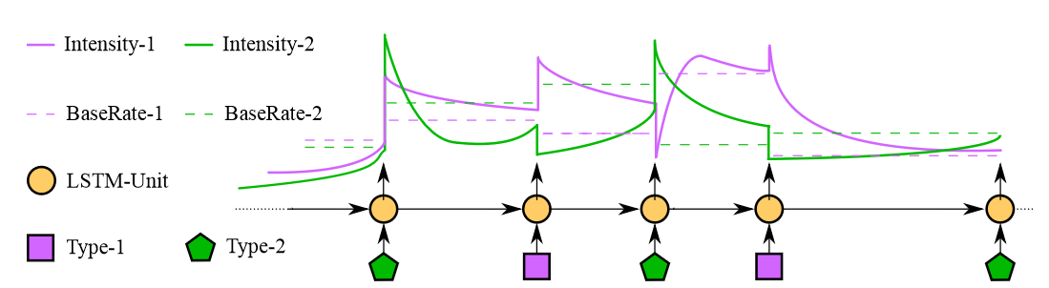
Background
Neural Hawkes process
Multi-variate point process
Each point corresponding to a finite set of events
Use cLSTM to model intensities
Notes:
5

Slide 6
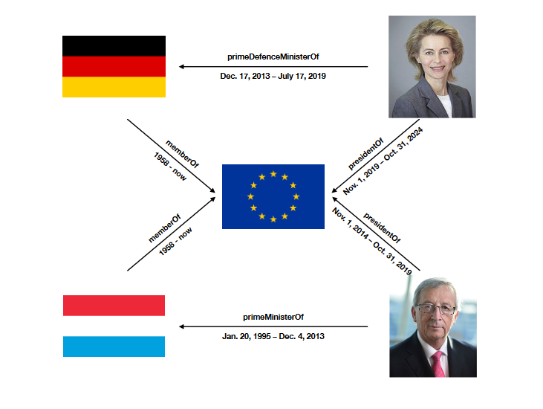
tKG’s
Temporal Knowledge Graphs:
A Knowledge Graph with nodes as subjects and objects
Additional time variable
(subject, predicate, object, time)
Notes:
6

Slide 7
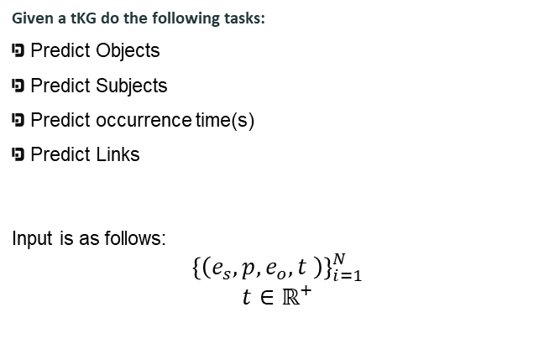
Input and Output
Given a tKG do the following tasks:
Predict Objects
Predict Subjects
Predict occurrence time(s)
Predict Links
Input is as follows:
$${\left\{\left(e_{s}, p, e_{o}, t \right)\right\}}_{i=1}^{N}$$
$$t∈ℝ^{+}$$
Notes:
7

Slide 8

Proposed Method
Have the following assumptions:
Given the history, concurrent events are independent
Links between objects and subjects with predicate p is only dependent on previous subjects and predicates denoted as: ( this is also true for object-predicates )
Time of (sub, pred, obj) is dependent only on data containing either (sub, pred) or (pred, obj).
Notes:
8

Slide 9
Proposed Method
Object prediction:
Just use neural HP on history for object.
Subject prediction can be done the same way.
Notes:
9

Slide 10
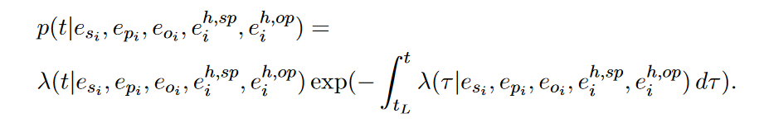
Proposed Method
Time prediction:
Just like object prediction but use both histories.
Notes:
10

Slide 11
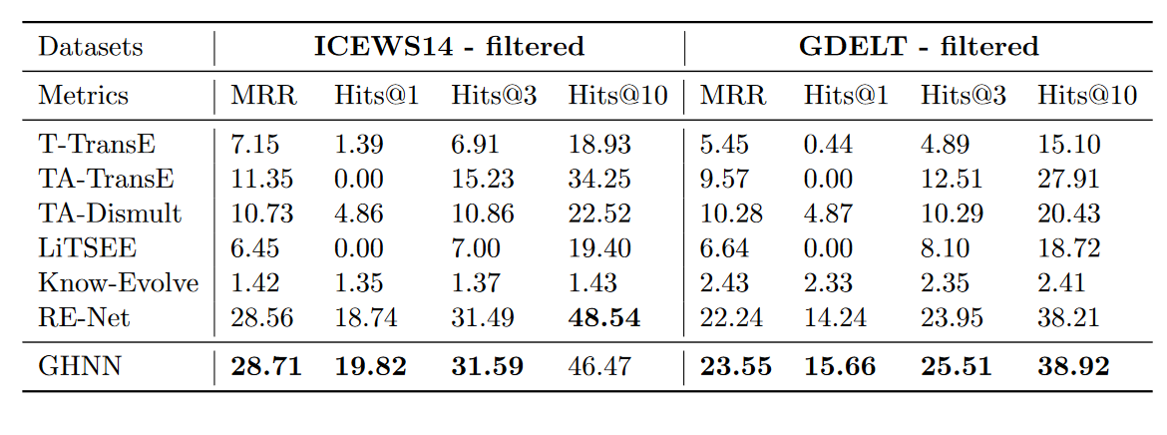
Results
Evaluation:
Notes:
11

Slide 12
Thank you!
Notes:
12

