Slide 1

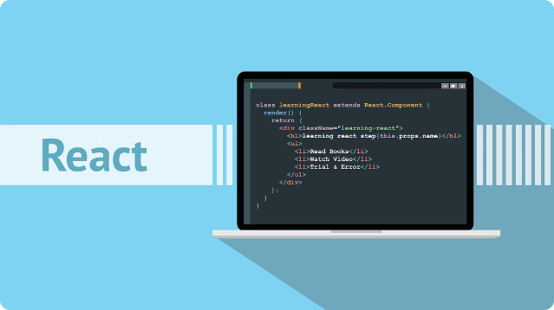

Introduction to React State
React state is a powerful tool for managing data within your React components. It allows you to keep track of changing information and dynamically update the user interface.
by Mir Junaid Rasool

Slide 2


What is State in React?
State is a JavaScript object that stores data specific to a component. It's the source of truth for a component's UI. When the state changes, the component re-renders to reflect the updated data.
Mutable
State can be modified and updated within a component.
Component-Specific
State is confined to the component that declared it.

Slide 3
Difference between State and Props
State is internal to a component, while props are passed in from the parent component. State changes can cause re-renders, while props only change based on parent component updates.
State
Props
Internal data managed by a component.
Data passed from a parent component.
Can be updated by the component itself.
Immutable; can only be changed by the parent.

Slide 4

Initializing State in React
State is initialized using the `useState` hook, which takes an initial value and returns an array containing the current state value and a function to update it.
import React, { useState } from 'react';
function Counter() {
const [count, setCount] = useState(0);
return (
Count: {count}
); }

Slide 5
Updating State in React
You update state by calling the function returned by the `useState` hook. The function accepts a new state value, which will cause the component to re-render with the updated data.
import React, { useState } from 'react';
function Counter() {
const [count, setCount] = useState(0);
return (
Count: {count}
); }

Slide 6

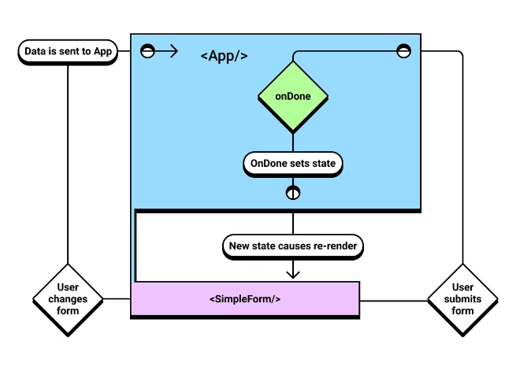


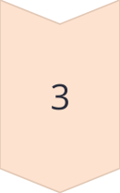
Unidirectional Data Flow
React follows a unidirectional data flow pattern. Data flows from parent to child components through props, and state updates propagate through the component tree. This makes it easier to reason about data flow and prevent unexpected state mutations.
Parent Component
Passes data to child component as props.
Child Component
Receives data as props and manages its internal state.
Event Handling
Updates child component's state, triggering a re-render.

Slide 7

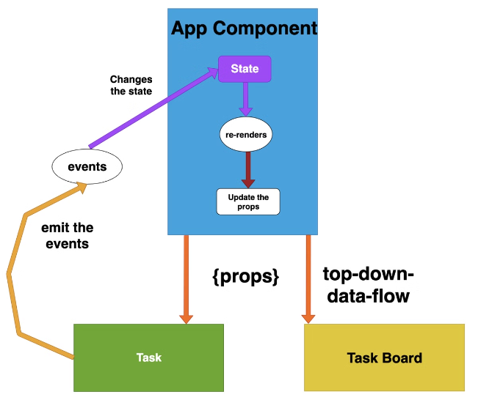
Lifting State Up
When multiple child components need to access and modify the same data, the state is "lifted up" to a common parent component. This ensures data consistency and allows for more efficient communication.
1
Centralized State
A single source of truth for data shared between components.
2
Improved Data Consistency
Ensures that changes to the state are reflected across all components.
3
Simplified Communication
Minimizes the need for complex prop drilling between components.

Slide 8

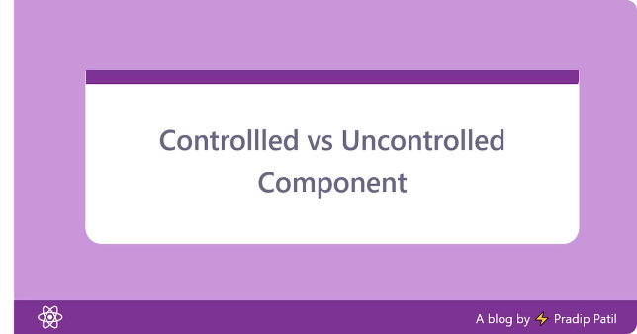
Controlled vs Uncontrolled Components
Controlled components have their value directly controlled by the component's state, while uncontrolled components rely on the DOM to manage their value. Each approach has its pros and cons.
Feature
Controlled Component
Uncontrolled Component
Value Control
Component's state
DOM
Validation
Easier
More complex
UI Synchronization
Guaranteed
Potentially asynchronous

Slide 9

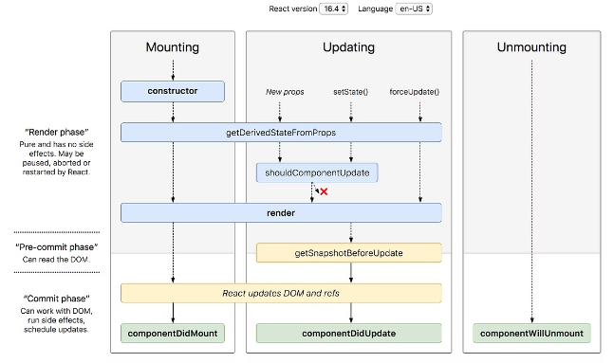
Lifecycle Methods in React
Lifecycle methods allow you to execute code at different stages of a component's lifecycle, such as mounting, updating, and unmounting. This lets you perform actions like fetching data or cleaning up resources at the appropriate time.
1
Mounting
`componentDidMount`
2
Updating
`componentDidUpdate`
3
Unmounting
`componentWillUnmount`

Slide 10





Conclusion and Key Takeaways
Understanding React state is fundamental to building dynamic and interactive user interfaces. By mastering concepts like state initialization, updating, and lifecycle methods, you can create complex and efficient React applications.
State is Mutable
It can be modified within a component.
Unidirectional Data Flow
Data flows from parent to child and state updates propagate through the component tree.
Lifecycle Methods
Allow you to execute code at different stages of a component's lifecycle.

