Slide 1




Introduction to State and Props in React
This presentation will cover fundamental concepts of React development, including state and props. We will explore how these concepts work together to build dynamic and interactive user interfaces.
by Mir Junaid Rasool

Slide 2
Understanding the Difference Between State and Props
State
Props
Internal data of a component that can be modified. Represents the current state of the UI.
Data passed from a parent component to a child component. Immutable and read-only. Can be used to customize child components.

Slide 3





Implementing State in React Components
Initialization
Create a state object with an initial value using the `useState` hook.
Accessing State
Retrieve the current state value using the first element returned by `useState`.
Modifying State
Update the state using the second element returned by `useState`, which is a function that accepts the new state value.

Slide 4

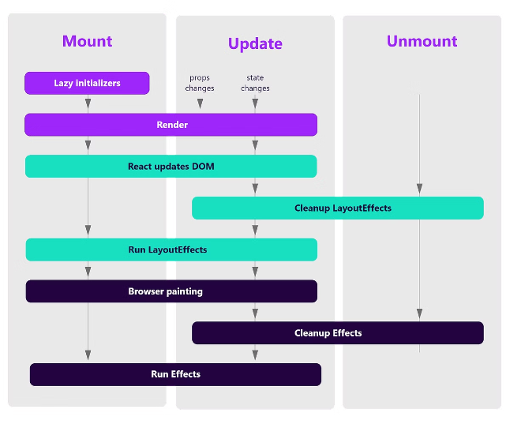
Updating State and Re-Rendering Components
1
State Changes
2
Re-rendering
When the state of a component changes, React automatically re-renders the component and its children.
Re-rendering updates the UI based on the new state. Ensures that the user interface reflects the latest state changes.
3
Efficiency
React's virtual DOM optimizes the re-rendering process, ensuring only necessary parts of the UI are updated.

Slide 5

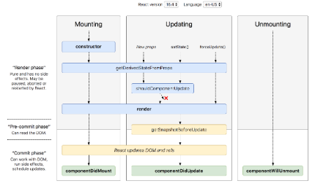
Lifecycle Methods in React
Mounting
Unmounting
Methods like `componentDidMount` are executed when the component is first added to the DOM.
Methods like `componentWillUnmount` are executed when the component is removed from the DOM.
1
2
3
Updating
Methods like `componentDidUpdate` are executed when the component's state or props change.

Slide 6

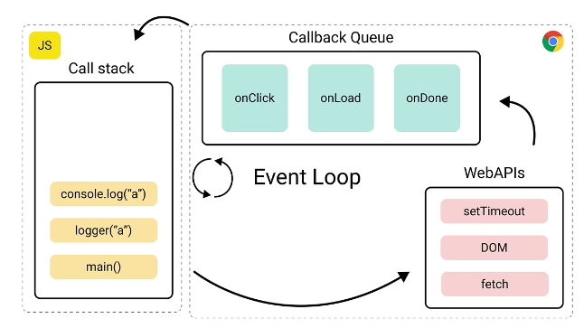
Handling Events and Updating State
Event
Handler
State Update
Click
onClick
Update state based on user interaction.
Input
onChange
Synchronize state with user input values.
Submit
onSubmit
Process form data and update relevant state.

Slide 7


Best Practices for Managing State and Props
State Lifting
State Management Libraries
Move state to a common parent component when shared by multiple child components.
Consider using libraries like Redux or MobX for complex state management in large applications.
Prop Types
Use `propTypes` to define expected prop types for better code clarity and error prevention.

Slide 8





Conclusion and Key Takeaways
Key Takeaways
State and props are fundamental concepts for building interactive React components.
Next Steps
Practice implementing state and props in your own React projects to solidify your understanding.
Benefits
Mastering state and props empowers you to build complex and dynamic user interfaces in React.

