Slide 1

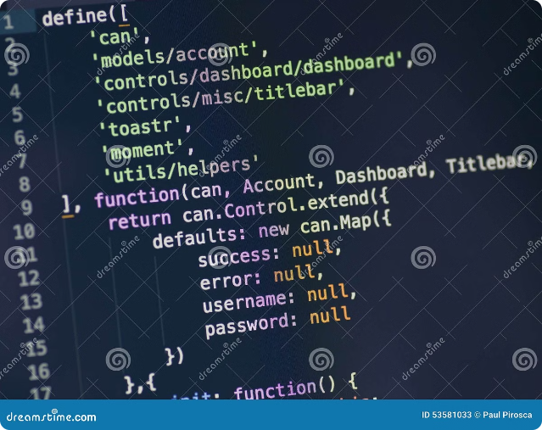


React Fundamentals
React is a powerful JavaScript library for building user interfaces. It's a popular choice for creating single-page applications, web apps, and mobile apps.
by Mir Junaid Rasool

Slide 2

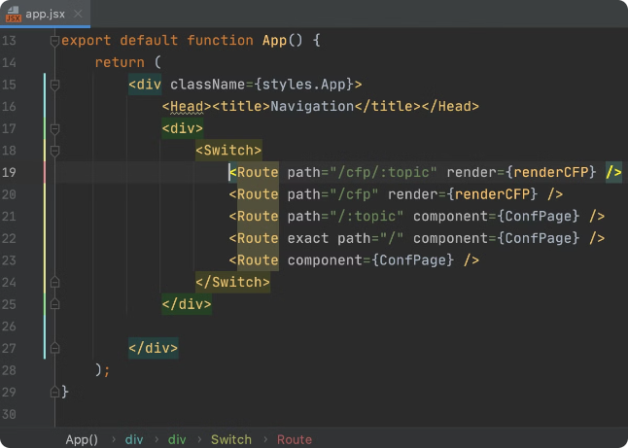
JSX: A Powerful Syntax
1
JSX Syntax
JSX is a JavaScript extension that lets you write HTML-like syntax within your JavaScript code, making it easier to structure and render UI elements.
2
JSX Benefits
JSX improves code readability and makes it easier to understand the relationship between components and their rendered output. It enhances developer productivity.
3
JSX Example
A simple example of JSX would be writing a <h1> tag inside your JavaScript file, creating a heading element.

Slide 3





Babel: The JSX Compiler
Code Transformation
JSX to JavaScript
Enhanced Compatibility
Babel is a transpiler that converts JSX code into standard JavaScript, which browsers can understand.
Babel essentially translates the JSX syntax into regular JavaScript functions and calls to React's DOM manipulation APIs.
Babel helps ensure compatibility with older browsers that may not support the latest JavaScript features, including JSX.

Slide 4
The Virtual DOM: Efficiency in Action
React's Secret Weapon
Minimizing DOM Operations
Enhanced Performance
React uses a virtual DOM, an in-memory representation of the actual DOM, for efficient updates.
By reducing unnecessary DOM updates, the virtual DOM significantly improves performance and makes React apps smoother.
React compares the virtual DOM with the actual DOM, only updating the necessary elements, minimizing DOM manipulations.

Slide 5

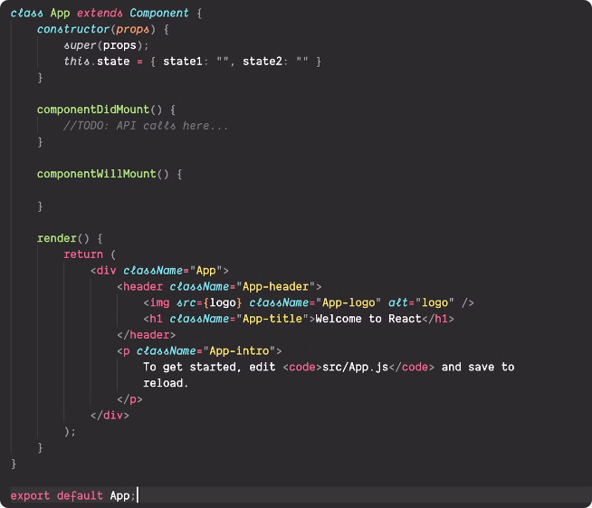
React DOM: Rendering Your Components
ReactDOM.render
The `ReactDOM.render` method is the key function for rendering React components into the actual DOM.
Component Hierarchy
React components can be nested to create complex UI structures. Components are reusable building blocks that encapsulate UI logic.
DOM Manipulation
React DOM takes care of manipulating the DOM behind the scenes, ensuring that updates are efficient and reflected accurately on the page.

Slide 6
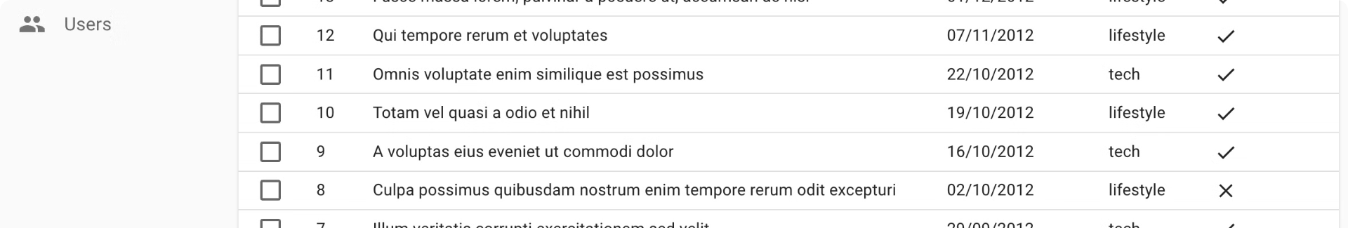
Lists and Keys: Organizing Your Data
Rendering Lists
1
React provides a way to render lists of data using `map` function, transforming data into a set of components.
2
Unique Keys
Each item in a list should have a unique key, essential for React to track elements and efficiently update the list.
Performance Optimization
3
Keys help React identify changes in the list, making updates faster and improving the user experience.

Slide 7

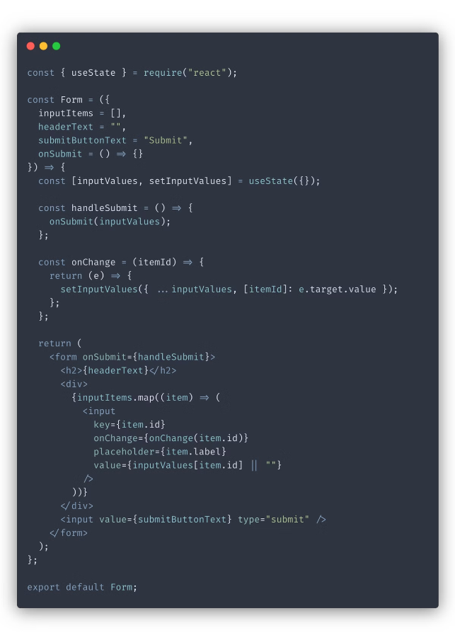
Forms and User Input: Interacting with the User
Input Types
Examples
Text Input
<input type="text" />
Password Input
<input type="password" />
Checkbox
<input type="checkbox" />
Radio Button
<input type="radio" />
Dropdown
<select><option></option></select>

Slide 8





Conditional Rendering: Dynamic UI Elements
if/else Statements
Use `if/else` statements to conditionally render different components or UI elements based on specific conditions.
Ternary Operator
Use the ternary operator for concise conditional rendering, simplifying the syntax for simple conditions.
Logical Operators
Combine conditions using logical operators (`&&` and `||`) to control the rendering of multiple UI elements.

Slide 9

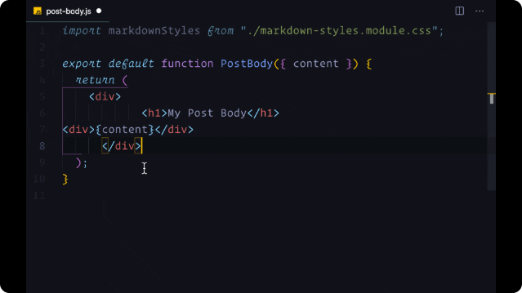
Recap and Next Steps
You've learned the fundamentals of React, covering key concepts like JSX, Babel, the Virtual DOM, and component rendering. You're well-prepared to dive into more advanced topics like state management, component lifecycle methods, and building complex user interfaces.

