Slide 1

State-of-the-art OCR technology - Mihir Shah

Slide 2
Agenda
State-of-the-art Tesseract OCR technology
Architecture
Training Tesseract
Evaluation

Slide 3
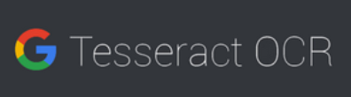
Tesseract OCR technology
Open-source OCR engine
Developed and Maintained by Google
Can detect over 100 languages
Can process even right-to-left text

Slide 4
Architecture Tesseract 4.0
New OCR engine that uses LSTM (Long Short-Term Memory)
Most effective solution for sequence prediction problems
Pytesseract python wrapper
Binary image
Character outlines
Adaptive Thresholding
Connected component Analysis
Input (Gray or Colour Image)
Find Text Lines & Words
Recognised word Pass 2
Recognised word Pass 2
Extracted Text
Character outlines organised into words
Figure: Architecture of Tesseract 4.0

Slide 5
Training Tesseract 4.0
Generating Training Data
Extract Generated model
Training for custom fonts
LSTM Model
Test Data for ‘Impact font’
Decreasing error rate
Combining fine-tunned model with trainned model
Re-male eval data for ‘Impact font ’
Combining fine-tunned model with trainned model
Figure: Flow Chart for Training Tesseract 4.0
Save & Perform detection

Slide 6
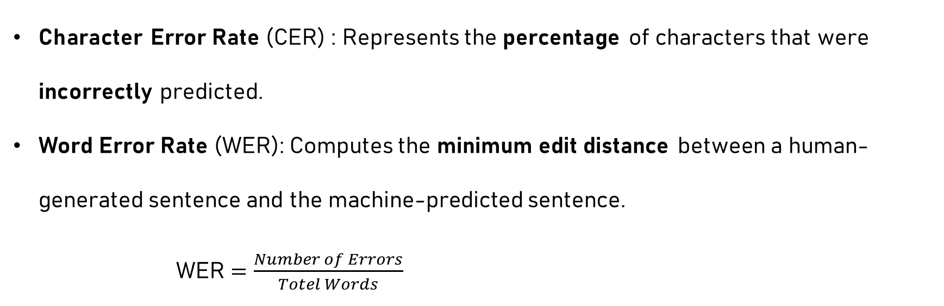
Evaluation Metrics
Character Error Rate (CER) : Represents the percentage of characters that were incorrectly predicted.
Word Error Rate (WER): Computes the minimum edit distance between a human-generated sentence and the machine-predicted sentence.
WER $=\frac{Number of Errors}{Totel Words}$

Slide 7
Thank you!

