Slide 1

An Ensemble Deep Learning Approach for Leukemia Stage Classification from Microscopic Blood Cell Images
Mir Siam
213–15–4438
Farkulid Araf
213-15-4434
Department of CSE
Daffodil International University
Ms. Umme Ayman
Senior Lecturer
Department Of CSE
Daffodil International University

Slide 2

Outline
Introduction
Objective
Background Study
Gap Analysis
Methodology
Results & Analysis
Novelty of the Work
Conclusion
References

Slide 3
Introduction
Leukemia is a fast-progressing blood cancer where early and accurate detection is crucial for effective treatment. Traditional microscopic diagnosis is time-consuming and often prone to human error due to subtle visual similarities between cell stages. This project proposes an ensemble deep learning approach to automate leukemia stage classification, improving diagnostic accuracy, speed, and clinical reliability.

Slide 4
Objective
Develop an ensemble CNN model for leukemia stage classification.
Improve data quality through preprocessing and augmentation.
Handle class imbalance for stable model training.
Enhance interpretability using saliency-based visualization.
Evaluate performance against baseline CNN models.

Slide 5
Background Study
Leukemia detection from PBS images is complex and expert-dependent.
Deep learning improves diagnosis but needs large, balanced datasets.
Image variations and noise require strong preprocessing and augmentation.
Single CNN models often fail to generalize across all leukemia stages.
Clinically reliable AI needs interpretable, explainable model outputs.

Slide 6
Gap Analysis
Gap Identified | Studies Showing the Gap | How this Study Addresses the Gap
1. Lack of feature reduction despite large, fused feature sets | Abdul Karim et al. [1], Ghada Atteia et al. [3], Paswan & Rathore [5] | Uses PCA to remove redundancy and produce compact feature sets.
2. Heavy reliance on deep models with high computational cost | i-Net [4], CNN-based works [6,13,14] | Uses lightweight feature extraction + efficient ML classifiers for faster, low-cost deployment.
3. Limited generalization due to curated datasets & inconsistent preprocessing | Abdul Karim et al. [1], Atteia et al. [3], Ghaderzadeh et al. [6] | Applies a unified preprocessing pipeline to improve consistency and robustness.
4. XAI used mainly for visualization, not integrated into workflow | Achir et al. [14], Ghaderzadeh et al. review [6] | Integrates Grad-CAM into the evaluation to validate and explain predictions.
5. Lack of real-world deployment and mobile-ready systems | Observed across multiple studies; i-Net [4] notes limited practical deployment | Builds a mobile-ready system enabling real-time prediction with explainability.

Slide 7
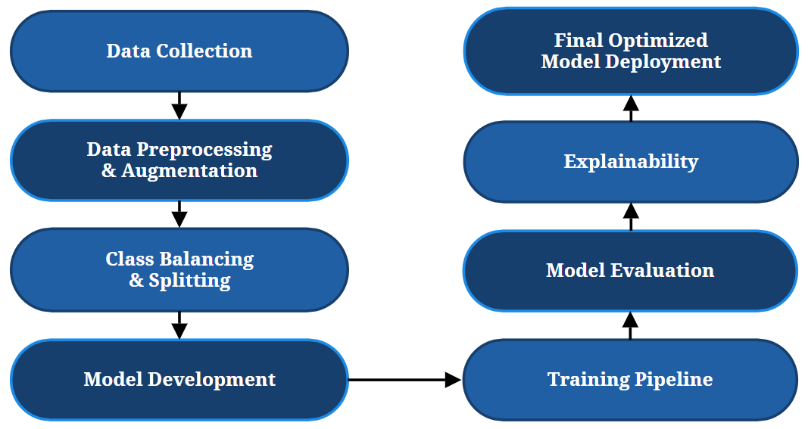
Methodology

Slide 8
Results and Analysis
Parameter Name | Parameter Value
Image Size | 224 x 224
Batch Size | Balanced
Optimizer | Adam
Learning Rate | 0.001
Dataset | In Percentage
Train set | 70%
Validation Set | 15%
Test Set | 15%
Models | Validation Accuracy | Test Accuracy
MobileNetV3 (Best Baseline) | 94.62% | 93.20%
ResNet18 | 97.10% | 96.26%
VGG16 | 97.30% | 96.60%
Ensemble (ResNet18+VGG16) | 98.64% | 99.49%

Slide 9
Novelty of the Work
Hybrid ensemble model surpasses single CNNs.
Strong preprocessing and augmentation tailored to PBS images.
Built-in explainability using saliency visualization.
High accuracy achieved despite limited, imbalanced data.

Slide 10
Conclusion
The proposed ensemble deep learning model successfully classifies four leukemia stages with high accuracy and strong generalization. Rigorous preprocessing, balanced training, and explainable visualization improved both performance and clinical reliability. Overall, the system demonstrates a practical, robust, and interpretable AI solution for leukemia stage detection from PBS images.

Slide 11
References
[1] A. Karim, A. Azhari, M. Shahroz, S. Brahim Belhaouri, and K. Mustofa, “Ldsvm: Leukemia cancer classification using machine learning,” 2022.
[2] K. Barua and P. Chakrabarti, “Detection and classification for blood cancer–a survey,” International Journal of Computer Trends and Tech nology, vol. 36, no. 2, pp. 65–70, 2024.
[3] G. Atteia, R. Alnashwan, and M. Hassan, “Hybrid feature-learning-based pso-pca feature engineering approach for blood cancer classification,” Diagnostics, vol. 13, no. 16, p. 2672, 2023.
[4] A. V. Ikechukwu and S. Murali, “i-net: a deep cnn model for white blood cancer segmentation and classification,” International Journal of Advanced Technology and Engineering Exploration, vol. 9, no. 95, pp. 1448–1464, 2022.
[5] S. Paswan and Y. K. Rathore, “Detection and classification of blood cancer from microscopic cell images using svm knn and nn classifier,” Int. J. Adv. Res. Ideas Innov. Technol, vol. 3, pp. 315–324, 2022.

Slide 12
THANK YOU

