Slide 1
Adaptable benchmarks for register blocked sparse matrix-vector multiplication
Berkeley Benchmarking and Optimization group (BeBOP)
Hormozd Gahvari and Mark Hoemmen
Based on research of:
  Eun-Jin Im
  Rich Vuduc

Slide 2
Outline
Sparse matrix-vector multiplication
(Optimized) sparse data structures
Current benchmarks and ours

Slide 3
Sparse matrix-vector multiplication (SpMV)
“Stream” through nonzero A(i,j)
  Do y(i) += A(i,j) * x(j)
SpMV expenses:
  Limited data reuse
  Index lookups / computations
  Already low FP/memory balance
Performance < 10% peak
  DGEMV: 10-30%

Slide 4
Sparse formats for SpMV
Many!
  SPARSKIT: supports 13
No “best,” but for SpMV:
Compressed Sparse Row (/Column)
  Modern cache-based processors
Others:
  Ellpack/Itpack, Jagged Diagonal (JAD)
    Vector machines

Slide 5
Compressed Sparse Row (CSR)
Two integers:
  M: number of rows
  NNZ: number of nonzero elements
Three arrays:
  int row_start[M+1];
  int col_idx[NNZ];
  double values[NNZ];

Slide 6
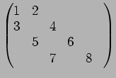
CSR example
(M,N)=(4,5)
NNZ = 8
row_start:
  (0,2,4,6,7)
col_idx:
  (0,1,0,2,1,3,2,4)
values:
  (1,2,3,4,5,6,7,8)

Slide 7
CSR SpMV
for (i = 0; i < M; i++)
for (j = row_start[i];
j < row_start[i+1]; j++)
{
y[i] += values[j] * x[col_idx[j]];
}

Slide 8
CSR advantages
Sequential accesses
Precomputed indices
Index reuse (row_start)
Destination vector reuse (y(i))
Popular
  PETSc, SPARSKIT
  Variants (AZTEC: MSR)

Slide 9
CSR disadvantages
Indirect indexing: x[col_idx[j]]
Locality suffers
Ignores dense substructures!
  BLAS 2/3: dense ==> reuse
  (Reordered) FEM matrices:
    Small dense blocks
    2x2, 3x3, 6x6

Slide 10
Register block optimization: BCSR
Each nonzero “elem”:
  Now: block of nonzeros (“Register block”)
  Contiguous in values[]
  Indices point to block starts
“Loop unrolled” SpMV
  Source vector (x) reuse
  Exploit specialized FP hardware

Slide 11
BCSR SpMV: 2 x 3
for (i = 0; i < M; i++, y += 2)
{
y0 = y[0]; y1 = y[1];
for (j = row_start[i]; j < row_start[i+1];
j++, val += 6)
{
k = col_idx[j];
x0 = x[k]; x1 = x[k+1]; x2 = x[k+2];
y0 += val[0]*x0; y1 += val[3]*x0;
y0 += val[1]*x1; y1 += val[4]*x1;
y0 += val[2]*x2; y1 += val[5]*x2;
}
y[0] = y0; y[1] = y1;
}

Slide 12
BCSR pays off
At best 31% peak, 4 x speedup
Nearing (dense) DGEMV
Large payoff + repeated SpMV ==>
  overcomes CSR->BCSR conversion costs

Slide 13
SpMV benchmarks:
Three strategies
“Simulation” with simpler ops
Analytic bounds
Do SpMV, with:
  “Real-life” matrices
  Generated test problems

Slide 14
1) Simulations of SpMV
STREAM http://www.streambench.org/
  Triad: a[i] = b[i] + s*c[i]
  Dense level-1 BLAS DAXPY
  No discerning power
    e.g. Next slide
Indirect indexed variants
  x[col_idx[j]] simulation
  Still not predictive

Slide 15
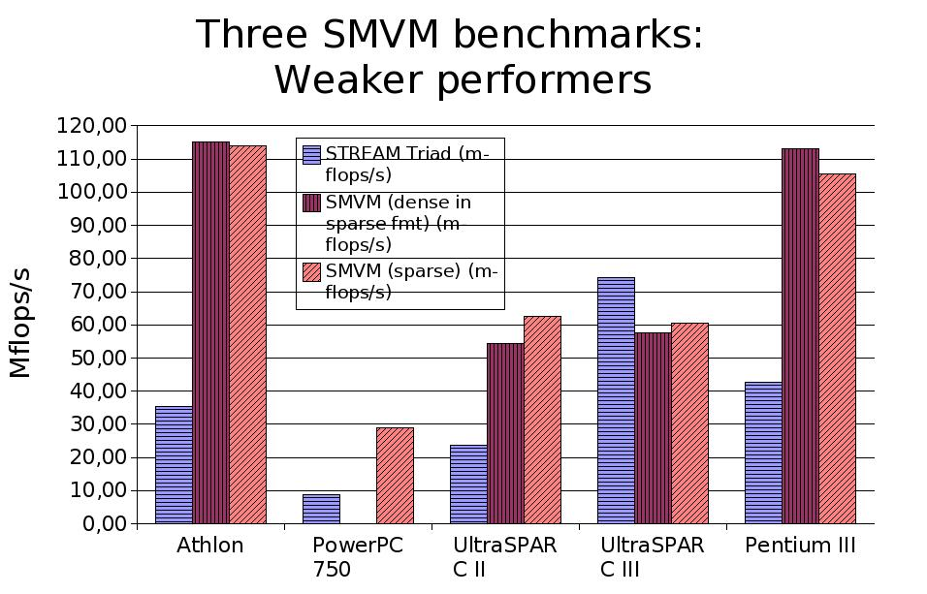

Slide 16
Dense in sparse (CSR) format
Heuristic in Sparsity system
Helpful for larger register blocks
1x1: no good

Slide 17
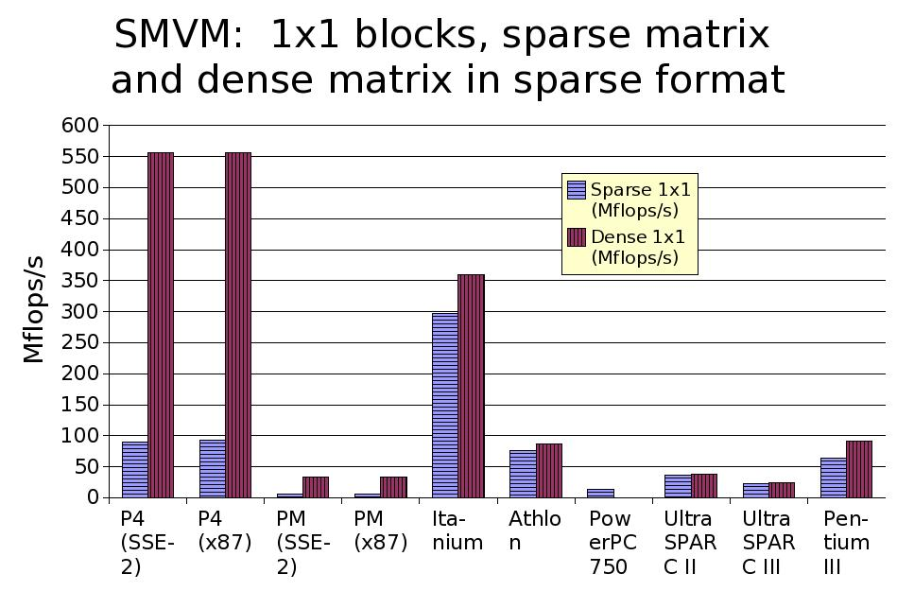

Slide 18
2) Analytic bounds and correlates
“Machine balance”
  Peak FP / sustainable main memory bandwidth
  as -> 2: SpMV, DGEMV -> peak
Actual SpMV: Usually w/in 75% of DGEMV; correlates to balance
  Exception: UltraSparc 3
    ==> need actual SpMV benchmark

Slide 19
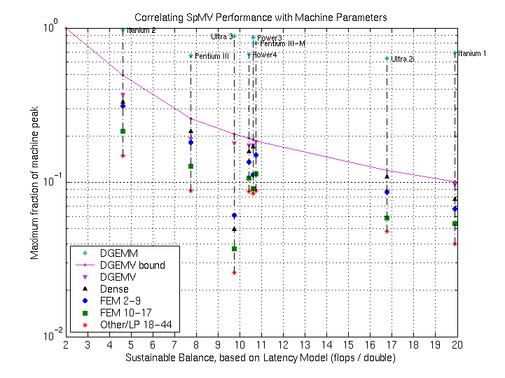

Slide 20
3) CSR SpMV as benchmark
Regular CSR “unfair”
  FEM frequent case
  Analogy: tuned BLAS ==> Matlab v. 6 dropped “flop/s”: So drop CSR!
BCSR makes processors competitive
  Pentium M vs. Pentium 4 vs. Athlon:
    1x1: P4 >> Athlon > PM
    Optimal blocks: P4 = 2 x PM = 4 x Athlon

Slide 22
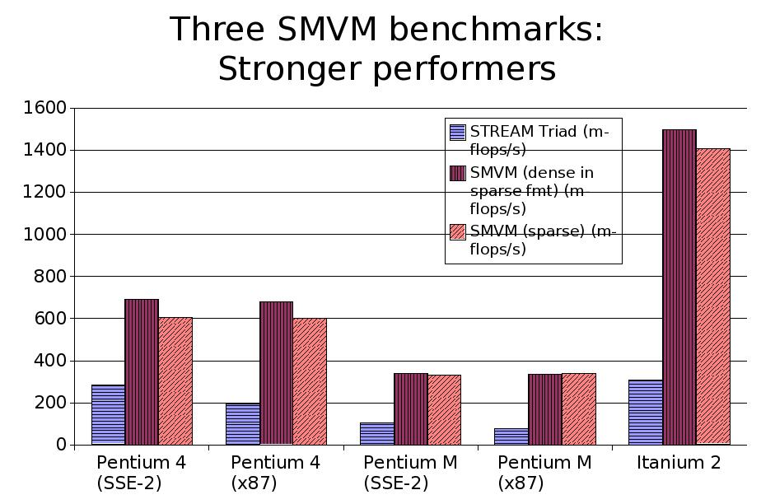

Slide 24
Standard CSR SpMV benchmarks
Examples:
  NAS-CG
  SparseBench
  SciMark 2.0 (see next slide – reflects 1x1)
No BCSR
CG/GMRES: heterogeneous ops
Fixed problem sizes, structure

Slide 26
3a) “Real-life” matrices
Storage cost
  Spark98:
    10 matrices
    28 MB compressed, 70 MB uncompressed
  Mark Adams' FEM
    1 problem: 60+MB compressed!
  big ==> fewer examples possible
Too specific
  “Average matrix”???
  Need different block sizes

Slide 27
3a) “Real-life” matrices (con't)
Fixed benchmark size
  Caches grow!
  Sparsity tuning
    “matrix out of cache”
Why not “stretch”?
  Changes x[col_idx[j]] stride
  “Shrinking” harder
    Future: less memory per node (BlueGene)

Slide 28
3b) Our strategy:
Dynamic generation
Randomly scattered blocks
  bandwidth option
All block dimensions in {1,2,3,4,6,8,12}²
Guaranteed fill
  runtime parameter

Slide 29
Benchmark output
Mflop/s for: 1x1, worst, median, best, common block sizes
Application-specific performance estimates
1x1 frequent: e.g. linear programming

Slide 30
Data set size selection
Sparsity: vectors in cache, matrix out
  ==> Choose M, NNZ
Pluses:
  Problems grow with processors
  “Fair”
Minuses:
  “Cache”: off-chip? huge?
  Fill (NNZ / M²) non-constant
    x locality
  No cache? (vector machines)
Now: memory bound only

Slide 31
Evaluation: Test matrix suite
44 matrices from R. Vuduc's thesis
1: Dense in sparse format
2-17: FEM
  2-9: Regular blocks (fills .044-.39%)
  10-17: Irregular (fills .087-.40%)
18-44: “non-FEM”
  18-39: Assorted
  40-44: Linear programming (.021-.12%)
Scale by test matrix “fill ratio”
  (block storage efficiency)

Slide 32
Itanium 2 prediction

Slide 33
UltraSparc 3 prediction

Slide 34
Benchmark tuning options
Diagonal bandwidth
Fill (NNZ / M²)
Nonzero distribution: random seed
Adjust for target application
Sensitivity underexplored

Slide 35
Plans
As component of shared-, distributed-memory parallel SpMV benchmarks
Incorporation into High-Performance Computing Challenge benchmark suite

Slide 36
Thanks! (1 of 2)
BeBOP leaders:
  Profs. James Demmel and Katherine Yelick
Sparsity SpMV code, assistance:
  Eun-Jin Im, Rich Vuduc
Other code contributions:
  Rajesh Nishtala

Slide 37
Thanks! (2 of 2)
Computing resources:
  Argonne National Lab
  Intel
  National Energy Research Scientific Computing Center
  Tyler Berry (tyler@arete.cc)
  Felipe Gasper (fgasper@fgmusic.org)

Slide 38
Resources
BeBOP:
  http://bebop.cs.berkeley.edu/
HPCC benchmarks:
  http://icl.cs.utk.edu/hpcc/index.html
Me:
  http://mhoemmen.arete.cc/

