Slide 1
Knee MRI Bone Segmentation Using Machine Learning Model
By Reem AlRowaili, Mingming Qiu
CS 631T Computer Vision Final Project
Seidenberg School of CSIS
Pace University

Slide 2
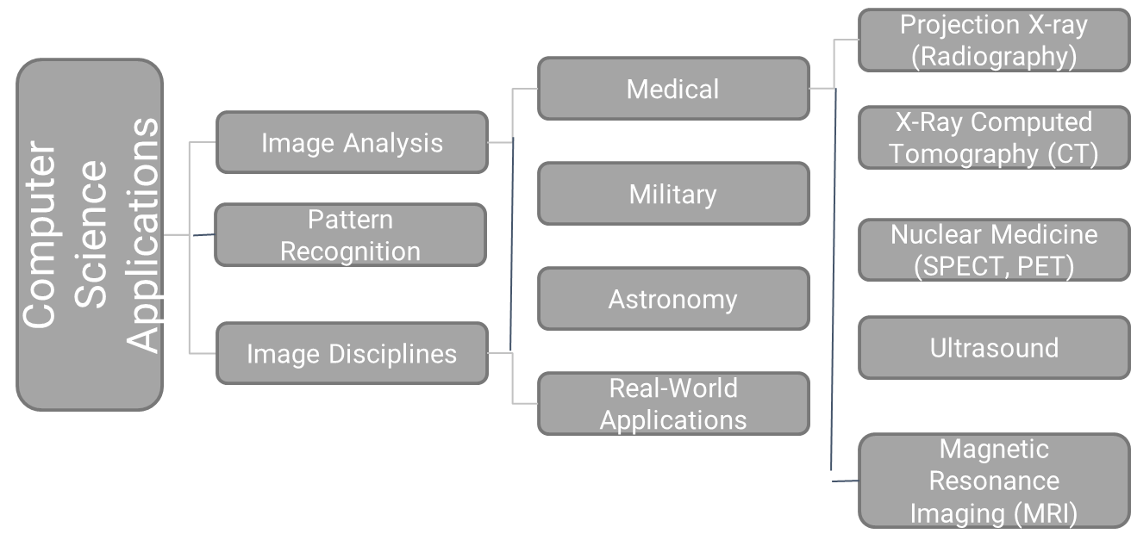
Introduction

Slide 3
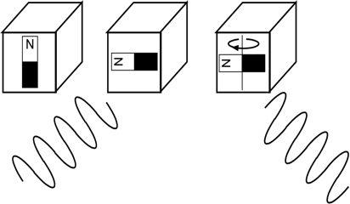
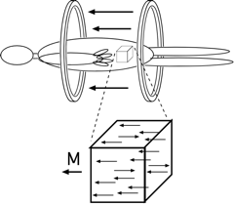
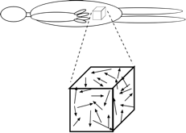


Magnetic Resonance Imaging
•Atomic nuclei and hydrogen nuclei, ¹H, in particular, have a magnetic moment
–Moments tend to become aligned to applied field
–Creates magnetization, m(x,y,z) (a tissue property)
•MRI makes images of m(x,y,z)
RF Excitation
(Energy into tissue)
Magnetic fields
are emitted
•The magnetization is excited into an observable state
Magnetization emits energy at a resonant frequency

Slide 4
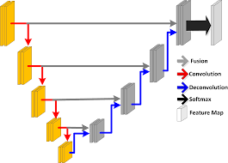
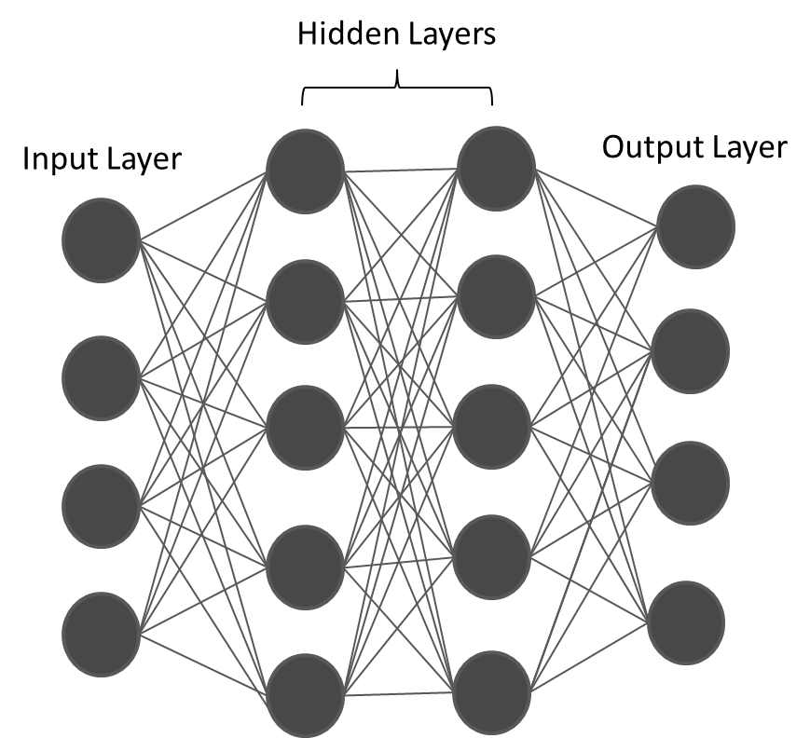
Methodology
Image acquisition
Pre-Processing
Feature Extraction
Feature output

Slide 5
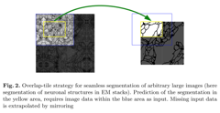
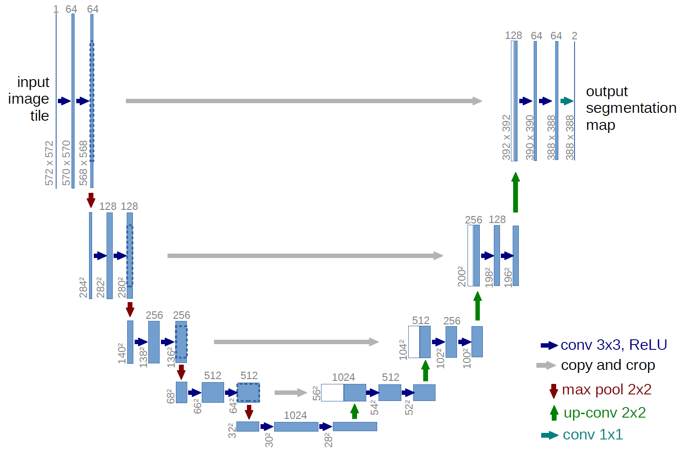

U-Net Model
•Current state of the art
–Very popular in MICCAI 2016
–Works well with low data
•Influenced by the previous
–Up-conv 2x2 = bilinear up-sampling then 2x2 convolution
–2D slices
–3x3 convolutions
Expansion
Construction
Sequence of up-convolutions and concatenation with high-resolution features from contracking path

Slide 6

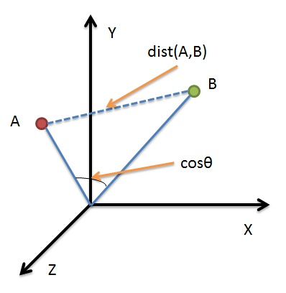

Popular Similarity Coefficients
Similarity metrics:
–Tanimoto coefficient
–value range: [0,1]
–Tc is also known as Jaccard coefficient
–Tc is the most popular similarity coefficient
–Dice coefficient
–Cosine coefficient
–value range: [0,1]
–correlated with the Tanimoto coefficient but not strictly monotonic with it

Slide 7
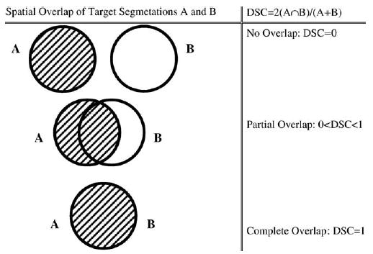
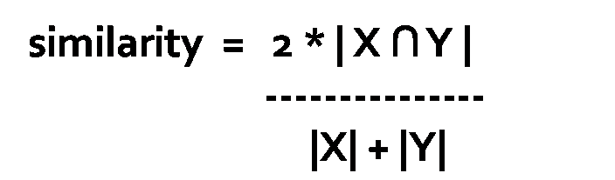
Dice Similarity Coefficient
A similarity measure is a function which computes the degree of similarity between a pair of objects.
–value range: [0,1]
–monotonic with the Tanimoto coefficient

Slide 8


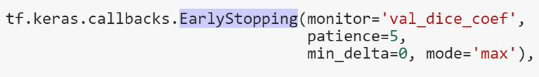
Experiments
10 cases experiment divided into:
Training: 7 cases
Validation: 2 cases
Testing: 1 cases
40 cases experiment divided into:
Training: 30 cases
Validation: 8 cases
Testing: 2 cases
Approximately 30 epochs

Slide 9
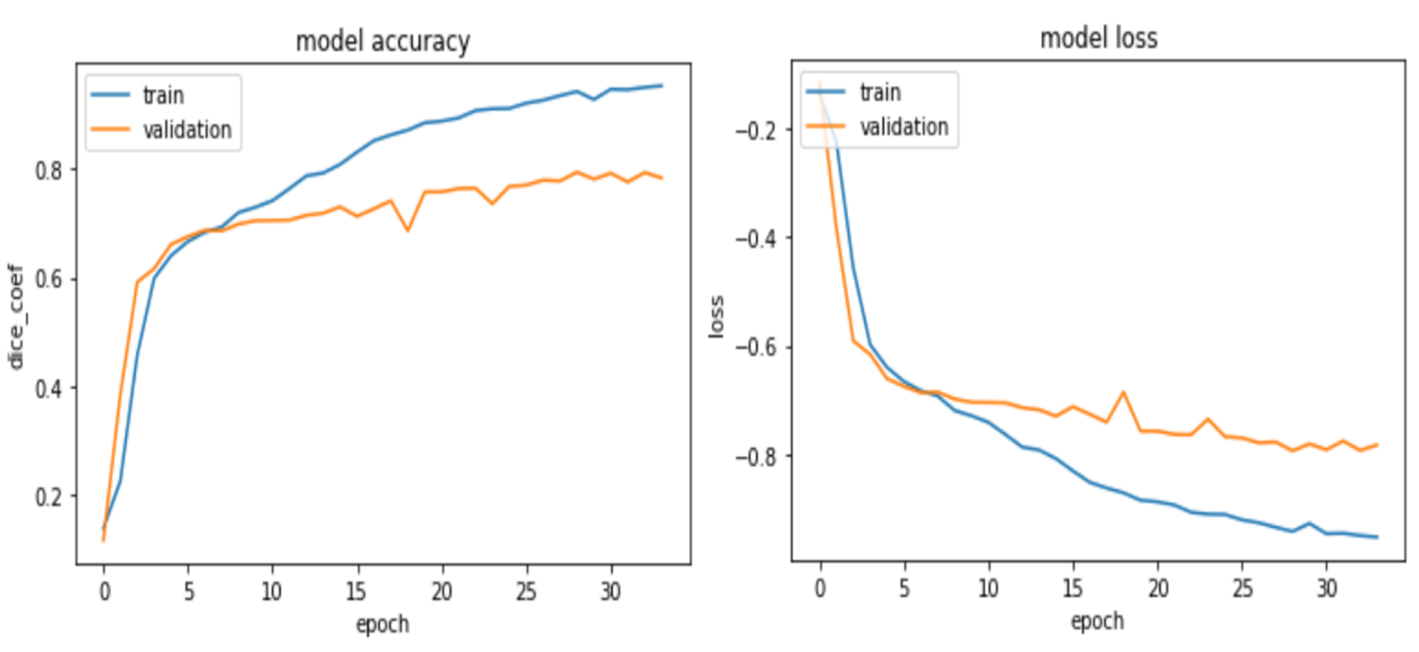
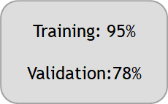
Results – First experiment

Slide 10
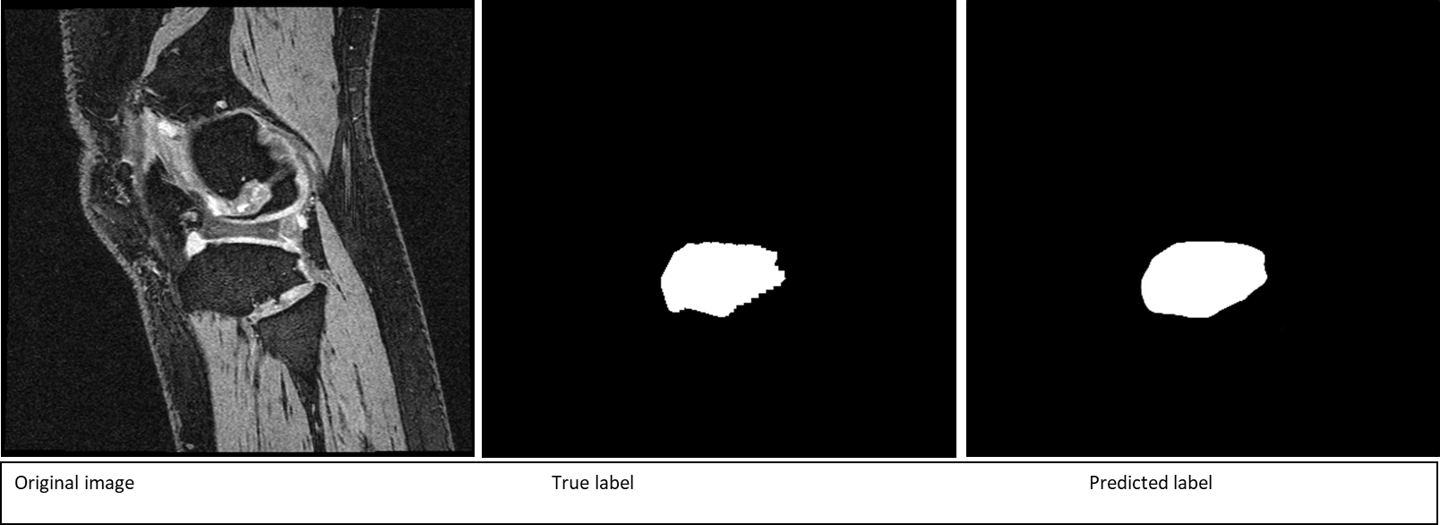
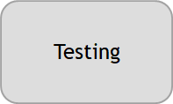
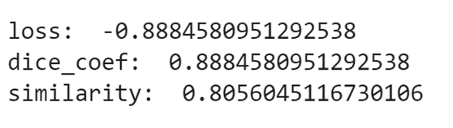
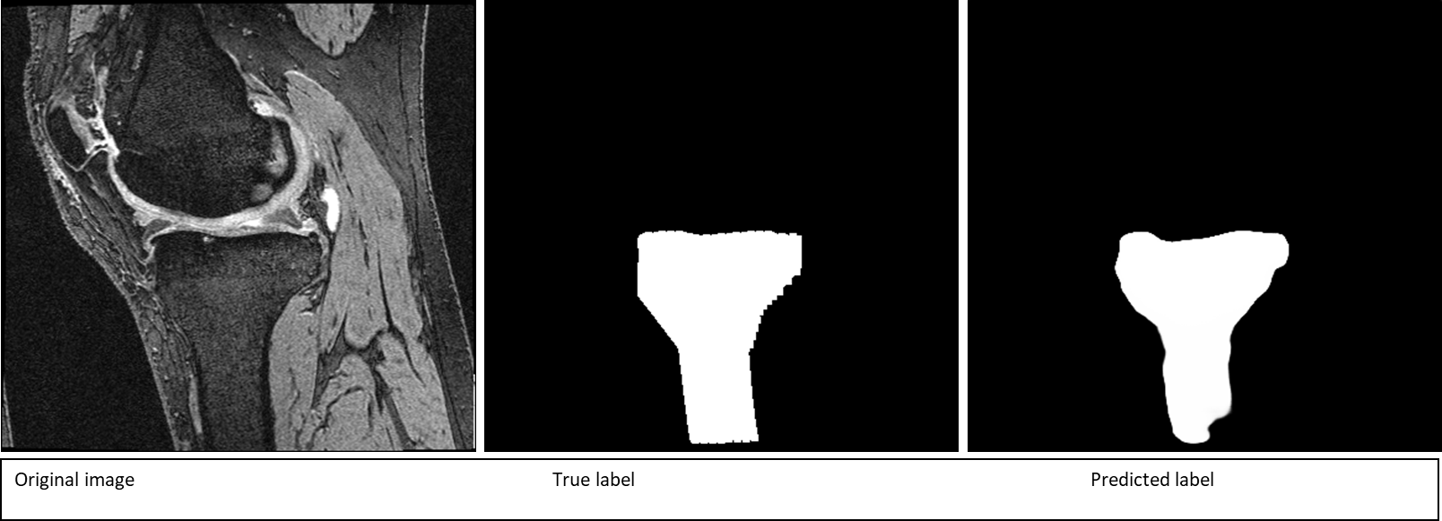
Results – First Experiment

Slide 11
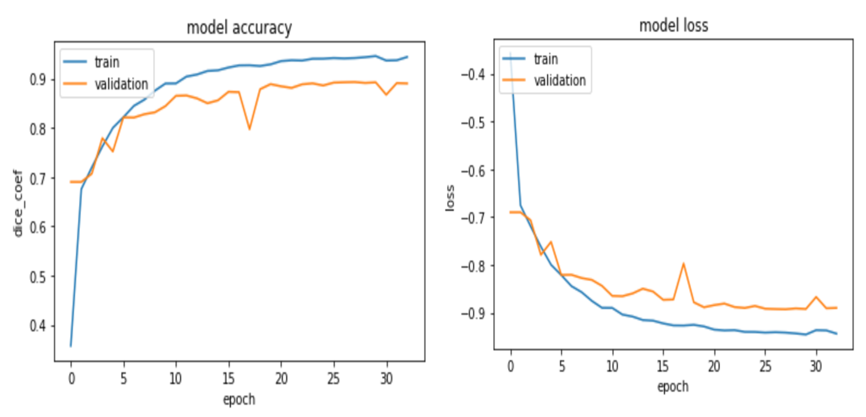
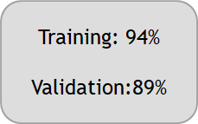
Results – Second Experiment

Slide 12

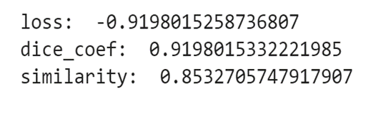
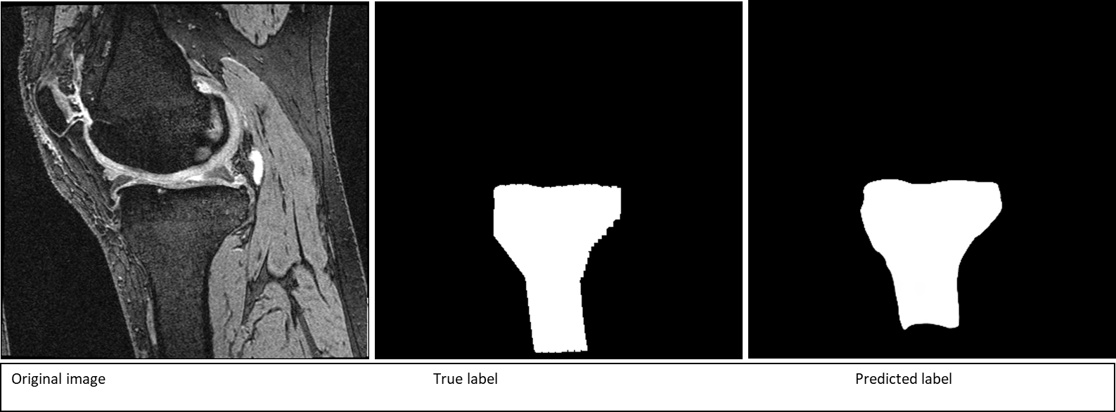
Results – Second Experiment

Slide 13
Results – Comparison
10 cases
40 cases

Slide 14
Conclusion
More Training data is needed to get more accurate prediction.
The convergence will happen faster if there are more data.
Suggestions
Getting more accurate labeling may enhance the accuracy of the prediction.
Enhancing the contrast of the original images could improve the accuracy.
Using other metrics for evaluations (cosine coefficient) might give better evaluation.

Slide 15



