Slide 1
Github - DesignHub
Team 4 – Matthew Tice, Mateo Terselich, Agil Madinali, Mingming Qiu, Jessica Thomas, Cesar Santana, Zixian Yang

Slide 2
Log-in Information
link: https://github.com/aristehub
username/email: aristehub@gmail.com
password: cs691@Pace

Slide 3
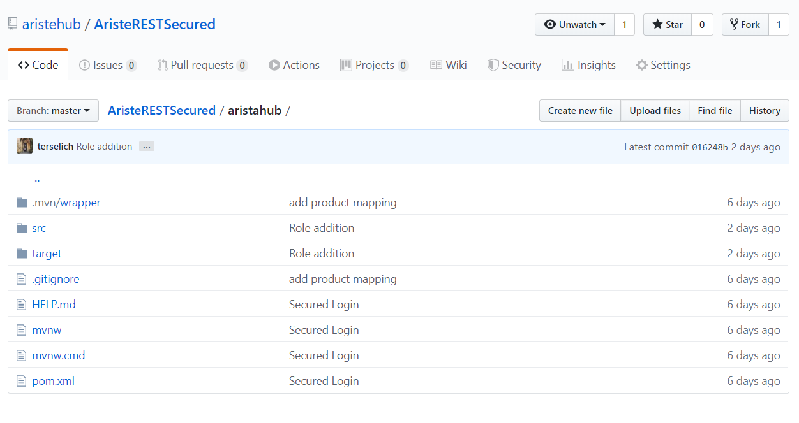
Repository Structure

Slide 4
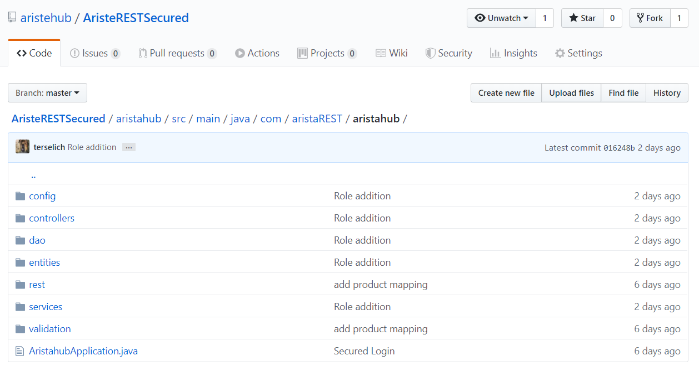
Repository Structure

Slide 5
Source Code for Application
TBA

