Slide 1
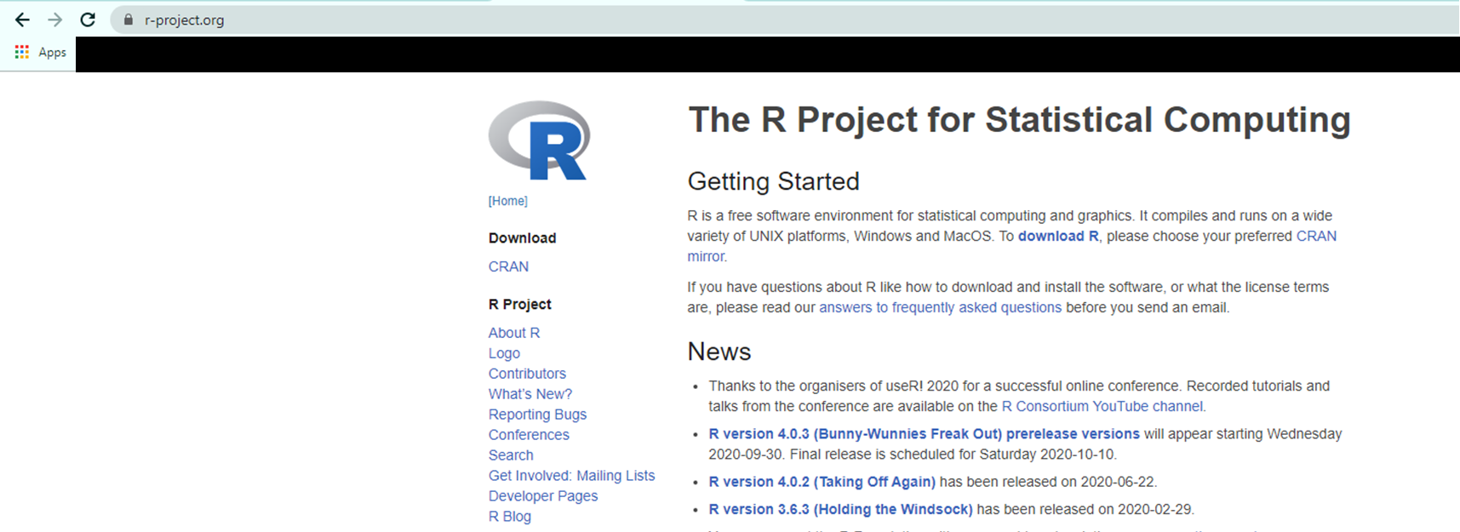
1. Install R
https://www.r-project.org
Install R 4.0.2

Slide 2
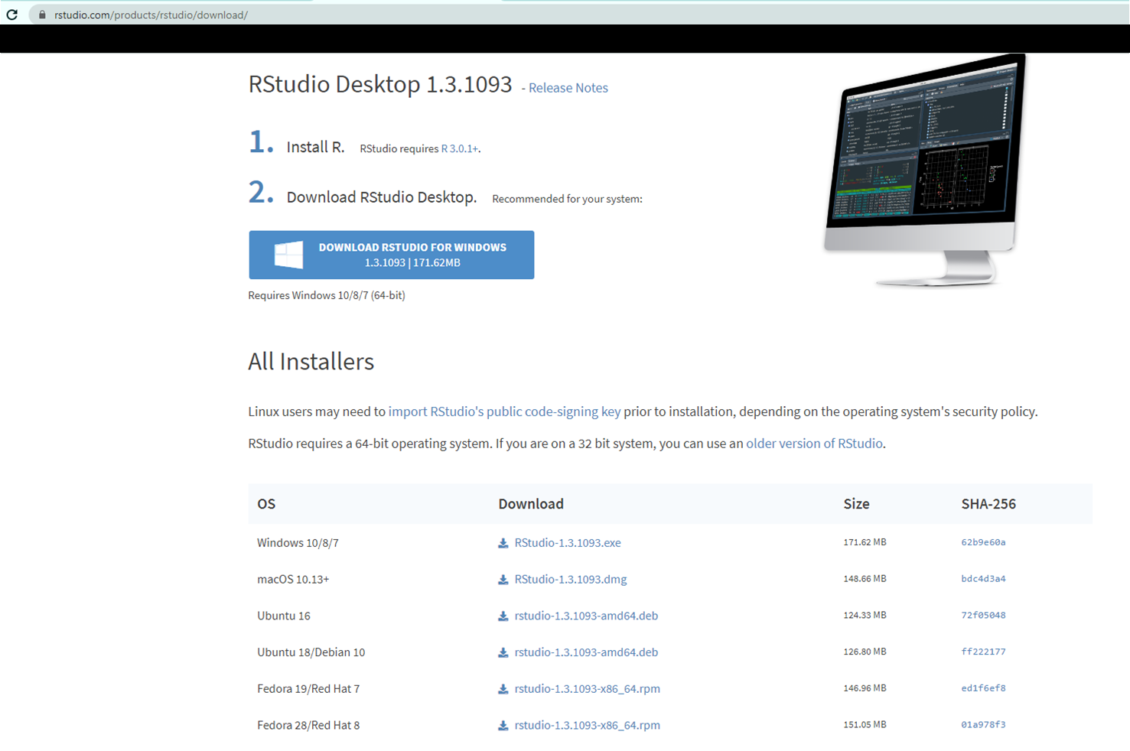
2. Install RStudio
https://rstudio.com/products/rstudio/download
Install Rstudio Desktop
Check out your OS

Slide 3
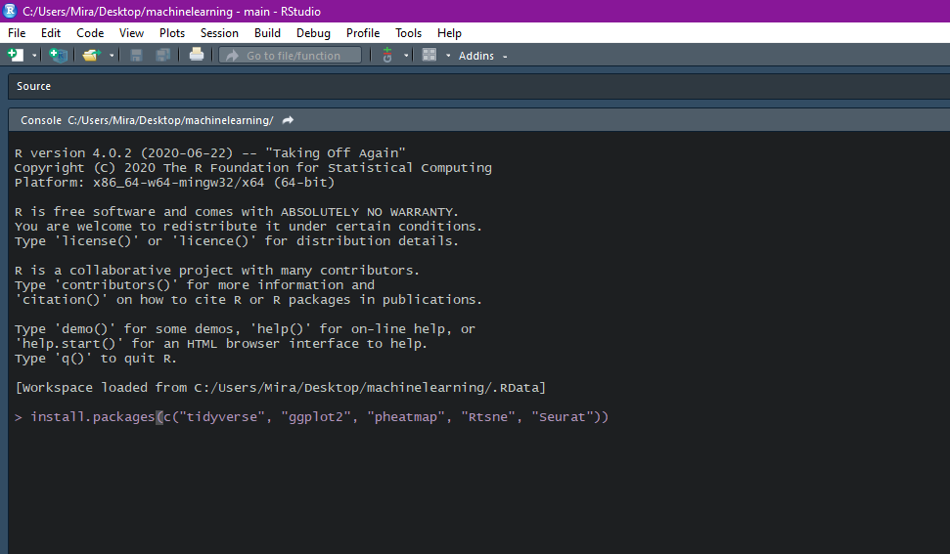
3. Install packages
install.packages(c("tidyverse", "ggplot2", "pheatmap", "Rtsne“, “Seurat”))

Slide 4
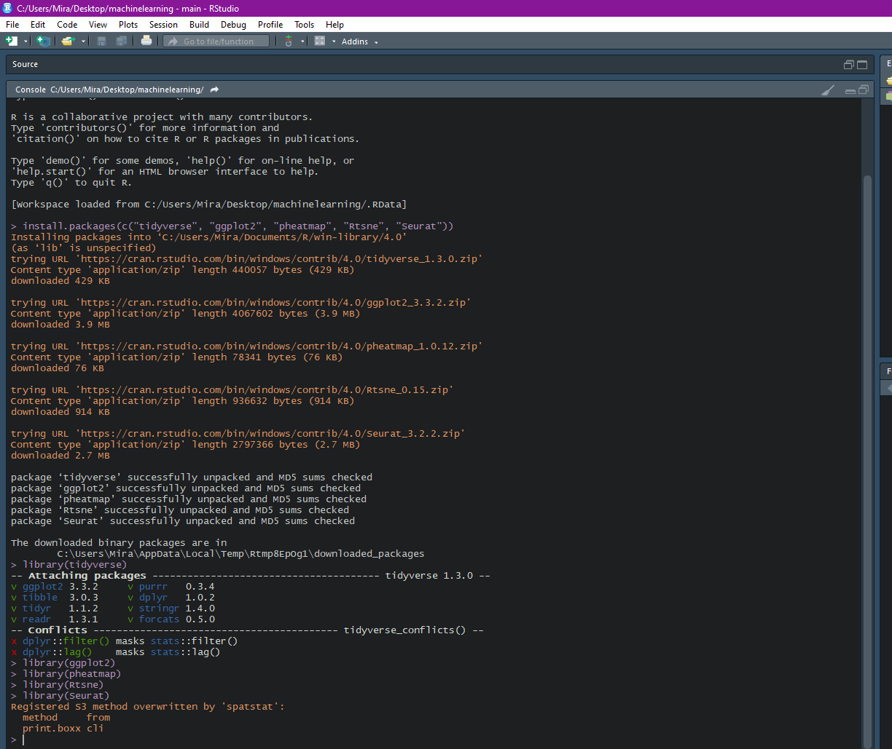
4. Test package loading:
library(packagename)
library(tidyverse)
library(ggplot2)
library(pheatmap)
library(Rtsne)
library(Seurat)

Slide 5
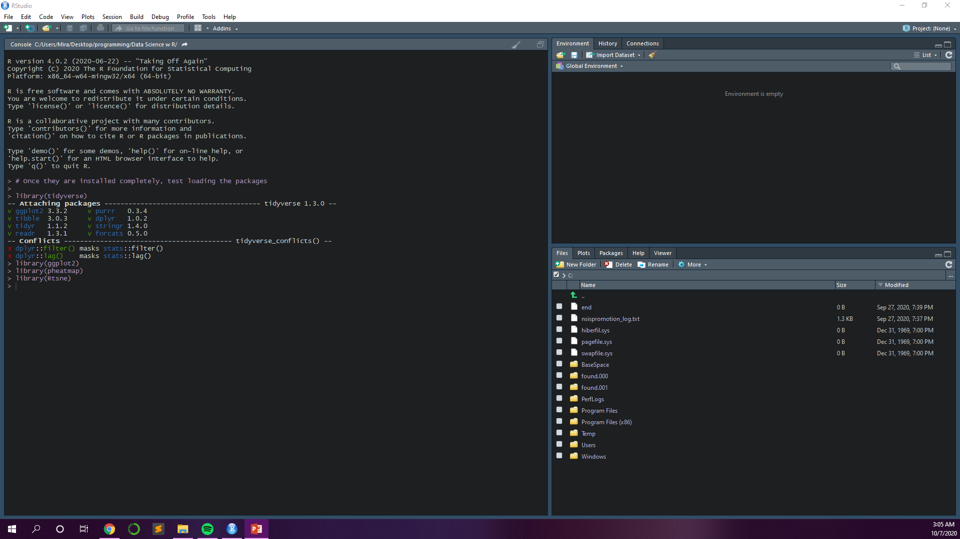
5. Set your working directory
Change your working directory

Slide 6
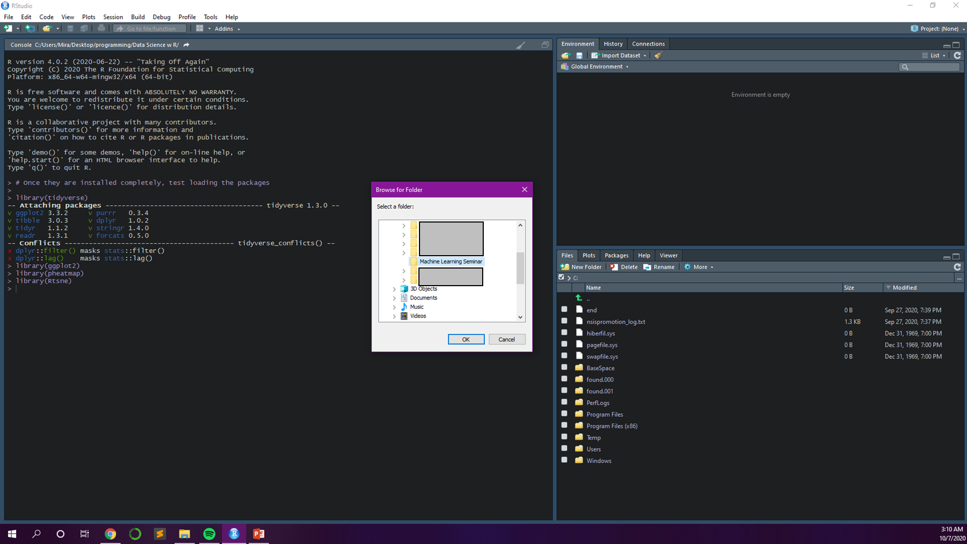
Choose your working directory in which raw data files are contained

Slide 7
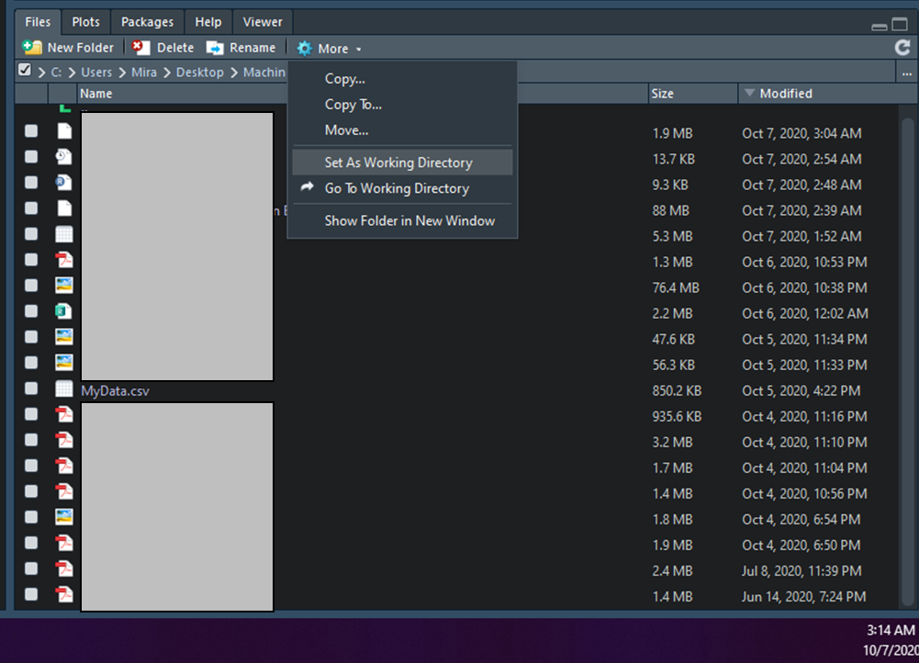
Complete directory setting
Your raw data

Slide 8
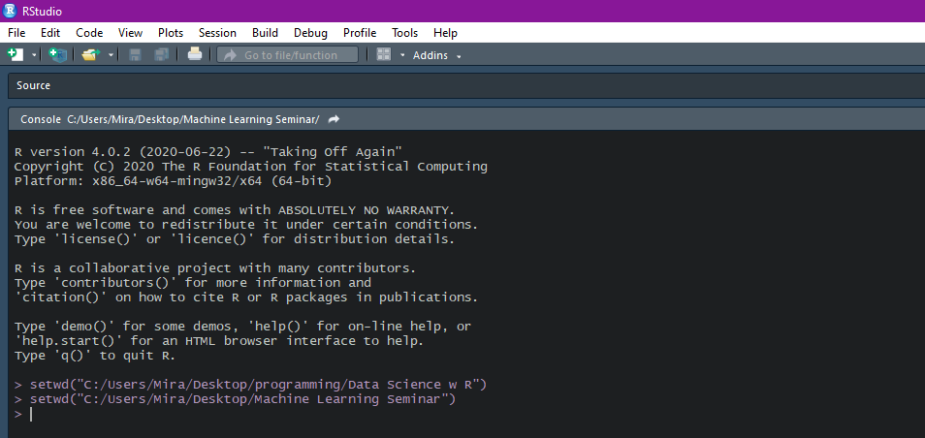
Check out this message

