Slide 1

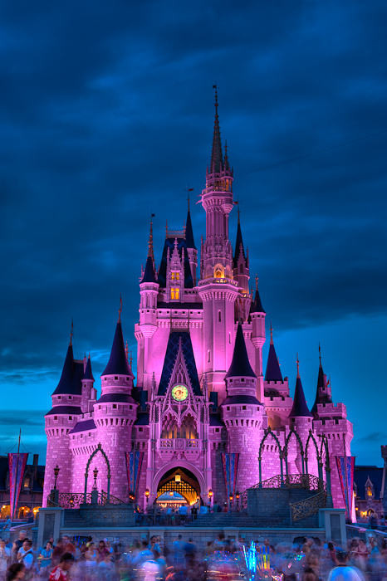
Disney+ and Machine Learning in the Streaming Age
GROUP – 2
Surya Saketh Akella
Mira Radhakrishnan
Pavithra Rajasekaran
Raghuraman Shankar
Yamini Veepuri
Jaswanth Yarlagadda

Slide 2

Agenda
Strategic goals
Machine Learning (ML) Use Cases to achieve strategic goals
Descriptive, Prescriptive and Predictive Analytics – Use Cases
Lessons from Netflix and other competitors
Data required to achieve ML goals
Potential data bias

Slide 3
Disney's strategic goals?
Subscriber acquisition and retention
Brand expansion
Integration with other business divisions
Revenue and profit growth:

Slide 4
SWOT Analysis
Strengths:
Strong brand recognition and reputation worldwide.
Vast content library and exclusive rights to certain franchises, such as Star Wars and Marvel.
Ability to leverage existing customer base and marketing channels.
Established relationships
Weaknesses:
Late entry into the market
High production costs associated with creating original content.
Limited experience in the video-on-demand industry.
Opportunities:
Increasing demand and growing global market for entertainment content.
Expansion of distribution channels through partnerships and collaborations. (Hotstar)
Integration of new technologies such as virtual reality and artificial intelligence.
Threats:
Intense competition from established players and new entrants.
Fluctuating consumer preferences and behavior.
Regulatory and legal challenges in some regions.
Economic downturns and recessions impacting disposable income of customers.

Slide 5
What machine learning use-cases would help Disney+ to achieve its goals?
Content recommendation: User’s viewing history, preferences, and behavior.
Customer service: Machine learning chatbot can provide 24/7 customer support to users.
Quality of service (QoS) optimization: Analyze streaming data, network conditions, and device capabilities to provide a seamless streaming experience.
Content categorization and tagging: To automatically categorize and tag its vast content library.
Ad targeting: Optimize advertising campaigns and increase ad revenue.
Predictive analytics: predict which shows and movies will be successful and which ones won't, based on factors such as user engagement and social media buzz.

Slide 6
Machine Learning Use-Cases based on SWOT Analysis
Strengths Brand Recognition: ML to create personalized recommendations, increasing brand loyalty. Exclusive Content: Predict which content performs well. Brand integration: incentivize theme park tickets to loyal subscribers. | Weaknesses New Entrant: ML can be used to create targeted marketing campaigns Limited Experience: Run ML on content produced by competitors and use data from external rating agencies like IMDB to produce successful content.
Opportunities Growing Market: Analyse market trends and take advantage of emerging content categories. International Expansion: Leverage ML to create localized content | Threats Competition: analyze competitor strategies and determine differentiating factors. Economic downturns: Determine dynamic pricing model that can offer subscriptions at subsidized rates and find ways to cut cost using ML.

Slide 7
Descriptive, prescriptive, and predictive analytics use cases.
Descriptive Analytics:
Primary objective - what has happened in the past
Data Analyzed - Viewing patterns of its users, how long users watched a particular program, and at what times of the day, how long customers stayed on the platform and which pages were visited more frequently.
Outcomes - Enhances the user experience and offer personalized recommendations.
Predictive Analytics:
Primary objective - Future events or trends based on historical data.
Data Analyzed - Customer behavior, likelihood of customer churn.
Outcomes - Forecast the likelihood of a particular event occurring.
Prescriptive Analytics:
Primary objective - Solutions to the business problems faced by Disney+ at Present.
Data Analyzed - User's viewing history.
Outcomes - Identify opportunities for cross-selling and upselling and increases user engagement.

Slide 8
What can we (and Disney+) learn from Netflix's use of Machine learning?
Netflix’s usage of ML:
Sense of personalization increases the time a user spends in Netflix.
Content creation.
Uses its own ML algorithms to recommend new content with a success rate of 80%
Determine expected hours of viewing for a piece of content
Heavy investment in R&D (10% of revenue)
Disney can also use the Machine learning algorithms in the similar way.

Slide 9
Data required for Disney+ to achieve its machine-learning goals?
Behavioral data – Analyzing user’s engagement on the platform.
Feedback data – Allow users to rate what they watched if they liked a particular movie
Demographic data – More personalization.
Streaming quality data – Collect streaming logs to improve user experience and minimize lags.

Slide 10
Potential Data Bias
Demographic Bias: The data used for training any algorithm must represent the population.
Sampling Bias: Any dataset for the purpose of training should always be sampled at random. This allows for the most accurate recommendations.
Historical Bias: Data used to make predictions should be free from any historical bias. Failing to do so would lead to inaccurate predictions and recommendations.

Slide 11
Recommendation – Prioritization Grid/ Scorecard
Use Case | Business Value | Complexity/Cost | Priority
Personalized Recommendations | High | Medium | 1
User Churn Prediction | High | High | 2
Content Curation & Tagging | Medium | High | 3
Dynamic Pricing | High | High | 4
Ad Targeting | Medium | High | 5
Fraud Detection | Medium | Medium | 6
Content Moderation | Low | High | 7

Slide 12

THANK YOU

