Slide 1
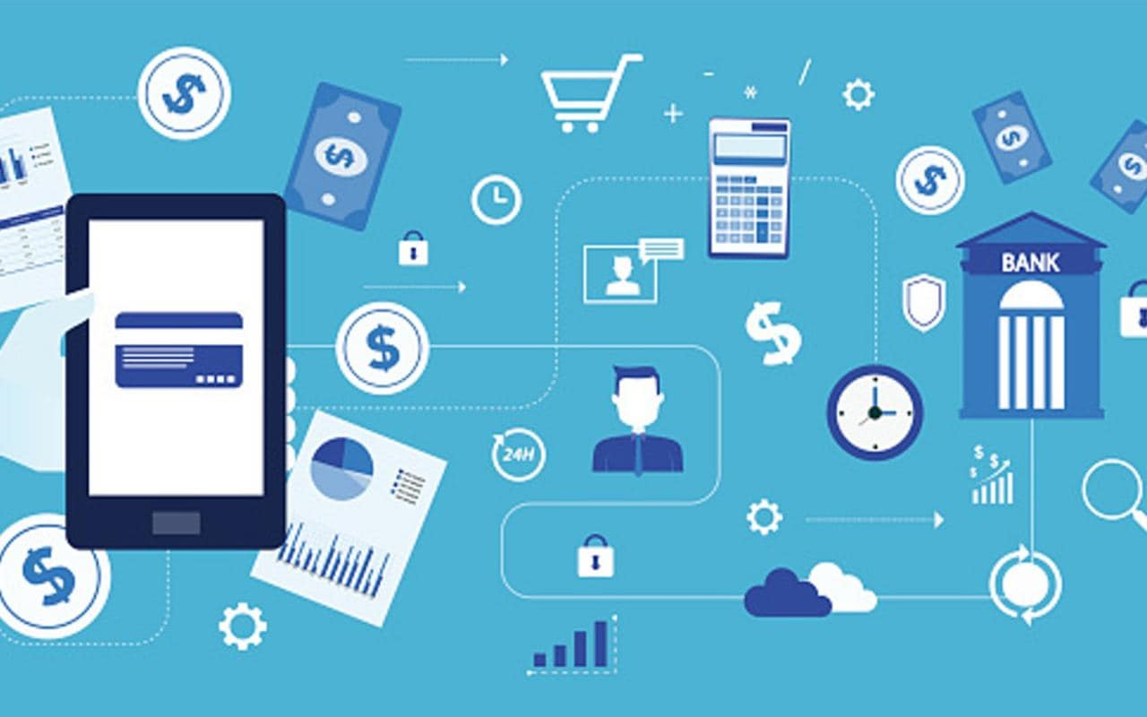
UNIFIED DATA ARCHITECTURE
GROUP 2
•Surya Saketh Akella
•Mira Radhakrishnan
•Pavithra Rajasekaran
•Raghuraman Shankar
•Yamini Veepuri
•Jaswanth Yarlagadda

Slide 2
AGENDA
Introduction
Current Challenges
Objectives
Proposed Solution
Benefits and Outcomes
Project Plan

Slide 3
Current challenges
Data duplication
Lack of data standardization and consistency
High maintenance cost
Inadaptable to changes
Varied data processing techniques
Inefficient data integration and representation of customer data
Data security
Inability to meet regulatory requirements

Slide 4
Objectives
A unified data analytics approach for internal and external teams
A single source of truth for data reporting and analysis
Facilitate data standardization across subsidiaries and divisions
Improve data security and scalability for acquiring and processing data
Cost optimization
Support batched and streaming data from various sources
Enable easy integration with downstream reporting and business systems
Accommodate future business growth and mergers/acquisitions

Slide 5
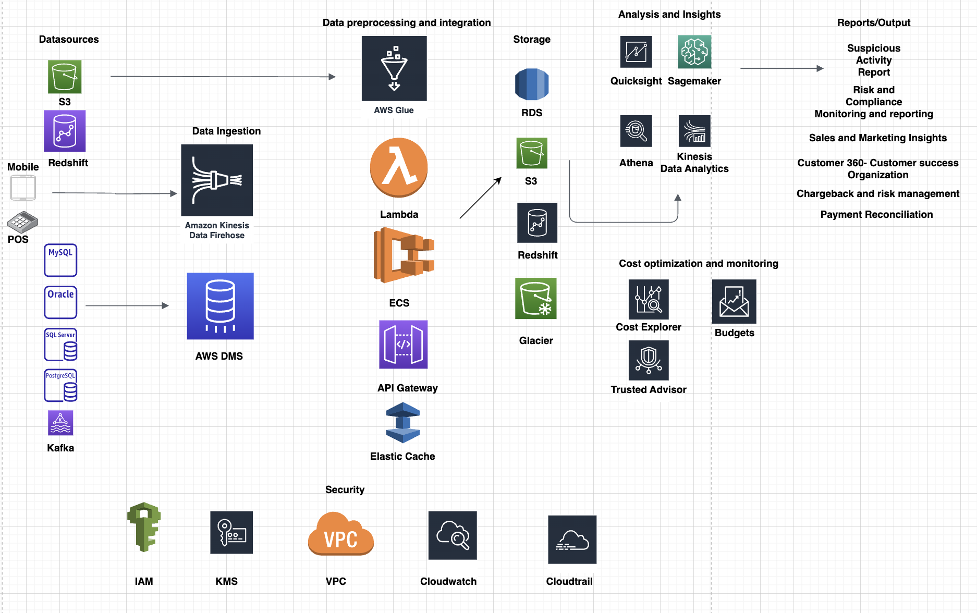
proposed solution

Slide 6
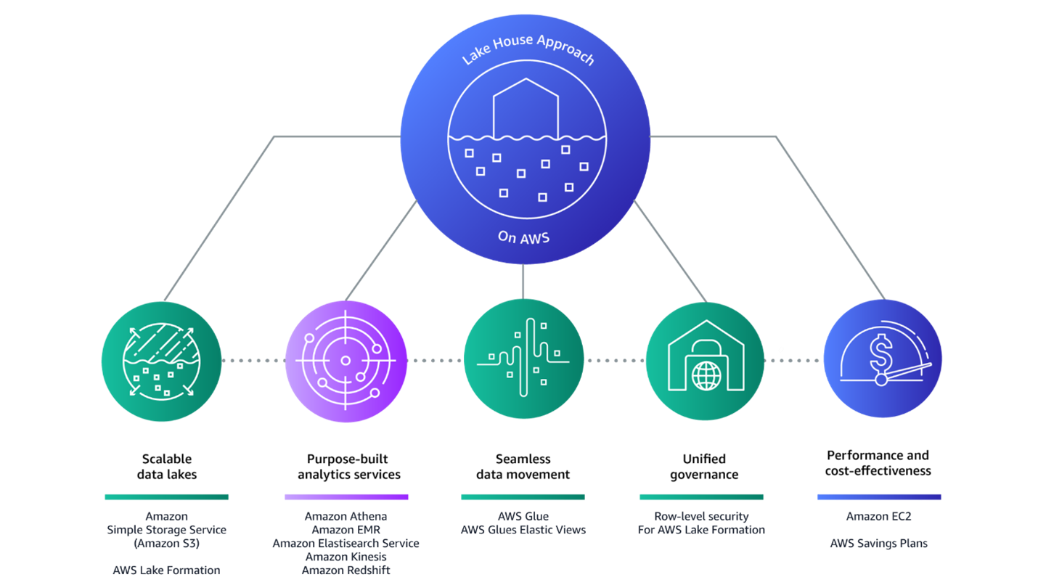
data access & Storage
Data lakehouse as a centralized data repository.
Amazon S3, AWS Redshift for scalable data storage and access.
AWS Identity and Access Management for compliance and security services.
Enable regulatory standards using PCI-DSS & HIPAA compliance certifications.
Implementation of CAP theorem principles using AWS services like Amazon S3, Glue, EC2, and Kinesis.

Slide 7
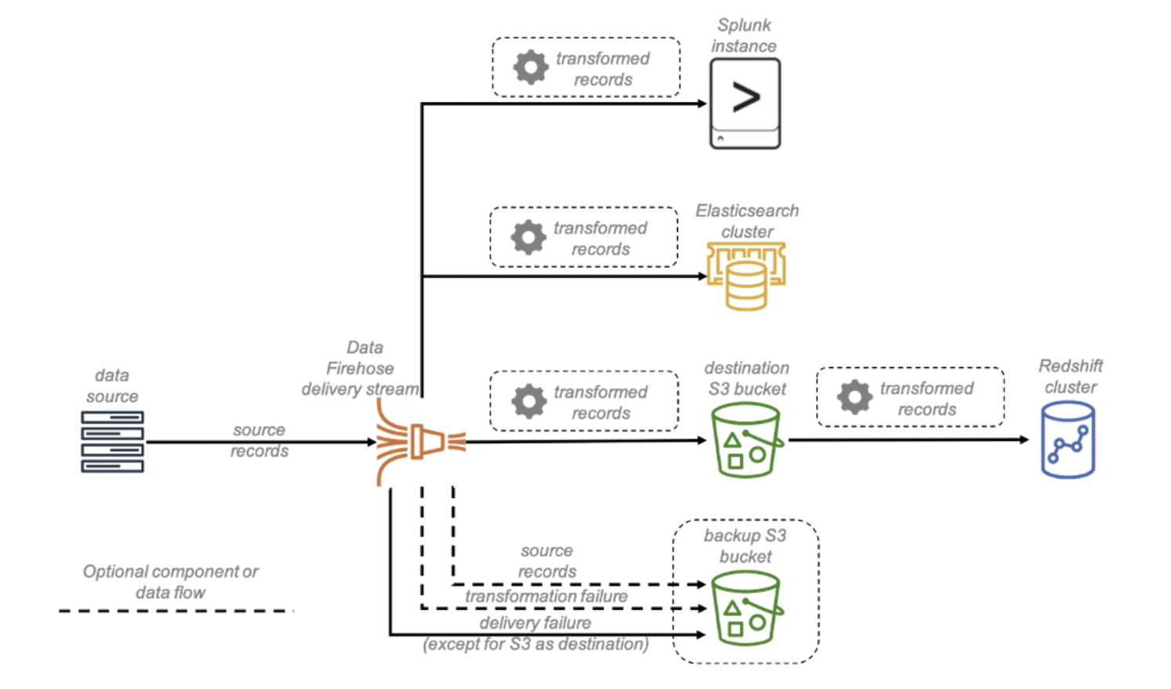
DATA ingestion & Extraction
Ingestion layer acts as an intermediary between the data sources and data lake.
ETL support for all forms of data.
AWS Kinesis data firehose for batch and streaming data.
AWS Data Migration Service for migrating on-premises data to cloud.
AWS Lambda for data preprocessing and analysis.

Slide 8


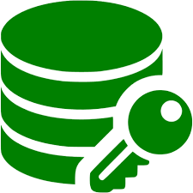

DATA SECURITY
Authentication and authorization
Data encryption
Network protection
Monitoring and logging

Slide 9
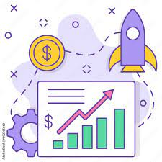
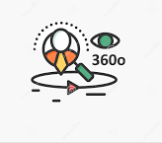


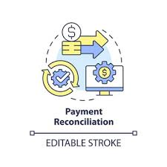
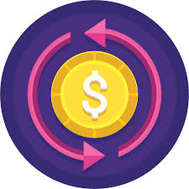

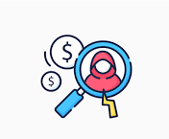
Optimal storage usecases
Risk and compliance
monitoring and reporting
Finance
Sales/Marketing Insights
Customer 360
Fraud detection & prevention
Payment Reconciliation
Chargeback management
Payment Gateway Optimization

Slide 10
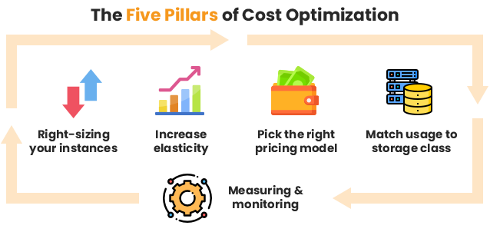
COST OPTIMIZATION
Start with a cost optimization plan
Implement Data life-cycle management
Data compression, sharding and partitioning
Use cost optimization tools
Use spot instances

Slide 11
Project plan
Project initiation and scoping
Data analysis and requirements gathering
Design and architecture
Infrastructure setup and deployment
Data ingestion and extraction implementation
Data integration implementation
Security implementation
Storage optimization and cost-efficiency implementation
Performance and scalability testing
User acceptance testing
Production deployment and ongoing maintenance

Slide 12
RISKS
Latency and network issues
Dependence on third-party vendors
Vendor lock-in
Cost management

Slide 13
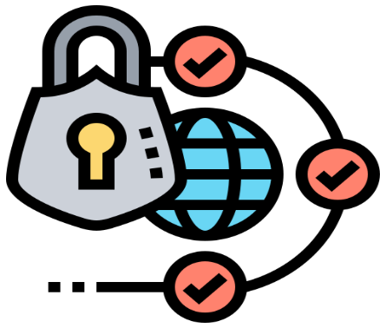

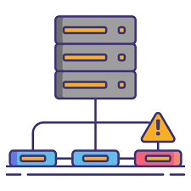
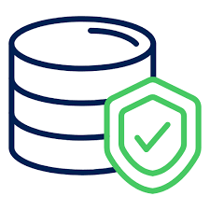
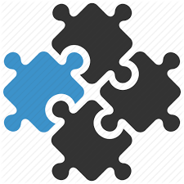
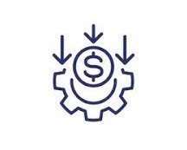

Benefits & Outcomes
Data Security
Data Security
Scalability
Fault tolerance
Transparency
Seamless Integration
Cost efficiency

Slide 14
