Slide 1
Homogenization & Semantics – End-to-End Data Transformation
From Raw JSON to Digital Twin Mapping

Slide 2
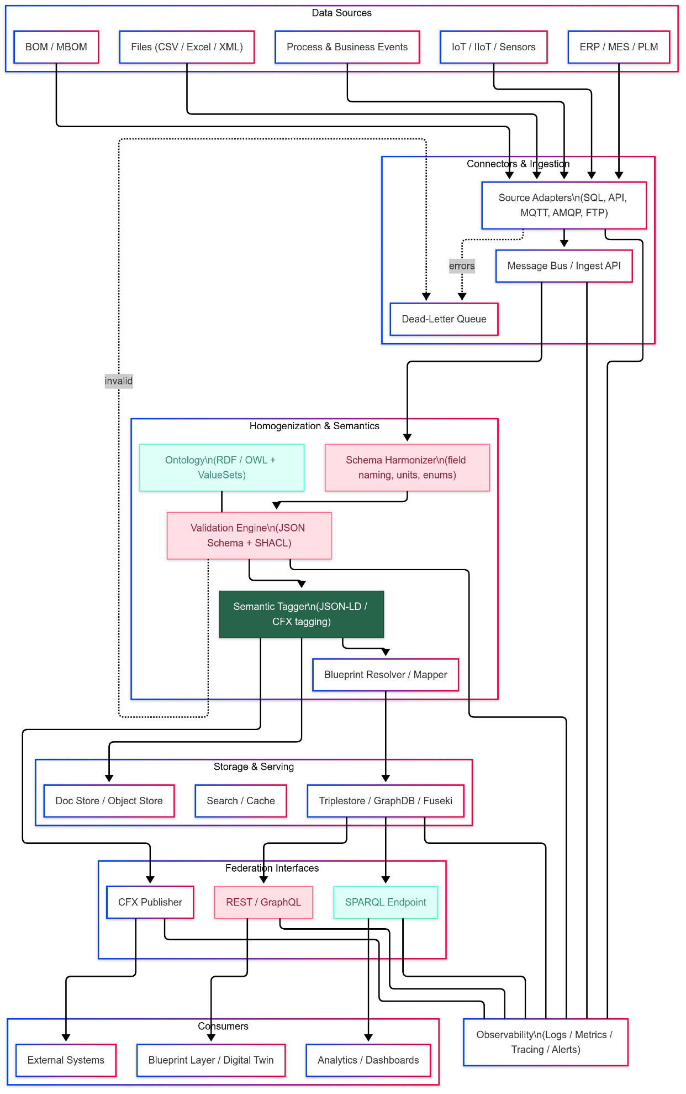

Slide 3
Step 1: Raw Data Input (Unstructured JSON)
This is the raw data we receive from an IoT device: { "deviceId": "M-101", "TMP": "296", "unit": "K", "timestamp": "2025-10-24T12:34:56Z", "status": "ok", "meta": { "locationName": "Plant A", "line": 3 } } Problems: • Inconsistent field names (TMP, unit) • Mixed types (string numbers) • No semantic meaning or linkage

Slide 4
Step 2: Schema Harmonizer
The Schema Harmonizer renames and converts fields for uniformity. Output: { "deviceId": "M-101", "temperature": 296.0, "temperature_unit": "K", "timestamp": "2025-10-24T12:34:56Z", "status": "ok", "location": { "site": "Plant A", "line": 3 } } ✅ Consistent structure ✅ Correct types and field names

Slide 5
Step 3: Ontology Reference
The ontology provides shared concepts and relationships. Ontology defines: • 'temperature' as a type of SensorReading • Units allowed: C, F, K • Conversion rules between units • Relationships: SensorReading → Machine → Line → Site Used by Validation and Tagging steps to ensure semantic consistency.

Slide 6
Step 4: Validation Engine
Checks both structure and semantic rules using JSON Schema + SHACL. ✅ Field types valid ✅ Unit within ontology rules ✅ Temperature converted to standard unit Output: { "deviceId": "M-101", "temperature": 296.0, "temperature_unit": "K", "temperature_celsius": 22.85, "timestamp": "2025-10-24T12:34:56Z", "status": "ok", "location": { "site": "Plant A", "line": 3 } }

Slide 7
Step 5: Semantic Tagger
Attaches ontology-based labels to make data machine-interpretable (JSON-LD). Output: { "@context": { "ex": "http://example.org/ontology#", "deviceId": "ex:Machine/id", "temperature_celsius": "ex:SensorReading/value", "timestamp": "ex:Observation/time", "location": "ex:Machine/locatedAt" }, "@type": "ex:Observation", "deviceId": "M-101", "temperature_celsius": 22.85, "timestamp": "2025-10-24T12:34:56Z", "status": "ok", "location": { "site": "Plant A", "line": 3 } } ✅ Adds meaning to each field ✅ Enables cross-system understanding

Slide 8
Step 6: Blueprint Mapper
Maps semantic data to the digital twin structure defined by the blueprint. Output: { "machine": { "id": "M-101", "metadata": { "location": { "site": "Plant A", "line": 3 } }, "sensors": { "temperature": { "currentValue": 22.85, "unit": "C", "lastUpdated": "2025-10-24T12:34:56Z" } } } } ✅ Data correctly placed in machine model ✅ Ready for analytics and dashboards

Slide 9
End-to-End Summary
• Raw data enters messy and inconsistent • Schema Harmonizer → unifies structure • Validation Engine → ensures correctness • Ontology → provides shared meaning • Semantic Tagger → adds contextual labels • Blueprint Mapper → connects to digital twin Result: clean, meaningful, interoperable data ready for enterprise use.

