Slide 1
SIS - Scheduling Module (NSWI130)
Matěj Foukal
Pavel Kubát
Dominik Mészáros
Ladislav Nagy
Jiří Zelenka
Martin Znamenáček

Slide 2
Feature Overview
Teacher view schedule - Pavel
Teacher adjust preferences - Dominik
Schedule validation - Matěj
Subject creation – Ladislav
Auto-generated scheduling - Martin
Student view schedule - Jiří

Slide 3
Responsibilities Overview
In total we identified around 100 responsibilities
We identified whether they belong to
P = presentation layer
B = bussiness layer
I = infrastructure layer
Here are some responsibilities we identified for the Subject creation

Slide 4
Use cases
Teacher creates a subject
Teacher edits a subject
Scheduling committee generates subjects from study plans
Scheduling committee edits a subject generated or hand created

Slide 5
Getting Data from Other Systems
Fetch the year’s harmonogram to check whether subject creation or editing is allowed. (I)
Fetch the current study plans. (I)
Fetch the number of students in different specializations. (I)

Slide 6
List of Created Subjects
Load the created subjects from the database. (I)
Filter the subjects, for committee members, all subjects should be loaded; for teachers, only those they created themselves should be loaded (B)
Display the received subjects (P)

Slide 7
Subject Creation
Ensure that all necessary data for subject creation is provided by the user on the frontend (P)
Validate the incoming data for subject creation on the backend (B)
Create a new subject in the database (I)

Slide 8
Subject Generation from Study Plan
Load the necessary data from the study plan (I)
Process the number of students in each specialization to determine how many lectures and exercises are needed for each generated subject (B)
Generate subjects with the appropriate name, number of credits, format (2/2, 2/1, 0/2, etc.), and information on exercises and their teachers (B)
Save the newly generated subjects into the database (I)

Slide 9
Notifications
Notify the committee chief when the right time comes to generate subjects - email (I)
Notify all teachers when they can start creating subjects - email (I)
Notify a teacher if their subject is edited by the committee - email (I)
Notify a teacher if they are assigned as a lecturer or exercise teacher for a subject - email (I)

Slide 10
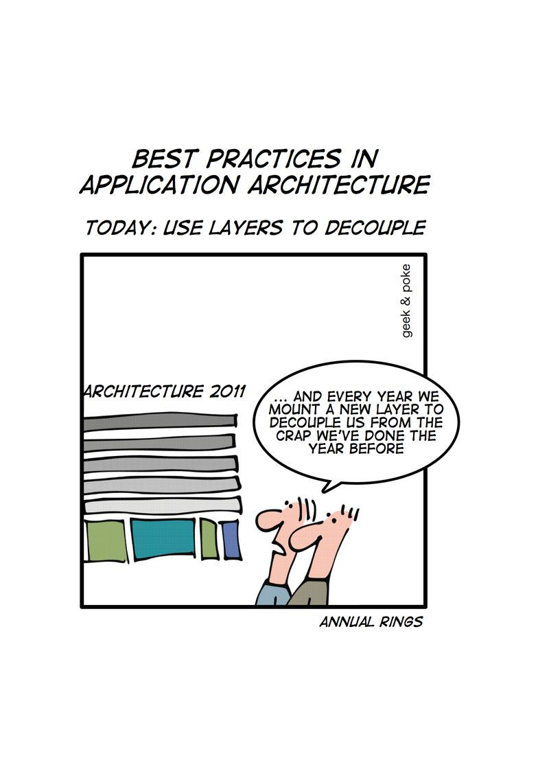

Slide 11
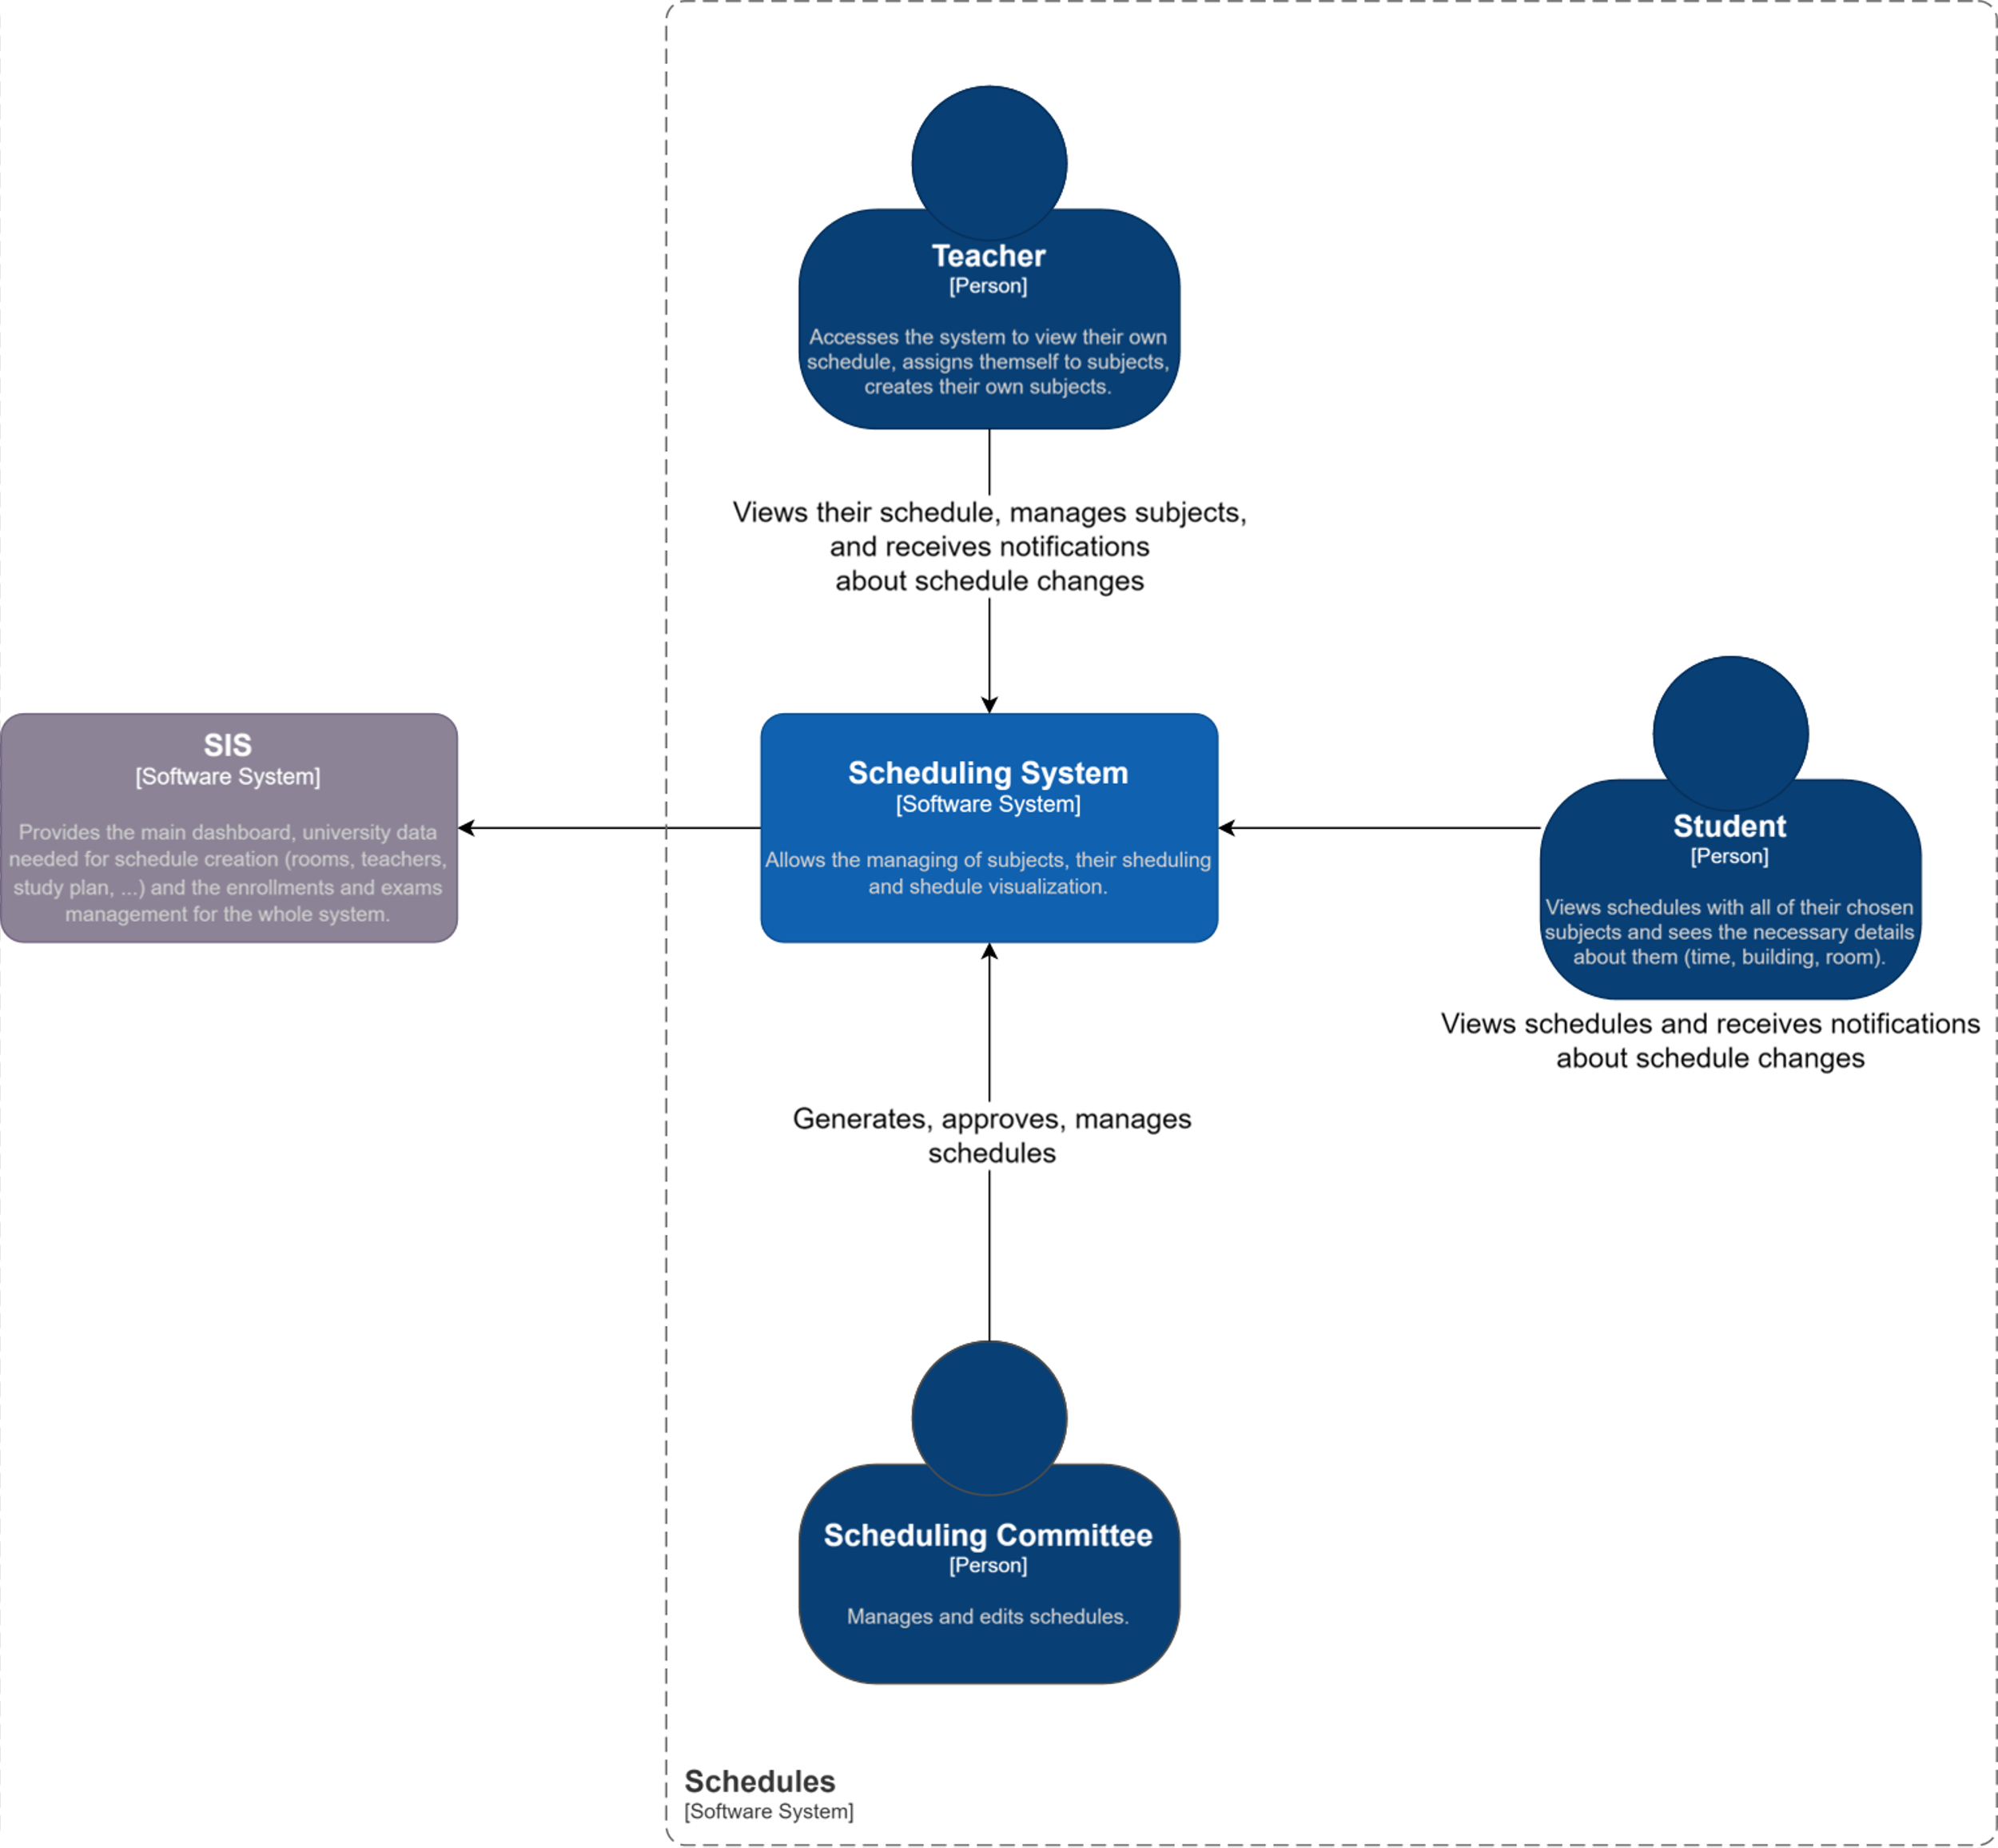
C4 Architecture – L1
SIS:
Provides necessary data (rooms, emails, plans).
Stakeholders:
Teacher: Views/manages schedules, creates subjects, assigns themselves to subejcts, sets schedule preferences.
Student: Views detailed schedules, receives updates.
Scheduling Committee: Generates and validates schedules.
Scheduling System:
Allows to edit, generate, visualize schedules.
Interfaces with SIS for data integration.
Jirka, Matej

Slide 12
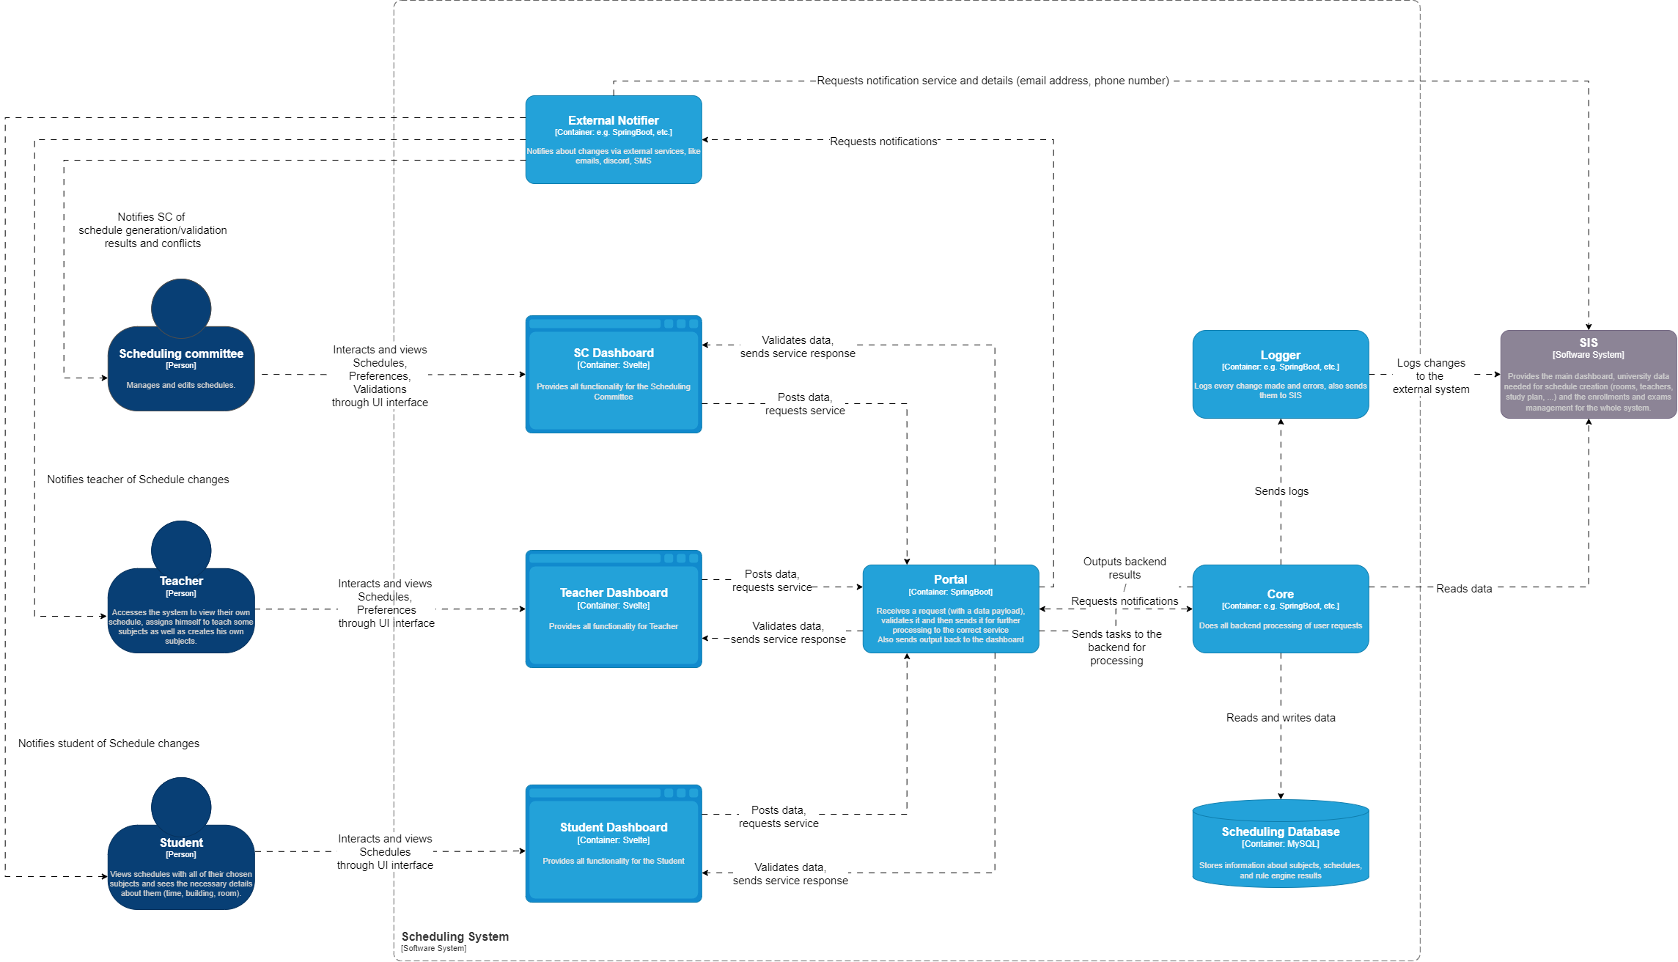
C4 Architecture – L2
Stakeholders:
Interact with their respective dashboards
Receive external notifications
Martin

Slide 13
C4 Architecture – L2
Dashboards:
Forward requests to the Portal
Receive and show errors in the request
Receive and show updated information
Martin

Slide 14
C4 Architecture – L2
Portal:
Receives requests from dashboards and forwards them to a service: External Notifier or Core.
Sends any errors in request back to the Dasboard
Sends results back to the Dashboard
Help against attacks
Martin

Slide 15
C4 Architecture – L2
External Notifier:
Collects credentials from SIS
Sends notifications to Stakeholders
Martin

Slide 16
C4 Architecture – L2
Core
Receives backend request from Portal
Does all backend processing (algorithms, reading from DB, SIS)
Outputs backend result to Portal
Logs operations to the Logger
Logger
Stores the log
Saves the log to SIS
Martin

Slide 17
Most Interesting Containers
select one or two most interesting containers from L2 and explain their components at L3 (2mins)
Rule engine: Generates schedules and validates changed/created schedules.
Logger: Logs every change made. Logs errors.

Slide 18
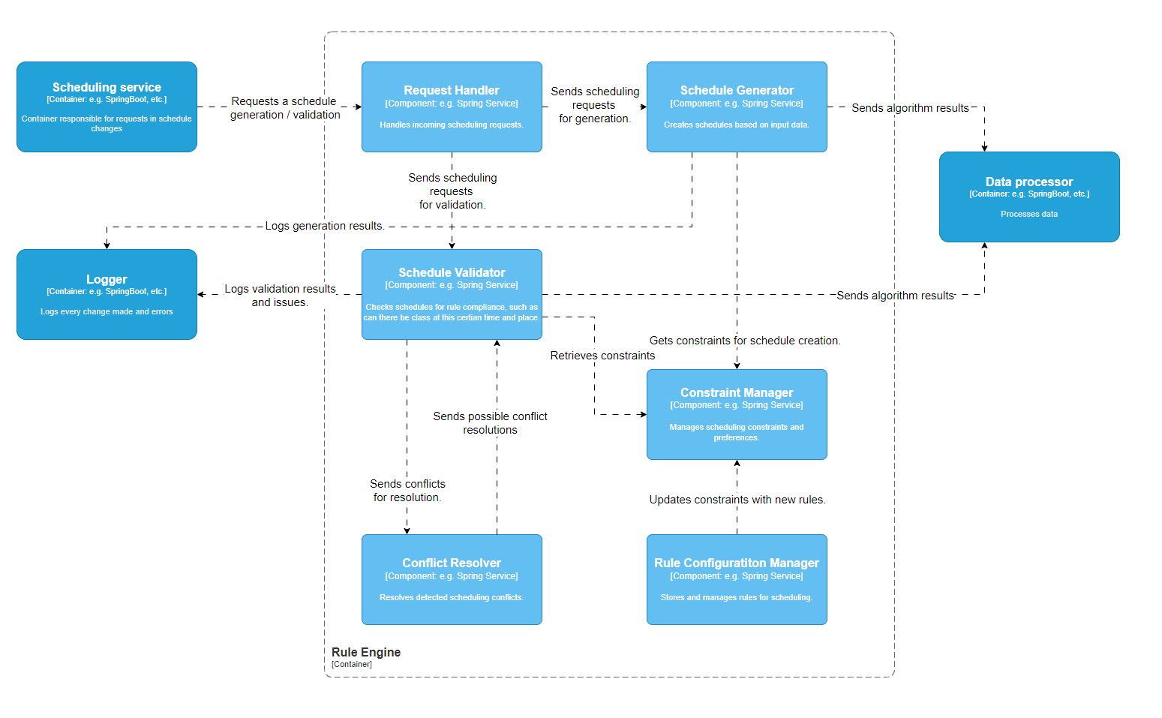
Rule Engine
Notes:
show one deployment diagram and explain it shortly, show who worked on it (2mins)
Go section by section, from top to bottom
At the end say that I made it and then we checked it all together to make sure everyone agrese and is on the same page about the structure

Slide 19
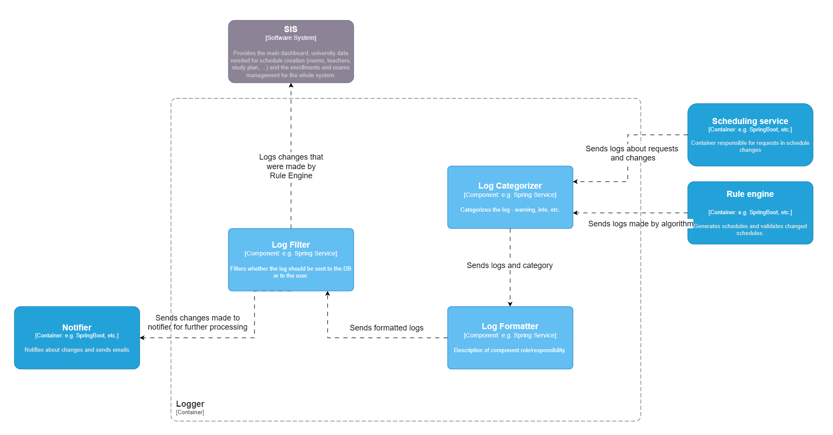
Logger
Notes:
show one deployment diagram and explain it shortly, show who worked on it (2mins)
Go section by section, from top to bottom
At the end say that I made it and then we checked it all together to make sure everyone agrese and is on the same page about the structure

Slide 20
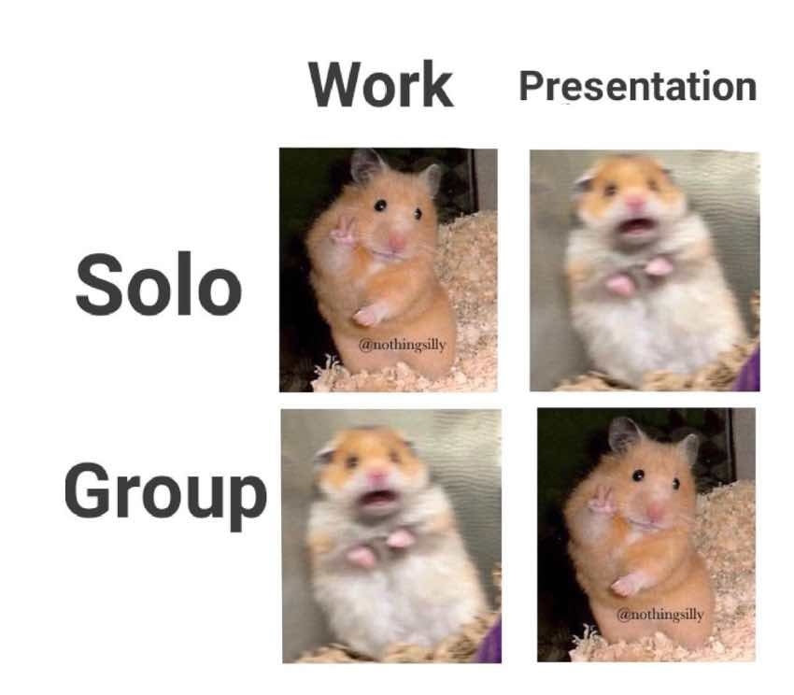
Wake up meme
https://cms-assets.tutsplus.com/cdn-cgi/image/width=850/uploads/users/2533/posts/42015/image-upload/Group_Work.jpg

Slide 21
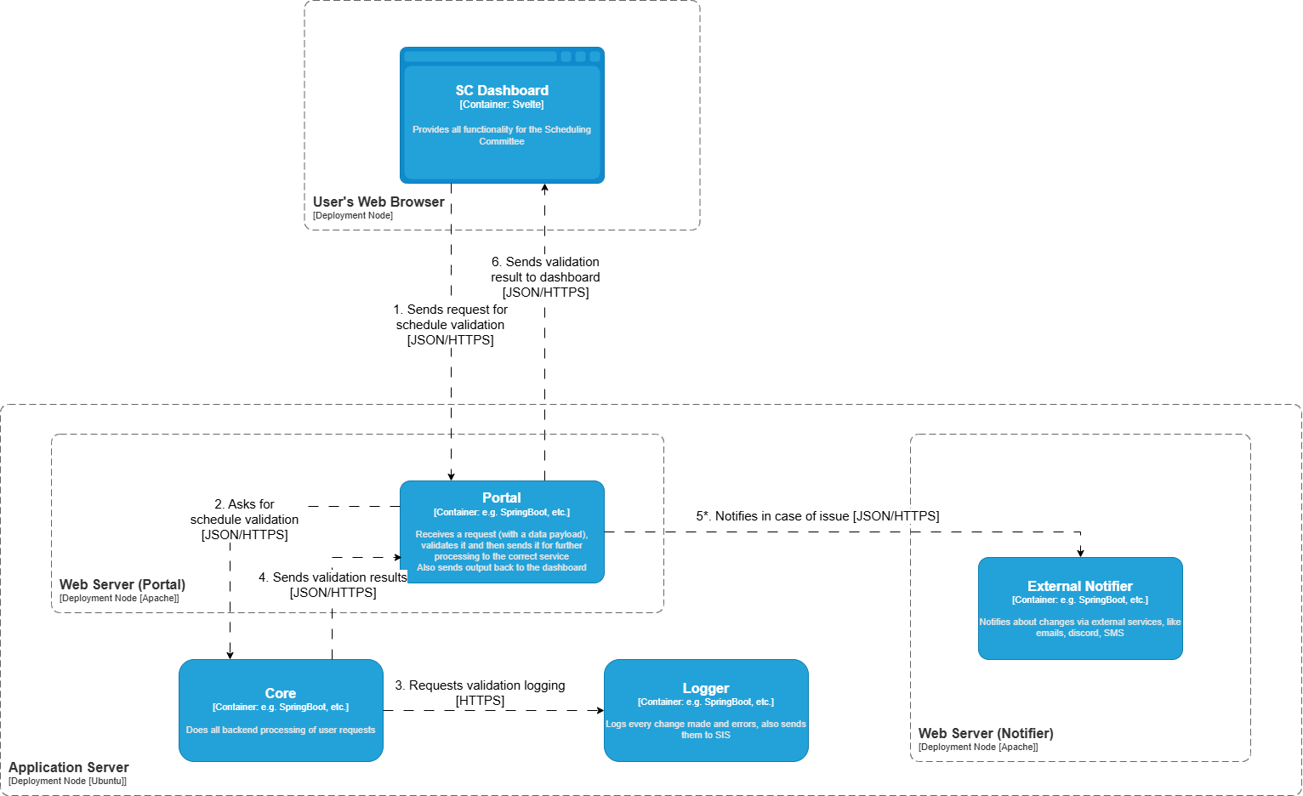
Dynamic Diagram Example
Notes:
show one deployment diagram and explain it shortly, show who worked on it (2mins)
Go section by section, from top to bottom
At the end say that I made it and then we checked it all together to make sure everyone agrese and is on the same page about the structure

Slide 22
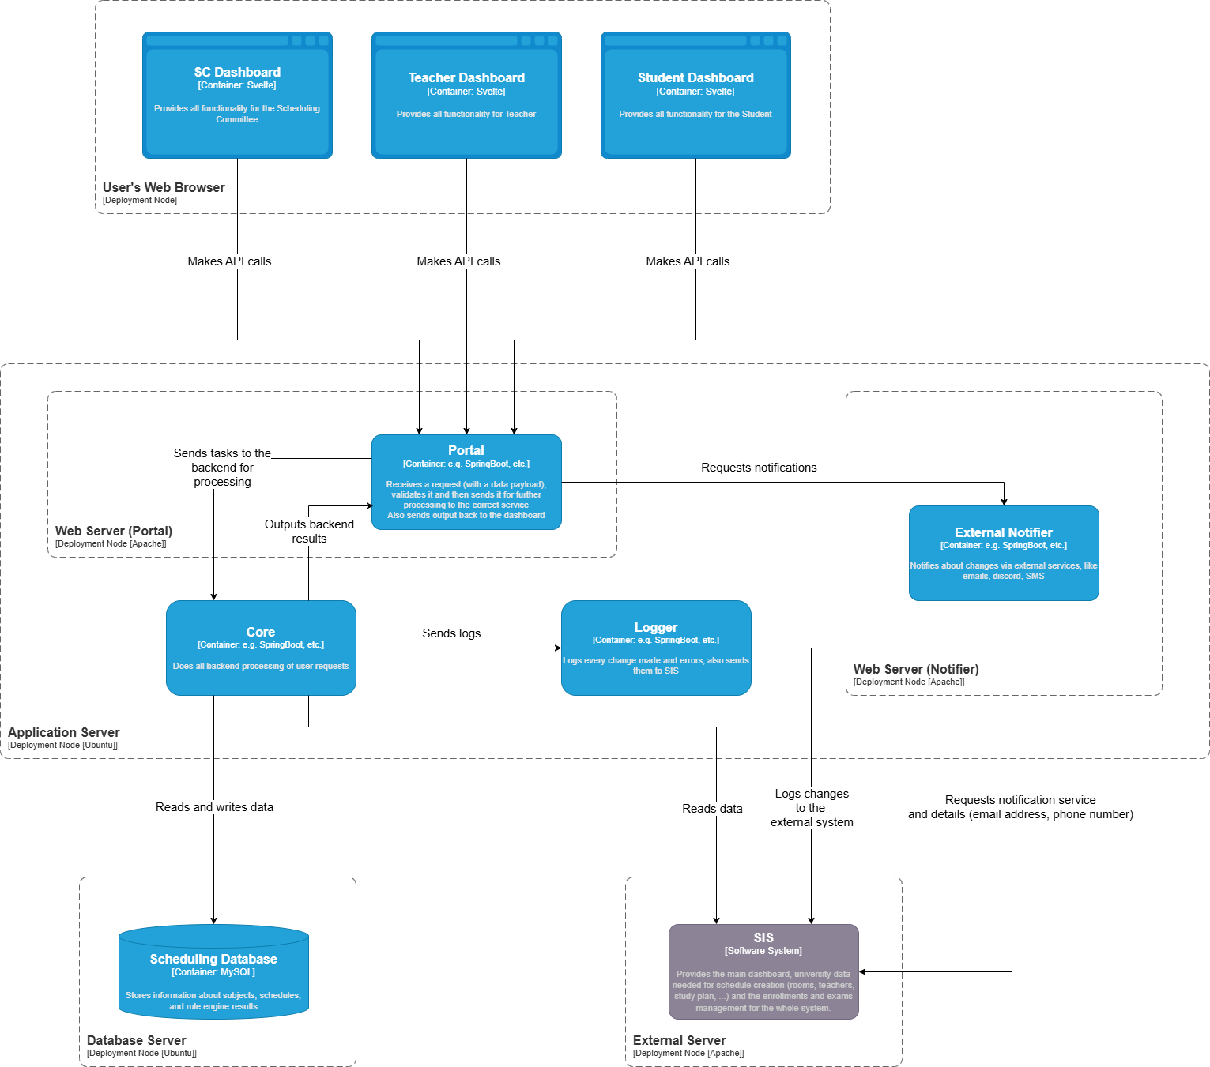
Production Deployment Diagram
Notes:
show one deployment diagram and explain it shortly, show who worked on it (2mins)
Go section by section, from top to bottom
At the end say that I made it and then we checked it all together to make sure everyone agrese and is on the same page about the structure

Slide 23
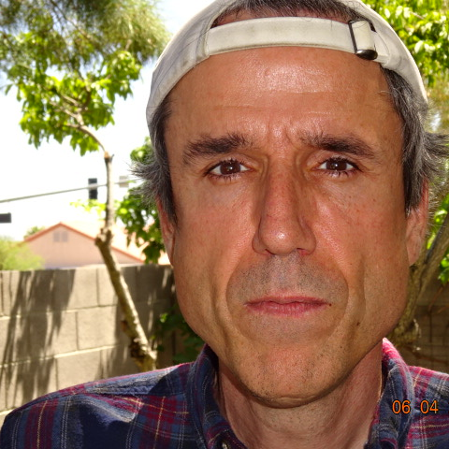
Thank you for your attention!

