Slide 1
SIS - Scheduling Module (NSWI130)
Matěj Foukal
Pavel Kubát
Dominik Mészáros
Ladislav Nagy
Jiří Zelenka
Martin Znamenáček

Slide 2
Our Projects
Matěj Foukal
Pavel Kubát
Dominik Mészáros
Ladislav Nagy
Jiří Zelenka
Martin Znamenáček
Old Project -> Schedules 2
New Project -> Enrollments 2

Slide 3
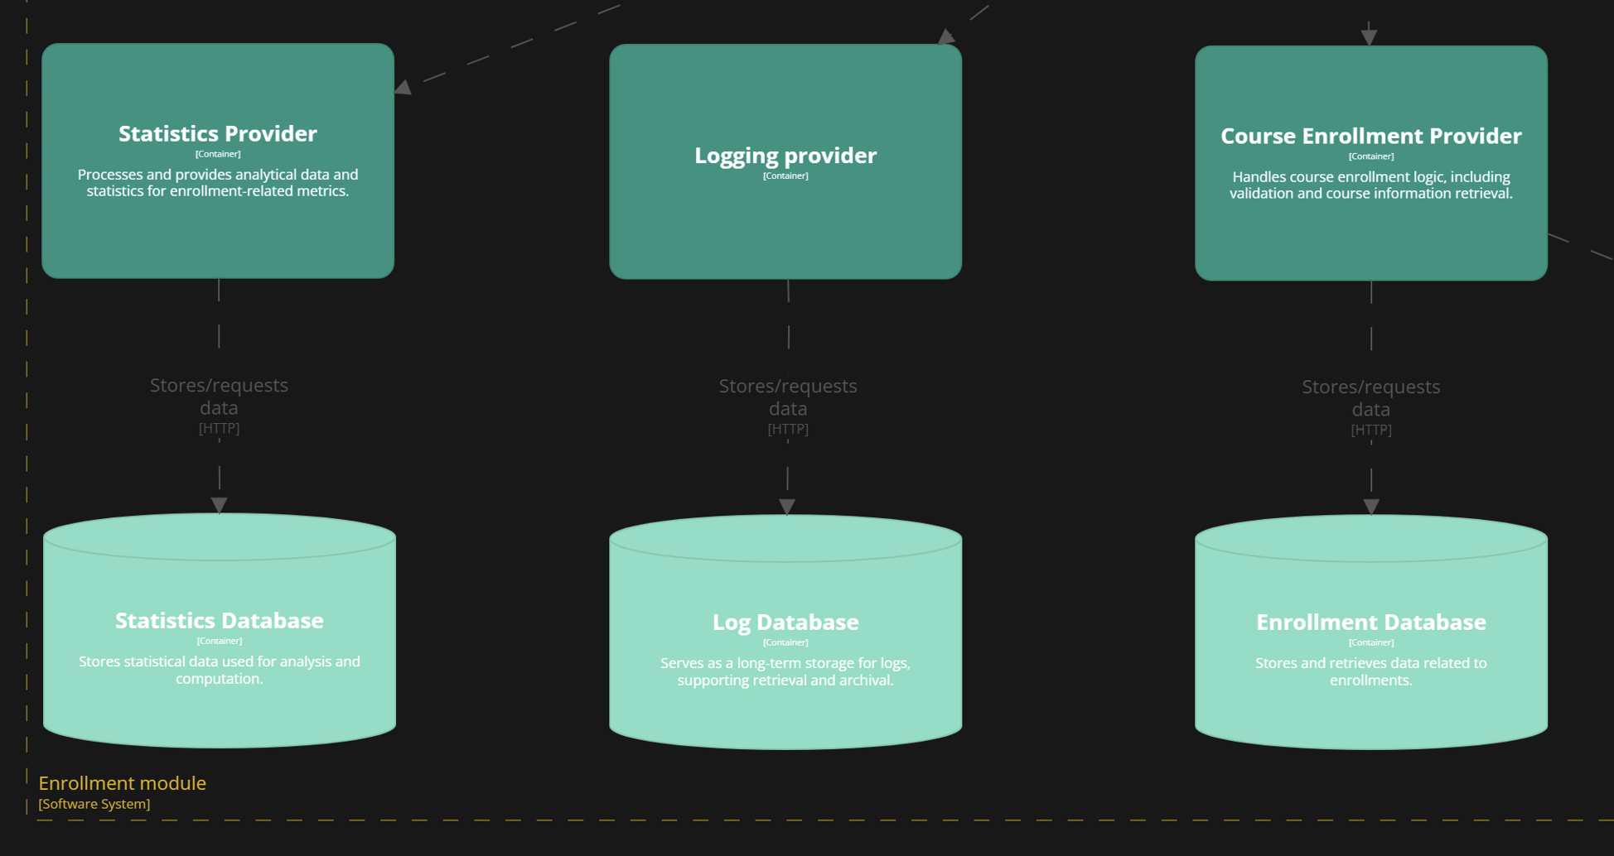


Scenario: Database High Availability
Quality attribute: Availability
Context: Critical databases like the Enrollment Database and Log Database need to be highly available to avoid system downtime during peak usage.
Result: Failed
Matěj Foukal

Slide 4
Scenario: Database High Availability
Architecture affected: No
Solution: Use a DBMS like PostgreSQL, which supports replication and failovers. For enhanced high availability, use Patroni, a PostgreSQL clustering tool that automates failovers.
Response measure: Failover occurs within 5-30 seconds, with no noticeable impact on UX.
Matěj Foukal

Slide 5
Scenario: Validating Complex Enrollment Conditions
Design-time atribute: Testability
Context: New prerequisites require extensive testing to ensure correct validation under all edge cases.
Result: Passed
Stimulus: Testers write automated tests for the Enrollment Validator to simulate diverse enrollment scenarios.
Response: The modular design of the Enrollment Validator allows isolated testing, with logs providing detailed insights into validation logic.
Response Measure: Automated tests cover 95% of scenarios, and manual edge-case validation is completed within 2 days.
Current architecture status: The separation of validation logic ensures focused testing and detailed observability.
Pavel Kubát

Slide 6
Scenario: Role-specific workflow
Design-time attribute: Testability
Context: Each user (teacher, student, admin/student affairs officer) has their own priviliges and valid operations they can perform.
Result: Passed
Dominik Mészáros

Slide 7
System results can be observed either intercepting requests or we can simply use Logging/Statistics provider, if they were tested already
Testability can be achieved by using some sort of test environment (new database, automatization of tests,…)
Enrollments in Course Enrollment Provider can be tested because of architecture (separated from logging, statistics,..)
Each mock user can be set in the mock database, then interact with system, and then get logs if attempts to perform action were successful or not

Slide 8
Scenario – A new API request needs to be added
Design-time attribute: Modifiability
Result: Failed
Context: A change in requirments require a new API endpoint to be added
Stimulus: A developer is adding a new API call to the backend.
Response: Because application has one entry point where new API call can be easilly registered the developer can easily program the call logic separately and only register the call in one place
Response Measure: The registration of the new call should be done under 1 hour
Ladislav Nagy

Slide 9
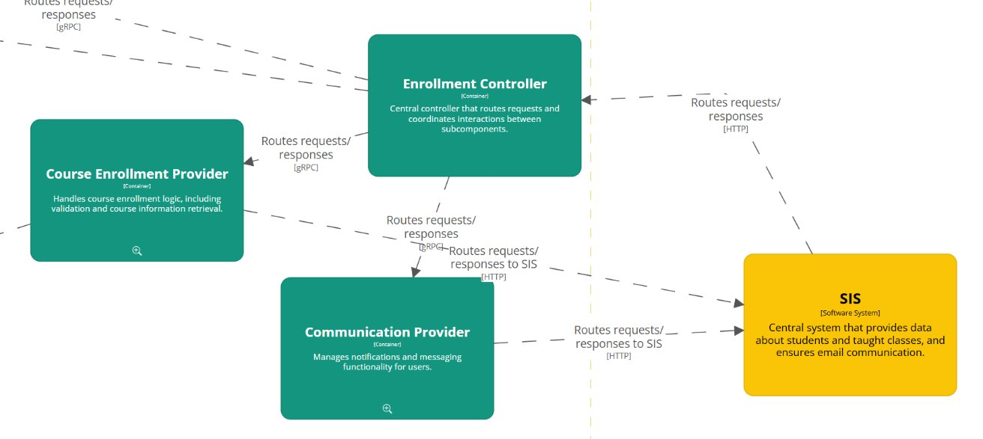
Current architecture status: The current application architecture doesn't have a single point of communication, which makes this impossible and makes adding API requests a much harder and time demanding task. (We are assuming the SIS component includes the frontend which makes the calls)

Slide 10
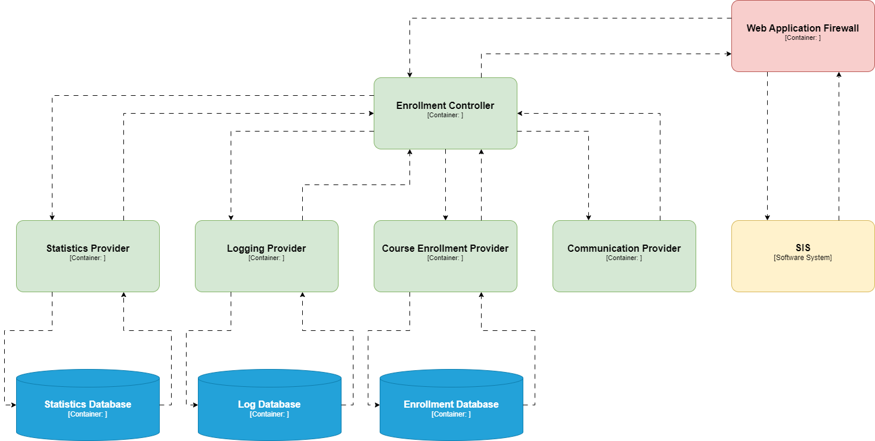
New architecture to solve the problem - The Enrollment Controler should solely take care of the outside communication, the Course Enrollment Provider should also only communicate with the Enrollment Provider and not with the frontend directly.

Slide 11
Scenario: High-Frequency Batch Enrollment
Run-time attribute: Scalability
Context: During registration, large batches of enrollment requests are submitted simultaneously.
Stimulus: A surge of requests hits the "Enrollment Controller" over a short period (1,000 requests in 1 minute).
Response: The system scales horizontally, leveraging load balancing and microservice replicas.
Result: Passed
Jiří Zelenka

Slide 12
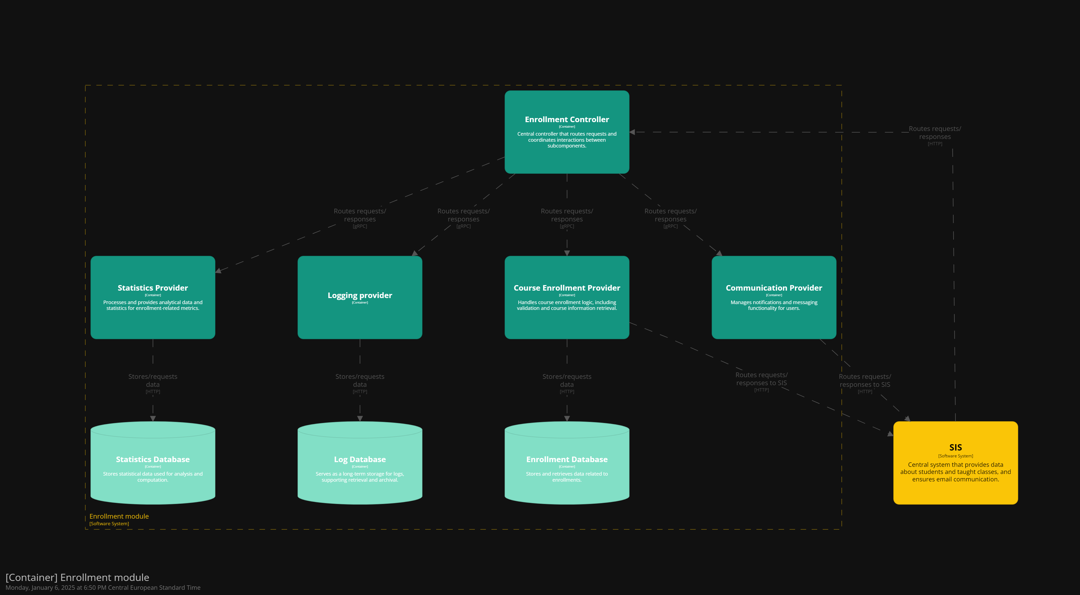
Scenario: Malicious Attack Attempt
Run-time attribute: Security
Context: A malicious user tries to exploit an API endpoint – presumably the Enrollment Controller, thus disabling services.
Result: Failed
Martin Znamenáček

Slide 13

Scenario: Malicious Attack Attempt
Architecture affected: Yes
Update: Add a WAF between the SIS and Enrollment Controller and route all requests through it.
Response measure: All incoming requests are now directed through a firewall for comprehensive filtering and inspection. Additionally, common application-layer attacks, like SQL injection or XSS, are effectively mitigated.
Martin Znamenáček

Slide 14

Thank you for your attention!

