Slide 1
SIS - Scheduling Module (NSWI130)
Matěj Foukal
Pavel Kubát
Dominik Mészáros
Ladislav Nagy
Jiří Zelenka
Martin Znamenáček

Slide 2
Our Projects
Matěj Foukal
Pavel Kubát
Dominik Mészáros
Ladislav Nagy
Jiří Zelenka
Martin Znamenáček
Old Project -> Schedules 2
New Project -> Enrollments 2

Slide 3
6 Quality Requirement Scenarios
Present n quality requirement scenarios, one per team member, and for each explain:
What quality attribute it is
Who worked on it (only have it on the slide, do not read it)
Show and explain the scenario
Explain its impact on the architecture (Is there an impact? If no, why? If yes, show the updated part of the architecture and explain)

Slide 4
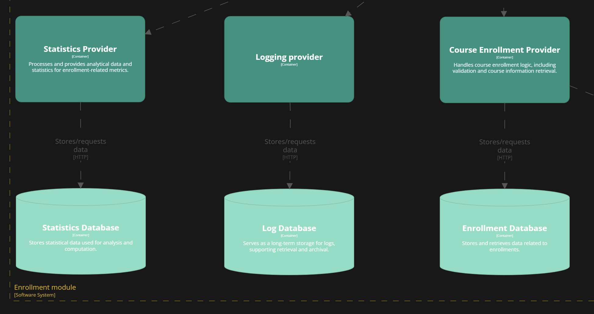
Scenario: Database High Availability
Quality attribute: Availability
Result: Failed
Solution: Create master-slave databases and use DBMS with automatic failover support (PostgreSQL)
Matěj Foukal

Slide 5
Scenario
Pavel Kubát

Slide 6
Scenario
Dominik Mészáros

Slide 7
Scenario
Ladislav Nagy

Slide 8
Scenario: High-Frequency Batch Enrollment
Run-time attribute: Scalability
Context: During late registration, large batches of enrollment requests are submitted simultaneously.
Result: Passed
Jiří Zelenka

Slide 9
Scenario
Martin Znamenáček

Slide 10
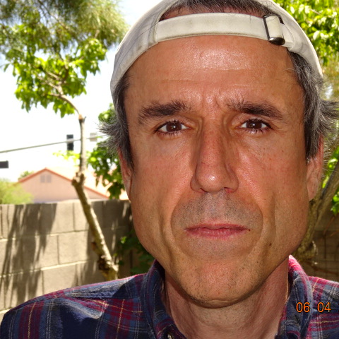
Thank you for your attention!

