Slide 1
SIS - Scheduling Module (NSWI130)
Matěj Foukal
Pavel Kubát
Dominik Mészáros
Ladislav Nagy
Jiří Zelenka
Martin Znamenáček

Slide 2
Our Projects
Matěj Foukal
Pavel Kubát
Dominik Mészáros
Ladislav Nagy
Jiří Zelenka
Martin Znamenáček
Old Project -> Schedules 2
New Project -> Enrollments 2

Slide 3
6 Quality Requirement Scenarios
present n quality requirement scenarios, one per team member, and for each explain:
what quality attribute it is
who worked on it (only have it on the slide, do not read it)
show and explain the scenario
explain its impact on the architecture (Is there an impact? If no, why? If yes, show the updated part of the architecture and explain)

Slide 4
Scenario
Matěj Foukal

Slide 5
Scenario
Pavel Kubát

Slide 6
Scenario
Dominik Mészáros

Slide 7
Scenario
Ladislav Nagy

Slide 8
Scenario
Jiří Zelenka

Slide 9
Scenario
Martin Znamenáček

Slide 10
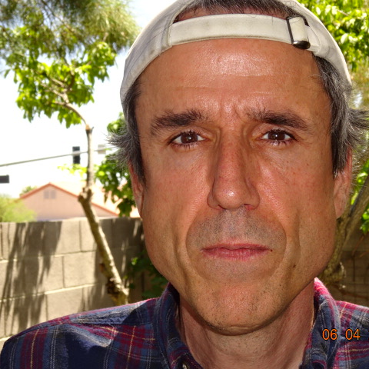
Thank you for your attention!

