Slide 1
Flutter - Context
Context - element daraxtidagi vidjetning o'rnini aniqlash va shu pozitsiyaga tegishli ma'lumotlarni olish imkonini beradi

Slide 2
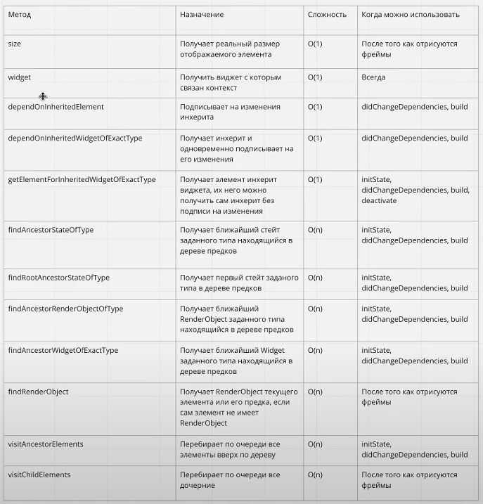
Size
Widget
InheritedElement
InheritedWidget
State
RenderObject
Element

Slide 3
