Slide 1

CodeAlpha Cybersecurity Internship Task 2: 🎣Phishing Awareness Training Prepared by Miracle Godwin Ogbo Penetration Tester Date July 2026

Slide 2
Training Objectives
✔ Understand phishing attacks
✔ Identify phishing emails
✔ Recognize fake websites
✔ Understand social engineering
✔ Learn how to stay safe online

Slide 3
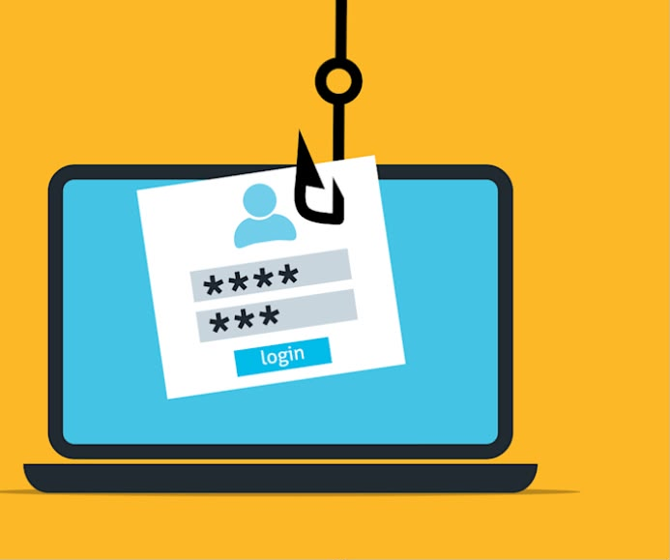
What is Phishing? 🎣
Phishing is a cyberattack where attackers impersonate trusted individuals or organizations to trick victims into revealing sensitive information, including Personally Identifiable Information (PII) and Sensitive Personally Identifiable Information (SPII).
Common Targets
Usernames
Passwords
Credit card details
Bank account information
Personal data

Slide 4
How Phishing Works
Attacker
↓
Creates fake email
↓
Victim clicks link
↓
Fake login page
↓
Credentials stolen
↓
Account compromised

Slide 5
Types of Phishing
📧 Email Phishing
Fake emails sent to many users.
🎯 Spear Phishing
Targets one specific person.
👔 Whaling
Targets executives.
📱 Smishing
SMS phishing.
📞 Vishing
Phone call phishing.
💬 Clone Phishing
Copies legitimate emails.
Very professional.

Slide 6
📧 Anatomy of a Phishing Email
From: CodeAlpha Support
support@codealpha-security.com 🔴
Subject: URGENT: Verify Your Student Portal 🔴
Dear Student, 🔴
As part of our cybersecurity internship verification process,
all interns are required to verify their student portal before
their internship account is activated.
Failure to complete verification within 24 hours may result in:
• Internship suspension
• Loss of access to project submissions
• Removal from the internship portal
Click the button below to verify your account.
[ VERIFY PORTAL ] 🔴
https://codealpha-verify-login.com 🔴
Thank you.
CodeAlpha Student Support Team
🚩 Warning Signs
❌ Fake sender
❌ Urgent subject
❌ Generic greeting
❌ Immediate action
❌ Fake website URL
Training Example: This email is fictional and created for awareness only.

Slide 7
Fake CodeAlpha Login Page (Phishing Website)
Fake Browser
🔒 codealpha-verify.net/login
🚩 Red Flags
❌ Suspicious domain name
❌ Requests password immediately
❌ Uses urgency to pressure users
❌ Generic login page
❌ Not an official CodeAlpha website
CODEALPHA Student Verification Portal
Verify your internship account to continue.
Email Address
Password
[ Verify Account ]
🛡️ Never enter your credentials until you have verified the website URL.

Slide 8
Spot the Difference: Fake vs. Legitimate Website
❌ Phishing Website
Domain Name:
codealpha-verify.net
HTTPS
May use HTTPS to appear trustworthy
Website Design
Similar or copied layout
Login Request
Unexpected request to verify your account
Contact Information
Missing, fake, or limited
Grammar & Spelling
Errors or unusual wording
✅ Legitimate Website
Domain Name:
codealpha.tech
HTTPS
May use HTTPS with official company domain
Website Design
Official branding and consistent design
Login Request
Normal login only when you intentionally visit the website
Contact Information
Official company contact details
Grammar & Spelling
Clear and professional language
🛡️ Key Takeaway: Always verify the DOMAIN NAME before entering your username or password. Attackers can copy a website's appearance, but they cannot use the company's official domain.

Slide 9
Social Engineering Techniques Used by Attackers
🎭 Impersonation
Pretending to be a trusted company or person.
🚨 Urgency
"Verify within 24 hours!"
Pressures victims to act fast.
🎁 Baiting
Offers fake rewards, gifts, internship with monthly, payment or job opportunities.
😨 Fear
Threatens account suspension or data loss.
🤝 Trust
Uses familiar brands like CodeAlpha, banks, Google.
🔒 Authority
Pretends to be IT support, HR, or company management.
🛡️ Key Takeaway Attackers often exploit human emotions rather than technical vulnerabilities. Stay calm, verify requests, and never rush to click suspicious links.

Slide 10
Best Practices to Prevent Phishing Attacks
🟩 Verify the Sender
Confirm the sender's email address.
🔗 Check Links
Hover over links before clicking
and verify the destination.
🔐 Enable MFA
Add an extra security
layer to your accounts.
🔄 Keep Software Updated
Install updates to fix known
security vulnerabilities.
🚫 Never Share Passwords
Legitimate organizations
won't ask via email.
⚠️ Report Suspicious Emails
Report phishing emails to your
IT team or email provider.
🛡️ Think Before You Click
Always verify emails, links, and websites before entering your credentials.

Slide 11
❓ Interactive Quiz: Spot the Phishing Signs
Which of the following is a common sign of a phishing email?
A. Email from your manager about today's meeting
B. Urgent request to verify your account immediately
C. Newsletter you subscribed to
D. Email from a trusted contact
2. Before clicking a link, you should:
A. Click immediately if it looks familiar
B. Hover over the link to inspect the destination
C. Ignore the sender's address
D. Disable your antivirus
3. What is the safest action if you suspect an email is phishing?
A. Reply asking if it's real
B. Enter your password to check
C. Report the email and delete it
D. Forward it to everyone
💡 Pause the video and choose your answers before moving on.

Slide 12
Quiz Answers & Key Takeaways
Question 1: B ✅
Urgent requests to verify your account are a common phishing tactic.
Question 2: B ✅
Always hover over links to verify the destination before clicking.
Question 3: C ✅
Report suspicious emails and delete them. Never interact with phishing messages.
🛡️ Remember:
🧠 Think Before You Click
📧 Verify the Sender
🌐 Check Website URLs
🔐 Enable MFA
🚩 Report Suspicious Emails

Slide 13
Thank You for Watching!
Stay Alert. Stay Informed. Stay Secure.
Have a question or cybersecurity tip to share?
Leave it in the comments below.
Let's learn and grow together!
Miracle Godwin Ogbo
CodeAlpha Cybersecurity Internship
July 2026
GitHub Portfolio:
github.com/Miracle-Godwin-Ogbo
LinkedIn:
linkedin.com/in/miracle-godwin-ogbo-19a3a2241

