Slide 1
PetMatrix - Web Application
Miracle Advance Technologies co. ltd.

Slide 2
Good afternoon and welcome to PetMatrix web application. Thank you all very much for coming today. Happy new year 2019 in advance. This is Surajit Sarkar. I’m presenting on behalf of PetMatrix development team. The purpose of today’s presentation to show PetMatrix application Prepared by Md Emdadul Haque, Sr Software Engineer (Team Lead) Md Golam Rabbi, Sr. Software Engineer Bipon Biswas , UX/UI Engineer

Slide 3
Introduction
PetMatrix Web Application: PetMatrix is a cloud-based veterinary practice management software, making life at the practice easier through the enhancement of client and care processes.
Our intuitive system is at the forefront of practice management technology. PetMatrix helps vets in all sectors of the veterinary profession including hundreds of first opinion practices, farm and equine vets as well as large referral and university hospitals.
Specific areas of application include scheduling of appointments, registration of cases including client and patient data, case history and electronic medical records, health care reports, reminders, inventory controls, reports and accounting.

Slide 4
Features
Registration (Client and Patient)
Patient Arrival
Worklist
Consultation
Advance Payment
Invoice
Reports

Slide 5
Technology
Angular 6 and primeng controls are used for client side application
Asp.Net Core, C#, Web Api core 2.0 and Entity Framework Core are used for server side
SQL Server 2016 for Database
SQL Server Reporting Service is used for Reports

Slide 6
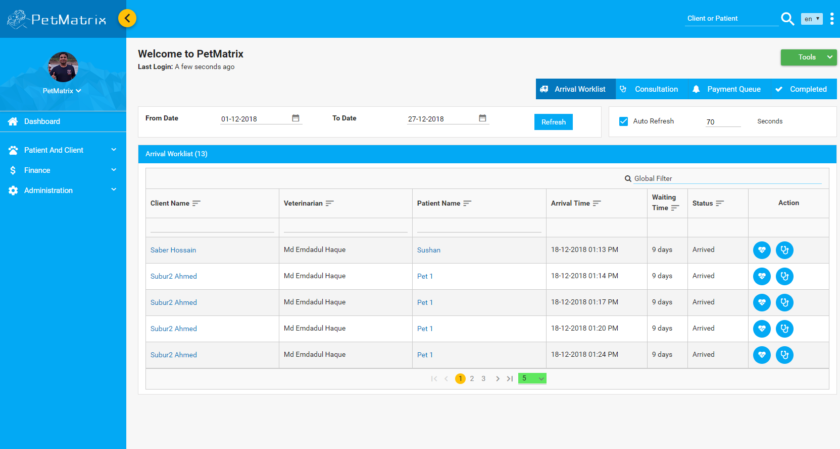
Present
Worklist
After successful login, user or doctor can able to see hi/her work list

Slide 7
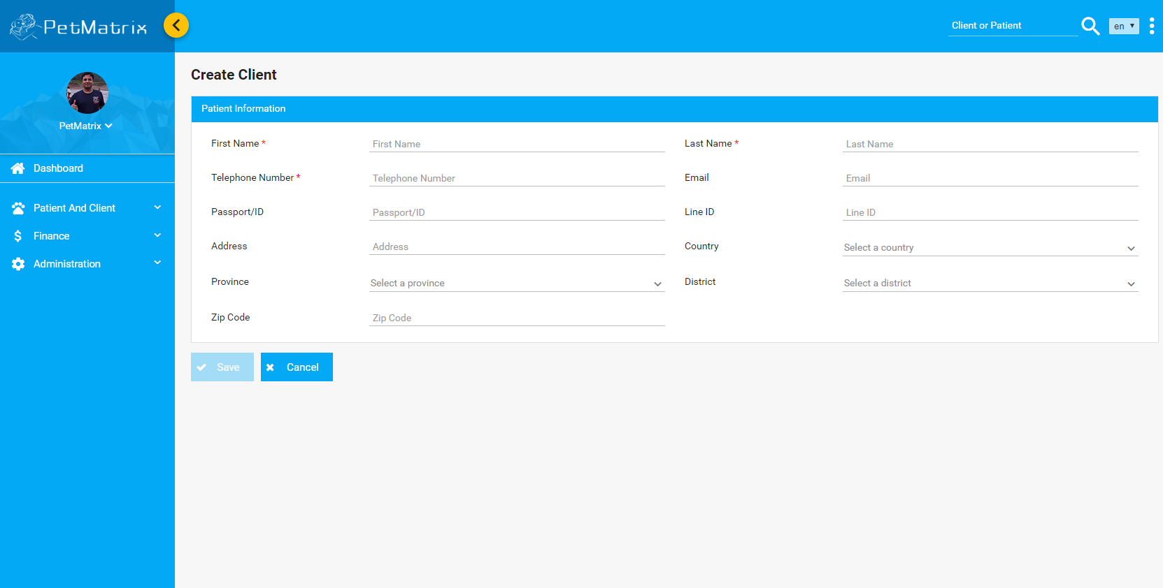
Present
Client Registration

Slide 8
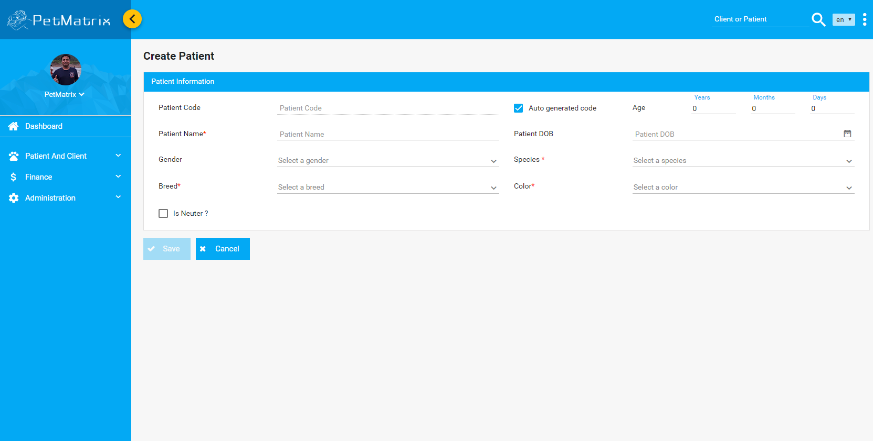
Present
Patient Registration

Slide 9
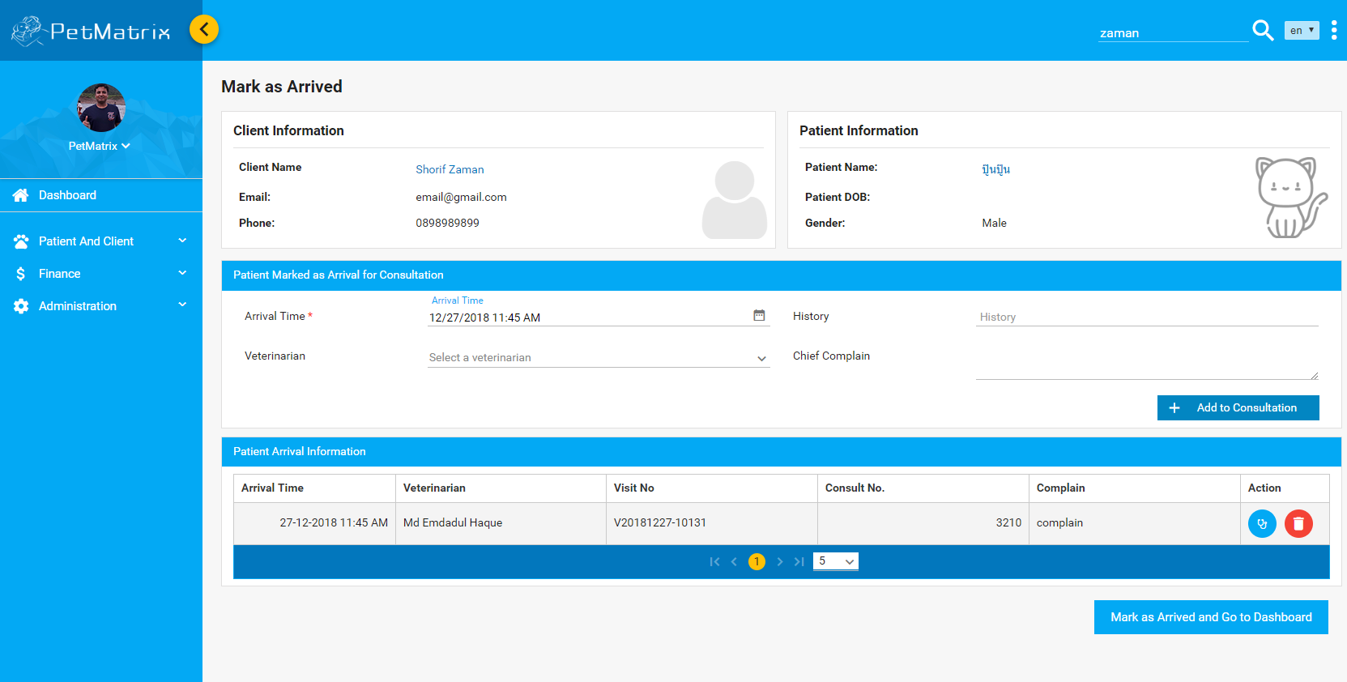
Present
Patient Arrival page

Slide 10
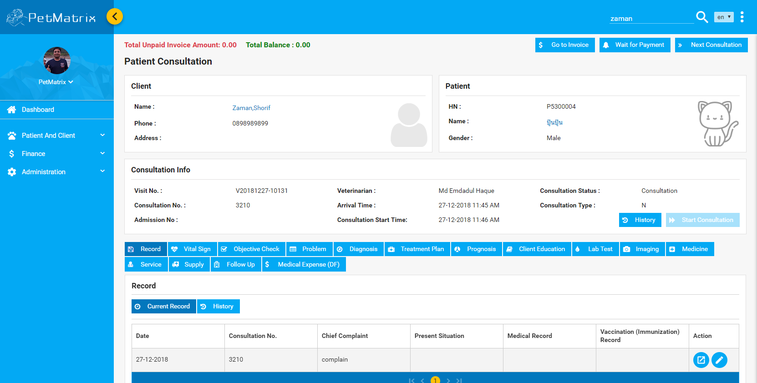
Present
Consultation

Slide 11
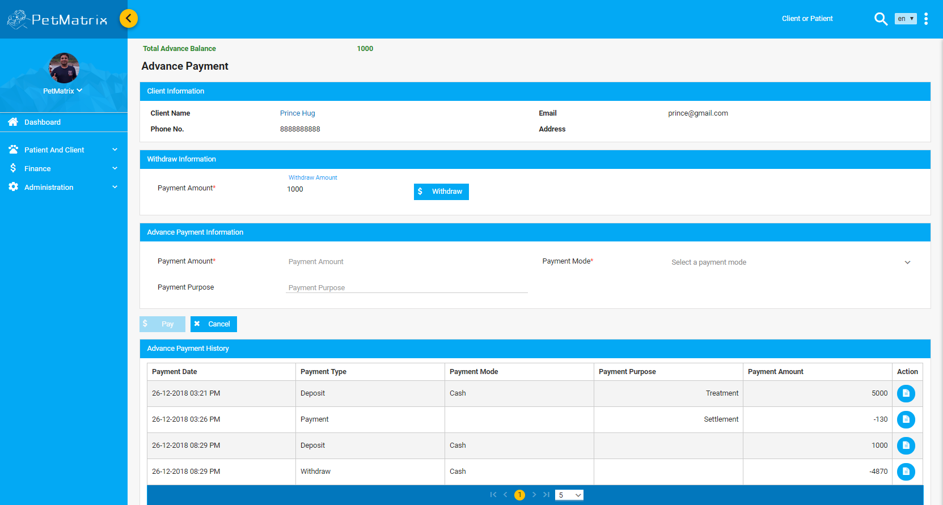
Present
Advance Payment

Slide 12
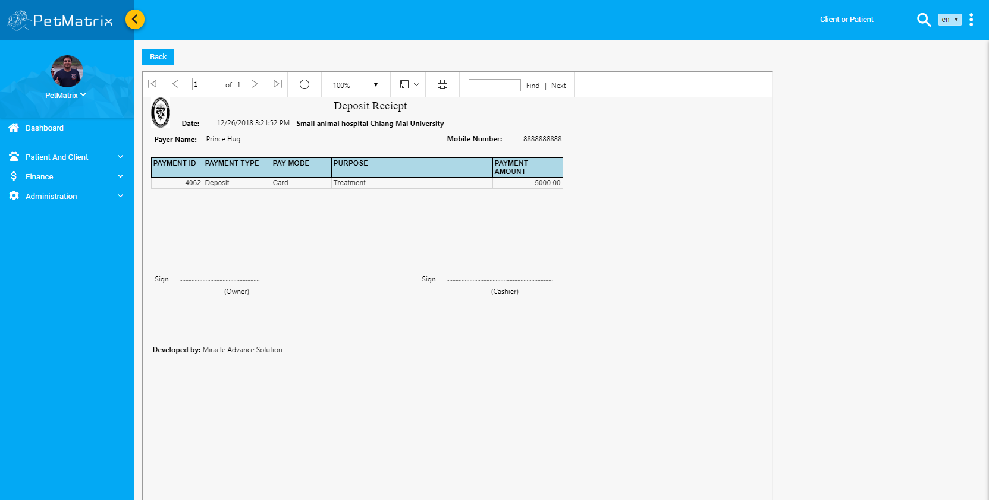
Present
Advance Payment Money Receipt

Slide 13
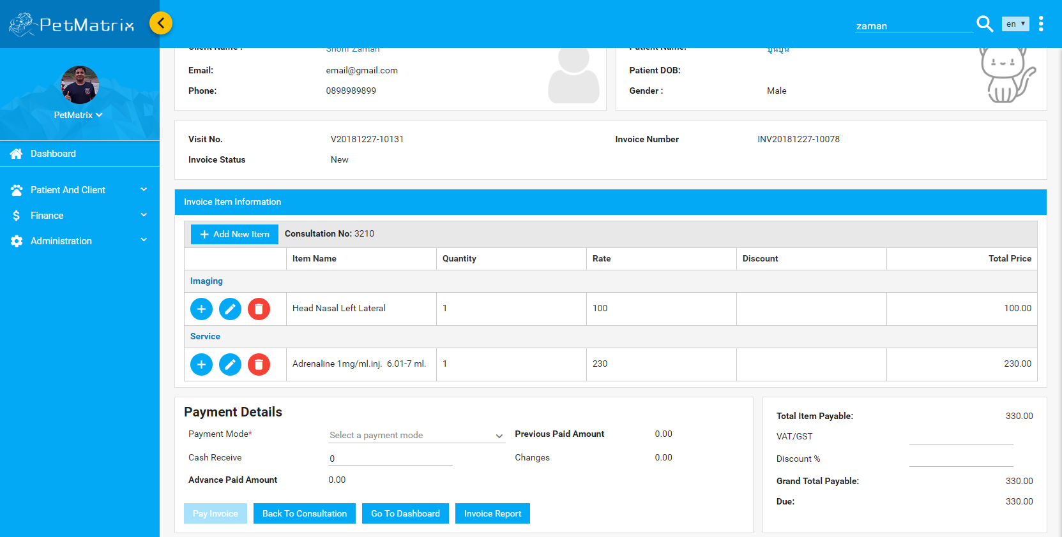
Present
Invoice

Slide 14
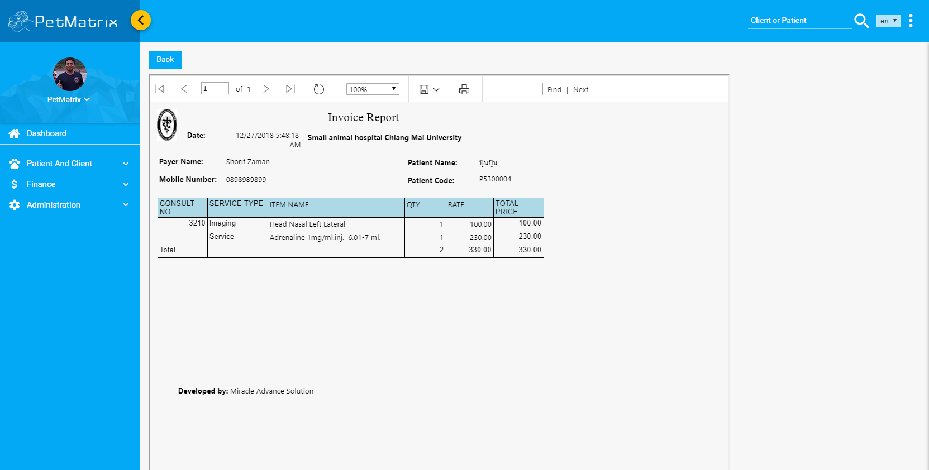
Present
Invoice Report

Slide 15
Roadmap
Inventory
IPD
LIS
RIS
OT
Emergency

Slide 16
Demo
The link of Petmatrix application
http://203.83.188.246:8087/#/

Slide 17
Thank You
Thank you everyone for your time.

