Slide 1
Comprehensive Overview of ERP Cloud Software Development
A Collaborative Session
Notes:
Comprehensive overview of ERP Cloud Software Development
ERP Cloud framework analysis and Knowledge sharing

Slide 2
Project Management

Slide 3
Project Management
DBML
DB use cases
API design
Figma
Unit
Integration
Performance
CI
CD
Design
Test
Deploy
Plan
Develop
Review
Backend
Frontend
Database
Peer Review
Feature Request
Use case analysis
Wireframe
Jira Board
Notes:
High level overview of our workflow
Agile

Slide 4
Plan
Group Discussion
Wireframing
Use case analysis
Feature Request
Product Team
Business Team

Slide 5
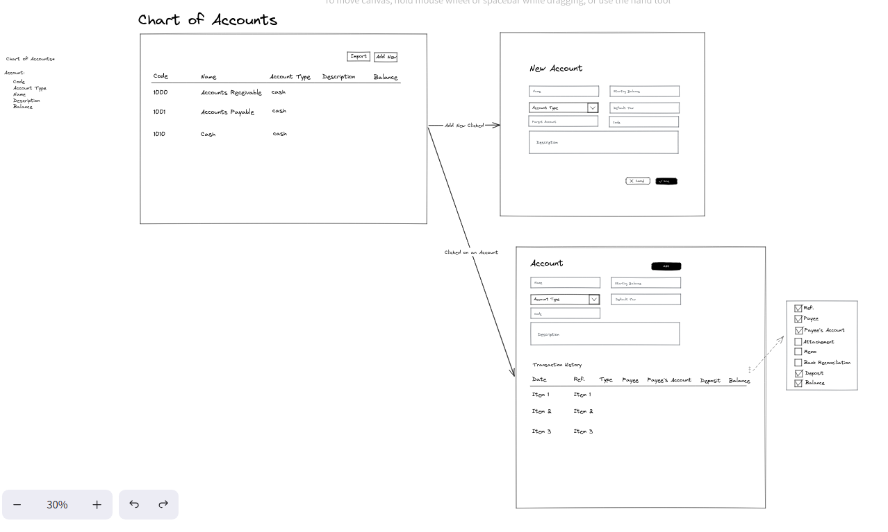

Slide 6
Plan
Group Discussion
Wireframing
Use case analysis
Feature Request
Jira Board
Product Team
Business Team
Sprint Plan
Github Integration
Issue Tracking

Slide 7
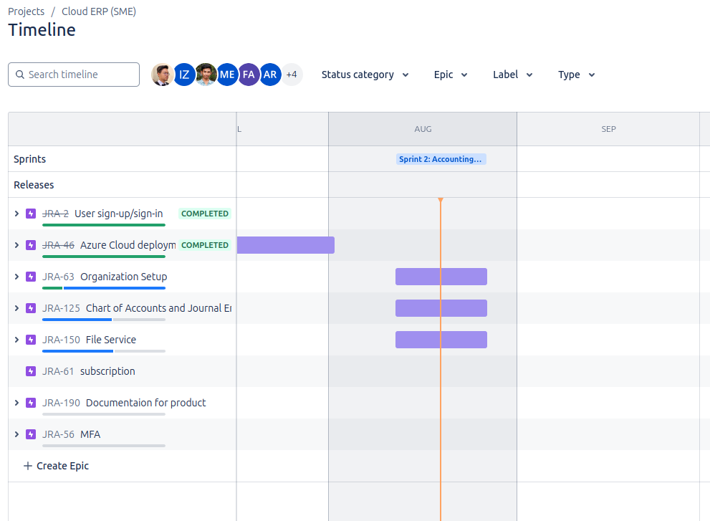
JIRA

Slide 8
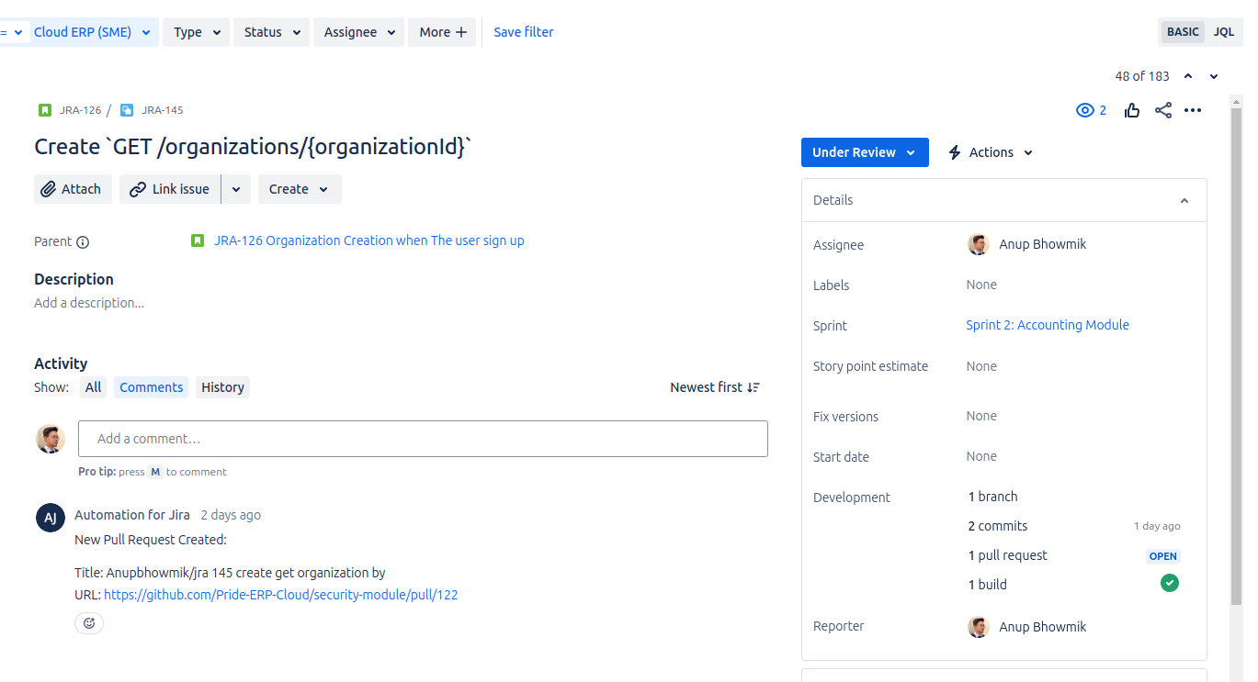
JIRA

Slide 9


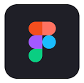
Design
Data Modeling
API Docs
UI/UX Design
Notes:
With proper documentation

Slide 10




Develop
Backend
Frontend
Database
Notes:
Language agnostic
Microservice

Slide 11



Test
3
Performance Test
Integration Test
2
1
Unit Test

Slide 12





Review & Deploy
Issue Create
Track Branch
Code
Code Review and Merge
Deploy in Cloud
Notes:
Coding convention
Commit convention
Documentation while coding
Code review, approval, test case passing (CI/CD in github workflow) in Pull Req, then merge to Main and Deploy

Slide 13
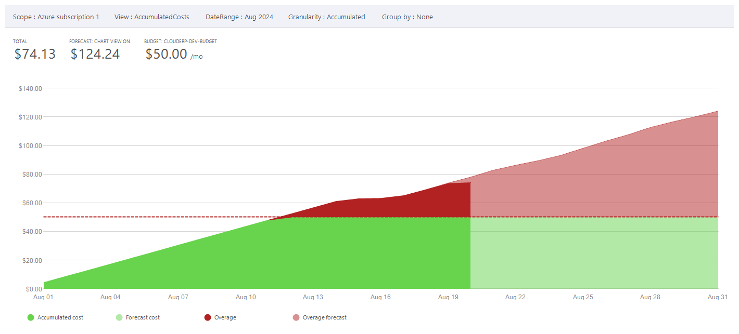
Development Costing
Notes:
No upfront cost

Slide 14
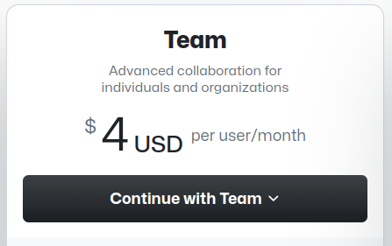
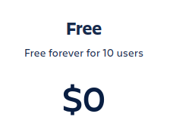
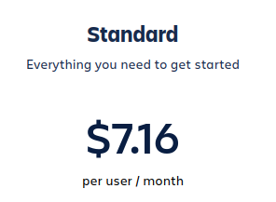
Development Costing
Features
Deployment Branches and secrets
Branch Protection
3,000 CI/CD minutes

Slide 15
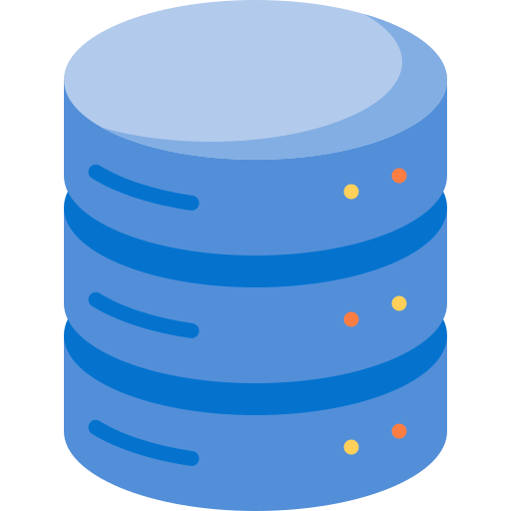
Sprint
Time Flow
R&D + Wireframe
UI/UX
Data Modeling
Frontend Dev
API Docs
Database Design
Backend Dev
Frontend Testing
Backend Unit + Performance Test
Integration Test
Deployment
Notes:
Dependency graph
summary

Slide 16
Architecture
High level System Design
Microservice architecture
Multi tenant architecture
Event driven Architecture
Database Perservice
Interservice communication
Async service communication

Slide 17
Architecture
Microservice, Multi-Tenant, SaaS

Slide 18
Monolithic Application
Security
Accounting
HR
Different Modules -
Security
Accounting
Sales
Purchase
HR
Inventory
Sales
Purchase
Inventory
SaaS
ERP Solution

Slide 19
Microservice Application
Security
Accounting
HR
Some microservices -
Security
Accounting
Sales
Purchase
HR
Inventory
Control resource usage individually
Sales
Purchase
SaaS
Inventory
ERP Solution

Slide 20
Subscriber wants to buy some specific modules
Specific Module needs to be scaled up/down independently
Microservice Architecture
SaaS Consideration

Slide 21
No ACID Property
Atomicity
Consistency
Isolation
Durability
Microservice Architecture
Different stack can be used for different services
Independent Database for each Services
Highly scalable
SQL / NoSQL
BASE Property
Basically Available
Soft-state
Eventually Consistent
Microservice Consideration

Slide 22
Single Database per Service
Different Schema for different organization
Logical Separation of data
Multi-tenant Architecture
Different Organization Consideration

Slide 23
SaaS Special Considerations
User can buy any modules independently
we need to scale each modules independently depending on the subscription
Solution:
Use of Microservice Architecture
Each microservice has its own database
Instead of ACID (Atomicity, Consistency, Isolation, Durability), uses BASE (Basically Available, Soft-state, Eventually-consistent)
Services are shared by different organizations, What about database?
Different Schema for different organization in same database
Logical Separation of data
Special Services for common tasks:
File Service
Utility Service (Email)

Slide 24




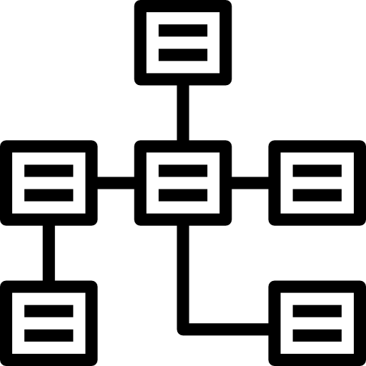

A Microservice
Secret Provider
Vault
Multi-tenant Architecture
Web Application
Schema
Company A
Database
Schema
Company A
Independent Development
Schema
Company A
Schema
Company A
Independent Database

Slide 25





Current Microservices
Message
Queue
Sales
Application
Gateway
Auth
Security
Accounting
File Service
Utility (Email)

Slide 26
Event Driven Architecture with Kafka
Kafka Cluster
Sales
Invoice_created
Accounting
Purchase
Order_created
HR
Salary_disbursed
Inventory
Consumers
Producers

Slide 27
Deep Dive into Authentication #Normal
Token / Session
Security

Slide 28
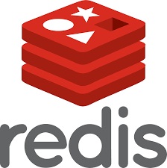
Deep Dive into Authentication #Low Latency
Token / Session
Security

Slide 29
Deep Dive into Authentication #Distributed
Token / Session
Security
US
Token / Session
Security
UAE

Slide 30
Deep Dive into Authentication #Distributed
JWT
Security
US
Shared Secret Key
JWT
Security
UAE
Shared Secret Key

Slide 31
Is JWT enough for authentication and authorization?

Slide 32
JWT
{
“userId”: “....”,
“organizationId”: “....”,
“role”: “member”,
“permissions”: ???
}
Is sent via ‘Authentication’ Header or as Cookie (which is also a HTTP Header)
Authentication Header Typical Limit is -
8kB
Accounting.ManualJournal = [“Create”, “Draft”, “Read”, “Edit”, “Approve”]

Slide 33
Some Calculation - Permission
There are about 500 permissions in current PrideERP, considering each permission can have 8 true/false values, we need -
500 * 8 bits = 500 Bytes binary data
JSON cannot have binary data, we encode the binary data as base64
500 Bytes * 133% = 665 Bytes (base64 encoding needs 33% more space)
JWT keeps JSON Payload as base64, so finally space needed in header
665 Bytes * 133% = 885 Bytes (which can be fitted to 8kB header)

Slide 34
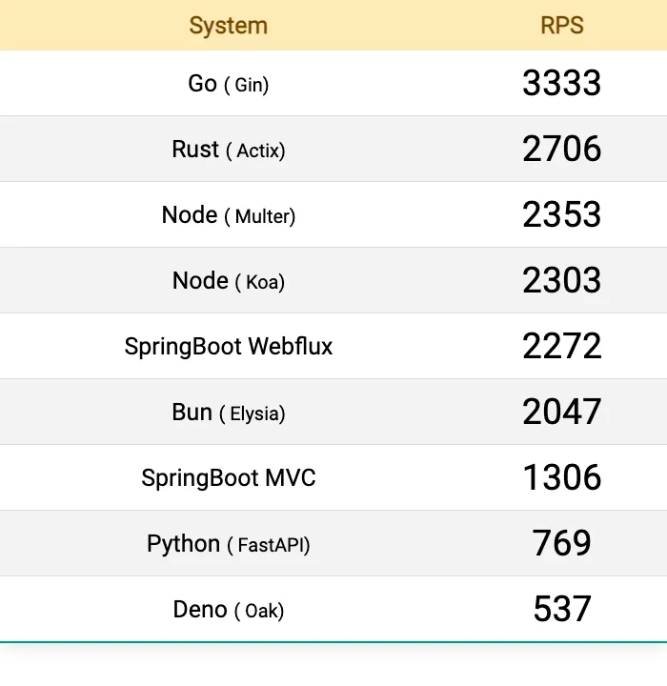
File Service - Golang
File Service uploads file to Azure Blob Storage
Go (Gin) outperforms 2.5x than Spring Boot due to its better concurrency support.
RPS - Request per Second
[Experiment Link]

Slide 35
Infrastructure
Current Hosted solution, why cloud?
Kubernetes
Infrastructure description
Managing infrastructure

Slide 36

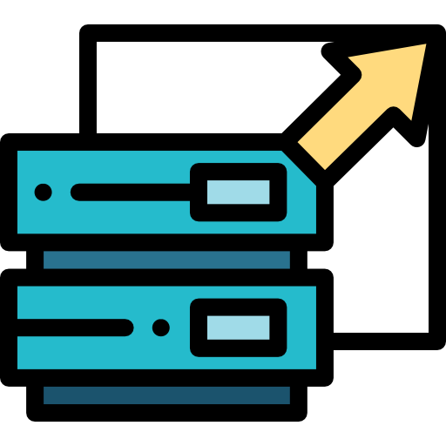
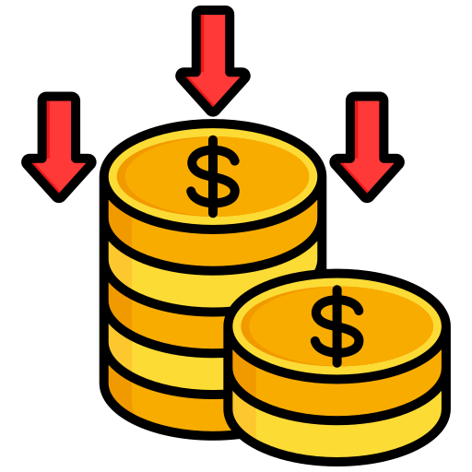
Cloud over On Premise
Global Customer Base
Scalability
Cost Efficiency

Slide 37
Kubernetes
NGINX Gateway / Reverse Proxy
Orchestration tool for container
Ingress
Ingress
Container ⇾ Pod [Instance]
Service
Service
Pod ⇾ ReplicaSet [Horizontal Scaling + Fault Tolerant]
Deployment
Deployment
ReplicaSet ⇾ Deployment [Load Balancer + Vertical Scaling]
Replica Set
Replica Set
Deployment ⇾ Service [Service Discovery]
Pod
Pod
Pod
Pod
Service ⇾ Ingress [Routing + TLS/SSL]
Container
Container
Container
Container
Ingress ⇾ Ingress Controller [NGINX Gateway]

Slide 38
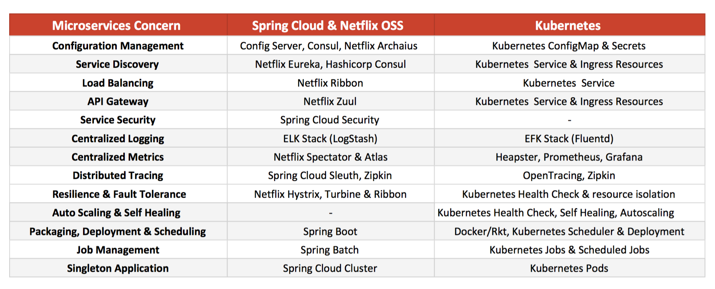
Life without Kubernetes

Slide 39
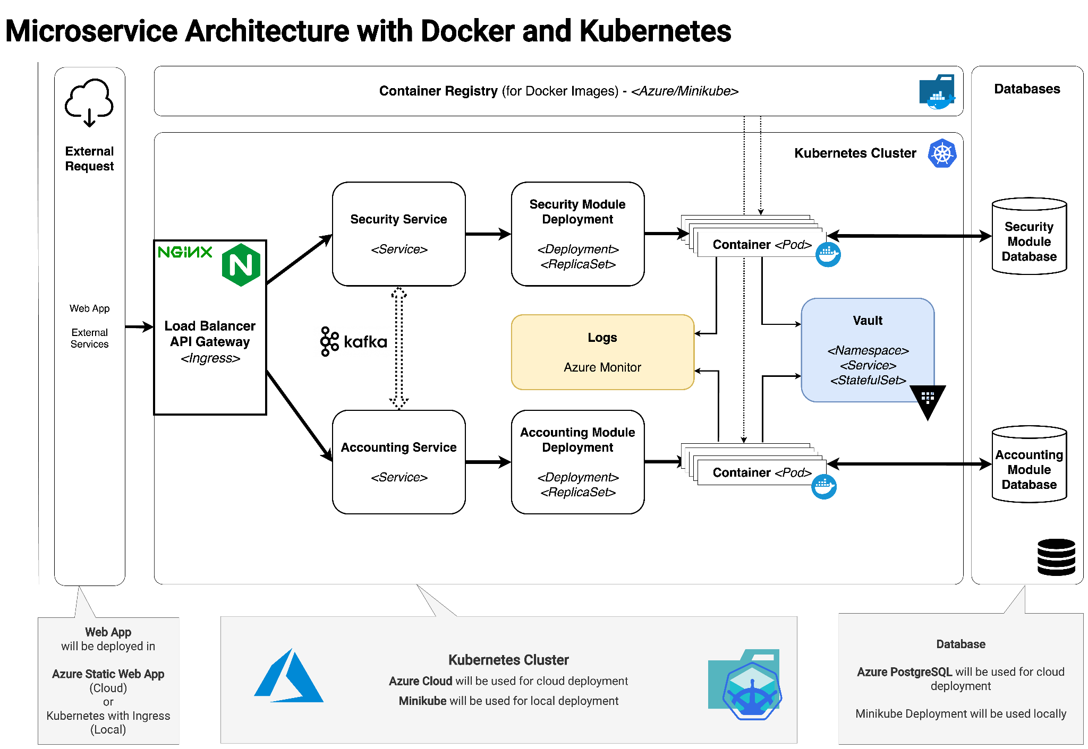

Slide 40
Infrastructure
Resource Provision, State management, Version controlling

Slide 41
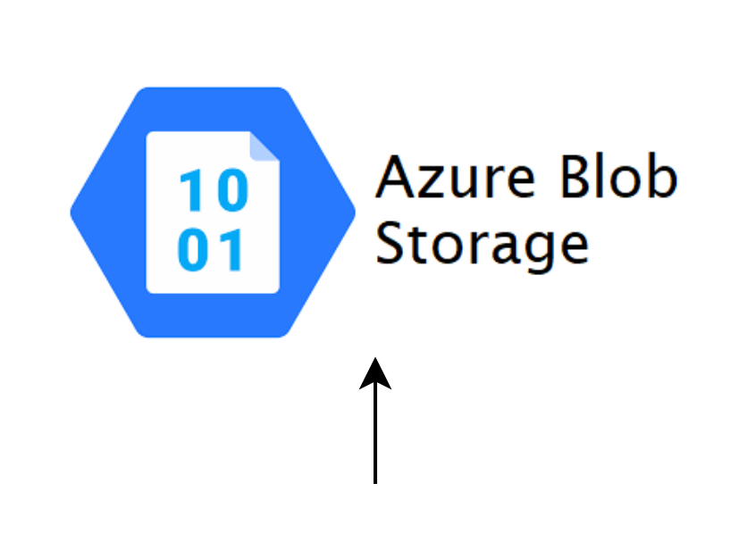
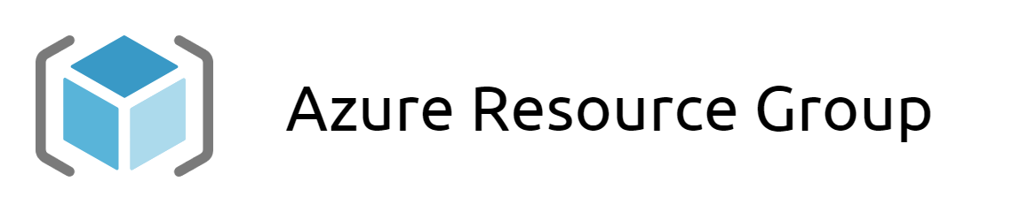
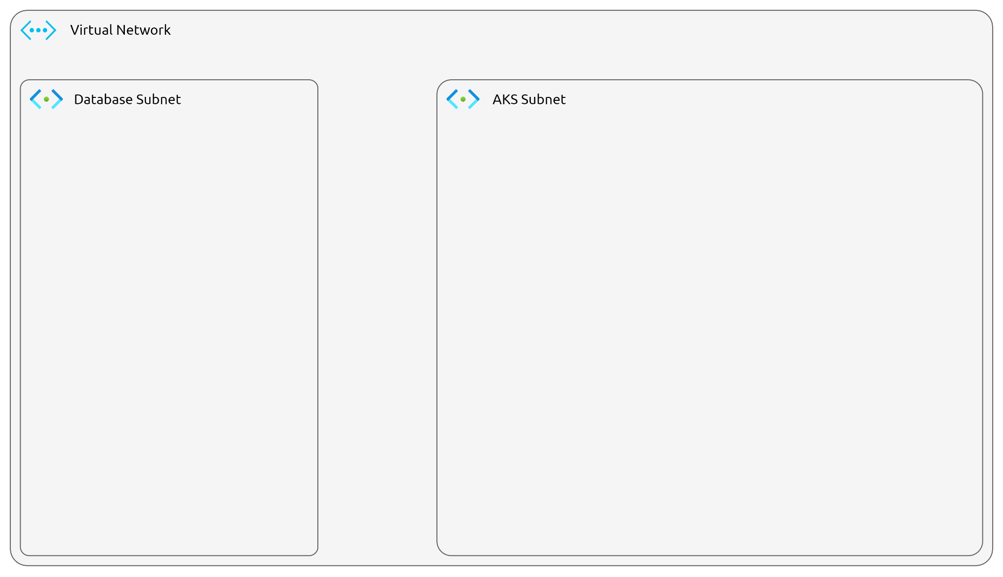
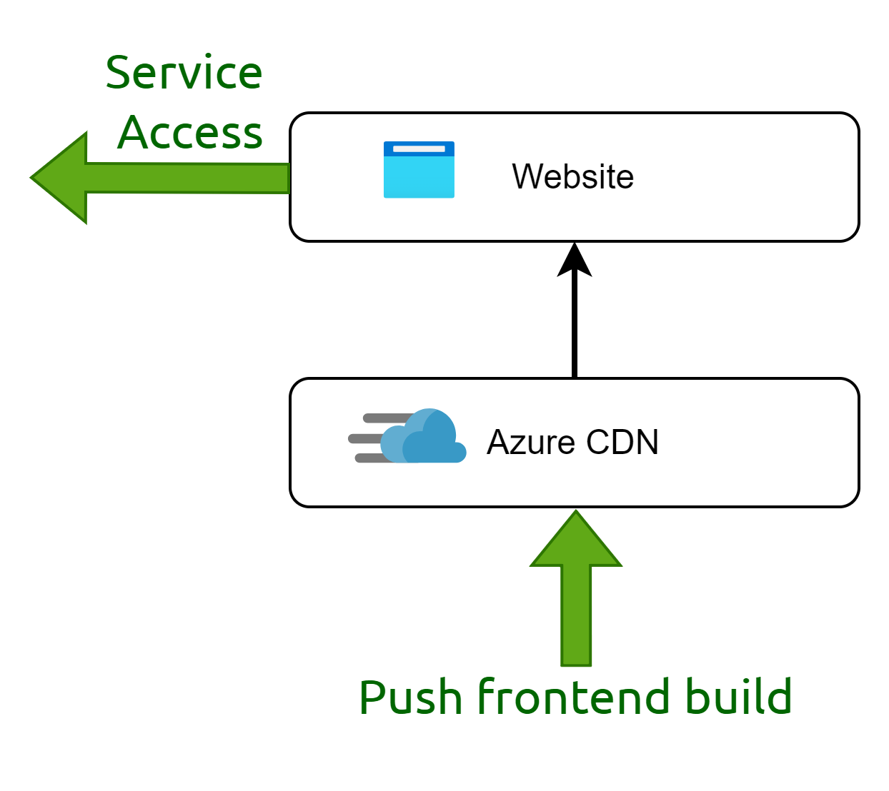
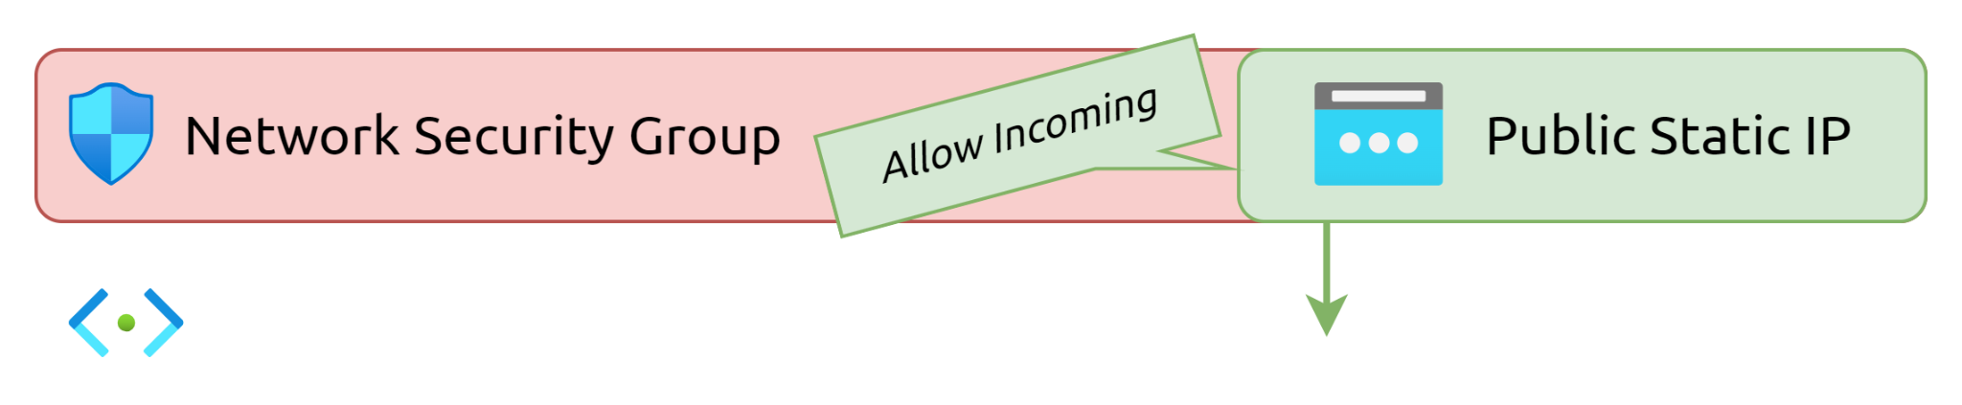
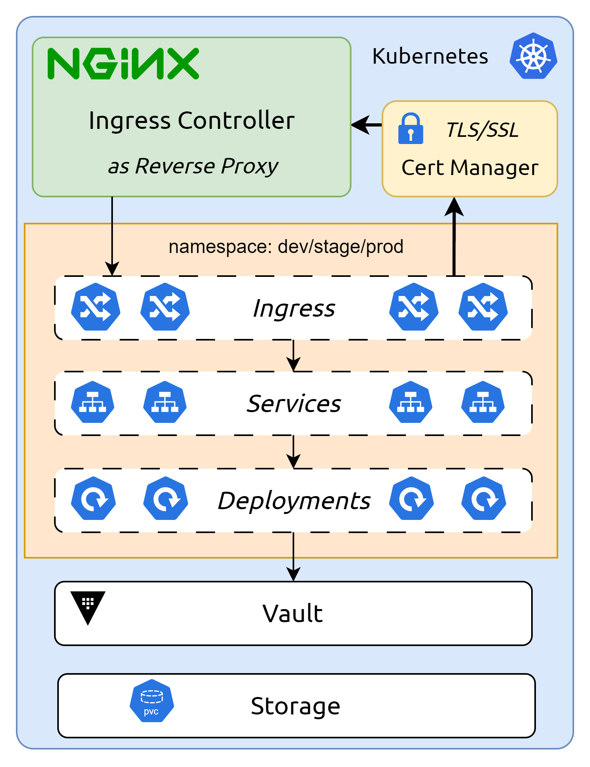
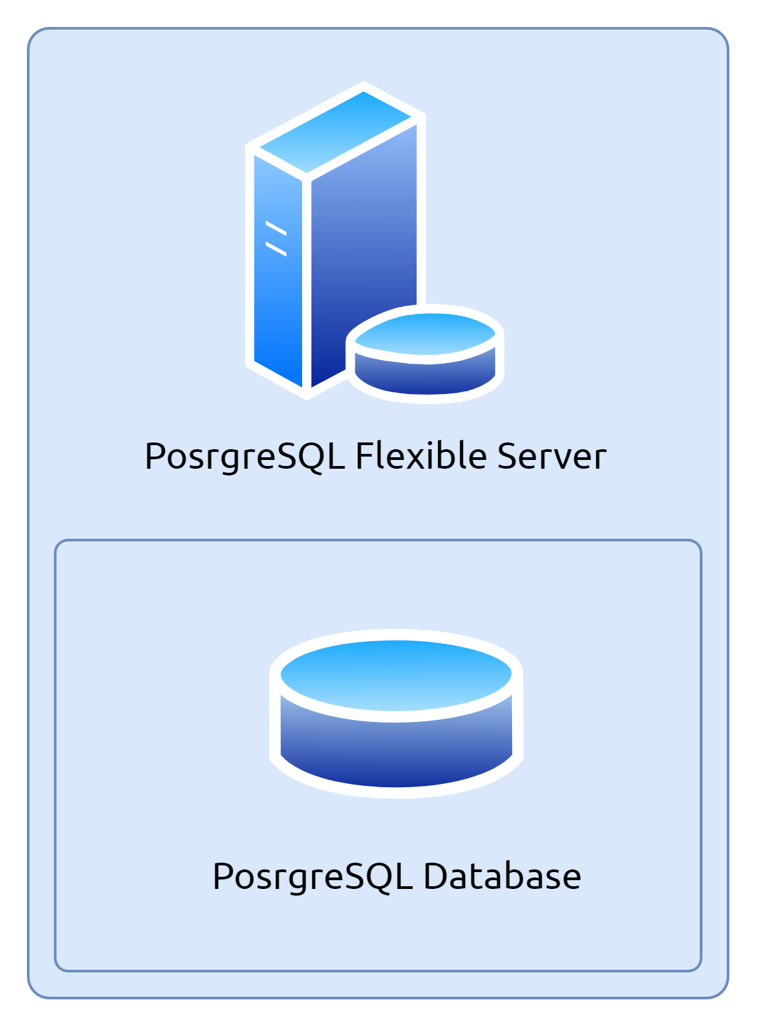
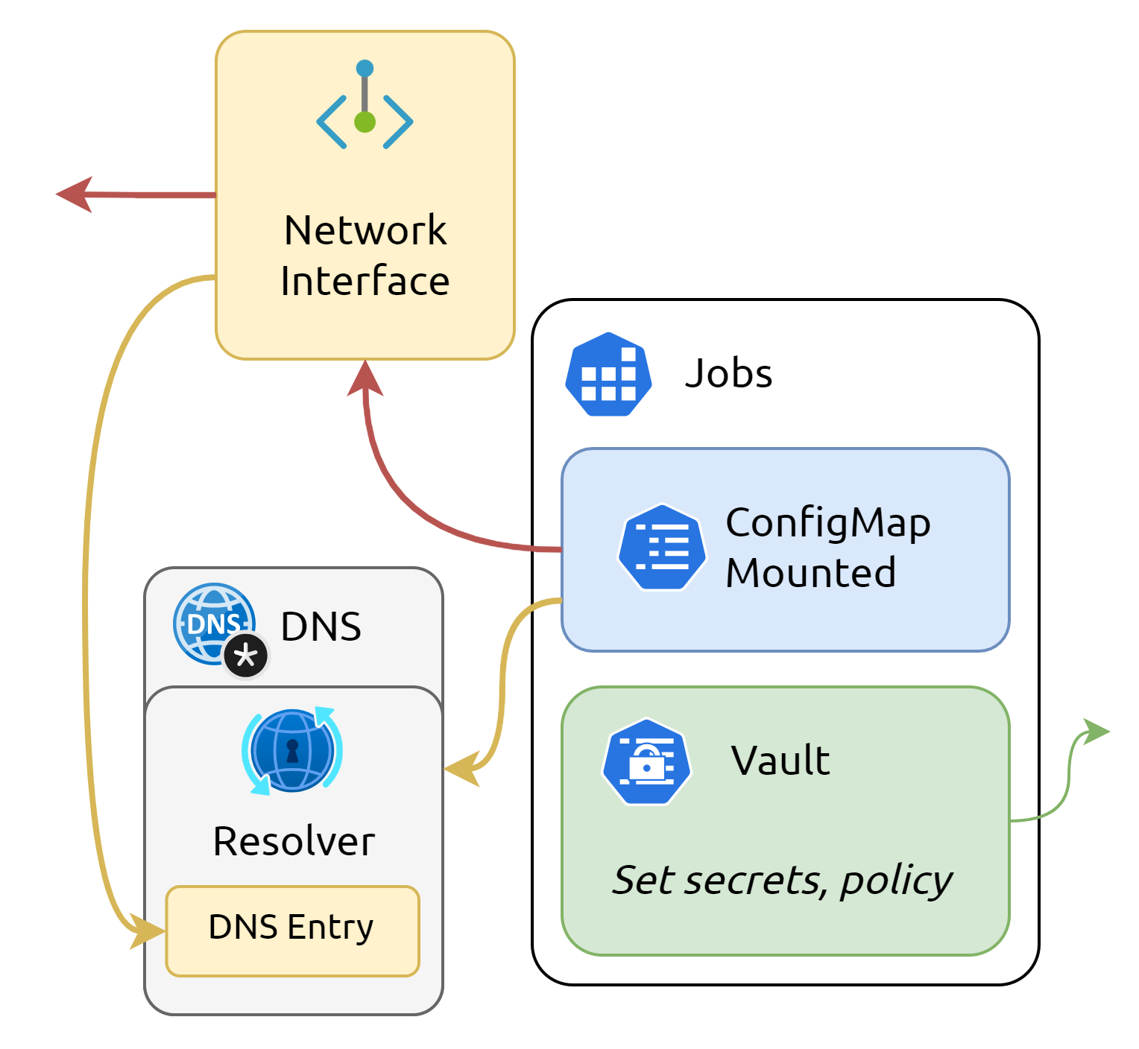
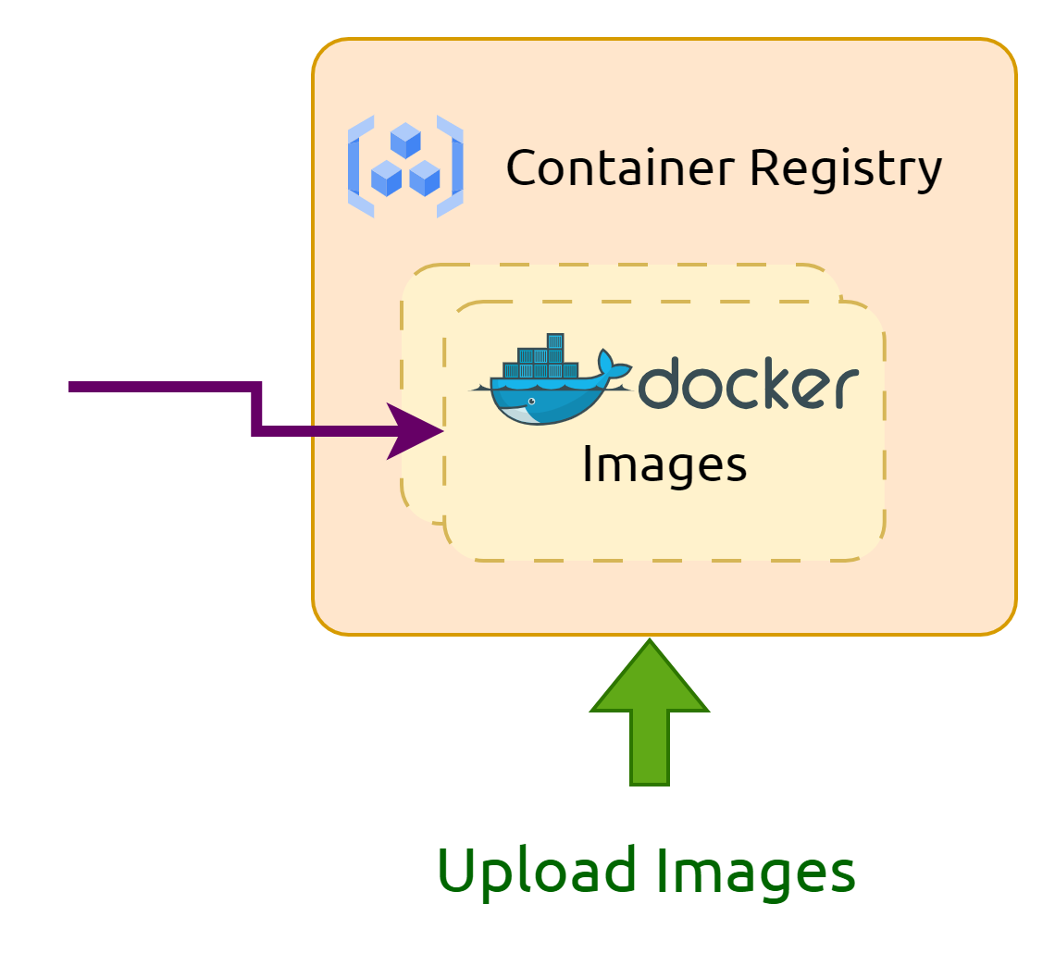
Infrastructure

Slide 42
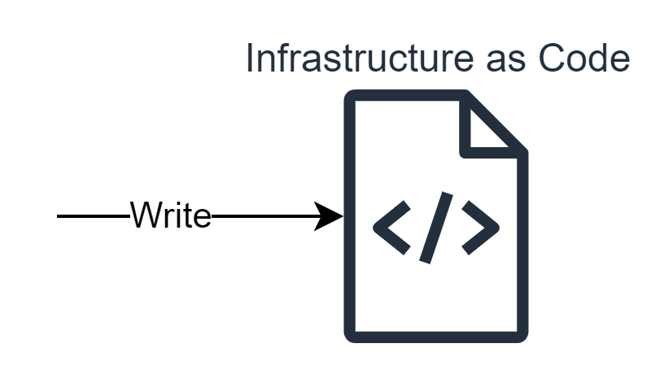
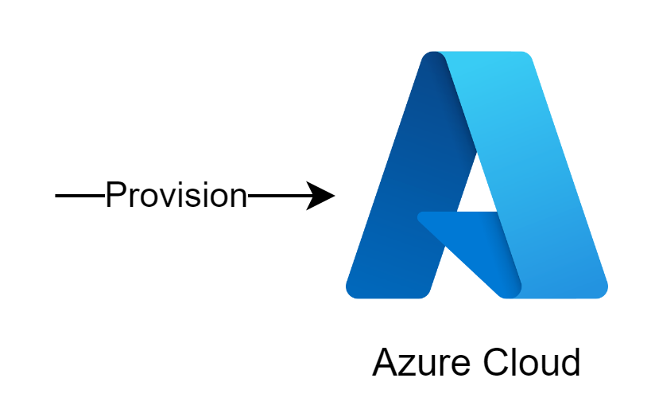

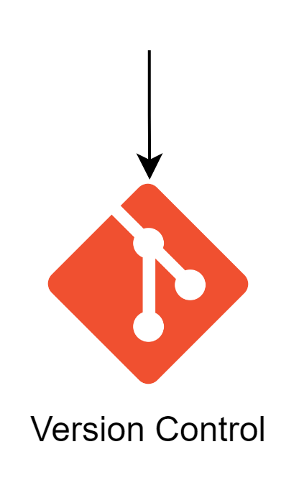
Infrastructure as Code (IaC)

Slide 43


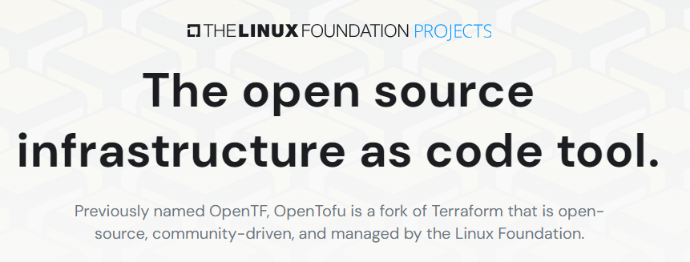
IaC Tool

Slide 44
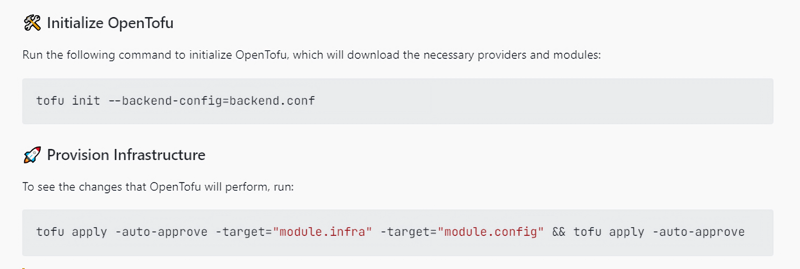
Infrastructure Provisioning

Slide 45
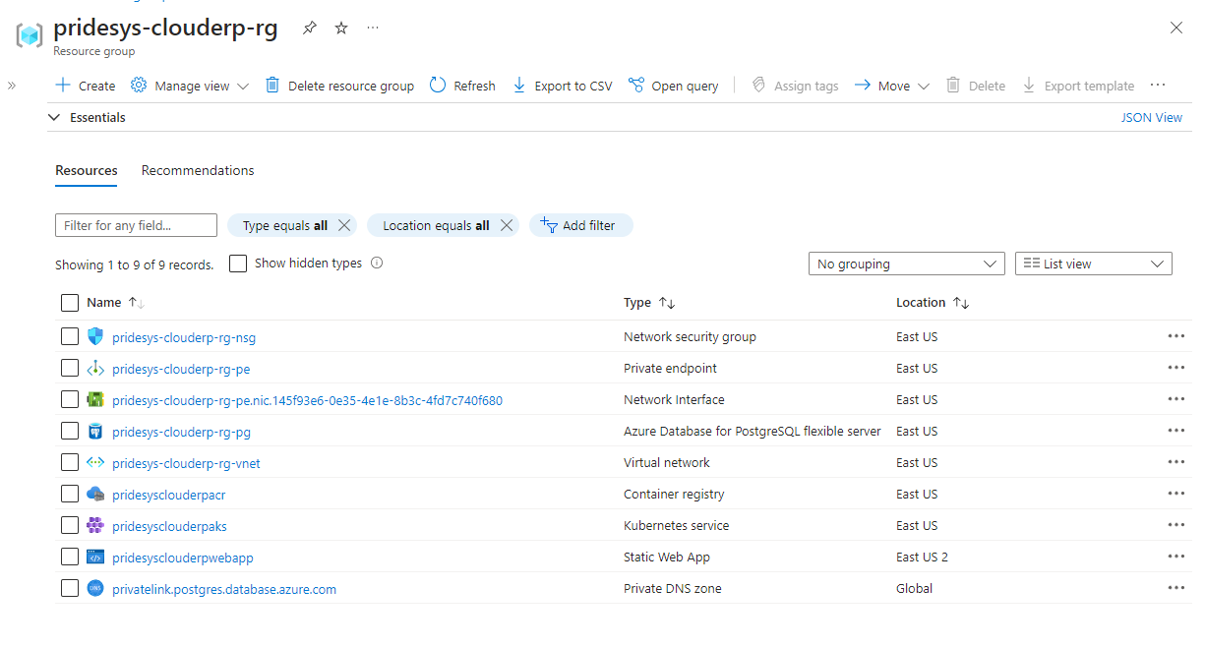
Infrastructure in Azure

Slide 46
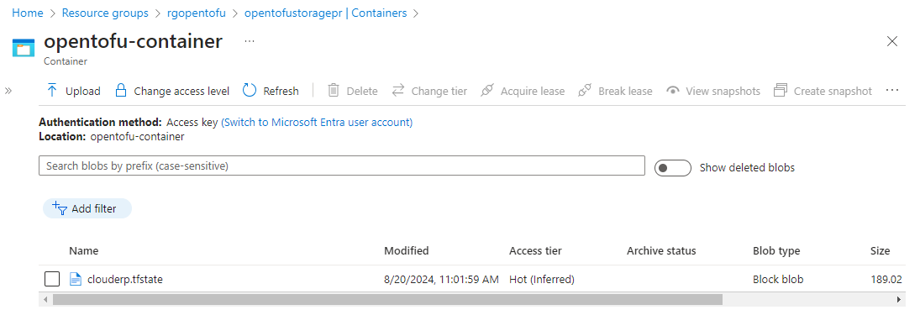
Infrastructure State Management

Slide 47
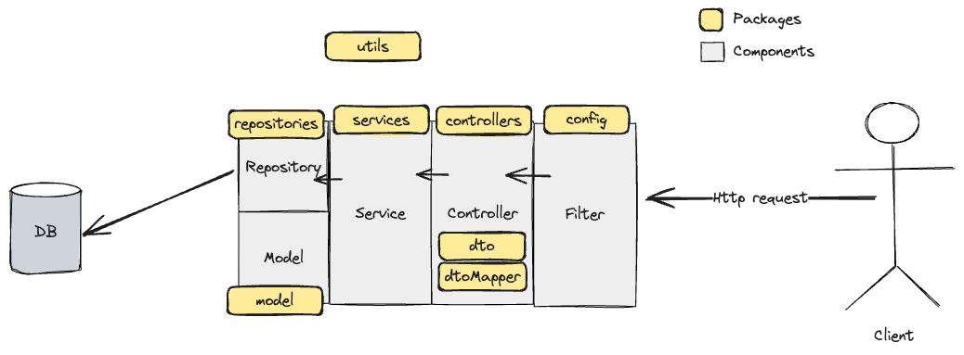
Service Development (Spring Boot)

Slide 48
Service Development (Spring Boot)
Filter
Controller
Service
Repository
Http request
DTO
DTO
Model
Http response
Exception
Exception
Exception
Exception
Client
DTO
Model
Http response with specific error status
Global Exception Handler
DTO Mapper

Slide 49
Project Structure
src
├── main
│ ├── java
│ │ └── com.pridesys.clouderp.security
│ │ ├── config
│ │ ├── controller
│ │ ├── dto
│ │ ├── dtoMapper
│ │ ├── exception
│ │ ├── model
│ │ ├── repositories
│ │ ├── service
│ │ ├── types
│ │ └── utils
│ └── resources
│ ├── db
│ └── templates
└── test
├── java
│ └── com.pridesys.clouderp.security
│ ├── controller
│ ├── repository
│ └── service
└── resources
└── templates

Slide 50
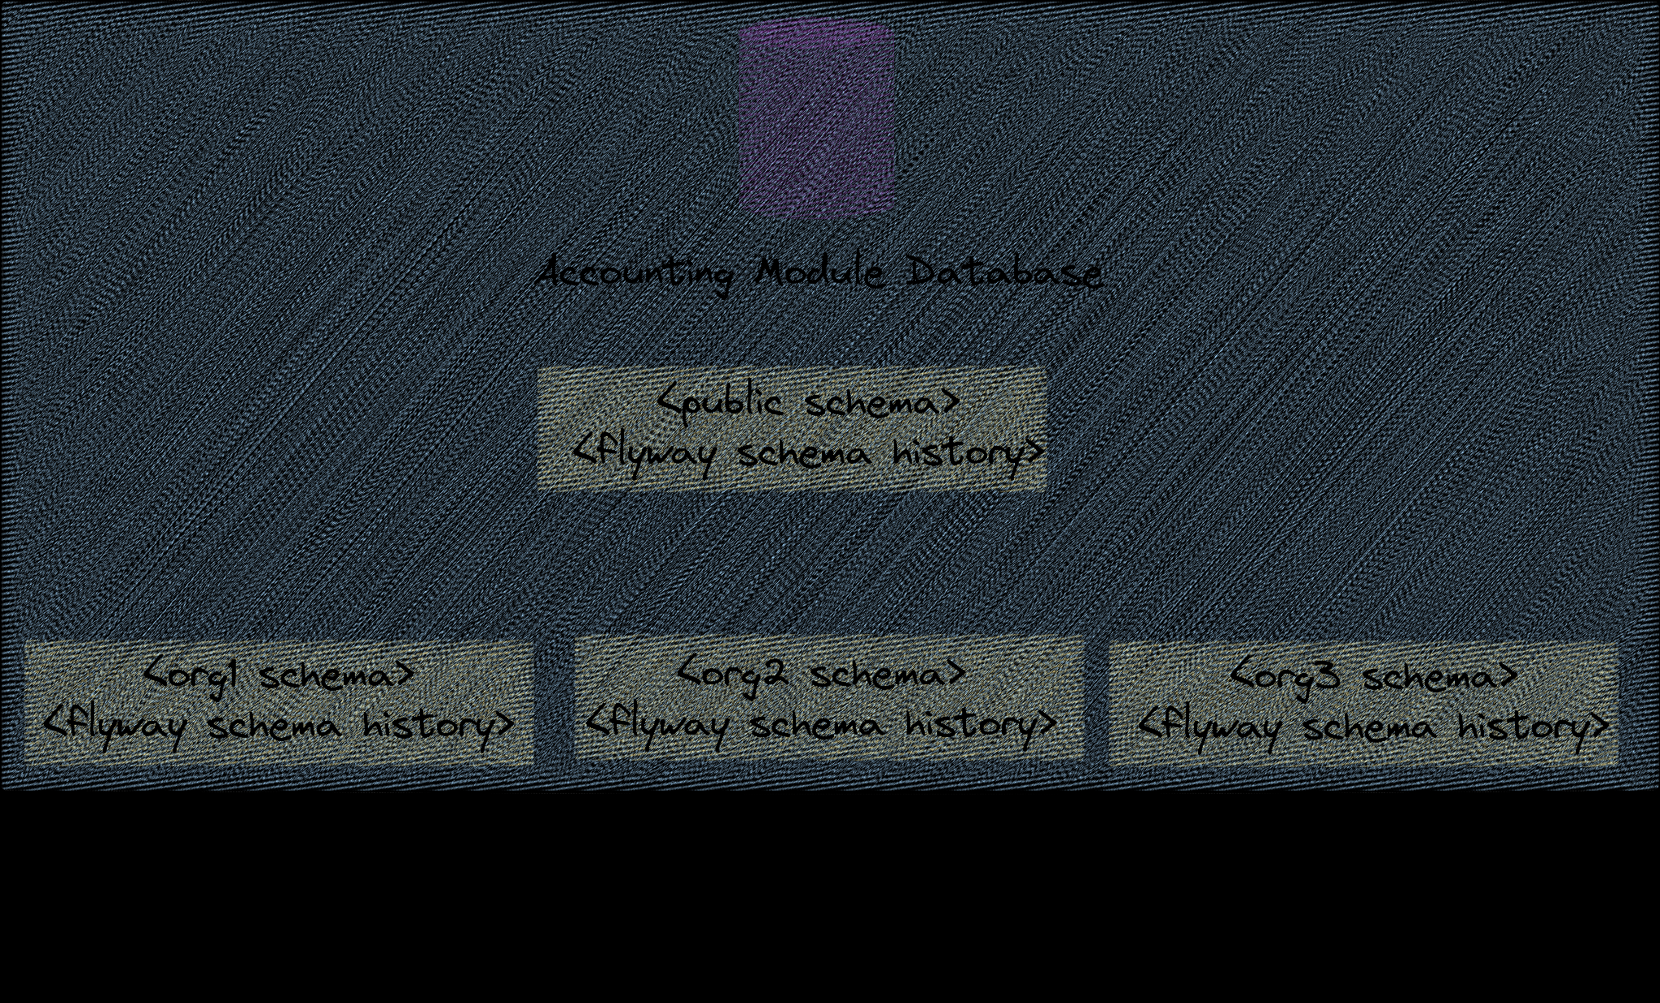
Multi-tenant Database

Slide 51
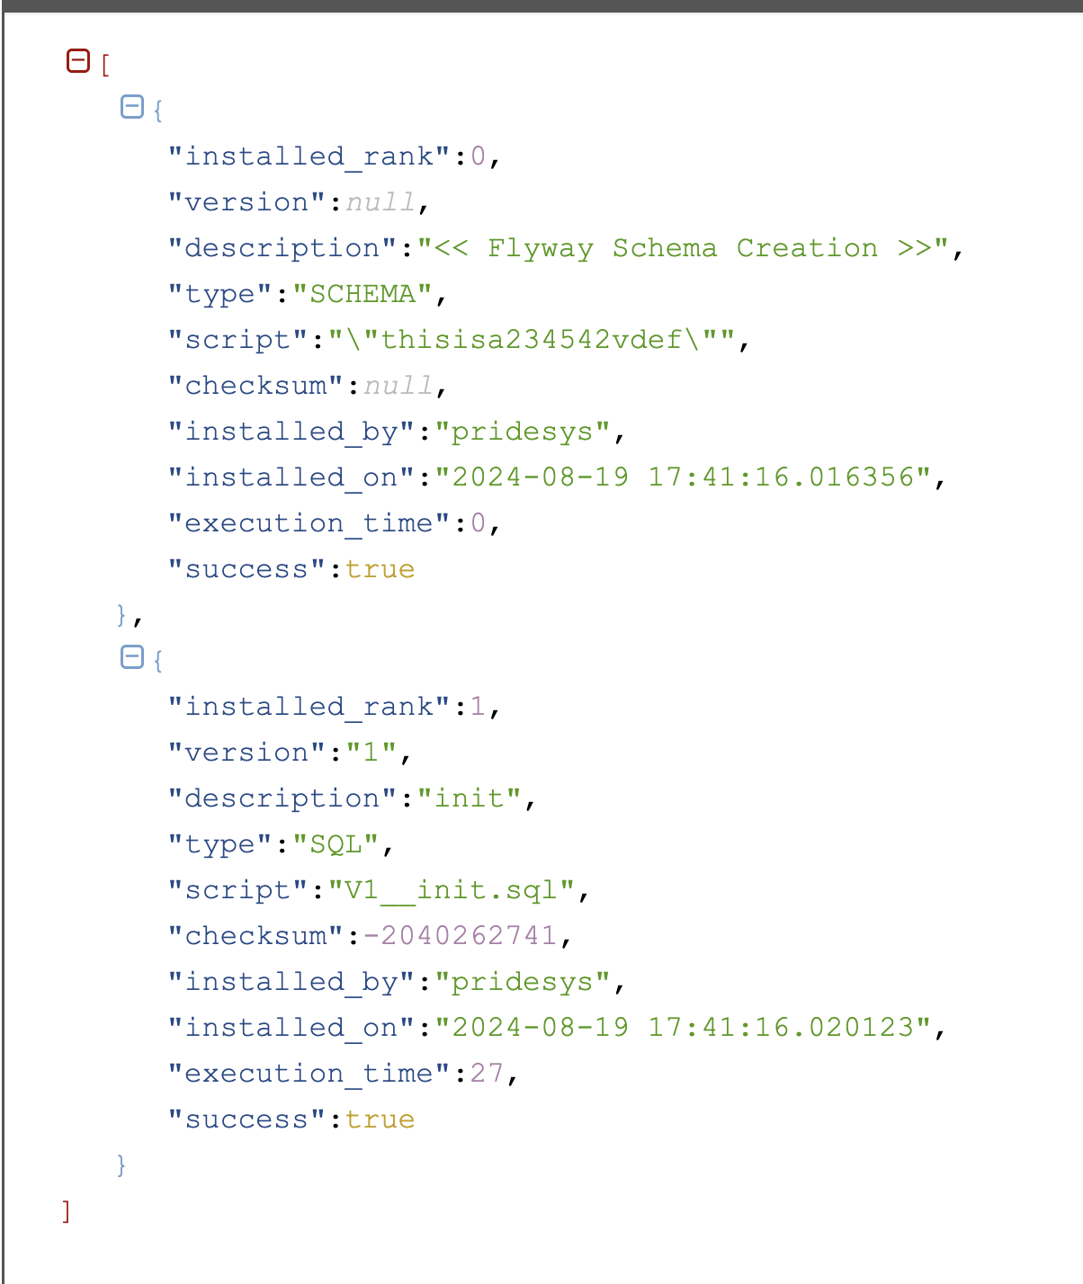
Flyway Schema History

Slide 52
DB Migration Structure
src
├── main
│ ├── resources
│ │ └── db
│ │ ├── migration
│ │ │ └── V1__init.sql
│ │ │ ├── V2__add_updatedat_col.sql
│ │ ├── tenants
│ │ └── V1__init.sql
│ │ ├── V2__add_journal_table.sql
│ └── resources
│ └── templates
└── test

Slide 53
Tests
Unit
Integration
Performance
Code coverage

Slide 54

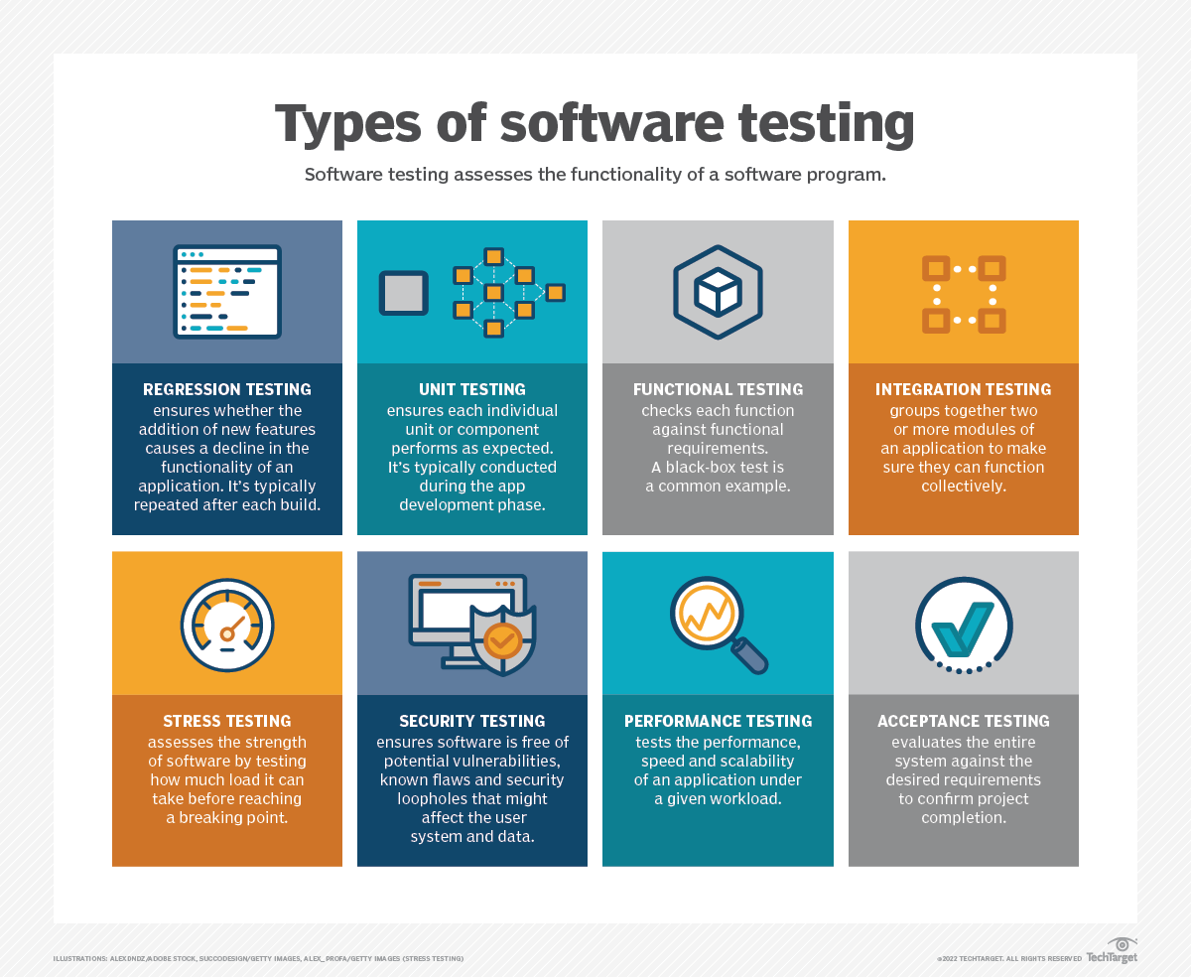

Unit Testing

Slide 55
Integration Tests

Slide 56

Performance Testing

Slide 57


Code Coverage

Slide 58
Devops
CI/CD

Slide 59
Devops
Continuous Integration
Continuous Deployment
Automation with external software
Automated update to JIRA
Notification to Chat solution

Slide 60
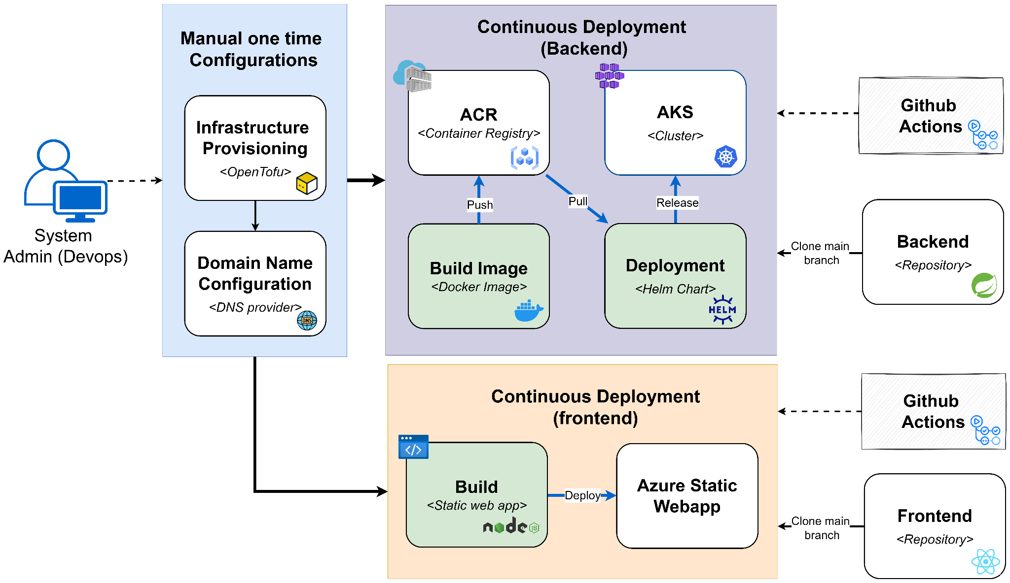
DevOps Lifecycle

Slide 61
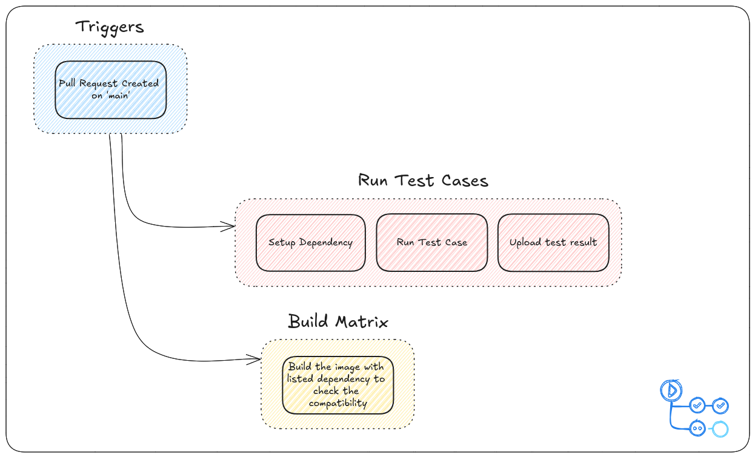
CI Workflow

Slide 62
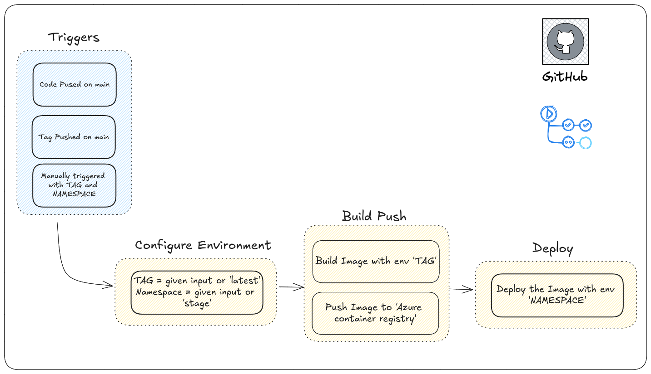
CD workflow

Slide 63
Automation in JIRA
When a branch is created ⮞ Move issue to ‘IN PROGRESS’
When all child issue are completed ⮞ Close the parent issue
When pull request is merged ⮞ Move the issue to ‘DONE’
When commit is created ⮞ Move issue to ‘IN PROGRESS’
When pull request is created ⮞ Move issue to ‘UNDER REVIEW’
When sub task is created ⮞ Automatically assign subtask from parent issues’ assignee

Slide 64
Notification to Chat solution
Whenever any sort of automation is triggered ⮞ Notify about the automation update in one channel.

Slide 65
Current Usage of automation
In JIRA:
Today current usage: 73
Limit in every month: 100
In GITHUB:
Last month’s usage: around 1100 minutes.
Limit in every month: 3000

Slide 66
Documentation
Let’s see all our documents: Documentation
Let’s see our Accounting Module API Documentation: API Doc

Slide 67
Any Questions?

