Slide 1
实验二 SPDK安装和使用
下载SPDK源代码并编译安装
运行NVME hello world程序
通过分析NVME hello world源码学习SPDK基本原理
修改hello world，实现zns命令I/O读写

Slide 2
下载spdk代码 git clone https://github.com/spdk/spdk --recursive
Installing Prerequisites
The scripts/pkgdep.sh script will automatically install the bare minimum dependencies required to build SPDK. Use --help to see information on installing dependencies for optional components.
Option –all will install all dependencies needed by SPDK features.
sudo scripts/pkgdep.sh –all
./configure
make

Slide 3
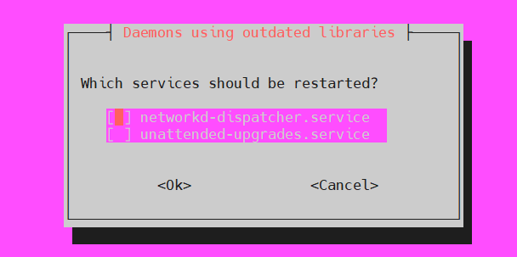
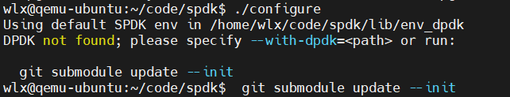
遇到提示框直接按回车跳过，如需重启服务可等待所有依赖库安装完成后进行重启
如遇到以上问题， 执行git submodule update --init

Slide 4
Running the Unit Tests
It's always a good idea to confirm your build worked by running the unit tests.
./test/unit/unittest.sh
You will see several error messages when running the unit tests, but they are part of the test suite. The final message at the end of the script indicates success or failure.
Running the Example Applications
Before running an SPDK application, some hugepages must be allocated and any NVMe and I/OAT devices must be unbound from the native kernel drivers. SPDK includes a script to automate this process on both Linux and FreeBSD. This script should be run as root. It only needs to be run once on the system.
sudo scripts/setup.sh

Slide 5
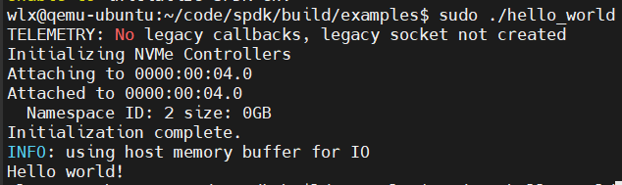
进入spdk/build/，运行sudo ./hello_world查 看结果
对应源码在spdk/examples/nvme/hello_world/hello_world.c

Slide 6
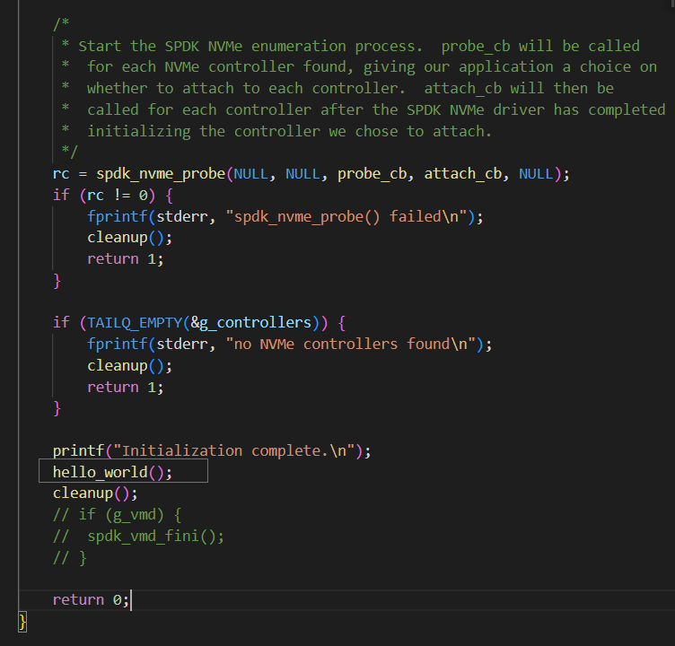
该示例通过spdk向ssd写入并读取了“hello world”字符串
Hello_world()是其主体代码，打开该函数进一步分析

Slide 7
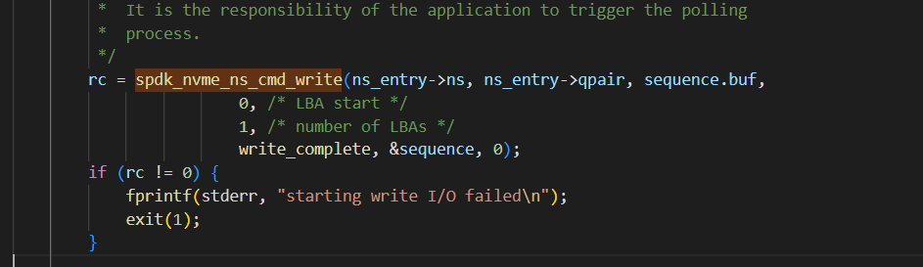
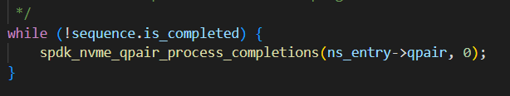
通过向NVME设备发送I/O命令进行数据写入
等待I/O命令完成

Slide 8
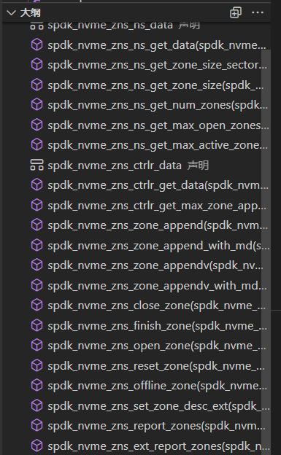
下一步我们需要调用ZNS相关函数修改hello world文件实现数据读写
打开include\nvme_zns.h文件，浏览SPDK提供的ZNS 驱动接口函数

Slide 9
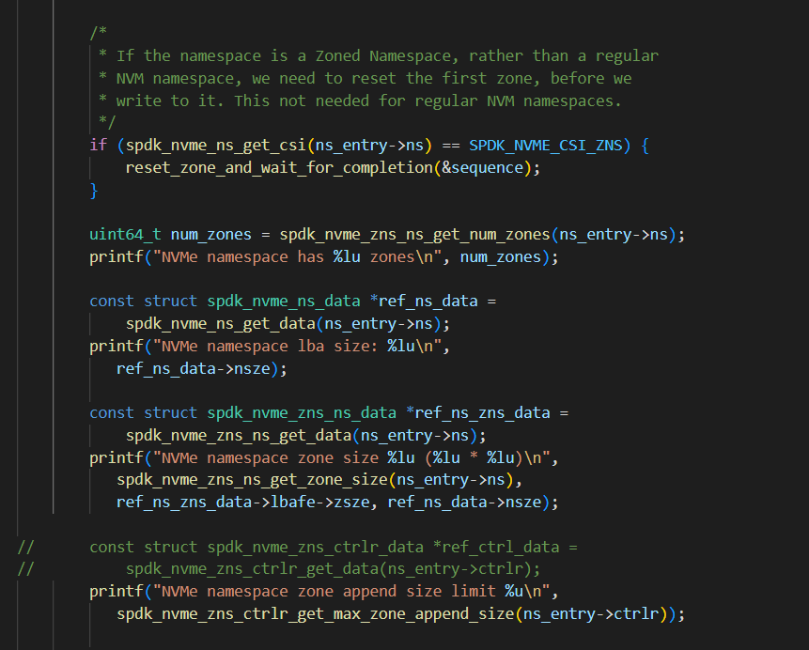
可用此部分代码输出NVMe ZNS信息

Slide 10
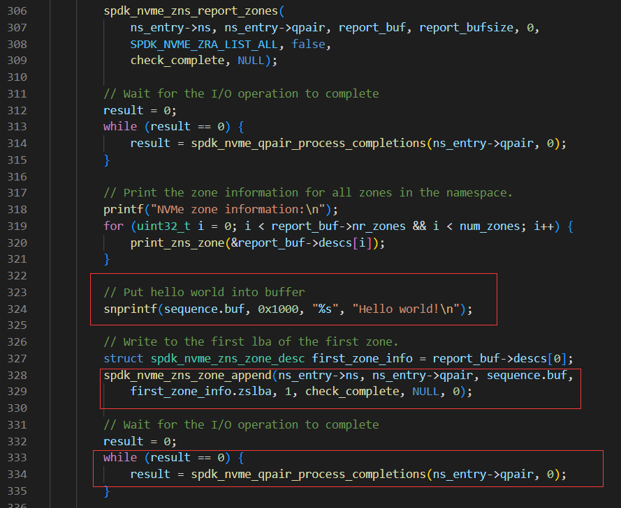
将数据写入缓存
调用ZNS 驱动函数将缓存数据append到zone中
等待队列完成

Slide 11
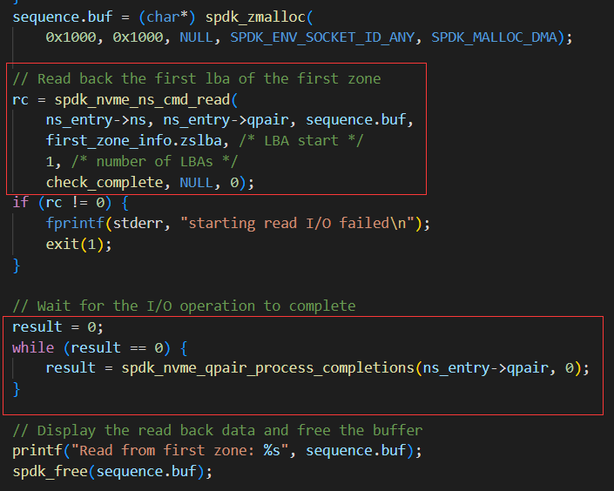
从ssd中读取数据到缓存
等待操作完成
输出读取结果
通过以上分析和代码修改实现可帮助我们理解SPDK ZNS基本读写操作原理

