Slide 1
Connecting your RPi to the IBM Watson IoT Foundation(NodeRed and Cloudant!)
March 09th, 2017 | IoT Training Workshop
AP Cloud Team
Leadership Members and Trainers
Miracle Software Systems, Inc.

Slide 2
Agenda
9:30 AM
Introducing AP Cloud, ViBUG and Workshop Agenda
9:45 AM
Setup and Installation
10:15 AM
Introductions to IoT
10:30 AM
Watson IoT Foundation
11:00 AM
Lab #1 - Connect OBD Simulator
1:00 PM
Interactive Lunch with Innovative Conversation
1:45 PM
Introduction to Node Red
2:00 PM
Lab #2 - Node Red to Cloudant
3:45 PM
Recap, Q&A and Interaction

Slide 3
AP Cloud and Our Goal
Delivering knowledge around SMAC Technologies to students across AP through the network of 50 associated Universities and Colleges and industry knowledge coming from affiliated US Based IT Organizations
100,000 Digital Transformation Skills Professionals enabled in Andhra Pradesh in the next 24 months

Slide 4
Vizag Bluemix User Group
Vizag-based User group focused on IBM Bluemix with topics including,
Cloud Infrastructure Provisioning
Cloud Application Architecture
Cognitive Services and Applications
IoT Platform and Devices
Sponsored By

Slide 5
ViBUG – Introduction and Goals
Spread Digital Technology with platforms such as IBM Bluemix and Watson
Meet every month and deliver hands-on workshops from a variety of speakers
Ensure that Vizag can become a hub for the skills required for digital transformation
Focus on student and IT professional enablement around IBM Bluemix
Have fun and build new things with technology!

Slide 6
An Explosion of Possibilities
2020
50.1 Billion!
50
2019
42.1 Billion
2018
34.8 Billion
2017
40
28.4 Billion
2016
22.9 Billion
2015
18.2 Billion
30
2014
Billions of Devices
14.4 Billion
2013
11.2 Billion
20
2012
8.7 Billion
1992
2009
1,00,000
IoT Inception
10
2002
0.5 Billion
0
‘90
‘92
‘94
‘96
‘98
‘00
‘02
‘04
‘06
‘08
‘10
‘12
‘14
‘16
‘18
‘20

Slide 7
An Explosion of Possibilities
2020
50.1 Billion!
“From homes to retail stores, things around you are starting to become intelligent and communicate with each other! Welcome to the new age of Connected Things ☺”
50
2019
42.1 Billion
2018
34.8 Billion
2017
40
28.4 Billion
2016
22.9 Billion
2015
18.2 Billion
30
2014
Billions of Devices
14.4 Billion
2013
11.2 Billion
20
2012
An Explosion of Possibilities
8.7 Billion
1992
2009
1,00,000
IoT Inception
10
2002
0.5 Billion
0
‘90
‘92
‘94
‘96
‘98
‘00
‘02
‘04
‘06
‘08
‘10
‘12
‘14
‘16
‘18
‘20

Slide 8
What can you do with IoT Data?
Predict
Outcomes and demand through data and patterns collected by connected things
Monetize
Data coming from your network of things and expose to the world for innovation
Extend
Your devices and sensors as APIs and Services to be consumed in innovative ideas
Control
Machines, homes and more through your smart phones and network of connections
Control your car with a mobile device (or) predict machine health and failure with a sensor!

Slide 9
IBM Bluemix and the Watson IoT Platform
Connect Devices and Sensors to the Cloud in minutes ☺

Slide 10



IBM Bluemix for Innovation
Deploy and manage hybrid apps seamlessly
Get a seamless dev and management experience across a number of hybrid implementations options
Rapidly bring new products and services to market at lower cost
Build your apps, your way
Use the most prominent compute technologies to power your app: Cloud Foundry, Docker, OpenStack
Scale more than just instances
Development, monitoring, deployment, and logging tools allow the developer to run and manage the entire application
Scale more than just instances
Development, monitoring, deployment, and logging tools allow the developer to run and manage the entire application
Balance agility with quality, security and governance
Extend apps with services
A catalog of IBM, third party, and open source services allow the developer to stitch an application together quickly
Flexible Pricing
Try compute options and services for free and, when you’re ready, pay only for what you use. Pay as you go and subscription models offer choice and flexibility
Extend existing IT investments into cloud business and delivery models

Slide 11
Watson IoT Platform
Responsive
Connectivity
Device
Management
Secure
Communication
Storage and
Access to Data
IBM Bluemix

Slide 12
Understanding Things?
MQTT
Your device or gateway
REST and Real-Time APIs
IBM Watson IoT Platform
Your application and analytics

Slide 13
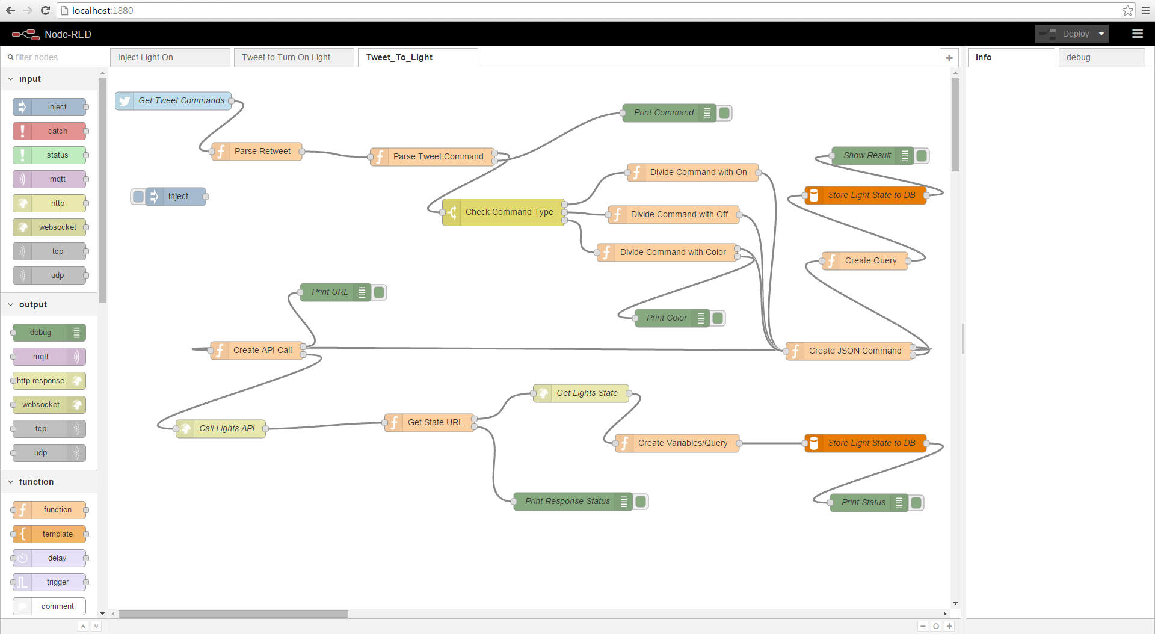
Introducing NodeRed
A Visual Tool for WIRING the Internet of Things ☺

Slide 14
Lets go Hands On with IoT and Devices
Storing data from your OBD Simulator to a Cloud DB

Slide 15
Our teams are dedicated to innovating with IT and redefining solutions for customer excellence. To learn more visit, www.miraclesoft.com

