Slide 1

Advertisement Impression Forecast
——Tencent advertising algorithm competition

Slide 2
01. Introduction
02. Data model
CONTENTS
01.项目简介
Project description
03. Machine Learning Method
目 录
02.市场分析
Market analysis
04. Conclusion
CONTENTS
Investment
03.产品设计
Product design
04.投资回报

Slide 3
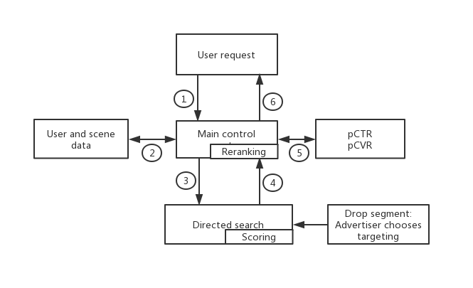
01. Introduction
Advertising exposure process：
1
User send request in this advertising slot
2
Supplement the user information
Send the request corresponding to the User
3
Send back some useful advertisement
4
Sort by some precise factors，pCTR,pCVR
5
Send back to the User
6

Slide 4
01. Introduction
CPM(Cost Per Mile)
1) Bid and billing model: According to the thousand exposure bidding / billing.
2) Performance indicator: Thousand exposure cost.
CTR
CPC(Cost Per Click)
1) Bid and billing model: According to the Click bidding / billing.
2) Performance indicator: Single click cost.
CVR
CPA(Cost Per Action)
1) Bid and billing model: According to the Conversion bidding / billing.
2) Performance indicator: Single conversion cost.
oCPA(optimized Cost Per Action)
1) Separation of bidding and billing methods.
2) Automatic bidding.
GSP(Generalized Second Price)
For bivalent billing, the bid of the i-th advertiser is equal to the bid of the i+1th advertiser plus a small value.

Slide 5


01. Introduction
Exposure competition mechanism：
Cpm_bid
1000*Cpm_bid*pctr
The winner advertisement
1000*Cpa_bid*pctr*pcvr
eCPM
pctr
Total eCPM
pcvr
Quality eCPM
Negative Feedback

Slide 6

01. Introduction
Our goal: Predict impression advertisement with some feature.
Notes:
High integration;
Small footprint;
Solid-liquid separation;
Stable effluent.

Slide 7
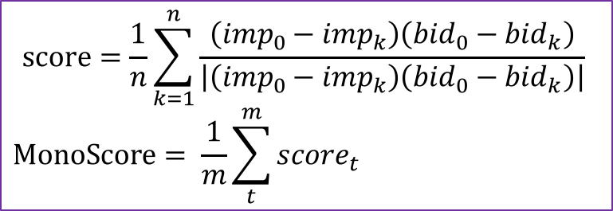
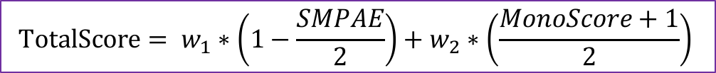
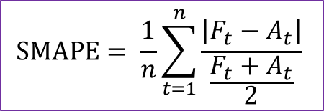
01. Introduction
How to access our prediction:
Accuracy score(SMAPE)：
Impression-bid monotonicity score：
$$score=\frac{1}{n}\sum_{k=1}^{n}{\frac{\left({imp}_{0}−{imp}_{k}\right)\left({bid}_{0}−{bid}_{k}\right)}{\left|\left({imp}_{0}−{imp}_{k}\right)\left({bid}_{0}−{bid}_{k}\right)\right|}}$$
$$MonoScore= \frac{1}{m}\sum_{t}^{m}{{score}_{t}}$$
$$SMAPE= \frac{1}{n}\sum_{t=1}^{n}{\frac{\left|F_{t}−A_{t}\right|}{\frac{F_{t}+A_{t}}{2}}}$$
$$TotalScore= w_{1}∗\left(1−\frac{SMPAE}{2}\right)+w_{2}∗\left(\frac{MonoScore+1}{2}\right)$$

Slide 8

“Data determine the upper bound of machine learning, and the algorithm only approximates it as close as possible.”

Slide 9
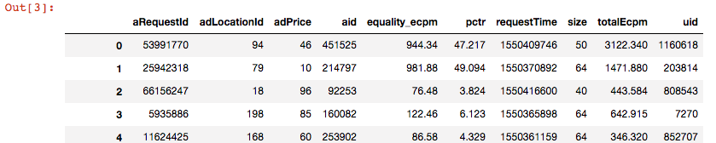
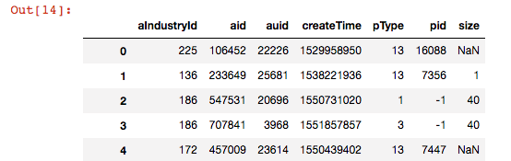

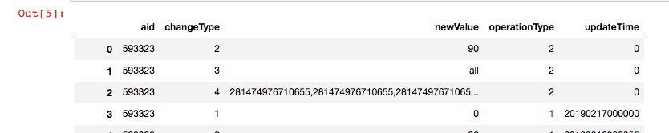
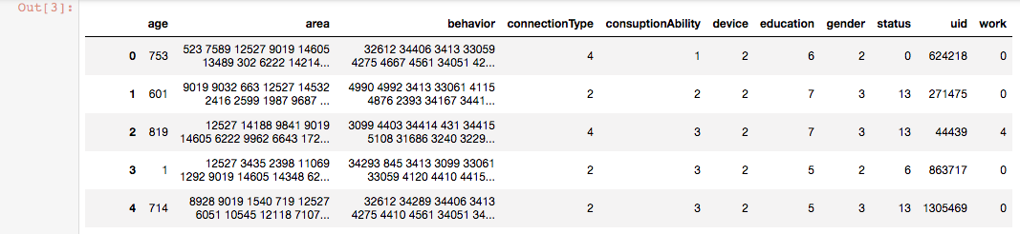

02. Data model
Explore data analysis:
totalExposureLog.out ——> totalExposureLog.csv
ad_static_feature.out ——> ad_static_feature.csv
ad_operation.dat ——> ad_operation.csv
user_data ——> user_data.csv

Slide 10
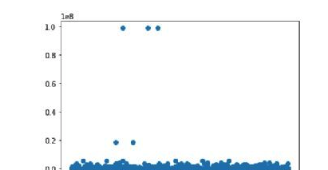
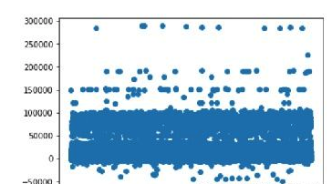
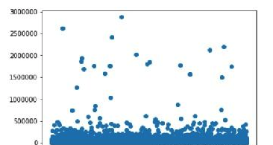
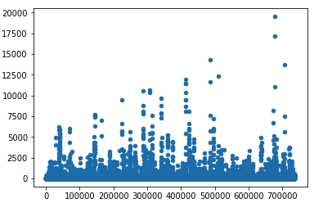
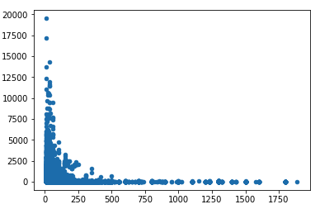
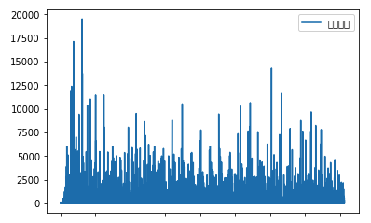
02. Data model
Explore data analysis:
bid Scatter plot
quality_ecpm Scatter plot
totalEcpm Scatter plot
Advertising Id with Exposure Number
bid with Exposure Number
Advertising Request Date with Exposure Number

Slide 11
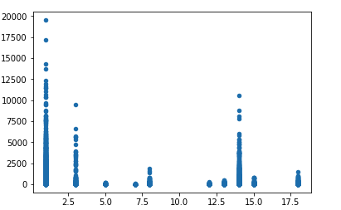
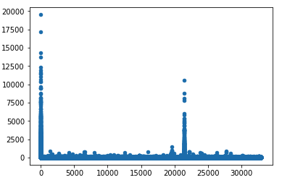
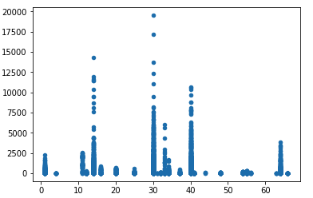
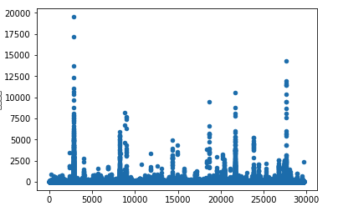
02. Data model
Explore data analysis:
Commodity Type with Exposure Number
Commodity ID with Exposure times
size with exposure times
Advertising account ID with Exposure times

Slide 12
02. Data model
Explore data analysis: Abnormal Value Processing
1. Remove some outliers from the scatter we can know the threshold.
2. For ad_operation , if there exists the aid is not in ad_static, we can remove it.
If the request time is beyond 2.30, we can remove it.
Remove the example in totalExposureLog, if the adlocationid is multivalued, ID class data appearing decimal.
Remove the example in totalExposureLog, if the aid is not in ad_static.
The same user, the same advertisement id, the same request time, the same request id, the same advertisement bit id, and the record of the same material size shall be regarded as improper operation by the user.(carton)
Remove the data in totalExposureLog, which don’t have advertising creation time, bid, target crowd and launch time.

Slide 13
02. Data model
Explore data analysis: Missing Value Processing
For totalExposureLog, if a field has a missing value/creation time of 0.
For other files, if a field has a miss value, we can use median or mode number to fill.

Slide 14
02. Data model
Construct Training Data Set (prototype):
In totalExposureLog, Groupby (['Advertising id','Request month','Request day') was used to calculate the frequency of occurrence. Which we can get the label.
In the test set which was given, we can know some obvious feature, like size, advertising industry id, commodity type, commodity id, advertising account ID, so we can just merge with ad_static data. And for other feature, like create time, the target people we can merge with ad_operation data, and for user features, we can merge with user data.
For data in totalExposureLog the feature Exposuretime and the feature crowed we can use CountVectorizer just simply do a statistics of a frequency Characteristic.
Offline verification, there are two ways, one is using the last day advertisement exposure data as the offline test set. Another one is K-folds cross-validation.

Slide 15
02. Data model
Training Data Set features:
Input= ['tid','aid','price', 'aIndustryId', 'createTime', 'pType', 'size', 'pricepersize', 'bigprice', 'age', 'connectionType', 'consuptionAbility', 'device', 'education', 'gender', 'status','status1', 'work','work1','equality_ecpm', 'pctr','totalEcpm’,’crowd’]——23 features
Label =[‘label’]
Test Data Set features:
The same as training data set feature.

Slide 16
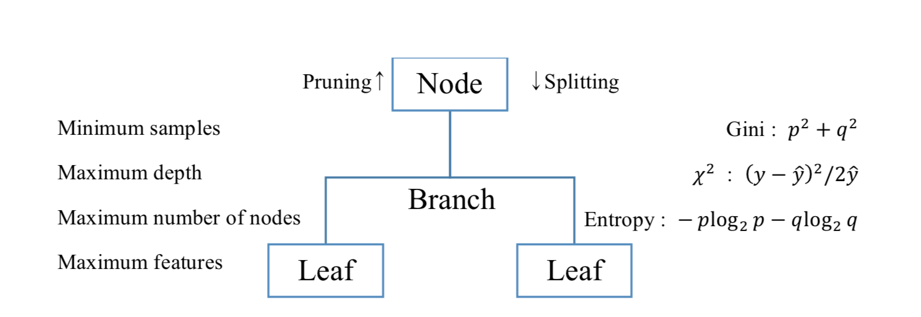
03. Machine Learning Method
1. Decision Tree
Simple description of Tre-based model
Disadvantages：overfitting and non-global optimization by Greedy algorithms. Also, the continuous variables are categorized causing information loss.

Slide 17
03. Machine Learning Method
2. Ensemble
Bootstrapping
Adaptive boosting
Bagging:
Boosting:
Random forest
Gradient boosting
XGBoost [21] is the representative model of gradient tree boosting algorithm, which has overcome the challenges of efficiency in machine learning due to sparsity aware algorithm and weighted quantile sketch for approximate learning.
LightGBM [22] is another typical method augmented by Gradient-based One-Side Sampling and Exclusive Feature Bundling.

Slide 18
04. Conclusion
1. Experiment
Use the previous data model to make the train data set.
Train the data in the different models.
1. Use the data model
2. Train the data in the different models
3. Predict the validate data in the trained model
4. Change the alpha constant
5. Compare the results by each criteria
The linear regression was also considered as control model. The setting of each model was simply adjusted as initial trial . Regression and regression tree were executed without any setting.
The period in given data was totally 31 days with more than 6GB, thus we produced different periods data from 1days before the day to 8 days.
Steps to build initial model

Slide 19
04. Conclusion
Random Forest |  | XGBoost |  | Lightgbm
Criterion | MSE | Objective | Linear regression | Objective | regression | Feature fraction | 0.9
 |  | Col sample by tree | 0.2 | Boosting type | gbdt | Bagging fraction | 0.8
 |  | Max depth | 10 | Metric | I2, I1 | Bagging frequency | 5
Number of estimators | 10 | alpha | 10 | Number of leaves | 31 | Verbose | 0
 |  | Number of estimators | 10 | Learning rate | 0.01
Parameter of each model

Slide 20
04. Conclusion
1. Experiment
Use the previous data model to make the train data set.
Train the data in the different models.
1. Use the data model
2. Train the data in the different models
3. Predict the validate data in the trained model
4. Change the alpha constant
5. Compare the results by each criteria
The linear regression was also considered as control model. The setting of each model was simply adjusted as initial trial . Regression and regression tree were executed without any setting.
The period in given data was totally 31 days with more than 6GB, thus we produced different periods data from 1days before the day to 8 days.
3. Predict the validate data in the trained model.
Based on the trained model, the predictions were generated by last day of given dataset, as validate data in order to compare with actual results.
Steps to build initial model

Slide 21

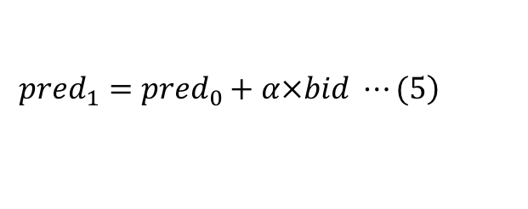
04. Conclusion
Impression-bid monotonicity score：
$$score=\frac{1}{n}\sum_{k=1}^{n}{\frac{\left({imp}_{0}−{imp}_{k}\right)\left({bid}_{0}−{bid}_{k}\right)}{\left|\left({imp}_{0}−{imp}_{k}\right)\left({bid}_{0}−{bid}_{k}\right)\right|}}$$
$$MonoScore= \frac{1}{m}\sum_{t}^{m}{{score}_{t}}$$
$$\left.{pred}_{1}={pred}_{0}+α×bid ⋯(5\right)$$

Slide 22
04. Conclusion
1. Experiment
1. Use the data model
2. Train the data in the different models
3. Predict the validate data in the trained model
4. Change the alpha constant
5. Compare the results by each criteria
4. Change the alpha constant to achieve monotonicity.
Add complement this part as Equation (5). We tried 4 different values of alpha, 0, 0.001, 0.0001, 0.00001.
5. Compare the results by each criteria.
Steps to build initial model

Slide 23
04. Conclusion
days | alpha | Score | Regression | Regression Tree | Random Forest | XGBoost | Light GBM
1 | 0 | SMPAE | 0.703 | 0.069 | 0.628 | 0.709 | 0.386
 |  | Mono | 0.205 | -0.036 | -0.021 | -0.173 | 0.598
 |  | Total | 62.105 | 67.547 | 56.806 | 50.652 | 80.216
1 | 0.001 | SMPAE | 0.774 | 0.238 | 0.710 | 0.548 | 0.386
 |  | Mono | 0.335 | 0.397 | 0.092 | 0.346 | 0.591
 |  | Total | 64.572 | 77.156 | 58.569 | 69.423 | 80.006
1 | 0.0001 | SMPAE | 0.711 | 0.093 | 0.639 | 0.669 | 0.386
 |  | Mono | 0.226 | 0.393 | 0.051 | 0.051 | 0.597
 |  | Total | 62.555 | 79.938 | 58.748 | 58.158 | 80.201
1 | 0.00001 | SMPAE | 0.703 | 0.071 | 0.630 | 0.704 | 0.386
 |  | Mono | 0.208 | 0.393 | 0.048 | -0.128 | 0.598
 |  | Total | 62.168 | 80.364 | 58.863 | 52.078 | 80.207
2 | 0 | SMPAE | 0.828 | 0.065 | 0.717 | 0.690 | 0.450
 |  | Mono | 0.206 | -0.037 | -0.034 | -0.171 | 0.597
 |  | Total | 59.611 | 67.577 | 54.658 | 51.072 | 78.919
2 | 0.001 | SMPAE | 0.886 | 0.236 | 0.788 | 0.533 | 0.450
 |  | Mono | 0.308 | 0.396 | 0.128 | 0.320 | 0.592
 |  | Total | 61.513 | 77.163 | 58.062 | 68.942 | 78.764
2 | 0.0001 | SMPAE | 0.836 | 0.090 | 0.726 | 0.650 | 0.450
 |  | Mono | 0.221 | 0.392 | 0.071 | 0.022 | 0.597
 |  | Total | 59.925 | 79.963 | 57.593 | 57.650 | 78.907
2 | 0.00001 | SMPAE | 0.829 | 0.683 | 0.718 | 0.685 | 0.450
 |  | Mono | 0.207 | 0.392 | 0.067 | 0.137 | 0.597
 |  | Total | 59.634 | 80.391 | 57.642 | 52.207 | 78.910
Results of experiment

Slide 24
04. Conclusion
days | alpha | Score | Regression | Regression Tree | Random Forest | XGBoost | Light GBM
4 | 0 | SMPAE | 0.827 | 0.060 | 0.719 | 0.674 | 0.777
 |  | Mono | 0.206 | -0.038 | -0.010 | -0.161 | 0.615
 |  | Total | 57.618 | 67.656 | 55.313 | 51.696 | 72.892
4 | 0.001 | SMPAE | 0.976 | 0.231 | 0.792 | 0.520 | 0.777
 |  | Mono | 0.292 | 0.395 | 0.096 | 0.297 | 0.613
 |  | Total | 59.243 | 77.246 | 57.031 | 68.512 | 72.854
4 | 0.0001 | SMPAE | 0.934 | 0.085 | 0.728 | 0.635 | 0.777
 |  | Mono | 0.218 | 0.392 | 0.045 | 0.014 | 0.614
 |  | Total | 57.855 | 80.057 | 56.788 | 57.722 | 72.883
4 | 0.00001 | SMPAE | 0.928 | 0.063 | 0.720 | 0.669 | 0.777
 |  | Mono | 0.207 | 0.392 | 0.041 | -0.131 | 0.614
 |  | Total | 57.645 | 80.486 | 56.829 | 52.700 | 72.883
8 | 0 | SMPAE | 0.967 | 0.058 | 0.775 | 0.661 | 0.775
 |  | Mono | 0.206 | -0.037 | 0.012 | -0.199 | 0.616
 |  | Total | 56.827 | 67.719 | 54.848 | 50.810 | 72.164
8 | 0.001 | SMPAE | 0.968 | 0.061 | 0.776 | 0.656 | 0.816
 |  | Mono | 0.207 | 0.391 | 0.058 | -0.169 | 0.616
 |  | Total | 56.850 | 80.505 | 56.210 | 51.823 | 72.156
8 | 0.0001 | SMPAE | 0.973 | 0.082 | 0.784 | 0.622 | 0.816
 |  | Mono | 0.217 | 0.391 | 0.060 | -0.008 | 0.616
 |  | Total | 57.065 | 80.075 | 56.120 | 57.319 | 72.154
8 | 0.00001 | SMPAE | 1.012 | 0.229 | 0.840 | 0.507 | 0.816
 |  | Mono | 0.290 | 0.395 | 0.089 | 0.303 | 0.615
 |  | Total | 58.478 | 77.272 | 55.893 | 68.939 | 72.126
Results of experiment

Slide 25
04. Conclusion
2. Discussion
 | Tree-based model | Ensemble model
Data inclusion | More is better | Recent one is better
Features adjusting | Needed | More adaptive
Comparison of Tree-based model and Ensemble model
Regression Tree and Lightgbm was the well predicting methods, but it differs in the aspect of the alpha influence and days included. The requirement of feature processing is not high and the effect is quite good to category feature and continuous feature，missing values can be trained without filling.
Regression Tree is more overly fitted to the data set, so more data is better and influence of important features would be reduced.
And boosting method allows the model to reflect recent data and role of features. The performance of Random Forest and XGBoost was poor, but it may be attributed to the poor parameterization.

Slide 26
04. Conclusion
3. Contribution
An Instant Feedback Online Advertising System forecasting algorithm. Where advertiser can see directly what the indicator result are.
We propose that in complex and dynamic systems, more complicated evaluation was suggested, so features related to the goal should be put more importance in the model.
General steps and data processing methods for predicting exposure.

Slide 27
04. Conclusion
4. Limitation
Dynamic data of users’ attributes and advertising transaction should be taken into account.
More technical feature engineering or parameterizing the model should be equipped for better performance.
The adjusting for monotonicity could be enhanced by more algorithmic methods such as regression.

Slide 28
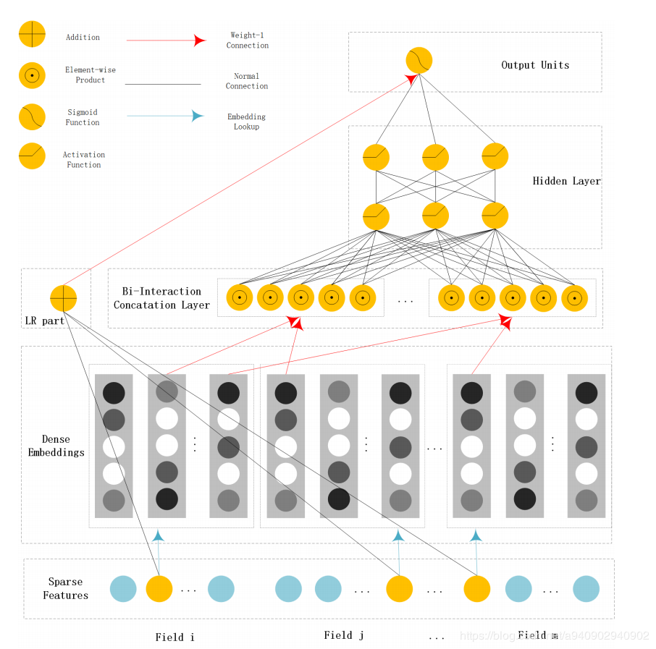
04. Conclusion
5. Future work
Model: we can use NFFM + LGB.
Add some rule model. (New advertisements are predicted entirely by models, but old advertisements equal to the winning rate of the previous day times the number of requests on that day, then adjust monotony)

Slide 29
Thanks for your listening!
Questions and Answers

