Slide 1
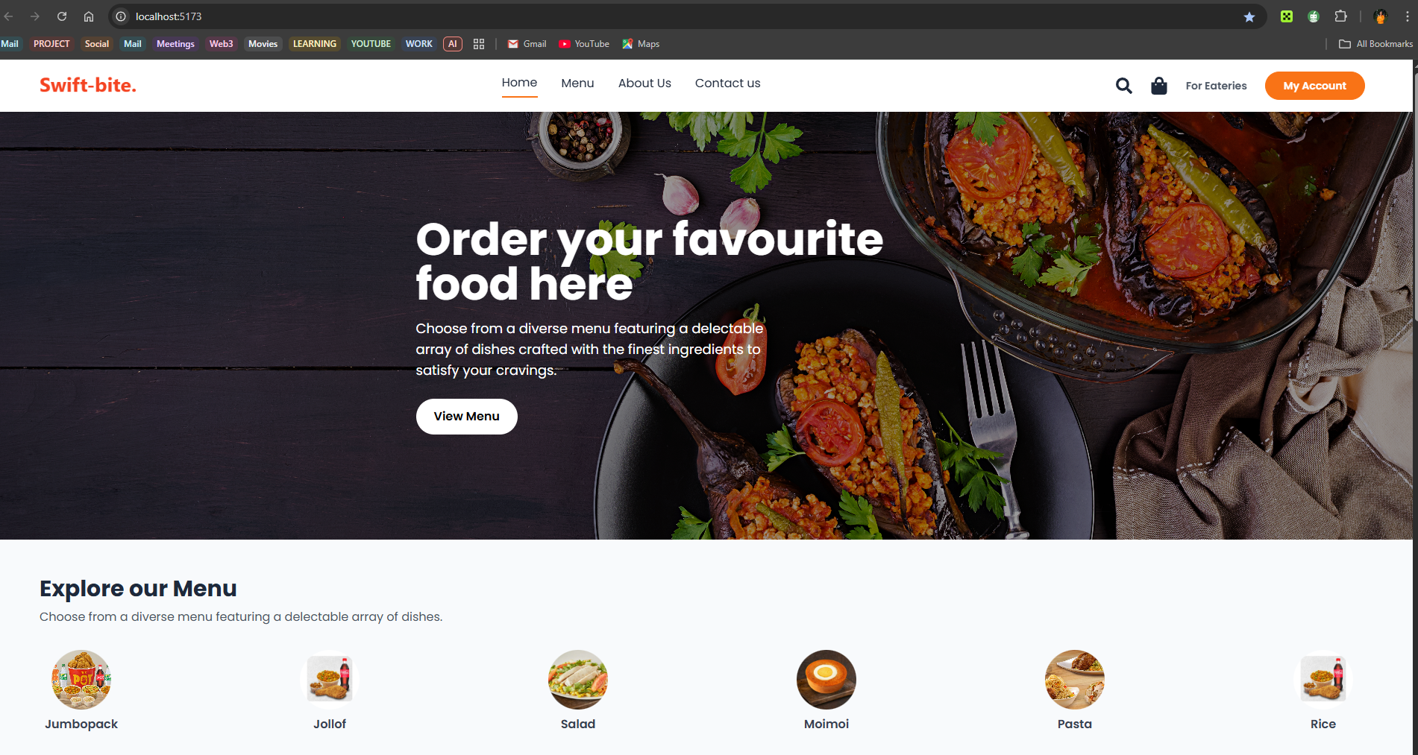
DEVELOPMENT OF A WEB BASED APLLICATION FOR SEAMLESS EATERY ORDERING AND DELIVERY SERVICES
By Okechukwu, Miracle Oluchi
20/SC/CO/1000

Slide 2
DEVELOPMENT OF A WEB-BASED APPLICATION FOR SEAMLESS EATERY ORDERING AND DELIVERY SERVICES
BY OKECHUKWU, MIRACLE OLUCHI
20/SC/CO/1000 SUBMITTED TO DEPARTMENT OF COMPUTER SCIENCE,
FACULTY OF COMPUTING,
UNIVERSITY OF UYO, UYO. IN PARTIAL FULFILLMENT OF THE REQUIREMENT FOR THE AWARD OF BACHELOR OF SCIENCE DEGREE (B.Sc) IN COMPUTER SCIENCE. AUGUST, 2025

Slide 3
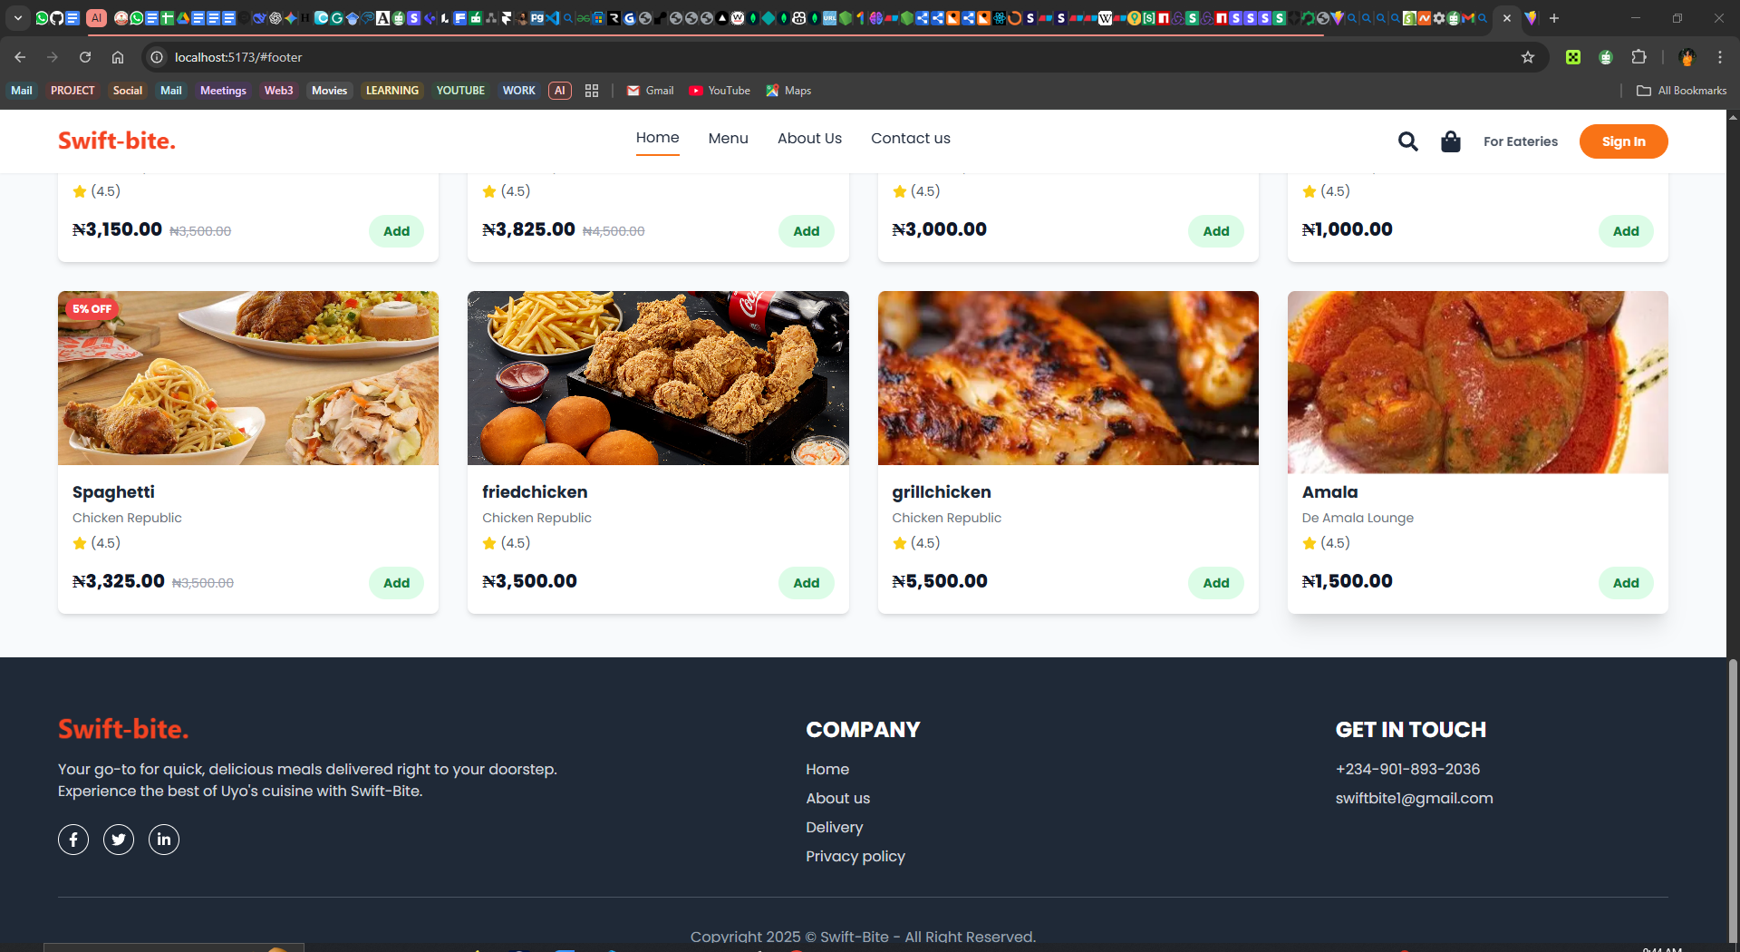
Introduction
The stock market is one of the most dynamic and unpredictable sectors of the financial world, where investors, buyers, and sellers interact to trade securities. Predicting stock prices has been a significant area of research, especially with the advent of machine learning and artificial intelligence (AI).
Traditionally, two main approaches have been proposed for predicting the stock price of an organization. The technical analysis method uses the historical price of stocks, like the closing and opening price, volume traded, adjacent close values, etc., of the stock for predicting the future price of the stock. The second type of analysis is qualitative, which is performed on the basis of external factors like company profile, market situation, political and economic factors, and textual information in the form of financial new articles, social media and even blogs by economic analyst.
This research explores a data-driven approach using machine learning.

Slide 4
Abstract
The traditional method of food ordering in Uyo, characterized by manual, paper-based systems, walk-ins, presents significant challenges, including operational inefficiencies, order inaccuracies, and a suboptimal customer experience. This project addresses these issues through the design and development of a web-based application for seamless eatery ordering and delivery services within Uyo metropolis. The primary aim of this study is to create an integrated digital platform that bridges the gap between customers and local eateries, thereby enhancing convenience and operational efficiency. The system is designed to provide a user-friendly interface for customers to browse menus, place orders, and make secure online payments. For eatery owners, it offers a robust dashboard for menu management, order taking, and sales analytics. The development of the web-based application for seamless eatery ordering and delivery services followed a structured methodology encompassing data collection from local eateries, system design using a multi-tiered client-server model, and implementation with modern web technologies such as Visual Studio Code, with deployment on Render.com. The application incorporates key features like real-time order tracking, estimated delivery times, and secure payment gateways to ensure a transparent and reliable service. By automating the ordering and delivery process, the development of a web application for seamless eatery ordering and delivery services plans to reduce waiting times, minimize human error, and provide a scalable solution for small and medium-sized eateries in Uyo to compete in the growing digital market.

Slide 5
Statement of Problem
This study seeks to address one problem which is
1. Poor Order Management & Customer Experience
Most eateries in Uyo currently employ out-dated, paper-based ordering systems, which lead to slow service, frequent order errors, and dissatisfied customers who are not kept abreast of the status of their food delivery, thus an immediate need for an integrated digital solution.

Slide 6
Aim and Objectives
Aim
The aim of this study is to design and develop a web application for seamless eatery ordering and delivery services.
Objectives
The objectives of the study are to
Collect data from different eateries in Uyo metropolis using an online survey form.
2. Data preprocessing to spot any unusual data, outliers, errors or spaces in the dataset using Excel sheet.
3. Analyse the collected data using Excel sheet.
4. Design the database which will be used to determine the type of data to be stored, such as customers, orders, products, eateries, etc. Using eraser.io.
5. Build and deploy the system using visual studio code and Render.com.
6. Add functionality to ensure the web application is limited to Uyo metropolis.
7. Identify areas for improvement and to assess the solution’s effectiveness etc. Using E2E testing (End-to-end testing).

Slide 7
Significance of Study
1. Enhanced Customer Convenience and Satisfaction
2. Business Growth for Eateries
3. Employment Opportunities for Delivery Personnel
4. Boost to Uyo’s Digital Economy
5. Academic and Technological Contribution

Slide 8
Scope of Study
This study focuses on developing a web application that is designed to facilitate online food ordering and delivery services exclusively for registered eateries within Uyo metropolis, incorporating features for user registration, menu management, order processing, delivery tracking, and payment integration.

Slide 9
Literature Review
The online food delivery industry, as it exists today, is the product of several decades of technological innovation and shifting consumer behaviors. Its evolution can be traced through distinct stages, each defined by the prevailing technology and business models of its time.
The concept of ordering food via a digital interface emerged concurrently with the public's access to the internet. The first documented online food order is widely cited as a transaction for a Pizza Hut pizza in 1994, facilitated by a service known as "Pizza Net" (Wikipedia, n.d., "Online food ordering"). This was shortly followed by the establishment of the first multi-restaurant online delivery platform, World Wide Waiter (which later became Waiter.com), in 1995. This service aggregated the menus of over 60 restaurants in the San Francisco Bay area, allowing users to place orders through a single web portal (Shimoff, 2015; Wikipedia, n.d., "Online food ordering"). These early systems were revolutionary, demonstrating the potential of the internet to disrupt traditional consumer services. However, their growth was constrained by the technological and cultural limitations of the dot-com era. Widespread consumer habits had not yet adapted to online purchasing, and the preference for immediate, in-store acquisition over waiting for a delivery remained dominant (Gan, 2000).

Slide 10
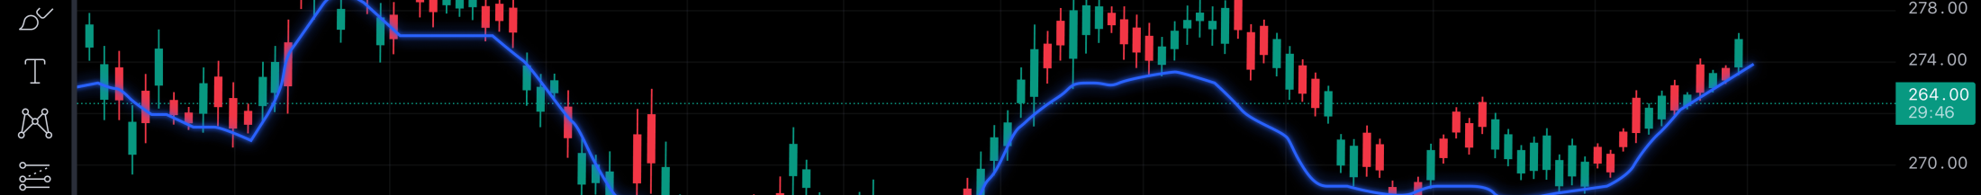
Research Methodology
My Approach
Data: Historical data for Reliance Industries from Yahoo Finance.
Preparation: Cleaned data, handled missing values, and created new features like Moving Averages (SMA, EMA).
Model Implementation: Implemented the Random Forest algorithm, a powerful ensemble learning method.
Validation: Used a time-series split to ensure accurate evaluation of the model.

Slide 11
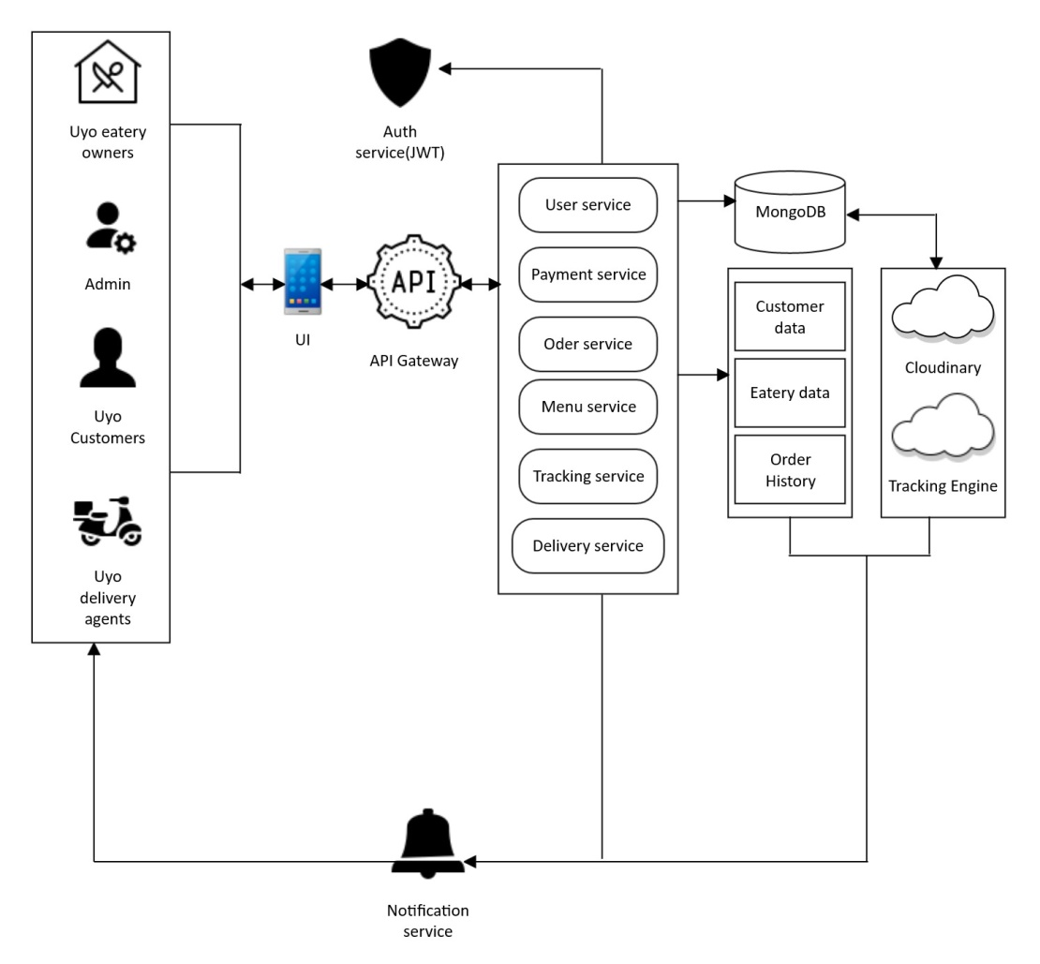
System Architecture

Slide 12
Tools Used
1. Integrated Development Environment (IDE): Visual Studio Code (VS Code)

Slide 13
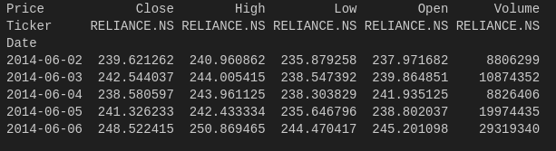
Data Collection
The foundation of any predictive modeling exercise lies in the quality and relevance of the data. For this study, historical stock market data for Reliance Industries Limited is sourced from Yahoo Finance, spanning a decade from June 1, 2014, to June 1, 2024. This extended timeframe is deliberately chosen to capture multiple market cycles, including periods of economic stability, volatility, and the unprecedented market conditions during the COVID-19 pandemic. The dataset comprises daily trading metrics, including opening, high, low, and closing prices, along with adjusted closing prices and trading volumes.

Slide 14
Data Preprocessing
Upon collection, the raw data underwent a rigorous preprocessing pipeline to ensure its quality and suitability for model training. This commenced with data cleaning, where meticulous attention was paid to identifying and addressing any null or missing values to maintain data integrity and consistency. Following cleaning, the data was subjected to visual inspection through various line plots.

Slide 15
Feature Engineering
Feature engineering is a critical process aimed at enhancing the predictive capabilities of the dataset by generating new, derived variables from raw historical stock market data. This allows the Random Forest model to better identify and leverage complex, non-linear patterns and temporal dependencies within the data, effectively enriching its predictive potential by supplying additional context and crucial predictive signals. This includes creating key technical indicators such as Simple Moving Average (SMA), Exponential Moving Average (EMA), Daily Returns, Volatility (Standard Deviation of daily returns over a period), and Momentum, all of which contribute to a more robust and accurate stock price prediction model.

Slide 16
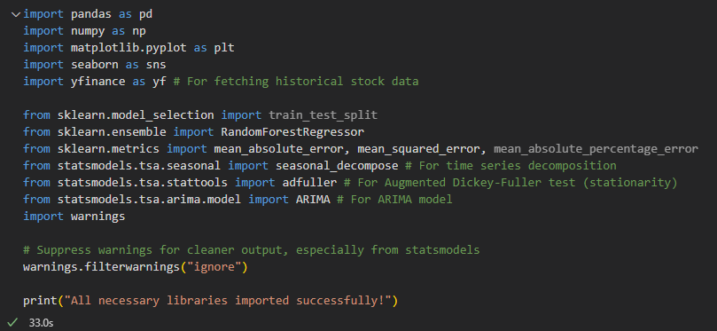
IMPLEMENTATION
The entire implementation was conducted within a robust computational environment designed to facilitate data-intensive machine learning tasks. The primary programming language utilized was Python, version 3.x, renowned for its extensive ecosystem of scientific computing and machine learning libraries. Key libraries instrumental to this project included Pandas for efficient data manipulation and analysis, particularly in handling time-series data structures, and NumPy for high-performance numerical operations.

Slide 17
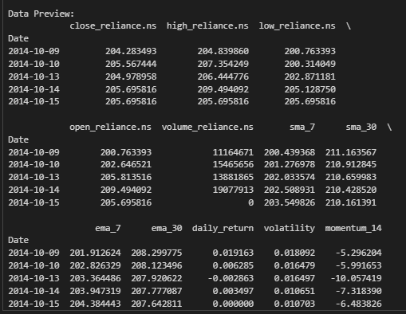
Snapshot showing output of dataset after preprocessing and feature engineering.

Slide 18
Model Selection and Implementation
The modeling phase adopts a dual-track approach, developing both Random Forest and ARIMA models in parallel to enable comprehensive comparison.
Random Forest Regressor: A Critical Explanation
The Random Forest (RF) algorithm, proposed by Leo Breiman (2001), is a powerful ensemble learning method capable of both regression and classification tasks. For regression, it operates by constructing a multitude of decision trees during the training phase and subsequently outputs the mean prediction of these individual trees. This approach makes Random Forest particularly well-suited for stock price prediction due to its inherent advantages in handling the complexities of financial data.

Slide 19
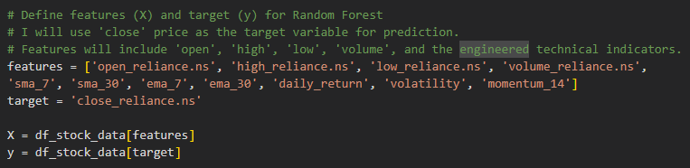
Snapshot showing code snippet for data splitting.

Slide 20
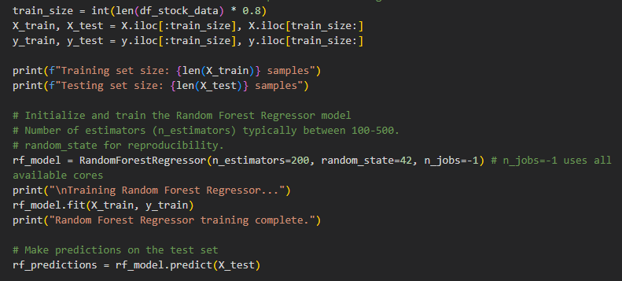
Snapshot showing code snippet for Random Forest train and test implementation.

Slide 21
Random Forest Regressor Performance:
Mean Absolute Error (MAE): 36.3166
Root Mean Squared Error (RMSE): 74.6587
Mean Absolute Percentage Error (MAPE): 2.5862%

Slide 22
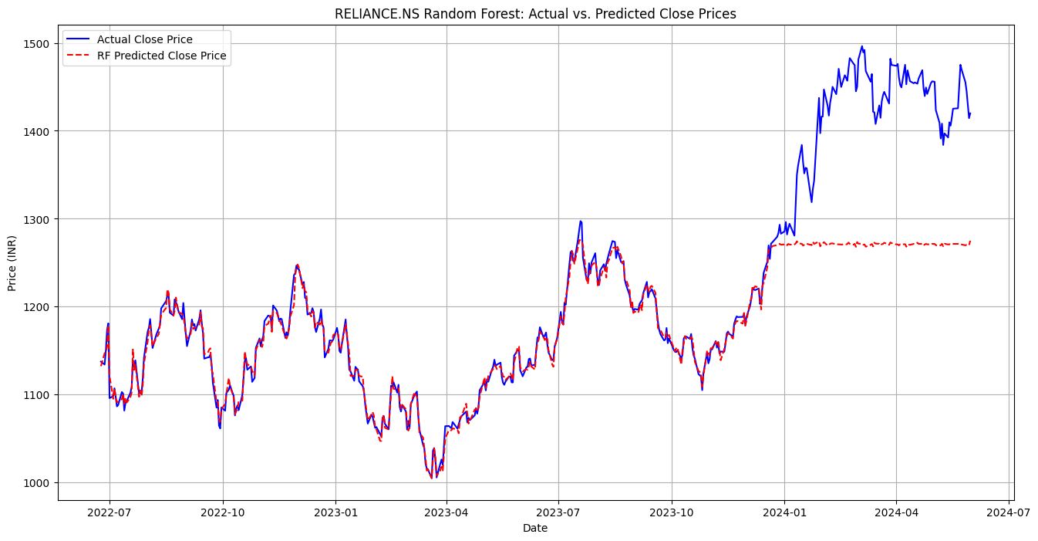
Snapshot showing output of actual vs. predicted close prices after Random Forest implementation.

Slide 23
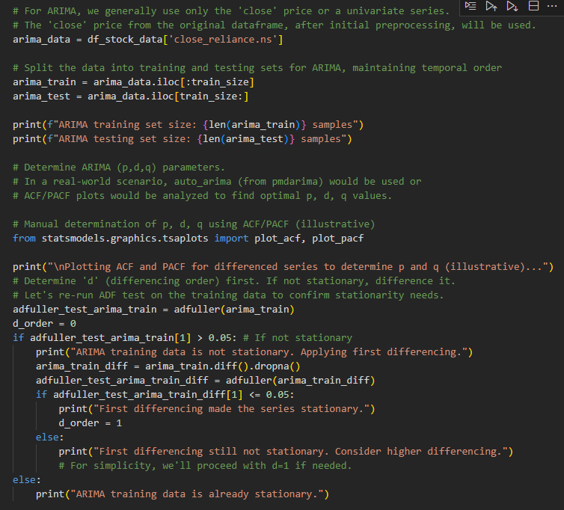
ARIMA Model Implementation
Snapshot showing code snippet used to obtain p, d and q values using the augmented Dickey-Fuller test to check stationarity of data.

Slide 24
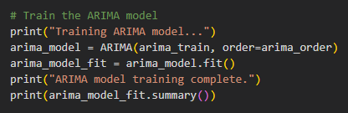
ARIMA Model Implementation
Snapshot showing code to train the ARIMA model.

Slide 25
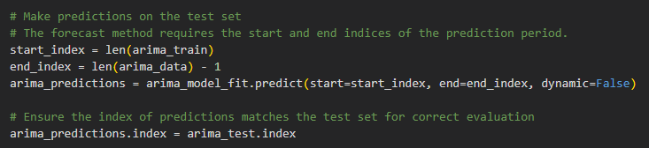
Snapshot showing code to test and predict with the ARIMA model.

Slide 26
ARIMA Model Performance:
Mean Absolute Error (MAE): 109.6851
Root Mean Squared Error (RMSE): 155.1513
Mean Absolute Percentage Error (MAPE): 8.3420%

Slide 27
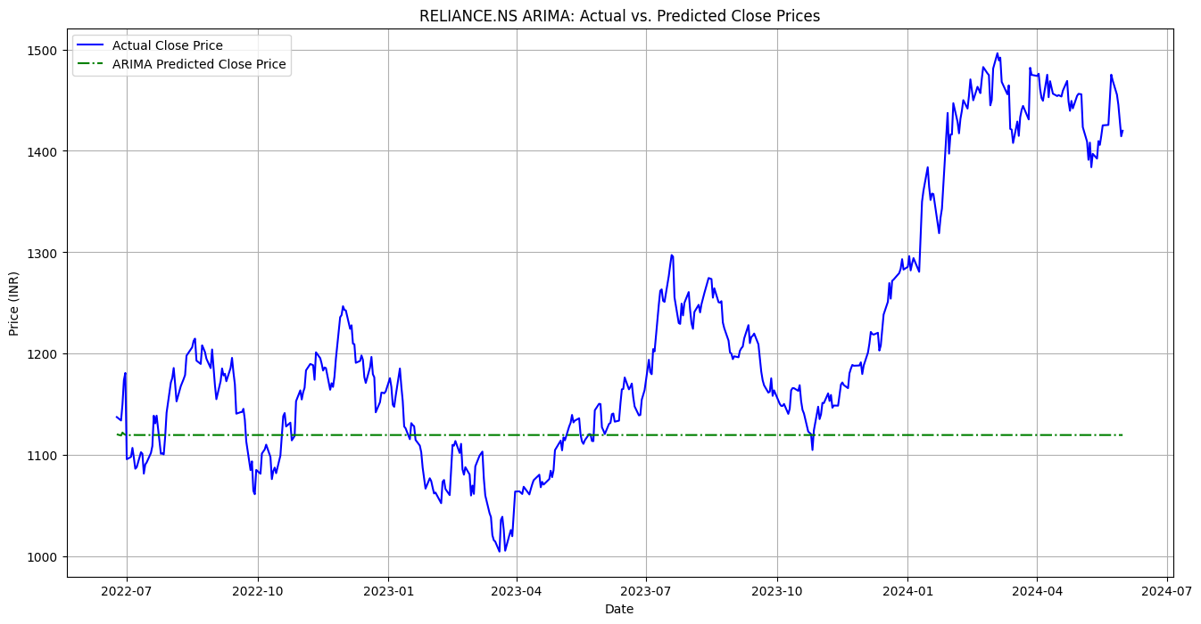
Snapshot showing plot of Reliance Stock's actual close price and predicted close price after training and testing.

Slide 28
Model Performance
Figure 4.22 presents the performance metrics for the Random Forest Regressor model, a powerful ensemble learning method used for forecasting. The results show a Mean Absolute Error (MAE) of 36.3166 and a Root Mean Squared Error (RMSE) of 74.6587. The MAE signifies that, on average, the model's predictions deviate from the actual stock prices by approximately 36.32 units. This metric is a straightforward and intuitive measure of the average forecasting error. The RMSE, however, provides a more nuanced view of the model's performance by heavily penalizing larger errors. The significant disparity between the MAE and RMSE (36.31 vs. 74.65) is particularly noteworthy. This large gap suggests that while the majority of the predictions are relatively accurate, the model makes a number of substantial errors on specific data points. In a stock market context, these larger errors could correspond to periods of high volatility, sudden market shifts, or flash crashes. I would interpret this as an indication that the Random Forest model, while generally effective, may struggle to predict outlier events or extreme price movements, which is a critical consideration for risk management and trading strategy development.

Slide 29
The Mean Absolute Percentage Error (MAPE) of 2.5862% is a highly significant metric for this research, as it provides a scale-independent measure of the model's predictive accuracy. This low MAPE value, approximately 2.59%, indicates that the model's predictions, on average, are very close to the actual values, deviating by only a small percentage. This metric is invaluable for comparing the Random Forest Regressor's performance to other models, such as the ARIMA model, which has a MAPE of 8.34% The stark difference in MAPE values (2.59% vs. 8.34%) suggests that the Random Forest Regressor demonstrates a substantially superior relative performance. The low MAPE suggests that the Random Forest Regressor is highly effective at capturing the complex, non-linear relationships within the stock market data, leading to more reliable and percentage-wise accurate forecasts, which is the ultimate goal of financial market prediction research.

Slide 30
Evaluation Metrics of Random Forest and ARIMA
Evaluation Metrics | Random Forest | ARIMA
MAE | 36.3166 | 109.6851
RSME | 74.6587 | 155.1513
MAPE | 2.5862% | 8.3420%

Slide 31
SUMMARY
This research focuses on predicting stock market prices using machine learning, specifically the Random Forest algorithm. The work addresses the challenges of stock market volatility and unpredictability, aiming to provide a more effective method for forecasting prices than traditional approaches. The study compares the performance of the Random Forest model against the traditional statistical time-series model, Autoregressive Integrated Moving Average (ARIMA), to determine which is more suitable for stock market price prediction.

Slide 32
CONCLUSIONS
While the study aims to suggest that Random Forest is superior to ARIMA for stock market prediction due to its ability to model non-linear patterns, the significant deviation between the predicted and actual prices shown in Figure 4.23 indicates a key limitation. This discrepancy suggests that the Random Forest model, as implemented, may not have been robust enough to capture the full complexity and inherent volatility of the stock market. The model's failure to accurately track the actual price movements could be a result of several factors, such as the chosen features not being comprehensive enough to represent all influential market dynamics, or the model's parameters not being optimally tuned. This highlights that while Random Forest is a powerful tool for time-series data, its effectiveness is highly dependent on the quality of the data and the careful configuration of the model.

Slide 33
Key Findings from Literature Review
Why Random Forest?
Ensemble models like Random Forest combine multiple decision trees to improve accuracy.
They are robust to noise and outliers, which are common in financial data.
They can identify important features, providing insight into which factors most influence stock prices.

Slide 34
Key Findings from Literature Review
- Adnan, R. M., Yuan, X., Kisi, O., and Curtef, V. (2017). Application of time series models for streamflow forecasting. Civil and Environmental Research, 9(3), 56-63.
- Ariyo, A. A., Adewumi, A. O., and Ayo, C. K. (2014). Stock price prediction using the ARIMA model.
- Computer Modelling and Simulation (UKSim), UKSim-AMSS 16th International Conference, 106-112.
- Awad, A. L., Elkaffas, S. M., and Fakhr, M. W. (2023). Stock market prediction using deep reinforcement learning. Applied System Innovation, 6(6), 106.
- Bahad, P., & Saxena, P. (2019, December). Study of adaboost and gradient boosting algorithms for predictive analytics. In International Conference on Intelligent Computing and Smart Communication 2019: Proceedings of ICSC 2019 (pp. 235-244). Singapore: Springer Singapore.
- Bansal, M., Goyal, A., and Choudhary, A. (2022). Stock market prediction with high accuracy using machine learning techniques. Procedia Computer Science, 215, 247-265.
- Bengio, Y. (2009). Learning deep architectures for AI. Foundations and trends® in Machine Learning, 2(1), 1-127.
- Bishop, C. M., & Nasrabadi, N. M. (2006). Pattern recognition and machine learning (Vol. 4, No. 4, p. 738). New York: springer.
- Breiman, L. (1999). Using adaptive bagging to debias regressions (p. 16). Technical Report 547, Statistics Dept. UCB.
- Breiman, L. (2001). Random forests. Machine learning, 45(1), 5-32.
- Chen, T., & Guestrin, C. (2016, August). Xgboost: A scalable tree boosting system. In Proceedings of the 22nd acm sigkdd international conference on knowledge discovery and data mining (pp. 785-794).
- Chouksey, S. (2019). Stock price prediction using time series models (Doctoral dissertation, Dublin Business School).
- Devadoss, A. V., and Ligori, T. A. A. (2013). Forecasting Of Stock Prices Using Multi Layer Perceptron. International journal of computing algorithm, 2(1), 440-449.

