Slide 1
Welcome To 471 Lab Presentation
Lab Section: 06
Lab Faculties
Md. Muzahidul Islam Rahi
Asadullah Al Galib

Slide 2
Bank Account Management System
Group 11
Miraj Mahmood
ID: 18101090
Abdur Rob Tanvir
ID: 18101211
Md. Zuhayer Islam
ID: 18101334

Slide 3
Project Planning
Online banking along with offline banking Decrease the cost and dependency on offline banking.
Reaching more customers.
Ensure more safety to the customers. Better Banking experience and services.
Lack of awareness among people.
24/7 Service

Slide 4
Requirement Analysis
Functional
The system will allow users to log in with their email and password.
The system will ask user to add NID number, Source of income, Nominee and introduction of a account holder along with photo for verification.
The system will allow user to credit amount, debit amount and check balance.
The system will allow users to use different services like insurance, loan, and bill payments. 1.5. The system will provide hotline services to the customer.
The system will show the nearest branch from the user for any emergency need.
Non-Functional
The system will run in Android, iOS and PC.
The system will take less than 2 seconds to log in.
The system will automatically log out the user for 5 minutes of inactivity.
The system will block account temporarily for attempting with wrong password for 3 times.
Should follow the terms and policies of Bangladesh Bank.

Slide 5
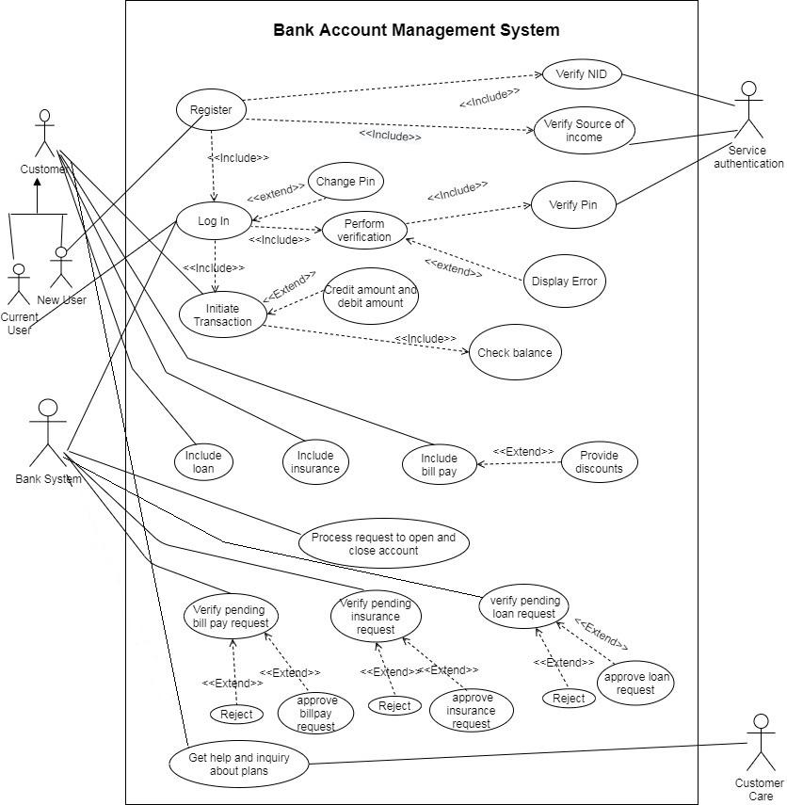
Use Case Diagram

Slide 6
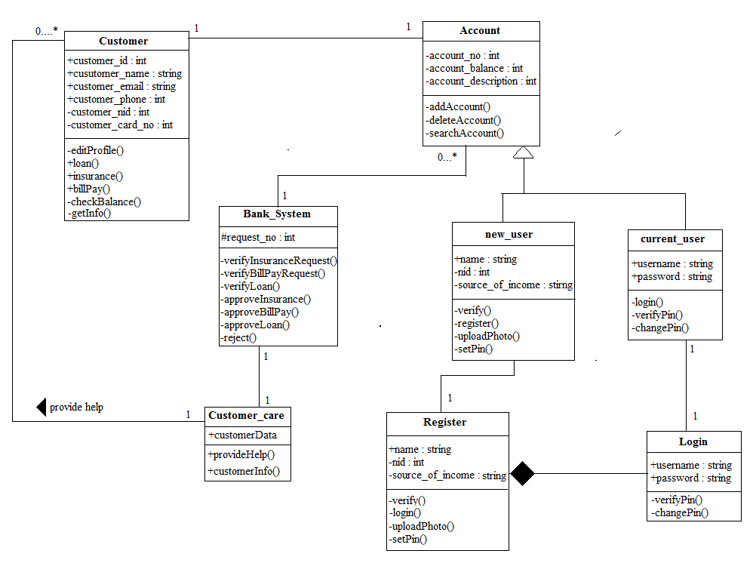
Class Diagram

Slide 7
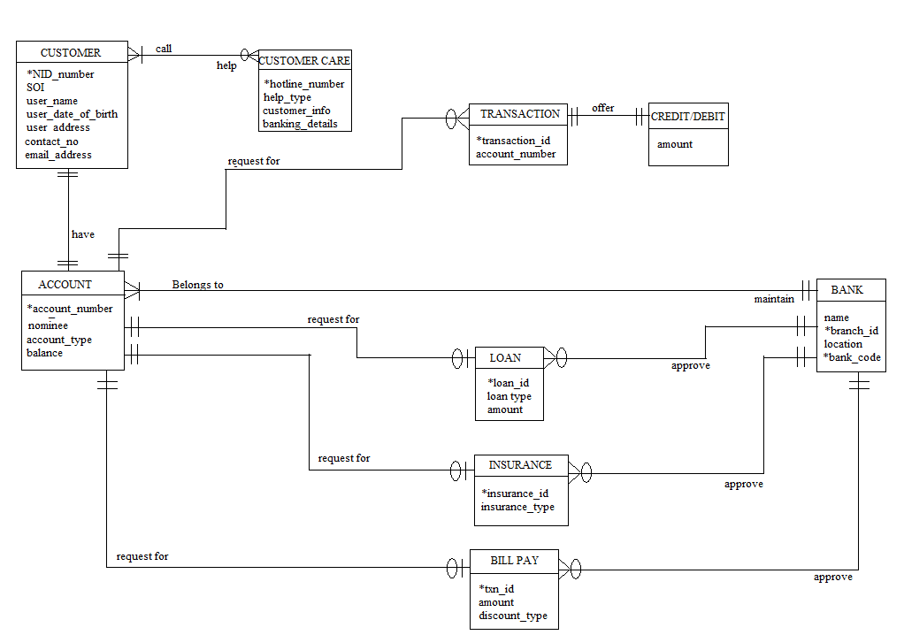
ER Diagram

Slide 8
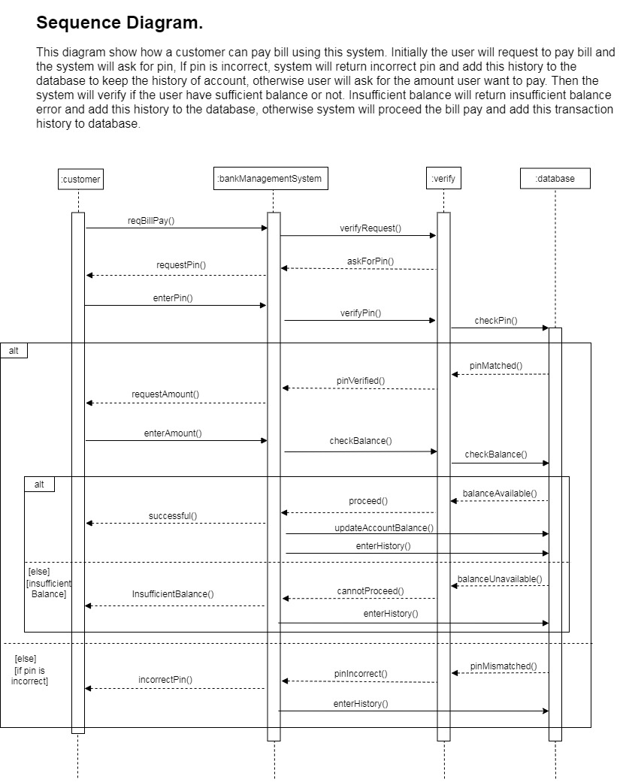
Sequence Diagram

Slide 9
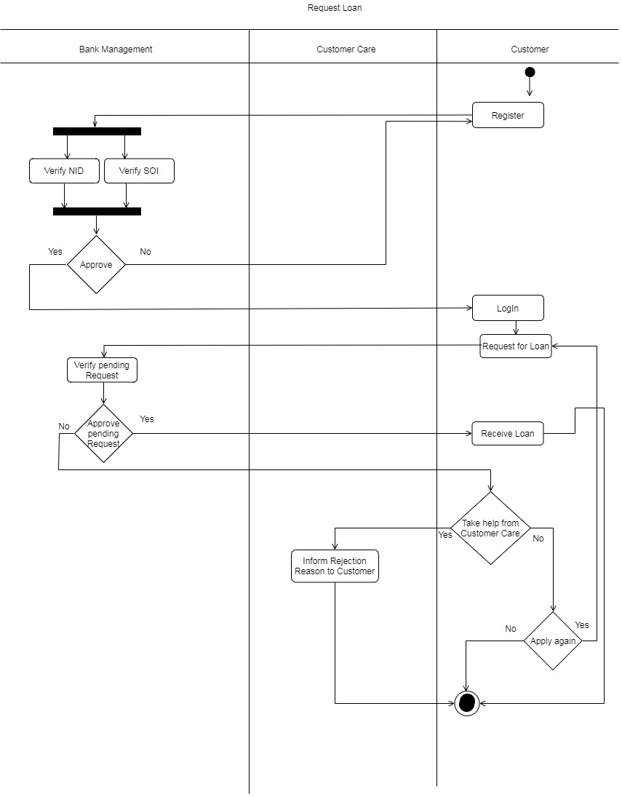
Activity Diagram

Slide 10
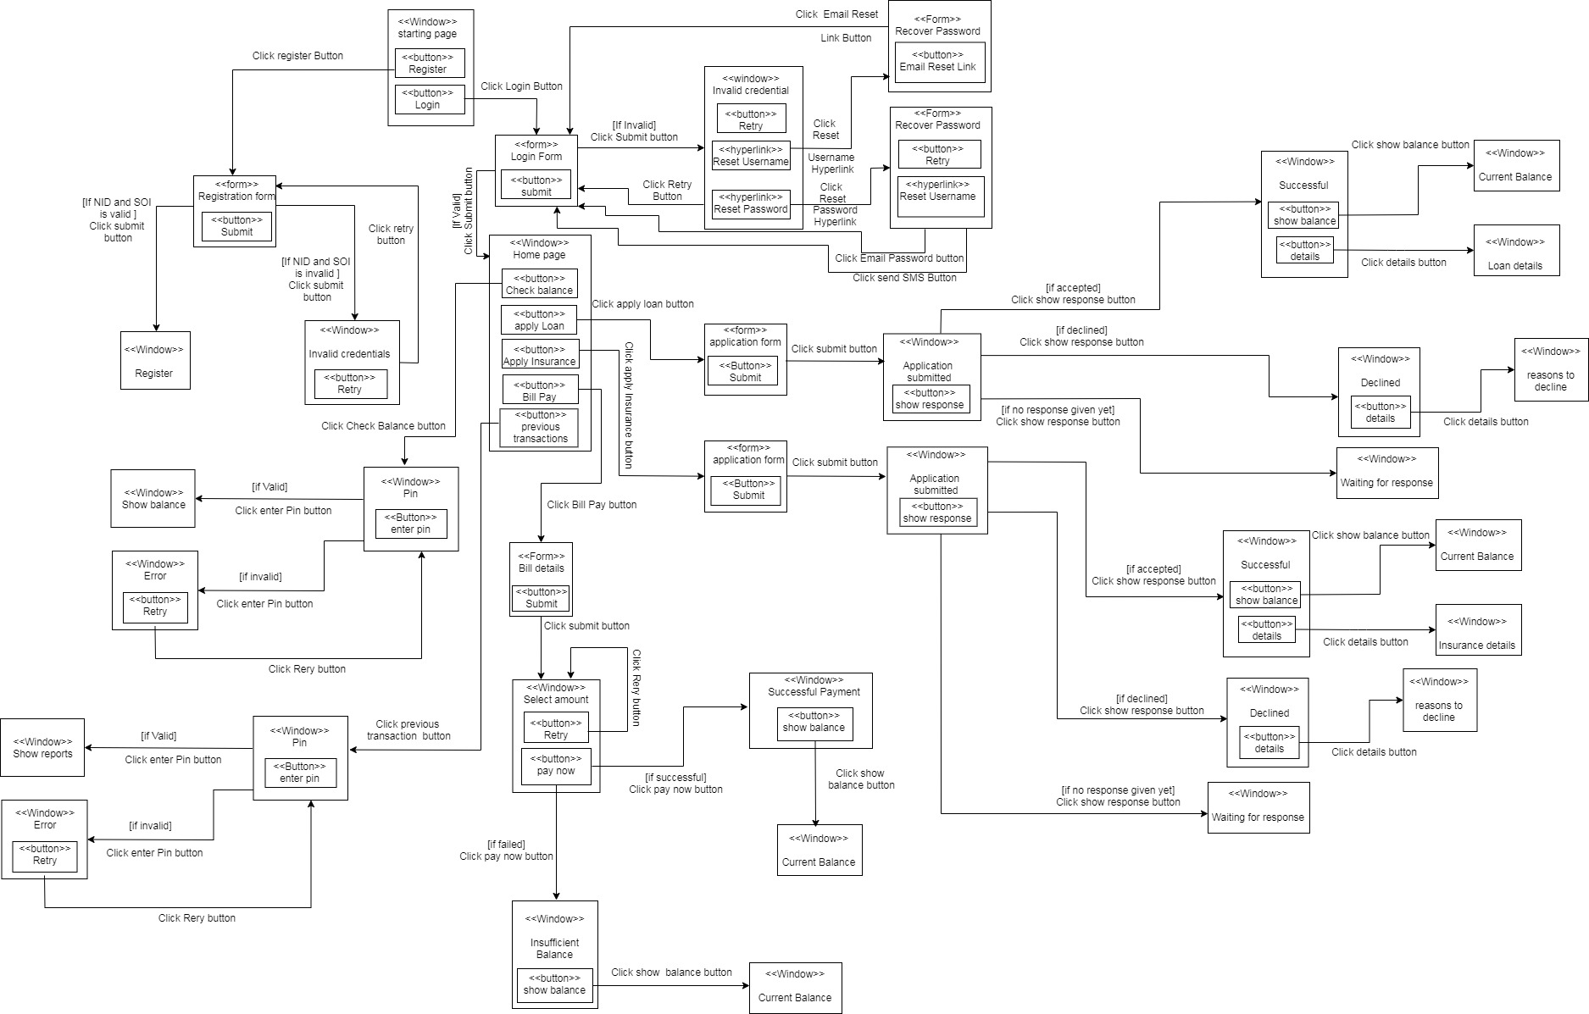
Window Navigation Diagram

Slide 11
Conclusion and Summary
Our goal is to serve nation through excellent banking experience.
Decrease the dependency from cash money.

Slide 12
Thank You

