Slide 1
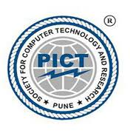
Pune Institute of Computer Technology, Pune Dept. of E&TC
304200: Mini Project (MP) (2019 Course)
“Title : Water Level Controller For Purifier”
Guided By: Prof. Sandeep Dhende
By:
1) Shivam suresh Kabra
2) Narendra vyankatro Lungare
3) Pratik Pramod Mirajkar

Slide 2
Aim
The basic function of a water level controller is to regulate water flow and optimize system performance. One of the main advantages of water level control devices includes the ability to control power fluctuations when the motor is switched on. Most of these devices ensures uninterrupted water supply by filling the overhead tank once it is below level. The motor power is switched on when the overhead tank becomes empty and switches off automatically when the underground tank is empty or the overhead tank becomes full. In this way it becomes easy to ensure 24 hours water supply without any kind of interruption.
Objective
The use of water level control also avoids running the pumps during odd hours, particularly at night. It also ensures maximum water supply during peak hours especially during morning hours. The special sensors and time controllers are apt in pumping the water level to its maximum before the peak hours. It also maintains the water level throughout the day.

Slide 3
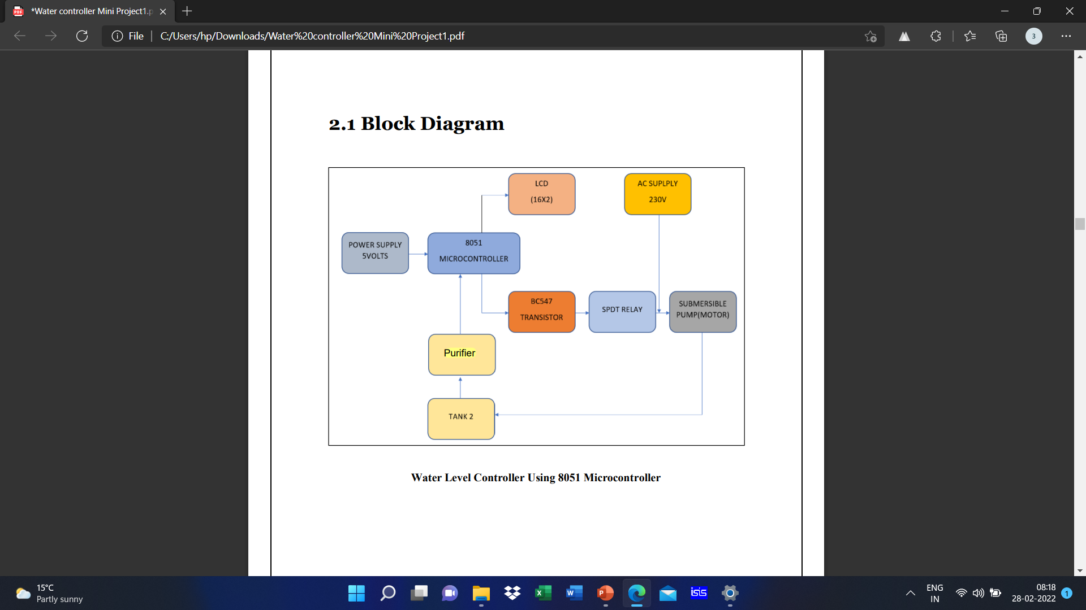
Block Schematic

Slide 4
Component Selection
AT89C51 Microcontroller (or any 8051 based Microcontroller)
8051 Programmer (Programming Board)
11.0592 MHz Quartz Crystal
2 x 33pF Capacitor
2 x 10KΩ Resistor (1/4 Watt)
10µF Capacitor
Push Button
1KΩ x 8 Resistor Pack
16 x 2 LCD Display
5V Relay
4 x 2N2222 (NPN) Transistors
DC Motor (for demonstration)
10KΩ Potentiometer
1N4007 PN Junction Diode
Programming cable
Float Sensor
Connecting wires
Power Supply
Keil µVision IDE
Proteus (for circuit diagram)

Slide 5
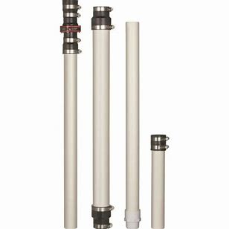
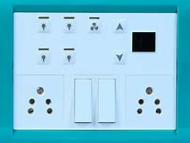
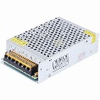
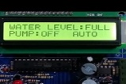
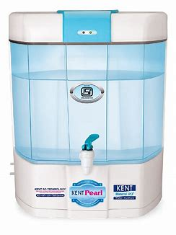

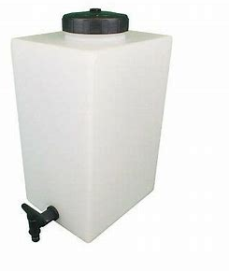
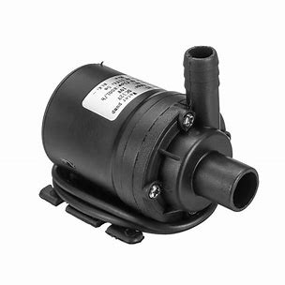
Working model Animation

Slide 6
Features
Automatic: These devices are made to turn on the pump the moment water level falls underneath the predetermined level and turn off once the tank is full. It’s also easy to decide the level of storage by using these products very easily.
Easy to Install: It is extremely simple to install these products in tanks and pools.
Continuous Operation: These controller products are very well suited for continuous operation because it consumes less energy in comparison to other kinds of electrical products.
Prevent Overflow: Probably the most significant feature of these products is that it helps you to prevent overflow in the tanks and for that reason helps you to prevent wastages to a large degree.
.

Slide 7
Future Scope
The basics need of human being is water and it is one of the most important necessary for all living beings. But unfortunately a huge amount of water is being wasted by uncontrolled use and due to our negligence. Some other automated water level monitoring system is also offered so far but most of the method has some shortness in practice. We tried to overcome these problems and implemented an efficient automated water level monitoring and controlling system for purifier. Main intension of this research work is to establish a flexible, economical and easy configurable system which can solve water losing problems

Slide 8
Resources required
https://www.electronicshub.org/water-level-controller-using-8051- microcontroller/
https://youtu.be/tYwQTTG-GDg
https://www.tutorialspoint.com/microprocessor/microcontrollers_8051_architec ture.html
https://www.electronicsforu.com/resources/learn-electronics/16x2-lcd-pinoutdiagram
https://www.instructables.com/id/All-You-Need-to-Know-About-Relays/
https://www.alldatasheet.com/datasheet-pdf/pdf/11551/ONSEMI/BC547.html
http://www.circuitstoday.com/water-level-controller-using-8051
https://m.indiamart.com/impcat/submersible-pumps.html
http://www.circuitstoday.com/5v-power-supply-using-7805

Slide 9
Thanks

