Slide 1
Cross Site Request Forgery (CSRF)

Slide 2
Outline
Cross-Site Requests and Its Problems
Cross-Site Request Forgery Attack
CSRF Attacks on HTTP GET
CSRF Attacks on HTTP POST
Countermeasures

Slide 3
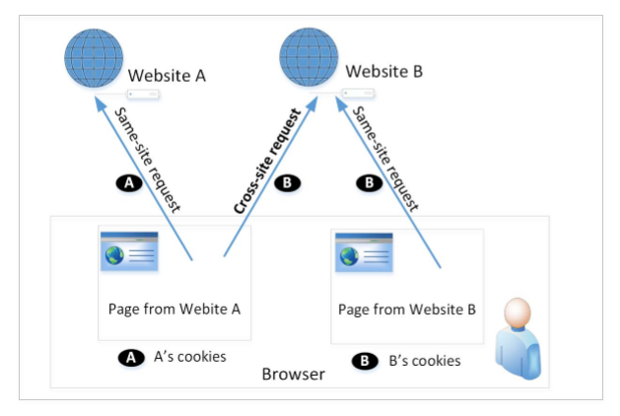
Cross-Site Requests and Its Problems
When a page from a website sends an HTTP request back to the website, it is called same-site request.
If a request is sent to a different website, it is called cross-site request because the where the page comes from and where the request goes are different.
Eg : A webpage (not Facebook) can include a Facebook link, so when users click on the link, HTTP request is sent to Facebook.

Slide 4
Cross-Site Requests and Its Problems
When a request is sent to example.com from a page coming from example.com, the browser attaches all the cookies belonging to example.com.
Now, when a request is sent to example.com from another site (different from example.com), the browser will attach the cookies too.
Because of above behaviour of the browsers, the server cannot distinguish between the same-site and cross-site requests
It is possible for third-party websites to forge requests that are exactly the same as the same-site requests.
This is called Cross-Site Request Forgery (CSRF).

Slide 5
Cross-Site Request Forgery Attack
Environment Setup:
Target website
Victim user who has an active session on the target website
Malicious website controlled
Steps:
The attacker crafts a webpage that can forge a cross-site request to be sent to the targeted website.
The attacker needs to attract the victim user to visit the malicious website.
The victim is logged into the targeted website.

Slide 6
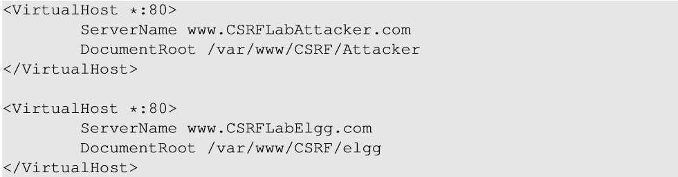
Environment Setup
Elgg: open-source web application for social networking
Countermeasures for CSRF is disabled by us in the VM
Target website: http://www.csrflabelgg.com
Attacker’s website: http://www.csrflabattacker.com
These websites are hosted on localhost via Apache’s Virtual Hosting

Slide 7
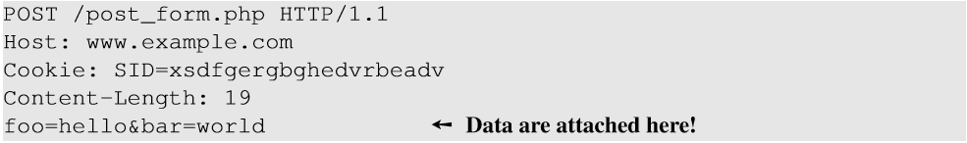
CSRF Attacks on HTTP Get Services
HTTP GET requests: data (foo and bar) are attached in the URL.
HTTP POST requests: data (foo and bar) are placed inside the data field of the HTTP request.

Slide 8
CSRF Attack on GET Requests - Basic Idea
Consider an online banking web application www.bank32.com which allows users to transfer money from their accounts to other people’s accounts.
An user is logged in into the web application and has a session cookie which uniquely identifies the authenticated user.
HTTP request to transfer $500 from his/her account to account 3220:
http://www.bank32.com/transfer.php?to=3220&amount=500
In order to perform the attack, the attacker needs to send out the forged request from the victim’s machine so that the browsers will attach the victim’s session cookies with the requests.

Slide 9
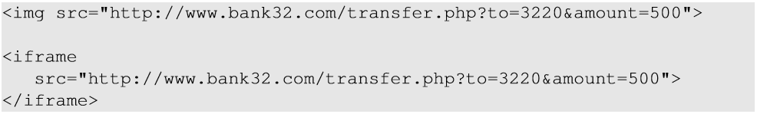
CSRF Attack on GET Requests - Basic Idea
The attacker can place the piece of code (to trigger request) in the form of Javascript code in the attacker’s web page.
HTML tags like img and iframe can trigger GET requests to the URL specified in src attribute. Response for this request will be an image/webpage.

Slide 10
Attack on Elgg’s Add-Friend Service
Goal : Add yourself to the victim’s friend list without his/her consent.
Investigation taken by the attacker Samy:
Creates an Elgg account using Charlie as the name.
In Charlie’s account, he clicks add-friend button to add himself to Charlie’s friend list. Using FireFox LiveHTTPHeaders extension to capture the add-friend HTTP request.

Slide 11
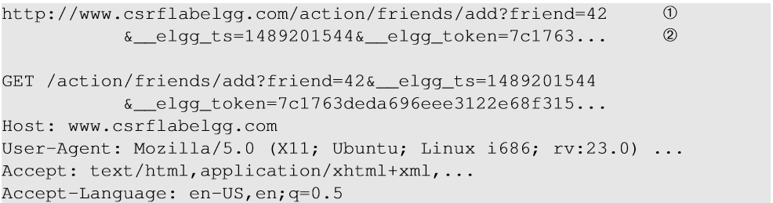
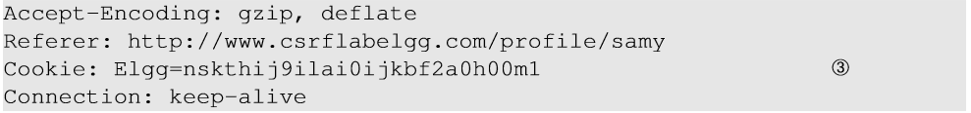
Captured HTTP Header
Line ① : URL of Elgg’s add-friend request. UserID of the user to be added to the friend list is used. Here, Samy’s UserID (GUID) is 42.
Line ② : Elgg’s countermeasure against CSRF attacks which are disabled.
Line ③ : Session cookie which is unique for each user. It is automatically sent by browsers.

Slide 12
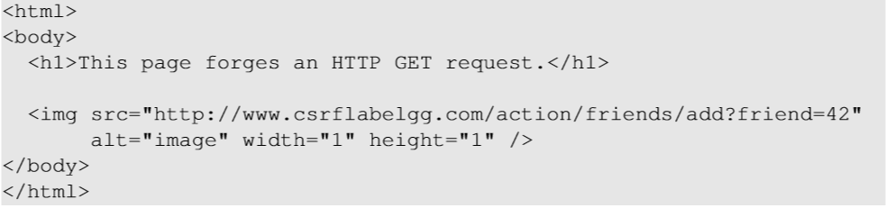
Create the malicious web page
The img tag will trigger an HTTP GET request. When browsers render a web page and sees an img tag, it sends an HTTP GET request to the URL specified in the src attribute.
The attacker use add-friend URL along with friend parameter. The size of the image is very small so that the victim is not suspicious.
3. The crafted web page is placed in the malicious website www.csrflabattacker.com (inside the /var/www/CSRF/Attacker folder).

Slide 13
Attract Victim to Visit Your Malicious Page
Samy can send a private message to Alice with the link to the malicious web page.
If Alice clicks the link, Samy’s malicious web page will be loaded into Alice’s browser and a forged add-friend request will be sent to the Elgg server.
On success, Samy will be added to Alice’s friend list.

Slide 14
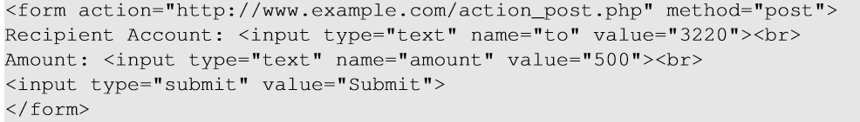
CSRF Attacks on HTTP POST Services
Constructing a POST Request Using JavaScript
POST requests can be generated using HTML forms. The above form has two text fields and a Submit button.
When the user clicks on the Submit button, POST request will be sent out to the URL specified in the action field with to and amount fields included in the body.
Attacker’s job is to click on the button without the help from the user.

Slide 15
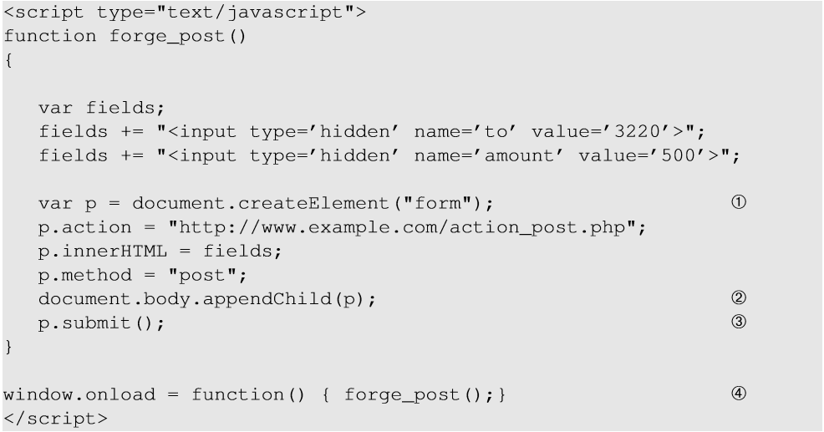
CSRF Attacks on HTTP POST Services
Line ①: Creates a form dynamically; request type is set to “POST”
Line ②: The fields in the form are “hidden”. Hence, after the form is constructed, it is added to the current web page.
Line ③: Submits the form automatically.
Line ④: The JavaScript function “forge_post()” will be invoked automatically once the page is loaded.

Slide 16
Attack on Elgg’s Edit-Profile Service
Goal : Putting a statement “SAMY is MY HERO” in the victim’s profile without the consent from the victim.
Investigation by the attacker Samy
Samy captured an edit-profile request using LiveHTTPHeader extension.

Slide 17
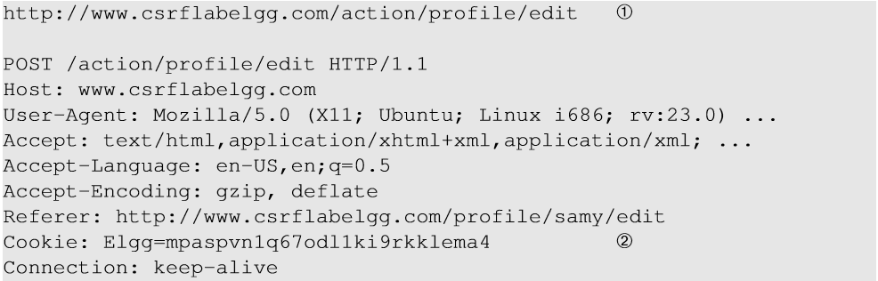
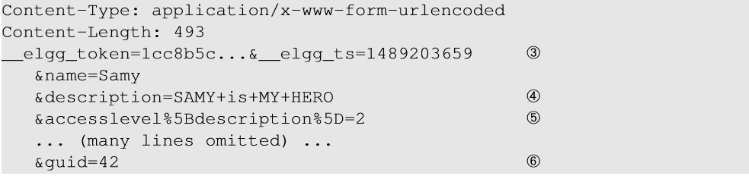
Attack on Elgg’s Edit-Profile Service
Line ① : URL of the edit-profile service.
Line ②: Session cookie (unique for each user). It is automatically set by browsers.
Line ③: CSRF countermeasures, which are disabled

Slide 18
Attack on Elgg’s Edit-Profile Service
Line ④: Description field with text “SAMY is MY HERO” (In encoded form)
Line ⑤: Access level of each field : 2 means viewable by everyone
Line ⑥: User Id (GUID) of the victim. This can be obtained by visiting victim’s profile page source, looking for the following:
Elgg.page_owner={“guid”:39,”type”:”user”,...}

Slide 19
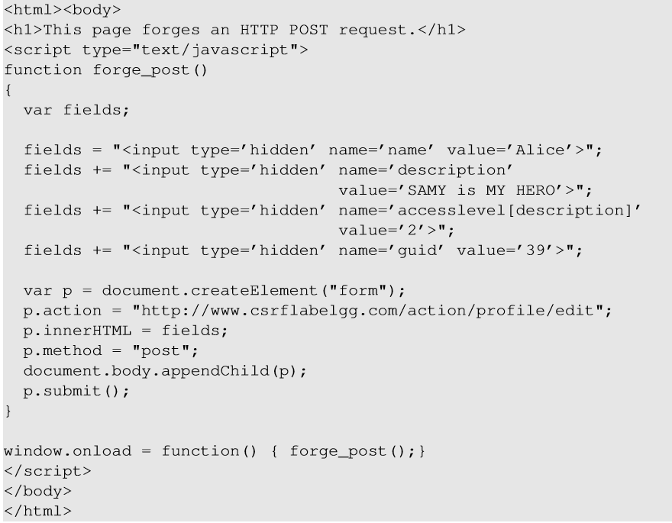
Craft the Malicious Web Page
The JavaScript function creates a hidden form with the description entry as our text.
When the victim visits this page, the form will be automatically submitted (POST request) from the victim’s browser to the edit-profile service at “http://www.csrflabelgg.com/action/profile/edit” causing the message to be added to the victim’s profile.

Slide 20
Fundamental Causes of CSRF
The server cannot distinguish whether a request is cross-site or same-site
Same-site request: coming from the server’s own page. Trusted.
Cross-site request: coming from other site’s pages. Not Trusted.
We cannot treat these two types of requests the same.
Does the browser know the difference?
Of course. The browser knows from which page a request is generated.
Can browser help?
How to help server?
Referer header (browser’s help)
Same-site cookie (browser’s help)
Secret token (the server helps itself to defend against CSRF)

Slide 21
Countermeasures: Referer Header
HTTP header field identifying the address of the web page from where the request is generated.
A server can check whether the request is originated from its own pages or not.
This field reveals part of browsing history causing privacy concern and hence, this field is mostly removed from the header.
The server cannot use this unreliable source.

Slide 22
Countermeasures: Same-Site Cookies
A special type of cookie in browsers like Chrome and Opera, which provide a special attribute to cookies called SameSite.
This attribute is set by the servers and it tells the browsers whether a cookie should be attached to a cross-site request or not.
Cookies with this attribute are always sent along with same-site requests, but whether they are sent along with cross-site depends on the value of this attribute.
Values
Strict (Not sent along with cross-site requests)
Lax (Sent with cross-site requests)

Slide 23
Countermeasures: Secret Token
The server embeds a random secret value inside each web page.
When a request is initiated from this page, the secret value is included with the request.
The server checks this value to see whether a request is cross-site or not.
Pages from a different origin will not be able to access the secret value. This is guaranteed by browsers (the same origin policy)
The secret is randomly generated and is different for different users. So, there is no way for attackers to guess or find out this secret.

Slide 24
Elgg’s Countermeasure
Uses secret-token approach : _elgg_tc and _elgg_token.
The values are stored inside two JavaScript variables and also in all the forms where user action is required.
The two hidden parameters are added to the form so that when the form is submitted via an HTTP request, these two values are included in the request.
These two hidden values are generated by the server (views/default/input/securitytoken.php) and added as a hidden field in each page.

Slide 25
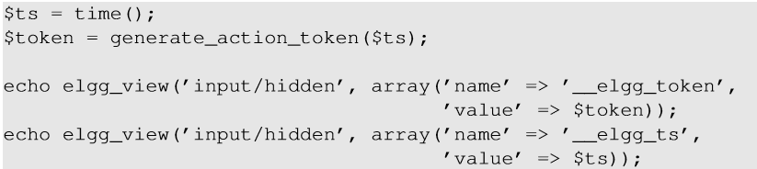

Elgg’s Countermeasure
Code to dynamically add the values to the web page.
JavaScript variables to access using JavaScript code.
Elgg’s security token is a MD5 digest of four pieces of information :
Site secret value
Timestamp
User session ID
Randomly generated session string

Slide 26
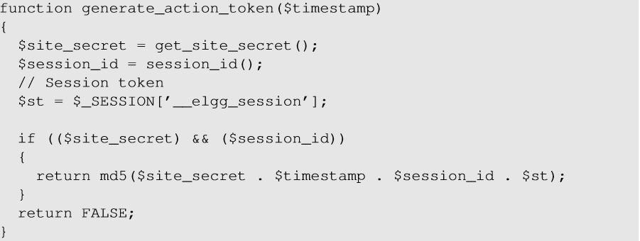
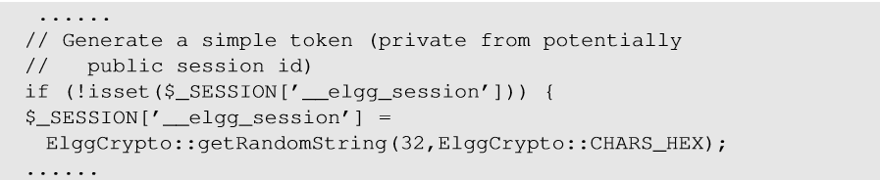
Elgg’s Countermeasure
Code to generate secret token and session string _elgg_session.

Slide 27
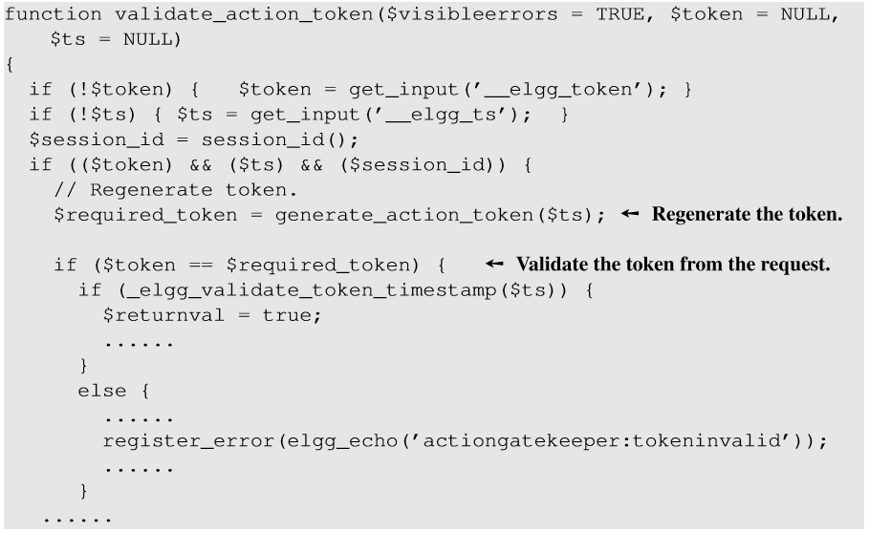
Elgg’s Countermeasure
The Elgg server validates the generated token and timestamp to defend against CSRF attacks.
Every user action calls validate_action_token() to validate the token.

Slide 28
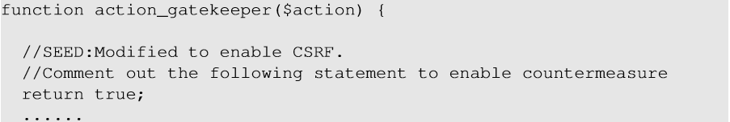
Turn on Elgg’s Countermeasure
Go to elgg/engine/lib/actions.php and find the function action_gatekeeper(). comment out the last statement of the function “return true”. This line was added to disable the countermeasure and let all the requests pass the check.

Slide 29
Summary
Cross-site requests v.s. same-site requests.
Why cross-site requests should be treated differently.
How to conduct CSRF attack
The fundamental cause of the CSRF vulnerability
How to defend against CSRF attack

