Slide 1
CSCI 3301: Chapter 2
Instructions: Language of the Computer
Abdullah Yasin Nur
Notes:
For free books, see https://cupola.gettysburg.edu/
For MIPS programming book, see https://cupola.gettysburg.edu/oer/2

Slide 2
Instruction Set
§2.1 Introduction
To command a computer’s hardware, you must speak its language.
The words of a computer’s language are called instructions, and its vocabulary is called an instruction set.
In this chapter we will study the instruction set of real computers.

Slide 3
Instruction Set
Early computers had very simple instruction sets
Simplified implementation
Many modern computers also have simple instruction sets
Different computers have different instruction sets
But with many aspects in common

Slide 4
The MIPS Instruction Set
Stanford MIPS commercialized by MIPS Technologies (www.mips.com), which is an elegant example of the instruction sets designed since the 1980s.
MIPS is a reduced instruction set computer (RISC) instruction set architecture (ISA).
Notes:
MIPS => Microprocessor without Interlocking Pipeline Stages

Slide 5
The MIPS Instruction Set
ARMv7 is similar to MIPS. More than 9 billion chips with ARM processors were manufactured in 2011, making it the most popular instruction set in the world.
The Intel x86, which powers both the PC and the cloud of the PostPC Era also very popular.
ARMv8, which extends the address size of the ARMv7 from 32 bits to 64 bits. Ironically, as we see, this 2013 instruction set is closer to MIPS than it is to ARMv7.

Slide 6
The MIPS Instruction Set
This similarity of instruction sets occurs because all computers are constructed from hardware technologies based on similar underlying principles.
Computer designers have a common goal: to find a language that;
makes it easy to build the hardware
the compiler while maximizing performance and minimizing cost and energy

Slide 7
Instructions
Hardware for a variable number of operands is more complicated than hardware for a fixed number.
Design Principle 1: Simplicity favors regularity
Regularity makes implementation simpler
Simplicity enables higher performance at lower cost

Slide 8
Arithmetic Operations
Thus, all arithmetic operations have this form in MIPS:
One operation.
Must always have exactly 3 variables.
Add and subtract, three operands
Two sources and one destination
add a, b, c # a gets b + c
§2.2 Operations of the Computer Hardware

Slide 9
Arithmetic Operations
If we want to place 4 variables: b, c, d, e into a (a = b + c + d + e)
we can do as following:
add a, b, c # a gets b + c
add a, a, d # a gets a + d
add a, a, e # a gets a + e
So, we need 3 instructions to sum 4 variables.
§2.2 Operations of the Computer Hardware
Notes:
For Intel we leant (in CSCI 2450):
ADD reg, reg
ADD mem, reg
ADD reg, mem
ADD reg/mem, imm
However, if we elaborate we see:
ADD AL, imm8
ADD AX, imm16
ADD EAX, imm32
ADD r/m8, imm8
ADD r/m16, imm16
ADD r/m32, imm32
ADD r/m16, imm8
ADD r/m32, imm8
ADD r/m8, r8
ADD r/m16, r16
ADD r/m32, r32
ADD r8, r/m8
ADD r16, r/m16
ADD r32, r/m32
For MIPS, it is just:
add reg, reg, reg

Slide 10
Arithmetic Example
Example for a C code snipped:
f = (g + h) - (i + j);
Compiled “MIPS code”:
add t0, g, h # temp t0 = g + h add t1, i, j # temp t1 = i + j sub f, t0, t1 # f = t0 - t1
Notes:
In real MIPS code, we do not have g, h, i ,j We only have $s1, $s2 etc.

Slide 11
Register Operands
Arithmetic instructions use register operands
MIPS has a 32 × 32-bit register file
Use for frequently accessed data
Numbered 0 to 31
32-bit data called a “word”
Assembler names
$zero, $at, $v0, $v1, $a0 - $a3,
$t0 - $t9 for temporary values
$s0 - $s7 for saved variables
$k0, $k1, $gp, $fp, $sp, $ra,
§2.3 Operands of the Computer Hardware

Slide 12
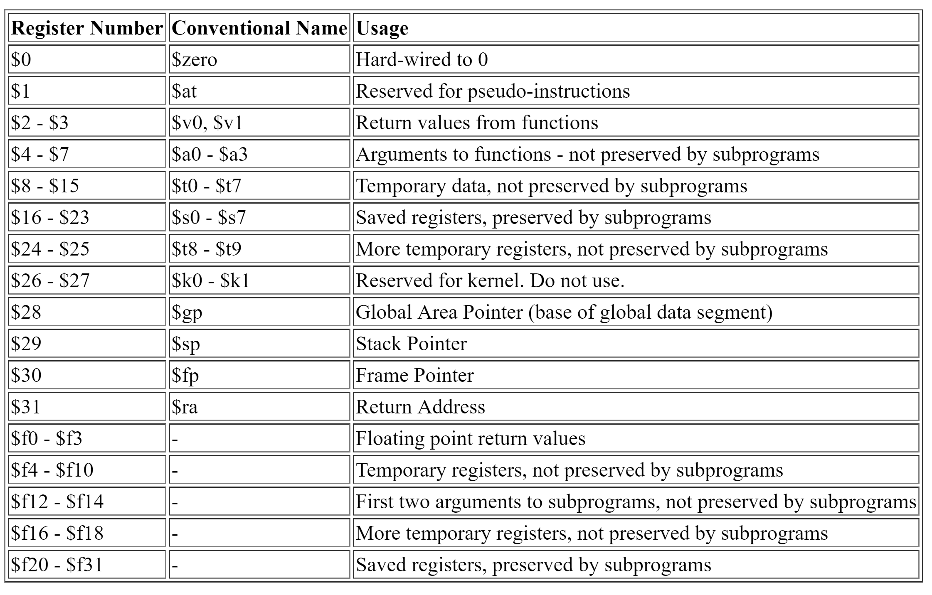

Slide 13
Register Operands
Why there are only 32 registers, why not more?
It will take longer clock cycle to compute and to travel longer.
Design Principle 2: Smaller is faster
Compared to: main memory having millions of locations
Why the size of a register is 32 bit?
32 bit occurs frequently and thus in MIPS, it has special name ‘word’
This size aligns well with the MIPS instruction format
§2.3 Operands of the Computer Hardware

Slide 14
Register Operand Example
The term ‘variable’ is vague here, actually registers will be used.
Revisiting the previous C code example:
f = (g + h) - (i + j);
f, …, j are mapped to $s0, …, $s4
Compiled MIPS code:
add $t0, $s1, $s2 add $t1, $s3, $s4 sub $s0, $t0, $t1

Slide 15
Memory Operands
Main memory used for composite data
Arrays, structures, dynamic data
To apply arithmetic operations
Load values from memory into registers
Store result from register to memory

Slide 16
Memory Operands
Since, arithmetic operations occur only on register in MIPS instructions, thus MIPS must include instruction that transfer data between memory and registers.
Thus, MIPS has data transfer instruction with an address to access particular memory location:
lw (load word): transfer data from memory to register
sw (store word): transfer data from register to memory

Slide 17
Memory Operands
Memory is byte addressed
Each address identifies an 8-bit (1 byte)
Words are aligned in memory
Address must be a multiple of 4

Slide 18
Memory Operand Example 1
C code:
g = h + A[8];
g in $s1, h in $s2, base address of A in $s3
Compiled MIPS code:
Index 8 requires offset of 32
4 bytes per word
lw $t0, 32($s3) # load word add $s1, $s2, $t0
offset
base register

Slide 19
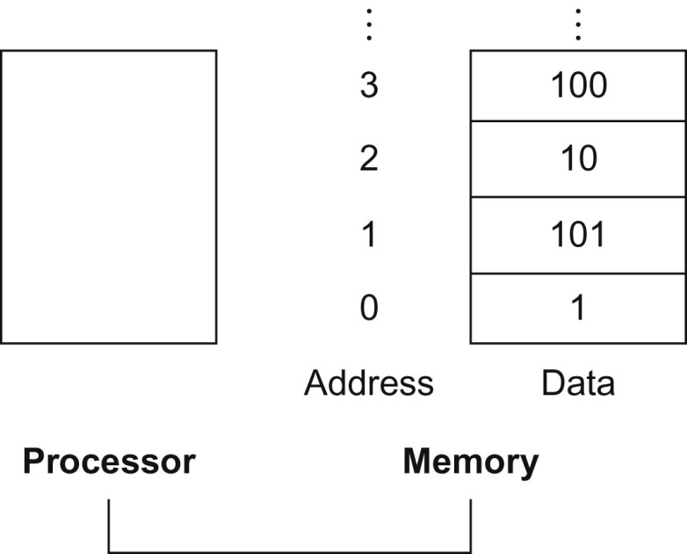
FIGURE 2.2 Memory addresses and contents of memory at those locations. If these elements were words, these addresses would be incorrect, since MIPS actually uses byte addressing, with each word representing four bytes. Figure 2.3 shows the memory addressing for sequential word addresses.
19
Copyright © 2014 Elsevier Inc. All rights reserved.

Slide 20
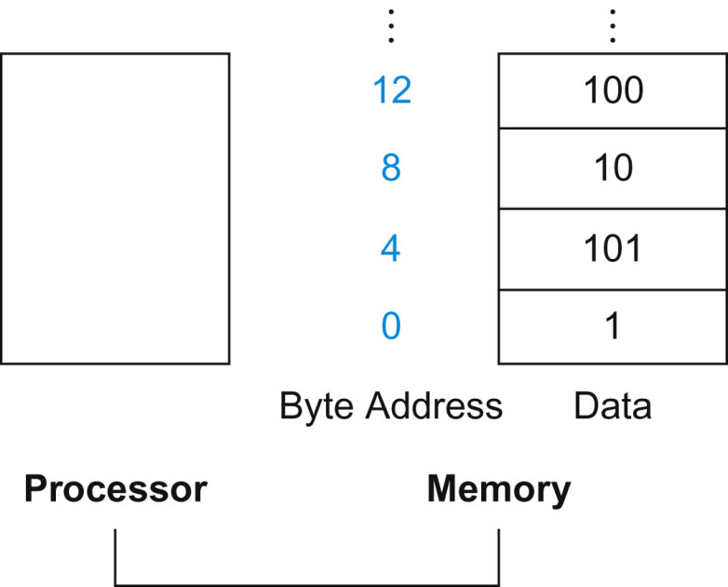
FIGURE 2.3 Actual MIPS memory addresses and contents of memory for those words. The changed addresses are highlighted to contrast with Figure 2.2. Since MIPS addresses each byte, word addresses are multiples of 4: there are 4 bytes in a word.
20
Copyright © 2014 Elsevier Inc. All rights reserved.

Slide 21
Memory Operand Example 2
C code:
A[12] = h + A[8];
h in $s2, base address of A in $s3
Compiled MIPS code:
Index 8 requires offset of 32
lw $t0, 32($s3) # load word add $t0, $s2, $t0 sw $t0, 48($s3) # store word

Slide 22
Registers vs. Memory
Registers are faster to access than memory
Operating on memory data requires loads and stores
More instructions to be executed
Compiler must use registers for variables as much as possible
Only spill to memory for less frequently used variables
Register optimization is important!

Slide 23
Memory Hierarchy
Recall
L1/L2 Cache
Registers
Main Memory
Secondary Storage
Magnetic Tape
Typical Access Time
Typical Capacity
1 nanosecond
< 1 KB
2 nanoseconds
32 KB/4 MB
10 nanoseconds
1 – 16 GB
10 milliseconds
128 - 2000 GB
100 seconds
500 - 1000 GB

Slide 24
Immediate Operands
Constant data specified in an instruction
addi $s3, $s3, 4
No subtract immediate instruction
Just use a negative constant
addi $s2, $s1, -1
Design Principle 3: Make the common case fast
Small constants are common
Immediate operand avoids a load instruction

Slide 25
The Constant Zero
MIPS register 0 ($zero) is the constant 0
Cannot be overwritten
Useful for common operations
E.g., move between registers
add $t2, $s1, $zero

Slide 26
Unsigned Binary Integers
Given an n-bit number
§2.4 Signed and Unsigned Numbers
Range: 0 to +2^{n} – 1
Example
0000 0000 0000 0000 0000 0000 0000 1011₂ = 0 + … + 1×2³ + 0×2² +1×2¹ +1×2⁰ = 0 + … + 8 + 0 + 2 + 1 = 11₁₀
Using 32 bits
0 to +4,294,967,295

Slide 27
Presenting positive and negative numbers
Obvious thought: use sign and magnitude; i.e., add a separate sign presented by single bit. Problems:
Where to put the sign bit, left or right?
Adders for sign and magnitude may need an extra steps to set the sign – because we can’t know in advance what the proper sign will be.
Both a positive and a negative 0 possible – needs attentive programming.

Slide 28
Simple Choice for Hardware
The solution was to pick the representation that made the hardware simple such as:
Leading 0s means positive and
Leading 1s mean negative number.
2’s complement supports these preferences.
The hardware only needs to check the leading digit to determine + or – #s.

Slide 29
Operation for Conversion
Convert to base 10: Either + or – the operations are almost same, only exception is the signed bit is multiplied by -2³¹ (when number is a number 32 bit number). That is:
(x₃₁ × -2³¹) + (x₃₀ × 2³⁰) + … + (x₁ × 2¹) + (x₀ × 2⁰)
For example:
1111 1111 1111 1111 1111 1111 1111 1100₂
= (1 × -2³¹) + (1 × 2³⁰) + … + (1 × 2²) + (0 × 2¹) + (0 × 2⁰)
= -2³¹ + 2³⁰ + 2²⁹ + … +2² + 2¹ + 2⁰
= -2,147,483,648₁₀ + 2,147,483,644₁₀
= - 4_{ten}

Slide 30
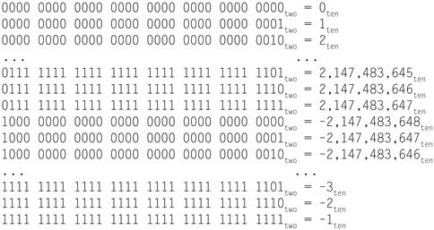
Two’s complement
The positive half of the numbers, from 0 to 2,147,483,647_{ten} (2³¹−1), use the same representation as before. The following bit pattern (1000 … 0000_{two}) represents the most negative number −2,147,483,648_{ten} (−2³¹). It is followed by a declining set of negative numbers: −2,147,483,647_{ten} (1000 … 0001_{two}) down to −1_{ten} (1111 … 1111_{two}).

Slide 31
2s-Complement Signed Integers
Given an n-bit number
Range: –2^{n – 1} to +2^{n – 1} – 1
Using 32 bits
–2,147,483,648 to +2,147,483,647

Slide 32
2s-Complement Signed Integers
Bit 31 is sign bit
1 for negative numbers
0 for non-negative numbers
Non-negative numbers have the same unsigned and 2s-complement representation
Some specific numbers
0: 0000 0000 … 0000
–1: 1111 1111 … 1111
Most-negative: 1000 0000 … 0000
Most-positive: 0111 1111 … 1111

Slide 33
Shortcut: Signed Negation
Complement and add 1
Complement means 1 → 0, 0 → 1
Example: negate +2
+2 = 0000 0000 … 0010₂
–2 = 1111 1111 … 1101₂ + 1 = 1111 1111 … 1110₂

Slide 34
Sign Extension
Representing a number using more bits
Preserve the numeric value
In MIPS instruction set
addi: extend immediate value
lb, lh: extend loaded byte/halfword
beq, bne: extend the displacement
Replicate the sign bit to the left
c.f. unsigned values: extend with 0s
Examples: 8-bit to 16-bit
+2: 0000 0010 => 0000 0000 0000 0010
–2: 1111 1110 => 1111 1111 1111 1110

Slide 35
Representing Instructions
Instructions are encoded in binary
Called machine code
MIPS instructions
Encoded as 32-bit instruction words
Small number of formats encoding operation code (opcode), register numbers, …
Regularity!
Register numbers
$t0 – $t7 are reg’s 8 – 15
$t8 – $t9 are reg’s 24 – 25
$s0 – $s7 are reg’s 16 – 23
§2.5 Representing Instructions in the Computer

Slide 36
MIPS R-format Instructions
op
rs
rt
rd
shamt
funct
6 bits
5 bits
5 bits
5 bits
5 bits
6 bits
Instruction fields
op: Basic operation of the instruction, called opcode or operation code.
rs: first source register number
rt: second source register number
rd: destination register number
shamt: shift amount (00000 for now)
funct: function code (extends opcode)

Slide 37
R-format Example
op
rs
rt
rd
shamt
funct
6 bits
5 bits
5 bits
5 bits
5 bits
6 bits
add $t0, $s1, $s2
special
$s1
$s2
$t0
0
add
0
17
18
8
0
32
000000
10001
10010
01000
00000
100000
00000010001100100100000000100000₂ = 02324020₁₆
See Appendix A for other instructions …

Slide 38
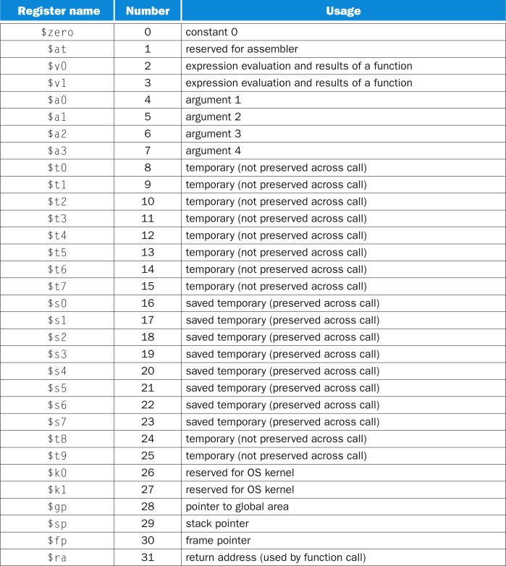
38
FIGURE MIPS registers and usage convention.
Copyright © 2014 Elsevier Inc. All rights reserved.

Slide 39
Hexadecimal
Base 16
Compact representation of bit strings
4 bits per hex digit
0 | 0000 | 4 | 0100 | 8 | 1000 | c | 1100
1 | 0001 | 5 | 0101 | 9 | 1001 | d | 1101
2 | 0010 | 6 | 0110 | a | 1010 | e | 1110
3 | 0011 | 7 | 0111 | b | 1011 | f | 1111
Example: eca8 6420
1110 1100 1010 1000 0110 0100 0010 0000

Slide 40
Limitations of R-format
When longer field is needed R-format has problem
Say, 5 bit field is too small (can have 2⁵ or 32 variations) for a load instruction to load an address
Thus we go for different format of the instruction. For example, I-format.

Slide 41
MIPS I-format Instructions
op
rs
rt
constant or address
6 bits
5 bits
5 bits
16 bits
Immediate arithmetic and load/store instructions
rt: destination or source register number
Constant: –2¹⁵ to +2¹⁵ – 1
Address: offset added to base address in rs
Design Principle 4: Good design demands good compromises
Different formats complicate decoding, but allow 32-bit instructions uniformly
Keep formats as similar as possible

Slide 42
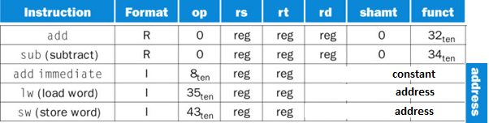
MIPS I-format Instructions
op
rs
rt
constant or address
6 bits
5 bits
5 bits
16 bits
Note: in a load instruction, the rt field specifies the destination register, which receives the result of the load.
Based on op, hardware can uniquely identify instructions among various formats.
FIGURE: MIPS instruction encoding. In the table above, “reg” means a register number between 0 and 31, “address” means a 16-bit address. Note that add and sub instructions have the same value in the op field; the hardware uses the funct field to decide the variant of the operation: add (32) or subtract (34).

Slide 43
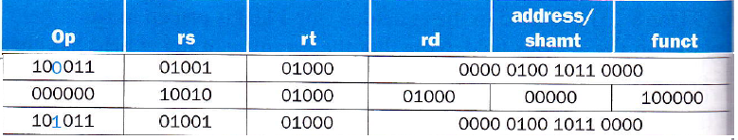
Translating MIPS to Machine Language
Example: A [300] = h + A [300];
If $t1 has the base of A and $s2 maps to h
then MIPS code can be
lw $t0, 1200($t1)
add $t0, $s2, $t0
sw $t0, 1200($t1)
The corresponding machine code (in decimal) can be as following:
The corresponding machine code (in binary) can be as following:

Slide 44
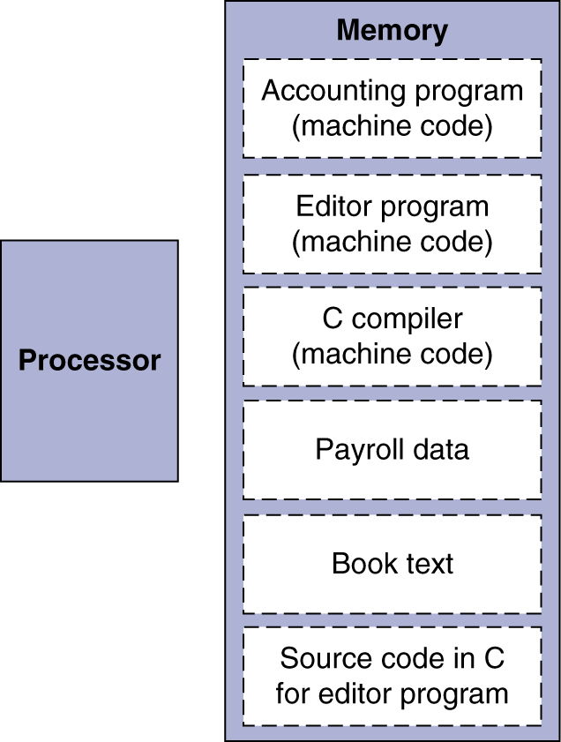
Stored Program Computers
The BIG Picture
Instructions are represented as numbers.
Programs are stored in memory to be read or written, just like data.
Programs can operate on programs
e.g., compilers, linkers, …
Binary compatibility allows compiled programs to work on different computers
Standardized ISAs

Slide 45
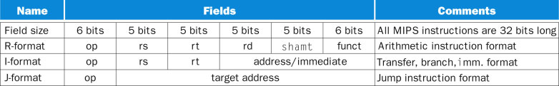
3 MIPS Instructions format: R, I, J
FIGURE: MIPS instruction formats: R, I, J.
45
Copyright © 2014 Elsevier Inc. All rights reserved.
Notes:
For immediate, rt is the destination register, for example: addi $rt, $rs, immediate_value

Slide 46
Logical Operations
Instructions for bitwise manipulation
§2.6 Logical Operations
Operation | C | Java | MIPS
Shift left | << | << | sll
Shift right | >> | >>> | srl
Bitwise AND | & | & | and, andi
Bitwise OR | | | | | or, ori
Bitwise NOT | ~ | ~ | nor
Useful for extracting and inserting groups of bits in a word
Notes:
sll => shift left logical
srl => shift right logical

Slide 47
Shift Operations
op
rs
rt
rd
shamt
funct
6 bits
5 bits
5 bits
5 bits
5 bits
6 bits
shamt: how many positions to shift
Shift left logical
Shift left and fill with 0 bits
sll by i bits multiplies by 2^{i}
Shift right logical
Shift right and fill with 0 bits
srl by i bits divides by 2^{i} (unsigned only)

Slide 48
AND Operations
Useful to mask bits in a word
Select some bits, clear others to 0
and $t0, $t1, $t2
$t2
0000 0000 0000 0000 0000 1101 1100 0000
$t1
0000 0000 0000 0000 0011 1100 0000 0000
$t0
0000 0000 0000 0000 0000 1100 0000 0000
Notes:
Another simulator, MARS simulator, http://courses.missouristate.edu/kenvollmar/mars/
Latest QtSpim for Windows, Mac, Linux etc can be found here: https://sourceforge.net/projects/spimsimulator/files/

Slide 49
SPIM code
.text
main:
li $t2, 0x00000dc0 # 0000 0000 0000 0000 0000 1101 1100 0000
li $t1, 0x00003c00 # 0000 0000 0000 0000 0011 1100 0000 0000
and $t0, $t1, $t2
jr $ra

Slide 50
OR Operations
Useful to include bits in a word
Set some bits to 1, leave others unchanged
or $t0, $t1, $t2
$t2
0000 0000 0000 0000 0000 1101 1100 0000
$t1
0000 0000 0000 0000 0011 1100 0000 0000
$t0
0000 0000 0000 0000 0011 1101 1100 0000

Slide 51
NOT Operations
Useful to invert bits in a word
Change 0 to 1, and 1 to 0
MIPS has NOR 3-operand instruction
a NOR b == NOT ( a OR b )
nor $t0, $t1, $zero
Register 0: always read as zero
$t1
0000 0000 0000 0000 0011 1100 0000 0000
$t0
1111 1111 1111 1111 1100 0011 1111 1111

Slide 52
32-bit Constants
Most constants are small
16-bit immediate is sufficient
For the occasional 32-bit constant
lui rt, constant
Copies 16-bit constant to left 16 bits of rt
Clears right 16 bits of rt to 0
§2.10 MIPS Addressing for 32-Bit Immediates and Addresses
lui $s0, 61
0000 0000 0011 1101 0000 0000 0000 0000
ori $s0, $s0, 2304
0000 0000 0011 1101 0000 1001 0000 0000
Notes:
lui => load upper immediate

Slide 53
Conditional Operations
Branch to a labeled instruction if a condition is true
Otherwise, continue sequentially
beq rs, rt, L1
if (rs == rt) branch to instruction labeled L1;
bne rs, rt, L1
if (rs != rt) branch to instruction labeled L1;
j L1
unconditional jump to instruction labeled L1
§2.7 Instructions for Making Decisions

Slide 54
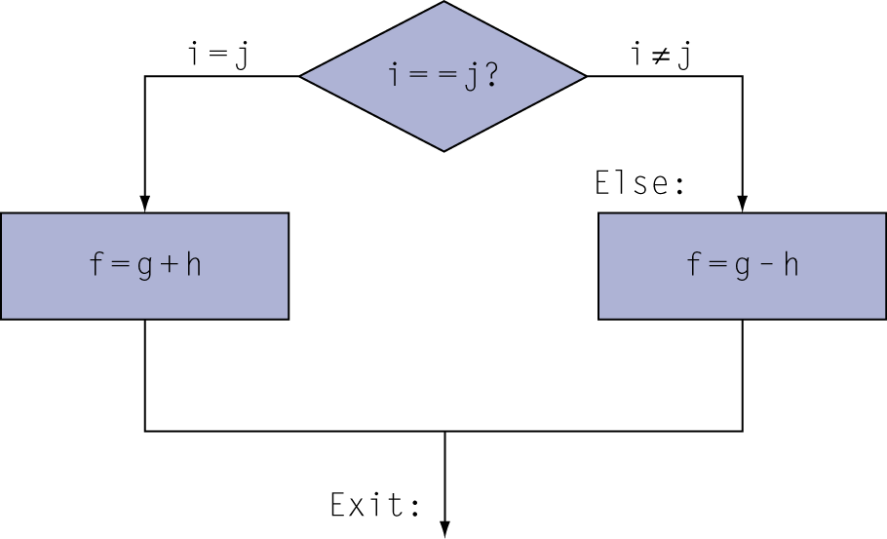
Compiling If Statements
C code:
if (i==j) f = g+h; else f = g-h;
f, g, … in $s0, $s1, …
Compiled MIPS code:
bne $s3, $s4, Else add $s0, $s1, $s2 j Exit Else: sub $s0, $s1, $s2 Exit: …
Assembler calculates addresses
Notes:
Assume: f, g, h, i, and j are represented by $s0, $s1, $s2, $s3 and $s4, respectively.

Slide 55
Instructions for comparison
slt or, set on less than
slt $t0, $s3, $s4 # $t0 = 1 if $s3 < $s4, else $t0 = 0
slti $t0, $s2, 10 # $t0 = 1 if $s2 < 10, else $t0 = 0
slt can be used for signed comparison whereas sltu is for unsigned comparison
If $s0 = 1111 1111 1111 1111 1111 1111 1111 1111₂
& $s1 = 0000 0000 0000 0000 0000 0000 0000 0001₂
Then:
slt $t0, $s0, $s1 # $t0 =1, since -1_{ten} < 1_{ten}.
sltu $t1, $s0, $s1 # $t1 =0, since 4,294,967,295_{ten} > 1_{ten}.

Slide 56
Branch Pseudoinstructions
blt (branch less than)
ble (branch less than or equal)
bgt (branch greater than)
bge (branch greater than or equal)
Use in combination with beq, bne
blt $s1, $s2, L
slt $t0, $s1, $s2 # if ($s1 < $s2)
bne $t0, $zero, L # branch to L

Slide 57
Branch Instruction Design
Why not blt, bge, etc?
Hardware for <, ≥, … slower than =, ≠
Combining with branch involves more work per instruction, requiring a slower clock
All instructions penalized!
beq and bne are the common case
This is a good design compromise

Slide 58
Compiling Loop Statements
C code:
while (save[i] == k) i += 1;
i in $s3, k in $s5, address of save in $s6
Compiled MIPS code:
Loop:sll $t1, $s3, 2 # $t1 = i * 4 add $t1, $t1, $s6 # $t1 = address of save[i] lw $t0, 0($t1) # $t0 = save[i] bne $t0, $s5, Exit # Exit if save[i]≠ k addi $s3, $s3, 1 # i = i + 1 j Loop # go to Loop Exit: …
Notes:
See slide 77 to see how to compute the labels’ address.

Slide 59
Basic Blocks
A basic block is a sequence of instructions with
No embedded branches (except at end)
No branch targets (except at beginning)
A compiler identifies basic blocks for optimization
An advanced processor can accelerate execution of basic blocks

Slide 60
Procedure Calling
Steps required
Place parameters in registers
Transfer control to procedure
Acquire storage for procedure
Perform procedure’s operations
Place result in register for caller
Return to place of call
§2.8 Supporting Procedures in Computer Hardware

Slide 61
Six Steps in details for Procedure call
Main routine (caller) places parameters in a place where the procedure (callee) can access them
$a0 - $a3: four argument registers
Caller transfers control to the callee
Callee acquires the storage resources needed
Callee performs the desired task
Callee places the result value in a place where the caller can access it
$v0 - $v1: two value registers for result values
Callee returns control to the caller
$ra: one return address register to return to the point of origin

Slide 62
Register Usage for Procedure
$a0 – $a3: arguments (reg’s 4 – 7)
$v0, $v1: result values (reg’s 2 and 3)
$t0 – $t9: temporaries
Can be overwritten by callee
$s0 – $s7: saved
Must be saved/restored by callee
$gp: global pointer for static data (reg 28)
$sp: stack pointer (reg 29)
$fp: frame pointer (reg 30)
$ra: return address (reg 31)

Slide 63
Procedure Call Instructions
Procedure call: jump and link
jal ProcedureLabel
Address of following instruction put in $ra. Basically, jal saves PC+4 in register $ra
Jumps to target address
Procedure return: jump register
jr $ra
Copies $ra to program counter
Can also be used for computed jumps
e.g., for case/switch statements

Slide 64
Leaf Procedure Example
C code:
int leaf_example (int g, h, i, j) { int f; f = (g + h) - (i + j); return f; }
Arguments g, …, j in $a0, …, $a3
f in $s0 (hence, need to save $s0 on stack)
Result in $v0

Slide 65
Leaf Procedure Example
MIPS code:
leaf_example: addi $sp, $sp, -4 sw $s0, 0($sp) add $t0, $a0, $a1 add $t1, $a2, $a3 sub $s0, $t0, $t1 add $v0, $s0, $zero lw $s0, 0($sp) addi $sp, $sp, 4 jr $ra
Save $s0 on stack
Procedure body
Result
Restore $s0
Return
Note: we could save $t0 and $t1 as we did for $s0, but by convention it is not needed.

Slide 66
Which registers to save & restore:
To avoid saving and restoring a register whose value is never used, which might happen with a temporary register, MIPS software separates 18 of the registers into 2 groups:
$t0 - $t9: are not preserved by the callee (i.e., the procedure) on a procedure call
$s0 - $s7: saved registers that must be preserved on a procedure call (if used, the callee saves and restores them)

Slide 67
Non-Leaf Procedures
Procedures that call other procedures
For nested call, caller needs to save on the stack:
Its return address
Any arguments and temporaries needed after the call
Restore from the stack after the call

Slide 68
Non-Leaf Procedure Example
C code:
int fact (int n) { if (n < 1) return 1; else return n * fact(n - 1); }
Argument n in $a0
Result in $v0

Slide 69
Non-Leaf Procedure Example
MIPS code:
fact: addi $sp, $sp, -8 # adjust stack for 2 items sw $ra, 4($sp) # save return address sw $a0, 0($sp) # save argument (~push) slti $t0, $a0, 1 # test for n < 1 beq $t0, $zero, L1 addi $v0, $zero, 1 # if so, result is 1 addi $sp, $sp, 8 # pop 2 items from stack jr $ra # and return L1: addi $a0, $a0, -1 # else decrement n jal fact # recursive call lw $a0, 0($sp) # restore original n lw $ra, 4($sp) # and return address addi $sp, $sp, 8 # pop 2 items from stack mul $v0, $a0, $v0 # multiply to get result jr $ra # and return

Slide 70
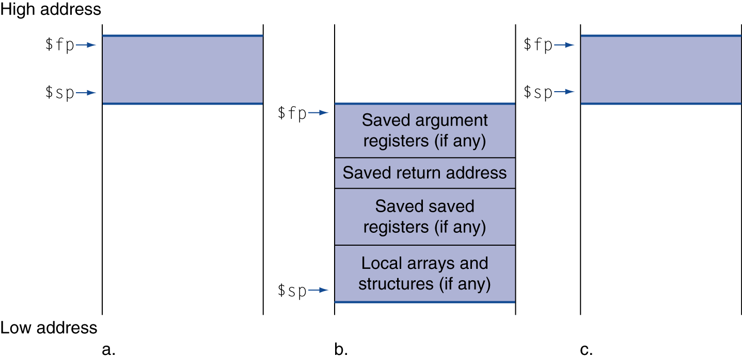
Local Data on the Stack
Local data allocated by callee
e.g., C automatic variables
Procedure frame (activation record)
Used by some compilers to manage stack storage

Slide 71
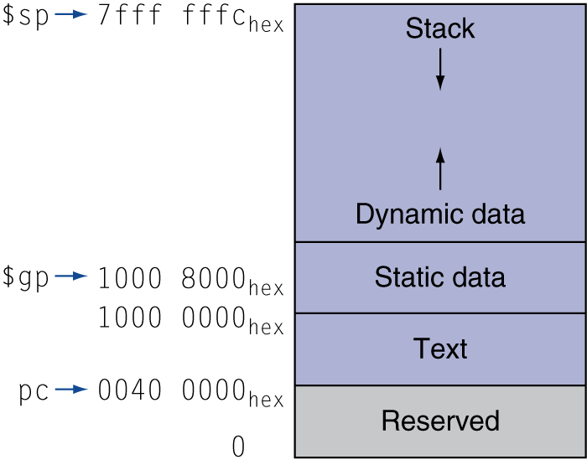
Memory Layout
Text: program code
Static data: global variables
e.g., static variables in C, constant arrays and strings
$gp initialized to address allowing ±offsets into this segment
Dynamic data: heap
E.g., malloc in C, new in Java
Stack: automatic storage

Slide 72
Memory Layout …
These addresses are only a software convention, and not part of the MIPS architecture.
The global pointer, $gp, is set to an address to make it easy to access data.
$gp is initialized to 1000 8000_{hex} so that it can access
- from 1000 0000_{hex}
- to 1000 ffff_{hex}
using the positive and negative 16-bit offsets from $gp.

Slide 73
Character Data
Byte-encoded character sets
ASCII: 128 characters
95 graphic, 33 control
Latin-1: 256 characters
ASCII, +96 more graphic characters
Unicode: 32-bit character set
Used in Java, C++ wide characters, …
Most of the world’s alphabets, plus symbols
UTF-8, UTF-16: variable-length encodings
§2.9 Communicating with People
Notes:
Note: UTF => Unicode Transformation Format

Slide 74
Byte/Halfword Operations
Could use bitwise operations
MIPS byte/halfword load/store
String processing is a common case
lb rt, offset(rs) lh rt, offset(rs)
Sign extend to 32 bits in rt
lbu rt, offset(rs) lhu rt, offset(rs)
Zero extend to 32 bits in rt
sb rt, offset(rs) sh rt, offset(rs)
Store just rightmost byte/halfword
Notes:
Note: b=> byte, h => halfword, l=> load, s=store.
lh -> sign extended load halfword
lhu -> zero extended or unsigned load halfword
lb, lbu -> Load the byte at address into register rt. The byte is sign-extended by lb, but not by lbu.
sb -> Store the low byte from register rt at address.
sh -> Store the low halfword from register rt at address.

Slide 75
String Copy Example
C code for copy string y to string x
Null-terminated string
void strcpy (char x[], char y[]) { int i; i = 0; while ((x[i]=y[i])!='\0') i += 1; }
Addresses of x, y in $a0, $a1
i in $s0

Slide 76
String Copy Example
MIPS code:
strcpy: addi $sp, $sp, -4 # adjust stack for 1 item sw $s0, 0($sp) # save $s0 add $s0, $zero, $zero # i = 0 L1: add $t1, $s0, $a1 # addr of y[i] in $t1 lbu $t2, 0($t1) # $t2 = y[i] add $t3, $s0, $a0 # addr of x[i] in $t3 sb $t2, 0($t3) # x[i] = y[i] beq $t2, $zero, L2 # exit loop if y[i] == 0 addi $s0, $s0, 1 # i = i + 1 j L1 # next iteration of loop L2: lw $s0, 0($sp) # restore saved $s0 addi $sp, $sp, 4 # pop 1 item from stack jr $ra # and return

Slide 77
32-bit Constants
Most constants are small
16-bit immediate is sufficient
For the occasional 32-bit constant
lui rt, constant
Copies 16-bit constant to left 16 bits of rt
Clears right 16 bits of rt to 0
§2.10 MIPS Addressing for 32-Bit Immediates and Addresses
Desired Number(4000000):
0000 0000 0011 1101 0000 1001 0000 0000
lui $s0, 61
0000 0000 0011 1101 0000 0000 0000 0000
ori $s0, $s0, 2304
0000 0000 0011 1101 0000 1001 0000 0000

Slide 78
Branch Addressing
Branch instructions specify
Opcode, two registers, target address
Most branch targets are near branch
Forward or backward
op
rs
rt
constant or address
6 bits
5 bits
5 bits
16 bits
PC-relative addressing
Target address = PC + offset × 4
PC already incremented by 4 by this time
Notes:
Statistics: Half of the conditional branches in SPEC benchmarks go to locations less than 16 instructions away.
With respect to the PC we can branch +/- 2^15 using the 16 bit field for the address.

Slide 79
Jump Addressing
Jump (j and jal) targets could be anywhere in text segment
Encode full address in instruction
op
address
6 bits
26 bits
(Pseudo)Direct jump addressing
Target address = PC_{31…28} : (address × 4)

Slide 80
Target Addressing Example
While loop code from earlier example (book p:92-93/ slide #52)
Assume Loop at location 80000
Loop: sll $t1, $s3, 2 | 80000 | 0 | 0 | 19 | 9 | 4 | 0
add $t1, $t1, $s6 | 80004 | 0 | 9 | 22 | 9 | 0 | 32
lw $t0, 0($t1) | 80008 | 35 | 9 | 8 | 0
bne $t0, $s5, Exit | 80012 | 5 | 8 | 21 | 2
addi $s3, $s3, 1 | 80016 | 8 | 19 | 19 | 1
j Loop | 80020 | 2 | 20000
Exit: … | 80024
Notes:
Why is it ‘2’ for label ‘Exit’?
Ans: Because => (PC+4) + (2 x 4) = PC + 12 = 80012 + 12 = 80024.
2. Why is ‘20000’ for j/Loop in line #80020?
Ans: The highest 4 bits of PC = 0000 here. The 26 bit becomes 28 with and the decimal value of the field indicates = 20000 x 4 = 80000.
So, the total address bits are (0000 from PC) + ( 00 0000 0000 0100 1110 0010 0000, 26 bit jump address) + 00 [Note: 20000 decimal = 4E20 hex]
= (0000) + (0000 0000 0001 0011 1000 1000 0000, 28 bit jump address) [Note: 0 0 1 3 8 8 0 hex = 80000 decimal]
= (0000 0000 0000 0001 0011 1000 1000 0000, 32 bit jump address)
= 80000 in decimal (or, 13880 in hex)

Slide 81
Branching Far Away
If branch target is too far to encode with 16-bit offset, assembler rewrites the code
Example
beq $s0,$s1, L1
Replace the above by a pair of instructions that offers a much greater branching distance.
↓
bne $s0,$s1, L2 j L1 L2: …

Slide 82
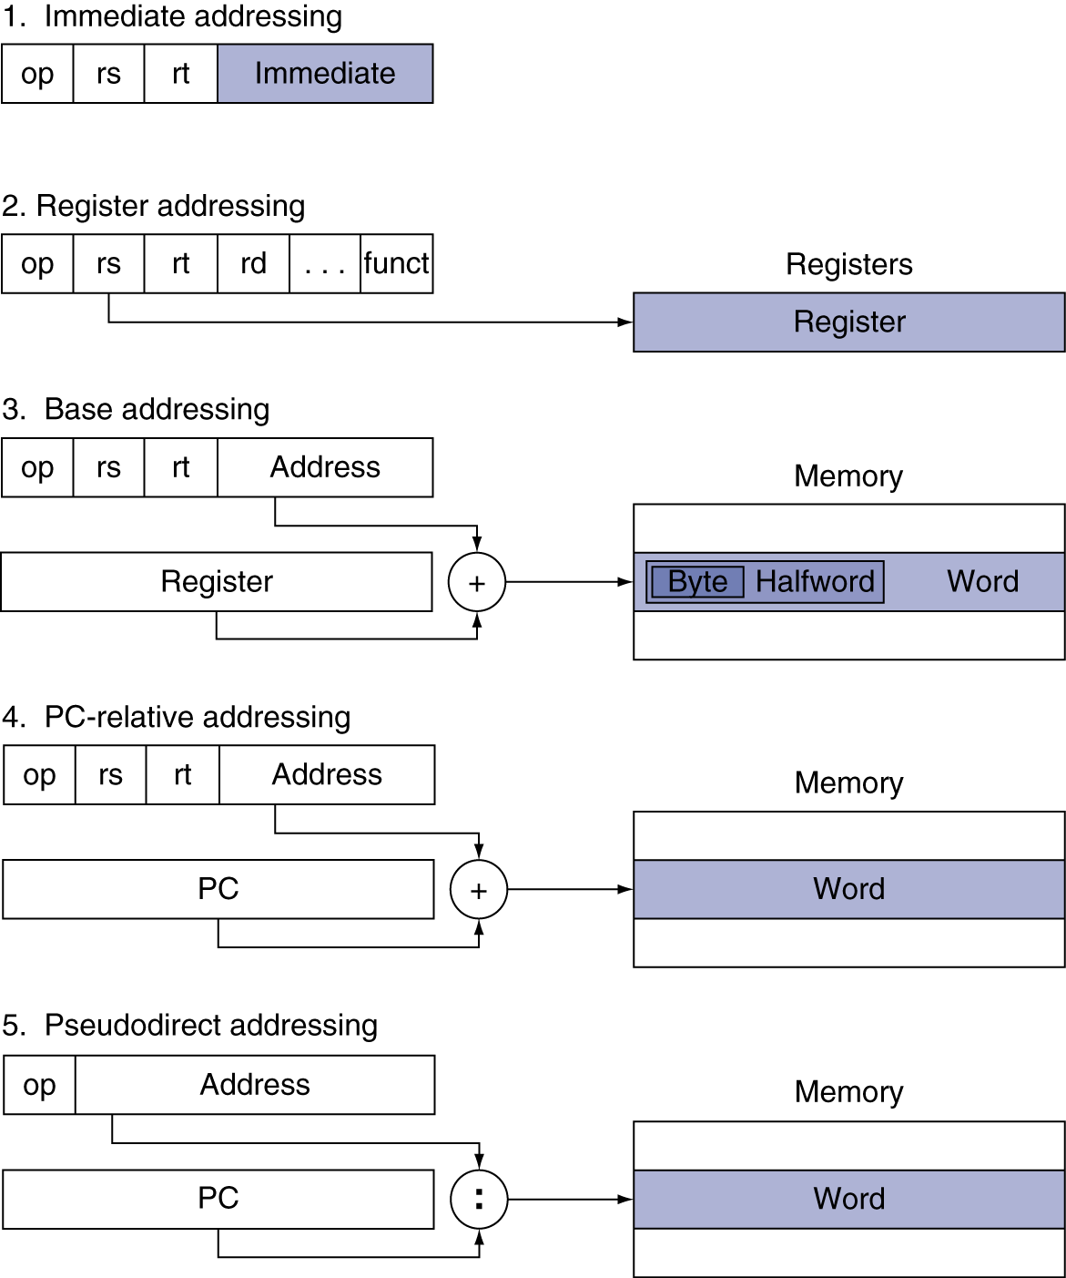
Addressing Mode Summary
Notes:
The operands are shaded in color.
The operand of mode 3 is in memory, whereas the operand for mode 2 is a register. Note that versions of load and store access bytes, halfwords, or words.
For mode 1, the operand is 16 bits of the instruction itself.
Modes 4 and 5 address instructions in memory, with mode 4 adding a 16-bit address shifted left 2 bits to the PC and
mode 5 concatenating a 26-bit address shifted left 2 bits with the 4 upper bits of the PC. Note that a single operation can use more than one addressing mode. Add, for example, uses both immediate (addi) and register (add) addressing.

Slide 83
Synchronization
Two processors sharing an area of memory
P1 writes, then P2 reads
Data race if P1 and P2 don’t synchronize
Result depends of order of accesses
Hardware support required
Atomic read/write memory operation
No other access to the location allowed between the read and write
Could be a single instruction
E.g., atomic swap of register ↔ memory
Or an atomic pair of instructions
§2.11 Parallelism and Instructions: Synchronization

Slide 84
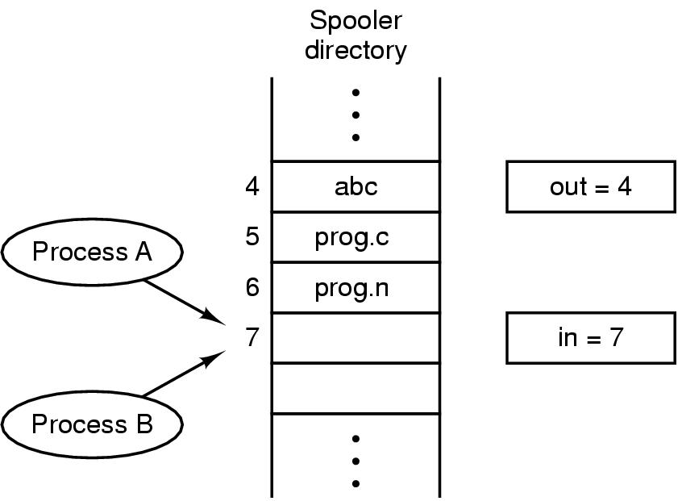
Race Conditions
Fig: Two processes want to access shared memory at the same time.
Tanenbaum, Modern Operating Systems 3 e, (c) 2008 Prentice-Hall, Inc. All rights reserved. 0-13-6006639
Notes:
Note: Simultaneous Peripheral Operations On Line => SPOOL
Situations, where two or more processes are reading or writing some shared data and the final results depends on who runs precisely when, are called race conditions.

Slide 85
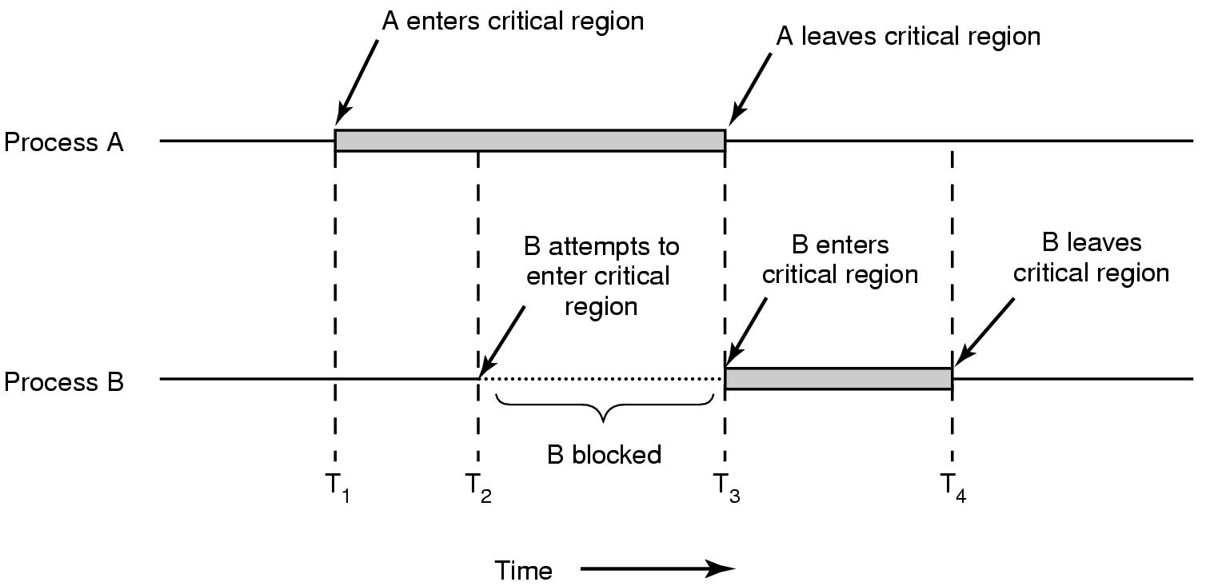
Example: Critical Regions
Fig: Mutual exclusion using critical regions.
Tanenbaum, Modern Operating Systems 3 e, (c) 2008 Prentice-Hall, Inc. All rights reserved. 0-13-6006639

Slide 86
Test and Set Lock (TSL)
TSL REGISTER, LOCK (hardware support)
Reads the contents of the memory word lock into register RX and stores a non-zero value at the memory address lock.
The memory bus is locked during this operation so no other process or CPU can access memory (e.g. change Lock’s value)
Mutual Exclusion
enter_region:
TSL REGISTER, LOCK | copy Lock to Reg and set Lock to 1
CMP REGISTER, #0 | was the Lock zero?
JNE enter_region | if Lock was nonzero, jump to top of loop
RET | return to caller, critical region entered
leave_region:
MOVE LOCK, #0 | store 0 in Lock
RET | return to caller

Slide 87
Synchronization in MIPS
Load linked: ll rt, offset(rs)
Store conditional: sc rt, offset(rs)
Succeeds if location not changed since the ll
Returns 1 in rt
Fails if location is changed
Returns 0 in rt
Example: atomic swap (to test/set lock variable)
try: add $t0,$zero,$s4 ;copy exchange value
ll $t1,0($s1) ;load linked
sc $t0,0($s1) ;store conditional
beq $t0,$zero,try ;branch store fails
add $s4,$zero,$t1 ;put load value in $s4
Notes:
The example in the above slide is about an “atomic” swap in between memory location 0($s1) and register $s4 using LL and SC instructions. Note: the memory location 0($s1) can be considered as a shared location.
For accessing shared resources exclusively, say for maintaining consistency in accessing shared database by many processes or for accessing single license etc., we need ‘synchronization’, which allows orderly access to the shared resources. For a process we call the section a ‘critical region’ when it is required to access a shared resource exclusively. MIPS provides two instruction pairs: Load Link (LL) and Store Conditional (SC), to support accessing a process in its critical region.
When LL instruction is executed, it sets a bit called Load Link bit (LLbit) and this bit is transparent to the user. The set LLbit is a ‘breakable’ link between the LL instruction and the subsequent SC instruction.
When SC instruction is executed, it performs a simple store operation iff the LLbit is set. However, if the LLbit is not set (i.e., reset in the meantime by other competitive process for exclusive access or, for occurrence of any event that even has potential to modify the lock-variable), then the store operation is failed to execute. Thus, execution status of SC could be a success or a failure and this status is indicated in the target register of this store operation. The register will have a ‘1’ for success and a ‘0’ failure.
Quiz Question: What is Llbit?
Answer: Bit of virtual state used to specify operation for instructions that provide lock-free atomic read-modify-write (RMW). LLbit is set when a linked load (LL) occurs; it is tested and cleared by the conditional store. It is cleared, during other CPU operation, when a store to the location would no longer be atomic. In particular, it is cleared by exception return instructions.

Slide 88
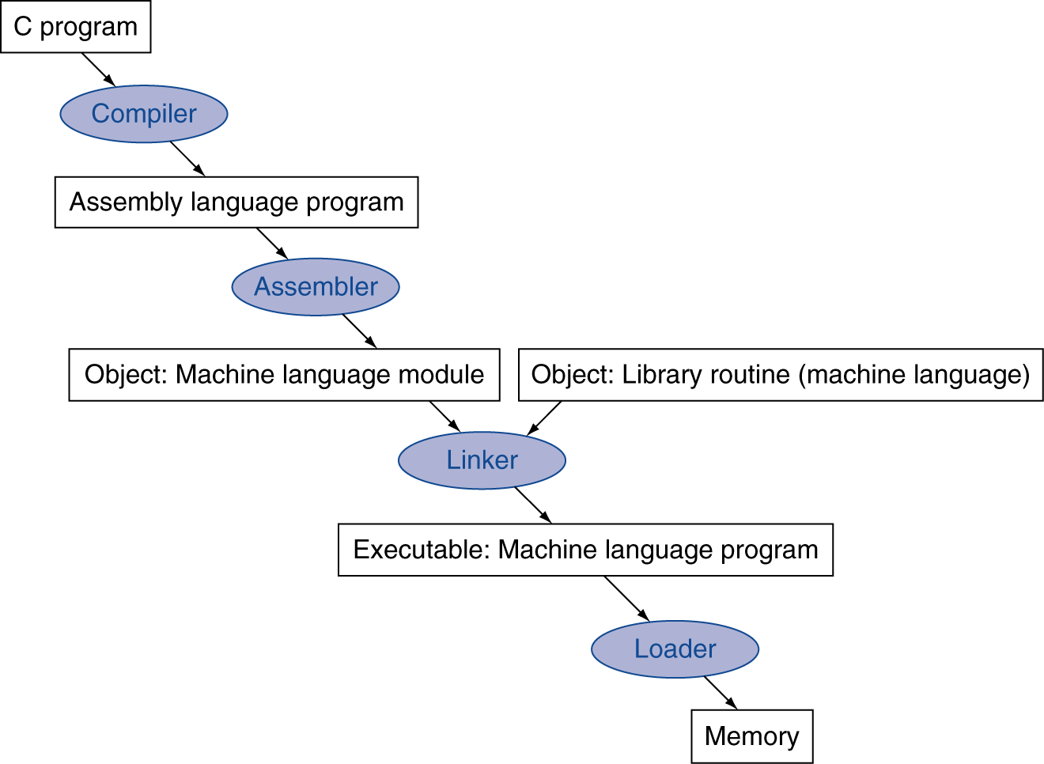
Translation and Startup
Many compilers produce object modules directly
§2.12 Translating and Starting a Program
Static linking
Notes:
DLL => Dynamic Link Library
OCX => Object Linking and Embedding (OLE) Control Extension

Slide 89
Complier to Assembler
So far we have studied C code snipped converted into MIPS assembly language, a sequence of instructions – complier will basically do this job.
Then assembler as its primary task generates machine code or the binary version of the sequence instructions.
As we have discussed, assembler can have pseudo-instructions, which further simplifies translation and programming.

Slide 90
Assembler Pseudoinstructions
Most assembler instructions represent machine instructions one-to-one
Pseudoinstructions: figments of the assembler’s imagination
$at (register 1): assembler temporary
Pseudo Instruction | → | Actual Instruction
move $t0, $t1 | → | add $t0, $zero, $t1
blt $t0, $t1, L | → | slt $at, $t0, $t1 bne $at, $zero, L

Slide 91
Producing an Object Module
To produce the binary version of each instruction in the assembly language program, the assembler (or complier) must determine the address corresponding to all labels. Assemblers keep track of labels in a symbol table. The table contains pairs of symbols and addresses.
The object file for UNIX system typically contains six distinct pieces:
Header: described contents of object module
Text segment: translated instructions
Static data segment: data allocated for the life of the program
Relocation info: for contents that depend on absolute location of loaded program
Symbol table: global definitions and external refs
Debug info: for associating with source code
Notes:
The debugging information contains a concise description of how the modules were complied so that a debugger can associate machine instructions with C source files and make data structures readable.

Slide 92
Linker or Link editor
We may need to recompile and assemble the whole program for a single change to one line of one procedure – wasteful, particularly for standard library routines.
Alternative: Compile and assemble each procedure independently and then stitches them together using linker or link editor.
The linker use the relocation information and symbol table in each object module to resolve all undefined labels.
If all external references are resolved, the linker next determines the memory locations each module will occupy.

Slide 93
Linker …
In summary, linker produces an executable file/image by the following steps:
1. Merges segments
2. Resolve labels (determine their addresses)
3. Patch location-dependent and external refs
Could leave location dependencies for fixing by a relocating loader
But with virtual memory, no need to do this
Program can be loaded into absolute location in virtual memory space

Slide 94
Loading a Program
Load from image file on disk into memory
1. Read header to determine segment sizes
2. Create virtual address space
3. Copy text and initialized data into memory
Or set page table entries so they can be faulted in
4. Set up arguments on stack
5. Initialize registers (including $sp, $fp, $gp)
6. Jump to startup routine
Copies arguments to $a0, … and calls main
When main returns, do exit syscall

Slide 95
Problem with static linking
Problems with linking before the program run (i.e., static linking):
All library routines become part of the executable code.
New library version is not automatically attached.
The library can be large compared to program’s own size.
Solution leads to Dynamically Linked Libraries (DLLs)

Slide 96
DLLs and Lazy Linkage
Only link/load library procedure when it is called
Requires procedure code to be relocatable
Avoids image bloat caused by static linking of all (transitively) referenced libraries
Automatically picks up new library versions
Further optimization: In lazy procedure linkage, routine is linked only after it is called.
Dummy routines are linked initially and then it is relocated/remapped with actual one later.

Slide 97
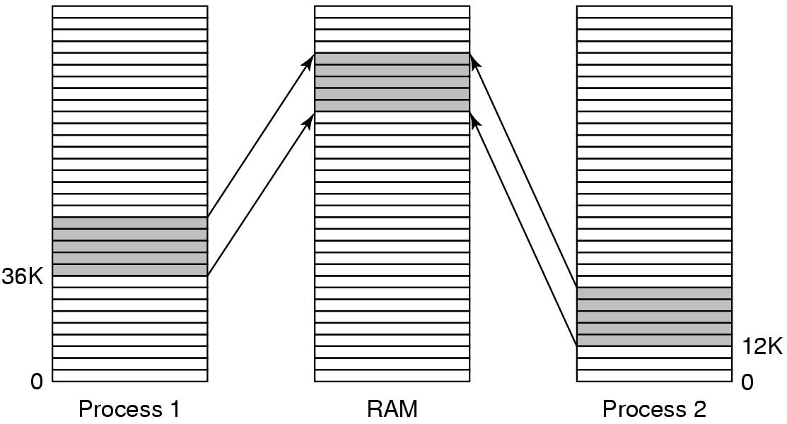
Shared Libraries
Fig: A shared library being used by two processes.
Single copy of the shared library can be used by more than one processes.
Problem: Address translation problem for the process.
Sol^{n}: Compile shared library with a special complier flag so ‘no absolute address’, instead only ‘relative address’ is used => position independent code.
Tanenbaum, Modern Operating Systems 3 e, (c) 2008 Prentice-Hall, Inc. All rights reserved. 0-13-6006639

Slide 98
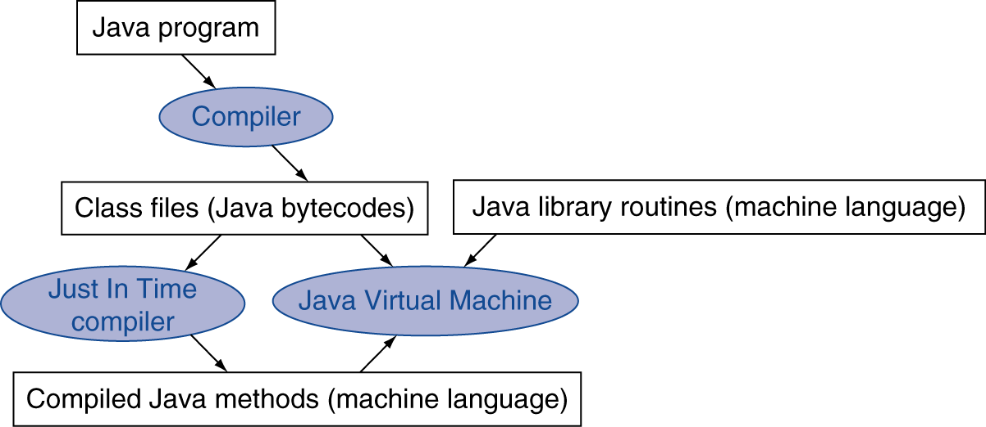
Starting Java Applications
Simple portable instruction set for the JVM
Compiles bytecodes of “hot” methods into native code for host machine
Interprets bytecodes

Slide 99
The Sort Procedure in C
Non-leaf (calls swap)
void sort (int v[], int n)
{
int i, j;
for (i = 0; i < n; i += 1) {
for (j = i – 1;
j >= 0 && v[j] > v[j + 1];
j -= 1) {
swap(v,j);
}
}
}
v in $a0, k in $a1, i in $s0, j in $s1

Slide 100
C Sort Example
Illustrates use of assembly instructions for a C bubble sort function
Swap procedure (leaf)
void swap(int v[], int k) { int temp; temp = v[k]; v[k] = v[k+1]; v[k+1] = temp; }
v in $a0, k in $a1, temp in $t0
§2.13 A C Sort Example to Put It All Together

Slide 101
The Procedure Swap
swap: sll $t1, $a1, 2 # $t1 = k * 4
add $t1, $a0, $t1 # $t1 = v+(k*4)
# (address of v[k])
lw $t0, 0($t1) # $t0 (temp) = v[k]
lw $t2, 4($t1) # $t2 = v[k+1]
sw $t2, 0($t1) # v[k] = $t2 (v[k+1])
sw $t0, 4($t1) # v[k+1] = $t0 (temp)
jr $ra # return to calling routine

Slide 102
The Procedure Body
move $s2, $a0 # save $a0 into $s2
move $s3, $a1 # save $a1 into $s3
move $s0, $zero # i = 0
for1tst: slt $t0, $s0, $s3 # $t0 = 0 if $s0 ≥ $s3 (i ≥ n)
beq $t0, $zero, exit1 # go to exit1 if $s0 ≥ $s3 (i ≥ n)
addi $s1, $s0, –1 # j = i – 1
for2tst: slti $t0, $s1, 0 # $t0 = 1 if $s1 < 0 (j < 0)
bne $t0, $zero, exit2 # go to exit2 if $s1 < 0 (j < 0)
sll $t1, $s1, 2 # $t1 = j * 4
add $t2, $s2, $t1 # $t2 = v + (j * 4)
lw $t3, 0($t2) # $t3 = v[j]
lw $t4, 4($t2) # $t4 = v[j + 1]
slt $t0, $t4, $t3 # $t0 = 0 if $t4 ≥ $t3
beq $t0, $zero, exit2 # go to exit2 if $t4 ≥ $t3
move $a0, $s2 # 1st param of swap is v (old $a0)
move $a1, $s1 # 2nd param of swap is j
jal swap # call swap procedure
addi $s1, $s1, –1 # j –= 1
j for2tst # jump to test of inner loop
exit2: addi $s0, $s0, 1 # i += 1
j for1tst # jump to test of outer loop
Move params
Outer loop
Inner loop
Pass params & call
Inner loop
Outer loop

Slide 103
The Full Procedure
sort: addi $sp,$sp, –20 # make room on stack for 5 registers
sw $ra, 16($sp) # save $ra on stack
sw $s3,12($sp) # save $s3 on stack
sw $s2, 8($sp) # save $s2 on stack
sw $s1, 4($sp) # save $s1 on stack
sw $s0, 0($sp) # save $s0 on stack
… # procedure body
…
exit1: lw $s0, 0($sp) # restore $s0 from stack
lw $s1, 4($sp) # restore $s1 from stack
lw $s2, 8($sp) # restore $s2 from stack
lw $s3,12($sp) # restore $s3 from stack
lw $ra,16($sp) # restore $ra from stack
addi $sp,$sp, 20 # restore stack pointer
jr $ra # return to calling routine

Slide 104
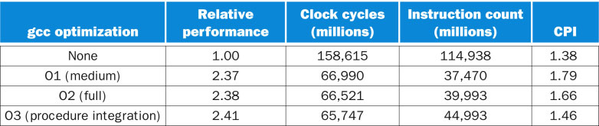
Effect of Compiler Optimization
Compiled with gcc for Pentium 4 under Linux
FIGURE: Comparing performance, instruction count, and CPI using compiler optimization for Bubble Sort.
The programs sorted 100,000 words with the array initialized to random values.
These programs were run on a Pentium 4 with a clock rate of 3.06 GHz and a 533 MHz system
bus with 2 GB of PC2100 DDR SDRAM. It used Linux version 2.4.20.
Notes:
This is for bubble sort
None => I * (C/I) = C => 114938 x 1.38 = 158614.44 ~158615
O1 => 37470 * 1.79 = 67071.3
O2 => 39993 * 1.66 =66388.38
O3 => 44993 * 1.46 = 65689.78
None / O3 = 158615 /65689.78 = 2.414606960169451
None / O2 = 158615 / 66388.38 = 2.389198230172208
None / O1 = 158615 / 67071.3 = 2.364871412959045

Slide 105
Comparisons in bar graphs …
Compiled with gcc for Pentium 4 under Linux
Notes:
This is for bubble sort

Slide 106
Effect of Language and Algorithm
Notes:
Java/int => Java Interpreter (JVM)

Slide 107
Lessons Learnt
Instruction count and CPI are not good performance indicators in isolation
Compiler optimizations are sensitive to the algorithm
Java/JIT compiled code is significantly faster than JVM interpreted
Comparable to optimized C in some cases
Nothing can fix a dumb algorithm!

Slide 108
Arrays vs. Pointers
Array indexing involves
Multiplying index by element size
Adding to array base address
Pointers correspond directly to memory addresses
Can avoid indexing complexity
§2.14 Arrays versus Pointers

Slide 109
Example: Clearing an Array
clear1(int array[], int size) { int i; for (i = 0; i < size; i += 1) array[i] = 0; } | clear2(int *array, int size) { int *p; for (p = &array[0]; p < &array[size]; p = p + 1) *p = 0; }
move $t0,$zero # i = 0 loop1: sll $t1,$t0,2 # $t1 = i * 4 add $t2,$a0,$t1 # $t2 = # &array[i] sw $zero, 0($t2) # array[i] = 0 addi $t0,$t0,1 # i = i + 1 slt $t3,$t0,$a1 # $t3 = # (i < size) bne $t3,$zero,loop1 # if (…) # goto loop1 | move $t0,$a0 # p = & array[0] sll $t1,$a1,2 # $t1 = size * 4 add $t2,$a0,$t1 # $t2 = # &array[size] loop2: sw $zero,0($t0) # Memory[p] = 0 addi $t0,$t0,4 # p = p + 4 slt $t3,$t0,$t2 # $t3 = #(p<&array[size]) bne $t3,$zero,loop2 # if (…) # goto loop2

Slide 110
Comparison of Array vs. Ptr
The array version is using sll and add inside the loop.
The pointer version increases pointer P directly.
In the pointer version, the sll and add are done outside the loop – thus have 4 instead of 6 instructions in the loop.
A compiler can do same optimization as we see the optimization for the pointer version over the array version.

Slide 111
ARM & MIPS Similarities
ARM: the most popular embedded core
Similar basic set of instructions to MIPS
§2.16 Real Stuff: ARM Instructions
 | ARM | MIPS
Date announced | 1985 | 1985
Instruction size | 32 bits | 32 bits
Address space | 32-bit flat | 32-bit flat
Data alignment | Aligned | Aligned
Data addressing modes | 9 | 3
Registers | 15 × 32-bit | 31 × 32-bit
Input/output | Memory mapped | Memory mapped
Notes:
“Data Alignment: Aligned”, what does it mean?
Ans: Data alignment implies putting the data @ multiple of word size in the memory (offset). This may require padding to form the perfect size.

Slide 112
Compare and Branch in ARM
Uses condition codes for result of an arithmetic/logical instruction
Negative, zero, carry, overflow
Compare instructions to set condition codes without keeping the result
Each instruction can be conditional
Top 4 bits of instruction word: condition value
Can avoid branches over single instructions

Slide 113
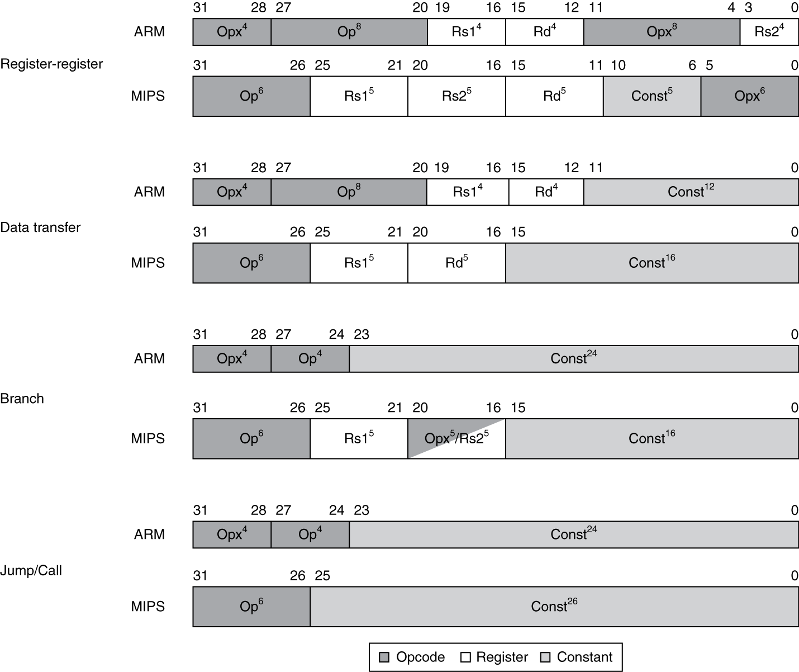
Instruction Encoding
Notes:
Note:
One unusual feature of ARM is that every instruction has the option of executing conditionally, depending on the conditional codes (Opx).
Every instruction starts with a 4-bit field that determines whether it will act as a no operation instruction (nop) or, as a real instruction, depending on the
Conditions codes.
ARM uses four condition code bits: negative, zero, carry and overflow.

Slide 114
The Intel x86 ISA
Evolution with backward compatibility
8080 (1974): 8-bit microprocessor
Accumulator, plus 3 index-register pairs
8086 (1978): 16-bit extension to 8080
Complex instruction set (CISC)
8087 (1980): floating-point coprocessor
Adds FP instructions and register stack
80286 (1982): 24-bit addresses, MMU
Segmented memory mapping and protection
80386 (1985): 32-bit extension (now IA-32)
Additional addressing modes and operations
Paged memory mapping as well as segments
§2.17 Real Stuff: x86 Instructions
Notes:
CISC -> Complex Instruction Set Computing
IA-32 -> Intel Architecture, 32-bit

Slide 115
The Intel x86 ISA
Further evolution…
i486 (1989): pipelined, on-chip caches and FPU
Compatible competitors: AMD, Cyrix, …
Pentium (1993): superscalar, 64-bit datapath
Later versions added MMX (Multi-Media eXtension) instructions
The infamous FDIV bug
Pentium Pro (1995), Pentium II (1997)
New microarchitecture (see Colwell, The Pentium Chronicles)
Pentium III (1999)
Added SSE (Streaming SIMD Extensions) and associated registers
Pentium 4 (2001)
New microarchitecture
Added SSE2 instructions

Slide 116
The Intel x86 ISA
And further…
AMD64 (2003): extended architecture to 64 bits
EM64T – Extended Memory 64 Technology (2004)
AMD64 adopted by Intel (with refinements)
Added SSE3 instructions
Intel Core (2006)
Added SSE4 instructions, virtual machine support
AMD64 (announced 2007): SSE5 instructions
Intel declined to follow, instead…
Advanced Vector Extension (announced 2008)
Longer SSE registers, more instructions
If Intel didn’t extend with compatibility, its competitors would!
Technical elegance ≠ market success

Slide 117
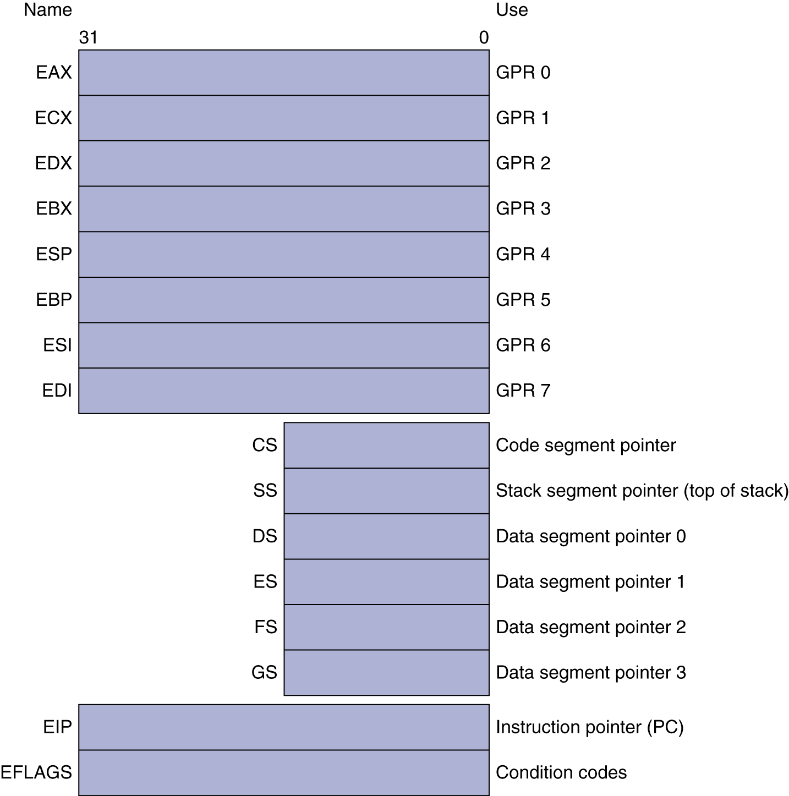
Basic x86 Registers

Slide 118
Basic x86 Addressing Modes
Two operands per instruction
Source/dest operand | Second source operand
Register | Register
Register | Immediate
Register | Memory
Memory | Register
Memory | Immediate
Memory addressing modes
Address in register
Address = R_{base} + displacement
Address = R_{base} + 2^{scale} × R_{index} (scale = 0, 1, 2, or 3)
Address = R_{base} + 2^{scale} × R_{index} + displacement

Slide 119
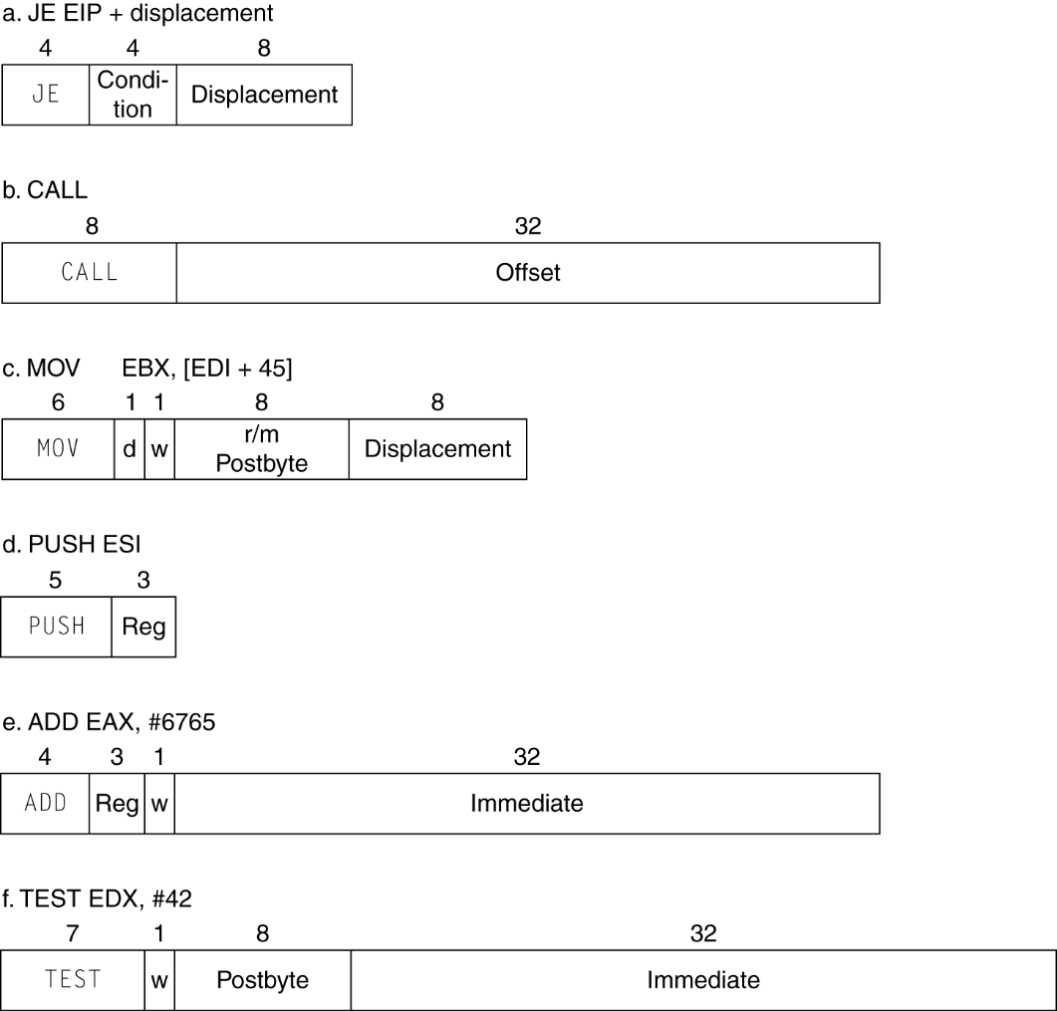
x86 Instruction Encoding
Variable length encoding
Postfix bytes specify addressing mode
Prefix bytes modify operation
Operand length, repetition, locking, …

Slide 120
Implementing IA-32
Complex instruction set makes implementation difficult
Hardware translates instructions to simpler microoperations
Simple instructions: 1–1
Complex instructions: 1–many
Microengine similar to RISC
Market share makes this economically viable
Comparable performance to RISC
Compilers avoid complex instructions

Slide 121
ARM v8 Instructions
In moving to 64-bit, ARM did a complete overhaul
ARM v8 resembles MIPS
Changes from v7:
No conditional execution field
Immediate field is 12-bit constant
Dropped load/store multiple
PC is no longer a GPR (General Purpose Register)
GPR set expanded to 32
Addressing modes work for all word sizes
Divide instruction
Branch if equal/branch if not equal instructions
§2.18 Real Stuff: ARM v8 (64-bit) Instructions
Notes:
“PC is no longer a GPR (General Purpose Register)” –
the change is because, if you wrote to PC, it would resulted in unexpected branches.

Slide 122
Fallacies
Powerful instruction ⇒ higher performance
Fewer instructions required
But complex instructions are hard to implement
May slow down all instructions, including simple ones
Compilers are good at making fast code from simple instructions
Use assembly code for high performance
But modern compilers are better at dealing with modern processors
More lines of code ⇒ more errors and less productivity
§2.19 Fallacies and Pitfalls

Slide 123
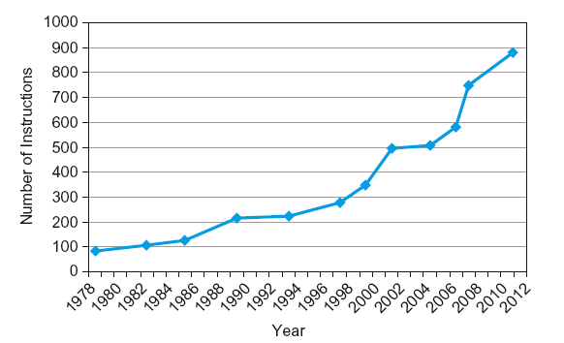
Fallacies
Backward compatibility ⇒ instruction set doesn’t change
But they do accrete more instructions
x86 instruction set

Slide 124
Pitfalls
Sequential words are not at sequential addresses
Increment by 4, not by 1!
Keeping a pointer to an automatic variable after procedure returns
e.g., passing pointer back via an argument
Pointer becomes invalid when stack popped

Slide 125
Concluding Remarks
Design principles
1. Simplicity favors regularity
2. Smaller is faster
3. Make the common case fast
4. Good design demands good compromises
Layers of software/hardware
Compiler, assembler, hardware
MIPS: typical of RISC ISAs
c.f. x86
§2.20 Concluding Remarks

Slide 126
Concluding Remarks
Measure MIPS instruction executions in benchmark programs
Consider making the common case fast
Consider compromises
Instruction class | MIPS examples | SPEC2006 Int | SPEC2006 FP
Arithmetic | add, sub, addi | 16% | 48%
Data transfer | lw, sw, lb, lbu, lh, lhu, sb, lui | 35% | 36%
Logical | and, or, nor, andi, ori, sll, srl | 12% | 4%
Cond. Branch | beq, bne, slt, slti, sltiu | 34% | 8%
Jump | j, jr, jal | 2% | 0%

