Slide 1
Chapter 5
Large and Fast: Exploiting Memory Hierarchy
Abdullah Yasin Nur

Slide 2
Principle of Locality
§5.1 Introduction
Programs access a small proportion of their address space at any time
Temporal locality
Items accessed recently are likely to be accessed again soon
e.g., instructions in a loop, induction variables
Spatial locality
Items near those accessed recently are likely to be accessed soon
E.g., sequential instruction access, array data

Slide 3
Memory Hierarchy
Recall
L1/L2 Cache
Registers
Main Memory
Secondary Storage
Magnetic Tape
Typical Access Time
Typical Capacity
1 nanosecond
< 1 KB
2 nanoseconds
32 KB/4 MB
10 – 100 nanoseconds
1 – 16 GB
10 milliseconds
128 - 2000 GB
100 seconds
500 - 1000 GB

Slide 4
Taking Advantage of Locality
Memory hierarchy
Store everything on disk
Copy recently accessed (and nearby) items from disk to smaller DRAM memory
Main memory
Copy more recently accessed (and nearby) items from DRAM to smaller SRAM memory
Cache memory attached to CPU

Slide 5
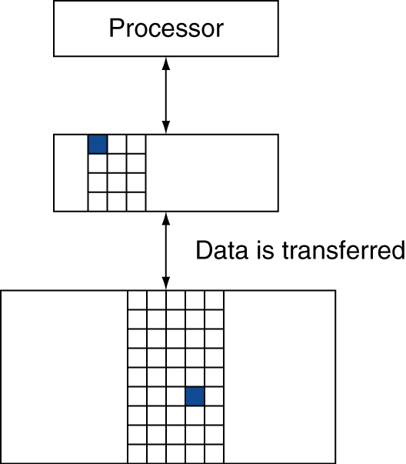
Memory Hierarchy Levels
If accessed data is present in upper level
Hit: access satisfied by upper level
Hit ratio: hits/accesses
If accessed data is absent
Miss: block copied from lower level
Time taken: miss penalty
Miss ratio: misses/accesses = 1 – hit ratio
Then accessed data supplied from upper level

Slide 6
The Memory Hierarchy: Terminology
Block (or line): the minimum unit of information that is present (or not) in a cache
Hit Rate: the fraction of memory accesses found in a level of the memory hierarchy
Hit Time: Time to access that level which consists of
Time to access the block + Time to determine hit/miss
Miss Rate: the fraction of memory accesses not found in a level of the memory hierarchy ⇒ 1 - (Hit Rate)
Miss Penalty: Time to replace a block in that level with the corresponding block from a lower level which consists of
Time to access the block in the lower level
+ Time to transmit that block to the level that experienced the miss
+ Time to insert the block in that level
+ Time to pass the block to the requestor
Hit Time << Miss Penalty

Slide 7
Memory Technology
Static RAM (SRAM) e.g. Cache
0.5ns – 2.5ns, $2000 – $5000 per GB
Dynamic RAM (DRAM) e.g. RAM
50ns – 70ns, $20 – $75 per GB
Magnetic disk e.g. Harddisk
5ms – 20ms, $0.20 – $2 per GB
Ideal memory
Fast access - Access time of SRAM
Large Capacity - Capacity and cost/GB of disk
§5.2 Memory Technologies

Slide 8
SRAM Technology
Integrated circuits that are memory arrays with a single port
Read or write
SRAMs use six to eight transistors per bit to prevent the information from being disturbed when read.
SRAM needs only minimal power to retrain the charge in standby mode.

Slide 9
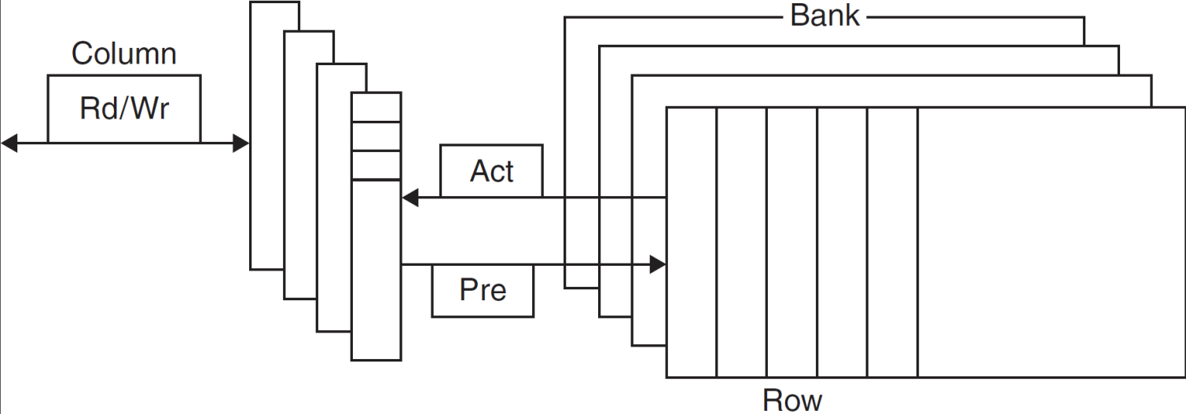
DRAM Technology
Data stored as a charge in a capacitor
Single transistor used to access the charge
Must periodically be refreshed
Read contents and write back
Performed on a DRAM “row”
Figure: Internal organization of a DRAM.
Modern DRAMs are organized in banks, typically 4 for DDR3.
Each bank consists of series of rows.
Notes:
Sending a PRE (precharge) command opens or closes a bank. A row address is sent with an Act (activate), which causes the row to transfer to a buffer. When the row is in the buffer, it can be transferred by successive column addresses at whatever the width of the DRAM is (typically 4, 8, or 16 bits in DDR3) or by specifying a block transfer and the starting address. Each command, as well as block transfers, is synchronized with a clock.

Slide 10
Advanced DRAM Organization
Self Study
Bits in a DRAM are organized as a rectangular array
DRAM accesses an entire row
Burst mode: supply successive words from a row with reduced latency
Double data rate (DDR) DRAM
Transfer on rising and falling clock edges
Quad data rate (QDR) DRAM
Separate DDR inputs and outputs

Slide 11
DRAM Generations
Ta2nrc → Total access time to a new row / column
Acat2er → Average column access time to existing row
Year | Capacity | $/GB
1980 | 64Kbit | $1500000
1983 | 256Kbit | $500000
1985 | 1Mbit | $200000
1989 | 4Mbit | $50000
1992 | 16Mbit | $15000
1996 | 64Mbit | $10000
1998 | 128Mbit | $4000
2000 | 256Mbit | $1000
2004 | 512Mbit | $250
2007 | 1Gbit | $50
Ta2nrc
Acat2er
ns →
Year →

Slide 12
DRAM Performance Factors
Self Study
Row buffer
Allows several words to be read and refreshed in parallel
Synchronous DRAM
Allows for consecutive accesses in bursts without needing to send each address
Improves bandwidth
DRAM banking
Allows simultaneous access to multiple DRAMs
Improves bandwidth
DIMMs (Dual Inline Memory Modules) contains 4 ~16 DRAMs, are organized to be 8 byte wide for servers.

Slide 13

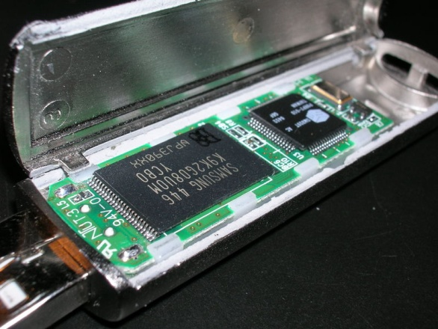
Flash Storage
§6.4 Flash Storage
Electrically Erasable Programmable Read-only Memory (EEPROM)
Non-volatile semiconductor storage
100× – 1000× faster than disk
Smaller, lower power, more robust
But more $/GB (between disk and DRAM)

Slide 14
Flash Types
Self Study
NOR flash: bit cell like a NOR gate
Random read/write access
Used for instruction memory in embedded systems
NAND flash: bit cell like a NAND gate
Denser (bits/area), but block-at-a-time access
Cheaper per GB
Used for USB keys, media storage, …
Flash bits wears out after 1000’s of accesses
Not suitable for direct RAM or disk replacement
Wear leveling: remap data to less used blocks

Slide 15

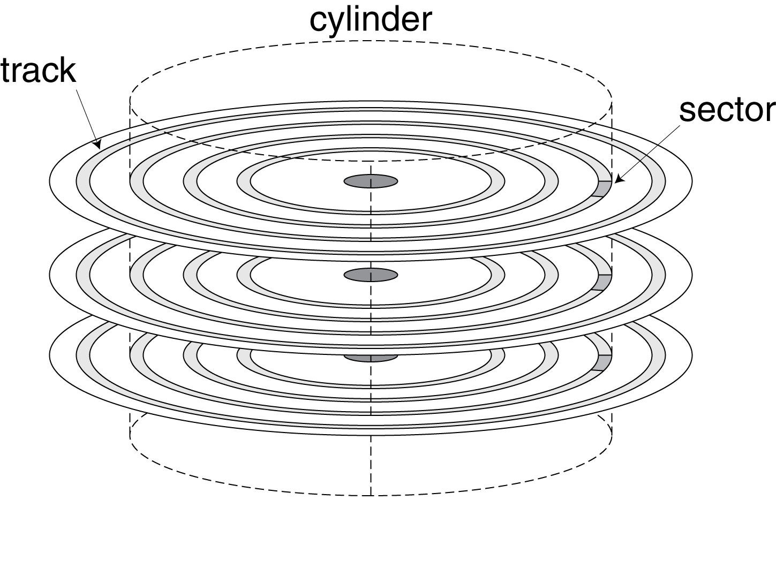
Disk Storage
§6.3 Disk Storage
Nonvolatile, rotating magnetic storage

Slide 16
Disk Storage
§6.3 Disk Storage
Consists of a collection of platters
Rotate on a spindle at 5400 to 15000 revolutions per minute (rpm)
Track: concentric circles
Tens of thousands of tracks pers surface.
Each track divided into sectors that contain the information.

Slide 17
Disk Sectors and Access
Each sector records
Sector ID
Data (512 bytes, 4096 bytes proposed)
Error correcting code (ECC)
Used to hide defects and recording errors
Synchronization fields and gaps
Access to a sector involves
Queuing delay if other accesses are pending
Seek: move the heads
Rotational latency
Data transfer
Controller overhead

Slide 18
Disk Sectors and Access
The operating system must direct the disk through a three stage process
Seek
Rotate
Disk access

Slide 19
Disk Sectors and Access
Seek time
Position the head over the proper track
Disk manufacturers report minimum, maximum and average seek time in their manuals
Average seek time is usually advertise as 3ms to 13ms.

Slide 20
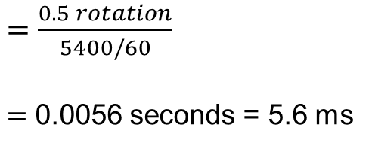
Disk Sectors and Access
Rotational delay
Once the head has reached the correct track, we must wait for the desired sector to rotate under the read/write head.
The average latency is halfway around the disk.
Head can go both way
The average rotational latency at 5400 RPM is
$Average Rotational Latency=$ $\frac{0.5 rotation}{5400 RPM}$
RPM => Revolutions per minute
$=$ $\frac{0.5 rotation}{5400/60}$
$=$ 0.0056 seconds = 5.6 ms

Slide 21
Disk Sectors and Access
Disk access, transfer time
The time to transfer a block of bits
Transfer rates in 2012 were between 100 and 200 MB/s
For a quick comparison between magnetic disk and DRAM
DDR3 data transfer rates up to 6.4 GB/s
DDR4 data transfer rates up to 25.6 GB/s

Slide 22
Disk Access Example
Given
512B sector, 15,000rpm, 4ms average seek time, 100MB/s transfer rate, 0.2ms controller overhead, idle disk
What is the time needed to transfer 512B?
Average read time (per sector)
4ms seek time + ½ / (15,000/60) = 2ms rotational latency + 512 / 100MB/s = 0.005ms transfer time + 0.2ms controller delay = 6.2ms
If actual average seek time is 1ms
Average read time = 3.2ms

Slide 23
Disk Performance Issues
Self Study
Manufacturers quote average seek time
Based on all possible seeks
Locality and OS scheduling lead to smaller actual average seek times
Smart disk controller allocate physical sectors on disk
Present logical sector interface to host
SCSI, ATA, SATA
Disk drives include caches
Prefetch sectors in anticipation of access
Avoid seek and rotational delay

Slide 24
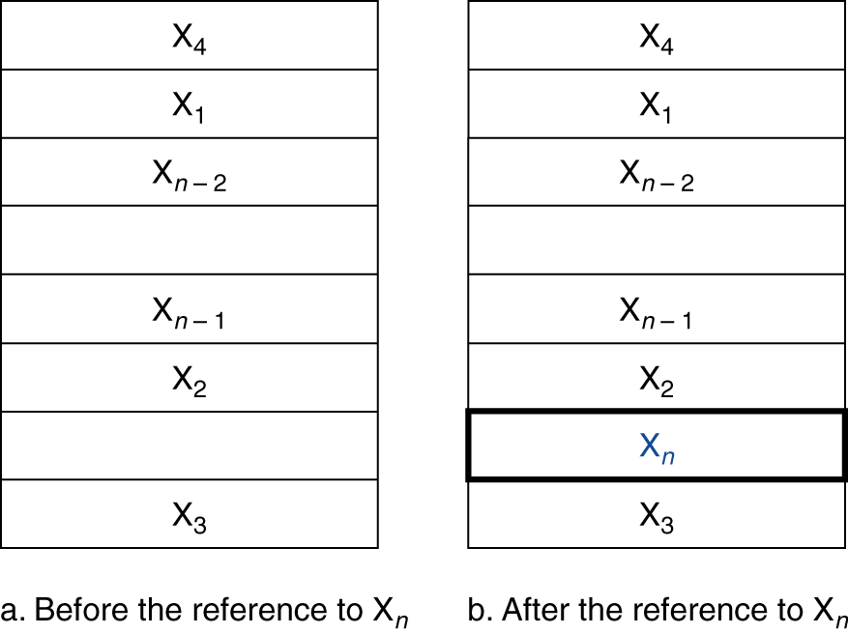
Cache Memory
Cache memory
The level of the memory hierarchy closest to the CPU
Locality of access
Given accesses X₁, …, X_{n–1}, X_{n}
§5.3 The Basics of Caches

Slide 25
Cache Basics
Two questions to answer (in hardware):
Q1: How do we know if a data item is in the cache?
Q2: If it is, how do we find it?
Direct mapped
Each memory block is mapped to exactly one block in the cache
lots of lower level blocks must share blocks in the cache
Address mapping (to answer Q2):
(block address) modulo (# of blocks in the cache)
Have a tag associated with each cache block that contains the address information (the upper portion of the address) required to identify the block (to answer Q1)

Slide 26
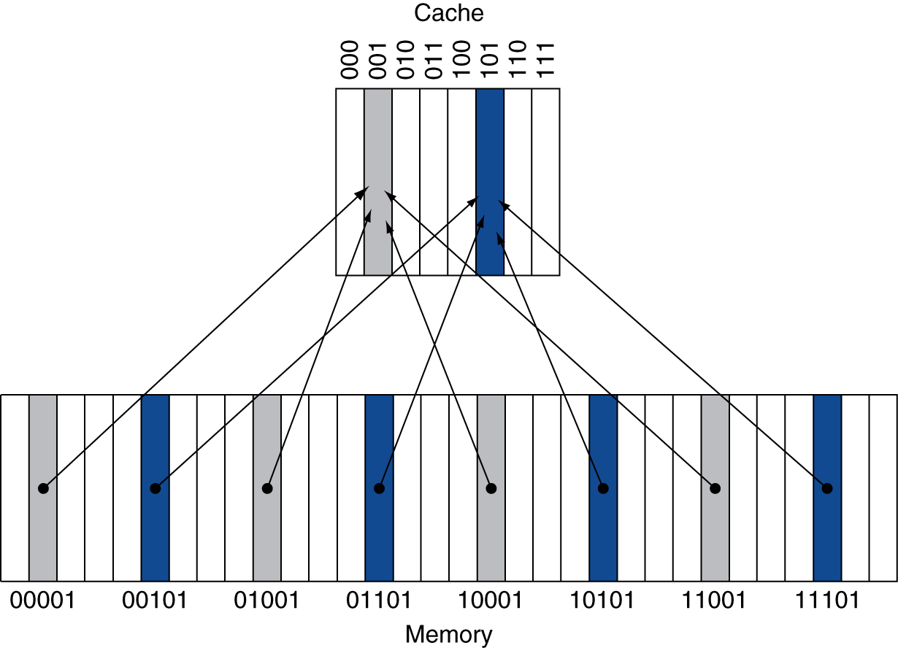
Direct Mapped Cache
Location determined by address
Direct mapped: only one choice
(Block address) modulo (#Blocks in cache)
#Blocks is a power of 2
Use low-order address bits
Notes:
A direct-mapped cache with eight entries showing the addresses of memory words between 0 and 31 that map to the same cache locations. Because there are eight words in the cache, an address X maps to the direct-mapped cache word X modulo 8. That is, the low-order log2(8) = 3 bits are used as the cache index. Thus, addresses 00001_{two}, 01001_{two}, 10001_{two}, and 11001_{two} all map to entry 001_{two} of the cache, while addresses 00101_{two}, 01101_{two}, 10101_{two}, and 11101_{two} all map to entry 101_{two} of the cache.

Slide 27
Tags and Valid Bits
How do we know which particular block is stored in a cache location?
Store block address as well as the data
Actually, only need the high-order bits
Called the tag
What if there is no data in a location?
Valid bit: 1 = present, 0 = not present
Initially 0

Slide 28
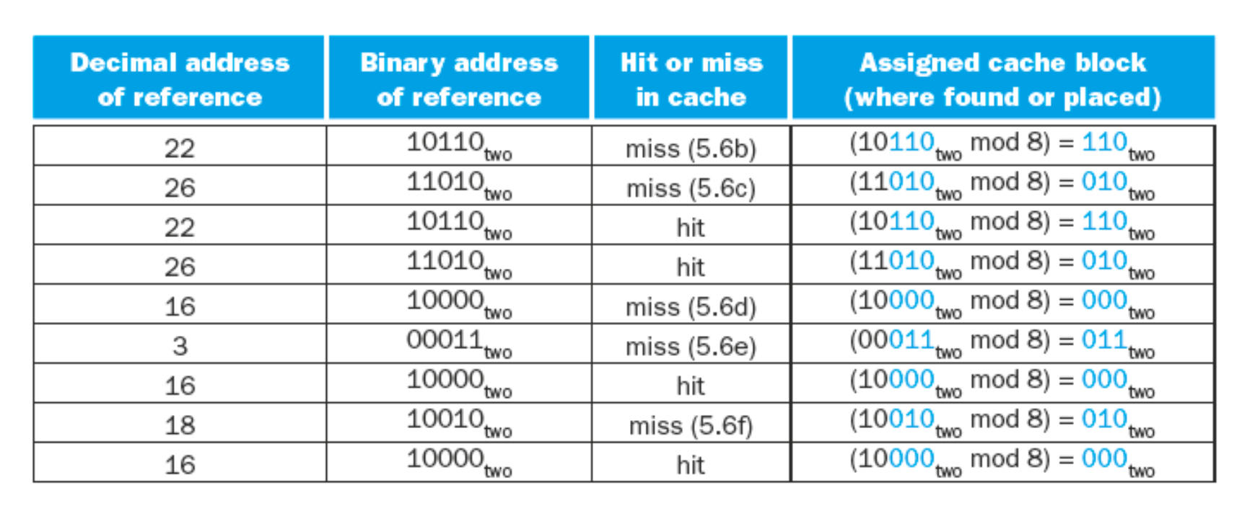
Cache Example

Slide 29
Cache Example
8-blocks, 1 word/block, direct mapped
Initial state
Index | V | Tag | Data
000 | N
001 | N
010 | N
011 | N
100 | N
101 | N
110 | N
111 | N

Slide 30
Cache Example
Word addr | Binary addr | Hit/miss | Cache block
22 | 10 110 | Miss | 110
Index | V | Tag | Data
000 | N
001 | N
010 | N
011 | N
100 | N
101 | N
110 | Y | 10 | Mem[10110]
111 | N

Slide 31
Cache Example
Word addr | Binary addr | Hit/miss | Cache block
26 | 11 010 | Miss | 010
Index | V | Tag | Data
000 | N
001 | N
010 | Y | 11 | Mem[11010]
011 | N
100 | N
101 | N
110 | Y | 10 | Mem[10110]
111 | N

Slide 32
Cache Example
Word addr | Binary addr | Hit/miss | Cache block
22 | 10 110 | Hit | 110
26 | 11 010 | Hit | 010
Index | V | Tag | Data
000 | N
001 | N
010 | Y | 11 | Mem[11010]
011 | N
100 | N
101 | N
110 | Y | 10 | Mem[10110]
111 | N

Slide 33
Cache Example
Word addr | Binary addr | Hit/miss | Cache block
16 | 10 000 | Miss | 000
3 | 00 011 | Miss | 011
16 | 10 000 | Hit | 000
Index | V | Tag | Data
000 | Y | 10 | Mem[10000]
001 | N
010 | Y | 11 | Mem[11010]
011 | Y | 00 | Mem[00011]
100 | N
101 | N
110 | Y | 10 | Mem[10110]
111 | N

Slide 34
Cache Example
Word addr | Binary addr | Hit/miss | Cache block
18 | 10 010 | Miss | 010
Index | V | Tag | Data
000 | Y | 10 | Mem[10000]
001 | N
010 | Y | 10 | Mem[10010]
011 | Y | 00 | Mem[00011]
100 | N
101 | N
110 | Y | 10 | Mem[10110]
111 | N

Slide 35
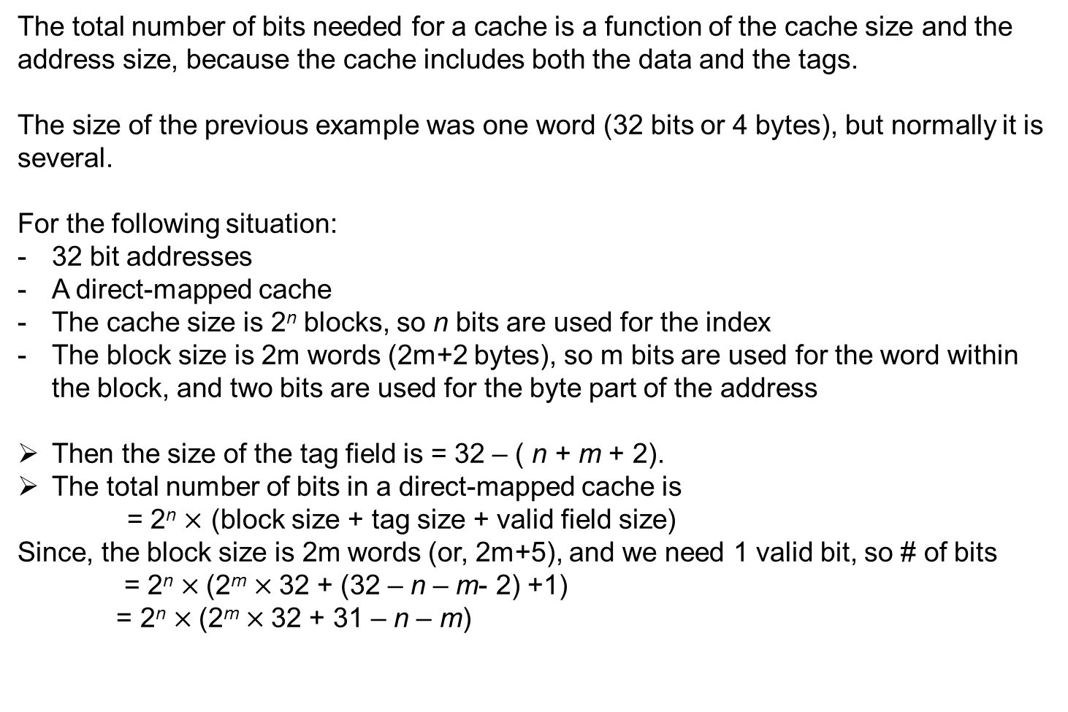
Measuring the Cache
2^{m}
(2^{m+2}
2^{m}
2^{m+5} bits
bits

Slide 36
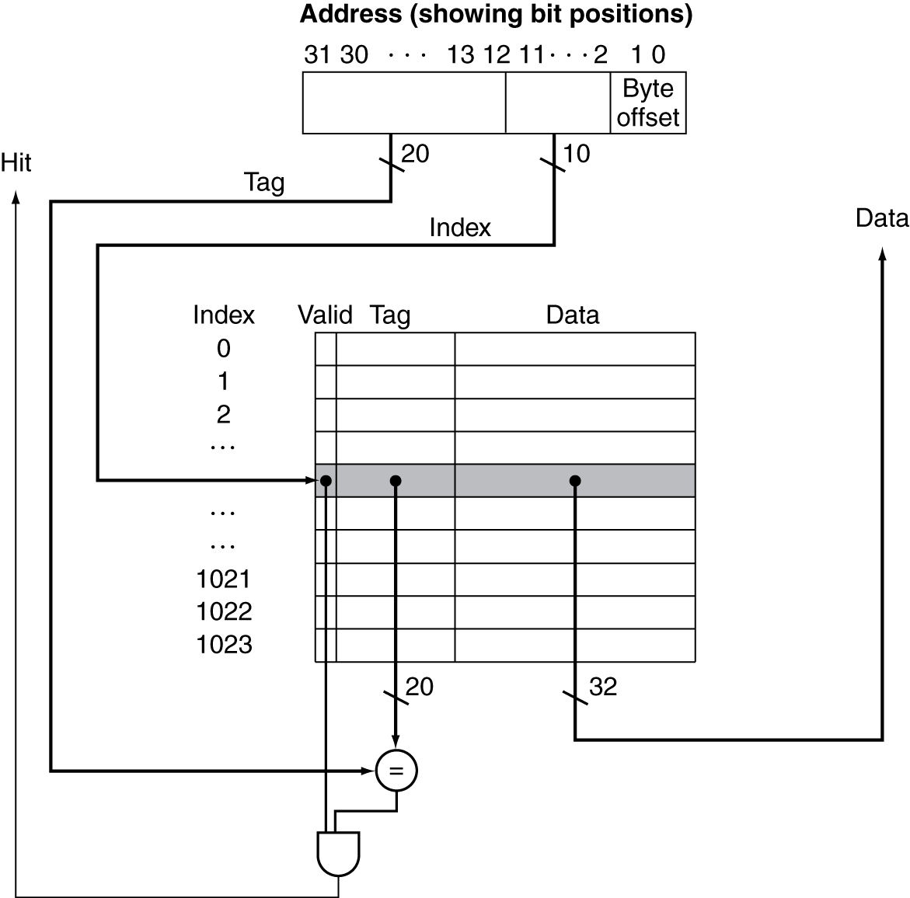
Address Subdivision
This cache holds 1024 words or 4 KiB.
Figure: For this cache, the lower portion of the address is used to select a cache entry consisting of a data word and a tag.
Notes:
This cache holds 1024 words or 4 KiB. We assume 32-bit addresses in this chapter. The tag from the cache is compared against the upper portion of the address to determine whether the entry in the cache corresponds to the requested address. Because the cache has 2¹⁰ (or 1024) words and a block size of one word, 10 bits are used to index the cache, leaving 32 −10 − 2 = 20 bits to be compared against the tag. If the tag and upper 20 bits of the address are equal and the valid bit is on, then the request hits in the cache, and the word is supplied to the processor. Otherwise, a miss occurs.

Slide 37
Example: Larger Block Size
Self Study
64 blocks, 16 bytes/block
To what block number does address 1200 map?
Block address = ⎣1200/16⎦ = 75
Block number = 75 modulo 64 = 11
31
10
9
4
3
0
Tag
Index
Offset
22 bits
6 bits
4 bits
Notes:
Note: In book 16 is written as 6, correct that in your book.

Slide 38
Block Size Considerations
Larger blocks should reduce miss rate
Due to spatial locality
But in a fixed-sized cache
Larger blocks ⇒ fewer of them
More competition ⇒ increased miss rate
Larger blocks ⇒ pollution
Larger miss penalty
Can override benefit of reduced miss rate
Early restart and critical-word-first can help

Slide 39
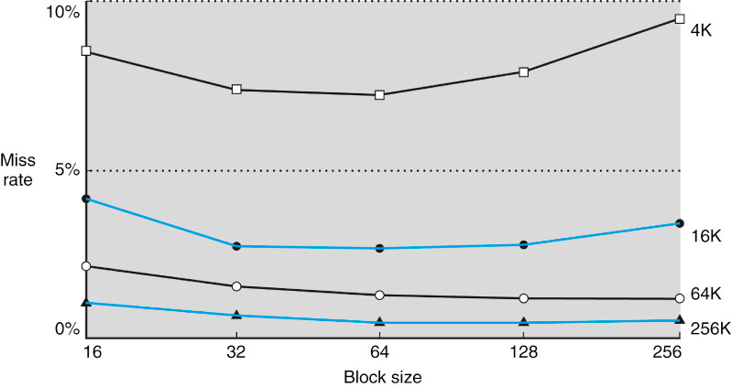
Miss Rate versus Block Size
Cache sizes
FIGURE #: Miss rate versus block size. Note that the miss rate actually goes up if the block size is too large relative to the cache size. Each line represents a cache of different size. (This figure is independent of associativity, discussed soon.) This data is based on SPEC92.

Slide 40
Cache Misses
On cache hit, CPU proceeds normally
On cache miss
Stall the CPU pipeline
Fetch block from next level of hierarchy
Instruction cache miss
Restart instruction fetch
Data cache miss
Complete data access

Slide 41
Write-Through
On data-write hit, could just update the block in cache
But then cache and memory would be inconsistent
Write through: also update memory
But this approach makes writes take longer
e.g., if base CPI = 1, 10% of instructions are stores, write to memory takes 100 cycles
Effective CPI = 1 + 0.1×100 = 11
Solution: write buffer
Holds data waiting to be written to memory
CPU continues immediately
Only stalls on write if write buffer is already full
Notes:
Effective CPI = [100 + (10 * 100)]/100 = 11

Slide 42
Write-Back
Alternative: On data-write hit, just update the block in cache
Keep track of whether each block is dirty
When a dirty block is replaced
Write it back to memory
Can use a write buffer to allow replacing block to be read first

Slide 43
Example: Intrinsity FastMATH
Self Study
Embedded MIPS processor
12-stage pipeline
Instruction and data access on each cycle
Split cache: separate I-cache and D-cache
Each 16KB: 256 blocks × 16 words/block
D-cache: write-through or write-back
SPEC2000 miss rates
I-cache: 0.4%
D-cache: 11.4%
Weighted average: 3.2%
Notes:
Note: I-cache => Instruction cache
D-cache => Data cache

Slide 44
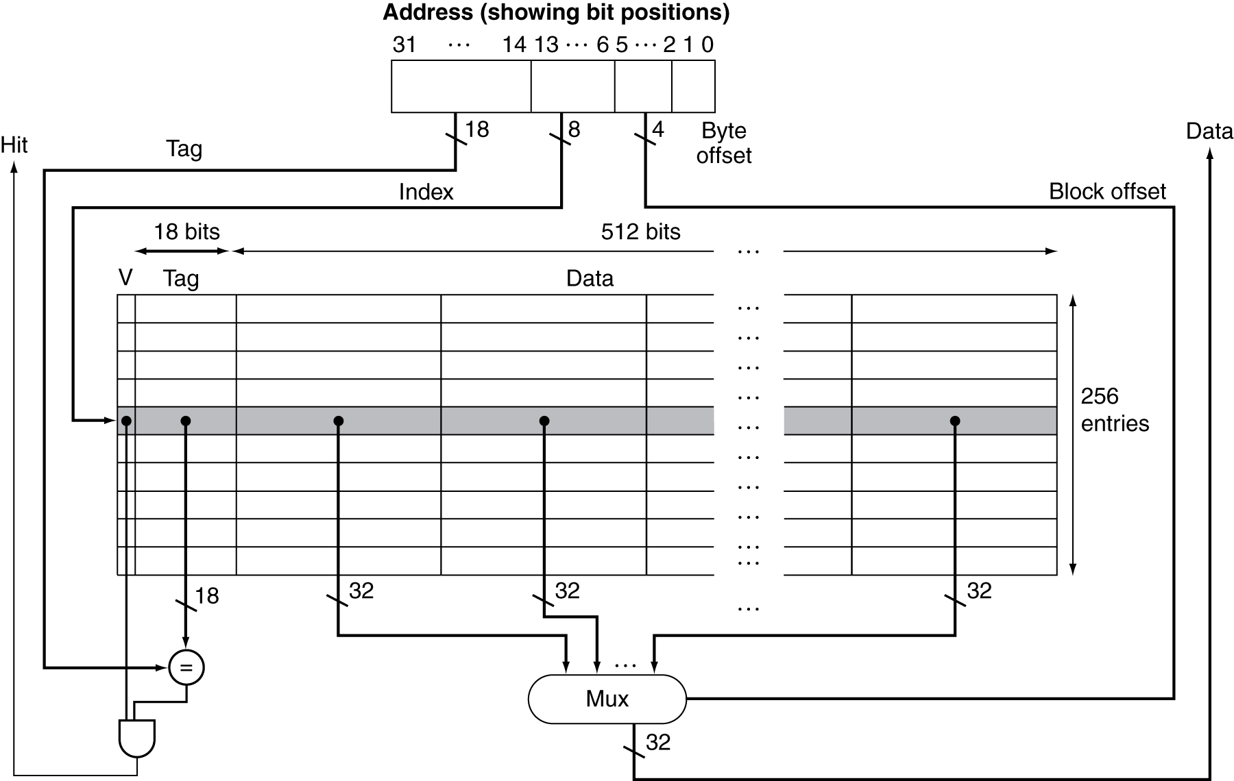
Example: Intrinsity FastMATH
Self Study
Figure: The 16 KiB caches in the Intrinsity FastMATH each contain 256 blocks with 16 words per block.
Notes:
The tag field is 18 bits wide and the index field is 8 bits wide, while a 4-bit field (bits 5–2) is used to index the block and select the word from the block using a 16-to-1 multiplexor. In practice, to eliminate the multiplexor, caches use a separate large RAM for the data and a smaller RAM for the tags, with the block offset supplying the extra address bits for the large data RAM. In this case, the large RAM is 32 bits wide and must have 16 times as many words as blocks in the cache.

Slide 45
5.4 Measuring and Improving Cache Performance

Slide 46
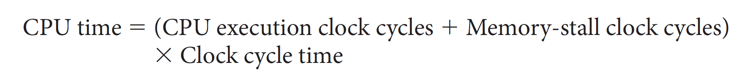
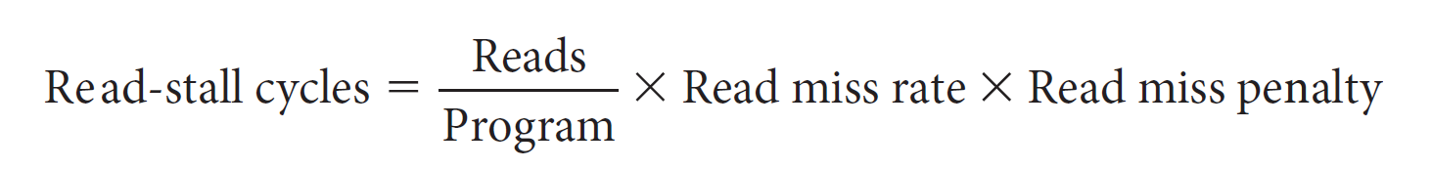
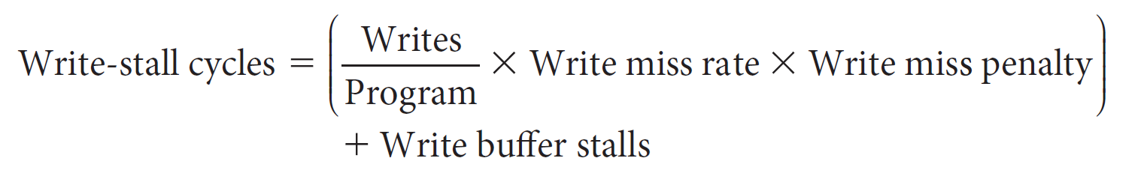
Measuring Cache Performance
§5.4 Measuring and Improving Cache Performance

Slide 47
Measuring Cache Performance
With simplifying assumptions:
§5.4 Measuring and Improving Cache Performance

Slide 48
Cache Performance Example
Given
I-cache miss rate = 2%
D-cache miss rate = 4%
Miss penalty = 100 cycles
Base CPI (ideal cache) = 2
Load & stores are 36% of instructions
Miss cycles per instruction
I-cache: 0.02 × 100 = 2
D-cache: 0.36 × 0.04 × 100 = 1.44
Actual CPI = 2 + 2 + 1.44 = 5.44
Ideal CPI is 5.44/2 =2.72 times faster
Notes:
I-cache: instruction cache
D-cache: data cache

Slide 49
Average Access Time
Hit time is also important for performance
Average Memory Access Time (AMAT)
AMAT = Hit time + Miss rate × Miss penalty
Example
CPU with 1ns clock, hit time = 1 cycle, miss penalty = 20 cycles, I-cache miss rate = 5%
AMAT = 1 + 0.05 × 20 = 2ns
2 cycles per instruction

Slide 50
Performance Summary
Decreasing base CPI
Greater proportion of time spent on memory stalls
Increasing clock rate
Memory stalls account for more CPU cycles
Can’t neglect cache behavior when evaluating system performance

Slide 51
Associative Caches
Fully associative
Allow a given block to go in any cache entry
Requires all entries to be searched at once
Comparator per entry (expensive)
n-way set associative
Each set contains n entries
Block number determines which set
(Block number) modulo (#Sets in cache)
Search all entries in a given set at once
n comparators (less expensive)

Slide 52
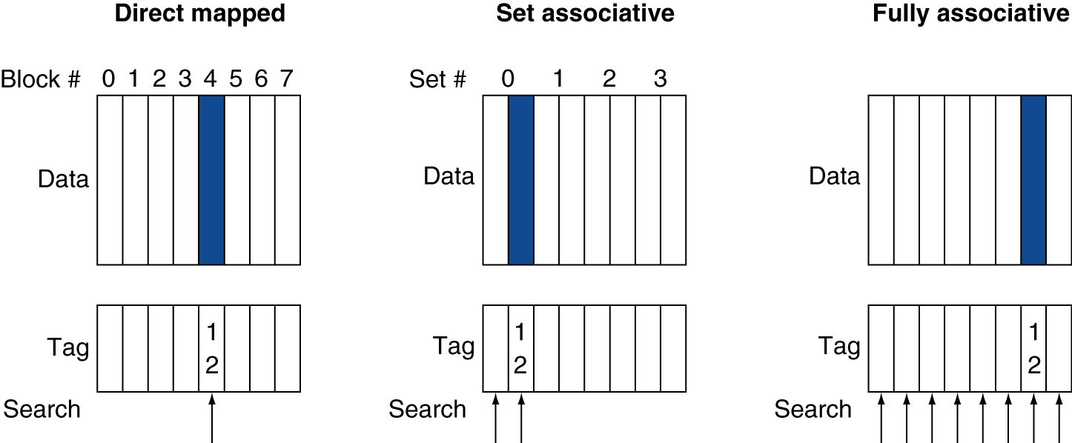
Associative Cache Example
Notes:
12 = 1100b => so lower 3 digit =100b (or, 4).

Slide 53
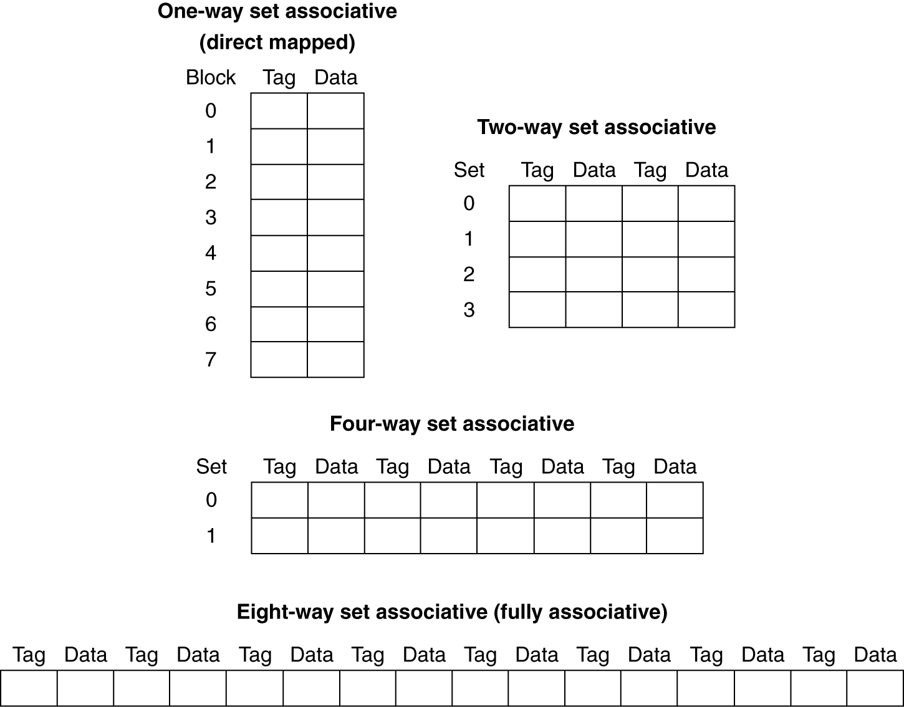
Spectrum of Associativity
For a cache with 8 entries

Slide 54
Associativity Example
Compare 4-block caches
Direct mapped, 2-way set associative, fully associative
Block access sequence: 0, 8, 0, 6, 8
Direct mapped
Block access sequence mod 4
[0 mod 4 = 0] , [8 mod 4 = 0], [6 mod 4 = 2]
Block address | Cache index | Hit/miss | Cache content after access
 |  |  | 0 | 1 | 2 | 3
0 | 0 | miss | Mem[0]
8 | 0 | miss | Mem[8]
0 | 0 | miss | Mem[0]
6 | 2 | miss | Mem[0] |  | Mem[6]
8 | 0 | miss | Mem[8] |  | Mem[6]
Time

Slide 55
Associativity Example
2-way set associative
Block address | Cache index | Hit/miss | Cache content after access
 |  |  | Set 0 |  | Set 1
0 | 0 | miss | Mem[0]
8 | 0 | miss | Mem[0] | Mem[8]
0 | 0 | hit | Mem[0] | Mem[8]
6 | 0 | miss | Mem[0] | Mem[6]
8 | 0 | miss | Mem[8] | Mem[6]
Time
Fully associative
Block address |  | Hit/miss | Cache content after access
0 |  | miss | Mem[0]
8 |  | miss | Mem[0] | Mem[8]
0 |  | hit | Mem[0] | Mem[8]
6 |  | miss | Mem[0] | Mem[8] | Mem[6]
8 |  | hit | Mem[0] | Mem[8] | Mem[6]
Time

Slide 56
How Much Associativity
Increased associativity decreases miss rate
But with diminishing returns
Simulation of a system with 64KB D-cache, 16-word blocks, SPEC2000
1-way: 10.3%
2-way: 8.6%
4-way: 8.3%
8-way: 8.1%

Slide 57
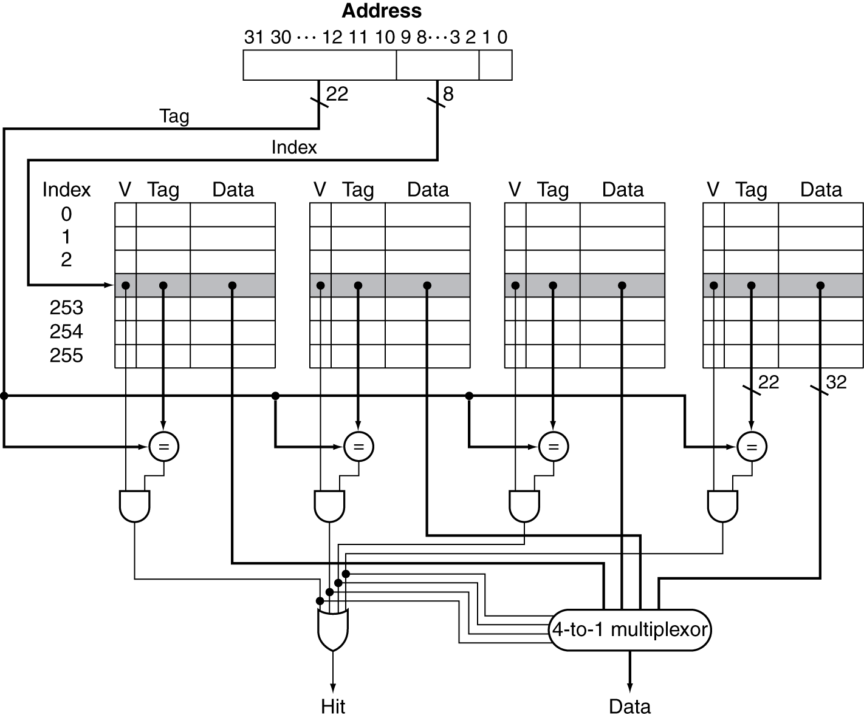
Set Associative Cache Organization
Figure: The implementation of a four-way set-associative cache requires four comparators and a 4-to-1 multiplexor.
Notes:
The comparators determine which element of the selected set (if any) matches the tag. The output of the comparators is used to select the data from one of the four blocks of the indexed set, using a multiplexor with a decoded select signal. In some implementations, the Output enable signals on the data portions of the cache RAMs can be used to select the entry in the set that drives the output. The Output enable signal comes from the comparators, causing the element that matches to drive the data outputs. This organization eliminates the need for the multiplexor.

Slide 58
Replacement Policy
Direct mapped: no choice
Set associative
Prefer non-valid entry, if there is one
Otherwise, choose among entries in the set
Least-recently used (LRU)
Choose the one unused for the longest time
Simple for 2-way, manageable for 4-way, too hard beyond that
Random
Gives approximately the same performance as LRU for high associativity

Slide 59
Multilevel Caches
To close the gap further between the fast clock rates of modern processors and the increasingly long time required to access DRAMs, most microprocessors support an additional level of caching.
This second-level cache is normally on the same chip and is accessed whenever a miss occurs in the primary cache.
If the second-level cache contains the desired data, the miss penalty for the first-level cache will be essentially the access time of the second-level cache, which will be much less than the access time of main memory.
If neither the primary nor the secondary cache contains the data, a main memory access is required, and a larger miss penalty is incurred.

Slide 60
Multilevel Caches
Primary cache attached to CPU
Small, but fast
Level-2 cache services misses from primary cache
Larger, slower, but still faster than main memory
Main memory services L-2 cache misses
Some high-end systems include L-3 cache

Slide 61
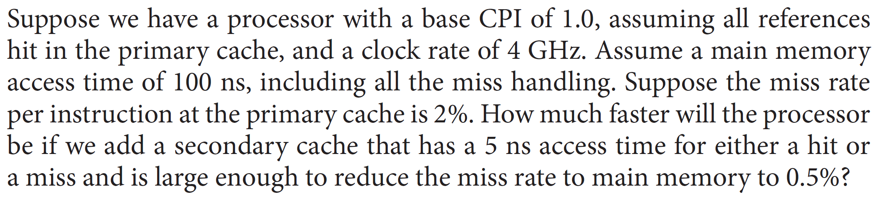
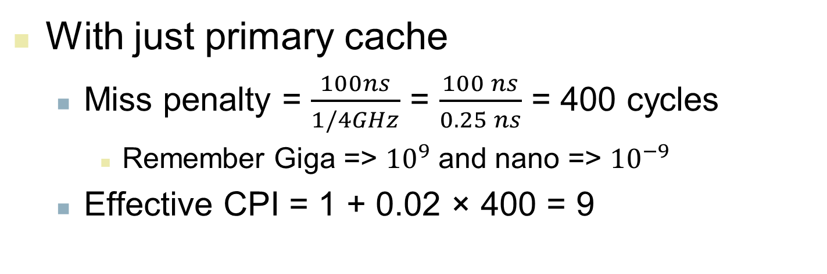
Multilevel Cache Example
With just primary cache
Miss penalty = $\frac{100ns}{1/4GHz}$ = $\frac{100 ns}{0.25 ns}$ = 400 cycles
Remember Giga => ${10}^{9}$ and nano => ${10}^{−9}$
Effective CPI = 1 + 0.02 × 400 = 9

Slide 62
Example (cont.)
Now add L-2 cache
Access time = 5ns
Global miss rate to main memory = 0.5%
Primary miss with L-2 hit
Penalty = 5ns/0.25ns = 20 cycles
Primary miss with L-2 miss
Extra penalty = 400 cycles (main memory access)
CPI = 1 + 0.02 × 20 + 0.005 × 400 = 3.4
Performance ratio = 9/3.4 = 2.6

Slide 63
Multilevel Cache Considerations
Primary cache
Focus on minimal hit time
L-2 cache
Focus on low miss rate to avoid main memory access
Hit time has less overall impact
Results
L-1 cache usually smaller than a single cache
L-1 block size smaller than L-2 block size

Slide 64
Interactions with Advanced CPUs
Out-of-order CPUs can execute instructions during cache miss
Pending store stays in load/store unit
Dependent instructions wait in reservation stations
Independent instructions continue
Effect of miss depends on program data flow
Much harder to analyse
Use system simulation

Slide 65
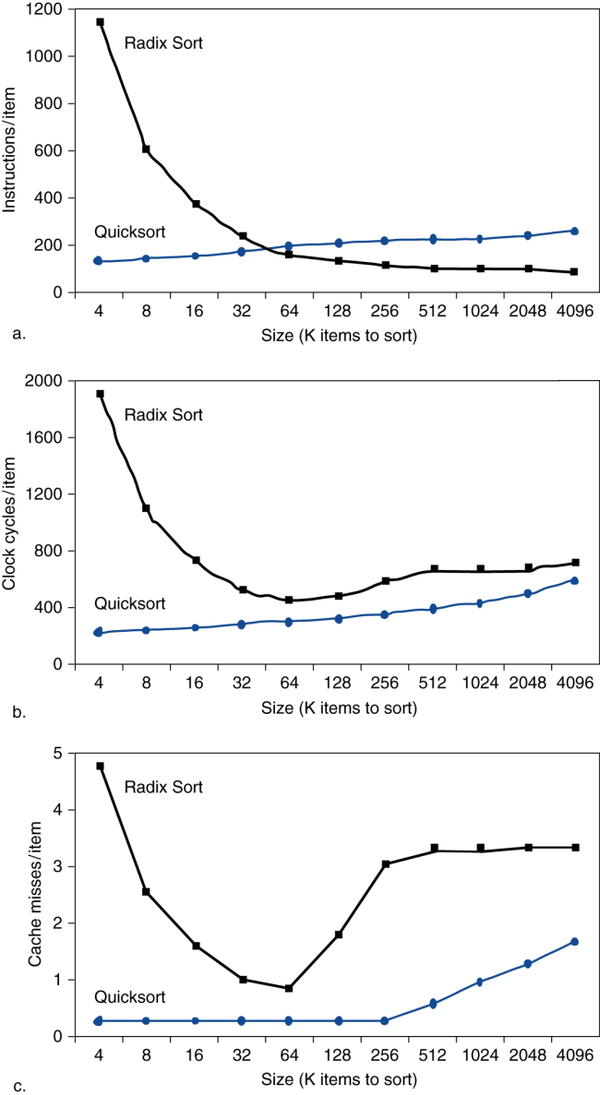
Interactions with Software
Self Study
For large arrays, Radix Sort has an algorithmic advantage over Quicksort in terms of number of operations.
Quicksort consistently has many fewer misses per item to be sorted.
Misses depend on memory access patterns
Algorithm behavior
Compiler optimization for memory access
Figure: Comparing Quicksort and Radix Sort by: (a) instructions executed per item sorted,
(b) time per item sorted, and
(c) cache misses per item sorted.
Notes:
This data is from a paper by LaMarca and Ladner [1996]. Due to such results, new versions of Radix Sort have been invented that take memory hierarchy into account, to regain its algorithmic advantages. The basic idea of cache optimizations is to use all the data in a block repeatedly before it is replaced on a miss

Slide 66
Lesson
Lesson learnt from the previous slide:
The basic idea of cache optimizations is to use all the data in a block repeatedly before it is replaced on a miss.
=> For example, for the matrix multiplication:
Instead of operating an entire row or columns of an array, blocked algorithms operate on submatrices or blocks.

Slide 67
Software Optimization via Blocking
Goal: maximize accesses to data before it is replaced
Consider inner loops of DGEMM:
for (int j = 0; j < n; ++j)
{
double cij = C[i+j*n];
for( int k = 0; k < n; k++ )
cij += A[i+k*n] * B[k+j*n];
C[i+j*n] = cij;
}

Slide 68
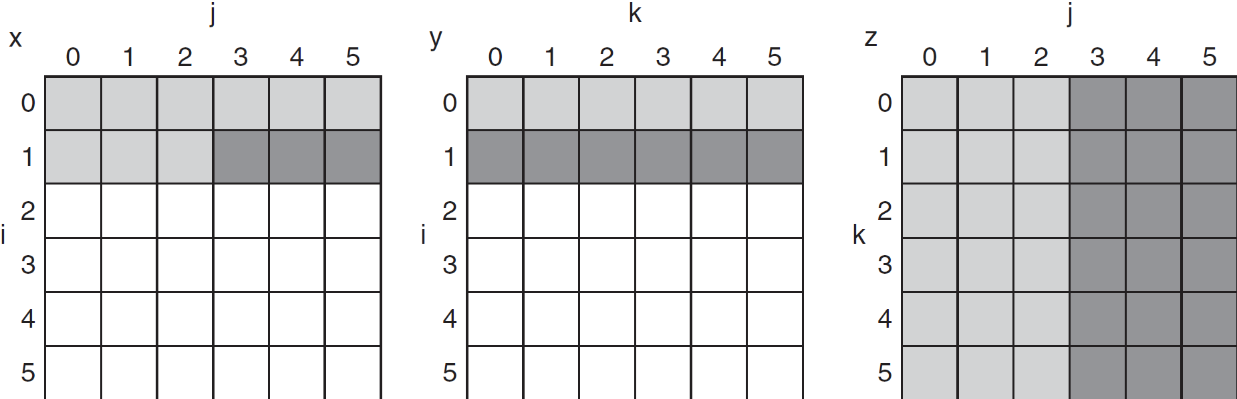
DGEMM Access Pattern
C, A, and B arrays
older accesses
new accesses

Slide 69
Cache Blocked DGEMM
Self Study
1 #define BLOCKSIZE 32
2 void do_block (int n, int si, int sj, int sk, double *A, double
3 *B, double *C)
4 {
5 for (int i = si; i < si+BLOCKSIZE; ++i)
6 for (int j = sj; j < sj+BLOCKSIZE; ++j)
7 {
8 double cij = C[i+j*n];/* cij = C[i][j] */
9 for( int k = sk; k < sk+BLOCKSIZE; k++ )
10 cij += A[i+k*n] * B[k+j*n];/* cij+=A[i][k]*B[k][j] */
11 C[i+j*n] = cij;/* C[i][j] = cij */
12 }
13 }
14 void dgemm (int n, double* A, double* B, double* C)
15 {
16 for ( int sj = 0; sj < n; sj += BLOCKSIZE )
17 for ( int si = 0; si < n; si += BLOCKSIZE )
18 for ( int sk = 0; sk < n; sk += BLOCKSIZE )
19 do_block(n, si, sj, sk, A, B, C);
20 }

Slide 70
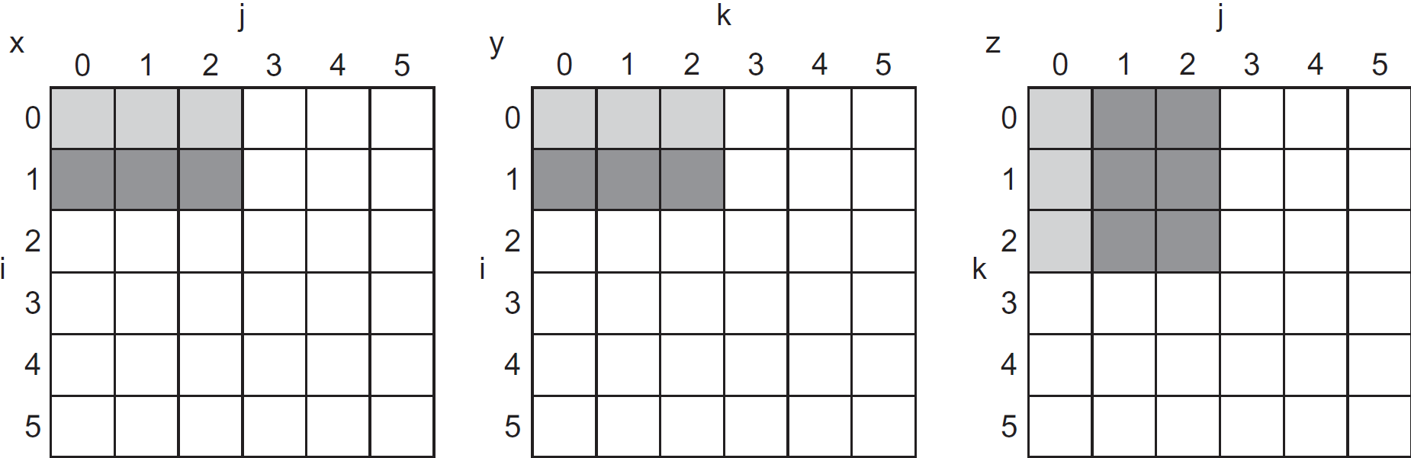
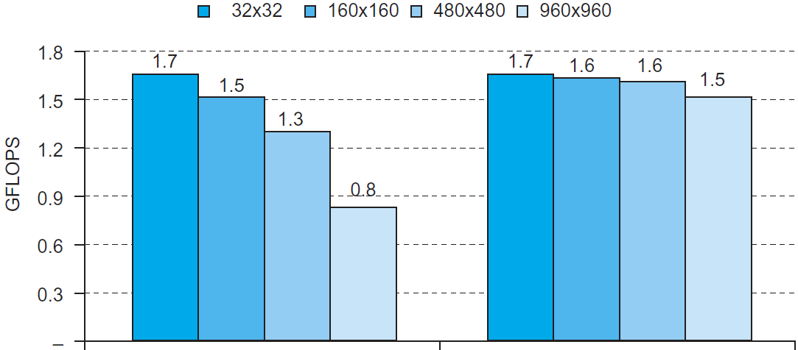
Blocked DGEMM Access Pattern
Self Study
Unoptimized
Blocked

Slide 71
Dependability
Service accomplishment
Service delivered as specified
§5.5 Dependable Memory Hierarchy
Fault: failure of a component
May or may not lead to system failure
Redundancy → Reliability
or, Dependability
Restoration
Failure
Service interruption
Deviation from specified service

Slide 72
Dependability Measures
Self Study
Reliability measure: mean time to failure (MTTF)
: Annual Failure Rate (AFR)
Service interruption: mean time to repair (MTTR)
Mean time between failures
MTBF = MTTF + MTTR
Availability = MTTF / (MTTF + MTTR)
Improving Availability
Increase MTTF: fault avoidance, fault tolerance, fault forecasting
Reduce MTTR: improved tools and processes for diagnosis and repair. If MTTR → 0, Availability → 1.0.

Slide 73
Error Correcting/Detecting Code
The Hamming Single Error Correcting Code (SEC)
&
Double Error Detecting Code (DEC)

Slide 74
Hamming Code
Richard Hamming
Turing Award in 1968
Linear error-correcting code
Single Error Correcting Double Error Detecting (SECDED) variant is widely used in RAM and some secondary storage
Adding additional bits to detect and correct errors
Increasing redundancy

Slide 75
Hamming Code
Bit positions that are powers of two are used as parity bits
That is, bit positions 1, 2, 4, 8, 16, 32, … are parity bits
The real data resides in remaining bits
That is, bit positions 3, 5, 6, 7, 9, 10, 11, 12, 13, 14, 15, …
Overhead is large at first, then tails off:
For 1 bit of real data, a 3-bit hamming code would be needed (123)
For 2 bits of real data, a 5-bit hamming code is needed (12345)
For 4 bits of real data, a 7-bit hamming code is needed (1234567)

Slide 76
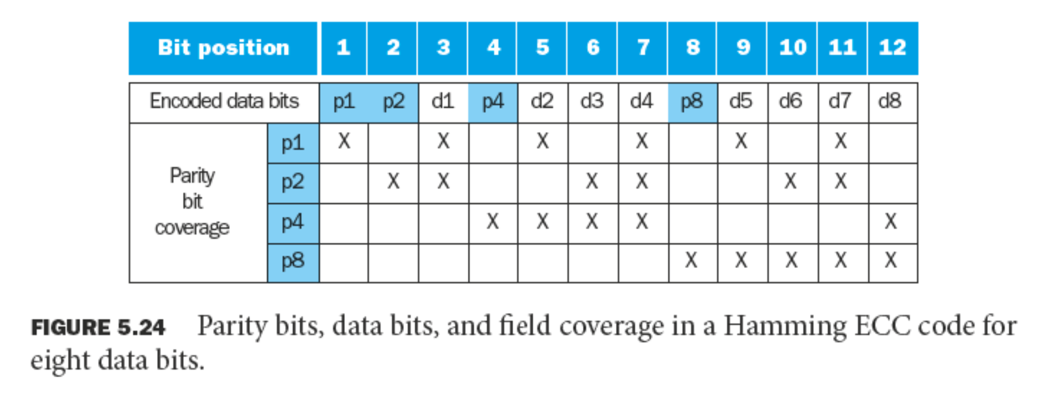
Hamming Code

Slide 77
Hamming Code Example
Ex: You want to store the 8-bit string 10011010
You need a 12-bit hamming code to store 8-bits of data:
??1?001?1010
p₁p₂1p₃001p₄1010
For p1 check bits: 1 3 5 7 9 11
P₁-1-0-1-1-1-
We have even number of 1s (4). Therefore, p1 = 0 (0 for even, 1 for odd)
0p₂1p₃001p₄1010
For p2 check bits: 2 3 6 7 10 11
-P₂1--01--01-
Odd number of 1s (3). P2 = 1
011p₃001p₄1010

Slide 78
Hamming Code Example
For p3 check bits: 4 5 6 7 12
---P₃001----0
Odd number of 1s (1). Therefore, p3 = 1
0111001p₄1010
For p4 check bits: 8 9 10 11 12
-------P₄1010
Even number of 1s (2). P4 = 0
011100101010

Slide 79
Hamming Code Example
Assume that you have a bit sequence 011100101110
Step 1: Check sequence for Parity bit 1
0-1-0-1-1-1-
Even number of 1s. NO PROBLEM
Step 2: Check sequence for Parity bit 2
-11- -01- -11-
Odd number of 1s. ERROR

Slide 80
Hamming Code Example
Step 3: Check sequence for Parity bit 3
- - -1001- - - -0
Even number of 1s. NO PROBLEM
Step 4: Check sequence for Parity bit 4
- - - - - - - 01110
Odd number of 1s. ERROR
Error in Parity bit 2 (Second bit) and parity bit 4 (Eighth bit)
2 + 8 = 10th bit is wrong
Invert the 10th bit!
Error sequence 011100101110
Correct sequence 011100101010

Slide 81
Hamming Code Example
Brainstorm
2 + 8 = 10th bit is wrong! HOW?
P1 : 1 3 5 7 9 11
P2 : 2 3 6 7 10 11
P3 : 4 5 6 7 12
P4 : 8 9 10 11 12
Error in P2 and P4, No error in P1 and P3.
Error must occur in the intersection of P2 and P4.
Also, it cannot be in other parity bit sequence.
If it is, that sequence would be wrong as well.
Intersection of P2 and P4 => 10 11
11 is in p1 sequence so it is correct since p1 is correct.
Error in bit 10

Slide 82
Hamming Code Example
How about 2 bit error?
Correct Number 011100101010
2-bit error 011100001110
P1 => 0-1-0-0-1-1- Error
P2 => -11- -00- -11- No Error
P3 => - - -1000- - - -0 Error
P4 => - - - - - - - - 01110 Error
Not possible to find which bits are not correct.
We use one more parity bit at the end of the number to check all 1s in the number.
E.g. 011100101010 => 0111001010100
Even number of 1s. Last parity bit value = 0

Slide 83
RAID Level 2 – Hamming Code
Self Study
Thinking Machines CM-2 used RAID Level 2 with 32-bit words and adding 6 ECC bits to form a 38-bit Hamming word
An extra bit for word parity was added as well
This machine used 39 drives, storing one bit on each drive
The Good:
Throughput: 32 sectors of data read in a single sector read time
With the ECC, drive failures can be handled on the fly
The Bad:
Nearly 1/5 overhead (you need 39 bits for a 32-bit data word)
RAID Controller must do a Hamming checksum for every word
The Ugly:
All 39 drives must be synchronized
RAID 2 is outdated since disks now employ ECC in the controller

Slide 84
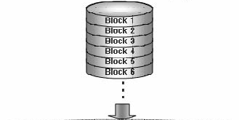
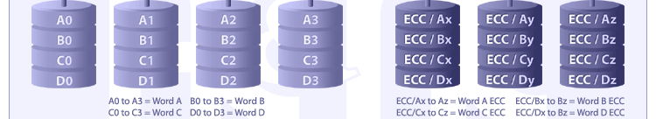
RAID Level 2 – Hamming Code
Self Study
Data is striped at word level, instead of sector level. A single bit is stored on each disk.
Remaining (non-data) disks are used to store a Hamming code: 4 data bits, 3 HC bits.
Drives must be synchronized in terms of arm position and rotational position.
A bad sector on one of the drives renders this sector useless for the drive set.
Notes:
ECC -> Error correcting code

Slide 85
5.6 Virtual Machines: Virtualization
Self Study
Multi-processors/computers attempt to make many machines an integrated resource (one computer with the power of 20)
Virtualization attempts the opposite: make a single machine appear as multiple independent systems
Viewed another way though, virtualization is similar
Instead of using multiple physical machines in a multicomputer or multiprocessor, we create multiple virtual machines
Consider a company with many servers (web, email, ftp, etc.)
These services may be hosted on separate machines
If the web server crashes, email and ftp are unaffected
Usually such crashes are caused by software failure
A virtual machine could be used to run all servers on 1 system but still maintain the fault tolerance of having separate servers

Slide 86
Virtualization
Self Study
Virtualization: Virtualization refers to technologies designed to offer a layer of abstraction between computer hardware systems and the software running on them. It can be a virtual version of computer hardware platform, operating system, a server, I/O systems, a storage device or network resources.
Advantages of Virtualization*:
Allow running multiple OS and applications on a single computer.
Combine H/W to obtain higher productivity from fewer servers and reduce hardware cost.
Ease the manageability significantly and allow monitoring and deploying new application conveniently.
*See: http://www.vmware.com/virtualization/
Notes:
http://.www.vmware.com/virtualization/virtualization-basics/what-is-virtualization.html
H/W => Hardware
See http://bcove.me/x9zhalcl
See http://bcove.me/ihjiwkd1

Slide 87
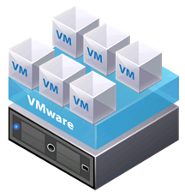

Virtualization
Self Study
Hypervisor (type 1) creates a layer of OS independence
Operating System
Bare Metal/Server
(a)
(b)
Figure (a) Hypervisor (VMWare/ESX product here) allows running several Virtual Machines (VMs) on top of it. (b) Each VM can run guest OS, OS allows running applications (apps).
Notes:
See www.vmware.com
ESX stands for Elastic Sky X
ESXi => ESX + integrated [that is ‘i’ is for ‘integrated’]

Slide 88
Virtualization
Self Study
If a standalone OS crashes, the entire system needs rebooting
With virtualization, a hypervisor runs in kernel mode
The hypervisor is far less complex than an entire OS (less buggy)
OSes run on top of the hypervisor
If an OS crashes, it can be restarted by the hypervisor
It does not bring the entire machine down, only the given OS
In fact, a hypervisor could run multiple instantiations of the same OS (say Windows)
One copy runs the email server, another the web server
If one BSoDs (Blue Screen of Death), then the others are unaffected
This isolation allows the fault tolerance of multiple machines without the associated cost
Unless the hardware fails!

Slide 89
Virtualization
Self Study
Some software is not designed to run multiple instantiations
The software may keep specific configuration files
Instead of buying a new machine for each instantiation of the software that is needed, virtualization can be used
Virtualization also simplifies checkpointing and migration
We can migrate an entire OS image to another machine
It’s all stored in memory by the hypervisor
If we run an OS on bare hardware, migrating processes is difficult because necessary info is in the OS system tables
But with virtualization, we move the entire OS running the app

Slide 90
Virtualization
Self Study
Virtual machines can be used to run legacy code
Instead of keeping a dedicated machine that runs Win95
Virtual machines can also be used for software development
Portability is a big concern for software developers
The code should be tested on as many OSes as possible
Instead of buying a separate machine for each OS
Many virtual machines run the different OSes for testing

Slide 91
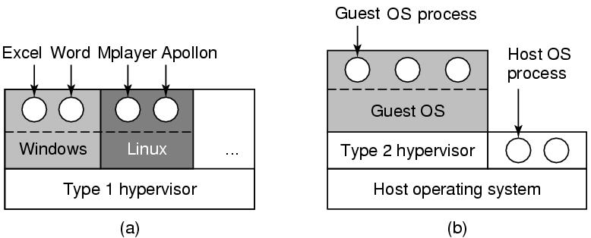
Type 1 vs 2 Hypervisors
Self Study
Hardware
Hardware
(a)
(b)
Figure: (a) A type 1 hypervisor. (b) A type 2 hypervisor.
Tanenbaum, Modern Operating Systems 3 e, (c) 2008 Prentice-Hall, Inc. All rights reserved. 0-13-6006639

Slide 92
Type 1 vs 2 Hypervisor
Self Study
Type 1 hypervisor software:
VMware ESX/ESXi
Hyper-V (from Microsoft)
XenServer (from Citrix)
Oracle VM Server for SPARC
Oracle VM Server for x86
IBM's z/VM
Type 2 hypervisor software:
VMware Workstation
Fusion (for Mac OS host)
VirtualBox
Tanenbaum, Modern Operating Systems 3 e, (c) 2008 Prentice-Hall, Inc. All rights reserved. 0-13-6006639

Slide 93
Virtual Memory
Self Study
§5.7 Virtual Memory
Use main memory as a “cache” for secondary (disk) storage
Managed jointly by CPU hardware and the operating system (OS)
Programs share main memory
Each gets a private virtual address space holding its frequently used code and data
Protected from other programs
CPU and OS translate virtual addresses to physical addresses
VM “block” is called a page
VM translation “miss” is called a page fault

Slide 94
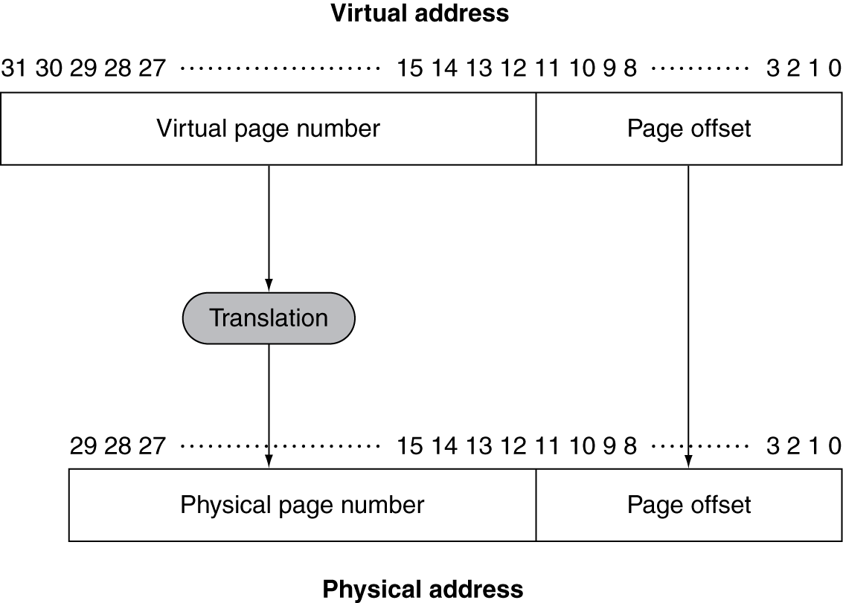
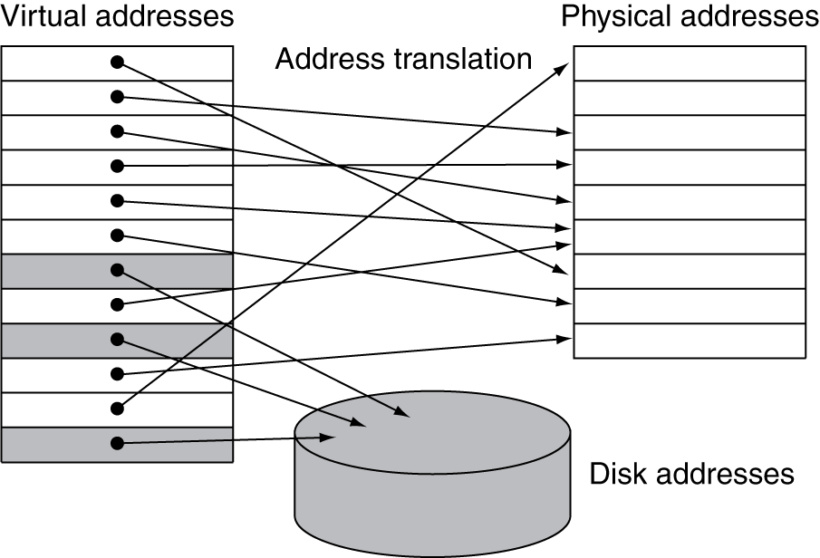
Address Translation
Self Study
Fixed-size pages (e.g., 4K)

Slide 95
Page Fault Penalty
Self Study
On page fault, the page must be fetched from disk
Takes millions of clock cycles
Handled by OS code
Try to minimize page fault rate
Fully associative placement
Smart replacement algorithms

Slide 96
Page Tables
Self Study
Stores placement information
Array of page table entries, indexed by virtual page number
Page table register in CPU points to page table in physical memory
If page is present in memory
PTE stores the physical page number
Plus other status bits (referenced, dirty, …)
If page is not present
PTE can refer to location in swap space on disk

Slide 97
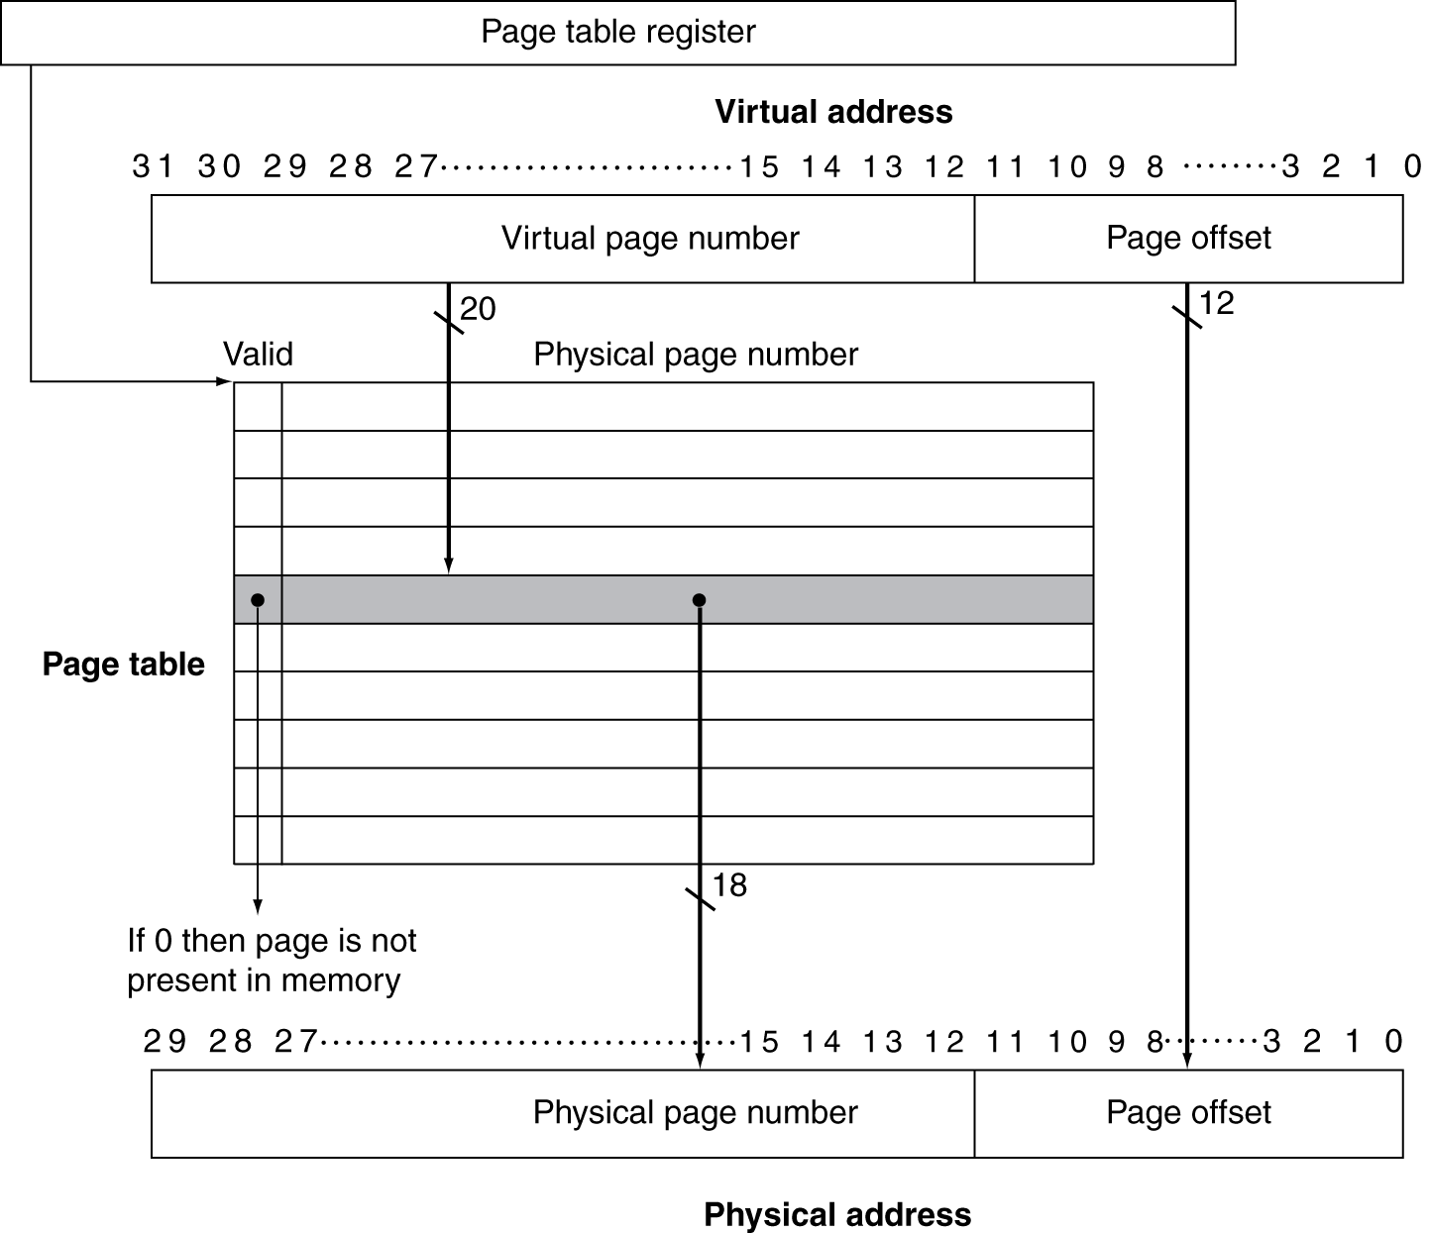
Translation Using a Page Table
Self Study

Slide 98
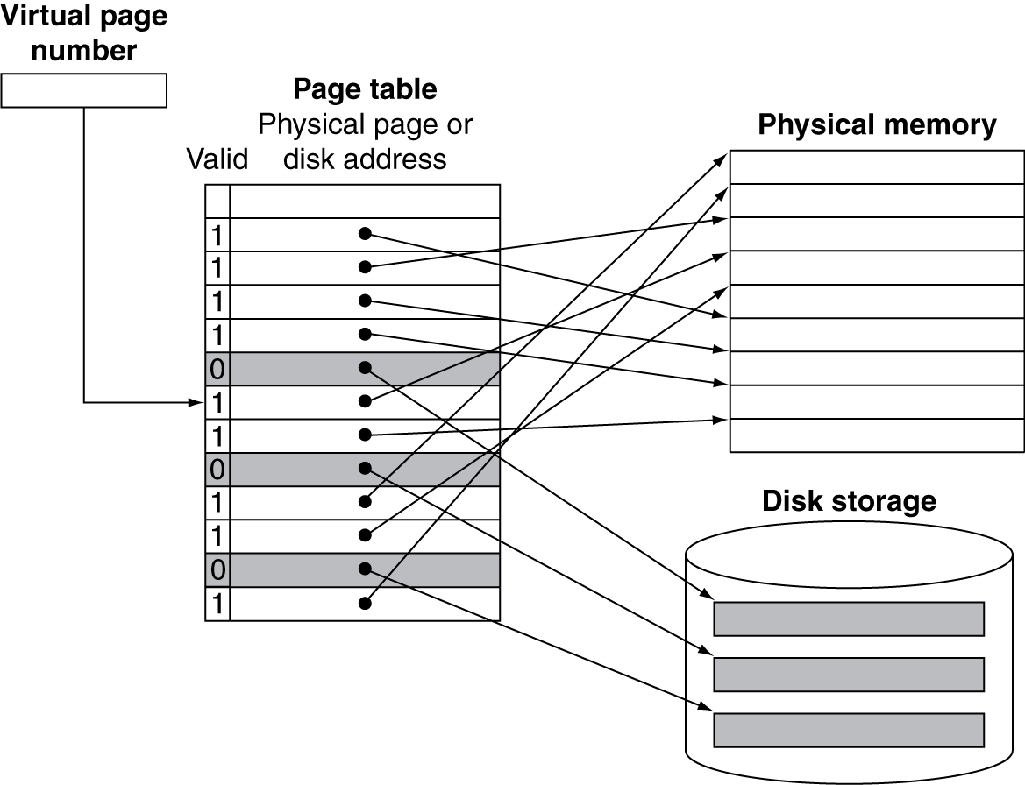
Mapping Pages to Storage
Self Study

Slide 99
Replacement and Writes
Self Study
To reduce page fault rate, prefer least-recently used (LRU) replacement
Reference bit (aka use bit) in PTE set to 1 on access to page
Periodically cleared to 0 by OS
A page with reference bit = 0 has not been used recently
Disk writes take millions of cycles
Block at once, not individual locations
Write through is impractical
Use write-back
Dirty bit in PTE set when page is written
Notes:
aka => also known as

Slide 100
Fast Translation Using a TLB
Self Study
Address translation would appear to require extra memory references
One to access the PTE
Then the actual memory access
But access to page tables has good locality
So use a fast cache of PTEs within the CPU
Called a Translation Look-aside Buffer (TLB)
Typical: 16–512 PTEs, 0.5–1 cycle for hit, 10–100 cycles for miss, 0.01%–1% miss rate
Misses could be handled by hardware or software

Slide 101
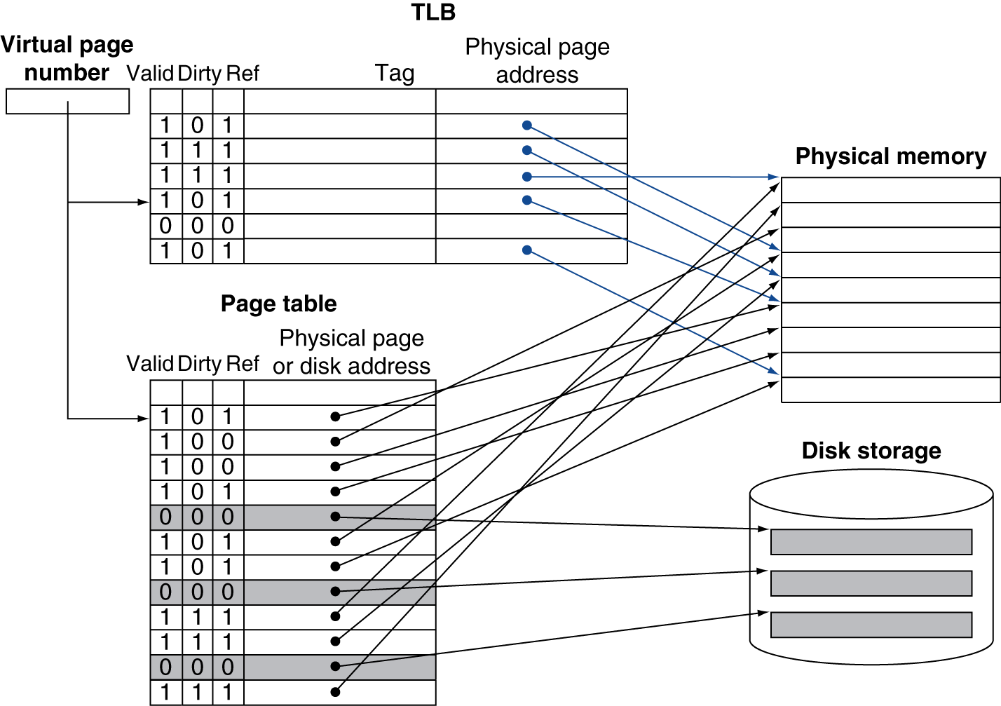
Fast Translation Using a TLB
Self Study

Slide 102
TLB Misses
Self Study
If page is in memory
Load the PTE from memory and retry
Could be handled in hardware
Can get complex for more complicated page table structures
Or in software
Raise a special exception, with optimized handler
If page is not in memory (page fault)
OS handles fetching the page and updating the page table
Then restart the faulting instruction

Slide 103
TLB Miss Handler
Self Study
TLB miss indicates
Page present, but PTE not in TLB
Page not preset
Must recognize TLB miss before destination register overwritten
Raise exception
Handler copies PTE from memory to TLB
Then restarts instruction
If page not present, page fault will occur

Slide 104
Page Fault Handler
Self Study
Use faulting virtual address to find PTE
Locate page on disk
Choose page to replace
If dirty, write to disk first
Read page into memory and update page table
Make process runnable again
Restart from faulting instruction

Slide 105
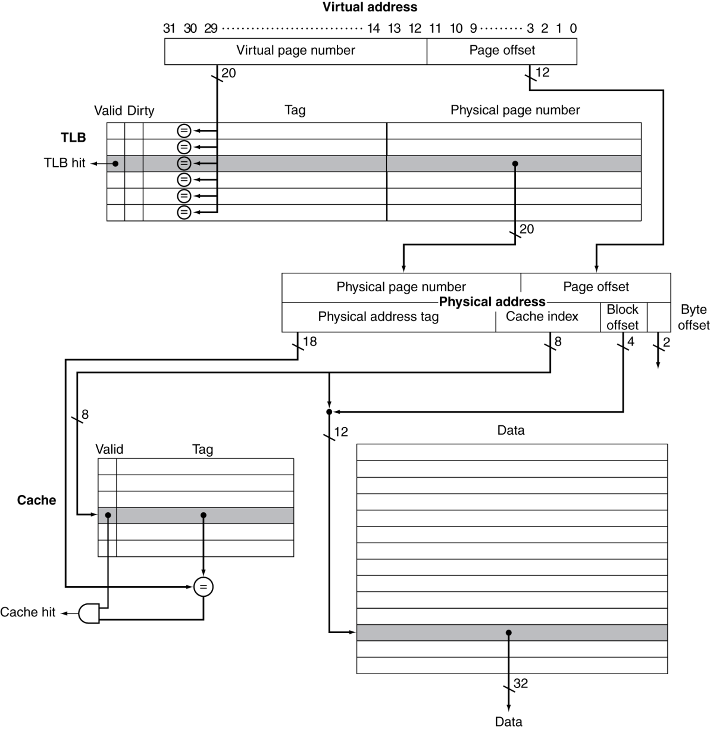
TLB and Cache Interaction
Self Study
If cache tag uses physical address
Need to translate before cache lookup
Alternative: use virtual address tag
Complications due to aliasing
Different virtual addresses for shared physical address
Figure: The TLB and cache implement, the process of going from a virtual address to a data item in the Intrinsity FastMATH.
Notes:
This figure shows the organization of the TLB and the data cache, assuming a 4 KiB page size. This diagram focuses on a read. Note that the tag and data RAMs are split. By addressing the long but narrow data RAM with the cache index concatenated with the block offset, we select the desired word in the block without a 16:1 multiplexor.
While the cache is direct mapped, the TLB is fully associative: Implementing a fully associative TLB requires that every TLB tag be compared against the virtual page number, since the entry of interest can be anywhere in the TLB. If the valid bit of the matching entry is on, the access is a TLB hit, and bits from the physical page number together with bits from the page offset form the index that is used to access the cache.

Slide 106
Memory Protection
Self Study
Different tasks can share parts of their virtual address spaces
But need to protect against errant access
Requires OS assistance
Hardware support for OS protection
Privileged supervisor mode (aka kernel mode)
Privileged instructions
Page tables and other state information only accessible in supervisor mode
System call exception (e.g., syscall in MIPS)

Slide 107
The Memory Hierarchy
The BIG Picture
Common principles apply at all levels of the memory hierarchy
Based on notions of caching
At each level in the hierarchy
Block placement
Finding a block
Replacement on a miss
Write policy
§5.8 A Common Framework for Memory Hierarchies

Slide 108
Block Placement
Determined by associativity
Direct mapped (1-way associative)
One choice for placement
n-way set associative
n choices within a set
Fully associative
Any location
Higher associativity reduces miss rate
Increases complexity, cost, and access time

Slide 109
Finding a Block
Associativity | Location method | Tag comparisons
Direct mapped | Index | 1
n-way set associative | Set index, then search entries within the set | n
Fully associative | Search all entries | #entries
 | Full lookup table | 0
Hardware caches
Reduce comparisons to reduce cost
Virtual memory
Full table lookup makes full associativity feasible
Benefit in reduced miss rate

Slide 110
Replacement
Choice of entry to replace on a miss
Least recently used (LRU)
Complex and costly hardware for high associativity
Random
Close to LRU, easier to implement
Virtual memory
LRU approximation with hardware support

Slide 111
Write Policy
Write-through
Update both upper and lower levels
Simplifies replacement, but may require write buffer
Write-back
Update upper level only
Update lower level when block is replaced
Need to keep more state
Virtual memory
Only write-back is feasible, given disk write latency

Slide 112
Sources of Misses
Self Study
Compulsory misses (aka cold start misses)
First access to a block
Capacity misses
Due to finite cache size
A replaced block is later accessed again
Conflict misses (aka collision misses)
In a non-fully associative cache
Due to competition for entries in a set
Would not occur in a fully associative cache of the same total size

Slide 113
Cache Design Trade-offs
Design change | Effect on miss rate | Negative performance effect
Increase cache size | Decrease capacity misses | May increase access time
Increase associativity | Decrease conflict misses | May increase access time
Increase block size | Decrease compulsory misses | Increases miss penalty. For very large block size, may increase miss rate due to pollution.

Slide 114
Cache Coherence Problem
Suppose two CPU cores share a physical address space
Write-through caches
Time step | Event | CPU A’s cache | CPU B’s cache | Memory
0 |  |  |  | 0
1 | CPU A reads X | 0 |  | 0
2 | CPU B reads X | 0 | 0 | 0
3 | CPU A writes 1 to X | 1 | 0 | 1
§5.10 Parallelism and Memory Hierarchies: Cache Coherence

Slide 115
Coherence Defined
Self Study
Informally: Reads return most recently written value
Formally:
P writes X; P reads X (no intervening writes) ⇒ read returns written value
P₁ writes X; sufficient time elapses, P₂ reads X ⇒ read the value written by P₁ (called Write- Propagation)
P₁ writes X, P₂ writes X ⇒ all processors see writes in the same order
End up with the same final value for X observed by all processors (called Write-Serialization)

Slide 116
Cache Coherence Protocols
Snooping protocols
Each cache monitors bus reads/writes; so if necessary, each corresponding processor can update the status/value of the shared variable/block.
Can be implemented for UMA processors
Directory-based protocols
Caches and memory record sharing status of blocks in a directory; directory basically keeps track of the sharing status of a block of memory
Suitable for NUMA processors
Non-uniform memory access

Slide 117
Cache Write Protocols
Write-Invalidate
A process obtains exclusive access of a variable/block before writing into it by invalidating all other copies of it.
Write-update
A process updates all the other shared copies of the variable/block when a process writes into it.

Slide 118
Snooping with Write-invalidate
Bus: all processors snoop on the bus
CPU_{A}
CPU_{B}
CPU_{C}
CPU_{D}
Memory
Cache
Cache
Cache
Cache
Computer starts, cache empty, block X is in main memory
P_{A} (CPU_{A}) wants to read X, P_{A} checks P_{A}’s cache, no copy exists, so places a ‘read X’ request on the bus, and everyone see the request.
It is expected that if X exists in other processors’ cache they should supply X to P_{A} (Why?*) Here, no processor has X in cache, so main memory supplies X to P_{A} though the bus.
*Why: it is faster to transfer value from cache than from main memory.
P_{A} places X in its cache with status shared ‘S’, indicating it is sharable and for read purpose.
Now, say, P_{B} wants to read X; P_{B} will check its cache, it is not there, so it will place a request on the bus.
All the processors will see the request but only P_{A} can and will supply X to P_{B}.
Notes:
*Why: it is faster to transfer value from cache than from main memory.

Slide 119
Snooping with Write-invalidate
Bus: all processors snoop on the bus
CPU_{A}
CPU_{B}
CPU_{C}
CPU_{D}
Memory
X
Cache X
S
Cache X
S
Cache
Cache
P_{B} now places X in its cache with status shared ‘S’, indicating it is sharable and for reading.
Now, P_{C} wants to write X, cache empty, so places ‘write X’ on bus.
P_{A} and P_{B}, don’t supply X while in ‘S’ state in response to write request (Why?), main-memory supplies it to P_{C}. P_{C} stores X in cache with modified ‘M’ status.
(Ans:) P_{A} and P_{B}, invalidates (‘I’) their cache copies of X. P_{C} can now modify X as many time as it needs without broadcasting about it and will write-back to main-memory when it needs to evict X from the cache of P_{C}.

Slide 120
Snooping with Write-invalidate
Bus: all processors snoop on the bus
CPU_{A}
CPU_{B}
CPU_{C}
CPU_{D}
Memory
X
Cache X
I
Cache X
I
Cache X
M
Cache
Now P_{B} wants to read X. P_{C} supplies the value to P_{B}. P_{B} places X in its own cache and marks ‘S’. P_{C} marks its X in cache from ‘M’ to ‘S’. Since, it is a transition from ‘M’ to ‘S’, P_{C} must update (write-back) X in main-memory.
Now, if either B or C wants to write, it will place ‘Write X’ on the bus and it will change its cache X’s status from ‘S’ to ‘M’ and other processors, if has a copy will mark from ‘S’ to ‘I’.
Here, based on bus information (by snooping on bus) processors update their cache at their own responsibility.
‘Write-propagation’ (check slide#115) is satisfied in the above steps.

Slide 121
Snooping with Write-invalidate
Bus: all processors snoop on the bus
CPU_{A}
CPU_{B}
CPU_{C}
CPU_{D}
Memory
X
Cache X
I
Cache X
S
Cache X
S
Cache
Now, the ‘Write-Serialization’ (check slide#115) is satisfied because of the bus properties. Assume, processor B and C both wants to write X, say values 10 and 15 respectively at the same time.
Bus arbitration will allow one to speak in the bus, hence write-serialization will be maintained – it may be B then C or, C then B, however, all other processor will see the same order or get the same final value.
For example, if processor A will read X=15 (when B writes and then C writes) then, D will read the same that is X=15, but not X=10, – otherwise, the ‘write-serialization’ is not maintained.

Slide 122
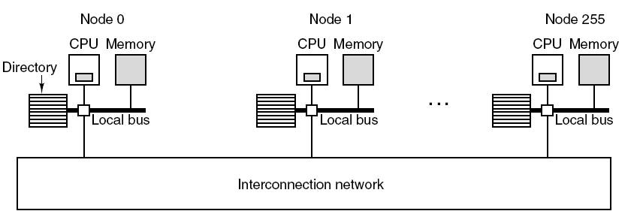
Directory Based Protocols
Self Study
/ Processor_{A}
/ P_{B}
Problem: Snoopy based protocol has scaling problem; as the number of node increases the bus becomes too busy to function.
Solution: Directory based solution.
In Directory based solution:
there is no bus but scalable network such as mesh. So, no need to broad-cast all messages all the time, rather point-to-point communication is possible.
No central memory, rather it is distributed among the nodes. E.g.: in the system there are 256 nodes and each has 16MB, then total memory of the system is 256 x 16MB = 4GB.
The memory is statically allocated among the nodes as: 0-16M in node #0, 16M-32M in #1, ..
So, for example, if Node#0 (N₀) or, Processor #A (P_{A}) is looking for block X, at memory location 35th M, then it needs to contact node#2 if the entry is not in node#0’s own cache. Since node#2 has 32M-48M memory.

Slide 123
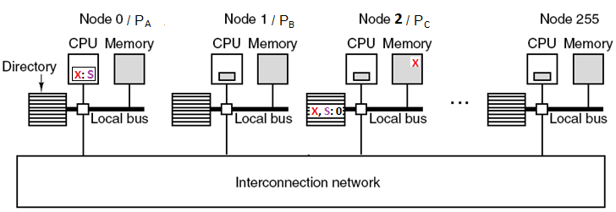
Directory Based Protocols
Self Study
Assume, X is not in N₀’s own cache. N₀ forwards a ‘read X’ request to N₂.
Note, the request is point-to-point unlike the bus based snooping protocol, so less or no traffic problem to other processors.
N₂’s directory keeps track of its memory block X, marks it shareable / shared ‘S’ with a empty list (‘list’ is about who is having a copy of it).
Now, N₀ reads N₂’s memory for X and N₂’s directory at the same time for status, finds it is ‘S’, implies a clean copy (not modified: ‘M’ or, not Invalidated: ‘I’) to be used.
N₀ gets the copy of X and put it in its own cache with status ‘S’ (shared / for reading only) and places ‘0’ in the list in N₂’s directory as: ‘S:0’

Slide 124
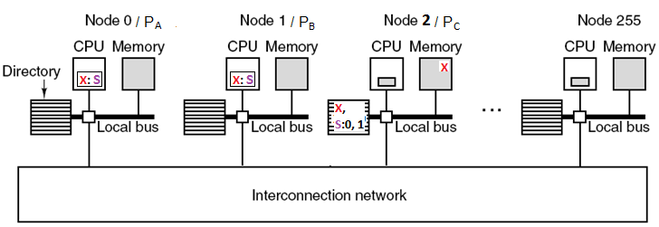
Directory Based Protocols
Self Study
Now, N₁ needs to read X. It could not find X in its own cache so sends a request to N₂ and gets a copy and places it in N₁’s own cache. This is updated in N₂’s directory list as from ‘S:0’ to ‘S:0,1’.
Now say, N₂₅₅ wants to ‘Write X’.

Slide 125
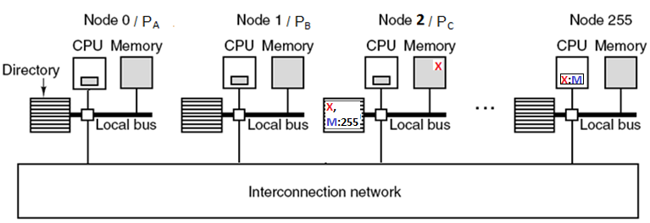
Directory Based Protocols
Self Study
Say N₂₅₅ does not find it in its cache, thus it sends ‘Write X’ request to N₂. The X for N₂₅₅ needs to be an exclusive copy for writing.
So, directory of N₂ sends command to N₀ and N₁ to invalidate their cache copies of X and proceeds after receiving ‘ACK’ (acknowledge) from them – because the architecture is NUMA and no snooping available – so it must be confirmed.
After getting ACKs, N₂’s directory sends copy of X to N₂₅₅. N₂₅₅ caches X in it with mark ‘M’ and directory of N₂ updates the list as: ‘M:255’ for block X.

Slide 126
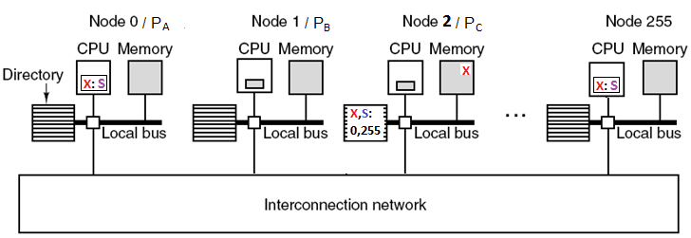
Directory Based Protocols
Self Study
Now, N₀ wants to read X, finds invalidated cache, so sends request to N₂.
N₂ finds from its directory that N₂₅₅ is modifying it. So, N₂ sends request to N₂₅₅ to supply update copy of X. N₂₅₅ downgrades its cache for X from M to S (M→S, subject to update the original source (memory) in N_{2.}), so getting the copy of X from N₂₅₅, N₂ updates its memory for X. N₂’s directory then sends X to N₀. N₂ updates its directory from ‘M:255’ to ‘S:0, 255’. N₀ caches the copy of X and set status to ‘S’.
If N₀, instead of a read X, would ask for a write X, then N₂₅₅ would have invalidated (‘I’) its cache rather making it ‘S’. And, N₀ receiving updated X, would have cashed it with status ‘M’.

Slide 127
Synchronization in Shared Memory Programs (Act of Lock)
Self Study

Slide 128
Synchronization
Recall, Ch2
Self Study
Two processors sharing an area of memory
P1 writes, then P2 reads
Data race if P1 and P2 don’t synchronize
Result depends of order of accesses
Hardware support required
Atomic read/write memory operation
No other access to the location allowed between the read and write
Could be a single instruction
E.g., atomic swap of register ↔ memory
Or an atomic pair of instructions
§2.11 Parallelism and Instructions: Synchronization

Slide 129
Test and Set Lock (TSL)
Recall, Ch2
Self Study
TSL REGISTER, LOCK (hardware support)
Reads the contents of the memory word lock into register RX and stores a non-zero value at the memory address lock.
The memory bus is locked during this operation so no other process or CPU can access memory (e.g. change Lock’s value)
Mutual Exclusion
enter_region:
TSL REGISTER, LOCK | copy Lock to Reg and set Lock to 1
CMP REGISTER, #0 | was the Lock zero?
JNE enter_region | if Lock was nonzero, jump to top of loop
RET | return to caller, critical region entered
leave_region:
MOVE LOCK, #0 | store 0 in Lock
RET | return to caller

Slide 130
Synchronization in Shared Memory Programs
Self Study
Bus: all processors snoop on the bus
Memory
CPU_{A}
CPU_{B}
CPU_{C}
CPU_{D}
L=0
Cache
Cache
Cache
Cache
Initially, Lock variable L=0 in memory
P_{A} runs: TSL; sets L=1 successfully, P_{A} cache L=1, with status: M
P_{A} enters CS (Critical Section) and now P_{B} wants to get in CS
P_{B} runs: TSL; L in P_{A} is invalidated, Mem: L=1; cached in P_{B} runs with L=1, status: M; so can not get in CS but loops.
Now P_{C} wants to get in CS: invalidates the entry in P_{B} and will have a copy of L=1 in P_{C}’s cache.
Once P_{A} releases (setting L=0); M in P_{A}’s cache. Others are in loop. Now, M→ S makes memory L=0.
Assume, P_{C}’s TSL call is ahead of P_{B}’s. So, P_{C} will acquire the lock, …

Slide 131
Synchronization in Shared Memory Programs
Self Study
Bus: all processors snoop on the bus
Memory
CPU_{A}
CPU_{B}
CPU_{C}
CPU_{D}
L=1
Cache
Cache
Cache L=1, M.
Cache
There is no violation of the purpose of the lock but it will be extremely inefficient keeping the common bus busy as the lock variable will be heavily moving among nodes’ caches and it happened when P_{A} was in CS.
To reduce the bus traffic we can simply use Test(L) to read L in a loop (so the read will be only from local cache) and once L=0, then we can run TSL(L) which involves ‘write’. So the modified code could be:

Slide 132
Synchronization in Shared Memory Programs
Self Study
In higher-level language:
Before:
While (TSL(L)); // read only
//from local cache
After
Repeat
While (L); // loop when L=1
Until (!(TSL(L));
In assembly code
After:
enter_region:
Test REGISTER, L; L is LOCK
CMP REGISTER, #0
JNE enter_region
TSL REGISTER, L;
CMP REGISTER, #0
JNE enter_region
RET
Basically, in assembly, the Test is having the value of lock in Register to test whether it is ‘0’ of ‘1’ . And, register is local, and so no write involves the global L.

Slide 133
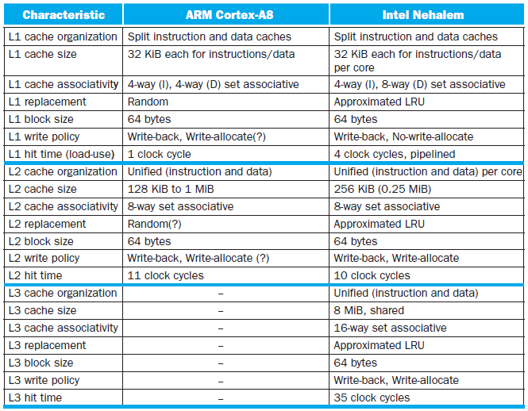
Multilevel On-Chip Caches
Self Study
§5.13 The ARM Cortex-A8 and Intel Core i7 Memory Hierarchies

Slide 134
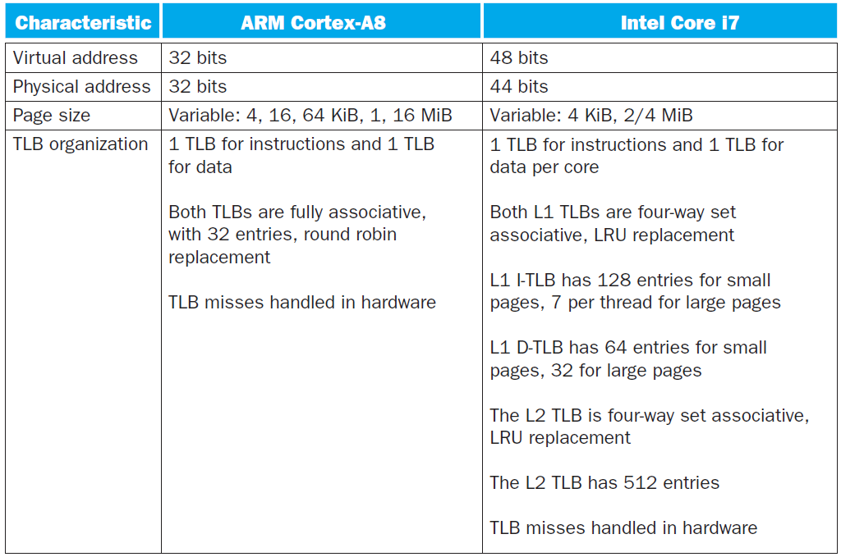
2-Level TLB Organization
Self Study

Slide 135
Pitfalls
Self Study
Byte vs. word addressing
Example: 32-byte direct-mapped cache, 4-byte blocks
Byte 36 maps to block 1
Word 36 maps to block 4
Ignoring memory system effects when writing or generating code
Example: iterating over rows vs. columns of arrays
Large strides result in poor locality
§5.15 Fallacies and Pitfalls

Slide 136
Pitfalls
Self Study
In multiprocessor with shared L2 or L3 cache
Less associativity than cores results in conflict misses
More cores ⇒ need to increase associativity
Using AMAT to evaluate performance of out-of-order processors
Ignores effect of non-blocked accesses
Instead, evaluate performance by simulation

Slide 137
Pitfalls
Self Study
Extending address range using segments
E.g., Intel 80286
But a segment is not always big enough
Makes address arithmetic complicated
Implementing a VMM on an ISA not designed for virtualization
E.g., non-privileged instructions accessing hardware resources
Either extend ISA, or require guest OS not to use problematic instructions

Slide 138
Concluding Remarks
Fast memories are small, large memories are slow
We really want fast, large memories ☹
Caching gives this illusion ☺
Principle of locality
Programs use a small part of their memory space frequently
Memory hierarchy
L1 cache ↔ L2 cache ↔ … ↔ DRAM memory ↔ disk
Memory system design is critical for multiprocessors
§5.16 Concluding Remarks

