Slide 1
Chapter 6
Parallel Processors from Client to Cloud
Abdullah Yasin Nur

Slide 2
Introduction
§6.1 Introduction
Goal: connecting multiple computers to get higher performance
Multiprocessors
Scalability
E.g. Hadoop for processing big-data. Hadoop platform is designed to solve problems where you have a lot of data. Hadoop is designed to run on a large number of machines that don’t share any memory or disks.
Availability / Reliability
If a single processor fails in a multiprocessor with n processor, these system would continue to provide service with n-1 processors.
Power Efficiency
One big processor vs many smaller processors

Slide 3
Introduction
§6.1 Introduction
Task-level (process-level) parallelism
High throughput for independent jobs
Parallel processing of a program
Single program run on multiple processors
Multicore microprocessors
Chips with multiple processors (cores)
Cluster
A set of computers connected over a local area network that function as a single large multiprocessor. Basically, it is composed of microprocessor housed in many independent server.

Slide 4
Hardware and Software
Hardware
Serial: e.g., Pentium 4
Parallel: e.g., quad-core Xeon e5345 or Core i7
Software
Sequential: e.g., matrix multiplication
Sequential programming involves a consecutive and ordered execution of processes one after another
Concurrent: e.g., operating system
A concurrent system is one where a computation can advance without waiting for all other computations to complete.

Slide 5
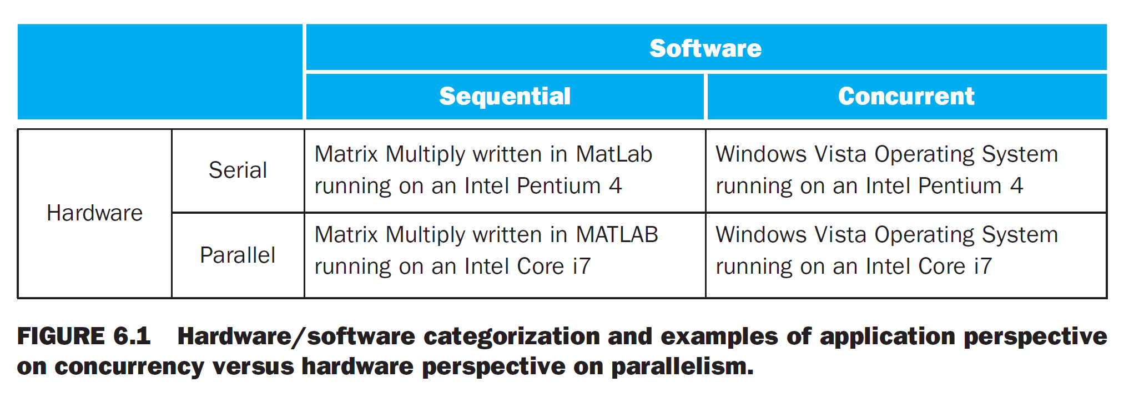
Hardware and Software
Sequential/concurrent software can run on serial/parallel hardware
Challenge: making effective use of parallel hardware

Slide 6
Parallel Programming
Parallel software is the bottleneck.
Need to get significant performance improvement
Otherwise, just use a faster uniprocessor, since it’s easier!
Difficulties
Partitioning
Coordination
Communications overhead
§6.2 The Difficulty of Creating Parallel Processing Programs

Slide 7
Parallel Programming
Sequential part can limit speedup
Remember the analogy in Chapter 1:
Eight reporters trying to write a single story in hopes of doing the work eight times faster.
To succeed, the task must be broken into eight equal-sized pieces, because otherwise some reporters would be idle while waiting for the ones with larger pieces to finish.
Another speed-up obstacle could be that the reporters would spend too much time communicating with each other instead of writing their pieces of the story.

Slide 8
Amdahl’s Law
Question: Suppose we want to achieve a speed-up of 90 times faster with 100 processors. What percentage of the original computation can be sequential?

Slide 9
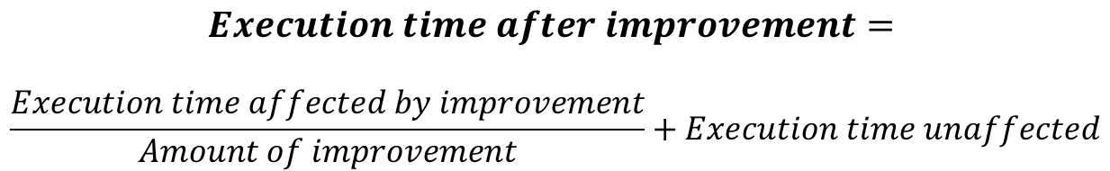
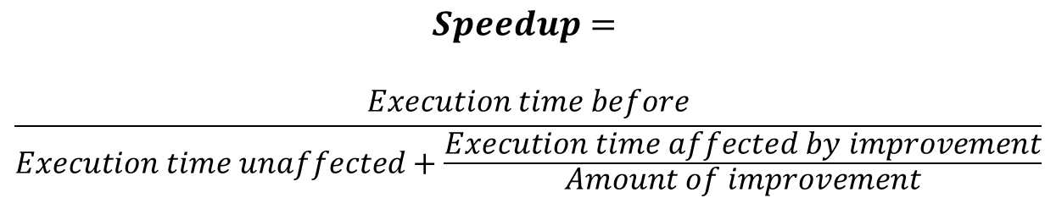
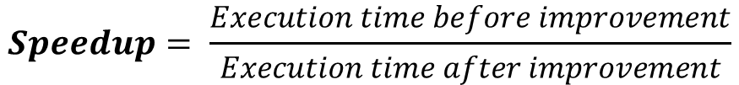
Amdahl’s Law
$$Execution time after improvement=$$
$$\frac{Execution time affected by improvement}{Amount of improvement}+Execution time unaffected$$
$$Speedup= \frac{Execution time before improvement}{Execution time after improvement}$$
$$Speedup=$$
$$\frac{Execution time before}{Execution time unaffected+\frac{Execution time affected by improvement}{Amount of improvement}}$$

Slide 10
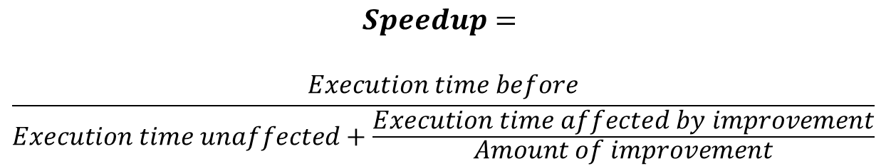
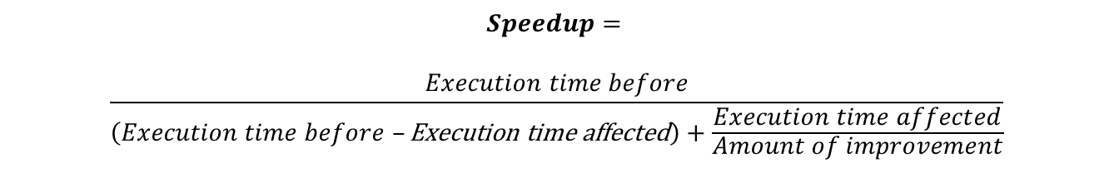
Amdahl’s Law
$$Speedup=$$
$$\frac{Execution time before}{Execution time unaffected+\frac{Execution time affected by improvement}{Amount of improvement}}$$
$Execution time unaffected= Execution time before$ – Execution time affected
$$Speedup=$$
$$\frac{Execution time before}{\left(Execution time before\text{ – }\text{Execution} \text{time} \text{affected}\right)+\frac{Execution time affected}{Amount of improvement}}$$

Slide 11



Amdahl’s Law
Assume that execution time before = 1
$$Speedup=$$
$$\frac{1}{\left(1\text{ – }\text{Execution} \text{time} \text{affected}\right)+\frac{Execution time affected}{Amount of improvement}}$$
$Amount of improvement$ = 100
because of 100 processors
$$90= \frac{1}{\left(1\text{ – }\text{Execution} \text{time} \text{affected}\right)+\frac{Execution time affected }{100}}$$
$\text{Execution} \text{time} \text{affected}$ = 0.999
Need sequential part to be 0.1% of original time

Slide 12
Scaling Example
Workload: sum of 10 scalars, and 10 × 10 matrix sum
Speed up from 10 to 100 processors
Single processor: Time = (10 + 100) × t_{add}
10 processors
Time = 10 × t_{add} + 100/10 × t_{add} = 20 × t_{add}
Speedup = 110/20 = 5.5
100 processors
Time = 10 × t_{add} + 100/100 × t_{add} = 11 × t_{add}
Speedup = 110/11 = 10
Assumes load can be balanced across processors

Slide 13
Scaling Example (cont)
What if matrix size is 100 × 100?
Single processor: Time = (10 + 10000) × t_{add}
10 processors
Time = 10 × t_{add} + 10000/10 × t_{add} = 1010 × t_{add}
Speedup = 10010/1010 = 9.9
100 processors
Time = 10 × t_{add} + 10000/100 × t_{add} = 110 × t_{add}
Speedup = 10010/110 = 91
Assuming load balanced

Slide 14
Instruction and Data Streams
One categorization of parallel hardware proposed in the 1960s is still used today.
Based on the number of instruction streams and the number of data streams
SISD : Single instruction stream, single data stream.
A uniprocessor
MIMD : Multiple instruction stream, Multiple data stream.
A multiprocessor
§6.3 SISD, MIMD, SIMD, SPMD, and Vector

Slide 15
Instruction and Data Streams
SPMD : Single Program, Multiple Data streams
The conational MIMD programming model, where a single program runs across all processors
SIMD : Single Instruction stream, Multiple Data streams
The same instruction is applied to many data streams, as in a vector processor.
§6.3 SISD, MIMD, SIMD, SPMD, and Vector
 |  | Data Streams
 |  | Single | Multiple
Instruction Streams | Single | SISD: Intel Pentium 4 | SIMD: SSE instructions of x86
 | Multiple | MISD: No examples today | MIMD: Intel Core i7

Slide 16
Comparing Vector to Conventional Code
Self Study
Suppose, we extend the MIPS instruction set architecture with vector instructions and vector registers.
Also, vector operations use the same name as MIPS operation, but with letter “V” appended.
addv.d: adds two double-precision vectors
addvs.d: adds a scalar register to each elements of a vector register
lv, sv: vector load and vector store an entire vector of double-precision
Now we will see the conventional MIPS code vs the vector MIPS code for:
Y = a × X + Y
where, X and Y are vectors of 64 double-precision floating-point numbers, initially resident in memory, and a is a scalar double-precision variable (so called DAXPY example).
Assume, starting address of X and Y are $s0 and $s1, respectively.
Notes:
DAXPY stands for double precision a × X plus Y.
AVX => Advanced Vector Extension => 32 vector registers, each has 64 64 bit elements.

Slide 17
Example: DAXPY (Y = a × X + Y)
Self Study
Conventional MIPS code
l.d $f0,a($sp) ;load scalar a addiu $t0,$s0,#512 ;upper bound of what to load loop: l.d $f2,0($s0) ;load x(i) mul.d $f2,$f2,$f0 ;a × x(i) l.d $f4,0($s1) ;load y(i) add.d $f4,$f4,$f2 ;a × x(i) + y(i) s.d $f4,0($s1) ;store into y(i) addiu $s0,$s0,#8 ;increment index to x addiu $s1,$s1,#8 ;increment index to y subu $t0,$t0,$s0 ;compute bound bne $t0,$zero,loop ;check if done
Vector MIPS code
l.d $f0,a($sp) ;load scalar a lv $v1,0($s0) ;load vector x mulvs.d $v2,$v1,$f0 ;vector-scalar multiply lv $v3,0($s1) ;load vector y addv.d $v4,$v2,$v3 ;add y to product sv $v4,0($s1) ;store the result
Notes:
Double is 8 bytes number, so, 8 x 64 = 512 (the upper bound).

Slide 18
Comparing Vector to Conventional Code
Self Study
In that example, vector processor greatly reduces the dynamic instruction bandwidth: 6 instructions vs 600 instructions, specifically.
The reduction in its fetch and execution saves energy.
In conv. MIPS, every add .d must wait for a mul .d, every s.d must wait for the add.d and every add.d & mul.d must wait for l.d.
On Vec. Proc., every vector ins. will only stall for the first element in the vector, rest will have smooth flow.

Slide 19
Vector Processors
Self Study
Highly pipelined function units
Stream data from/to vector registers to units
Data collected from memory into registers
Results stored from registers to memory
Example: Vector extension to MIPS
32 × 64-element registers (64-bit elements)
Vector instructions
lv, sv: load/store vector
addv.d: add vectors of double
addvs.d: add scalar to each element of vector of double
Significantly reduces instruction-fetch bandwidth

Slide 20
Vector vs. Scalar
Self Study
Vec. is equivalent to execute an entire loop
Each element in vector is independent, so hardware does not have to check for data-hazards within a vector instruction.
Vec. architecture and compilers are well known of making efficient usage of MIMD for data-level parallelism
H/W need to check for data-hazard bet^{n} 2 vector ins once per vector operand, not for every elements. Saves energy.

Slide 21
Vector vs. Scalar
Self Study
For Vec., fetching is mostly from aligned memory element, thus latency is seen once for vector but not for each elements.
As an entire loop is replaced by a vector ins, control hazards are non-existent.
Savings in ins bandwidth, hazard checking and efficient use of memory help save energy.
Thus, replacing scalar operations with vector operations as much as possible is a better choice.
Notes:
Ins => instruction

Slide 22
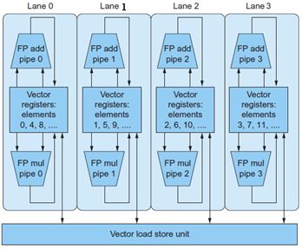
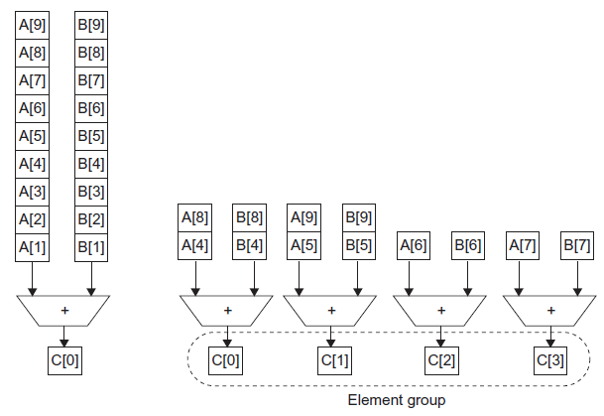
Vector vs. Multimedia Extensions
Self Study
Vector instructions have a variable vector width, multimedia extensions have a fixed width
Vector instructions support strided access, multimedia extensions do not
Vector units can be combination of pipelined and arrayed functional units:

Slide 23
Hardware Multithreading
Performing multiple threads of execution in parallel
Replicate registers, PC, etc.
Fast switching between threads
Fine-grain multithreading
Switch threads after each cycle => Interleaved execution of multiple threads, round-robin style
If one thread stalls – it is skipped but others are executed => can hide throughput losses due to stall
Coarse-grain multithreading
Only switch on long stall (e.g., L2-cache miss)
Simplifies hardware, but doesn’t hide short stalls (eg, data hazards)
§6.4 Hardware Multithreading

Slide 24
Simultaneous Multithreading (SMT)
SMT uses the resources (Functional Units) of a multiple-issue dynamically scheduled processor
Exploits thread-level parallelism as well as ins. level parallelism (ILP)
Within threads, dependencies handled by scheduling and register renaming conveniently
Example: Intel Pentium-4 HT
Two threads: duplicated registers, shared function units and caches
Notes:
FUs=> Functional Units

Slide 25
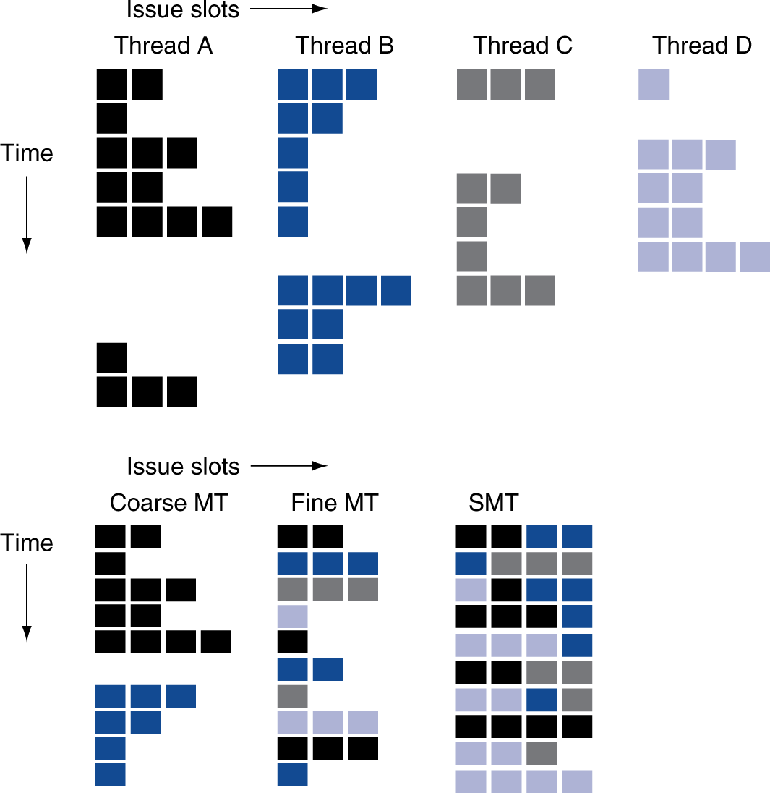
Multithreading Example
Figure: How do 4 threads use the issue slots of a superscalar processor in different approaches?

Slide 26
Multicore & other Shared Memory Multiprocessor
Question: given the difficulty of rewriting old programs to run well on parallel Hardware, what can computer designer do to simplify the task?
Ans:
Provide a single physical address space that all processor can share. Ease the concern of the data location per processors, instead merely programs may be executed in parallel.
This also makes all variables of a program available to any time to any processor.
A shared memory multiprocessor (SMP) offers a single physical address space across all processors – which is also the case for multicore chips.
§6.5 Multicore and Other Shared Memory Multiprocessors
Notes:
H/W => Hardware
S/W => Software

Slide 27
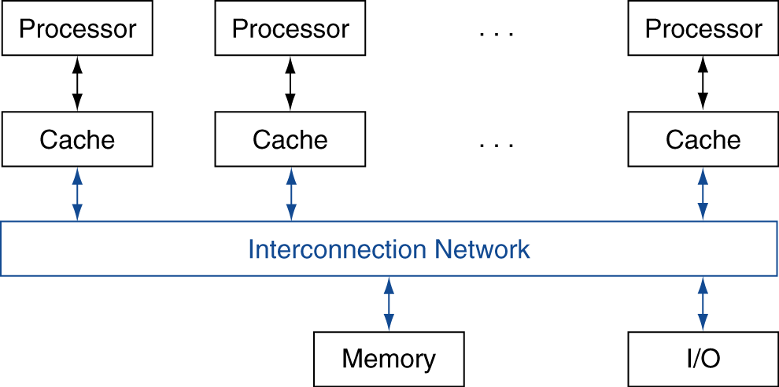
Shared Memory
SMP: shared memory multiprocessor
Hardware provides single physical address space for all processors
Synchronize shared variables using locks
Memory access time
UMA (uniform memory access ) vs. NUMA (nonuniform ~)

Slide 28
Example: Sum Reduction
Sum 64,000 numbers on 64 processor uniform memory access
Each processor has ID: 0 ≤ Pn ≤ 63
Partition 1000 numbers per processor
Initial summation on each processor
sum[Pn] = 0;
for (i = 1000*Pn; i < 1000*(Pn+1); i = i + 1)
sum[Pn] = sum[Pn] + A[i];
Now need to add these partial sums
Reduction: divide and conquer
Half the processors add pairs, then quarter, …
Need to synchronize between reduction steps

Slide 29
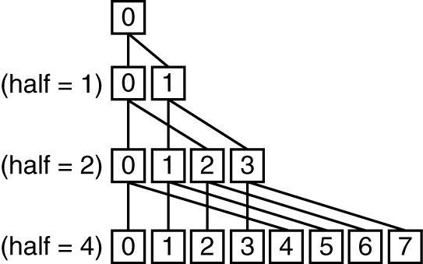
Example: Sum Reduction
Self Study
half = 64;
repeat
synch();
if (half%2 != 0 && Pn == 0)
sum[0] = sum[0] + sum[half-1];
/* Conditional sum needed when half is odd;
Processor0 gets missing element */
half = half/2; /* dividing line on who sums */
if (Pn < half) sum[Pn] = sum[Pn] + sum[Pn+half];
until (half == 1);

Slide 30
History of GPUs
Early video cards
Frame buffer memory with address generation for video output
3D graphics processing
Originally high-end computers
Moore’s Law ⇒ lower cost, higher density
3D graphics cards for PCs and game consoles
Graphics Processing Units
Processors oriented to 3D graphics tasks
Vertex/pixel processing, shading, texture mapping, rasterization
§6.6 Introduction to Graphics Processing Units

Slide 31
GPU vs CPU
GPU are accelerators that supplement CPU for graphics works. GPU can not do all, so CPU completes it.
GPU’s problem sizes are few hundred MB to GB, but not hundreds of GB to TB.
GPU do not rely on multilevel cache, rather on hardware multithreading, as GPU executes hundreds to thousands of independent threads.
DRAM chips for GPUs are wider and are of higher bandwidth than DRAM of CPUs.
For GP-GPU, consider the transfer time from CPU to GPU, as GPU is rather a coprocessor.
Notes:
GP-GPU: general purpose GPU

Slide 32
GPU Architectures
Processing is highly data-parallel
GPUs are highly multithreaded
Use thread switching to hide memory latency
Less reliance on multi-level caches
CPU for sequential code, GPU for parallel code
Programming languages/APIs
DirectX, OpenGL
C for Graphics (Cg), High Level Shader Language (HLSL)
NVIDIA’s CUDA (Compute Unified Device Architecture)

Slide 33
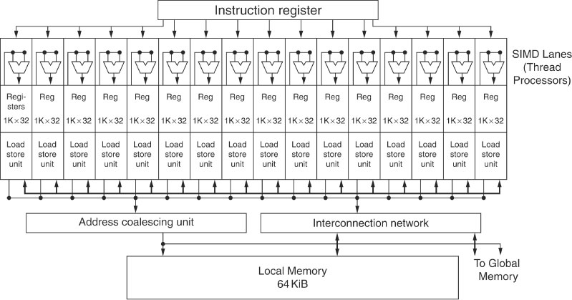
NVIDIA GPU Architectures
Figure: Block-diagram of the datapath of a multithreaded SIMD Processor
GPU has 16 SIMD Lanes; i.e., GPU is a MIMD composed of multithreaded SIMD.
The SIMD instructions of these threads are 32 wide.
Notes:
SIMD : Single Instruction stream Multi Data streams

Slide 34
NVIDIA GPU Architectures
Basically, the GPU hardware has two levels of hardware schedulers:
The Thread Block Scheduler that assigns blocks of threads to multithreaded SIMD processors, and
the SIMD Thread Scheduler with a SIMD processor, which schedules when SIMD threads should run.
Notes:
SIMD : Single Instruction stream Multi Data streams

Slide 35
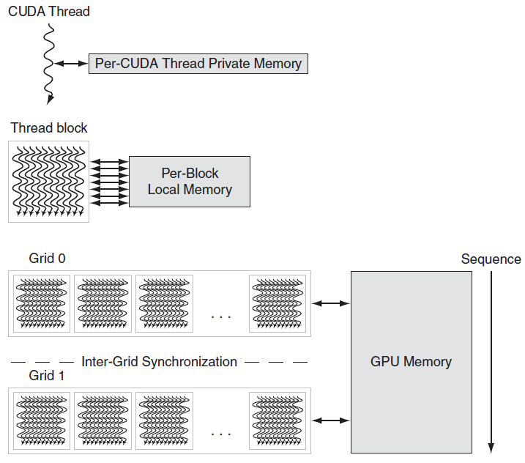
GPU Memory Structures
Self Study
GPU memory is shared by the vectorized loops. All threads of SIMD instructions within a thread block share Local Memory.

Slide 36
Putting GPUs into Perspective
Self Study
Feature | Multicore with SIMD | GPU
SIMD processors | 4 to 8 | 8 to 16
SIMD lanes/processor | 2 to 4 | 8 to 16
Multithreading hardware support for SIMD threads | 2 to 4 | 16 to 32
Typical ratio of single precision to double-precision performance | 2:1 | 2:1
Largest cache size | 8 MB | 0.75 MB
Size of memory address | 64-bit | 64-bit
Size of main memory | 8 GB to 256 GB | 4 GB to 6 GB
Memory protection at level of page | Yes | Yes
Demand paging | Yes | No
Integrated scalar processor/SIMD processor | Yes | No
Cache coherent | Yes | No

Slide 37
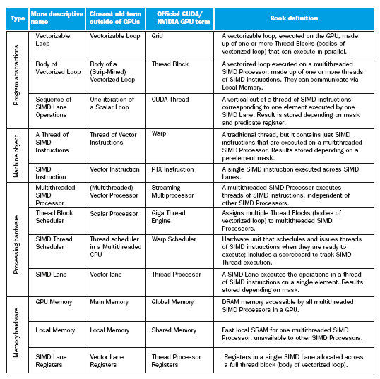
Guide to GPU Terms
Self Study

Slide 38
Multiprocessors
A shared-memory multiprocessor is a computer system where two or more CPUs share full access to the memory system
Memory system is the means of communication between CPUs
Functions much like a single processor system
All processors in a multiprocessor can access all of memory
UMA (Uniform Memory Access) multiprocessors have the property that every memory word takes the same time to access
NUMA (Non-UMA) multiprocessors do not provide this guarantee
This is dependent on the interconnect in use and RAM organization

Slide 39
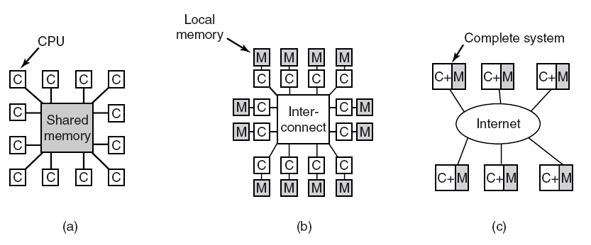
Multiple Processor Systems
Figure: (a) A shared-memory multiprocessor. (b) A message-passing multicomputer. (c) A wide area distributed system.

Slide 40
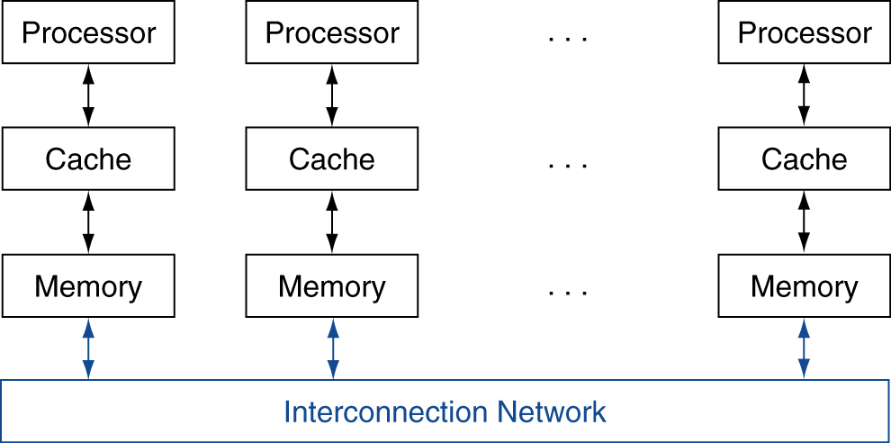
Message Passing
Each processor has private physical address space
Hardware sends/receives messages between processors
§6.7 Clusters, WSC, and Other Message-Passing MPs

Slide 41
UMA Multiprocessors
Self Study
Bus-Based Architecture (without caching)
Shared
memory
CPU
CPU
CPU
CPU
Memory
Bus contention becomes the largest issue
When a CPU wants to access memory it checks the bus
If the bus is busy it must wait, otherwise it accesses memory
This is fine for very few processors
A 32 processor machine wouldn’t work well though
The solution is to interpose a cache for each CPU
But this creates its own set of problems

Slide 42
UMA Multiprocessors
Self Study
With caching:
CPU
CPU
CPU
CPU
Memory
Cache
Cache
Cache
Cache
When a CPU wants to access memory it checks its cache
Each cache block is marked as “read-only” or “read-write”
A read-only block can be present in multiple caches but a read-write block can only be present in one
If a CPU attempts to write a word that is in one or more caches, the bus hardware informs all other caches of the write
If the word is modified in a RW cache, then it is written back from there

Slide 43
UMA Multiprocessors
Self Study
With caching and private memory:
Private memory
Shared
memory
CPU
CPU
CPU
CPU
Memory
Cache
Cache
Cache
Cache
To use this configuration (dedicated bus for private memory) optimally, steps are taken to reduce bus traffic, such as:
Compiler can place all the program text, string, constants and other read-only data, stacks, and local variables in private memories.
The shared memory can then only be used for writable shared variables.

Slide 44
Crossbar Switch UMA
Self Study
Memory is broken into N banks accessed independently
Contention is greatly reduced so more CPUs can be supported than the bus-based architecture
The size of the crossbar (number of join points) grows as N²
This is too expensive for really large installations
But it provides good performance for moderate sized MPs

Slide 45
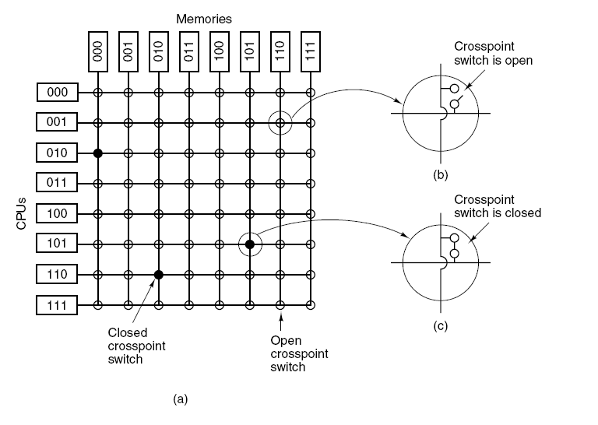
UMA Multiprocessors
Self Study
Using Crossbar Switches:
Figure: (a) An 8 × 8 crossbar switch. (b) An open crosspoint. (c) A closed crosspoint.

Slide 46
NUMA Multiprocessors
Self Study
UMA multiprocessors are limited in size
A bus-based UMA can support only a handful of processors
Bus contention becomes a problem quickly even with caching
Crossbar switches are expensive which limits size as well
For large multiprocessor systems we must abandon UMA
This means memory access times are variable
Practically, it means non-local accesses will take a ‘long time’
NUMAs still have a single address space visible to all CPUs
Access to memory is still achieved via a load-store method
But non-local accesses will likely to go over a network connection
Can be far slower even than going to disk

Slide 47
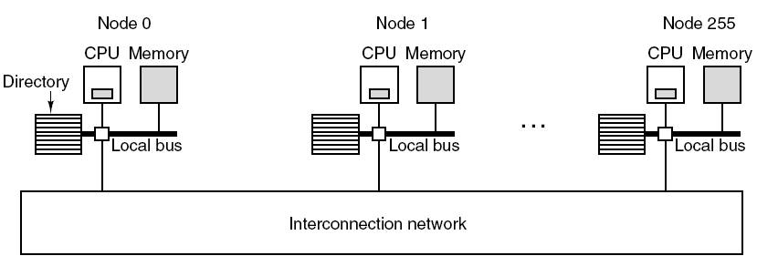
NUMA Multiprocessors
Self Study
Figure: A 256-node directory-based multiprocessor.
Each processor is self contained with its own bus, RAM, etc.
The interconnection network is used to connect the processors
Access to local memory is ‘fast’, remote memory is ‘slow’
Directory is used to keep track of caching across machines

Slide 48
NUMA Multiprocessors
Self Study
Why do we care that access times are not uniform?
We don’t really care that accesses take ‘different’ times
What we do care is that non-local accesses are very slow
This forces the programmer of a NUMA architecture to be aware of the placement of data
After all, if we access memory with no regard to local vs non-local, then the application may run slower on a NUMA than if we ran it on a single processor
NUMA programmers must carefully place and process their data
One way to alleviate some of the burden of accessing non-local data is to cache data from other processors
But this opens up a whole new can of worms

Slide 49
Multicomputers
Multicomputers offer an alternative to shared memory MPs
Multiprocessors with shared memory offer a simple communication model that programmers are familiar with
This load-store approach allows for synchronization using locks, semaphores, monitors and other well-established techniques
The problem is that multiprocessors are expensive to build
Multicomputers are tightly coupled CPUs with no shared memory
They are easy and cheap to build using stripped commodity PCs
Communication is done via message passing over the network
High performance network cards and connectivity is used
Message passing presents new challenges to the programmer

Slide 50
Multicomputer Hardware
A node of a multicomputer consists of the CPU, memory, network interface card and occasionally a hard disk
There is no need for other standard PC components such as a graphics card, monitor, keyboard, mouse, etc.
Interconnection Technology
Each node has a NIC connected to one or two cables
If one cable, it is connected to a switch
If two cables, the node may be connected to other nodes directly
There are a variety of connection topologies in use
Each has its own purpose, strengths and weaknesses

Slide 51
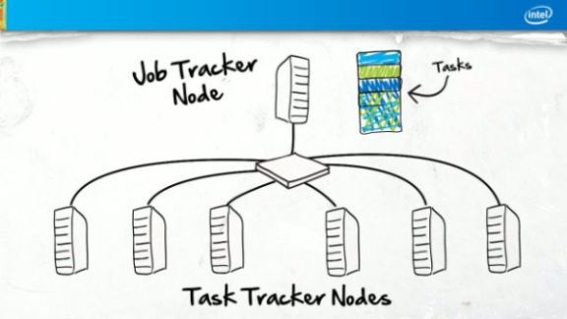
Multicomputer Systems
Figure: Hadoop Cluster
Notes:
Ref: Intel

Slide 52
Star Topology
Node
Node
Node
Node
Node
Switch
Node
Node
Node
Each node is connected to a central switch
Modern switched Ethernets (suitable for small # of nodes)
Diameter (longest path between any two nodes) is 2

Slide 53
Ring Topology
Node
Node
Node
Node
Node
Node
Node
Node
Each node is connected to two adjacent nodes
No switches are necessary (two cables out of each NIC)
Diameter is n/2

Slide 54
Grid Topology
Node
Node
Node
Node
Node
Node
Node
Node
Node
Node
Node
Node
Node
Node
Node
Node
Diameter is 2(√n -1) + 2 = 2√n
Notes:
n = number of nodes

Slide 55
Double Torus Topology
Node
Node
Node
Node
Node
Node
Node
Node
Node
Node
Node
Node
Node
Node
Node
Node
A grid with the edges circularly connected
Reduces diameter further and improves fault tolerance

Slide 56
Cube Topology
Node
Node
Node
Node
Node
Node
Node
Node
Diameter is 3 (corner to opposite corner)

Slide 57
Hypercube Topology
A 4-dimensional hypercube is shown (n=16)
Diameter scales with dimension of the hypercube (log₂n)

Slide 58
Parallel Benchmarks
Self Study
Linpack: matrix linear algebra
SPECrate: parallel run of SPEC CPU programs
Job-level parallelism
SPLASH: Stanford Parallel Applications for Shared Memory
Mix of kernels and applications, strong scaling
NAS (NASA Advanced Supercomputing) suite
computational fluid dynamics kernels
PARSEC (Princeton Application Repository for Shared Memory Computers) suite
Multithreaded applications using Pthreads and OpenMP
§6.10 Multiprocessor Benchmarks and Performance Models

Slide 59
Code or Applications?
Self Study
Traditional benchmarks
Fixed code and data sets
Parallel programming is evolving
Should algorithms, programming languages, and tools be part of the system?
Compare systems, provided they implement a given application
E.g., Linpack, Berkeley Design Patterns
Would foster innovation in approaches to parallelism

Slide 60
Modeling Performance
Self Study
Assume performance metric of interest is achievable GFLOPs/sec
Measured using computational kernels from Berkeley Design Patterns
Arithmetic intensity of a kernel
FLOPs per byte of memory accessed
For a given computer, determine
Peak GFLOPS (from data sheet)
Peak memory bytes/sec (using Stream benchmark)

Slide 61
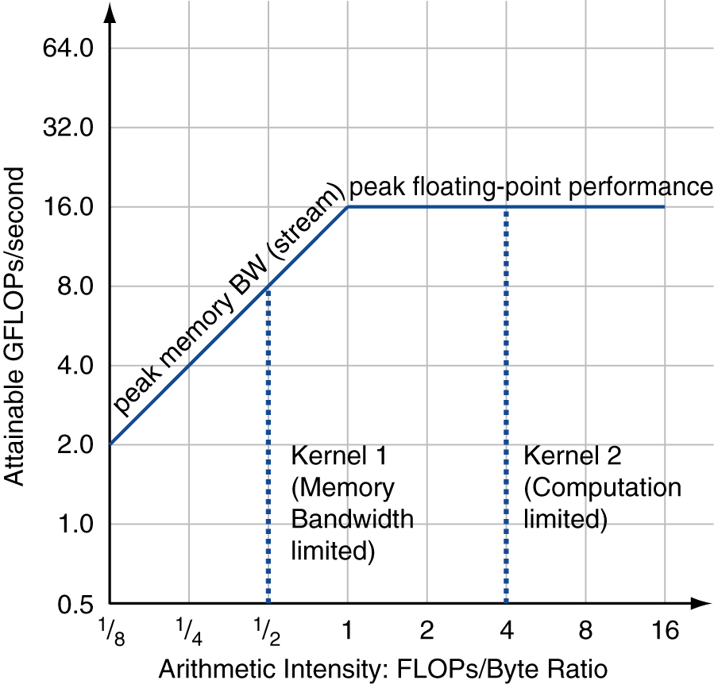
Roofline Diagram
Self Study
Attainable GPLOPs/sec
= Max ( Peak Memory BW × Arithmetic Intensity, Peak FP Performance )

Slide 62
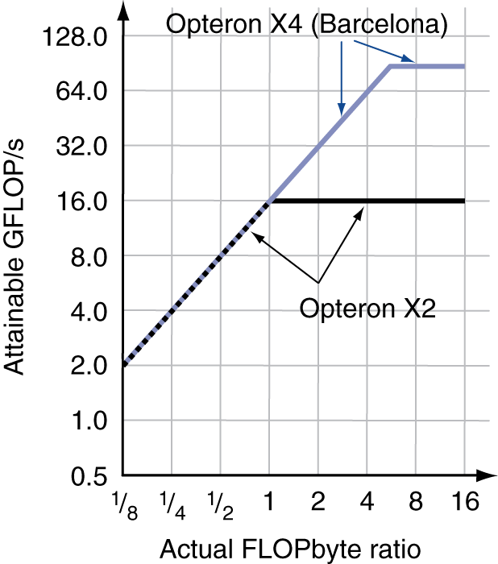
Comparing Systems
Self Study
Example: Opteron X2 vs. Opteron X4
2-core vs. 4-core, 2× FP performance/core, 2.2GHz vs. 2.3GHz
Same memory system
To get higher performance on X4 than X2
Need high arithmetic intensity
Or working set must fit in X4’s 2MB L-3 cache

Slide 63
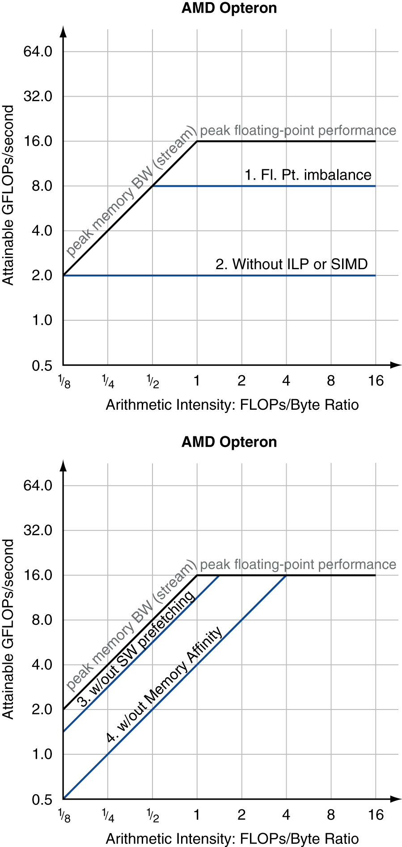
Optimizing Performance
Self Study
Optimize FP performance
Balance adds & multiplies
Improve superscalar ILP and use of SIMD instructions
Optimize memory usage
Software prefetch
Avoid load stalls
Memory affinity
Avoid non-local data accesses

Slide 64
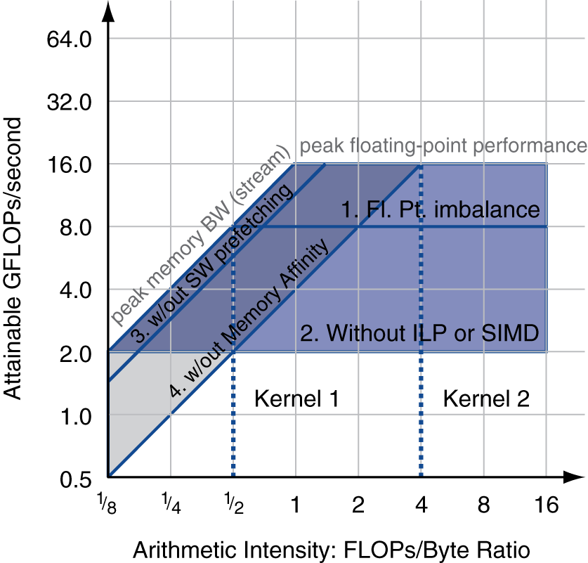
Optimizing Performance
Self Study
Choice of optimization depends on arithmetic intensity of code
Arithmetic intensity is not always fixed
May scale with problem size
Caching reduces memory accesses
Increases arithmetic intensity

Slide 65
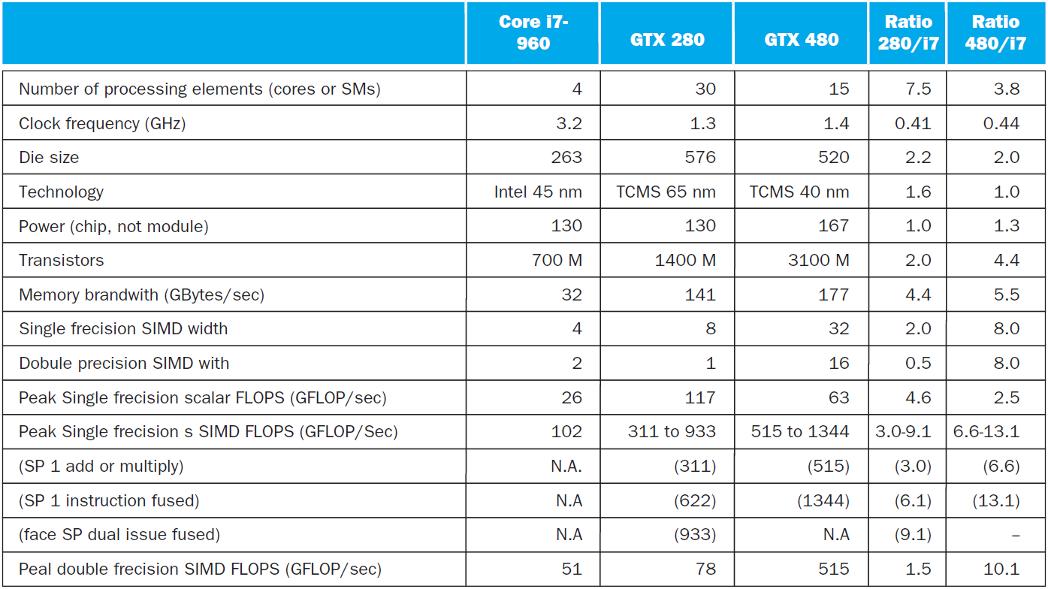
i7-960 vs. NVIDIA Tesla 280/480
Self Study
§6.11 Real Stuff: Benchmarking and Rooflines i7 vs. Tesla

Slide 66
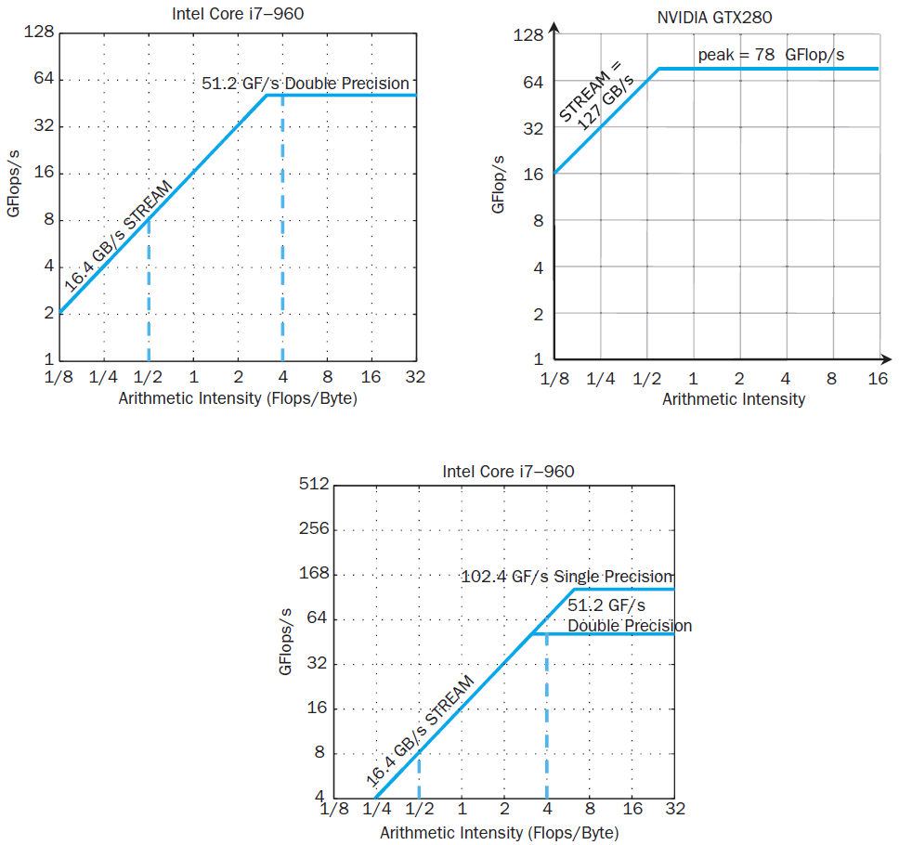
Rooflines
Self Study

Slide 67
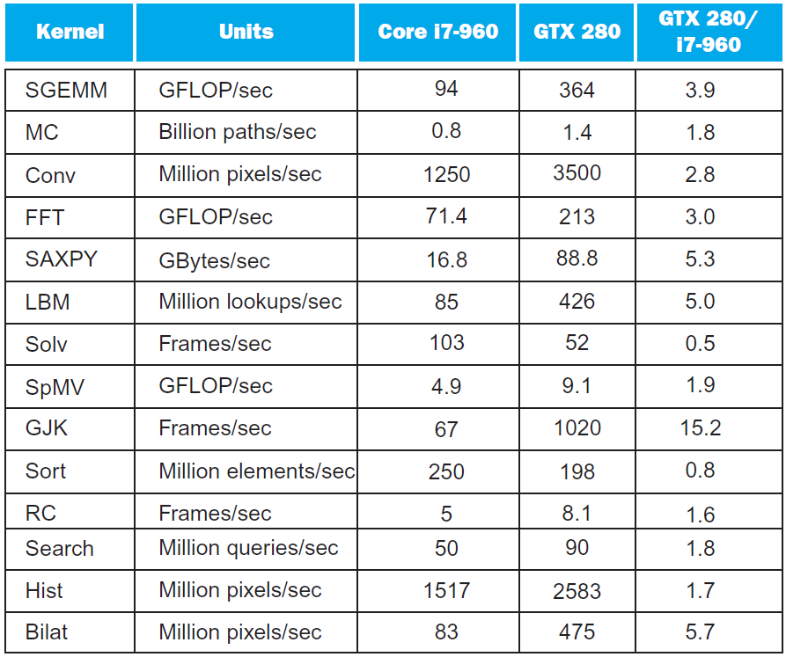
Benchmarks
Self Study

Slide 68
Performance Summary
Self Study
GPU (480) has 4.4 X the memory bandwidth
Benefits memory bound kernels
GPU has 13.1 X the single precision throughout, 2.5 X the double precision throughput
Benefits FP compute bound kernels
CPU cache prevents some kernels from becoming memory bound when they otherwise would on GPU
GPUs offer scatter-gather, which assists with kernels with strided data
Lack of synchronization and memory consistency support on GPU limits performance for some kernels

Slide 69
Multi-threading DGEMM
Self Study
Use OpenMP:
void dgemm (int n, double* A, double* B, double* C)
{
#pragma omp parallel for
for ( int sj = 0; sj < n; sj += BLOCKSIZE )
for ( int si = 0; si < n; si += BLOCKSIZE )
for ( int sk = 0; sk < n; sk += BLOCKSIZE )
do_block(n, si, sj, sk, A, B, C);
}
§6.12 Going Faster: Multiple Processors and Matrix Multiply

Slide 70
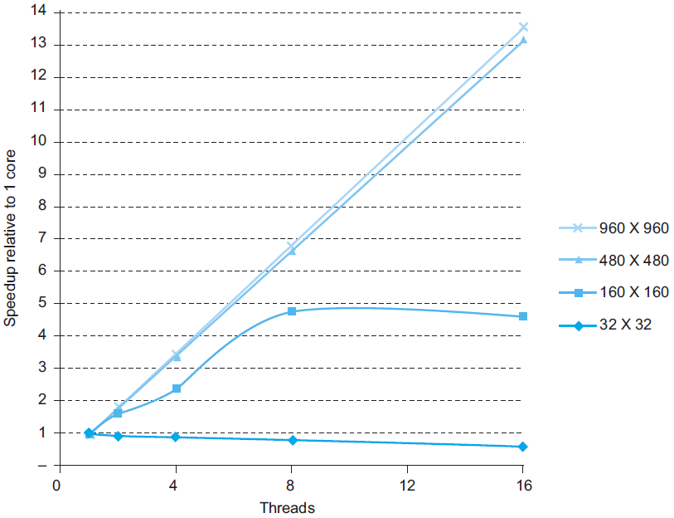
Multithreaded DGEMM
Self Study

Slide 71
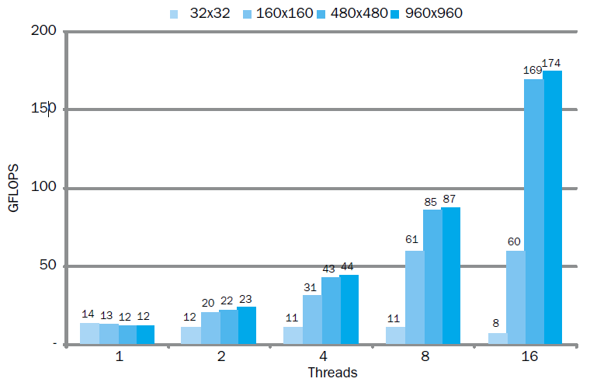
Multithreaded DGEMM
Self Study

Slide 72
Fallacies
Self Study
Amdahl’s Law doesn’t apply to parallel computers
Since we can achieve linear speedup
But only on applications with weak scaling
Peak performance tracks observed performance
Marketers like this approach!
But compare Xeon with others in example
Need to be aware of bottlenecks
§6.13 Fallacies and Pitfalls

Slide 73
Pitfalls
Self Study
Not developing the software to take account of a multiprocessor architecture
Example: using a single lock for a shared composite resource
Serializes accesses, even if they could be done in parallel
Use finer-granularity locking

Slide 74
Concluding Remarks
Goal: higher performance by using multiple processors
Difficulties
Developing parallel software
Devising appropriate architectures
SaaS (Software as a Service) importance is growing and clusters are a good match
Performance per dollar and performance per Joule drive both mobile and WSC (Warehouse Scale Computer) hardware, and parallelism is the key to delivering on those sets of goals.
§6.14 Concluding Remarks

