Slide 1
CSCI 4401/5401: Principles of Operation Systems
James Wagner
University of New Orleans
Week 1, Lecture 2
August 17th, 2023

Slide 2
Announcements
Assignment 1 is due Monday, September 4th @ 11:59pm
Using your UNO credentials, log into https://cyber-range.cs.uno.edu/
I cannot add you to the class until you log in.
Do this right away!

Slide 3
What We’re Doing Today
Lecture 1 Review
Computer Hardware Review
Interrupts
System Calls
Virtual Machines

Slide 4
Lecture 1 Review

Slide 5
Review
What are the two main purposes of an OS?
In a multiprogramming or time-sharing environment, many users share the same system simultaneously. What are some security problems with this?

Slide 6
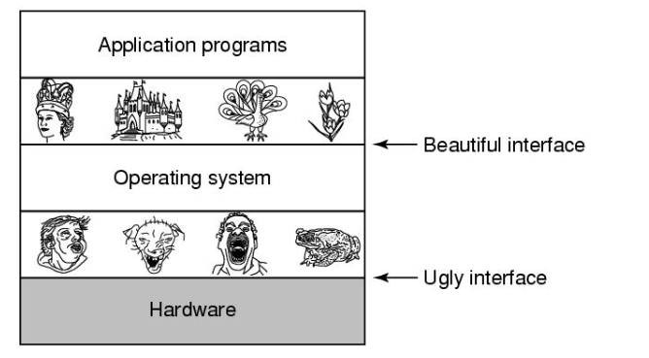
Purpose #1: Resource Abstraction
How does an OS abstract file creation, reads, and writes?
An application does not need to know how a device works to read a file.

Slide 7
Purpose #2: Resource Manager
What would happen if two programs are allowed to print simultaneously?
The OS provides controlled allocation of processors, memory, and I/O devices to programs
Some resources …
Can be shared, e.g., each process gets its own memory allocation
Must take turns, e.g., print jobs

Slide 8
Multiprogramming & Time-sharing security problems
Privacy – who can read who’s data?
Integrity – who can modify someone else’s data?
Denial of service – prevent another user from using the system?

Slide 9
Computer Hardware Review

Slide 10
Motivation
An operating system extends a computer’s instruction set and manages resources.
Must know a lot about hardware
We are reviewing hardware to know how the operating system sees it.

Slide 11
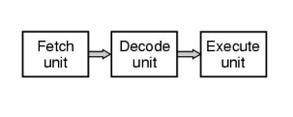
Processors
CPU -> “brain”
Pipelining: fetch instructions and execute them
Fetch instruction₁ from memory
Decode instruction₁
Execute instruction₁
Move to instruction₂

Slide 12
Processors: Registers
CPU registers store variables and temporary results.
Instructions usually say what data to load from memory into a register
Several special registers are made available to programs
Program Counter: memory address of the next instruction
Stack Pointer: points to the top of the current stack in memory.
Process stack: input parameters, local variables, temp variables, variables not typically stored in registers
The OS must be aware of all registers to stop/restart processes
Can be expensive…

Slide 13
Processors: Multithreading
Thread: lightweight process (more in weeks 2 & 3)
Multithreading allows the CPU to hold the state of two threads
Switching back and forth is much faster than stop/restart process
One process at a time is still running but OS sees each thread as a separate CPU.
Example: 2 CPUs each with 2 threads:
OS sees 4 CPUs
Anyone see a trade-off?

Slide 14
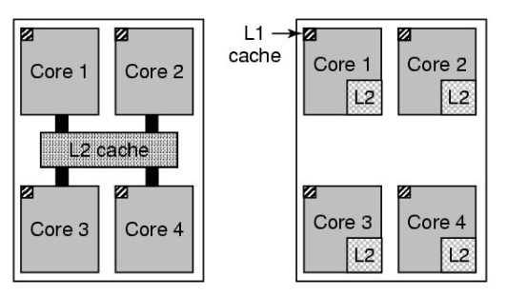
Processors: Multicores
CPU chips have 4, 8, or more complete processors (or cores)
Each core has own independent CPU
Caches can be shared or separate
Shared
L2 cache (e.g., Intel)
Separate
L2 caches
(e.g., AMD)
Quad-core
chips
Trade-offs?

Slide 15
Memory
We don’t want to hold up the CPU. L1 and L2 caches are fast but can only store so much.
What can we use that is fast, larger, and cheaper?

Slide 16
Memory: Storage Hierarchy
L1/L2 Cache
Registers
Main Memory
Secondary Storage/Magnetic disk
Magnetic Tape
Typical Access Time
Typical Capacity
1 nanosecond
< 1 KB
2 nanoseconds
32 KB/4 MB
10 nanoseconds
1 – 64 GB
10 milliseconds
128 - 5000 GB
100 seconds
500 - 1000 GB

Slide 17
Memory: Storage Hierarchy (v2)
Faster, Expensive
CPU Registers
Volatile
Caches
RAM
SSD
Non-Volatile
HDD
Tapes, Network Storage
Slower, Cheaper
Magnetic tape is cheaper than disk but no built-in read/write components. Why would anyone use it?

Slide 18
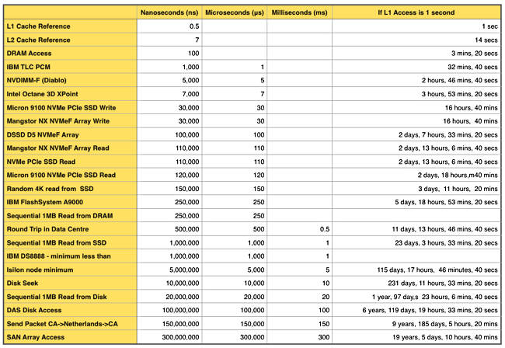
Storage Access Latency

Slide 19
Memory: Caching
Caching
Use of higher-speed memory to hold frequently-accessed data
Can be applied at different level of the hierarchy
Introduces memory management complexity
Data must be simultaneously stored at multiple levels: cache consistency
Requires a cache management policy

Slide 20
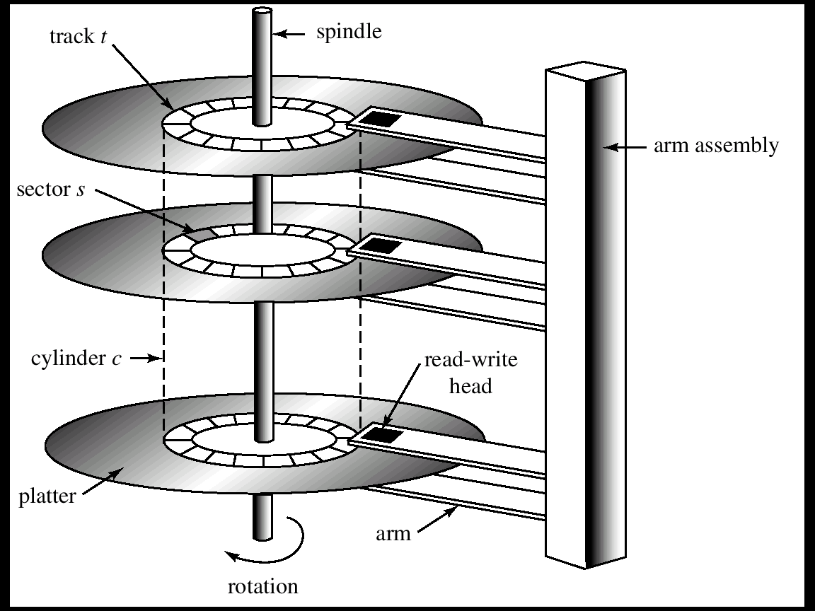
Disks: Why are they so slow?

Slide 21
I/O Devices
I/O devices interact heavily with the OS. They have two parts:
Controller
Device itself
Controller: a set of chips that physically controls the device and accepts commands from the OS.
Device controller (hardware) is an intermediary between Device and OS
The driver (software) is an interface between controller and OS
Example: OS sends command to read Sector #11,206 from Disk #2. The controller converts this command into a cylinder, sector, and read/write head.
I/O communication is done across buses
Three ways to perform I/O:
Busy waiting
Interrupts
Direct Memory Access

Slide 22
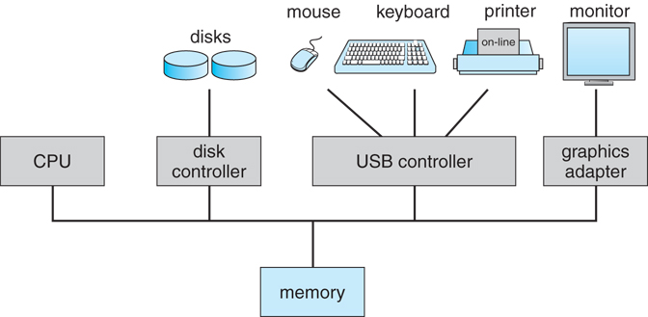
I/O: Buses

Slide 23
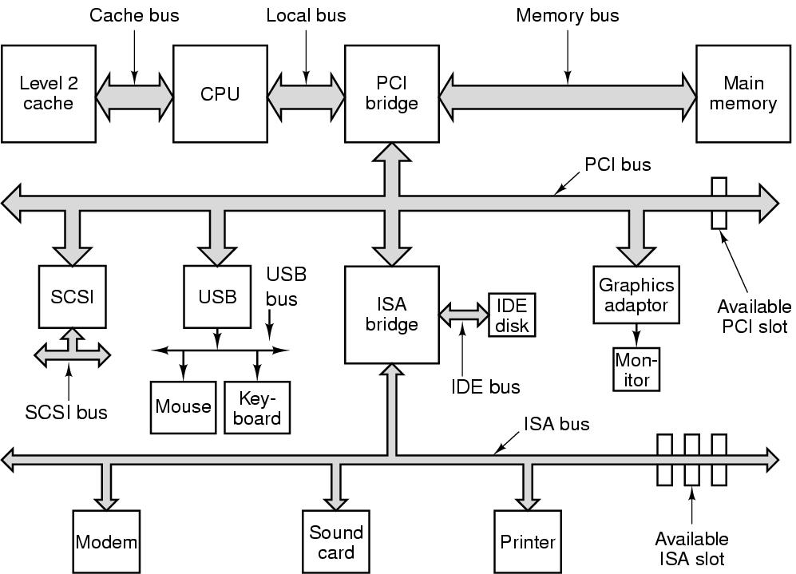
I/O: Buses
Many different buses with different speeds and functions.
PCIe – main bus, graphics, ethernet
USB – USB devices
SATA – HDDs and DVDs
The structure of a large
Pentium system.

Slide 24
I/O: Busy Waiting
Simplest way to do I/O
Ties up the I/O until device is finished
Not commonly used
User program issues a system call
The kernel translates this system call to the appropriate driver
The driver starts the I/O device
Sit in a loop and CPU polls the device until it is done

Slide 25
I/O: Interrupts
Operating systems are interrupt driven
Respond to events
When the device has data for the processor, the device driver sends an interrupt to the CPU.
Eliminates need for busy wait
Servicing interrupts must be quick!
Devices have limited storage buffers -> data can be overwritten
Examples:
A key is pressed on keyboard
Mouse is moved/clicked

Slide 26
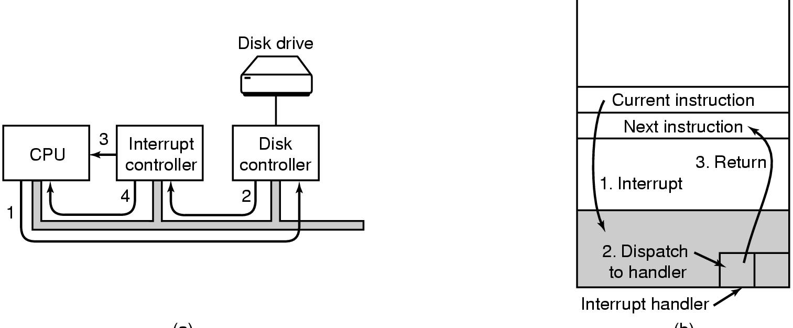
I/O: Receiving Interrupts
1. Driver tells the controller what to do by writing into device registers
Controller then starts the device

Slide 27
I/O: Receiving Interrupts
2. The controller finishes reading/writing data it has been told to transfer. Then it signals the interrupt controller via bus lines.
The interrupt controller could be busy

Slide 28
I/O: Receiving Interrupts
3. If the Interrupt Controller is ready, it accepts the interrupt and asserts a pin on the CPU chip

Slide 29
I/O: Receiving Interrupts
4. The interrupt controller puts the number of the device on the bus so the CPU knows which device just finished.

Slide 30
I/O: Handling Interrupts
When a CPU accepts an interrupt:
Finish current instruction
The OS saves the current CPU state (registers and program counter)
Move to the interrupt handler and learns the status of the device.
When the handler is finished, move back to next instruction (for the previously running program)

Slide 31
I/O: Direct Memory Access (DMA)
Our third way to perform I/O.
Typically used for block devices (storage devices or buffering is used)
Don’t interrupt the CPU for every I/O transfer
The device controller transfers data directly into memory
Generate an interrupt when the device is done (usually 1 interrupt/block)

Slide 32
I/O: Direct Memory Access (DMA)
DMA controller is used for the flow of data between a device and memory
CPU sets up DMA controller by indicating
How much data to transfer
Where on the device to transfer to/from
Where in memory to transfer to/from
DMA controller performs the data transfer and sends an interrupt
CPU is free for other work while I/O is happening

Slide 33
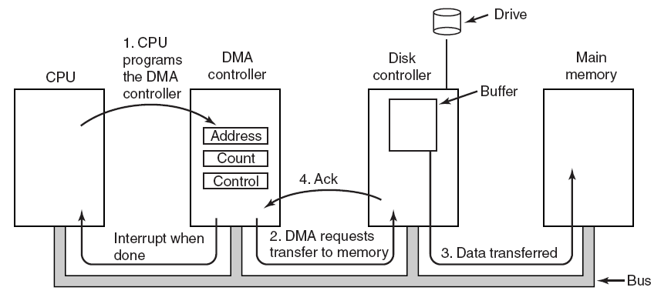
I/O: Direct Memory Access (DMA)

Slide 34
Operating System Services

Slide 35
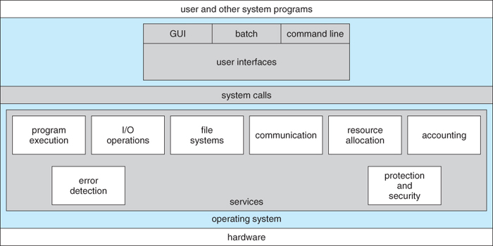
View of OS Services

Slide 36
OS Services: UI’s
Means by which users can issue commands to the system.
Can be
command-line interface
GUI
batch commands (punch card days)

Slide 37
OS Services: Program Execution
Loads programs into RAM
Runs programs
Terminates programs (normally or abnormally)

Slide 38
OS Services: I/O Operations
Transfers data to and from I/O devices.
Keyboards, terminals, printers, storage devices, etc.

Slide 39
OS Services: File-System Manipulation
Maintains a directory and a subdirectory structure.
These structures map the file names to specific blocks of data storage.

Slide 40
OS Services: Communication
Inter-process communication (IPC) – either between process running on the same processor or separate processors.
Done with shared memory, message passing, or pipes

Slide 41
System Calls

Slide 42
System Calls
They provide a means for programs to call upon OS services.

Slide 43
Example
We have a simple program that reads data from one file and copies it to another file.
Let’s say the program prompts the user for the two file names.
Our program writes a prompting message on the screen (a system call)
Reads the characters from the keyboard (a system call)
Next, the program opens the input file (a system call) and creates the output file (a system call).
Next, the program enters a loop to read the input file (a system call) and writes to the output file (a system call).
Finally, the program closes both files (a system call).

Slide 44
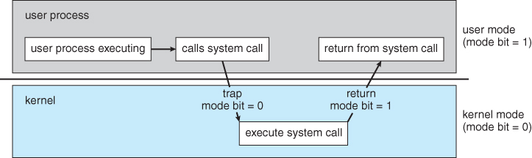
User Mode and Kernel Mode
When a user application requests a service from the OS (via a system call), it transitions from user mode and passes control over to the OS in kernel mode.

Slide 45
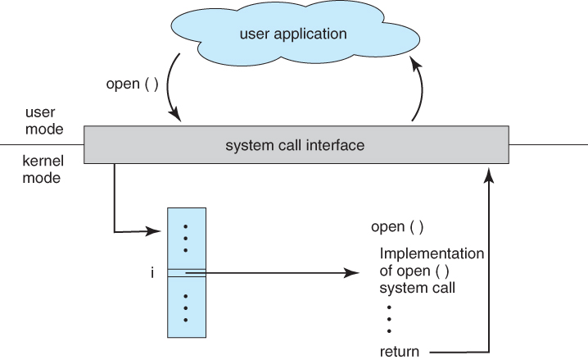
System Call Interface
The use of an API allows for better program portability – OS looks up calls in a table.

Slide 46
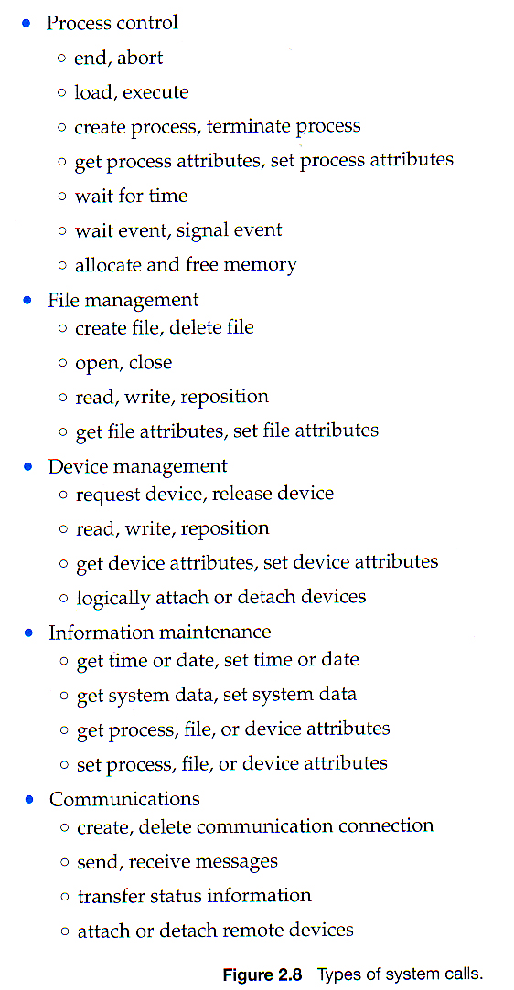
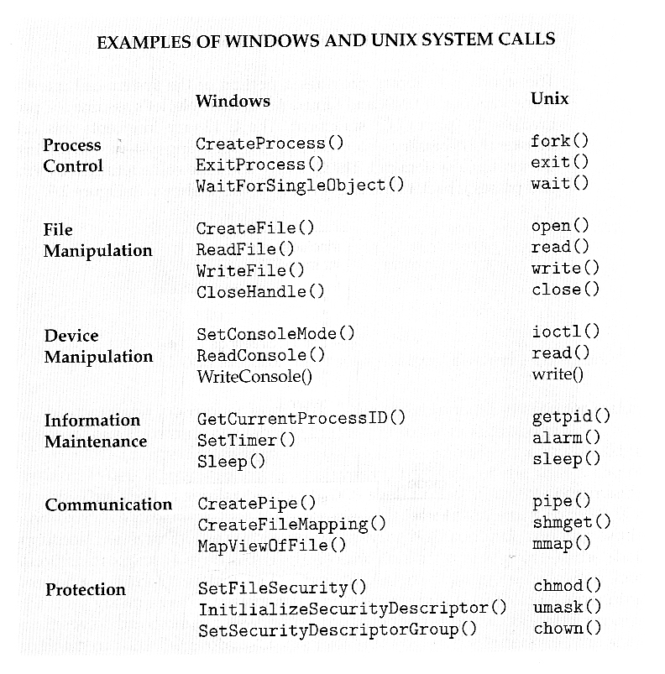
Types of System Calls

Slide 47
Virtual Machines

Slide 48
VM: Concepts
VM’s provide an interface that looks like independent hardware to multiple different OSes running simultaneously on the same physical hardware.
Each OS believes that it has access to and control over its own CPU, RAM, I/O devices, hard drives, etc.

Slide 49
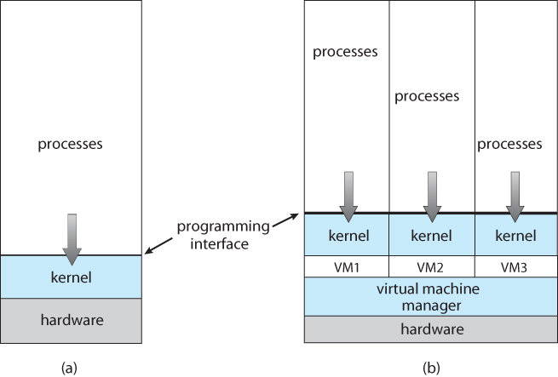
General VM Functionality

Slide 50
VM Benefits
Each OS runs independently offering protecting and security benefits.
Perform OS development without affecting other users using the real machine.

Slide 51
Example: VMware
One method to support virtualization is to have the virtualization tool run in user mode as an application on top of the host OS.
The VM believes it is running on bare hardware but is in fact running inside a user application.
The physical disk is really just a file.
VMware Workstation is a popular tool that takes this approach.

Slide 52
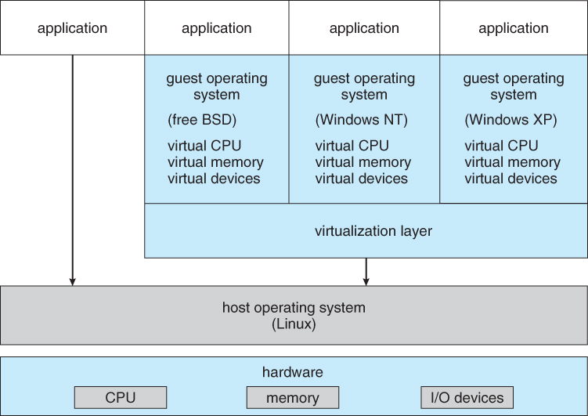
VMware Architecture

Slide 53
Summary/Review
How is I/O performed?
Hint: We discussed three but only two are relevant.
What is a system call?

Slide 54
What’s Next?
We will begin process management, which will take us until the midterm. Topics include:
Processes
Threads
Process Synchronization
CPU Scheduling
Deadlocks

Slide 55
Process Concept

Slide 56
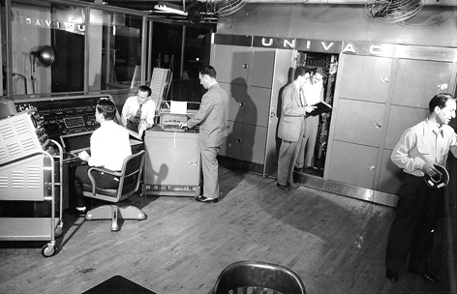
Motivation
Early computer systems executed one program at a time
This program had
complete control of the system
Unrestricted access to resources

Slide 57
Motivation
Our computers now execute multiple programs concurrently.
A need to compartmentalize programs led to the notion of a process.
We can potentially have processes run concurrently with the CPU switching between them.
Make the computer more productive!

Slide 58
Our Goal(s): Understand …
The notion of a process.
The various processes features. Including:
Scheduling
Creation/termination
Communication between processes

Slide 59
Class Reminders
Read Chapters 1.1 – 1.6 of Tanenbaum
Assignment 1 is due Monday, 9/4 @ 11:59pm

