Slide 1
CSCI 4401/5401: Principles of Operation Systems
James Wagner
University of New Orleans
Week 2, Lecture 3
August 22nd, 2023

Slide 2
Announcements
Assignment 1 is due Monday, 9/4 @ 11:59pm
The department is looking for student mentors for CSCI 1583 through CSCI 2467
8 hrs/week for 14 weeks
Pay is $15/hr
Minimum qualification is passed CSCI 2125 with a C or better
If interested fill out this form
Do it right away. The selection process is starting this week.
Dr. Summa will oversee the selection process

Slide 3
Upcoming Schedule
Week 2: Processes – fork(), process communication
Week 3: Threads – user vs kernel, models, libraries, examples
Week 4: CPU Scheduling – algorithms, problems, synchronization, critical section.
Week 5: Critical Section – solutions (software, hardware, semaphores, monitors), Java monitors, transactions
Week 6: Deadlocks – characteristics, methods, prevention, avoidance, detection & recovery
Weeks 7/8: TBD - buffer days, start main memory, review & midterm
Quiz 1 (take-home) will be out next week. Covers Lectures 1 – 4.
HW 2 will be posted next week if you want to start early.

Slide 4
What We’re Doing Today
Define Processes
Stack vs Heap Example
Process States
Process Control Blocks
Process Scheduling
Operations on Processes

Slide 5
Process Concept

Slide 6
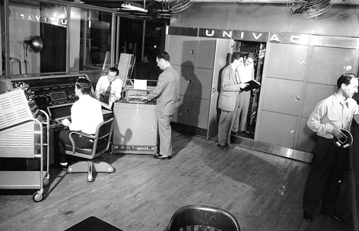
Motivation
Early computer systems executed one program at a time
This program had
complete control of the system
Unrestricted access to resources

Slide 7
Motivation
Our computers now execute multiple programs concurrently.
A need to compartmentalize programs led to the notion of a process.
We can potentially have processes run concurrently with the CPU switching between them .
Make the computer more productive!

Slide 8
Our Goal(s): Understand …
The notion of a process.
The various processes features. Including:
Scheduling
Creation/termination
Communication between processes

Slide 9
Process Concept
A process is …
A program is …
program in execution.
active (contains a program counter to the next instruction)
more than just code
a process when it is loaded into memory.
passive (e.g., a file on disk)
code
- Two processes may be associated with the same program, but they are still different execution sequences

Slide 10
Process: More than just code
Address (hex)
Max(FFFF)
Start(0000)
Each process has its own address space.
This address space is protected from those of other processes.
Stack
Address
Space
Heap
Data
Text

Slide 11
Process in memory: Text Segment
Address (hex)
Max(FFFF)
Start(0000)
Compiled program code.
i.e., the instructions
Static & read-only
Multiple processes can share the same text segment
2nd copy of program is executed concurrently
OS uses a pointer instead of duplicate text segment
Stack
Address
Space
Heap
Data
Text

Slide 12
Process in memory: Data Segment
Address (hex)
Max(FFFF)
Start(0000)
Stack
Global variables
A process can request more data segment space:
Heap
Address
Space
Heap
Data
Text

Slide 13
Process in memory: Heap
Address (hex)
Max(FFFF)
Start(0000)
Stack
Grows from the data segment
Added by a process with memory allocation routines
E.g., malloc() or calloc()
Need to deallocate with free()
Address
Space
Heap
Data
Text

Slide 14
Process in memory: Stack Segment
Address (hex)
Max(FFFF)
Start(0000)
Stack
Local variables, function parameters, return addresses
Address
Space
Heap
Data
Text

Slide 15
Stack vs Heap Example
Stack
Heap
CPU manages stack memory for you
When a function declares a variable, it is pushed onto stack
When a function exits, those variables are freed (i.e., deleted)
It does have size limits.
Not managed for you.
To allocate memory use malloc() or calloc()
YOU are responsible for freeing memory with free()
Memory leak – wasted memory
Size limit is your computers physical limitations.

Slide 16
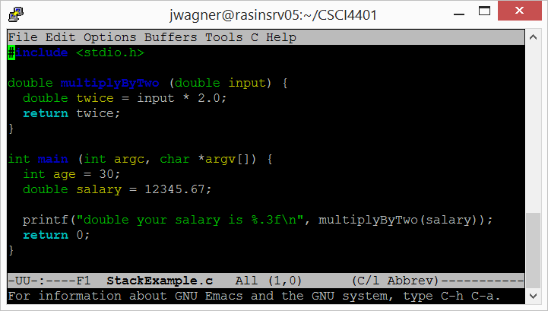
Stack Example
Pushed onto stack as soon as main() allocates them

Slide 17
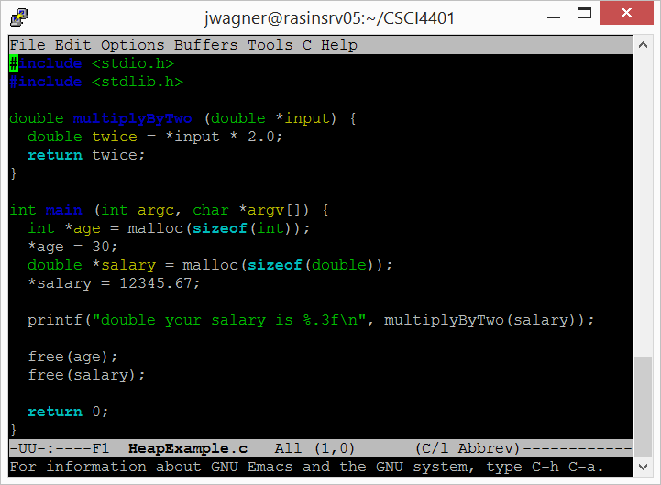
Heap Example
Use malloc() to allocate memory on the heap
Stars are pointers
malloc() deals w/ pointers
Use free() to deallocate memory on the heap

Slide 18
Stack vs. Heap: When to use which
Stack
Heap
Small values for function’s lifetime
Easier to manage
You have a large block of data (e.g., array, dictionary)
Keep a variable around for a long time (similar to a global variable)

Slide 19
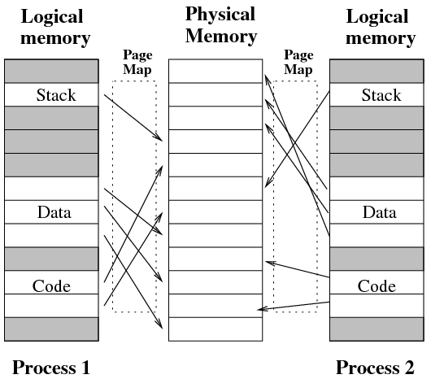
Logical vs Physical Memory
Note that we have been considering logical memory.
A process is likely to be fragmented in physical memory.
We will come back to this…

Slide 20
Process States

Slide 21
Process States
As a process executes it changes its state (or current activity).
Process states:
New – it is being created
Running – instructions are being executed
Waiting – it is waiting for an event (e.g., I/O completion -> disk read completes)
Ready – it is waiting to be assigned to a CPU, but another process is using it
Terminated – it has finished execution
Note: these names are arbitrary, but the concepts are found across systems.

Slide 22
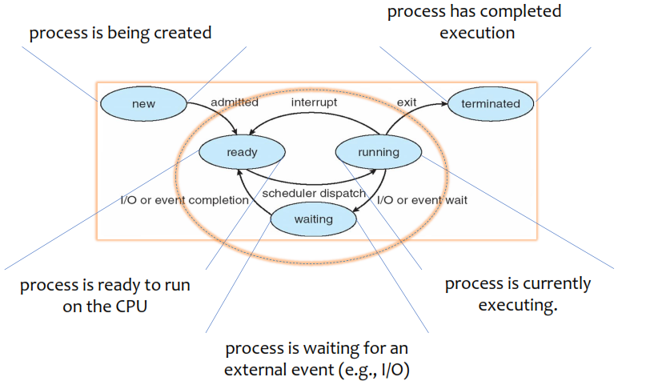
Process States

Slide 23
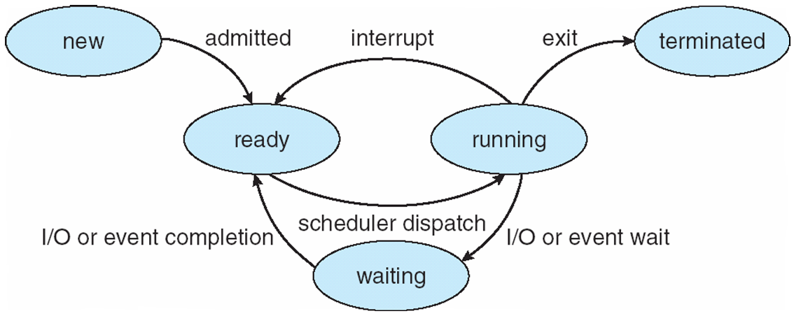
Process States: Ready
Process has been allocated all necessary resources except processor.
It’s waiting for processor allocation.
It can execute immediately when the processor is allocated.
Transition from ready to running state
Many processes can be in the ready state.

Slide 24
Process States: Running
The process owns the processor now
Running -> Ready
An interrupt is generated
Running -> Waiting
Cannot proceed until it gets a resource (e.g., file)
Only one process can be in the running state (for a given processor).

Slide 25
Process States: Waiting
The process has requested some resource other than processor or memory and it is waiting for them.
Waiting -> Ready
Resource is now available and the process has acquired it.
Many process can be in the waiting state.

Slide 26
Process Control Blocks

Slide 27
Process State
The process context is all the information that describes the exact state of a process.
If we take a snapshot of the process state, we can freeze it and restart it.
The context information from that snapshot is stored in a process control block (PCB).

Slide 28
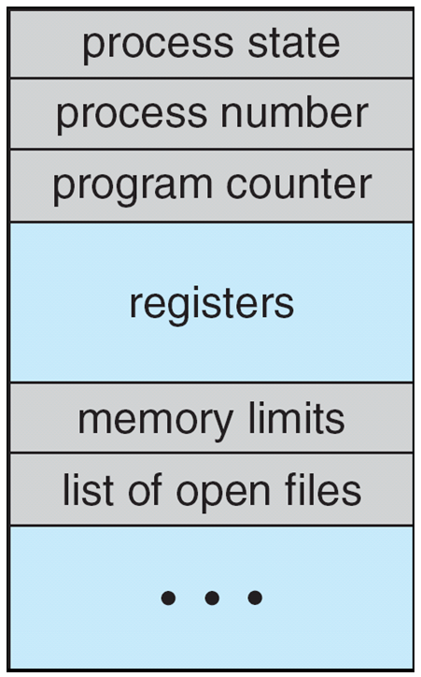
Process Control Block (PCB)
Process State: new, ready, running, waiting
Program Counter: the address of the next instruction.
CPU Registers: e.g., stack pointer
Memory-management information: e.g., page tables
I/O status information: e.g., a list of I/O devices allocated to the process, a list of open files

Slide 29
Context Switching
Context switching: the process control blocks must be saved when an interrupt occurs.
This allows a process to be continued later.
Three major events trigger a context switch:
I/O interrupts
System Calls -> switching from user mode to kernel mode
CPU scheduler switches out the process

Slide 30
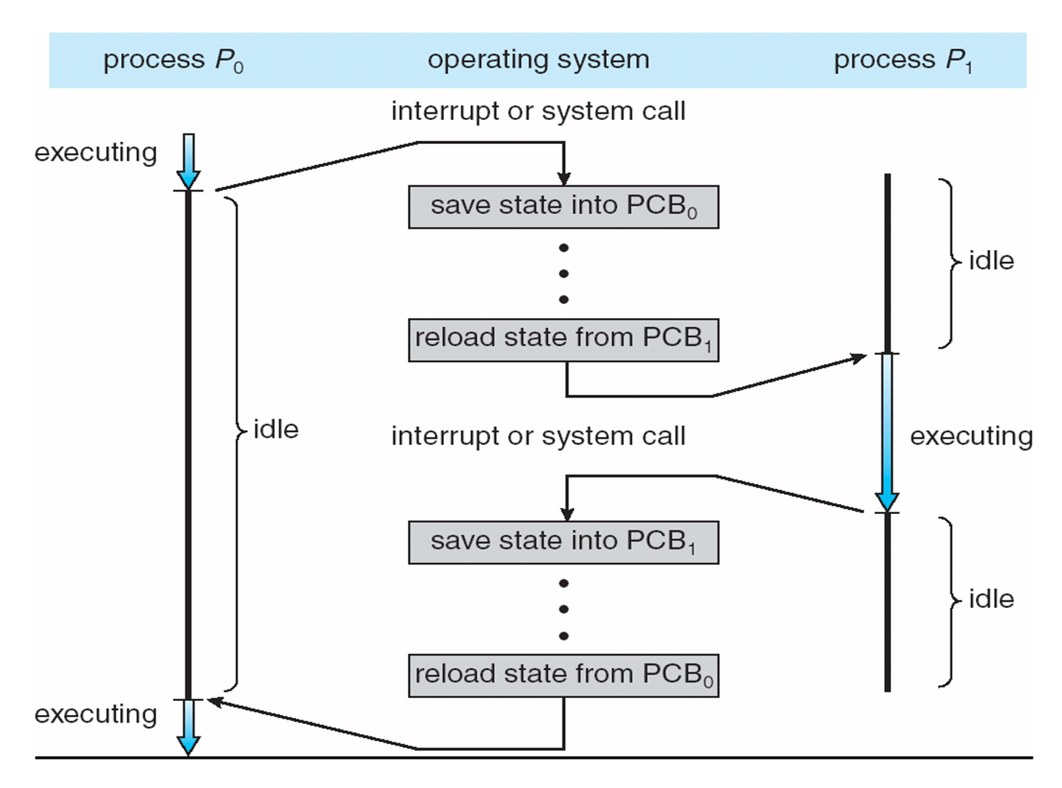
Context Switching
time

Slide 31
Context Switching
Step1. Update P₀’s PCB, save it, and move it to a queue
time

Slide 32
Context Switching
- Re-map the physical memory pages
- Re-load the registers
- Return to next process instruction
Step2. Select P₁ for execution, update its PCB (now running state), execute
time

Slide 33
Context Switching
Step3. Update P₁’s PCB, save it, and move it to a queue
time

Slide 34
Context Switching
Step4. Select P₀ for execution, update its PCB (now running state), execute
time

Slide 35
Process Scheduling

Slide 36
Motivation
We want to keep the CPU busy – have a process running at all times.
How does the CPU keep track of processes and decide what process gets executed next?
We will get more into CPU scheduling before the midterm, but for now …

Slide 37
Scheduling Queues
As processes enter the system, they are added to a job queue.
All processes in the system are recorded in the job queue.
Ready queue: a list of processes that are ready or waiting to execute
Linked list
RQ header contains pointers to next and previous PCBs on the list.
Device queue: list of processes waiting for a particular I/O device.
task 0
task 1
task 2
…
task N

Slide 38
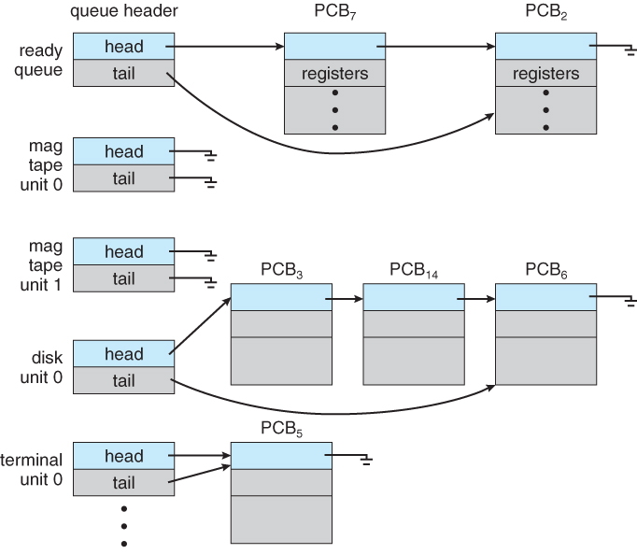
Ready Queue and Device Queues

Slide 39
Schedulers
Processes migrate among various scheduling queues.
The OS selects processes from these queues using a scheduler.
Three types of schedulers:
Long-term
Short-term (or CPU)
Medium-term

Slide 40
Long-Term Scheduler
Selects processes from a batch to load into memory for execution.
Typically, used for batch processing systems.
Usually doesn’t exist on most UNIX or Windows systems.

Slide 41
Short-Term (CPU) Scheduler
Selects the next process to be executed and allocates the CPU.
Happens frequently and must happen fast.
Example:
100 milliseconds for a process to complete
If it takes 10 milliseconds to decide to execute the next process …
10/(100 + 10) = 9% of the CPU is wasted on scheduling work

Slide 42
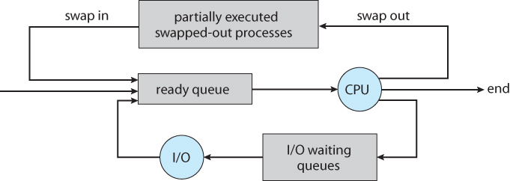
Medium-term Scheduler
Sometimes it is advantageous to remove a process from memory.
Reduce the degree of multiprogramming
Later the process can be brought back into memory and continue executing were it left off -> swapping
More when we get to memory management

Slide 43
Operations on Processes

Slide 44
Motivation
Our processes execute concurrently; they may be created & deleted dynamically.
We need mechanisms for process creation and termination.

Slide 45
Process Creation
A process may create new processes via a create-process system call – fork()
The parent and the children processes form a tree where each process is identified by a unique process identifier.
Linux process IDs:
$ps – all processes for a user
$ps aux – all processes in the system
Usually helps to pipe it to less: $ps aux | less
P
C1
C2
C11

Slide 46
Process Creation
A process may create new processes via a create-process system call – fork()
The parent and the children processes form a tree where each process is identified by a unique process identifier.
Linux process IDs:
$ps – all processes for a user
$ps aux – all processes in the system
Usually helps to pipe it to less: $ps aux | less
P
C1
C2
C11

Slide 47
System Calls: Process Management
fork() - creates a new process:
Exact duplicate of the original process (file descriptors, registers, etc.)
Parent and child process now
Execute the next instruction following the fork()
getpid() – process ID
getppid() – parent process ID
waitpid() – current (parent) process waits until the child terminates

Slide 48
Note for Example1
Everyone should have access to a Linux VM from Assignment 1.
You can also ssh into a UNO Linux server:
Download PuTTY: https://www.putty.org/
Host Name: cook.cs.uno.edu
Port: 22
Use your UNO username/password
UNIX users: $ssh cook.cs.edu –l [your UNO username]

Slide 49
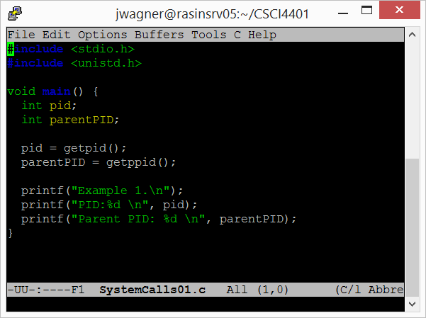
Example: Process ID

Slide 50
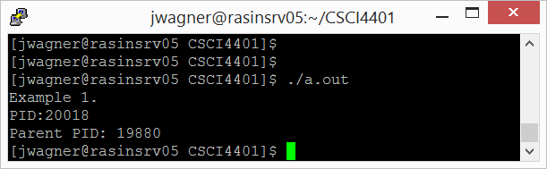
Example: Process ID
What is the parent PID?
Notes:
The parent is the shell

Slide 51
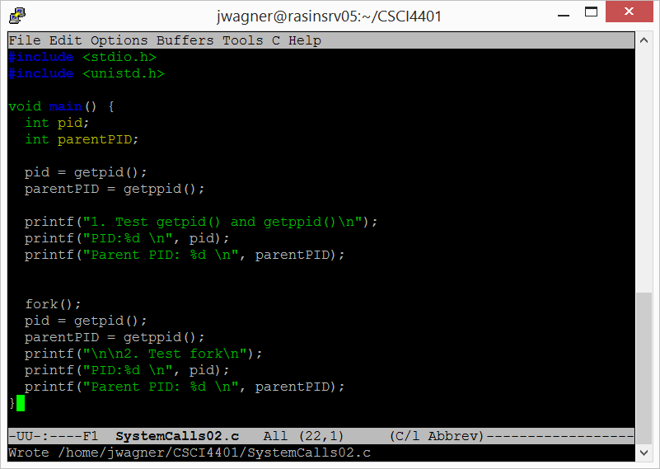
Example: Fork

Slide 52
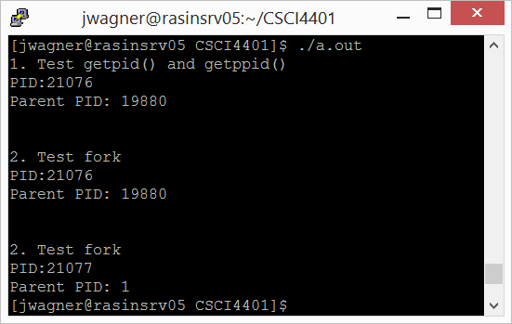
Example: Fork
Which is the parent/child?
Why parent PID = 1?
Notes:
The original parent 21076 completed. Reassigned the root process (PID = 1) as the parent

Slide 53
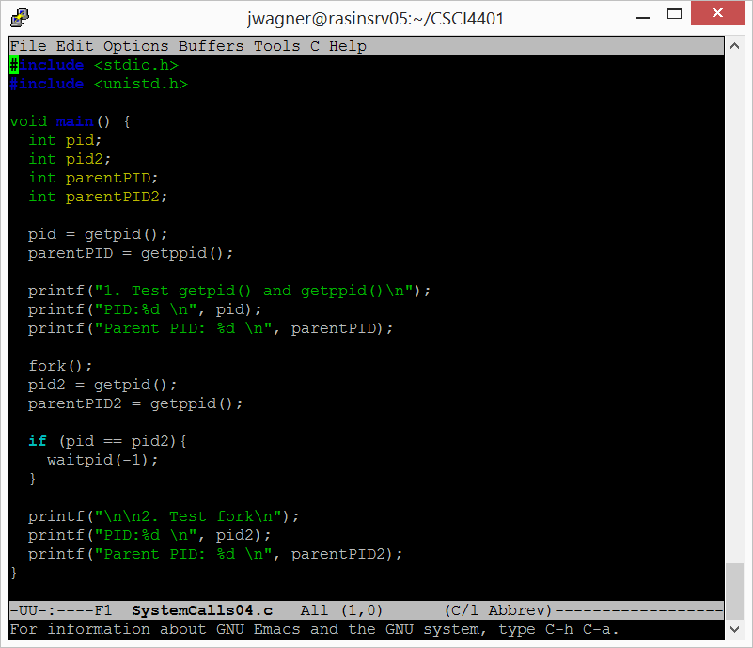
Example: Waitpid
Can wait for a specific PID or any (all) children with -1.

Slide 54
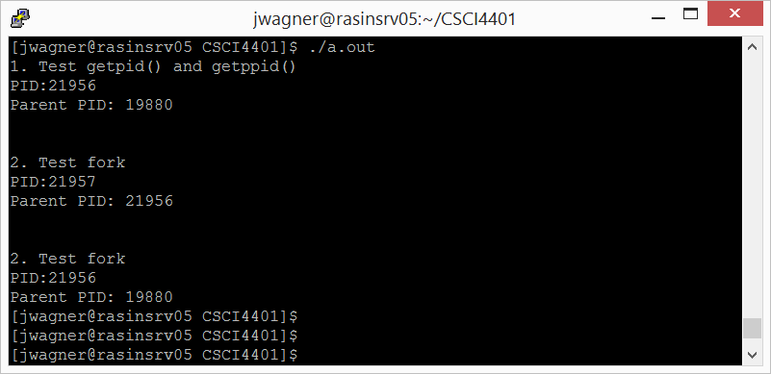
Example: Waitpid

Slide 55
Fork Tree
for (i= 1 to n){ fork() }
How many children will I get for n = 1, 2, 3, 4, etc.?

Slide 56
Fork Tree
P
N = 0
N = 1
N = 2?
P
C1

Slide 57
Fork Tree
P
N = 2
N = 3?
C11
C1
C2

Slide 58
Fork Tree
P
N = 3
Conclusion:
2^{N} – 1 children
C1
C2
C11
C111
C12
C21
C3

Slide 59
Process Termination
All good processes must come to an end. But how?
exit() system call
All process resources (memory, open files, etc.) are deallocated by the OS
Remove PCB from kernel data structures
If the OS cleans up after me, do I have to do it?
Disregarding “good programming practices”, doing it before exiting a process is a waste of time.
And as long as you don’t have other process threads remain executing
More on threads to come.

Slide 60
Summary/Review
If a process creates a new process using fork(), which process components can be shared between the parent and child?
What are some trade-offs between the stack and the heap?
What is a memory leak?
What state(s) can a process transition to from the running state?
How does an OS know how to restart a suspended process?
How many child processes are created by the following program? void main() { fork(); fork(); }
Notes:
Only Text. Each process gets its own copy of the global variables.

Slide 61
Next time
More on Processes
Finish operations on processes
Process communication

Slide 62
Class Reminders
Read Section 2.1 & 2.3.8 of Tanenbaum
Assignment 1 is due Monday, 9/4 @ 11:59pm

