Slide 1
CSCI 4401: Operation Systems
James Wagner
University of New Orleans
Week 2, Lecture 4
August 24th, 2023

Slide 2
Announcements
Assignment 1 is due Monday, 9/4 @ 11:59pm
Cyber Range access
Lecture grades are only inputted for Lectures 1 & 2
2 lectures * 4pts/lec = 8 points
Quiz 1 will be available after lecture. Due Monday, 9/4 @ 11:59pm.
Covers Lectures 1 - 4
Open book & notes. Take individually
You have 5 attempts, best score counts
1 – 5 multiple choice one answer, 6 – 10 multiple choice select all

Slide 3
What We’re Doing Today
Review Lecture 3: Processes
Interprocess communication
Introduce threads

Slide 4
Lecture 3 Review

Slide 5
Process in memory
What is the difference between a process and a program?
What does a process in memory look like? What are the different segments?

Slide 6
Process: More than just code
Address (hex)
Max(FFFF)
Start(0000)
Each process has its own address space.
This address space is protected from those of other processes.
Stack
Address
Space
Heap
Data
Text

Slide 7
Stack vs Heap Example
Stack
Heap
CPU manages stack memory for you
When a function declares a variable, it is pushed onto stack
When a function exits, those variables are freed (i.e., deleted)
It does have size limits.
Not managed for you.
To allocate memory use malloc() or calloc()
YOU are responsible for freeing memory with free()
Memory leak – wasted memory
Size limit is your computers physical limitations.

Slide 8
Processes: Context Switches
What is a context switch?
Analogy: Your brain is the processor, and you have multiple tasks.
Where is the process state stored when context switches occur?
What are the possible process states?

Slide 9
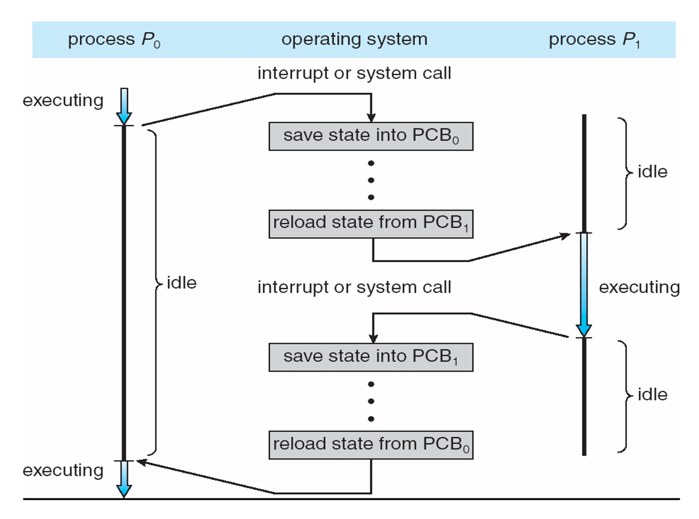
Context Switching
time

Slide 10
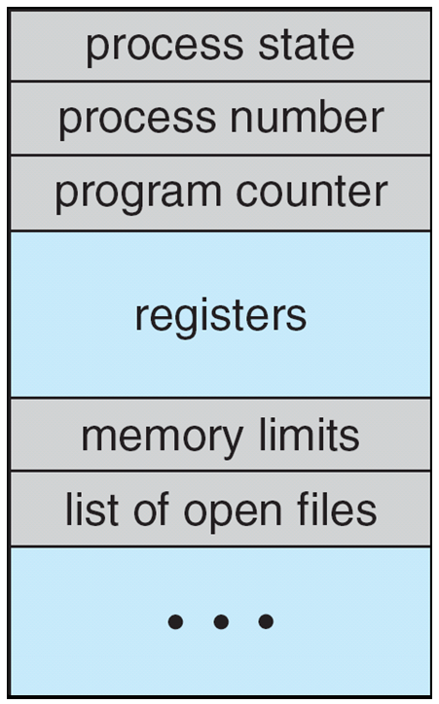
Process Control Block (PCB)
Process State: new, ready, running, waiting
Program Counter: the address of the next instruction.
CPU Registers: e.g., stack pointer
Memory-management information: e.g., page tables
I/O status information: e.g., a list of I/O devices allocated to the process, a list of open files

Slide 11
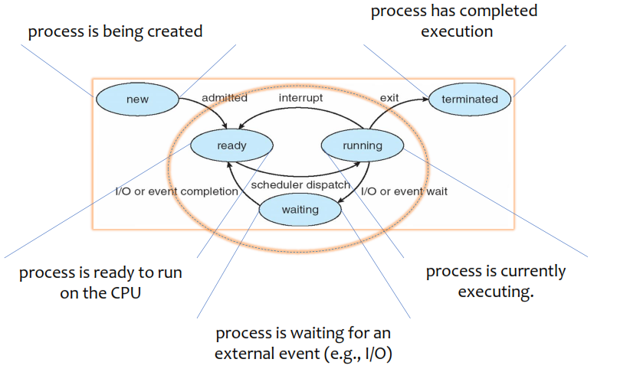
Process States

Slide 12
System Calls for Processes
What does fork() do? Why would you want to use fork()?

Slide 13
System Calls: Process Management
fork() - creates a new process:
Exact duplicate of the original process (file descriptors, registers, etc.)
Parent and child process now
Execute the next instruction following the fork()
getpid()
getppid() – parent process ID
waitpid() - parent process waits until the child terminates

Slide 14
System Calls for Processes
Both processes have separate but identical address spaces.
Examples of fork():
Your shell uses fork() to run programs – we saw an example.
Whenever you create a new process
Web servers may use fork() to create multiple server processes
if one fails, the entire server isn’t brought down
Different than handling requests with threading - fork() is not the same as multi-threading.
Fork() is best for writing servers, shells, viruses, or operating systems

Slide 15
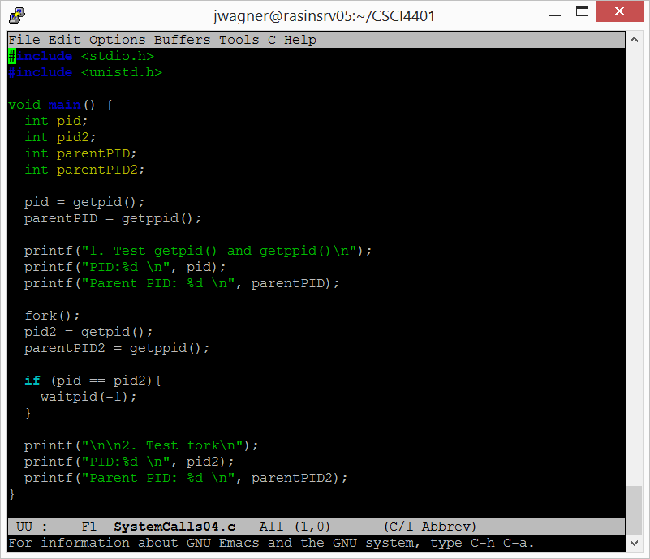
Example: Waitpid
Can wait for a specific PID or any (all) children with -1.
What is pid2? Let’s draw the steps.
P

Slide 16
Summary/Review
If a process creates a new process using fork(), which process components can be shared between the parent and child?
What are some trade-offs between the stack and the heap?
What is a memory leak?
What state(s) can a process transition to from the running state?
How does an OS know how to restart a suspended process?
How many child processes are created by the following program? void main() { fork(); fork(); }
Notes:
Only Text. Each process gets its own copy of the global variables.

Slide 17
Process States

Slide 18
Interprocess Communication

Slide 19
Introduction
Processes executing concurrently on the OS may be either:
Independent
Cooperating
Independent – cannot affect or be affected by other processes (default)
Cooperating – it can affect or be affected by other process

Slide 20
Reasons for Process Cooperation
Information Sharing – multiple users access the same data (e.g., a file)
Computation Speedup – break a large task into subtasks to run in parallel (e.g., matrix multiplication). Speedup is only useful if multiple processing elements, e.g., CPUs and I/O
Modularity – divide the system into smaller systems but still function as a whole (e.g., faults and security reasons)

Slide 21
Interprocess Communication
Interprocess Communication (IPC): a mechanism for cooperating processes to exchange data and info
Two models of IPC:
Shared memory – establish a region of memory shared by cooperating processes. Exchange data by read/writes to memory.
Message passing – communication between the processes.

Slide 22
IPC Model Trade-offs
Message Passing
Shared Memory
+ Good for exchanging small amount of data. Don’t have to worry about conflicts.
+ Easier to implement, use system calls.
- Message passing requires kernel intervention (system calls).
+ Much faster
+ System calls are only needed to establish shared memory regions.
- Need to make sure both processes aren’t trying to access shared memory concurrently.

Slide 23
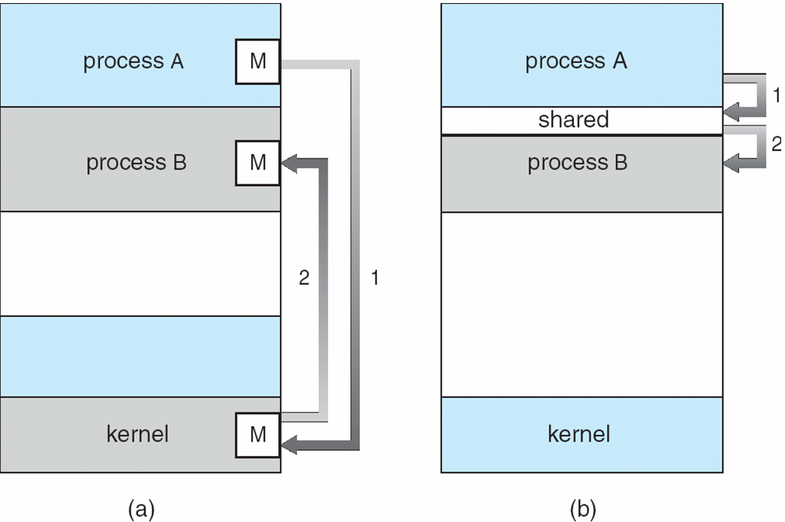
IPC Models
Message Passing
Shared Memory
Copy of data is passed along
+ more generic & secure
- less efficient
Reference to the data is passed
+ more efficient
- requires trust & synchronization

Slide 24
Interprocess Communication: Shared-Memory Segments

Slide 25
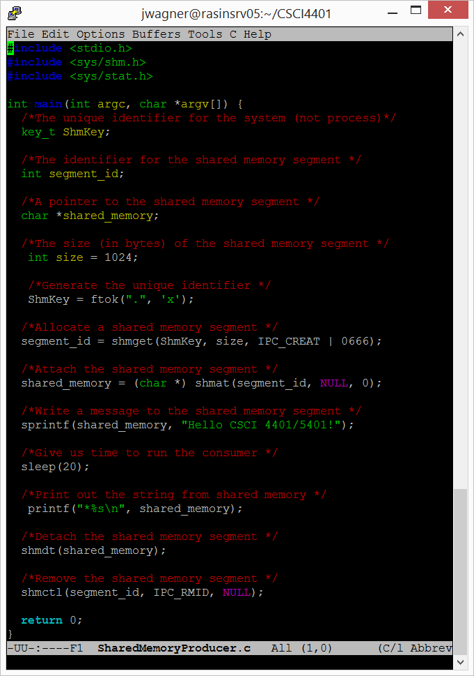
Shared Memory Example: Producer
We need a unique key that can be used by our IPC functions:
ftok()
Returns a key based on:
path – any existing directory
ID – any characters
Returns the same key when the path and key are the same.

Slide 26
Shared Memory Example: Producer
The process must create a shared memory segment.
shmget()
SHared Memory GET
Returns an integer
Takes 3 parameters
Key – unique identifier or IPC_PRIVATE can be used for parent/child.
Size – size of the segment
Flag – specify how memory will be used.
IPC_CREAT | 0666 – create and grant read/write access to the server

Slide 27
Shared Memory Example: Producer
If a process wants to access the shared-memory segment, it must attach it to their address space.
shmat()
SHared Memory Attach
Returns a pointer to the shared memory
Takes 3 parameters
ShmID – shared memory ID
Pointer – typically NULL -> let the OS select the location for us
Flag – access type, 0 allows both reads and writes

Slide 28
Shared Memory Example: Producer
Write to shared memory.
sprintf()

Slide 29
Shared Memory Example: Producer
Detach a process from the shared-memory segment.
Remove the shared-memory segment from the system.

Slide 30
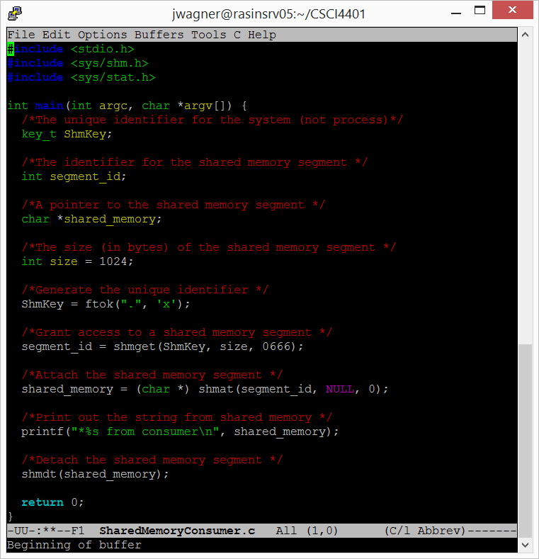
Shared Memory Example: Consumer
Grant access to a shared-memory segment.
Attach to the memory segment.
Detach from the memory segment.

Slide 31
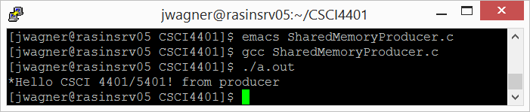
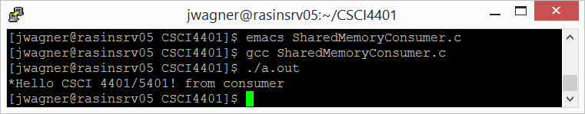
Shared Memory Example

Slide 32
Shared-Memory Messages: A few comments…
Producer-consumer paradigm
The producer can produce one item while the consumer is consuming another item.
Requires synchronization so the consumer is not trying to consume something that does not exist.
Inconsistencies if the producer and consumer attempt to access the shared memory at the same time.
More when we get to process synchronization …

Slide 33
Interprocess Communication: Message Passing

Slide 34
Message Passing Systems
Two processes that want to send/receive messages without sharing memory must establish a communication link with the operations:
send(P, message) – send a message to process P
Copies message into the kernel buffer
receive(Q, message) – receive a message from process Q
Copies message into user buffer
Logical implementations of communication links:
Synchronous and asynchronous communication
Automatic or explicit buffering

Slide 35
Synchronization
Blocking (or synchronous)
Blocking send() – sender is blocked until receiver gets the message
Blocking receive() – receiver blocks until a message is available
Nonblocking (or asynchronous)
Nonblocking send() – sender sends message and resumes operation
Nonblocking receive() – receiver retrieves a valid message or null
Different combos of send() and receive() are possible.
We will see synchronous/asynchronous throughout the course (e.g., OS algorithms for I/O)

Slide 36
Buffering
Receiver
Exchanged messages can reside in a queue:
Zero capacity – no buffering, queue length 0.
Sender blocks until receiver receives message
Bounded capacity – n messages can be stored in the queue.
Sender blocks on full buffer.
Unbounded capacity – any number of messages can be queued.
Sender never blocks
Sender
Sender
Receiver

Slide 37
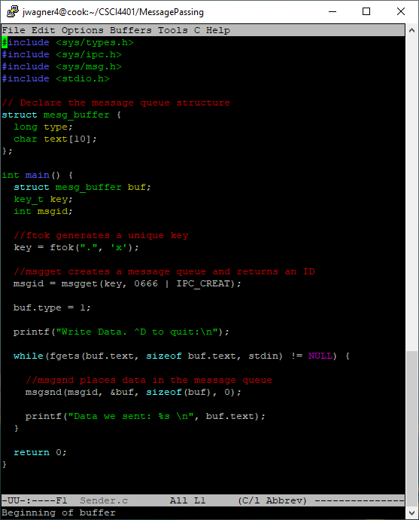
Sender.c
Define the message structure.
Type – ID for the message type
Text – data we send

Slide 38
Sender.c
Generate key like we did for shared memory

Slide 39
Sender.c
Create a message queue using the key and similar permissions we used for shared memory
Specify the message type. Could be any number.

Slide 40
Sender.c
Read from the terminal and store it in the message (buf.text)
msgsnd()
The queue ID
Pointer to our message
Size of our message
Used for flags, e.g., blocking

Slide 41
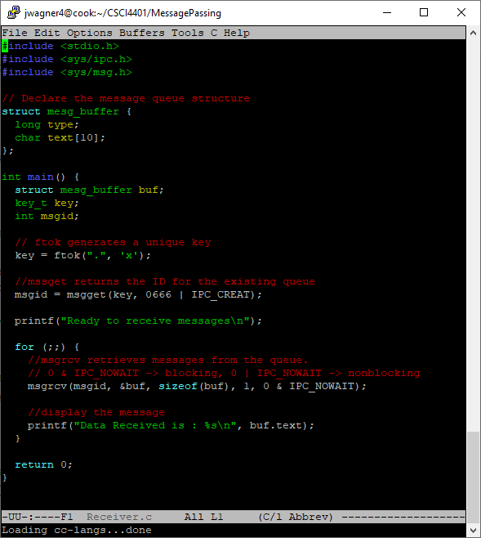
Receiver.c
Similar steps as the producer
msgrcv()
Includes the message type, 1

Slide 42
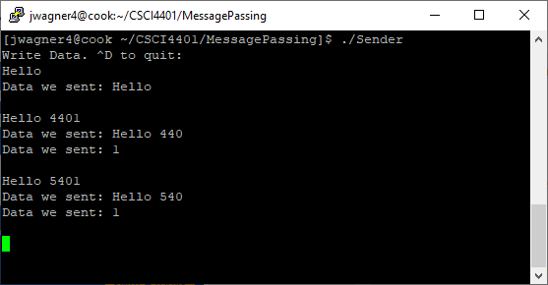
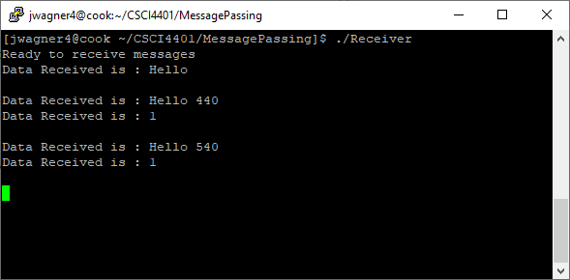
Sender and Receiver

Slide 43
Summary/Review
What are some of the benefits of cooperating processes?
What are two models of IPC?
What is the difference between blocking and nonblocking message passing?
After a process creates a shared-memory segment and grants read/write access, can it begin writing messages in the shared-memory segment?

Slide 44
Review of Processes
Describe the actions to context-switch between processes.
What is the producer-consumer paradigm? What issues can arise between the producer and consumer?
What’s the difference between synchronous (i.e., blocking) and asynchronous (i.e., non-blocking) message passing?
While a process in a X state can transition directly to a Y state, a process in Y state cannot transition to X state. Suitable choice(s) for (X, Y) is/are:
(Waiting, Running)
(Running, Waiting)
(Waiting, Ready)
(Ready, Waiting)
(Running, Ready)

Slide 45
Next time
Threads (Tanenbaum 2.2)

Slide 46
Class Reminders
Read Section 2.1 & 2.3.8 of Tanenbaum
Assignment 1 is due Monday, 9/4 @ 11:59pm
Quiz 1 will be available after lecture. Due Monday, 9/4 @ 11:59pm.
Covers Lectures 1 - 4
Open book & notes. Take individually
You have 5 attempts, best score counts
1 – 5 multiple choice one answer, 6 – 10 multiple choice select all

Slide 47
Threads

Slide 48
Introduction
So far, we have assumed that a process has a single thread.
Threads are also referred to as lightweight processes (LWP)

Slide 49
Example: Web Browser
Use a separate thread for each separately downloaded image.
Let another thread respond to mouse clicks.
Maybe have separate threads for each tab or page image.
Anything where separate execution patterns need to share data.

Slide 50
Example: Word Processor
One thread displays graphics.
Another thread responds to keystrokes from the user.
Another thread performs spell check in the background.
Again, separate execution patterns that need to share data.

Slide 51
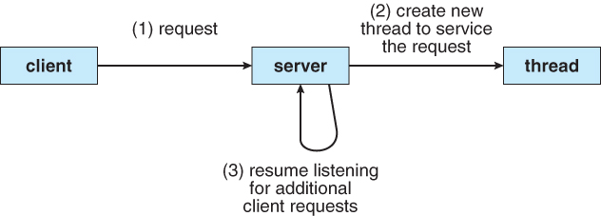
Example: Web Server
Web servers accept client requests for Web pages, images, sound, etc.
Could have 1000’s of clients at once.
A single-threaded process could only serve on client at a time.
Creating a new process for each request is resource intensive.
Multi-threaded web server:
A single process accepts requests
Create a thread for each request
Resume listening

Slide 52
Thread Defined
Thread: a basic unit of CPU utilization.
A thread contains:
Thread ID
Program Counter
Register Set
Stack Segment
A thread shares with other (same) process threads:
Text (code) Segment
Heap & Data Segment
Other OS resources (e.g., open files)
A process with multiple threads can perform more than one task at a time.

Slide 53
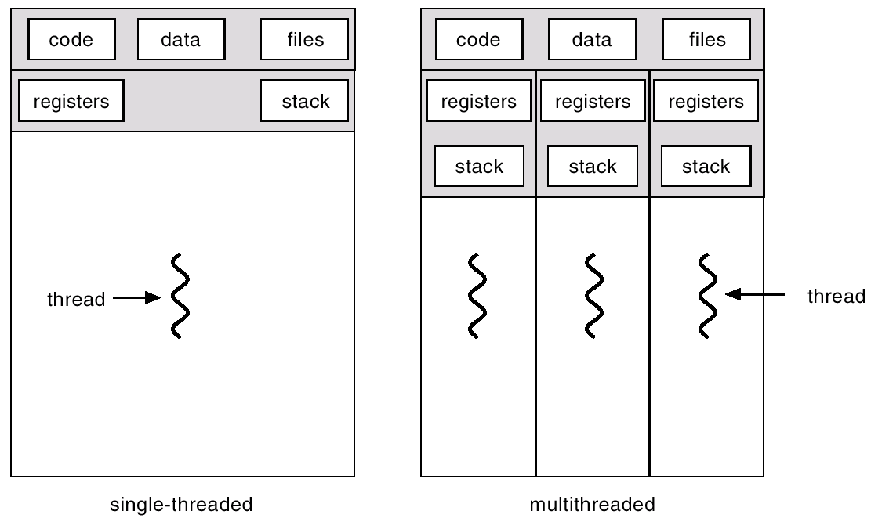
Single-threaded vs Multithreaded

Slide 54
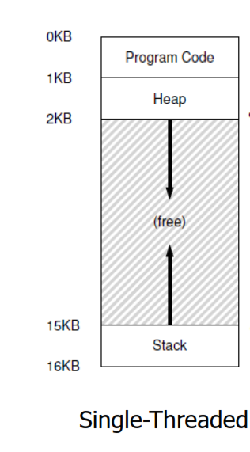
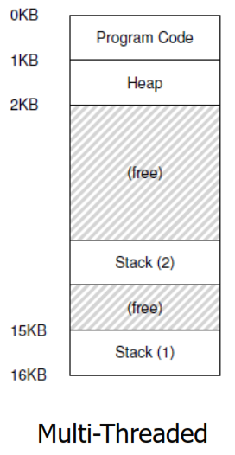
Single-threaded vs Multithreaded

Slide 55
Advantages of Threads
Multithread programming benefits can be broken down into four categories:
Responsiveness
Resource Sharing
Economy
Scalability

Slide 56
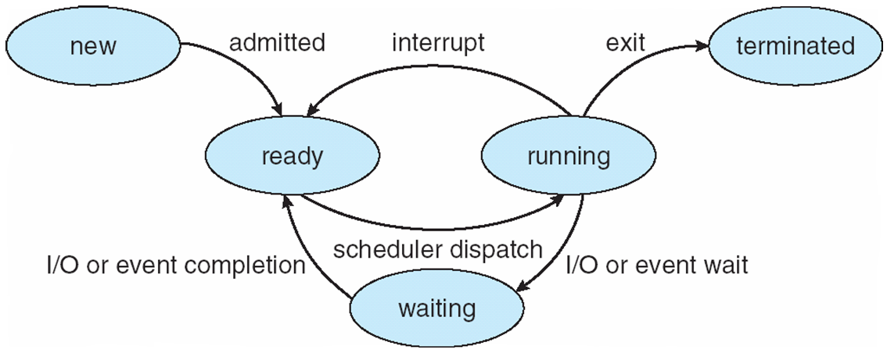
Advantages of Threads (1 of 4)
Responsiveness – the process can continue even if part of it is blocked.
Increase responsiveness to the user.
Web browser example: one thread allows user interaction while another thread loads an image

Slide 57
Advantages of Threads (2 of 4)
Efficient Communication & Resource Sharing – threads share resources
Processes exchange data with shared memory or message passing
More work for you (the programmer).
Threads share memory and resources by default
New file open example:
A child process can inherit an opened file
A child process does not inherit a newly opened file
Threads can see a newly opened file

Slide 58
Advantages of Threads (3 of 4)
Economy – more economical to create threads and context switch threads
Each process needs own memory, resources, and more management

Slide 59
Thread Switching
Thread switching is a context switch from one thread to another in the same process.
Cheaper because less information needs to be switched -> program counter, registers, and stack pointers
Not switching the process address space
Thread Control Blocks (TCB)
Similar idea as process control blocks (PCBs)

Slide 60
Thread Control Blocks
Thread 1 Control Block
process id
state
PC
PC
registers
registers
memory limits
process id
Stack pointer
file descriptors
Thread 2 Control Block
state
Ptr to next TCB
process id
PC
state
PC
PC
registers
registers
registers
memory limits
Stack pointer
Stack pointer
Thread 3 Control Block
file descriptors
file descriptors
process id
Ptr to next TCB
List of TCBs
state
PC
PC
registers
Process Control Block
registers
memory limits
Stack pointer
file descriptors
Ptr to next TCB

Slide 61

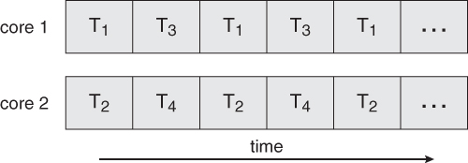
Advantages of Threads (4 of 4)
Scalability – threads can run in parallel on a multiprocessor computer
A single-threaded process can only run on one processor.

Slide 62
Scalability Challenges
If our system has multiple cores, it sounds like a good idea to design multithreaded programs to take advantage of these cores.
But there are some challenges to consider:
Dividing activities: need to examine an application to find areas that can be divided into separate concurrent tasks (i.e., run in parallel).
Balance: tasks should also perform equal work.
Data dependency: examine tasks that rely on data from other tasks, need to ensure synchronized execution

Slide 63
Process vs. Thread
Process
Thread
Heavy weight, resource intensive.
Each process has its own memory
Limited resource sharing
Newly opened file example
Context switching requires changing the address space
If the process is blocked, no other process tasks can be performed.
Light weight, less resources
Threads can share certain memory
More resource sharing
Newly opened file example
Thread switching does not require the address space to change
If one thread is blocked and waiting, a second thread can run.

