Slide 1
CSCI 4401/5401: Principles of Operation Systems
James Wagner
University of New Orleans
Week 3, Lecture 5
August 29th, 2022

Slide 2
Announcements
Assignment 1 is due Monday, 9/4 @ 11:59pm.
Quiz 1 is due Monday, 9/4 @ 11:59pm.

Slide 3
What We’re Doing Today
Threads
Definition
User vs Kernel Level Threads
Threading Models
Threading Issues
Thread Libraries

Slide 4
Threads

Slide 5
Introduction
So far, we have assumed that a process has a single thread.
Threads are also referred to as lightweight processes (LWP)

Slide 6
Example: Web Browser
Use a separate thread for each separately downloaded image.
Let another thread respond to mouse clicks.
Maybe have separate threads for each tab or page image.
Anything where separate execution patterns need to share data.

Slide 7
Example: Word Processor
One thread displays graphics.
Another thread responds to keystrokes from the user.
Another thread performs spell check in the background.
Again, separate execution patterns that need to share data.

Slide 8
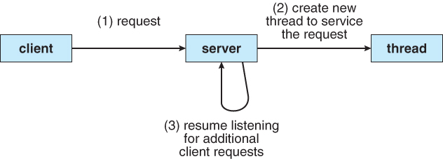
Example: Web Server
Web servers accept client requests for Web pages, images, sound, etc.
Could have 1000’s of clients at once.
A single-threaded process could only serve on client at a time.
Creating a new process for each request is resource intensive.
Multi-threaded web server:
A single process accepts requests
Create a thread for each request
Resume listening

Slide 9
Thread Defined
Thread: a basic unit of CPU utilization.
A thread contains:
Thread ID
Program Counter
Register Set
Stack Segment
A thread shares with other (same) process threads:
Text (code) Segment
Heap & Data Segment
Other OS resources (e.g., open files)
A process with multiple threads can perform more than one task at a time.

Slide 10
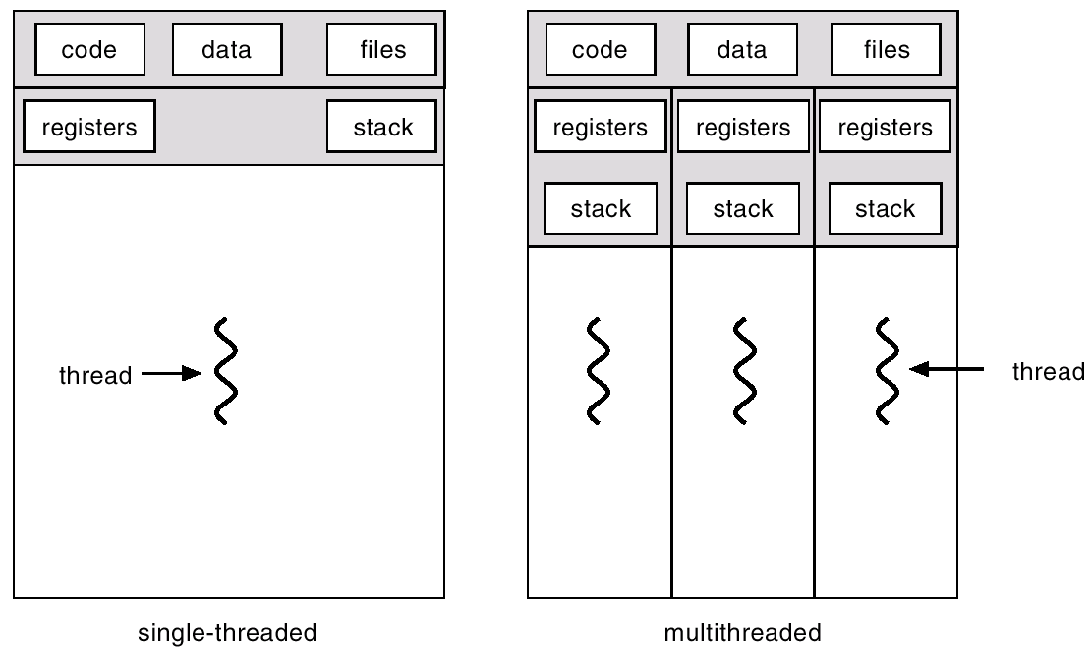
Single-threaded vs Multithreaded

Slide 11
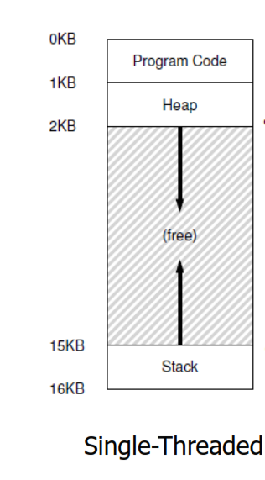
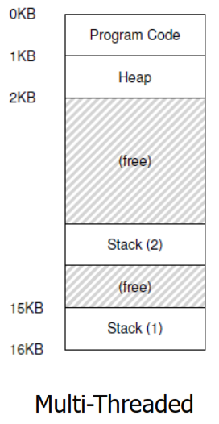
Single-threaded vs Multithreaded

Slide 12
Advantages of Threads
Multithread programming benefits can be broken down into four categories:
Responsiveness
Resource Sharing
Economy
Scalability

Slide 13
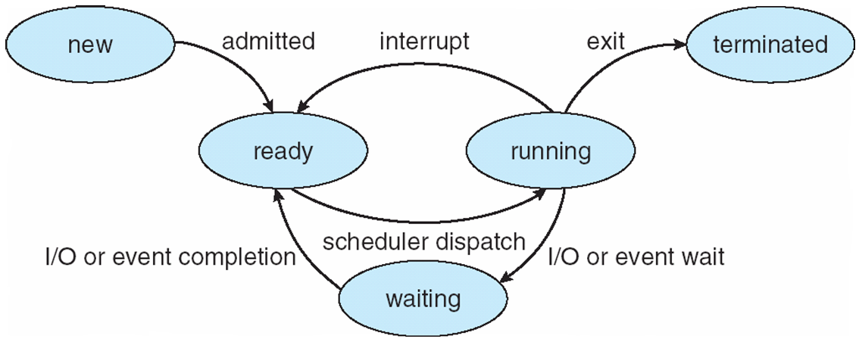
Advantages of Threads (1 of 4)
Responsiveness – the process can continue even if part of it is blocked.
Increase responsiveness to the user.
Web browser example: one thread allows user interaction while another thread loads an image

Slide 14
Advantages of Threads (2 of 4)
Efficient Communication & Resource Sharing – threads share resources
Processes exchange data with shared memory or message passing
More work for you (the programmer).
Threads share memory and resources by default
New file open example:
A child process can inherit an opened file
A child process does not inherit a newly opened file
Threads can see a newly opened file

Slide 15
Advantages of Threads (3 of 4)
Economy – more economical to create threads and context switch threads
Each process needs own memory, resources, and more management

Slide 16
Thread Switching
Thread switching is a context switch from one thread to another in the same process.
Cheaper because less information needs to be switched -> program counter, registers, and stack pointers
Not switching the process address space
Thread Control Blocks (TCB)
Similar idea as process control blocks (PCBs)

Slide 17
Thread Control Blocks
Thread 1 Control Block
process id
state
PC
PC
registers
registers
memory limits
process id
Stack pointer
file descriptors
Thread 2 Control Block
state
Ptr to next TCB
process id
PC
state
PC
PC
registers
registers
registers
memory limits
Stack pointer
Stack pointer
Thread 3 Control Block
file descriptors
file descriptors
process id
Ptr to next TCB
List of TCBs
state
PC
PC
registers
Process Control Block
registers
memory limits
Stack pointer
file descriptors
Ptr to next TCB

Slide 18

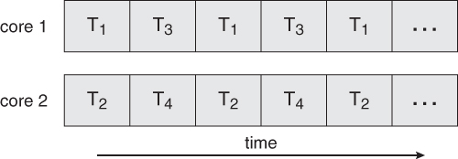
Advantages of Threads (4 of 4)
Scalability – threads can run in parallel on a multiprocessor computer
A single-threaded process can only run on one processor.

Slide 19
Scalability Challenges
If our system has multiple cores, it sounds like a good idea to design multithreaded programs to take advantage of these cores.
But there are some challenges to consider:
Dividing activities: need to examine an application to find areas that can be divided into separate concurrent tasks (i.e., run in parallel).
Balance: tasks should also perform equal work.
Data dependency: examine tasks that rely on data from other tasks, need to ensure synchronized execution

Slide 20
Process vs. Thread
Process
Thread
Heavy weight, resource intensive.
Each process has its own memory
Limited resource sharing
Newly opened file example
Context switching requires changing the address space
If the process is blocked, no other process tasks can be performed.
Light weight, less resources
Threads can share certain memory
More resource sharing
Newly opened file example
Thread switching does not require the address space to change
If one thread is blocked and waiting, a second thread can run.

Slide 21
Types of Threads

Slide 22
Motivation
We’ve looked at threads in a generic sense.
Threads can be implemented in one of two ways:
User level thread – user managed threads, OS doesn’t know about them
Kernel level thread – supported and managed directly by the OS

Slide 23
User Level Threads
A process starts with a single user level thread.
The thread library contains code to:
Create/destroy threads
Pass data between threads
Save/restore thread context
The kernel is not aware of the existence of multiple user level threads.
The thread scheduler finds the highest priority thread that’s in the ready state.
PC, registers, etc. are restored from TCB
Notes:
Thread scheduler is part of the thread library

Slide 24
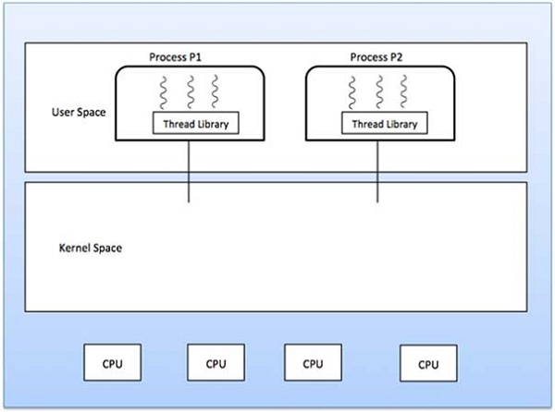
User Level Threads

Slide 25
Kernel Level Threads
Thread management is done by the kernel.
No thread management code in the application (user) area.
Kernel threads are supported directly by the operating system.
Generally slower to create

Slide 26
User-Level vs Kernel-Level Threads
User-Level
Kernel-Level
Faster to create/manage.
Thread switching does not require a trap to the kernel
Implementation is by a user-level thread library.
No hardware support needed
Generic and runs on any OS.
If one thread blocks, the entire process is process blocked
Slower to create/manage.
Thread switching requires a trap to the kernel
OS supports creation of kernel threads.
Hardware support needed
Specific to the OS.
If one thread blocks, the kernel can run another thread from same process or run another process

Slide 27
Multithreading Models

Slide 28
Motivation
We need some type of relationship between the user level and kernel level threads. Three models:
Many-to-Many
Many-to-One
One-to-One

Slide 29
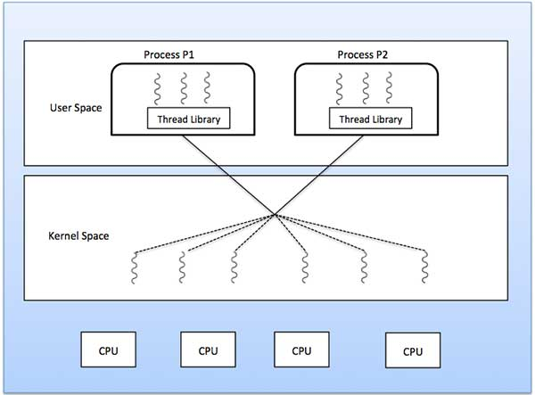
Many-to-Many Model
Multiplexes any number of user threads onto an equal or smaller number of kernel threads.

Slide 30
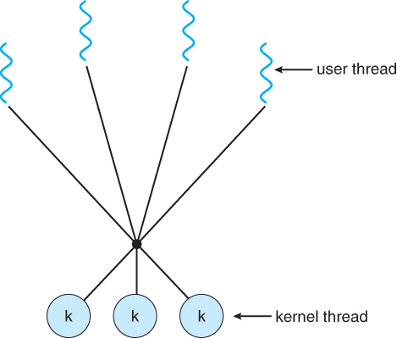
Many-to-Many Model
Pros:
Use multiple CPUs
Not all threads are blocked by system calls.
Cons:
Need thread schedulers in user level and kernel level to work with each other.
Difficult to write and maintain.

Slide 31
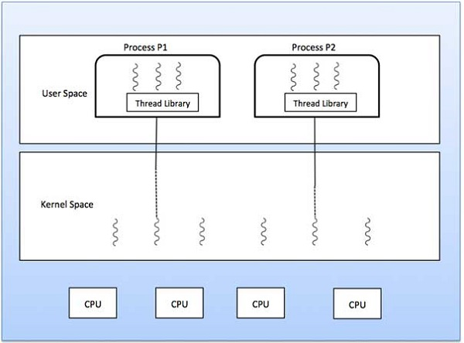
Many-to-One Model
Maps many user-level threads to one kernel thread.

Slide 32
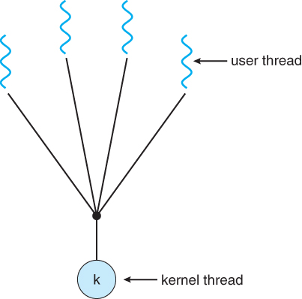
Many-to-One Model
Pros:
Thread creation is easy to manage and cheap.
Lots of threads can be created.
Cons:
Kernel scheduler doesn’t know about threads so can’t be scheduled across CPU.
A blocking system call can block all process threads.

Slide 33
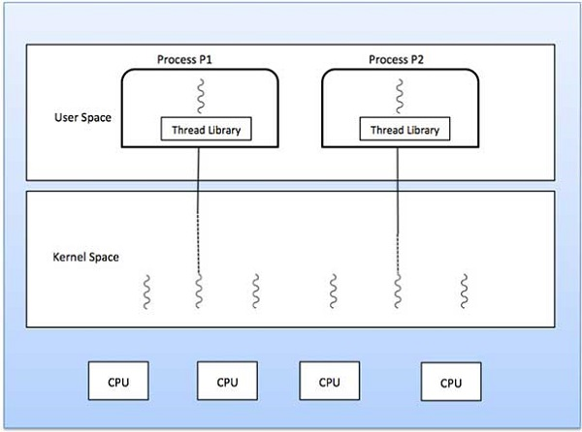
One-to-One Model
Each user thread is mapped to a kernel thread.
This is what most OSes use (Windows and Linux)

Slide 34
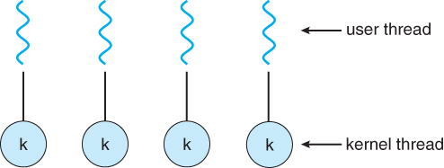
One-to-One Model
Pros:
Threads can run in parallel on multiple CPUs.
Threads don’t block each other.
Cons:
Setup overhead – creating a user thread requires creating a kernel level thread.
For this reason, some systems may limit the number of threads you can create
i.e., limited number of threads

Slide 35
Threading Issues

Slide 36
Introduction
Let’s look at some of problems we can see in multithreaded programs:
fork() Semantics
Thread cancellation
Thread Pools

Slide 37
fork() Semantics
fork() – creates a new process (as we’ve seen)
Problem: If one thread calls fork(), does the child process duplicate all threads or is the child process single-threaded?

Slide 38
fork() Semantics
fork() – creates a new process (as we’ve seen)
Problem: If one thread calls fork(), does the child process duplicate all threads or is the child process single-threaded?
Depends on the OS but typically only duplicate only the calling thread.

Slide 39
Thread Cancellation
Thread cancellation – terminate a thread before it has completed.
Example:
Multiple threads are concurrently searching through a database.
One thread finds/returns result.
Remaining threads might be canceled.
Problem: What if a thread is canceled while it is in the middle of updating/sharing data with another thread?

Slide 40
Thread Cancellation
Thread cancellation – terminate a thread before it has completed.
Example:
Multiple threads are concurrently searching through a database.
One thread finds/returns result.
Remaining threads might be canceled.
Problem: What if a thread is canceled while it is in the middle of updating/sharing data with another thread?
Asynchronous communication -> immediately terminate target thread
Deferred cancellation -> the target thread periodically checks if it should terminate.

Slide 41
Thread Pools
If we allow all concurrent requests to be serviced in a new thread, we don’t have a limit.
Problem: Unlimited threads -> we exhaust system resources
One solution is a thread pool.

Slide 42
Thread Pools
Create some threads at process startup and place them into a pool.
They sit and wait for work.
When a request is received, a thread from the pool is used.
If no available threads, the request waits.
+ Don’t need to wait for a thread to be created
When the thread is done, it returns to the pool.

Slide 43
Thread Libraries

Slide 44
Introduction
Thread library: provides us with an API to create/manage threads.
We will look at thread libraries in C and Java
Use a separate thread for a summation function:
For N = 5, sum = 5 + 4 + 3 + 2 + 1 = 15
N
∑
sum =
i
i=0

Slide 45
Pthreads

Slide 46
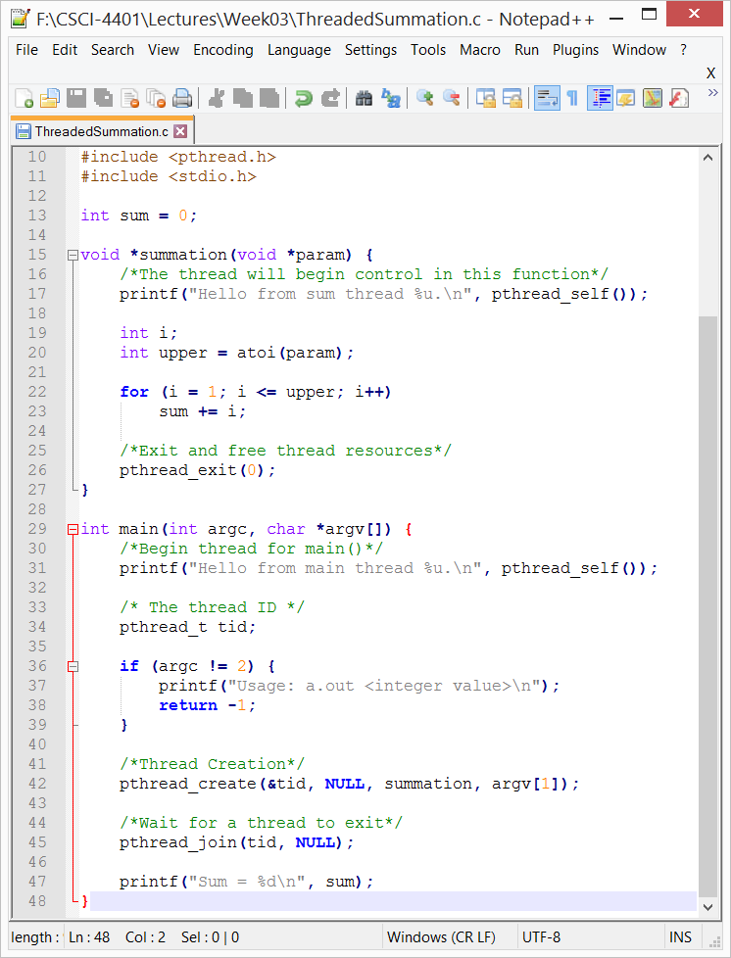
Pthread Example
All pthread programs require the pthread.h header file

Slide 47
Pthread Example
main()
A single thread begins

Slide 48
Pthread Example
pthread_t tid – initialize an ID for our thread
pthread_create() - creates the thread, 4 arguments:
Our thread ID
Thread attributes – NULL -> default values
The function for thread execution
Function argument(s)
Notes:
Thread attributes include the stack size and scheduling info.

Slide 49
Pthread Example
pthread_create() – creates the thread
Returns two threads:
main() thread
New summation thread

Slide 50
Pthread Example
pthread_join()
blocks the calling thread until the specified thread terminates
Two arguments:
A thread ID
Pointer to a return value

Slide 51
Pthread Example
Pthread_exit()
Causes thread to:
Exit
Free it’s resources
Notes:
Pthread_exit can accept a pointer (or id) to another thread

Slide 52
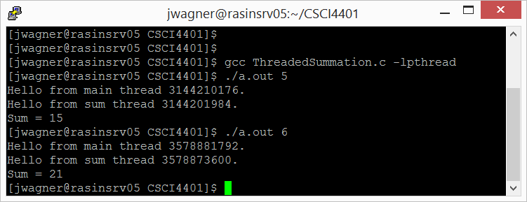
Pthread Example
Don’t forget to link to the library when compiling

Slide 53
Java Threads

Slide 54
Introduction
The Java language and its API provide plenty of features for the creation and management of threads.
Two ways to create threads:
Create a new class to override the run() from the Thread class.
Define a class that implements the Runnable interface.
This is what our examples will use.

Slide 55
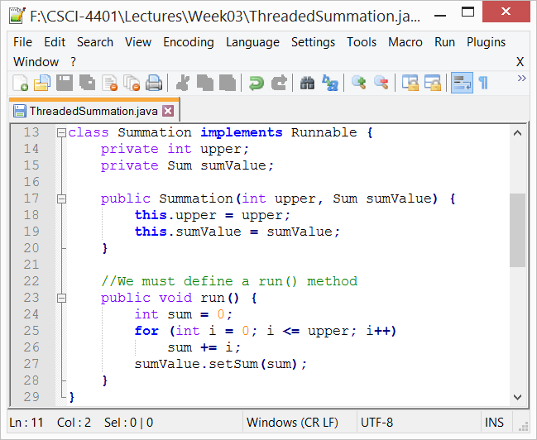
Define run()
When a class implements Runnable, it must define a run() method.
The code implementing the run() method is what runs a separate thread.
The thread terminates when it exits from its run() method.

Slide 56
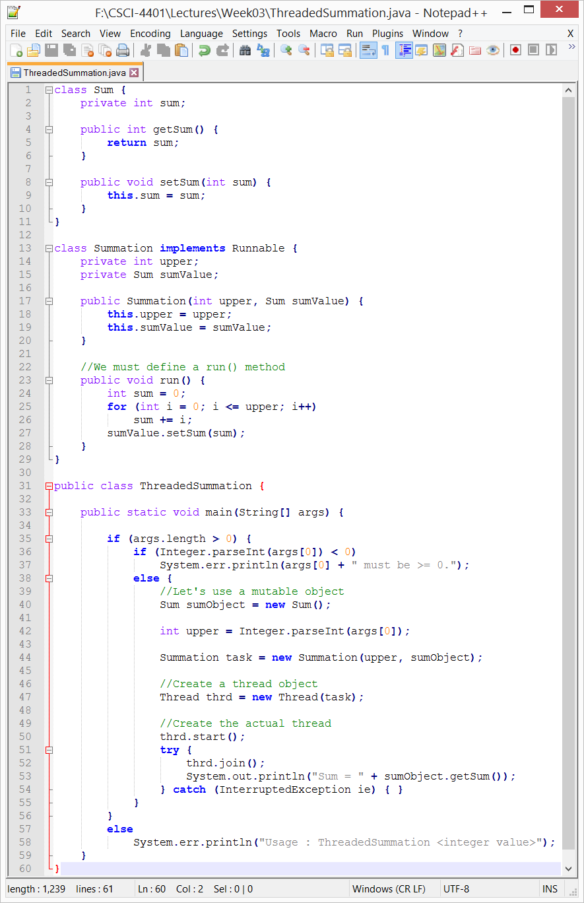
Example
main() – begins a single thread

Slide 57
Example
Create a Thread object - doesn’t create a new thread
start() creates the new thread:
Allocates memory and initializes the new thread
Calls the run() – we never call run, start() does it for us

Slide 58
Example
join() provides similar functionality to pthread_join()
Wait for the thread to finish

Slide 59
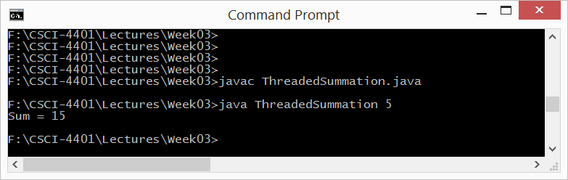
Example
Output

Slide 60
Example: Matrix Multiplication

Slide 61
Matrix Multiplication
Dot Product
For the 1st row and 1st column, multiply the matching positions and sum the results.
7 8
9 10
11 12
1 2 3
4 5 6


Slide 62
Matrix Multiplication
For the 1st row and 1st column, multiply the matching positions and sum the results.
(1, 2, 3) • (7, 9, 11) = 1 * 7 + 2 * 9 + 3 * 11 = 58
7 8
9 10
11 12
1 2 3
4 5 6
? ?
? ?

=

Slide 63
Matrix Multiplication
For the 1st row and 1st column, multiply the matching positions and sum the results.
(1, 2, 3) • (7, 9, 11) = 1 * 7 + 2 * 9 + 3 * 11 = 58
7 8
9 10
11 12
1 2 3
4 5 6
58 ?
? ?

=

Slide 64
Matrix Multiplication
1st row and 2nd column …
(1, 2, 3) • (8, 10, 12) = 1 * 8 + 2 * 10 + 3 * 12 = 64
7 8
9 10
11 12
1 2 3
4 5 6
58 64
? ?

=

Slide 65
Matrix Multiplication
2nd row and 1st column = 139
2nd row and 2nd column = 154
7 8
9 10
11 12
1 2 3
4 5 6
58 64
139 154

=

Slide 66
Matrix Multiplication
What would the pseudo-code look like?
7 8
9 10
11 12
1 2 3
4 5 6
? ?
? ?

=

Slide 67
Matrix Multiplication
What would the pseudo-code look like?
Matrix1 -> m x n (2 rows, 3 columns)
Matrix2 -> n x p (3 rows, 2 columns)
Result -> m x p (2 rows, 2 columns)
7 8
9 10
11 12
1 2 3
4 5 6
? ?
? ?

=

Slide 68
Matrix Multiplication
What would the pseudo-code look like?
Matrix1 -> m x n
Matrix2 -> n x p
Result -> m x p
7 8
9 10
11 12
1 2 3
4 5 6
? ?
? ?

=
// 1. Iterate through Matrix1 rows:

Slide 69
Matrix Multiplication
What would the pseudo-code look like?
Matrix1 -> m x n
Matrix2 -> n x p
Result -> m x p
7 8
9 10
11 12
1 2 3
4 5 6
? ?
? ?

=
// 1. Iterate through Matrix1 rows:
For i in m:

Slide 70
Matrix Multiplication
What would the pseudo-code look like?
Matrix1 -> m x n
Matrix2 -> n x p
Result -> m x p
7 8
9 10
11 12
1 2 3
4 5 6
? ?
? ?

=
For i from 1 to m:
// 2. Iterate through Matrix2 columns

Slide 71
Matrix Multiplication
What would the pseudo-code look like?
Matrix1 -> m x n
Matrix2 -> n x p
Result -> m x p
7 8
9 10
11 12
1 2 3
4 5 6
? ?
? ?

=
For i from 1 to m:
// 2. Iterate through Matrix2 columns
For j from 1 to p:

Slide 72
Matrix Multiplication
What would the pseudo-code look like?
Matrix1 -> m x n
Matrix2 -> n x p
Result -> m x p
7 8
9 10
11 12
1 2 3
4 5 6
? ?
? ?

=
For i from 1 to m:
For j from 1 to p:
//3. Calculate a new cell
sum = 0

Slide 73
Matrix Multiplication
What would the pseudo-code look like?
Matrix1 -> m x n
Matrix2 -> n x p
Result -> m x p
7 8
9 10
11 12
1 2 3
4 5 6
? ?
? ?

=
For i from 1 to m:
For j from 1 to p:
sum = 0
//4. Match positions

Slide 74
Matrix Multiplication
What would the pseudo-code look like?
Matrix1 -> m x n
Matrix2 -> n x p
Result -> m x p
7 8
9 10
11 12
1 2 3
4 5 6
? ?
? ?

=
For i from 1 to m:
For j from 1 to p:
sum = 0
//4. Match positions
For k from 1 to n:

Slide 75
Matrix Multiplication
What would the pseudo-code look like?
Matrix1 -> m x n
Matrix2 -> n x p
Result -> m x p
7 8
9 10
11 12
1 2 3
4 5 6
? ?
? ?

=
For i from 1 to m:
For j from 1 to p:
sum = 0
For k from 1 to n:
//5. Calculate Sum

Slide 76
Matrix Multiplication
What would the pseudo-code look like?
Matrix1 -> m x n
Matrix2 -> n x p
Result -> m x p
7 8
9 10
11 12
1 2 3
4 5 6
? ?
? ?

=
For i from 1 to m:
For j from 1 to p:
sum = 0
For k from 1 to n:
//5. Calculate Sum
sum += Matrix1_{ik} * Matrix2_{kj}
Result_{ij} = sum

Slide 77
Matrix Multiplication
What would be a task you would create separate threads for?
Matrix1 -> m x n
Matrix2 -> n x p
Result -> m x p
7 8
9 10
11 12
1 2 3
4 5 6
? ?
? ?

=
For i from 1 to m:
For j from 1 to p:
sum = 0
For k from 1 to n:
sum += Matrix1_{ik} * Matrix2_{kj}
Result_{ij} = sum

Slide 78
Summary/Review
What process components are shared across threads in a process?
What are some of the advantages of threads?
What are some differences between user-level and kernel-level threads?
What are the 3 different threading models and their trade-offs?

Slide 79
What’s up next?
Everything up until the midterm deals with process management.
Finish Threads -> thread libraries and some examples (next time)
CPU scheduling (~ 1 week)
Which process gets the processor next?
Synchronization (~ 1 week)
Revisit the consumer-producer paradigm
Deadlocks (~ 1 week)
Processes are waiting on each other to release resources

Slide 80
Class Reminders
Assignment 1 is due Monday, 9/4 @ 11:59pm.
Quiz 1 is due Monday, 9/4 @ 11:59pm.

