Slide 1
CSCI 4401/5401: Principles of Operation Systems
James Wagner
University of New Orleans
Week 3, Lecture 6
August 31st, 2023

Slide 2
Announcements
Assignment 1 is due Monday, 9/4 @ 11:59pm.
Quiz 1 is due Monday, 9/4 @ 11:59pm.
Assignment 2 is posted and due Monday, September 25th @ 11:59pm.

Slide 3
What We’re Doing Today
Discuss Assignment 2
Thread Libraries
Java matrix multiplication example
Start CPU Scheduling (if we have time)

Slide 4
Assignment 2

Slide 5
Details
Due Monday, September 25th @ 11:59pm
Reading: Tanenbaum Chapter 2
Submission Guidelines:
1. This assignment is worth 100 points for all students.
2. This submission will require you to submit multiple files. Files must be clearly labeled and referenced in your main submission file.
3. Screenshots must use the PrintScreen command so that they are readable.
4. It is your responsibility to make sure all files are readable and submitted on time.
Submission:
- Part A requires you to submit a .c script and two output files.
- Part B requires you to submit a script of your choice (e.g., Python, Java, C++, etc.) used for visualization and two graphs.
- Part C requires you to submit a .c script and two graphs.
- Part D is optional extra credit for 4401 students and required for 5401 student. This requires you to submit a single .c script and a screenshot of your running program.

Slide 6
Running your C programs
You’ll need a gcc compiler to run your C programs.
If you are using a Linux or Mac OS, you should be able to install from the terminal:
Linux - $sudo apt install build-essential
Mac - $brew install gcc
For Windows users, Windows assumes most users won’t be compiling C programs
There are some compilers you can try to download or runtime environments (e.g., Cygwin)
However, I recommend connecting to a Linux machine.
CyberRange poses a challenge with transferring files.
You can access the cook server through the UNO Web Terminal: https://webterminal.cs.uno.edu/#/
You can only use ssh (e.g., Putty) if you are on the Uno domain.

Slide 7
Transferring Files
You may want to transfer files between cook.cs.uno.edu and your local machine. There’s a couple of ways to do this:
Simple copy-paste:
On Cook, $less [your file]
Then highlight and paste in a text editor on your local machine
Git repository
(Only if you are on the UNO domain) Run an FTP (file transfer protocol) client on your local machine.

Slide 8
Java Threads

Slide 9
Introduction
The Java language and its API provide plenty of features for the creation and management of threads.
Two ways to create threads:
Create a new class to over the run() from the Thread class.
Define a class that implements the Runnable interface.
This is what our examples will use.

Slide 10
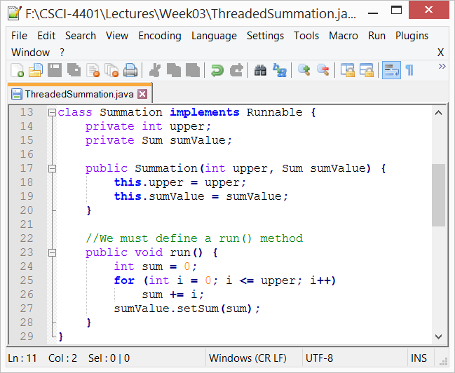
Define run()
When a class implements Runnable, it must define a run() method.
The code implementing the run() method is what runs a separate thread.
The thread terminates when it exits from its run() method.

Slide 11
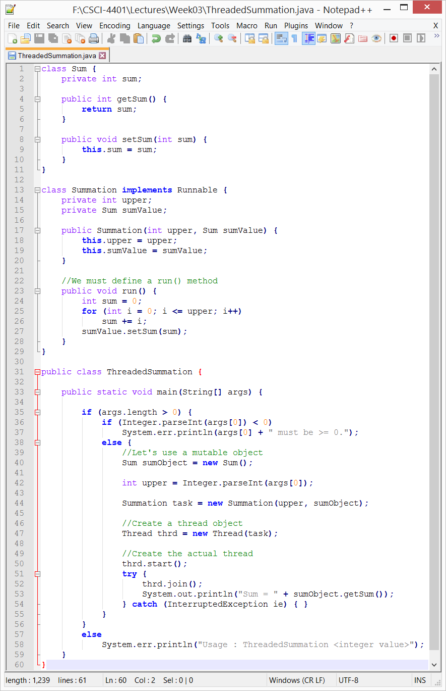
Example
main() – begins a single thread

Slide 12
Example
Create a Thread object - doesn’t create a new thread
start() creates the new thread:
Allocates memory and initializes the new thread
Calls the run() – we never call run, start() does it for us

Slide 13
Example
join() provides similar functionality to pthread_join()
Wait for the thread to finish

Slide 14
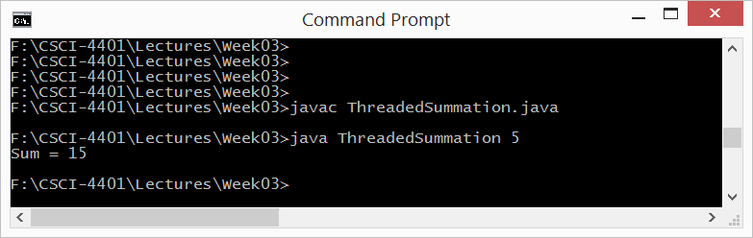
Example
Output

Slide 15
Java Example: Matrix Multiplication

Slide 16
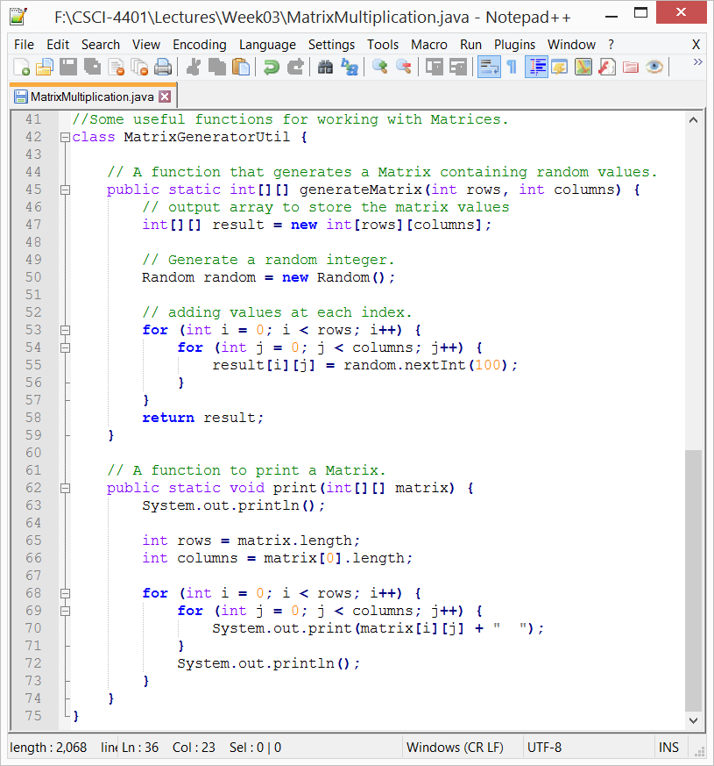
Some setup …
generateMatrix()
Pass # of rows and # of columns
Return a matrix containing random integers
print()
Iterate through a matrix and print each value

Slide 17
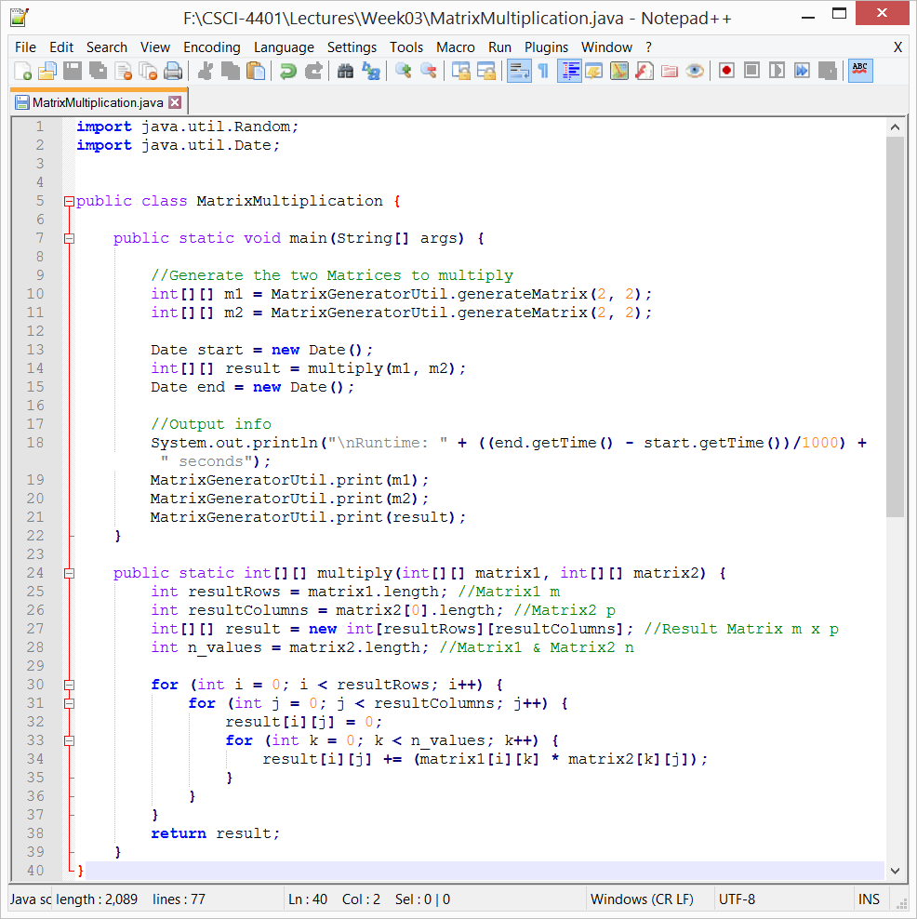
Matrix Multiplication
Generate our two matrices.
Our algorithm

Slide 18
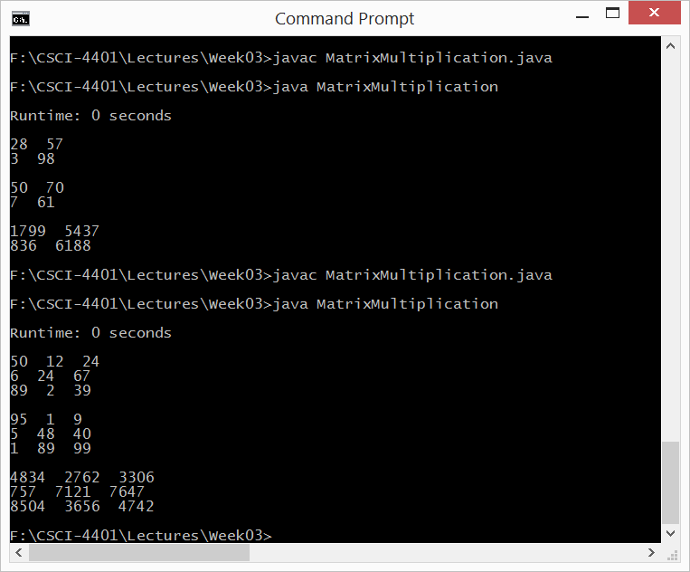
Matrix Multiplication
Test the output
2 x 2 Matrices
3 x 3 Matrices

Slide 19
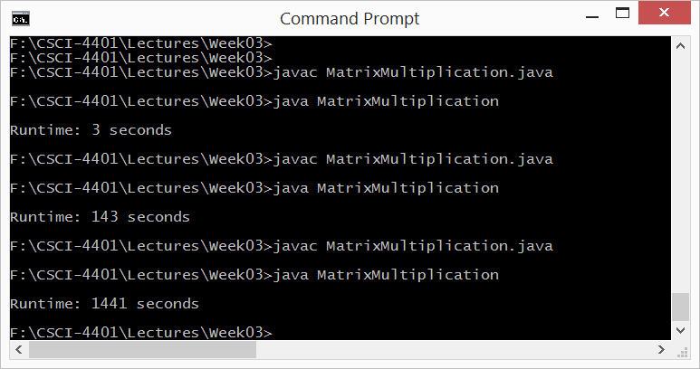
Matrix Multiplication
Let’s try more expensive calculations…
Larger integers -> random integer * 10
1000 x 1000 Matrices
2000 x 2000 Matrices
4000 x 4000 Matrices

Slide 20
Java Example: Matrix Multiplication w/ Threads

Slide 21
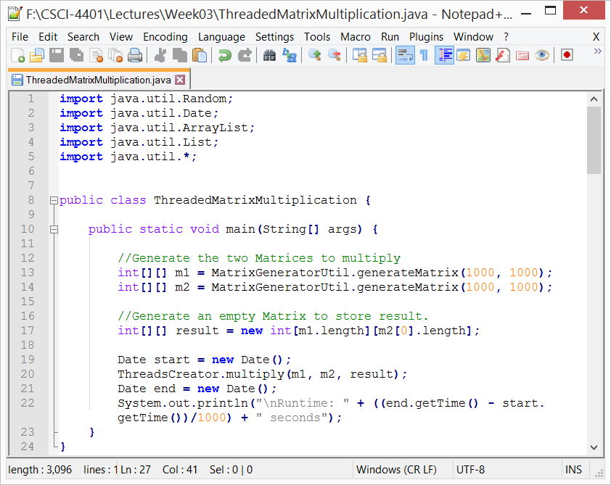
Matrix Multiplication
Generate our two matrices.
Generate an empty matrix to store our results.
Time our function with our algorithm

Slide 22
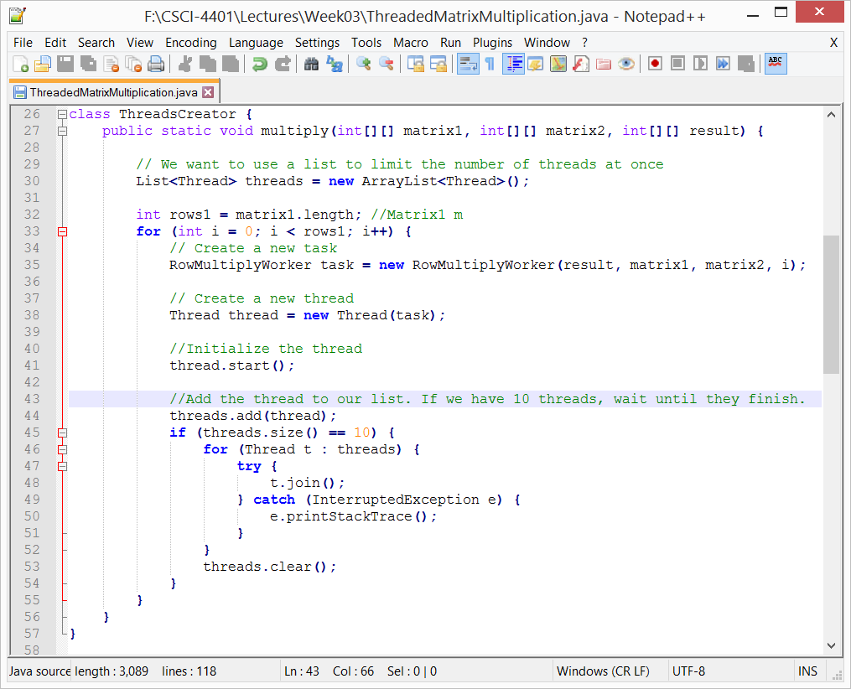
Matrix Multiplication
Limit the number of threads by keeping them in a list.
When our list reaches a certain size, wait until they finish.

Slide 23
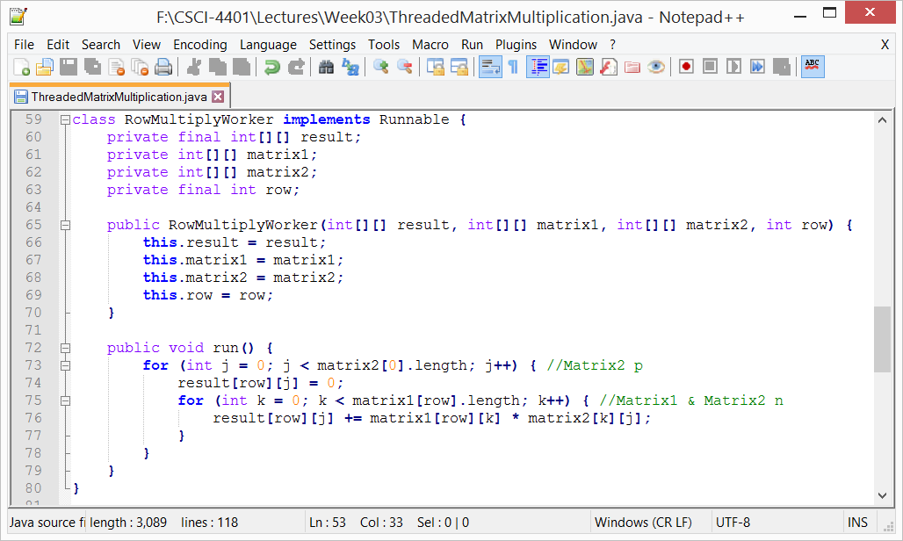
Matrix Multiplication
Our code that defines the run() method.

Slide 24
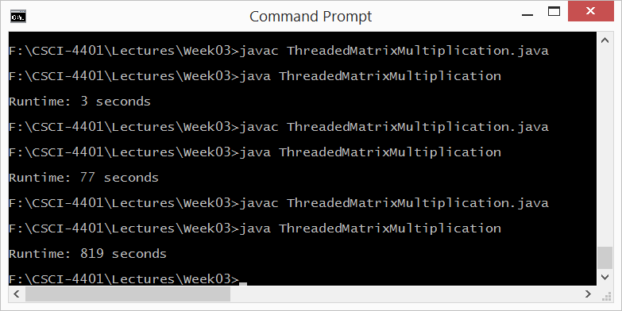
Matrix Multiplication
Some runtimes compared to the single-threaded code.
1000 x 1000 Matrices
2000 x 2000 Matrices
4000 x 4000 Matrices

Slide 25
Next Time
CPU Scheduling

Slide 26
Class Reminders
Assignment 1 is due Sunday, 9/4 @ 11:59pm.
Quiz 1 is due Sunday, 9/4 @ 11:59pm.

Slide 27
CPU Scheduling: Basic Concepts

Slide 28
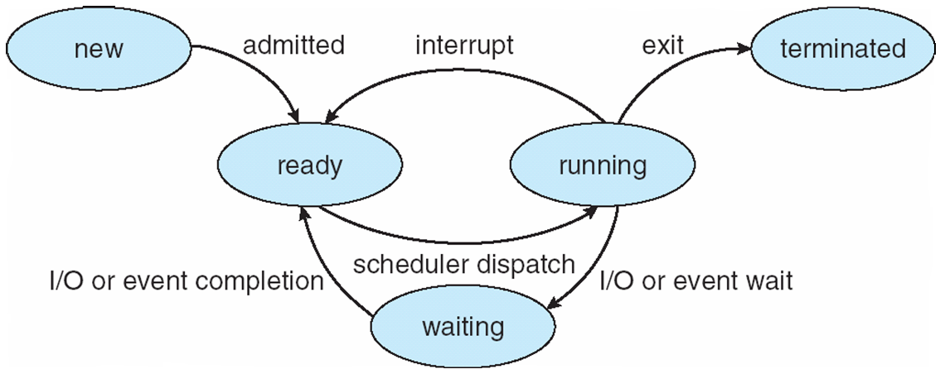
Introduction
We want a process running at all times to maximize CPU utilization.
A process is executed until it is moved to the waiting (or blocking) state
E.g., the completion of an I/O request
The OS takes the CPU away from the waiting process and gives it to another.

Slide 29
Introduction
The continuous scheduling of the CPU is a fundamental OS function.
We will talk about the algorithms used to decide which process gets the CPU next.
But first, a few terms …
Note: the OS actually schedules kernel-level threads, not processes. Therefore, process scheduling and thread scheduling are interchangeable.

Slide 30
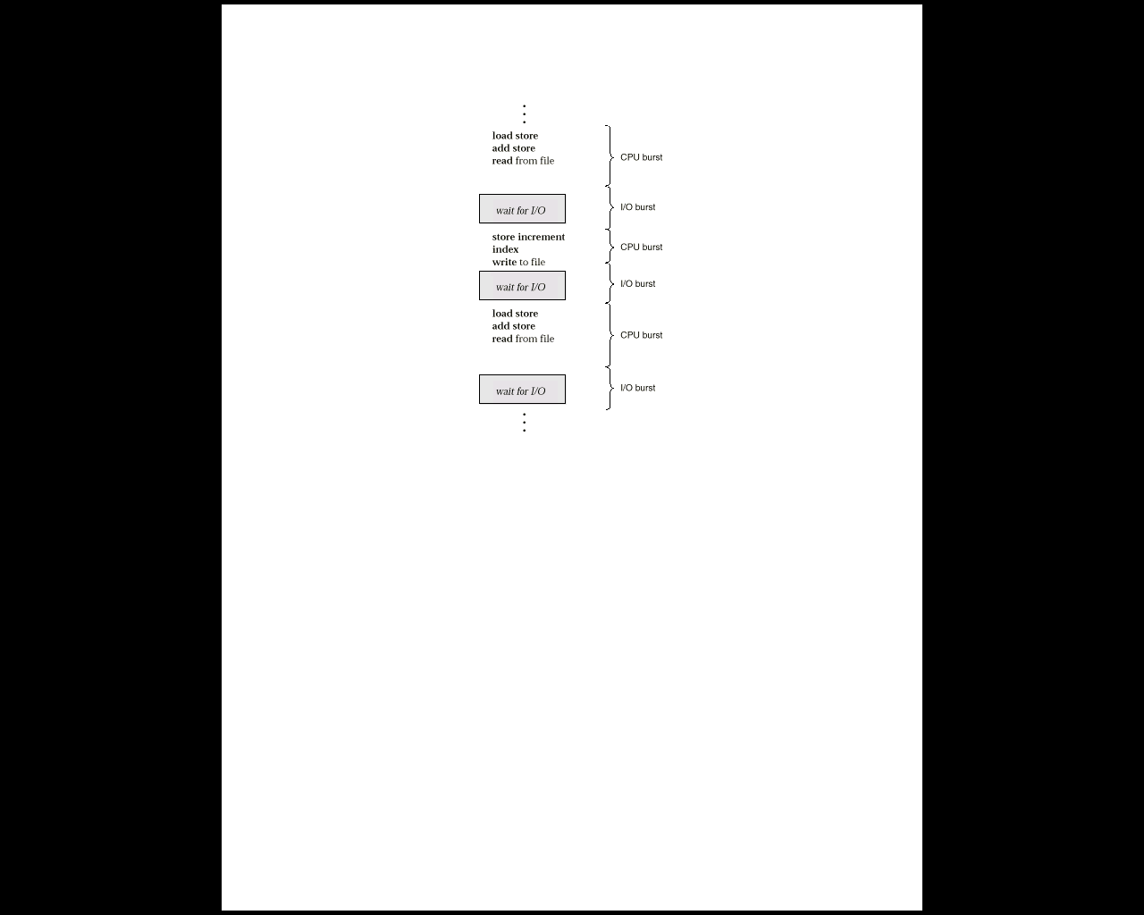
CPU-I/O Burst Cycle
Process execution is a cycle of
CPU bursts (executions)
I/O bursts (waits)
CPU scheduling depends on process CPU bursts and I/O bursts.

Slide 31
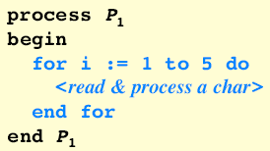
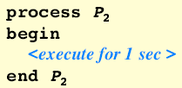
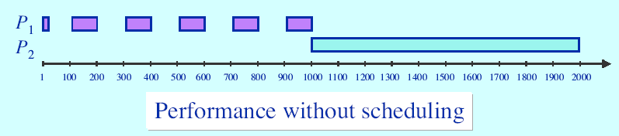
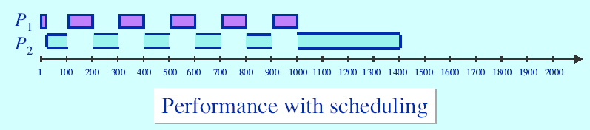
Scheduling has a critical impact on CPU utilization

Slide 32
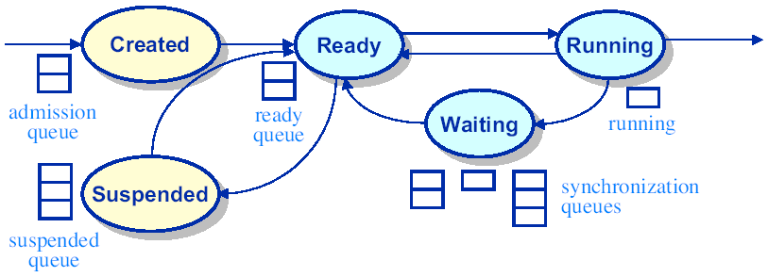
CPU Scheduler
If the CPU becomes idle, the OS selects a process from the ready queue.
Short-term scheduler (or CPU scheduler)
The short-term scheduler selects a process that is in the ready state.
the ready queue is not always first-in, first-out
Records in the queues are the PCBs
Dispatcher – moves the process from the ready queue and control of CPU

Slide 33
Dispatcher
Dispatcher – gives control of the CPU to the process selected by the short-term scheduler.
Involved in every process switch.
Stops one process and starts another
Dispatch Latency – time for this operation

Slide 34
Preemptive Scheduling
CPU scheduling decisions take places when a process changes state:
running -> waiting
E.g., I/O request, wait for child process
running -> ready
E.g., an interrupt
waiting -> ready
E.g., I/O completion
terminates

Slide 35
Preemptive Scheduling
running -> waiting
running -> ready
waiting -> ready
A process terminates
For 1 & 4, only one scheduling choice:
Select a new process for execution.
Nonpreemptive or cooperative – we never forcibly strip a process of the CPU

Slide 36
Preemptive Scheduling
running -> waiting
running -> ready
waiting -> ready
A process terminates
For 2 & 3, there are multiple choices
Preemptive or nonpreemptive
Preemptive – forcibly strip the CPU from a process
Which is better?

Slide 37
Scheduling Criteria

Slide 38
Introduction
Different CPU-scheduling algorithms have different properties.
Best response time, max CPU usage, etc.
One algorithm may favor one process over another.
These algorithms can be characterized with several criteria …

Slide 39
Utilization Criteria
CPU Utilization – keep the CPU as busy as possible
Theoretically: 0% – 100%, Real Systems: 40% - 90%
Throughput – number of processes per unit of time
E.g., 1 process/hour, 10 processes/second, etc.
Turnaround time – time to execute the process
= time to read into memory + time in ready queue + CPU execution + I/O
Waiting time – time a process spends in the waiting and ready queues
Response time - alternative to turnaround time. Time from request until first response (or starts responding)

Slide 40
A few words on scheduling criteria
We want to maximize
CPU utilization
Throughput
We want to minimize
Turnaround time
Waiting time
Response time
In general, optimize the minimum and maximum values. Example:
We want to make sure all users get good service.
Minimize the maximum response time.

