Slide 1
CSCI 4401/5401: Principles of Operation Systems
James Wagner
University of New Orleans
Week 4, Lecture 7
September 5th, 2023

Slide 2
Announcements
Assignment 2 is due Monday, 9/25 @ 11:59pm.
Important Note: If you are using WebTerminal, use the systems-lab server rather than cook.
A link to WebTerminal is under “Supplemental Material & Other” on Canvas

Slide 3
What We’re Doing Today
Review Quiz 1
CPU Scheduling
Basic Concepts
Scheduling Criteria
Scheduling Algorithms

Slide 4
Assignment 2: Notes

Slide 5
Part A
When writing your output, I recommend simply writing the ppid and the pid.
This will simplify reading the data in Part B
Example:
FILE *out;
out = fopen("pids.csv", "w");
… some code
fprintf(out, "%d, %d\n", ppid, pid);
You have to decide where to put this

Slide 6
Part B
Now we want to read the ppid’s and pid’s in the Python code.
infile = "pids.csv"
input = open(infile, "r")
lines = input.readlines()
Iterate over the lines
parent = str(line.split(",")[0].strip())
child = str(line.split(",")[1].strip())

Slide 7
Quiz 1 Review

Slide 8
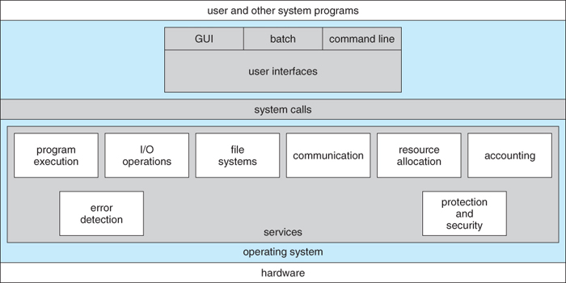
#3. What is the purpose of system calls?

Slide 9
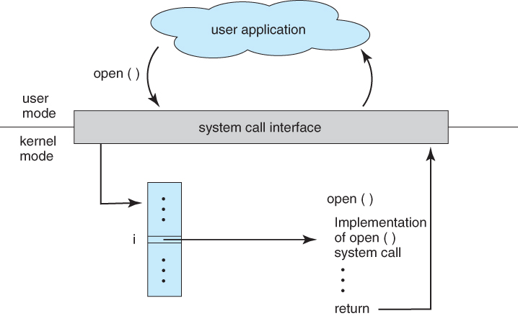
#3. What is the purpose of system calls?

Slide 10
#4. How many children will be created by the following program?
void main() { fork(); fork(); fork(); fork();
}
Notes:
15

Slide 11
#5. What is a memory leak?
Stack
Heap
CPU manages stack memory for you
When a function declares a variable, it is pushed onto stack
When a function exits, those variables are freed (i.e., deleted)
It does have size limits.
Not managed for you.
To allocate memory use malloc() or calloc()
YOU are responsible for freeing memory with free()
Memory leak – wasted memory
Size limit is your computers physical limitations.

Slide 12
#8.
Two processes exchange messages. Given that the sender is blocking (or synchronous) and the receiver is nonblocking (or asynchronous), which of the following is true?
Notes:
The sender suspends operation until the receiver gets the message.
The sender always resumes operation when it sends a message.
The receiver cannot resume operation until it gets a message from the sender.
The receiver will never enter the waiting state even if it performs I/O.

Slide 13
Synchronization
Blocking (or synchronous)
Blocking send() – sender is blocked until receiver gets the message
Blocking receive() – receiver blocks until a message is available
Nonblocking (or asynchronous)
Nonblocking send() – sender sends message and resumes operation
Nonblocking receive() – receiver retrieves a valid message or null
Different combos of send() and receive() are possible.
We will see synchronous/asynchronous throughout the course (e.g., OS algorithms for I/O)

Slide 14
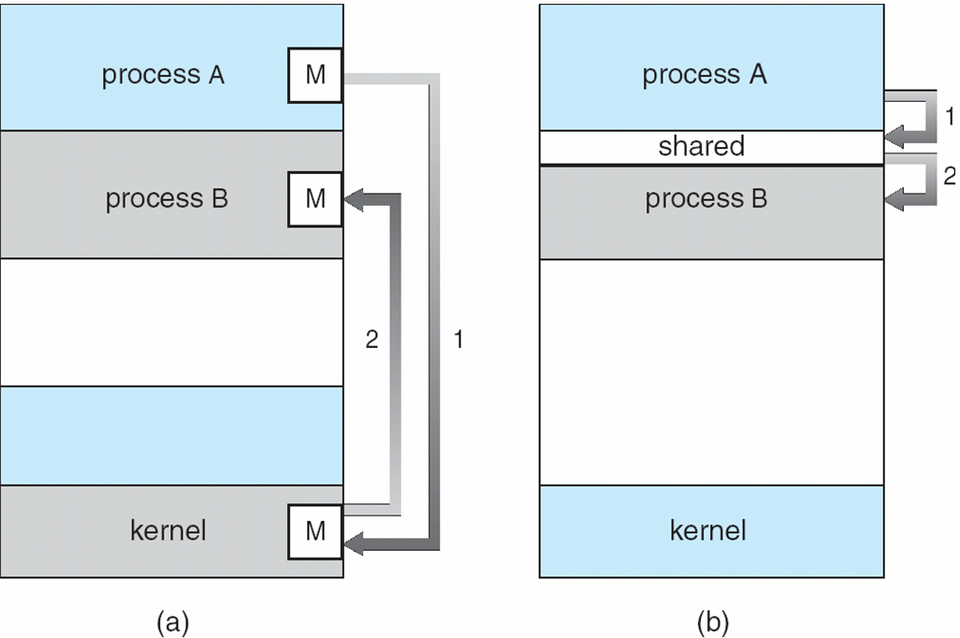
#9. What are two ways we discussed for process communication?
Message Passing
Shared Memory
Copy of data is passed along
+ more generic & secure
- less efficient
Reference to the data is passed
+ more efficient
- requires trust & synchronization

Slide 15
#9 What are two ways we discussed for process communication?
Message Passing
Shared Memory
+ Good for exchanging small amount of data. Don’t have to worry about conflicts.
+ Easier to implement, use system calls.
- Message passing requires kernel intervention (system calls).
+ Much faster
+ System calls are only needed to establish shared memory regions.
- Need to make sure both processes aren’t trying to access shared memory concurrently.

Slide 16
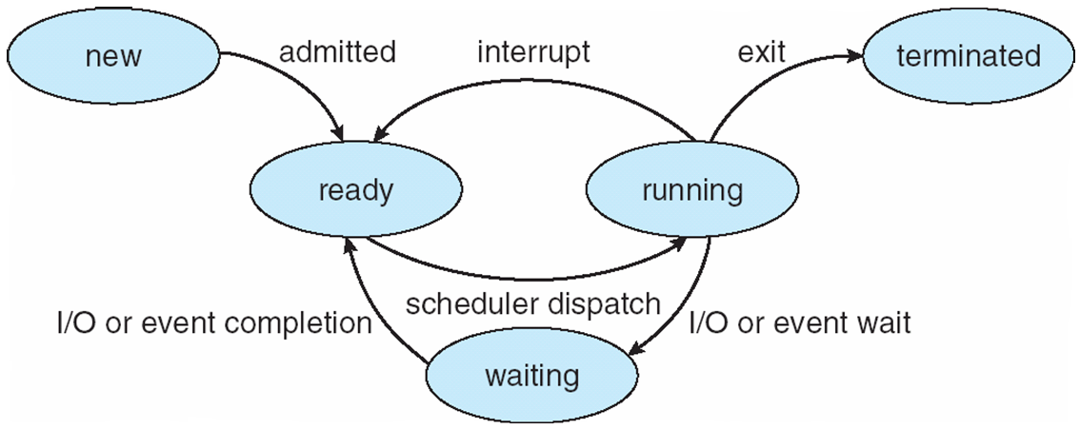
#10. A process just entered the waiting state. What could have been its previous state?

Slide 17
CPU Scheduling: Basic Concepts

Slide 18
Introduction
We want a process running at all times to maximize CPU utilization.
A process is executed until it is moved to the waiting (or blocking) state
E.g., the completion of an I/O request
The OS takes the CPU away from the waiting process and gives it to another.

Slide 19
Introduction
The continuous scheduling of the CPU is a fundamental OS function.
We will talk about the algorithms used to decide which process gets the CPU next.
But first, a few terms …
Note: the OS actually schedules kernel-level threads, not processes. Therefore, process scheduling and thread scheduling are interchangeable.

Slide 20
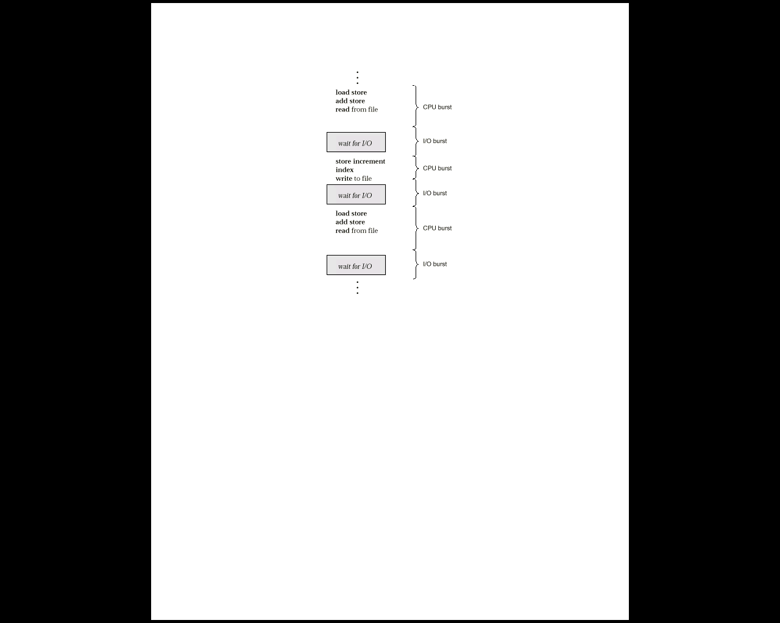
CPU-I/O Burst Cycle
Process execution is a cycle of
CPU bursts (executions)
I/O bursts (waits)
CPU scheduling depends on process CPU bursts and I/O bursts.

Slide 21
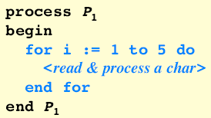
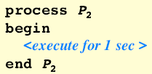
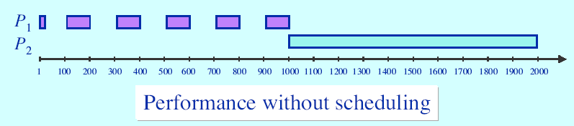
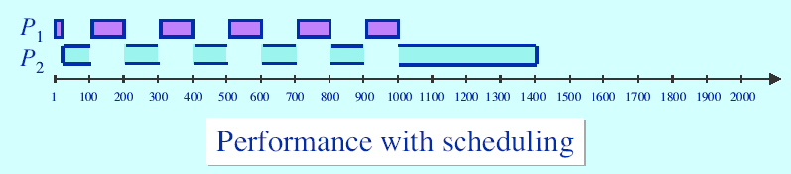
Scheduling has a critical impact on CPU utilization

Slide 22
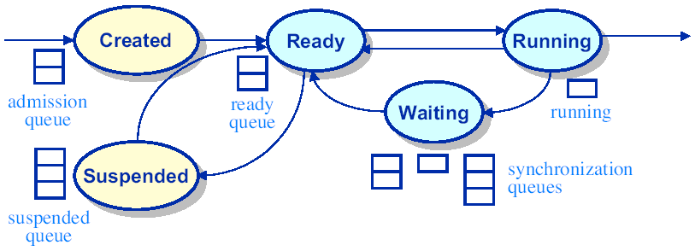
CPU Scheduler
If the CPU becomes idle, the OS selects a process from the ready queue.
Short-term scheduler (or CPU scheduler)
The short-term scheduler selects a process that is in the ready state.
the ready queue is not always first-in, first-out
Records in the queues are the PCBs
Dispatcher – moves the process from the ready queue and control of CPU

Slide 23
Dispatcher
Dispatcher – gives control of the CPU to the process selected by the short-term scheduler.
Involved in every process switch.
Stops one process and starts another
Dispatch Latency – time for this operation

Slide 24
Preemptive Scheduling
CPU scheduling decisions take places when a process changes state:
running -> waiting
E.g., I/O request, wait for child process
running -> ready
E.g., an interrupt
waiting -> ready
E.g., I/O completion
terminates

Slide 25
Preemptive Scheduling
running -> waiting
running -> ready
waiting -> ready
A process terminates
For 1 & 4, only one scheduling choice:
Select a new process for execution.
Nonpreemptive or cooperative – we never forcibly strip a process of the CPU

Slide 26
Preemptive Scheduling
running -> waiting
running -> ready
waiting -> ready
A process terminates
For 2 & 3, there are multiple choices
Preemptive or nonpreemptive
Preemptive – forcibly strip the CPU from a process
Which is better?

Slide 27
Scheduling Criteria

Slide 28
Introduction
Different CPU-scheduling algorithms have different properties.
Best response time, max CPU usage, etc.
One algorithm may favor one process over another.
These algorithms can be characterized with several criteria …

Slide 29
Utilization Criteria
CPU Utilization – keep the CPU as busy as possible
Theoretically: 0% – 100%, Real Systems: 40% - 90%
Throughput – number of processes per unit of time
E.g., 1 process/hour, 10 processes/second, etc.
Turnaround time – time to execute the process
= time to read into memory + time in ready queue + CPU execution + I/O
Waiting time – time a process spends in the waiting and ready queues
Response time - alternative to turnaround time. Time from request until first response (or starts responding)

Slide 30
A few words on scheduling criteria
We want to maximize
CPU utilization
Throughput
We want to minimize
Turnaround time
Waiting time
Response time
In general, optimize the minimum and maximum values. Example:
We want to make sure all users get good service.
Minimize the maximum response time.

Slide 31
Scheduling Algorithms

Slide 32
Introduction
We need an algorithm(s) to decide which process in the ready queue will be allocated the CPU next.
Basic Scheduling algorithms:
First come, first serve
Shortest job first
More realistic algorithms
Priority
Round robin
Multilevel Queue
Multilevel Feedback Queue

Slide 33
First-Come, First-Serve Scheduling (FCFS)
FCFS is the simplest CPU-scheduling algorithm.
The process that requests the CPU, gets allocated the CPU first.
The FCFS policy is managed with a first-in, first-out (FIFO) queue.
When a process enters the ready queue, its PCB is linked onto the tail of the queue.
When the CPU is free, it is allocated to the process at the head of the queue, and the running process is removed from the queue.

Slide 34
First-Come, First-Served: Example
Process CPU Burst Time(ms)
P₁ 24
P₂ 3
P₃ 3
Waiting time for P₁ = 0; P₂ = 24; P₃ = 27ms
Average waiting time: (0 + 24 + 27)/3 = 17ms
Gantt Chart
P₁
P₂
P₃
Time(ms)
0
24
27
30

Slide 35
First-Come, First-Served: Example
Suppose that the processes arrive in the order
P₂, P₃, P₁
Waiting time: P₁ = 6; P₂ = 0; P₃ = 3
Average waiting time: (6 + 0 + 3)/3 = 3ms
Much better than previous case!
Convoy effect if short process is behind a long process
P₂
P₃
P₁
Time(ms)
0
3
6
30

Slide 36
FCFS Algorithm: Observations
Advantage: easy to implement and understand. However…
A lot seems to depend on fate.
Waiting time fluctuates wildly depending on arrival order and characteristics of processes (not generally predictable).
Convoy effect – all other processes wait for one big process to get off the CPU

Slide 37
FCFS Algorithm: Observations
There seems to be something good about scheduling the short guys first to get them out of the way.
Express checkout?

Slide 38
Shortest-Job-First Scheduling (SJF)
SJF tries to run the process with the shortest CPU burst time next.
Waiting time for P₁ = 3; P₂ = 16; P₃ = 9, P₄ = 0
Average waiting time: (3 + 16 + 9 + 0)/4 = 7ms
FCFS avg = 10.25ms
Process CPU Burst Time(ms)
P₁ 6
P₂ 8
P₃ 7
P₄ 3
P₄
P₁
P₃
P₂
Time(ms)
0
3
9
16
24

Slide 39
SJF Observations
SJF is optimal in that it gives the minimum average waiting time for a given set of processes.
The problem is knowing the length of the next CPU burst.
No way to know.
We can approximate it using previous CPU bursts.
Exponential average

Slide 40
Preemptive SJF Algorithm
Non-preemptive – stick with your current choice until it’s done with CPU
Preemptive (shortest-remaining-time-first scheduling) – interrupt current job if one with smaller remaining time comes along.

Slide 41
Preemptive SJF Examples
P₁ starts at time 0 -> it’s the only process
P₂ arrives at time 1, P₁ still has 7ms left
Average waiting time: [(10 – 1) + (1 – 1) + (17 – 2) + (5 – 3)]/4 = 6.5ms
Nonpreemptive SJF = 7.75ms
Process CPU Burst Time(ms) Arrival Time
P₁ 8 0
P₂ 4 1
P₃ 9 2
P₄ 5 3
P₁
P₂
P₄
P₁
P₃
Time(ms)
0
1
5
10
17
26

Slide 42
Priority Scheduling
Priority scheduling algorithm -> associate a priority with each process.
Usually a numbering system chosen by system
E.g., 1 – 127 (high – low)
SJF is a special case of the general priority scheduling algorithm.
Smaller CPU burst, higher priority
Other examples to define priority:
Memory requirements
Number of open files
Ratio of avg I/O burst to avg CPU burst

Slide 43
Priority Scheduling Observations
Let’s say we have a low priority process P_{low}
We also have many high priority processes coming in
P_{low} may wait indefinitely
Starvation – a process does not get the CPU
Common solution – aging:
Gradually increase process priority over time
Example: increment priority every 15 minutes

Slide 44
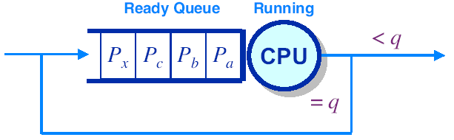
Round-Robin (RR) Scheduling
Give each process a small bit of CPU time (quantum) each trip.
If a process exhausts the quantum q, preempt and put at back of queue.
CPU burst could be less than q. Why?
Each n processes will get (1/n) of the available CPU
5 processes, q = 20ms -> each process will get 20ms every 100ms

Slide 45
Example of RR w/ Time Quantum = 20
Process Burst Time
P₁ 53
P₂ 17
P₃ 68
P₄ 24
Typically, higher average turnaround than SJF, but better response.
P₁
P₂
P₃
P₄
P₁
P₃
P₄
P₁
P₃
P₃
0
20
37
57
77
97
117
121
134
154
162

Slide 46
RR Observations
Critical issue
How big should a quantum be?
Let q = quantum:
If q is too large, we approach FCFS scheduling.
If q is too small, context switch overhead will dominate and consume available CPU.
Better response time than SJF.

Slide 47
Multilevel Queue Scheduling
Classify processes into groups -> partition the ready queue into separate queues.
Memory size
Process priority
Process type
Example. Classify based on response-time requirements.
Foreground (interactive) processes
Background (batch) processes
Each queue has its own scheduling algorithm. Example:
the foreground queue -> RR algorithm
the background queue -> FCFS
There must also be scheduling among queues. For example, the foreground queue may have absolute priority over the background queue.

Slide 48
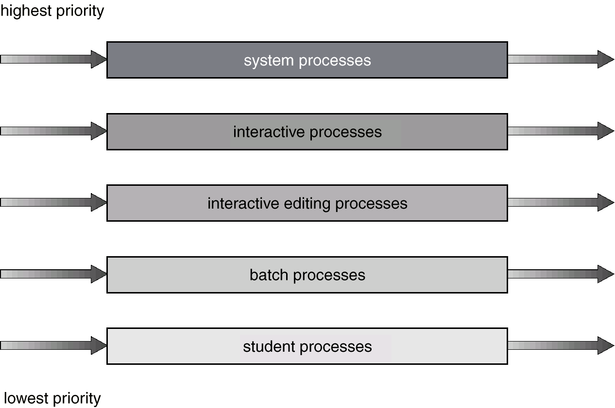
Multilevel Queue Scheduling: Example
Each queue has absolute priority over the other.
No process in the batch queue can run unless the higher priority queues are empty.
Starvation? Use a time slice between queues. Ex:
80% CPU to foreground
20% CPU to background

Slide 49
Multilevel Feedback Queue Scheduling
Multilevel Feedback Queue Scheduling allows a process to move between queues.
Separate processes based on their CPU bursts.
If a process uses too much CPU time, move it to lower priority queue.

Slide 50
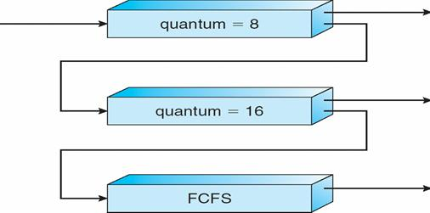
Multilevel Feedback Queue Scheduling: Example
Priority 0 (High)
P₁ = 6ms
Priority 1
Priority 2 (Low)

Slide 51
Multilevel Feedback Queue Scheduling: Example
Priority 0 (High)
P₂ = 30ms
P₁
Priority 1
Priority 2 (Low)

Slide 52
Multilevel Feedback Queue Scheduling: Example
Priority 0 (High)
P₃ = 10ms
P₂ = 22ms
Priority 1
Priority 2 (Low)

Slide 53
Multilevel Feedback Queue Scheduling: Example
Priority 0 (High)
P₃ = 2ms
Priority 1
P₂ = 22ms
Priority 2 (Low)

Slide 54
Multilevel Feedback Queue Scheduling: Example
Priority 0 (High)
P₃ = 2ms
Priority 1
P₂ = 6ms
Priority 2 (Low)

Slide 55
Multilevel Feedback Queue Scheduling: Example
Priority 0 (High)
Priority 1
P₃
P₂ = 6ms
Priority 2 (Low)

Slide 56
Multilevel Feedback Queue Scheduling: Example
Priority 0 (High)
Priority 1
P₂
Priority 2 (Low)

Slide 57
Summary/Review
CPU scheduling is concerned with the cycle of _______ and ______ .
What is the difference between preemptive and nonpreemptive scheduling?
Consider the set of processes, with the length of the CPU burst.
Process Burst Time(ms) Priority
P1 10 3
P2 1 1
P3 2 3
P4 1 4
P5 5 2
A. Draw four Gantt charts to illustrate the process execution for FCFS, SJF, nonpreemptive priority, and RR scheduling algorithms.
B. What is the waiting time of each process for each algorithm?
C. Which algorithm results in the minimum avg waiting time?

Slide 58
FCFS
P1
P2
P3
P4
P5
Time
(ms)
0
 | Wait (ms) | Turnaround (ms) | Response (ms)
P1
P2
P3
P4
P5
AVG
Process Burst Time(ms) Priority
P1 10 3
P2 1 1
P3 2 3
P4 1 4
P5 5 2

Slide 59
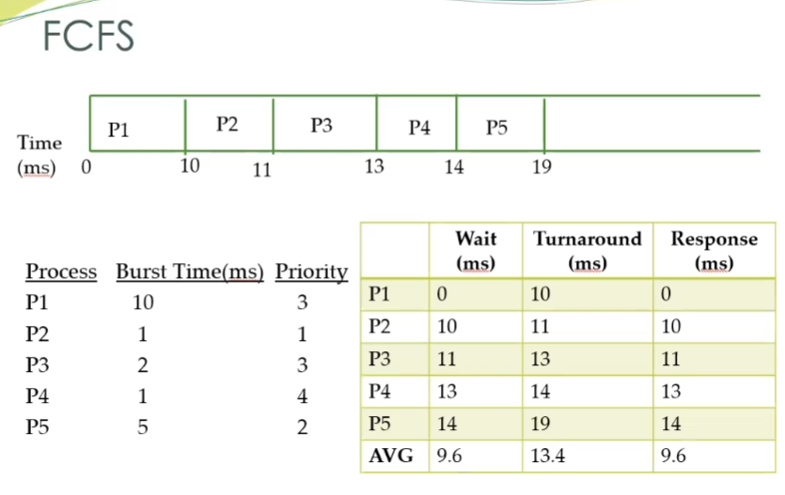

Slide 60
SJF
P3
P4
P2
P5
P1
Time
(ms)
0
 | Wait (ms) | Turnaround (ms) | Response (ms)
P1
P2
P3
P4
P5
AVG
Process Burst Time(ms) Priority
P1 10 3
P2 1 1
P3 2 3
P4 1 4
P5 5 2

Slide 61
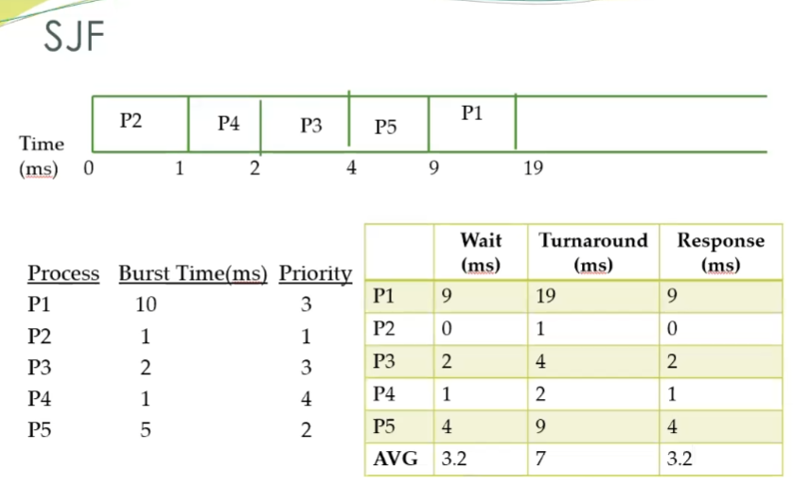

Slide 62
Non-preemptive Priority
P1
P2
P3
P4
P5
Time
(ms)
0
 | Wait (ms) | Turnaround (ms) | Response (ms)
P1
P2
P3
P4
P5
AVG
Process Burst Time(ms) Priority
P1 10 3
P2 1 1
P3 2 3
P4 1 4
P5 5 2
Lowest number is highest priority

Slide 63
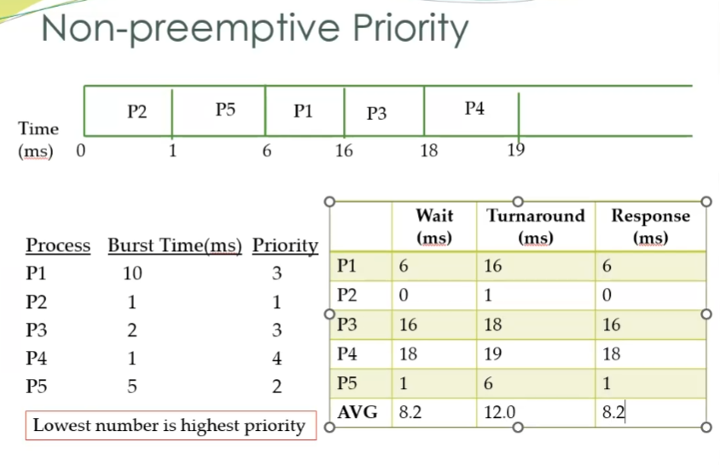

Slide 64
RR
P1
P2
P3
P4
P5
P1
P2
P3
P4
P5
Time
(ms)
0
Time
(ms)
 | Wait (ms) | Turnaround (ms) | Response (ms)
P1
P2
P3
P4
P5
AVG
Process Burst Time(ms) Priority
P1 10 3
P2 1 1
P3 2 3
P4 1 4
P5 5 2
Quantum = 1ms

Slide 65
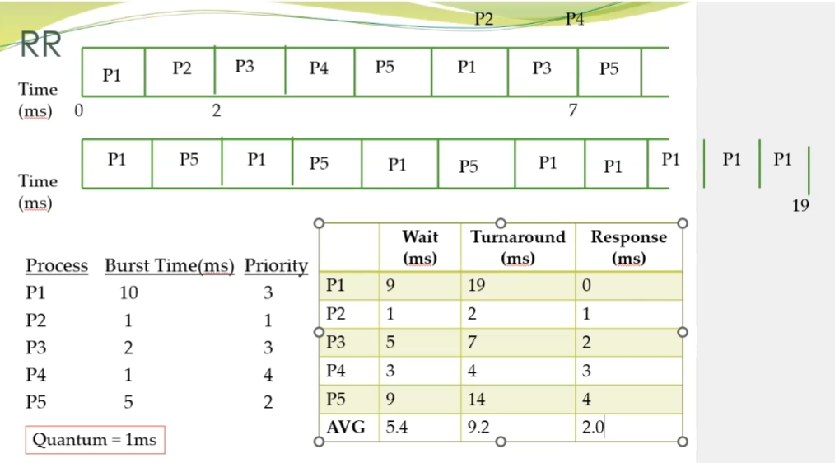

Slide 66
Comparison
 | Wait (ms) | Turnaround (ms) | Response (ms)
FCFS
SJF
Priority
RR
Which algorithm results in the minimum avg of each criteria?

Slide 67
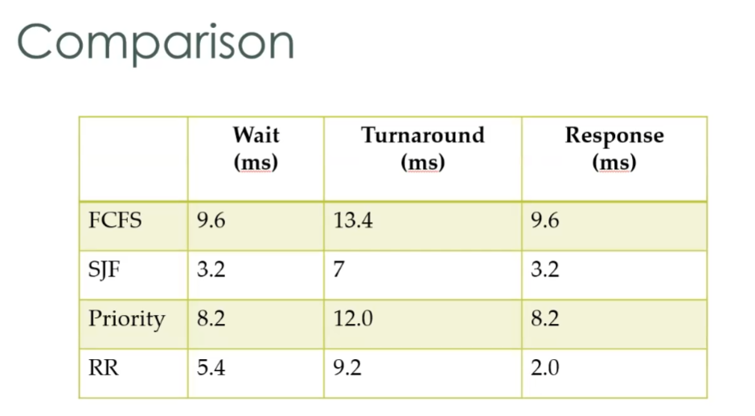

Slide 68
Next Time
Finish CPU Scheduling
Process Synchronization

Slide 69
Class Reminders
Assignment 2 is due Monday, 9/25 @ 11:59pm.
Important Note: If you are using WebTerminal, use the systems-lab server rather than cook.
A link to WebTerminal is under “Supplemental Material & Other” on Canvas

